Slide 1
HTLV-1 and ATLL
Lucy B Cook
Clinical Research Fellow
l.cook@imperial.ac.uk

Slide 2
Outline
Background ; HTLV- associated diseases/ transmission/epidemiology
History: How HTLV-1 discovered and general importance to molecular biology
HTLV-1 structure and replication
How the provirus may drive leukaemia
Current treatment for Adult T cell leukaemia

Slide 3
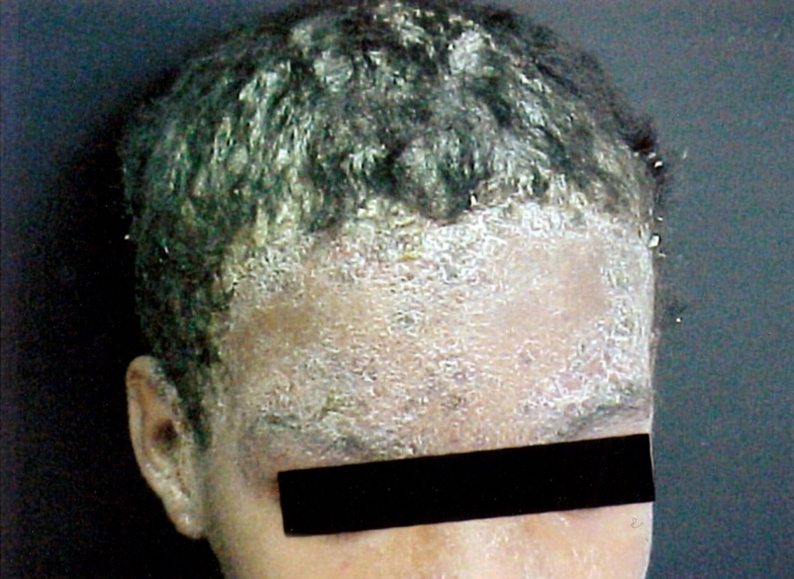
HTLV-1 associated disease
Aggressive clinical diseases
Asymptomatic carriers
~90-95%
Adult T cell leukaemia / lymphoma
- Lifetime risk if infected in infancy ~ 5%
- males > female
- 4 subtypes: ‘Aggressive ‘
‘Indolent’
HTLV-1 associated myopathy/tropical spastic paraparesis
  Lifetime risk ~3%
  Females > males
  ‘Other’ inflammatory disorders
  - alveolitis, uveitis, polymyositis
Infectious complications
  Recurrent VZV infection
  TB co-infection
  Strongyloides stercoralis
  Infective dermatitis
Notes:
20 million infected worldwide. Burden of disease is in parts of Japan, Carribean, South America and Sub Saharan Africa.
Majority AC but not always benign condition. Predisposition to VZV and TB.
Strongyloides ,a parasitic disorder also common in tropics, usually benign (bit of tummy ache and diarrhoea) results in a hyperinfection in about 1/3 of HTLV- infected patients and death 85%
Aggressive clinical diseases are ATL and HAM/TSP with a lifetime risk around 5%. Some differences globally
- Japanese median onset 10 years older than the carribean, Indolent subtypes much more common in South America than Japan
- Unusual to see HAM and ATL together in Japan but reasonably common here.

Slide 4
HTLV-1: Introduction
20 million infected worldwide
Japan, Caribbean, S. America, Sub-Saharan Africa
Transmission
Breast milk, sexual, infected blood products
Important to remember: Most of family also infected
(need screening, less suitable as HLA-matched donors for allograft, may also be at risk of developing clinical disease….)
Notes:
ATL main cause of leuk in endemic parts of Japan

Slide 5
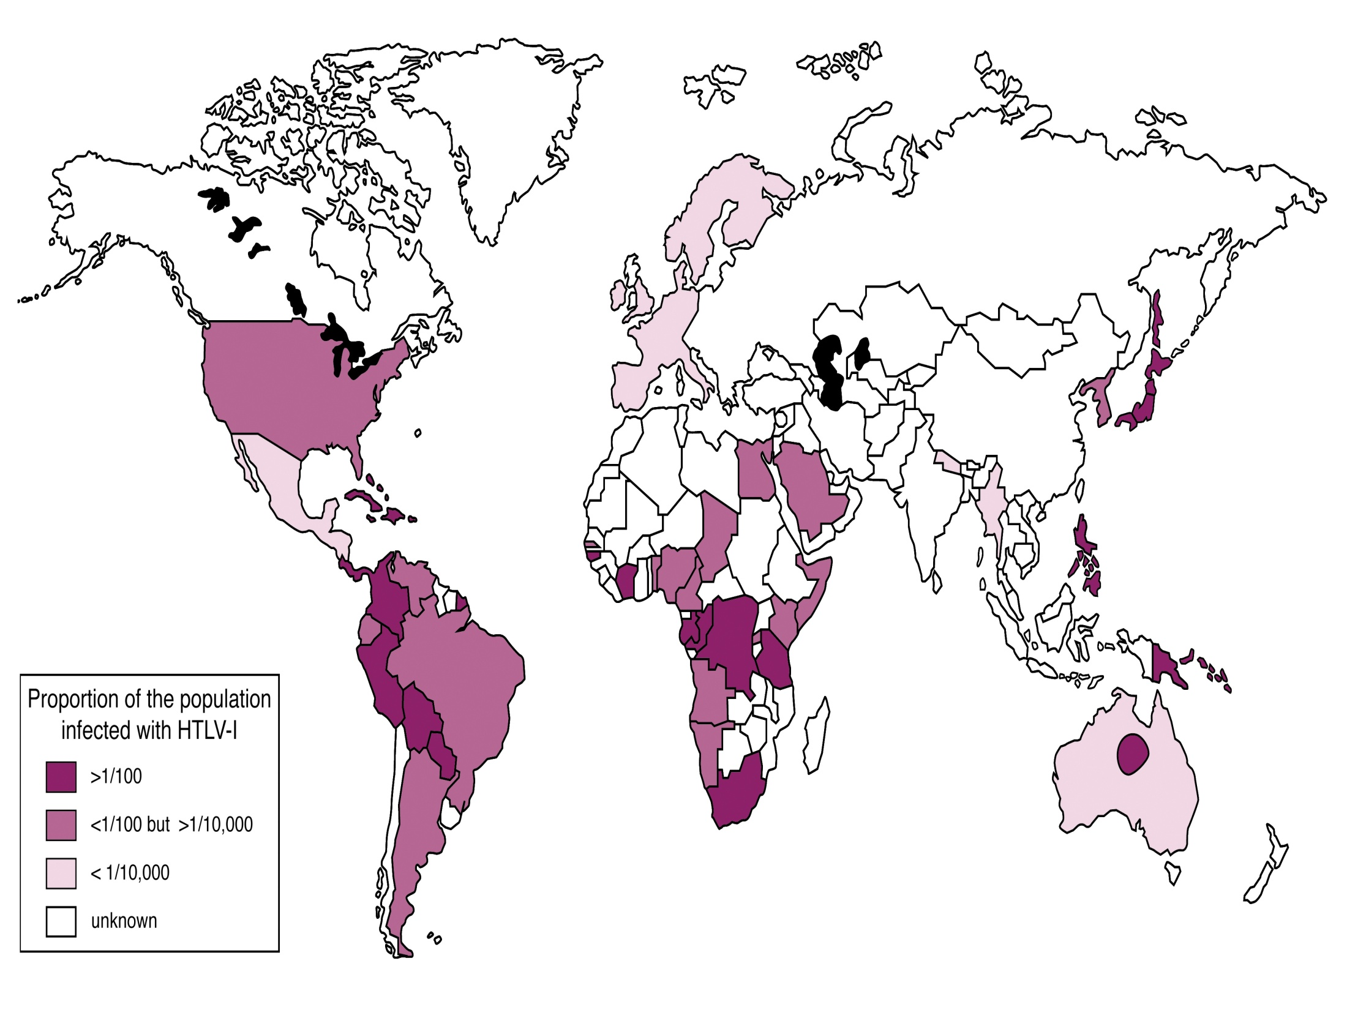

Slide 6
History (1): Early 1970s: Disproving the dogma
Originally thought DNA RNA protein
Known animal retroviruses (RNA viruses) caused cancers. No known human retroviruses.
e.g Rous sarcoma virus sarcoma
Bovine leukaemia virus leuk/lymphoma
1970: 2 groups identified virions containing an RNA-dependent DNA polymerase (reverse transcriptase)
  RNA DNA RNA protein
  Nobel prize in 1975:
David Baltimore, Nature 226, 1209 - 1211 (27 June 1970);
Howard Temin & Satoshi Mizutani Nature 226, 1211 - 1213 (27 June 1970)

Slide 7
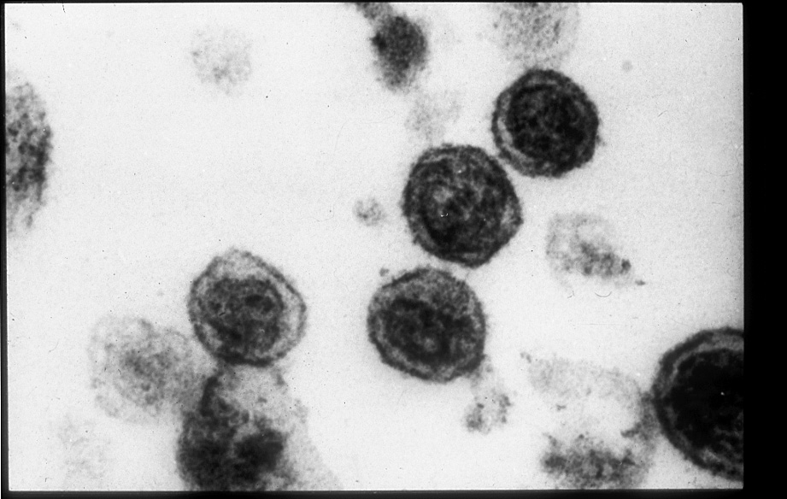
History (2): Identification of first human retrovirus
Robert Gallo (USA), 1970s:-
Identified IL2 as an important chemokines to maintain growth leukaemic cell lines.
Working on T cells from a patient with “Mycosis Fungoides” (cutaneous T cell lymphoma) and following discovery of reverse transcriptase identified retroviral particles from peripheral blood of this patient
Proc. Natl. Acad. Sci. USA 1980; 77 (12): 7415-7419
BERNARD J. POIESZ, FRANCIS W. RUSCETT, ADI F. GAZDAR, PAUL A. BUNN, JOHN D. MINNA, & ROBERT C. GALLO

Slide 8
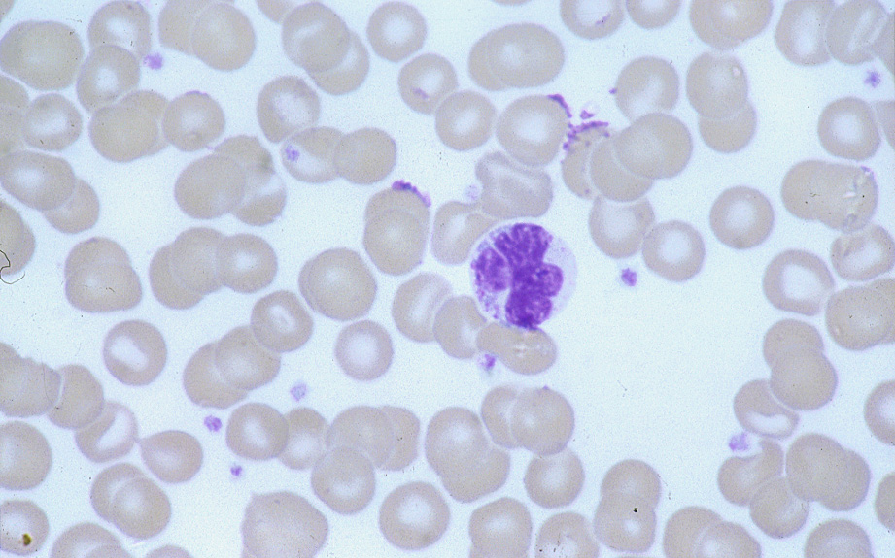
History [3]: Description of Adult T-cell Leukaemia/Lymphoma
Clusters of cases of an aggressive malignancy with special morphological features and clinical phenotype seen in Southern Japan, suggesting infectious agent…..
Following on from Gallo’s work identifying retroviral particles it was shown that these Japanese cases also had same retrovirus → named HTLV-1
“FLOWER CELL”
Uchiyama, T., et al., Adult T-cell leukemia: clinical and hematologic features of 16 cases. Blood, 1977. 50(3): p. 481-92

Slide 9
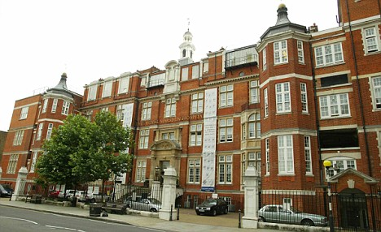
History [4]: ATLL described in patients from the West Indies in an unexpected quarter
In London the connection was made between diseases in West Indies and Japan!
Catovsky D, Greaves MF, Rose M, Galton DA, Goolden AW, McCluskey DR, White JM, Lampert I, Bourikas G, Ireland R, Brownell AI, Bridges JM, Blattner WA, Gallo RC
Lancet. 1982 Mar 20;1(8273):639-43

Slide 10
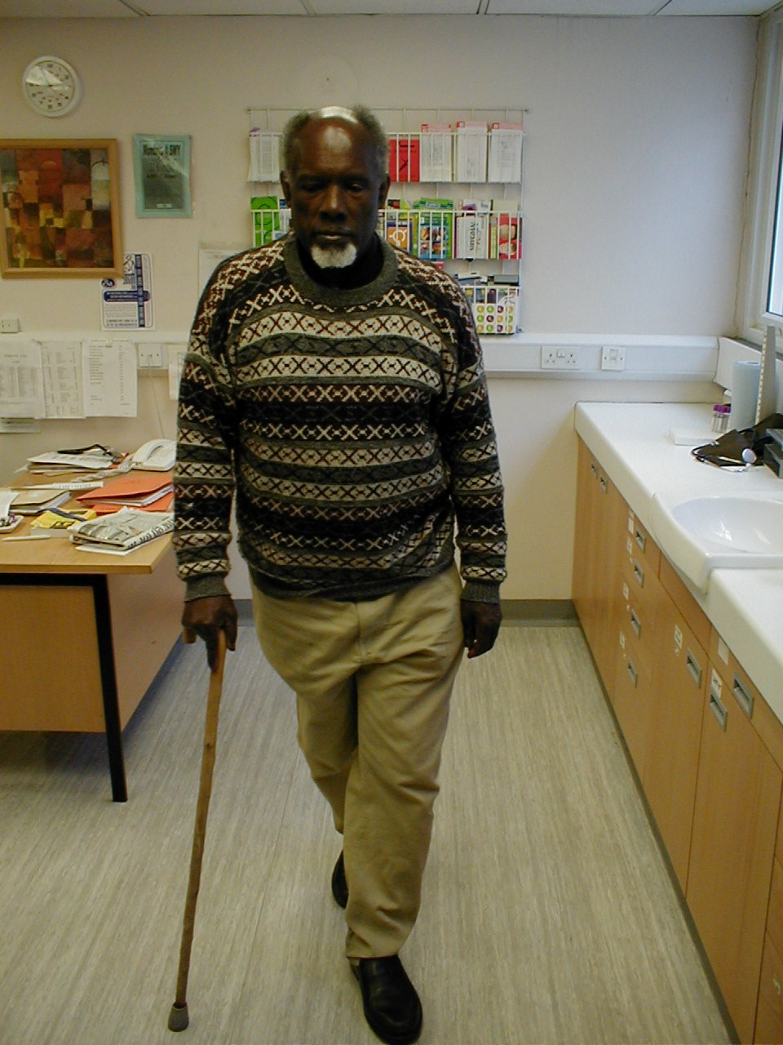
HTLV-1 associated myelopathy (HAM)
‘Tropical Spastic paraparesis’ (old name)
Weak & Stiff legs
Lumbar Pain ± leg pain
Bladder Dysfunction
Erectile dysfunction
Constipation
-→ Resembles primary progressive
multiple sclerosis
HTLV-1 antibody identified in CSF
So now called HAM
Lancet. 1985 Aug 24;2(8452):407-10. Antibodies to human T-lymphotropic virus type-I in patients with tropical spastic paraparesis.

Slide 11
Major problem
No means of predicting who will get disease
- Diseases of long clinical latency
Very little effective treatment for either clinical condition, both of which are aggressive disorders

Slide 12
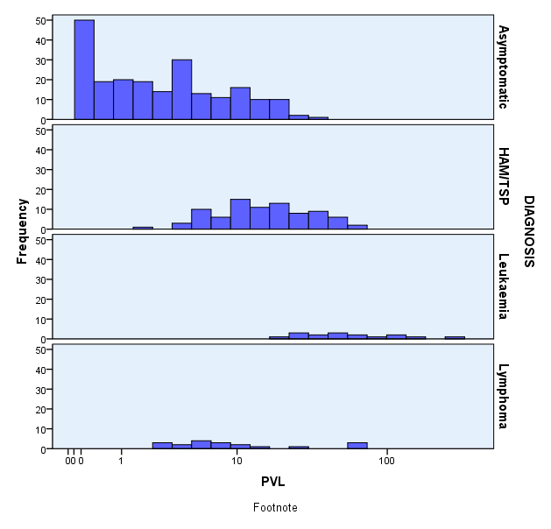
Risk of clinical disease rises with proviral load >10%

Slide 13
Within an individual the proviral load (PVL) stays stable over years

Slide 14
Shimoyama/ WHO (2008)
Acute (60%) - ↑↑WCC, Skin lesions, LN, multiple viscera involved (liver/spleen/gut/lungs/CNS...)
↑Ca²⁺ (70%)↑LDH, ↑ Eos
Median survival: 6 months
Lymphomatous (20%)
Marked LN (aggressive) with ↑LDH, <1% ATL on film
+/- skin/viscera, +/- ↑Ca
Median survival: 10 months
Chronic (15%)
>5% ATLL cells with ↑abs LØ
Skin, liver, lung, LN only
Median survival: 2 years
Smouldering (5%)
1-5% ATLL cells, normal abs LØ
Skin/lung infiltrates only
Median survival: >2 years
Aggressive⁺⁺⁺
‘Indolent’

Slide 15
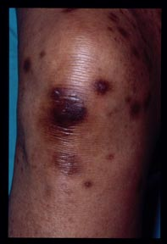
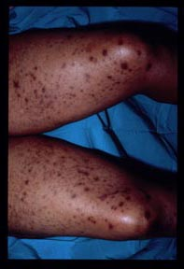
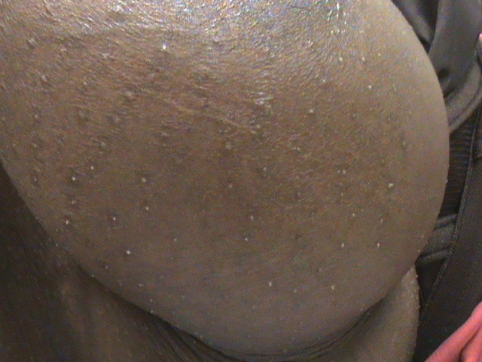

Slide 16
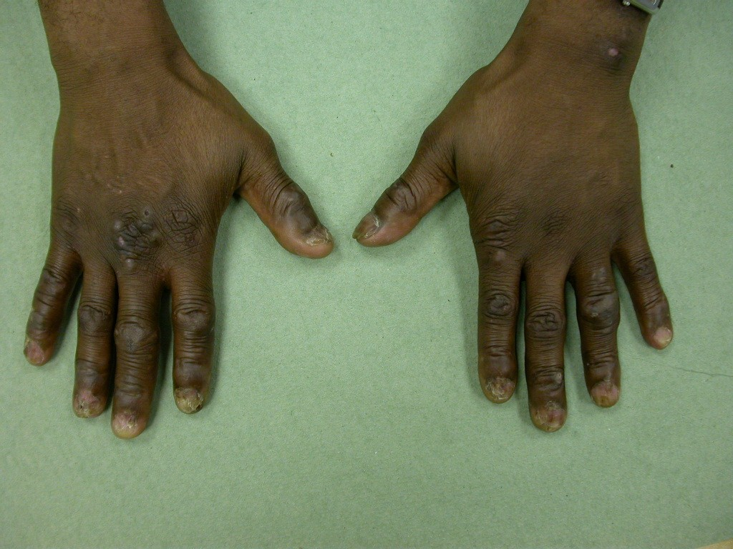

Slide 17
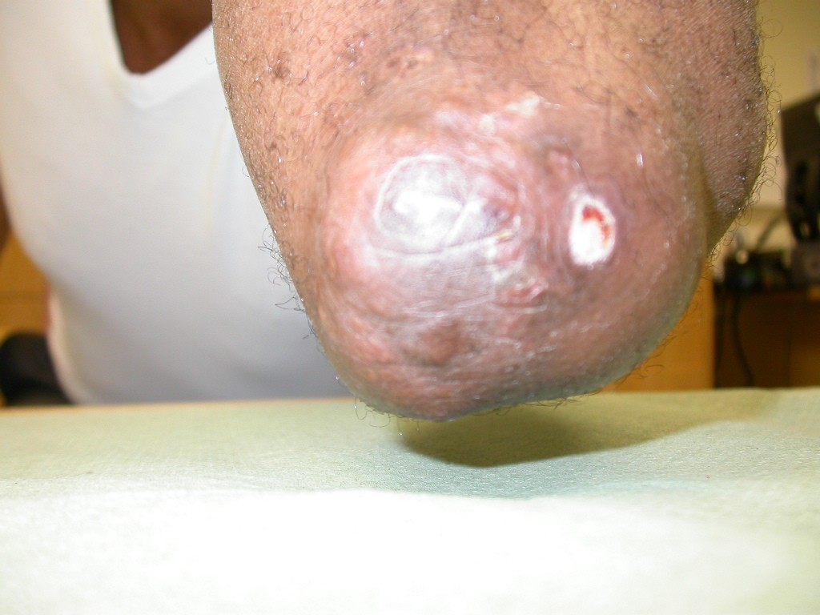

Slide 18
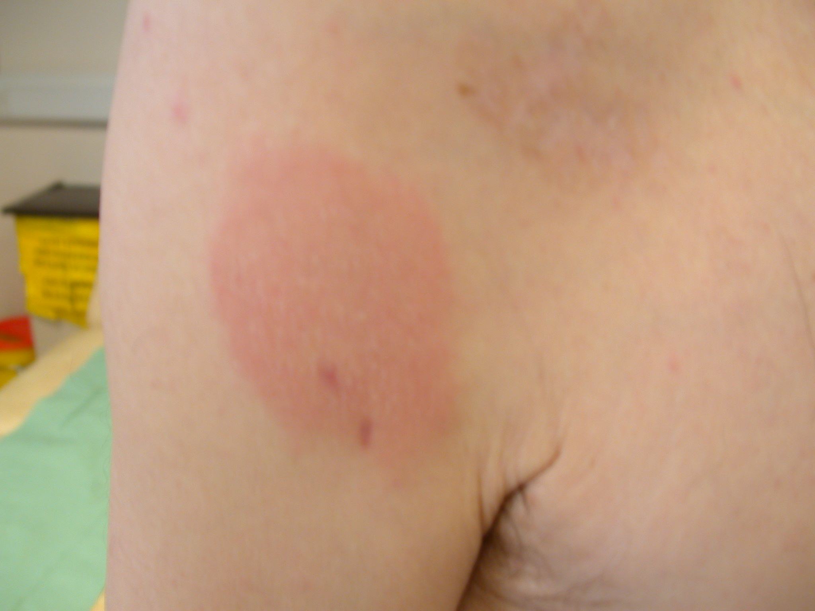

Slide 19
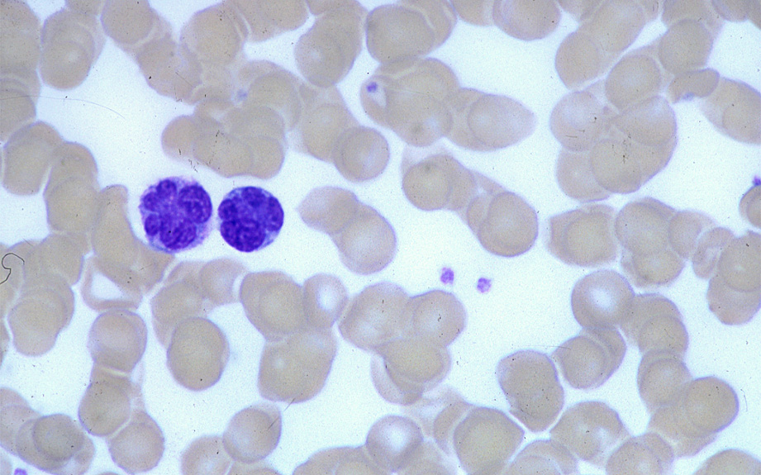
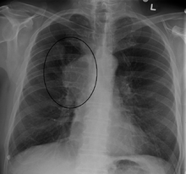
Clinical diagnosis
Full blood count
Film
Biochemistry
Corr Ca, LDH
Imaging

Slide 21
Specialist diagnostic tests
Bone marrow biopsy
Flow cytometry (min panel)
CD3 (weak), CD4+, CD25+, HLADR +
CD8 usually negative, CD7 neg
TCR α/β clonally rearranged
Cytogentics
  Multiple anomalies may be seen
  (or normal)
  Nil recurrent (diagnostic)
HTLV-1 serology
LUMBAR PUNCTURE
  Check for CNS disease
  Exclude cryptococcus (common)
  Endoscopy – GI tract often involved

Slide 22
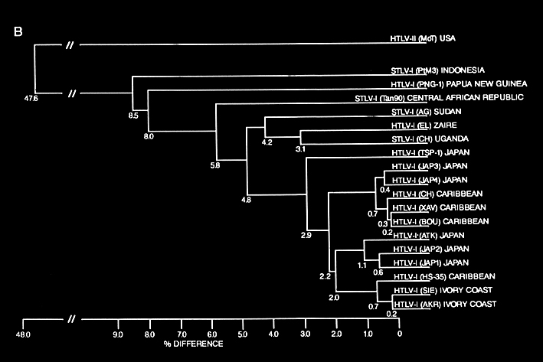
HTLV-1 (and STLV-1 ) genome is conserved
1-2% divergence between HTLV-1 and STLV-1 genomes
Disease phenotype does not relate to viral genotype
Notes:
This process of replication through cell division is thought to contribute to the conserved nature of the HTLV-I genome. Here you can see that many isolates of HTLV-I are only 1-2% divergent with the most divergent, the Melanesian subtype clustering with an STLV isolate from Indonesia. There are no monkeys in Melanesia and the population, isolated until the last century has lived there at least 5,000 years.

Slide 23
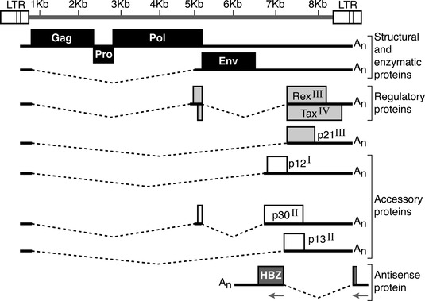
Structure HTLV-1
Tax (transactivator)
Immortalises human cells
Tax transgenics drive tumour formation
Tax immunodominant (CTL response)
Expressed protein in 40% ATL cases
HBZ
HBZ transgenics develop tumours
HBZ mRNA expression 100% ATL cases

Slide 24
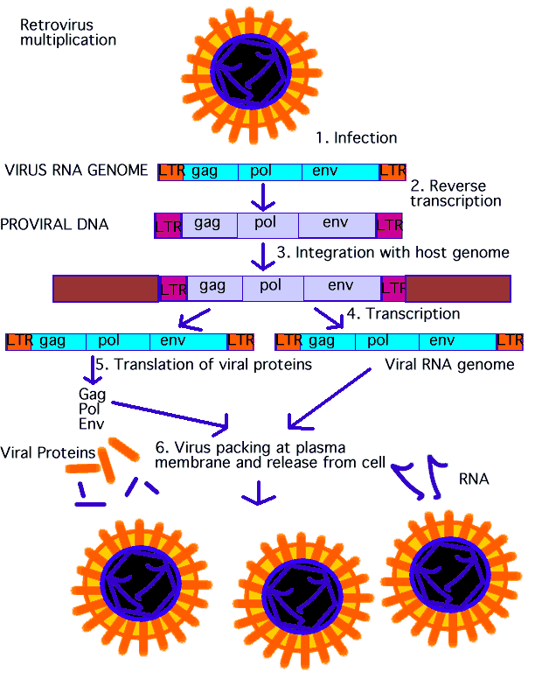
HTLV life cycle
Following integration host machinery hijacked:
Allows viral replication and repackaging and expression of viral genes within host cell

Slide 25
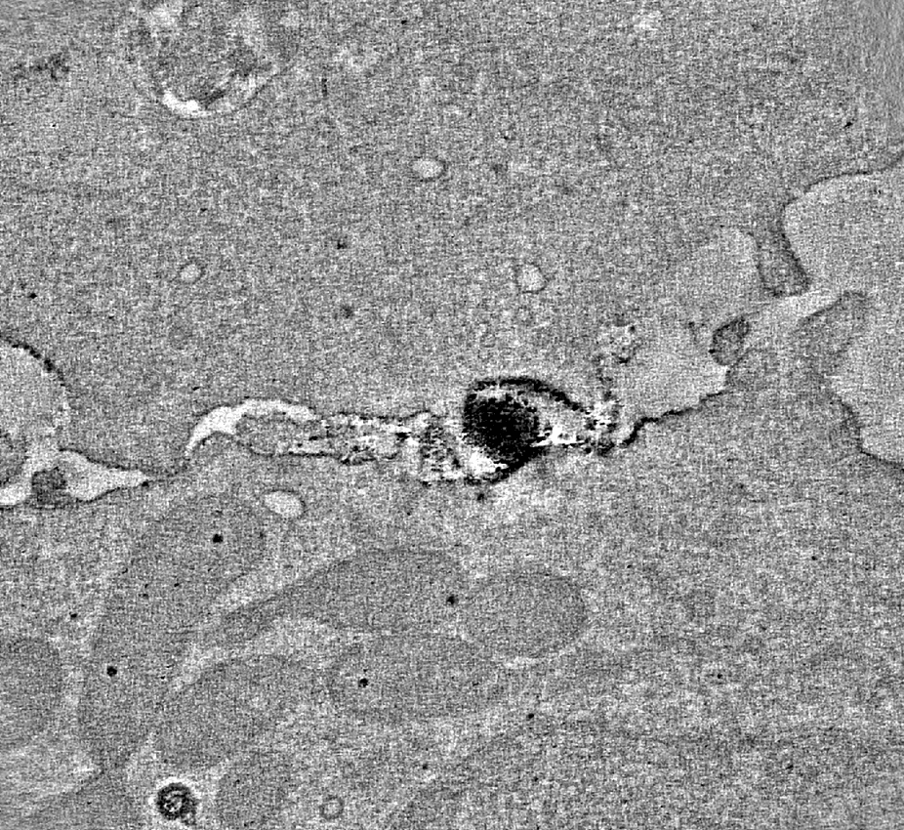
Viral spread (1): INFECTIOUS and MITOTIC
1. Infectious spread
Target
T-cell
Viral particles spread by
Cell-cell contact
No free virions detected in plasma
Important early in
Infection for viral spread.
Significance in chronic infection unknown
Donor
T-cell

Slide 26
Viral spread (2): INFECTIOUS and MITOTIC
2. MITOTIC SPREAD
Chronic Infection
Virus persists by driving clonal expansion of infected CD4+ T cells (mitotic replication)
(which is why anti-retrovirals have no significant effect)
Clones
Group of cells with same unique integration site (UIS).
Clone A
Clone B

Slide 27
Mitosis and ATL
HTLV-1 drives clonal expansion
  Mechanisms unclear
  Proviral Tax expression and HBZ expression promote cellular proliferation
  Some component of host environment (genetics e.g. HLA type, genetic alterations permissive environment), poor CTL response
  Integration event selected in a ‘proliferative’ region of the genome

Slide 28
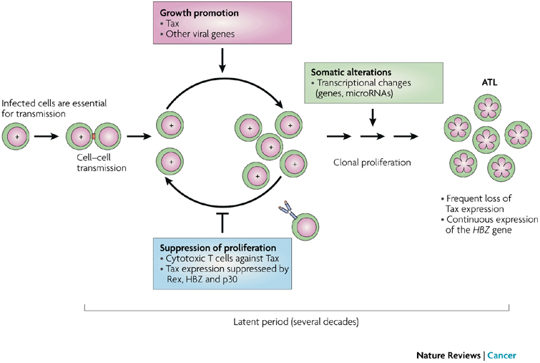

Slide 29
Effects of viral genes on host genome
TAX
HBZ
Pro proliferative
‘Transactivator’ viral transcription from 5’LTR.
Decreases apoptosis
Impairs cell-cycle checkpoints
Induces DNA damage
Immortalises T cells
Immunodominant (immune escape mechanisms)
Early role in ATL development
Protein not easily detected
mRNA:-
Can inhibit Tax
Present in all ATL cases
Not immunodominant
Maintains transformed cells

Slide 30
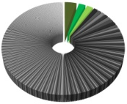
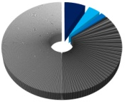
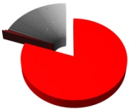

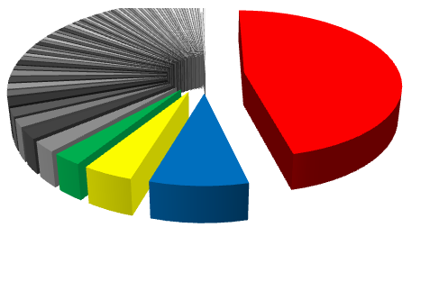
Clonal expansion in different disease states
Pattern of clonal distribution differs between patients
Asymptomatic HAM/TSP chronic ATL Lymphoma (LN) Acute ATL
OCI: 0.48 0.43 0.83 0.85 0.72
Clones: 471 1442 269 5 77
PVL: 3% 16% 18% 74% 58%
Each segment of pie represents relative size of a single clone in 1 patient.
OCI =oligoclonality index and is Scored from 0-1, 0= poly, 1= monoclonal
Notes:
Each segment of the pie chart refers to the relative abundance of each clone. TCI quite polyclonal with a few relatively abundant clones on a large polyclonal background whereas HAY has larger clones on an abundant background.
Acute leuks describe. It is frequently said that ATL has monoclonal disease but TDC (right) at diagnosis shows a dominant clone with a oligoclonal background.
Raise the fundamental question of how to interpret these pie charts. We cannot say with complete certainty which is the malignant clone. Malignant behaviour is defined by growth in vivo. It is presumed to be the most abundant clone.
It is a fundamental point of HTLV-1 biology to determine whether there is a single copy of HTLV-1 integrated into each host genome.

Slide 31
How do other retroviruses cause cancer?
Transduction of cellular oncogene - rapidly transforming (days/weeks) e.g. Rous sarcoma virus
2. Cis-activating -chronically transforming (months) e.g. ALV
5’ LTR
gag
pol
env
src
3’ LTR
Transduction of cellular oncogene – provirus contains viral oncogene v-src
(one off chance event that viral genome now contains an oncogene)
provirus
host
myc
Promotor insertion (PV upstream) - transcription initiated from viral promotor
Enhancer insertion (PV up or downstream) - transcription initiated from host cellular promotor
Notes:
The typically described mechanisms of retroviral oncogenesis are those which are rapidly transforming e.g. RSV which occurs by transduction of cellular oncogene to the proviral genome. In this example this occurs at the expense of env.
Src is a non receptor tyrosine kinase which signals for the cells to divide.
Second mechanism which is a model of chronic transformation over months occurs in Avian leukosis virus. These proviruses don’t contain a v-onc and the provirus is inserted either upstream or downstream of the cellular oncogene and either the cellular gene is transcribed under the influence of the viral promotor or enhancer. Th
2. chronic: ALV integrates anywhere in genome but in tumours always in a similar position (ALV >80% are near cellular gene c-myc). Level of c-myc translation greatly increased i.e. Insertion next to c-myc is like carrying v-onc.
If provirus upstream c-myc comes under LTR promotor “promotor insertion”
Also known as “insertional mutagenesis” which is a current clinical problem with gene therapy trials.

Slide 32
Retroviral integration ATL
No single common locus of integration
Preference to integrations within genes and active regions of the genome (e.g. CpG islands, activating epigenetic marks)
Notes:
Retroviral integration first investigated 25 years ago and shown no common locus for integration.
Another 20 years, following completion of human genome projects that it was revisited. 2 publications in 2004 and 2005 showing conflicting results. First publication by Hanai, suggested 52 % within gene
Doi et al show less 30% (like random) but in 70% ATL cases favour TSS and disfavour alphoid repetas suggesting integration in sites favouring viral gene transcripton
More recently in this lab, Nico published a high throughput approach

Slide 33
Who is at risk of ATLL?

Slide 34
Shimoyama classification – outcome data
 | Mean survival (months) | 2 year survival | 4 year survival
Smouldering | NR | 77.7 | 62.8
Chronic | 24.3 | 52.4 | 26.9
Lymphoma | 10.2 | 21.3 | 5.7
Acute | 6.2 | 16.7 | 5

Slide 35
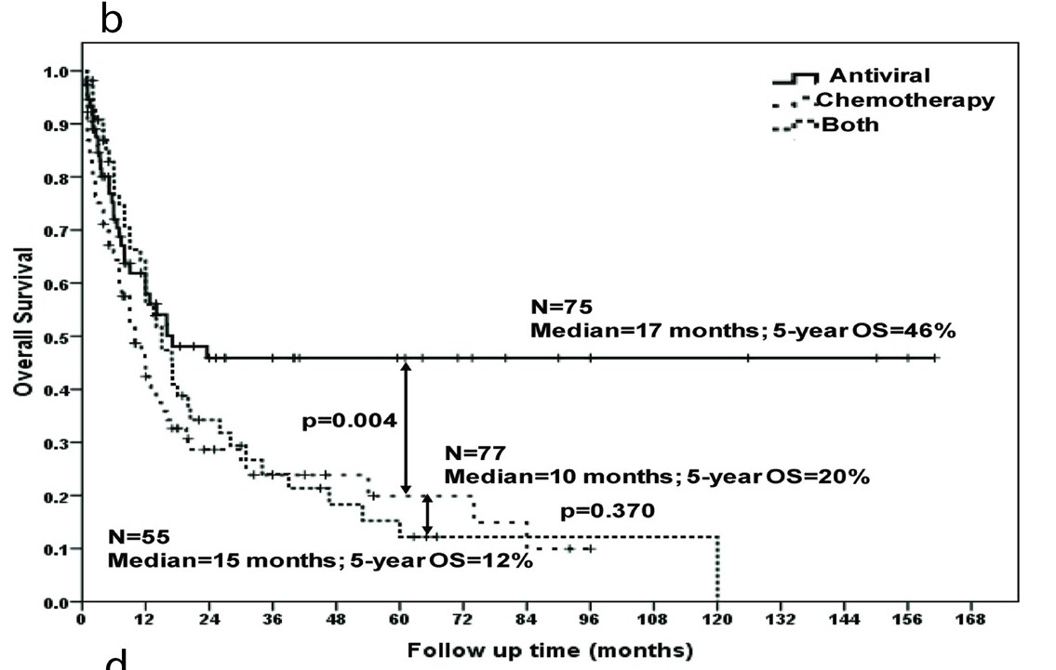
Survival by therapy combined for all disease types (first line therapy)
Bazarbachi et al, JCO 2010

Slide 36
Treatment by subgroup
Aggressive disease (pure lymphoma or bulky lymphoma with leukaemia)
CHOP + AZT/IFN*
Qn: When to start antivirals?
At diagnosis with chemo?
2 cycles chemo then AZT/IFN?
When in remission?
NEEDS RCT
AZT= zidovudine
IFN= interferon alpha
Mechanism AZT NOT antiviral , but unknown (probably pro-poptotic)

Slide 37

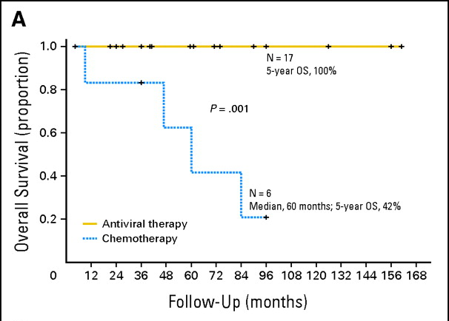
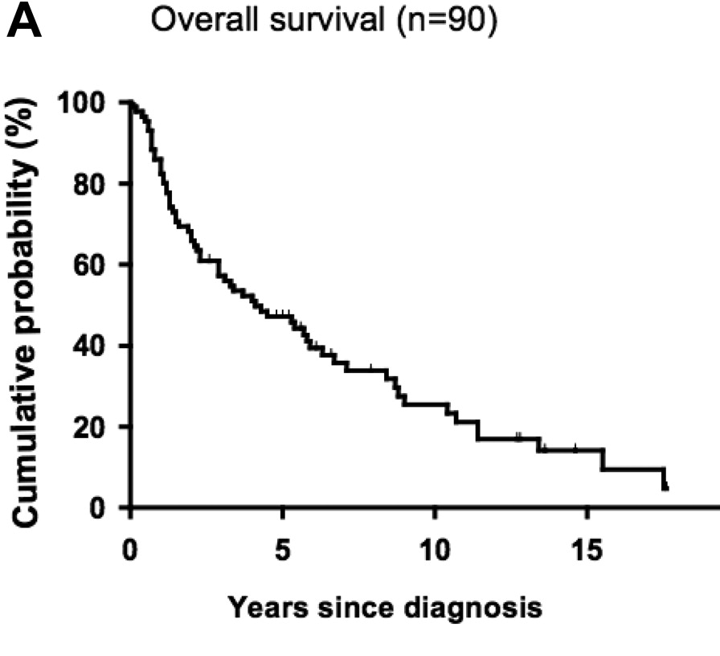
Chronic Adult T cell leukaemia/lymphoma
AZT and Interferon
Indolent disease ?
Death: Transformation to acute ATL (aggressive disease), bulky disease (multi organ failure), drug resistance, hypercalcaemia,opportunistic infection due to T cell immunodeficiency
Takasaki Y et al. Blood 2010;115:4337-4343
Bazarbachi A et al. JCO 2010;28:4177-4183
Notes:
One of the 4 sub forms of adult T cell leukaemia
All associated with appalling clinical outcome. Aggressive subtypes have median survival of around 6-10 months
Chronic subtype is regarded as indolent: Historically based upon 20 yr old Japanese data suggesting 4yr overall survival of 26%
Treatment lead by the French 2 yrs ago shows promising results.
Recent re-look at long term follow up. Curve doesn’t plateau and median survival around 4 years, despite advances in supportive management.
AZT is antiretroviral and IFN immune modulatory –mechansim by which they work in HTLV-1 s not clear.

Slide 38
At relapse
Standard options
Variety of intensive leukaemia/lymphoma salvage combinations (e.g. DHAP)
‘Novel therapies’
  - Anti CD25
  Anti CCR4
  HDAC inhibitors
  Bortezomib
  Arsenic trioxide
  Allogeneic bone marrow transplantation

Slide 39
Allogeneic BMT “curative” but not suitable.....
  Principle: Transplant kills tumour cells and provides new immune surveillance
    Directly via conditioning
    Graft versus leukaemia/lymphoma – takes ~ 3months to establish
    Donor lymphocyte infusions (GVL)
    Conditioning – Fully ablative versus reduced intensity (RIC)
    TBI based. High TRM. Ideally < 40 yrs. Problem as most ATLL patients are older, co-morbidities; PD.
  TRM 40-60% 100 days (Fukushima et al, Kato et al)
  RIC: More recent – Immunosuppressive chemotherapy regimens (Flu/Bu, ATG)
  Tanosaki et al: TRM 10% first 100 days, 24% overall
  CMV reactivation 83%
  “Graft versus tumour” effect (and GVHD) – takes weeks/ months
  Amenable to DLI
  Further consideration: Japan: 2/3 sib donors HTLV-1 infected.
  ATL relapses can be donor derived.

Slide 40
Thank you!

