Slide 1
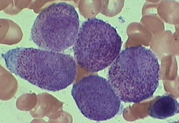

Acute Promyelocytic Leukaemia
From Highly Fatal to Highly Curable !!
Dr Vishal Jayakar
Consultant Haematologist
Kingston & Royal Marsden Hospitals
With thanks to BJ Bain and Sasha Marks

Slide 2


A MYTH……..
ANNA
HOLLYWOOD…
NOT THE IDEAL TOOL TO LEARN MEDICINE!
KATE

Slide 3


WHICH LEUKAEMIA WOULD YOU WANT TO HAVE?
Ideally none!
But if forced to, I’ll take APML!

Slide 4
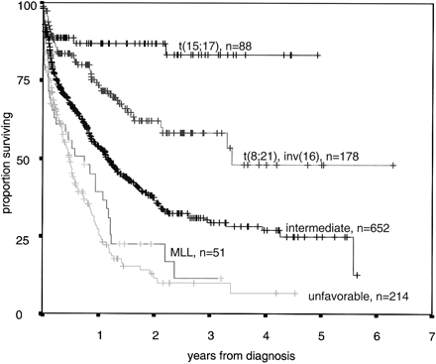
Acute promyelocytic leukaemia
Schoch et al. (2003) Blood, 102, 2395.

Slide 5
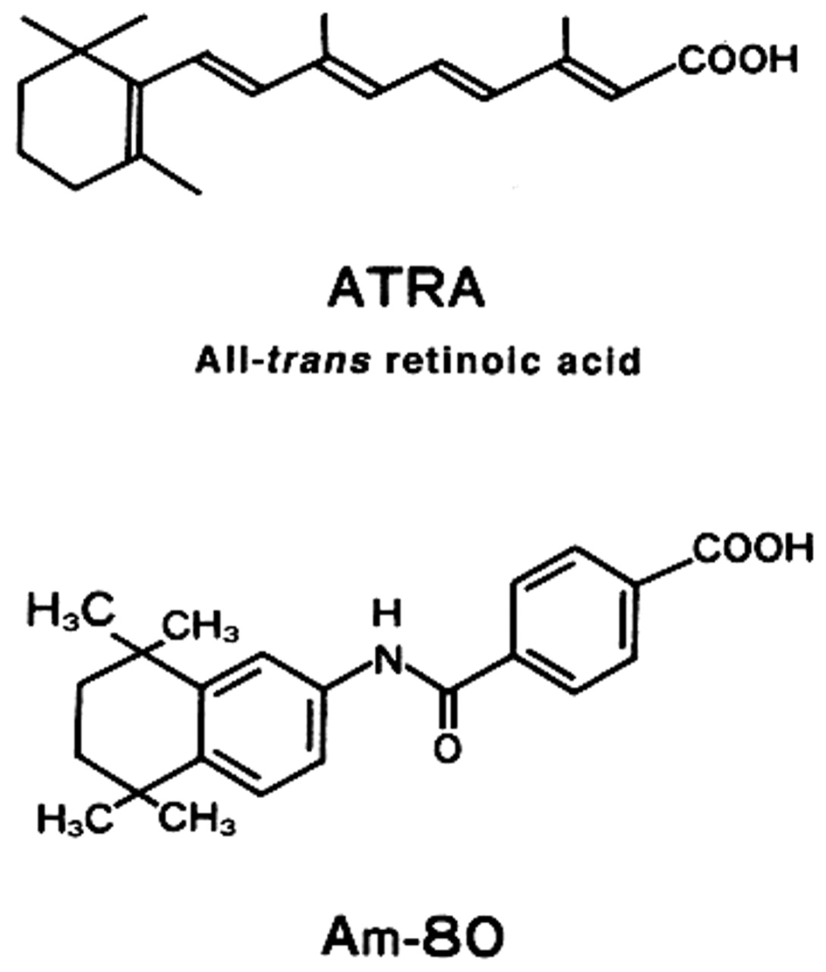

A SUCCESS STORY
ALMOST LIKE CML…!!

Slide 6
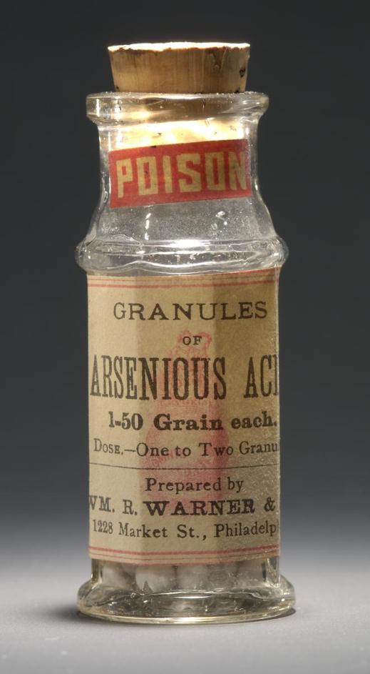

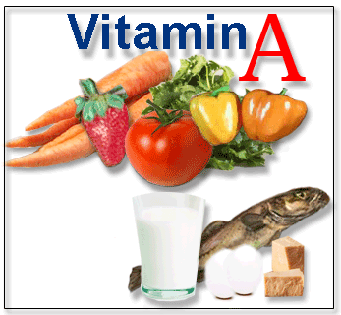
STORY OF THE EAST…!

Slide 7

STRUCTURE OF THE TALK
Introduction
Clinical Features
Diagnosis
Variants
History
Pathogenesis
Treatment

Slide 8
Acute promyelocytic leukaemia
INTRODUCTION
FAB-M3
5-8% of AML
Median Age ~40 years
Distinct Subtype- Why?
t(15;17)
CURE WITH
ATRA/ASO !
DIC

Slide 9
Acute promyelocytic leukaemia
CLINICAL FEATURES
Presentation with haemorrhage resulting from DIC
WBC relatively low
Platelet count much lower than in other sorts of AML

Slide 10
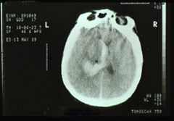
Acute promyelocytic leukaemia
Clinical features
Cerebral haemorrhage about a week after presentation
© Wiley-Blackwell from Bain BJ, Interactive Haematology Imagebank, 2nd Edition, 2012

Slide 11
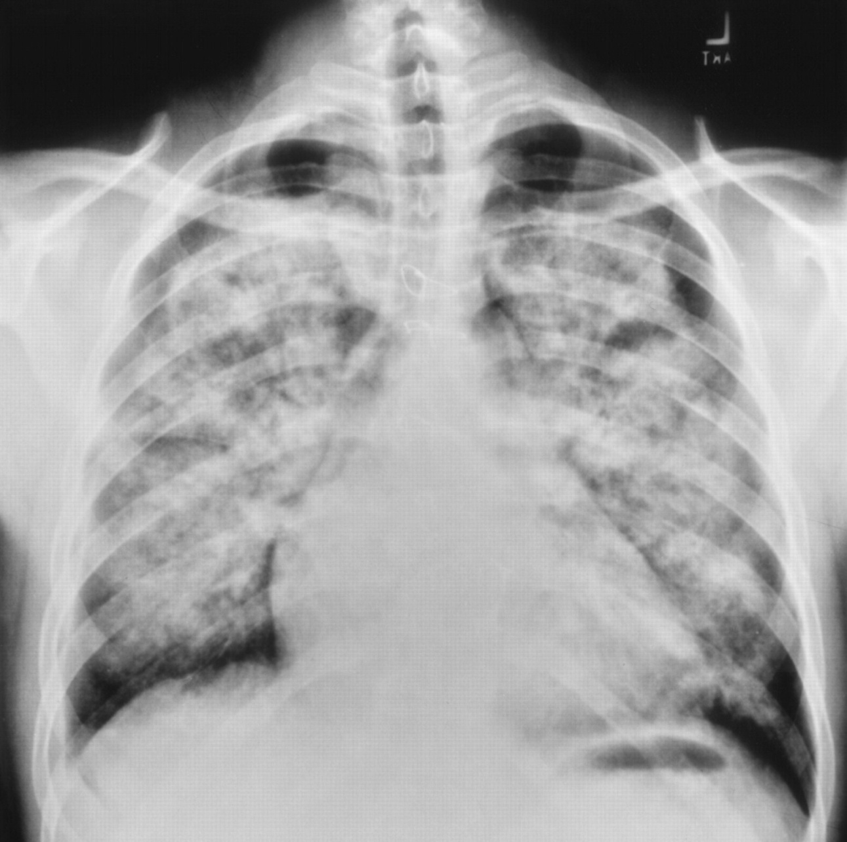
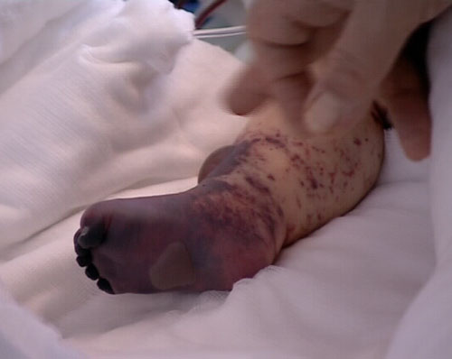
DIC-APML (85% of cases)
Expression of tissue factor
Increased fibrinolytic activity – annexin II

Slide 12
APML-DIAGNOSIS
BLOOD FILM
BONE MARROW ASPIRATE
FISH FOR t(15;17)
CYTOGENETICS
ANTI-PML ANTIBODY
Does Immunophenotyping have a role?
RAPID DIAGNOSIS
AND TREATMENT MANDATORY!

Slide 13
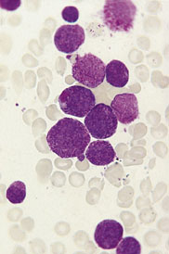
Acute promyelocytic leukaemia
DIAGNOSIS
Classical M3 AML with t(15;17)
RAPID DIAGNOSIS
ESSENTIAL!
© Wiley-Blackwell from Bain BJ, Blood Cells, 4th Edn,, 2006

Slide 14
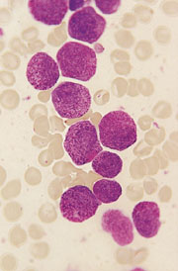
Acute promyelocytic leukaemia
Classical M3 AML with t(15;17)
© Wiley-Blackwell from Bain BJ, Leukaemia Diagnosis 4th Edn,, 2010

Slide 15
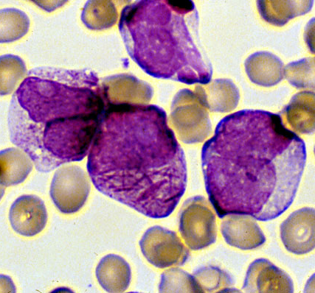

Acute promyelocytic leukaemia
Classical M3 AML with t(15;17)
faggot cell
From www.pathguy.com

Slide 16
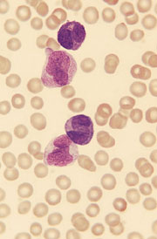
Acute promyelocytic leukaemia
M3 variant AML with t(15;17)
blood film
© Wiley-Blackwell from Bain BJ, Leukaemia Diagnosis 4th Edn, 2006

Slide 17
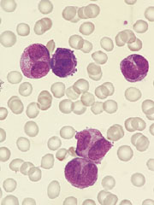
Acute promyelocytic leukaemia
M3 variant AML with t(15;17) blood film
© Wiley-Blackwell from Bain BJ, Leukaemia Diagnosis 4th Edn, 2006

Slide 18
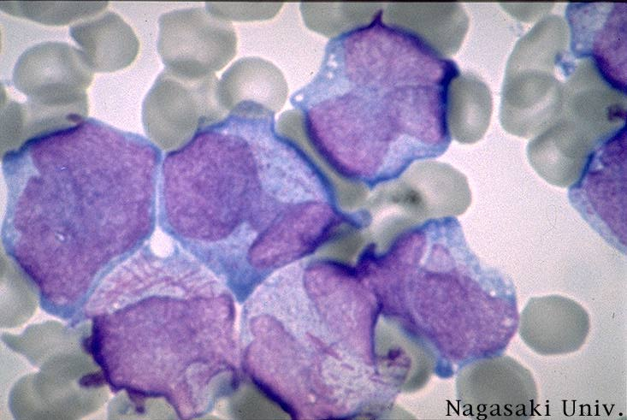
Acute promyelocytic leukaemia
M3 variant AML with t(15;17)—blood film
From http://labmed.hallym.ac.kr

Slide 19
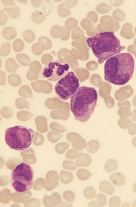
Acute promyelocytic leukaemia
M3 variant AML with t(15;17) bone marrow
© Wiley-Blackwell from Bain BJ, Leukaemia Diagnosis 4th Edn, 2006

Slide 20
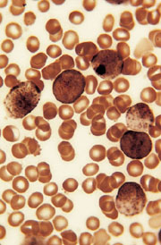
Acute promyelocytic leukaemia
M3 variant AML with t(15;17), bone marrow
peroxidase
© Wiley-Blackwell from Bain BJ, Leukaemia Diagnosis 4th Edn, 2006

Slide 21
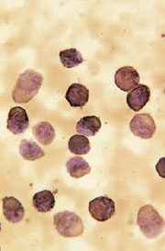
Acute promyelocytic leukaemia
M3 variant AML with t(15;17)
bone marrow Sudan black B
© Wiley-Blackwell from Bain BJ, Leukaemia Diagnosis 4th Edn, 2006

Slide 22
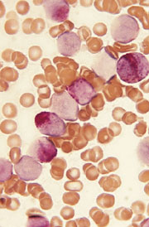
Acute promyelocytic leukaemia
M3 variant AML with t(15;17), bone marrow chloroacetate esterase
Immunophenotyping?
© Wiley-Blackwell from Bain BJ, Leukaemia Diagnosis 4th Edn, 2006

Slide 23
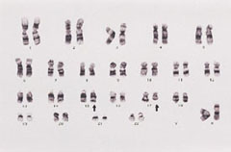
Acute promyelocytic leukaemia
Karyogram of classical M3 and variant M3 AML showing t(15;17)(q22;q21)
Waiting for conventional cytogenetics by G banding can delay the diagnosis
© Wiley-Blackwell from Bain BJ, Leukaemia Diagnosis 4th Edn, 2006

Slide 24
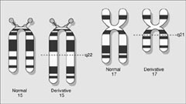
Acute promyelocytic leukaemia
Typical promyelocytic leukaemia results from t(15;17)(q22;q21) with formation of two fusion genes, PML-RARA and RARA-PML
© Wiley-Blackwell from Bain BJ, Leukaemia Diagnosis 4th Edn, 2006

Slide 25
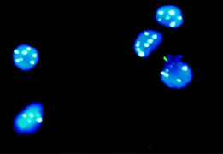
Acute promyelocytic leukaemia
Distribution of PML in normal cell and in other types of leukaemia
© Wiley-Blackwell from Bain BJ, Leukaemia Diagnosis 4th Edn, 2006

Slide 26
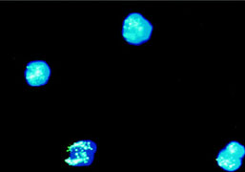
Acute promyelocytic leukaemia
Microparticulate distribution of PML in M3 and M3 variant AML
© Wiley-Blackwell from Bain BJ, Leukaemia Diagnosis 4th Edn, 2006

Slide 27


APML-HISTORY!
Blood 2008 111: 2505-2515

Slide 28

APML
First described by Swedish author Hillestad- 1957 (3 patients)
Further described by Bernard et al-1959 (20 patients)
Bernard demonstrated that APML leukaemic cells were sensitive to anthracycline- 1973
t(15:17) was identified by Rowley et al-1977

Slide 29
Before 1985…………..
BUT CURE 35-45%

Slide 30

1985..
A NEW PAGE IN THE HISTORY OF APML….!
ATRA + CHEMO!

Slide 31
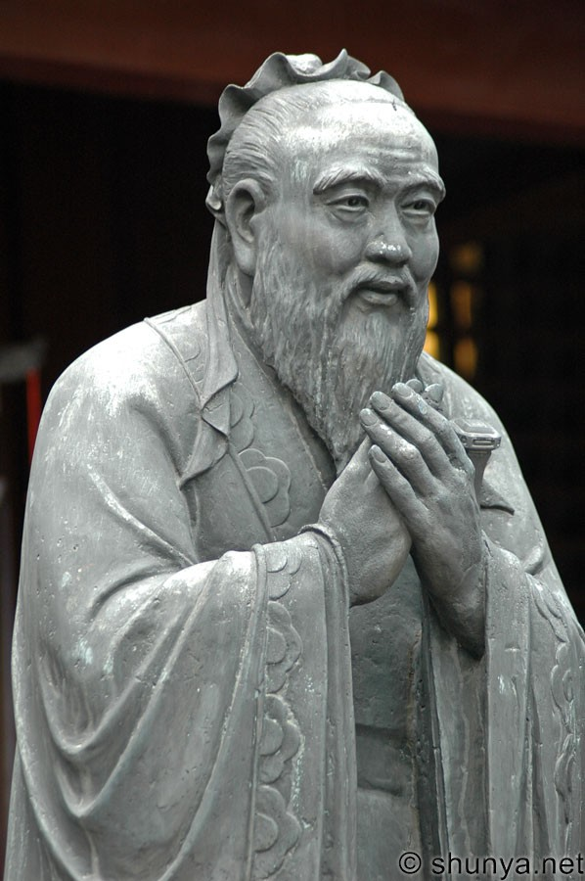
CONFUCIUS PHILOSOPHY
NOT LAW AND PUNISHMENT
BUT GUIDANCE AND RITES WILL INSTIL SENSE OF SHAME AND RIGHT

Slide 32
STORY OF THE EAST…!
if cancer cells are considered elements with “bad” social behaviour in our body, “educating” rather than killing these elements might represent a much better solution

Slide 33



CONFUCIUS PHILOSOPHY
APML- BLOCKAGE OF GRANULOCYTIC DIFFERENTIATION AT THE PROMYELOCYTIC STAGE…….
CANCER CELL
DIRECTED…
Killing cancer cells is not the only way to success…….

Slide 34
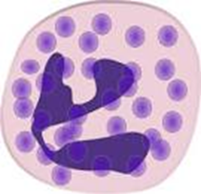
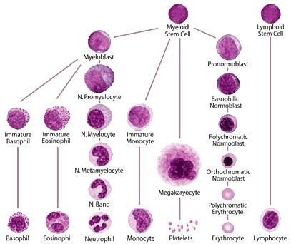




Facilitate Differentiation
A new mechanism of combating leukaemia!
ATRA
to unblock..!

Slide 35
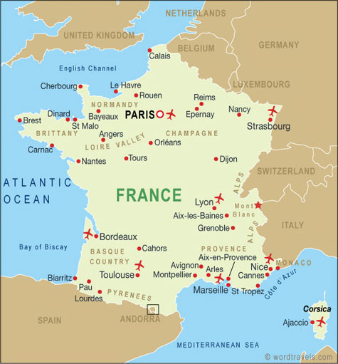
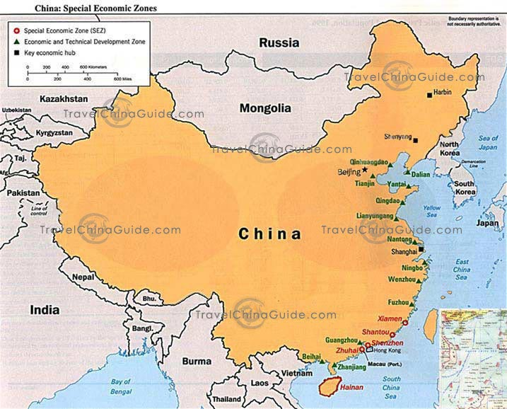
FIRST 6 PATIENTS TREATED WITH ATRA!-1987
Fig 3. Huang Meng Er (first author of the first
report on ATRA in APL), Wang Zhen Yi,
Degos Laurent and Dr Chang in Shanghai in
1987 when the first APL patients were treated
with all-trans retinoic acid.
British Journal of Haematology 122: 539–553

Slide 36
The first production of all-trans retinoic acid for clinical use,
as 10 mg tablets, made by the Shanghai Pharmaceutical Unit.
Courtesy of L. Degos.
British Journal of Haematology 122: 539–553

Slide 37
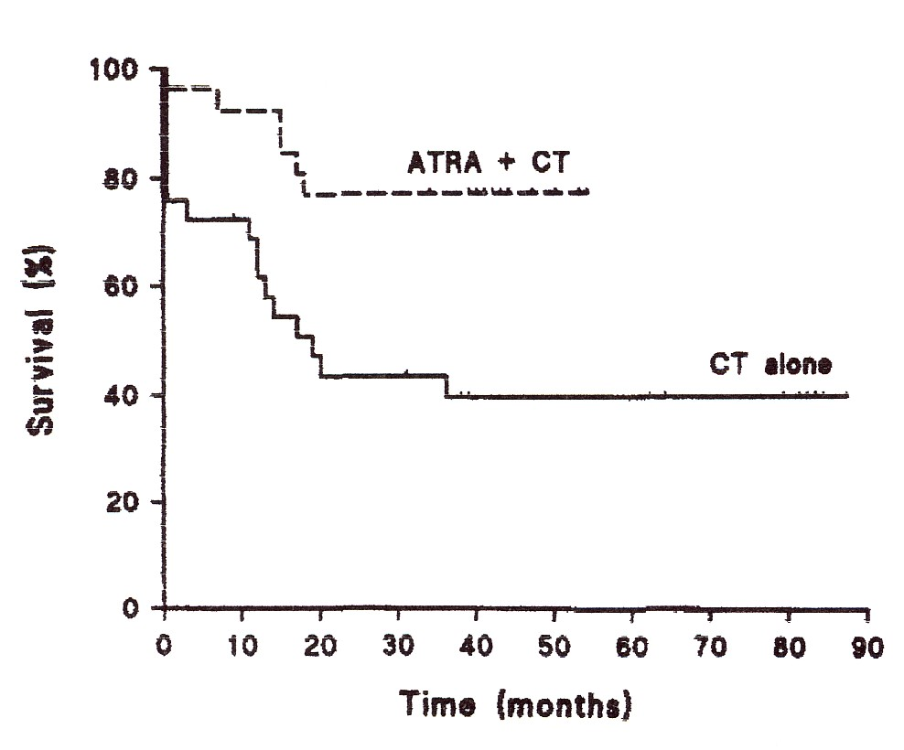
Acute promyelocytic leukaemia
Degos et al. (1995) Blood, 85, 2643.

Slide 38
The Arsenic Story
CHINESE STORY (Again!)

Slide 39
Textbook of medicine for students in 1894, stating that ‘the
best treatment for leukaemia is arsenic…’. With the permission of
Masson, Paris, France.
British Journal of Haematology 122: 539–553

Slide 40
Production of the first arsenic preparation by the Harbin
Medical University (1995). Courtesy of L. Degos.
British Journal of Haematology 122: 539–553

Slide 41
THE 3 ERAS OF APML
PRE-ATRA
1957-1987
ATRA
1988-1993
ARSENIC PHASE
1993…….

Slide 42
Acute Promyelocytic Leukaemia Oncogenic mechanisms
PML-RARA is expressed in all cases
RARA-PML is expressed in about 70% of patients
PML-RARA is therefore more likely to be relevant to leukaemogenesis
A supplementary role for RARA-PML is not excluded

Slide 43
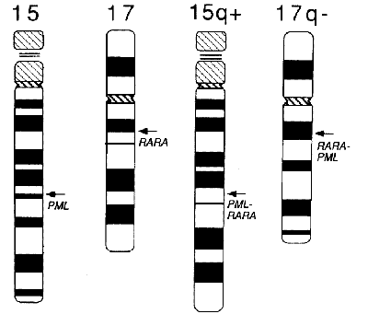
Acute promyelocytic Leukaemia Oncogenic mechanisms
Source not recorded

Slide 44
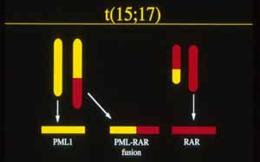
Acute promyelocytic leukaemia Oncogenic mechanisms
www.webtie.org/sots/meetings

Slide 45
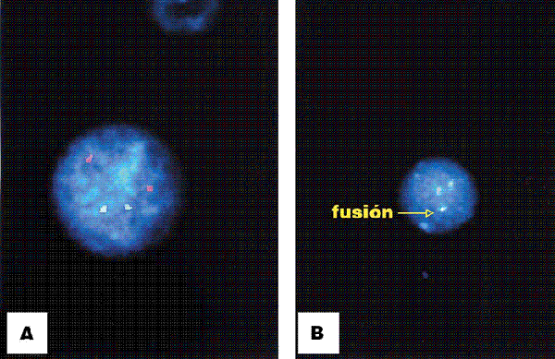
Acute promyelocytic leukaemia Oncogenic mechanisms
Normal cell, PML red,
RARA green
Abnormal cell, PML red, RARA
green, yellow fusion signal
www.scielo.com, Revista Médica de Chile

Slide 46
Acute promyelocytic leukaemia
Here is an explanation of some of the molecular mechanisms believed to be operating
You will hear this again in another lecture so this is just a first introduction

Slide 47
Action of RARα in normal cells in the absence of retinoic acid (RA)
RARα dimerizes with retinoid X receptor (RXR) through its zinc finger domain
The RARα-RXR dimer binds to retinoic acid response elements (RARE) in the promoter of target genes
RARE
RARα
RXR
Jones and Saha (2002) Br J Haematol, 118, 714 Mistry et al. (2003) Blood Rev, 17, 71-97
B. J. Bain

Slide 48
Action of RARα in normal cells in the absence of retinoic acid (RA)
RARα interacts with nuclear receptor co-repressor (NCoR) through a large ligand interacting/ligand-dependent transactivation domain
it recruits Sin3 and histone deacetylase (HDAC) to form a repressor complex
RARE
RARα
NCoR
RXR
HDAC
Sin3
CHROMATIN CONDENSATION REPRESSION OF TRANSCRIPTION
B. J. Bain

Slide 49
Action of RARα in normal cells in the presence of retinoic acid (RA)
RARE
In the presence of its ligand, retinoic acid, the binding of RARα to NCoR is disrupted and repressor complex formation does not occur
RARα
RXR
RA
NCoR
HDAC
Sin3
B. J. Bain

Slide 50
Action of RARα in normal cells in the presence of retinoic acid (RA)
RARE
Instead, RARα recruits transcriptional coactivators such as CREB-binding protein (CBP) and p300 and functions as a ligand-dependent transcription factor
RARα
RA
CBP/p300
RXR
CHROMATIN RELAXATION ACTIVATION OF TRANSCRIPTION
B. J. Bain

Slide 51
Action of RARα in normal cells in the presence of retinoic acid (RA)
RARE
Histone acetylase can also be recruited, contributing to a multiprotein co-activator complex
RARα
RA
Histone acetylase
RXR
CHROMATIN RELAXATION ACTIVATION OF TRANSCRIPTION
B. J. Bain

Slide 52
Acute promyelocytic leukaemia
Therefore, in normal cells, retinoic acid exposure leads to activation of transcription

Slide 53
Action of RARα in normal cells in the presence of retinoic acid (RA)
The down-stream genes activated as a result of the binding of RARα-RXR dimers to RARE in the presence of retinoic acid are not known with certainty
However, they appear to include C/EBPα and C/EBPε, genes encoding transcription factors that are critical for myeloid development
Sirulnik et al. (2003) Best Prac & Res Clin Haematol, 16, 387

Slide 54
Acute promyelocytic leukaemia
Therefore, in normal cells, retinoic acid exposure leads to activation of transcription
How do the cells in acute promyelocytic leukaemia differ?

Slide 55
PML-RARα fusion protein
PML-RARα dimerizes with RXR and binds PML
It oligomerizes through the coiled coil domain of PML
It then recruits NCoR avidly and a repressor complex is formed
RXR
PML-RARα
RARE
PML
HDAC
NCoR
Sin3
CHROMATIN CONDENSATION REPRESSION OF TRANSCRIPTION
B. J. Bain

Slide 56
PML-RARα fusion protein
RXR
PML-RARα
RA
Formation of this repressor complex is not disrupted by physiological levels of RA
RARE
HDAC
NCoR
Sin3
CHROMATIN CONDENSATION REPRESSION OF TRANSCRIPTION
B. J. Bain

Slide 57
PML-RARα fusion protein
Pharmacological doses of RA (e.g. ATRA therapy) disrupt the repressor complex and ‘normality’ is restored
ATRA also degrades PML-RARα, releasing RXR to bind with RARα and PML to re-form nuclear bodies
RXR
PML-RARα
ATRA
RARE
HDAC
NCoR
Sin3
CHROMATIN RELAXATION ACTIVATION OF TRANSCRIPTION
B. J. Bain

Slide 58
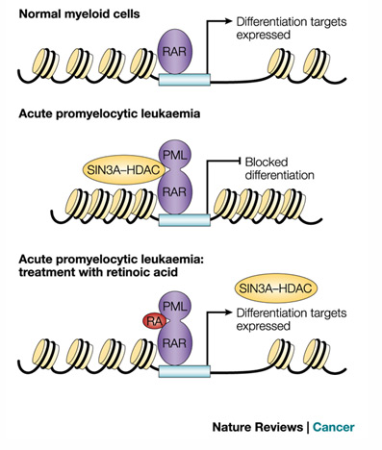
Acute promyelocytic leukaemia
PML-RARA and the promyelocytic leukaemia cell—summary
PML-RARα binds more strongly to co-repressors than RAR α and does not dissociate in the presence of physiological levels of RA
However, pharmacological levels of ATRA correct the situation
B. J. Bain

Slide 59


Acute promyelocytic leukaemia
The net effect of the presence of PML-RARα is
  A block in differentiation at the promyelocyte stage
  Continued proliferation
  Failure of apoptosis

Slide 60
Acute promyelocytic leukaemia
The effects of ATRA are
  Induction of terminal differentiation to neutrophils
  Facilitation of apoptosis of neutrophils
  Disappearance of the leukaemic clone as cells of the clone mature and die
  Replacement of the leukaemic clone by normal cells

Slide 61
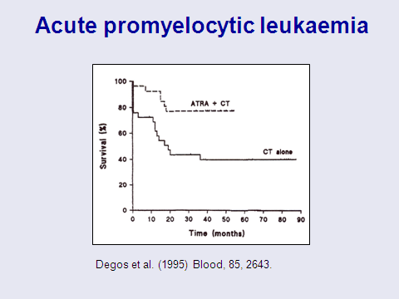
Acute promyelocytic leukaemia
ATRA plus chemotherapy is better than either alone
ATRA reduces the DIC and therefore reduces the chance of early death from haemorrhage

Slide 62
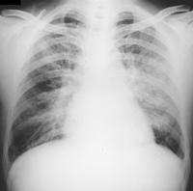
ATRA syndrome
Clinical syndrome: dyspnoea, oedema, weight gain, pulmonary infiltrates, hypotension
Occurs early in treatment with ATRA
Can also occur with ASO treatment
Aetiology unclear but related to rising numbers of differentiating myeloid cells
Can be fatal – very rarely
Treatment: dexamethasone, stop ATRA temporarily
New term “differentiation syndrome” is better since it can also follow ASO

Slide 63
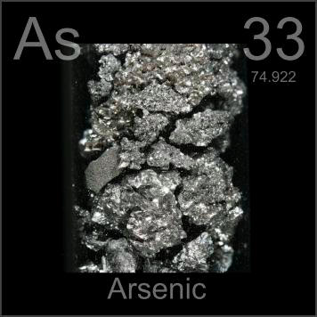
Acute promyelocytic leukaemia
As₂O₃ has also been found to be effective in M3 AML with PML-RARA fusion, including ATRA-resistant cases
It degrades PML-RARα without degrading RARα
It also induces apoptosis by an unrelated mechanism
Jing 2004 Leuk Lymphoma, 45, 639.

Slide 64
Acute promyelocytic leukemia: from highly fatal to highly curableZhen-Yi Wang and Zhu Chen
2008 111: 2505-2515

Slide 65
Acute promyelocytic leukaemia
Conclusions
Acute promyelocytic leukaemia is a unique form of AML
The classical hypergranular and the variant (hypogranular form) are clinically very similar
The only important difference is that the WBC tends to be higher in the variant form
For this reason the prognosis may be slightly worse in the variant form

Slide 66
Acute promyelocytic leukaemia
Conclusions
This is the first type of acute leukaemia where a specific effective treatment can be related to the underlying molecular mechanism
The RARA gene, encoding retinoic acid receptor, contributes to a fusion gene, PML-RARA and treatment with a retinoic acid analogue (ATRA) has greatly improved the prognosis

Slide 67
Acute promyelocytic leukaemia
Conclusions
The benefit of ATRA was discovered by empirical observation but its efficacy gives hope that treatment specific to the molecular mechanism may have a similar effect in other form of AML
Arsenic has been used for treatment of leukaemia for more than a century
It appears to be particularly efficacious in this subtype of AML

Slide 68
Further lecture on
Acute Promyelocytic Leukaemia
Professor D Grimwade
Thursday 29 November 2013
12.30-1.30
Cockburn Lecture Theatre

Slide 69
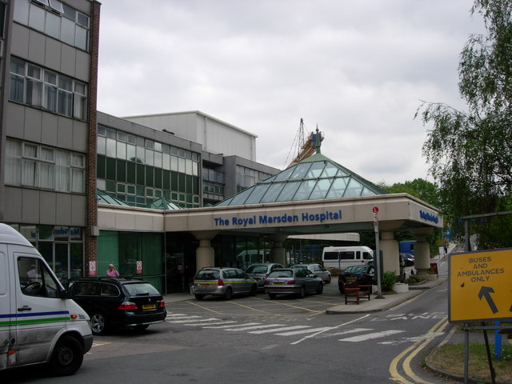

ACKNOWLEDGEMENTS
Prof B Bain
Dr Sasha Marks

