Slide 1


Von Willebrand Factor
BSc Haematology Foundation
Dr Tom McKinnon
Dept. Haematology, Imperial College London

Slide 2
Von Willebrand factor: learning objectives
Understand the roles of VWF in haemostasis
Understand the structure-function relationship of VWF
Understand the way VWF is produced and regulated
Understand the haemostatic defect in von Willebrand disease

Slide 3
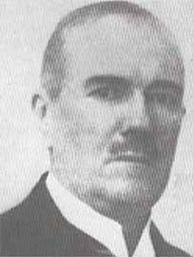
Dr Erik Adolf von Willebrand
1st February 1870 – 12 September 1949

Slide 4
Von Willebrand disease: History
1924 Erik von Willebrand
  Familial bleeding in families from Aaland islands
  Several members died from bleeding (mostly female)
  Others had milder bleeding symptoms
Different from Factor VIII deficiency(Haemophilia) inheritance & bleeding pattern
Confusion
  Low levels of FVIII (1950’s)
  Corrected by factor VIII concentrate
  Corrected by haemophilia plasma (no FVIII)
von Willebrand Factor:
  Purified in 1970’s
  Cloned 1986
  Circulates in association with Factor VIII

Slide 5
Von Willebrand Factor
Large multimeric plasma glycoprotein
Size 500 – 20000kDa
Is the carrier molecular for pro-coagulant factor VIII
Supports platelet adhesion to thrombogenic surfaces and aggregation under high sheer stress conditions.

Slide 6
How does VWF perform its roles?
1. It has appropriate functional domains (binding sites)
2. It has a complex multimeric structure (bridge)

Slide 7
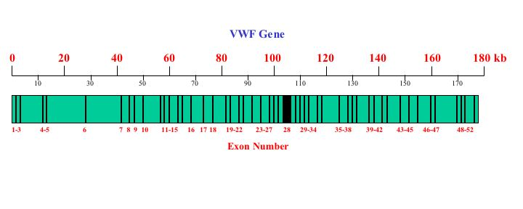
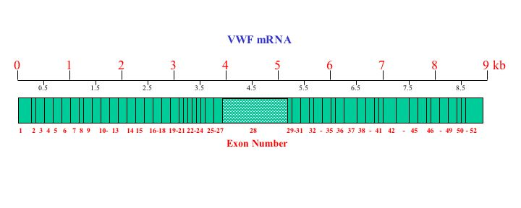
Schema of the VWF gene (12p)
VWF mRNA (~9kb)
Chromosome 12 p(13.3)

Slide 8
VWF Monomeric Structure - old
ADAMTS13 cleavage
Multimerisation
Dimerisation
D1
D2
D3
A1
A2
A3
D4
C1
C2
CK
D'
_{B1-3}
FVIII
GPIb
Collagen I & VI
Collagen III
GPIIbIIIa
Propeptide Mature VWF

Slide 9
Post-translational modification of VWF
E. R.
Golgi
Post Golgi
Extracellular
N-linked glycosylation
Carbohydrate processing
ABH
O-linked glycosylation
Multimerisation
Dimerisation
Sulphation
Propeptide cleavage
Time after synthesis

Slide 10
COOH
VWF monomer
NH₃

Slide 11
COOH
VWF monomer
NH₃
C-terminal dimerisation via the CK knot (ER)

Slide 12
Dimerisation
D1
D2
D3
A1
A2
A3
D4
C1
C2
CK
D'
_{B1-3}
Propeptide Mature VWF

Slide 13
COOH
VWF monomer
NH₃
C-terminal dimerisation (ER)
N-terminal multimerisation (Golgi)

Slide 14
Multimerisation
Dimerisation
D1
D2
D3
A1
A2
A3
D4
C1
C2
CK
D'
_{B1-3}
Propeptide Mature VWF

Slide 15
COOH
VWF monomer
NH₃
C-terminal dimerisation (ER)
N-terminal multimerisation (Golgi)
Furin
Propeptide removal by furin  secretion/storage

Slide 16
VWF propeptide (VWF Ag II)
Essential for multimerisation
Can act in cis or trans
Has disulphide isomerase activity
Essential for direction to WPB
Not required for VWF function
Secreted with VWF and circulates in plasma (no clear function)

Slide 17
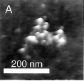
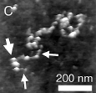
VWF Structure

Slide 18
VWF structure: Summary
VWF is a complex molecule!!!
  Each monomer has multiple functional sites
  Monomers are assembled into large multimers
  Multimers undergo extensive processing
    Propeptide cleavage
    Glycosylation
  Multimers can adopt globular or linear configuration

Slide 19
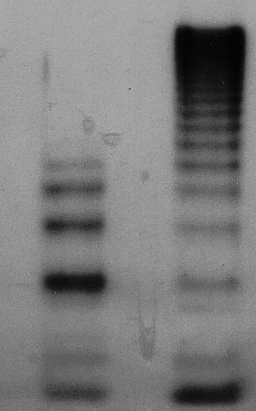
Electrophoresis to analyse plasma VWF multimers
High molecular
weight multimers
dimers

Slide 20
VWF: sites of synthesis
1. Vascular endothelial cells - main source of plasma VWF
2. Megakaryocytes - do not contribute significantly to plasma VWF

Slide 21
VWF: sites of synthesis
VWF expression is highest in the lung, brain and heart
In general higher levels are seen in larger vessels and in venous EC compared to arterial EC

Slide 22
VWF: synthesis (1): Endothelial cells
Traditional view
Lumenal
Constitutive path (95%)
Weibel-Palade bodies
Regulated path (5%)
Released in response to
Epinephrine, DDAVP,
Histamine, thrombin etc
Golgi
ER
Sub endothelial
matrix
Ablumenal

Slide 23
VWF: synthesis (2): Endothelial cells
Recent view
Lumenal
Constitutive pathway
Basal
secretion
Golgi
Weibel-Palade bodies
Regulated path
ER
Sub endothelial
matrix
Ablumenal

Slide 24
VWF and Weibel Palade bodies
WPB found only in endothelial cells
VWF is required for WPB formation
      Specifically the propeptide
WPB contain HMW VWF
Also contain P-selectin, CD63, IL-8, Ang2, OPG, Endothelin, FVIII

Slide 25
VWF Multimer gels – ultra large VWF
Secreted from endothelial cells
Normal plasma

Slide 26
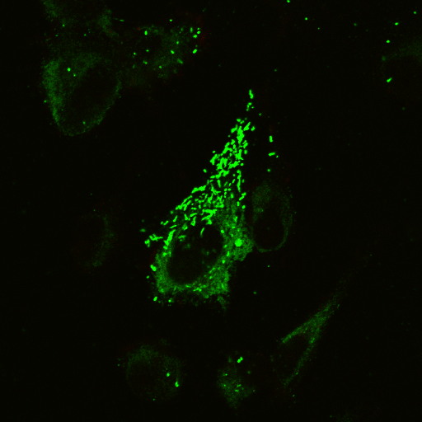
HUVECs: Weibel Palade bodies

Slide 27
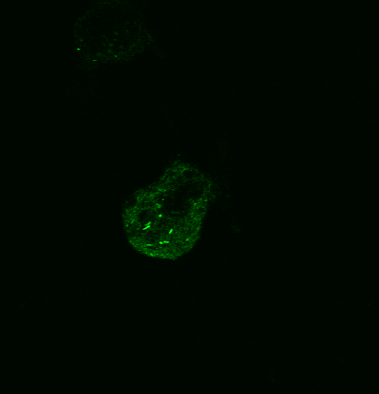
VWF can induce WPB formation
HEK293 cells transfected with VWF

Slide 28
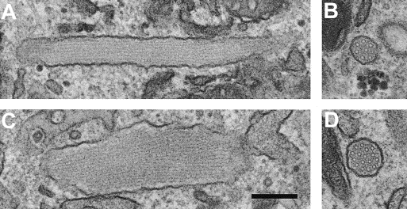
VWF can induce WPB formation
HUVEC
HEK + VWF

Slide 29
VWF: synthesis (2): Megakaryocytes
All platelet VWF is stored in alpha granules
Does not contribute to plasma VWF (BMT effect)
Can compenstate for lack of EC VWF
VWF released on platelet activation

Slide 30
VWF processing in plasma
30% of propeptides are still present on secretion and are removed in plasma
VWF is in ultralarge multimers when released
  Cleavage by ADAMTS 13 reduces multimer size
  Generates smaller multimers and ‘triplets’
  Regulates functional activity

Slide 31
VWF levels in Plasma
VWF plasma levels vary over a six fold range
  40 – 240%
VWF levels are elevated at birth
VWF levels rise slowly with age (~10% per decade) – (link with stroke??)

Slide 32
VWF level in plasma varies over 6 fold range
Genetic
Environmental
  Age
  Stress
  Exercise
ABO blood group
20%
40%
40%
VWF gene
5`SNPs VWF gene
Secretor blood group

Slide 33
Modulation of VWF level
ABO blood group
Stress/exercise
Inflammation
Pregnancy
Menstrual cycle
Oestrogen therapy
Acquired von Willebrand syndromes

Slide 34
VWF: Function
Primary haemostasis
Factor VIII

Slide 35
VWF and Factor VIII
Factor VIII and VWF circulate as a complex in plasma
Protects VIII from degradation
Prevents premature association with Factor X
Free FVIII half life ≈ 2 hours
vWF bound FVIII half life ≈ 12 hours
50x excess of FVIII binding sites in plasma D’D3
Half time for complex ≈ 2 seconds
FVIII activation releases it from vWF

Slide 36
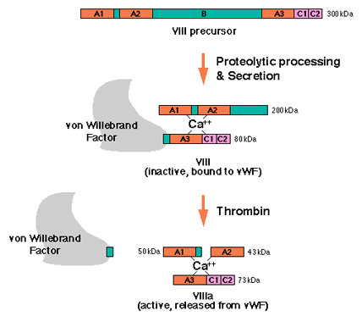
VWF and Factor VIII
Where does this step occur?
Factor VIII activation releases it from VWF

Slide 37
vWF and Factor VIII: pathology
1.
Defects of VWF leading to reduced FVIII binding cause Type 2N (Normandy) von Willebrand disease.
Easily confused with mild haemophilia
Autosomal recessive inheritance.
2.
When there is no circulating VWF (Type 3 VWD), the FVIII level is also very low although the gene and synthesis are normal

Slide 38
VWF: Function
1. Primary haemostasis

Slide 39
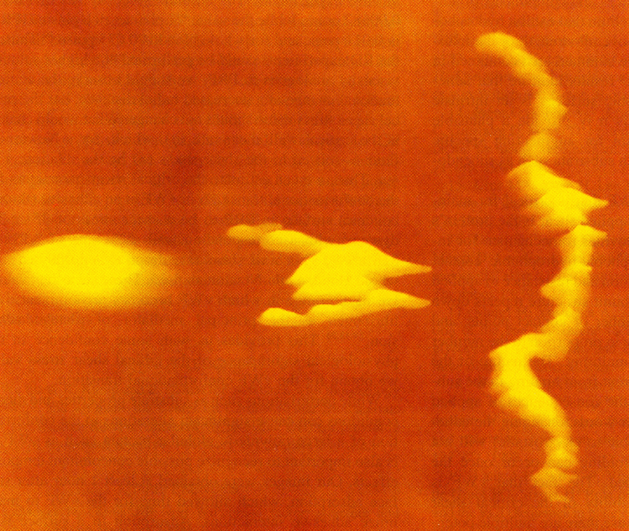
Effect of shear stress on immobilised VWF
Shear stress

Slide 40
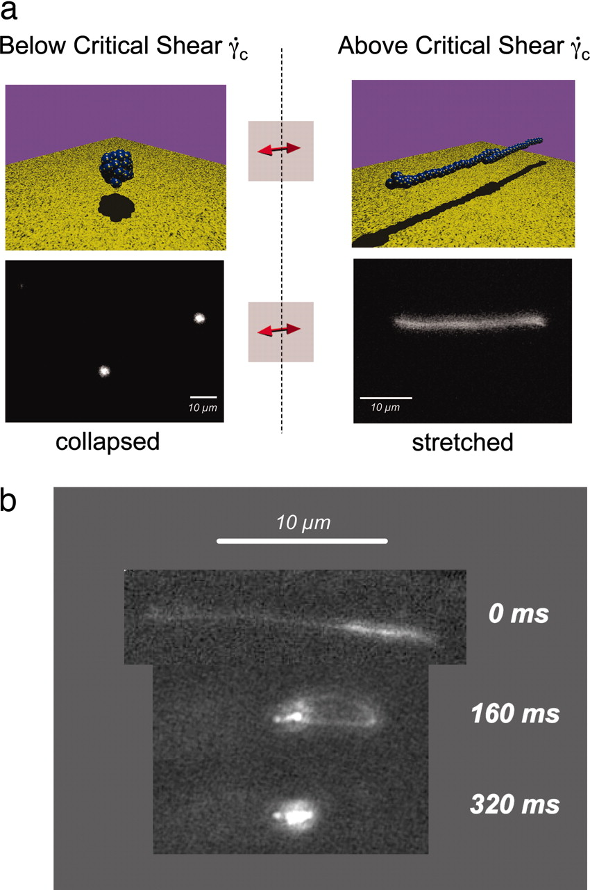
Dynamic conformational change of VWF under shear
Schneider S W et al. PNAS 2007;104:7899-7903
©2007 by National Academy of Sciences
Notes:
Dynamic conformational change of VWF under shear. (a) Cartoon (Upper) and selected fluorescence (Lower) images of a video sequence (SI Movie 1, acquired at 25 frames per second) of VWF below and above the critical shear rate of a few thousand s−1. Above γ̇crit, the protein is in an elongated conformation. The little yellow spots on the protein are meant to represent a variety of known binding sites. To assure that only unbound VWF was detected, the focus of the microscope was set ≈10 μm above the surface of the chip in the middle of the channel. (b) Relaxation of VWF. Selected fluorescence images of a video sequence (SI Movie 1, acquired at 25 frames per second). Once the hydrodynamic shear force is reduced below γ̇crit at 0 ms, the protein immediately relaxes back to its compact state. The unfolding process is reversible and presumably does not include protein denaturation.

Slide 41
Blood Flow
VWF
VWF
VWF
VWF
VWF
Platelet
VWF
VWF
VWF
VWF
VWF
VWF
VWF
VWF
VWF
VWF
VWF
Endothelium
Sub-endothelium

Slide 42
Blood Flow
VWF
VWF
VWF
VWF
VWF
VWF
VWF
VWF
VWF
VWF
VWF
VWF
VWF
VWF
VWF
Vascular Insult
VWF
Endothelium
Sub-endothelium

Slide 43
VWF: Collagen binding
VWF has 2 collagen binding sites
  A1 - binds collagen type I and VI
  A3 – binds collagen types I and III
Binding probably facilitated by heparin binding sites (D’ and A1)
Dependent on multimeric structure – larger multimers bind collagen with greater affinity

Slide 44
VWF: Collagen binding
Type I & III
D3
A1
A2
A3
D4
C1
C2
CK
D'
_{B1-3}
Type I & VI

Slide 45
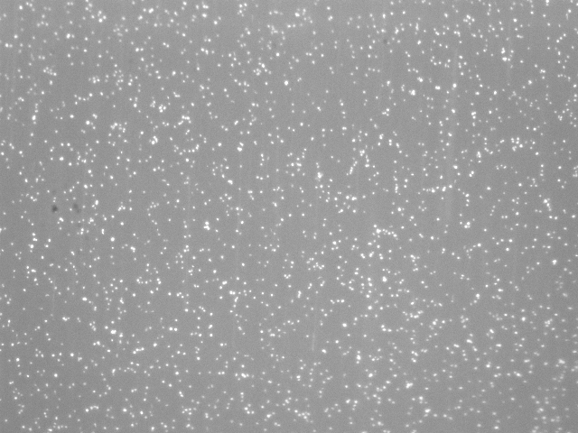
Collagen surface, plasma free blood with VWF

Slide 46
VWF function – secretion from EC

Slide 48
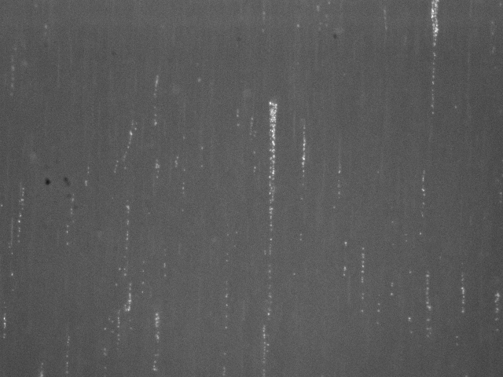

Slide 49
VWF binding to platelet GP’s
A1 contains binding site for GPIb
Rapid on - rapid off
Facilitated by binding to collagen
  allosteric change?
  multiple sites exposed?
C1 contains integrin binding RGD sequence for binding to GPIIbIIIa.
Requires ‘inside-out’ activation
RGD also binds to
  a_{v}b₃ on EC’s
  Fibrinogen
  fibronectin
Notes:
Rapid on means ok at high shear. Rapid off means will not be irreversible adhesion.

Slide 50
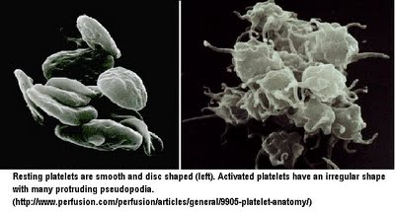

Slide 51
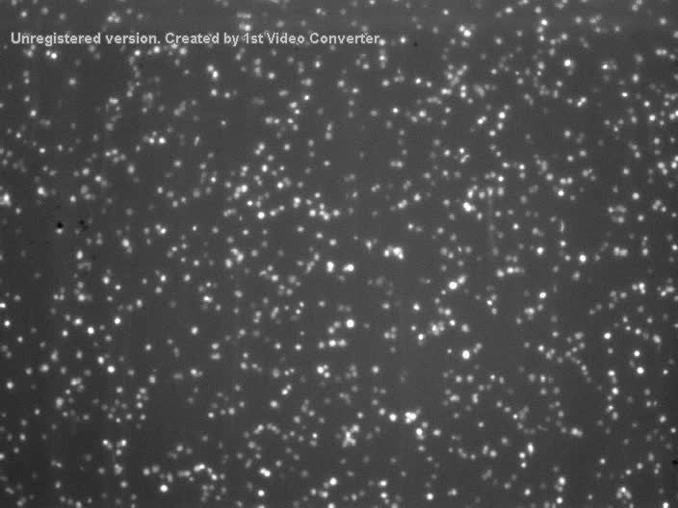

Slide 52
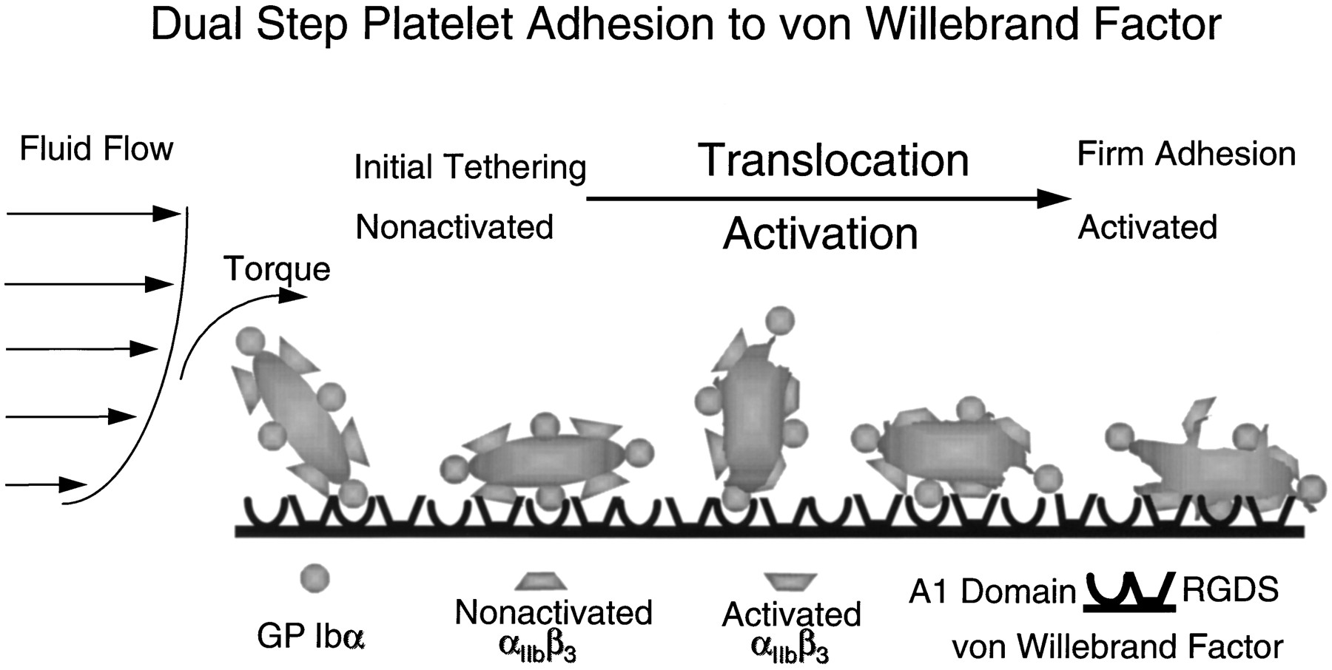
The first contact between platelets and immobilized VWF is mediated by GPIb .
The bond between the VWF A1 domain and GP Ib forms rapidly and has high resistance to tensile stress but intrinsically high dissociation rate
Platelets roll due to the torque imposed by the flowing fluid
Translocation continues until IIb becomes activated and binds to RGDS in C1
IIb-C1 bond has low dissociation rate and can mediate irreversible adhesion.

Slide 53
Steps in primary haemostasis
VWF binds to exposed collagen / secreted from EC
Shear stress elongates VWF exposing multiple binding sites
Shear stress opens GPIb – catches on VWF
Platelets roll along VWF via GPIb
GpIIb IIIa adopts active configuration
Platelets ‘fixed’ to VWF via IIbIIIa
Platelets degranulate, releasing more VWF
Further platelets captured forming platelet plug
Fibrinogen and fibronectin contribute to plug stability

Slide 54
How is VWF function regulated??

Slide 55
VWF Proteolysis by ADAMTS13
platelet
Proteolysis increased by:
  Elevated shear stress (aortic stenosis)
  VWD type 2A(II) mutations
  Denaturants (urea, guanidine)

Slide 56
VWF Proteolysis by ADAMTS13
Time
Decrease multimer size

Slide 57
Significance of VWF

Slide 58
Von Willebrand Disease
A quantitative or qualitative deficiency of VWF:
leading to an increased tendency to bleeding
Features:
defect of primary haemostasis
  Prolonged bleeding time
Reduced level of Factor VIII
  Coagulation defect – deep bleeding

Slide 59
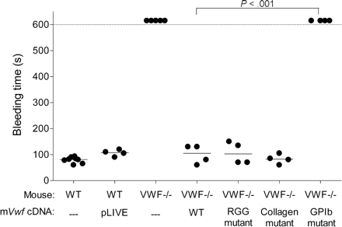
Murine studies
Effect of VWF on bleeding time

Slide 60
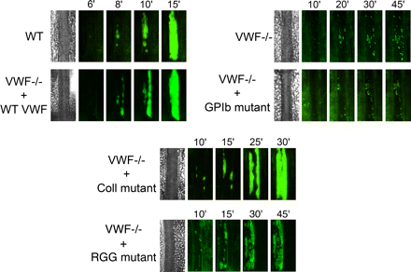
Murine studies
Effect of VWF on thrombus formation

Slide 61
Role of VWF in vascular disease

Slide 62
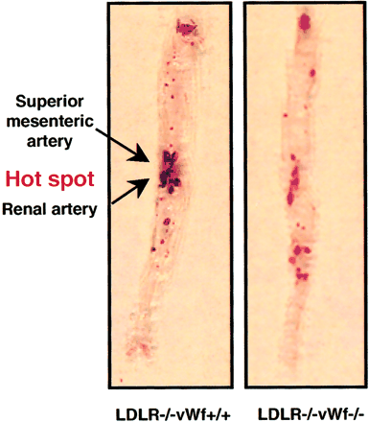
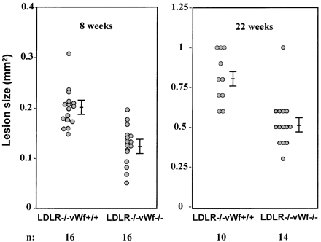
Localized reduction of atherosclerosis in von Willebrand factor–deficient mice

Slide 63
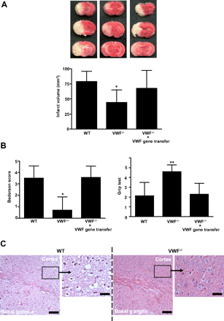
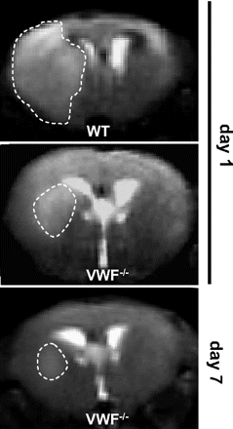
VWF^{-/-} mouse protected from stroke

Slide 64
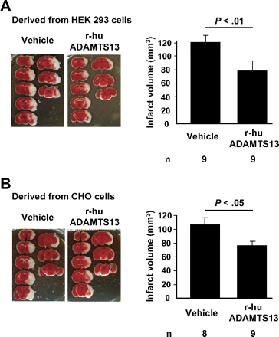
VWF^{-/-} mouse protected from stroke – role of ADAMTS13

Slide 65
Human studies (1)
- High levels of VWF increase the risk of first ischemic stroke (Stroke. 2006 Nov;37(11):2672-7. Epub 2006 Sep 21.)
- ADAMTS13 and von Willebrand factor and the risk of myocardial infarction in men. (Blood. 2007 Mar 1;109(5):1998-2000. Epub 2006 Oct 19.)
- High VWF, low ADAMTS13 and oral contraceptives increase the risk of ischemic stroke and myocardial infarction in young women. (Blood 2012)
- Various genetic studies have established a link between high VWF and CVD

Slide 66
Human studies (2)
Patients With Type 3 Severe von Willebrand Disease Are Not Protected Against Atherosclerosis (Circulation 2004)

Slide 67
Is VWF a novel therapeutic target for CVD??
Repro – anti IIbIIIa monoclonal already in widespread clinical use
Several new agents in animal trials and clinical trials – (ARC1779 and ARC15105 aptamers)
Anti VWF:Collagen antibodies used in animal models

