Slide 1
BSc Haematology Module 1
Introduction to Thrombophilia
Professor David Lane
Department of Haematology
Hammersmith Hospital Campus,
d.lane@imperial.ac.uk

Slide 2
Learning objectives:
Understand how natural anticoagulant deficiency predisposes to venous thrombosis
Understand how common polymorphisms (factor V Leiden, prothrombin G20210A) may predispose to thrombosis
Understand the importance of environmental risks in thrombosis
Understand the concept and implications of the multicausal model of thrombosis

Slide 3
TF/FVIIa
End Stage Blood
Coagulation
FIXa
+
FVIII
FVIIIa
FX
FXa
+
FV
FVa
Prothrombin
Thrombin
Procoagulant
Fibrinogen
Fibrin

Slide 4
Coagulation Regulation
By Antithrombin
FIXa
FXa-Antithrombin
+
Complex
FVIII
FVIIIa
Anticoagulant
FX
FXa
+
FV
FVa
Antithrombin
+ Heparin or EC
Heparan Sulphate
Anticoagulant
Prothrombin
Thrombin
Thrombin-Antithrombin
Procoagulant
Complex
Fibrinogen
Fibrin

Slide 5
Coagulation Regulation
by Activated Protein C
FIXa
+
FVIII
FVIIIa
FVIIIi
FX
FXa
+
FV
FVa
FVi
Protein S (free)
Protein Ca
Protein C/EPCR
Prothrombin
Thrombin
Procoagulant
Anticoagulant
Fibrinogen
Fibrin
Thrombomodulin

Slide 6
Early History of Genetic Predisposition to Venous
Thrombosis
(after: Allaart & Briet, 1994)
1905 Briggs Johns Hopk Hosp Bull 16, 228
1924 Grafe Munch Mediz Wochenshr 1, 643
1956 Jordon & Nandorff Acta Med Scand 156, 267
Reports largely ignored!
1965 (AT deficiency) Egeberg Thromb Diath Haemorrh 13, 516
1981 (PC deficiency) Griffin et al J Clin Invest 68, 1370
1984 (PS deficiency) Swartz et al Blood 64, 1297
Single gene mutation hypothesis of venous thrombosis????

Slide 7
AT, PC, PS deficiencies identified by specific plasma-based
assays.
AT, PC and PS deficient individuals are usually heterozygous
for a single gene abnormality.
Heterozygotes have increased risk of thrombosis after
late teens.
Homozygotes are generally severely disabled, or die in
Utero, or at birth

Slide 8
Clinical Manifestations in Heterozygotes for Hereditary
Inhibitor Deficiencies
Common:
-Superficial recurrent vein thrombosis
-Deep vein thrombosis in legs
-Pulmonary embolism
-Pregnancy associated thromboembolism
-increased fetal loss
Also reported:
-Coumarin induced skin necrosis (PC, PS deficiencies)
-Thrombosis in cerebral, mesenteric, portal, axillary, inferior caval, renal and retinal veins
-Arterial occlusions in coronary, femoral, splanchic and cerebral
arteries
Important: Deficiency not associated with increased mortality

Slide 9
Antithrombin mutation database (Lane et al 1997) Protein C mutation database (Reitsma et al 1995) Protein S mutation database (Gandrille et al 2000)
-Several 100 mutations described for each gene
-Some founder effects mutations and a few repeat mutations
-Deficiency genetically highly heterogeneous
Accounts for only <10% of thrombosis.
Simple genetic testing for deficiency not feasible.

Slide 10
Factor V Leiden (G1691A, Arg506Gln), Prothrombin
(G20210A) Polymorphisms and Familial Thrombosis
1993 (APCR) Dalhback et al Proc Natl Acad Sci 90, 1004
1993 (LETS) Koster et al Lancet 342, 1503
1994 (FV1691A) Bertina et al Nature 369, 64
1994 (FV1691A + PC) Koeleman et al Blood 84, 1031
1994 (FV1691A + OC) Vandenbrouke et al Lancet 344, 1453
1996 (PT 20210A) Poort et al Blood 88, 3698
Multi gene mutation/gene-environment (multi-causal)
hypothesis of thrombosis

Slide 11
Venous Thromboembolism is a Multigenetic, or Multicausal, Disorder
Risk Factors
Genetic + Genetic
Risk Factors
Genetic + Acquired
Venous thromboembolism

Slide 12
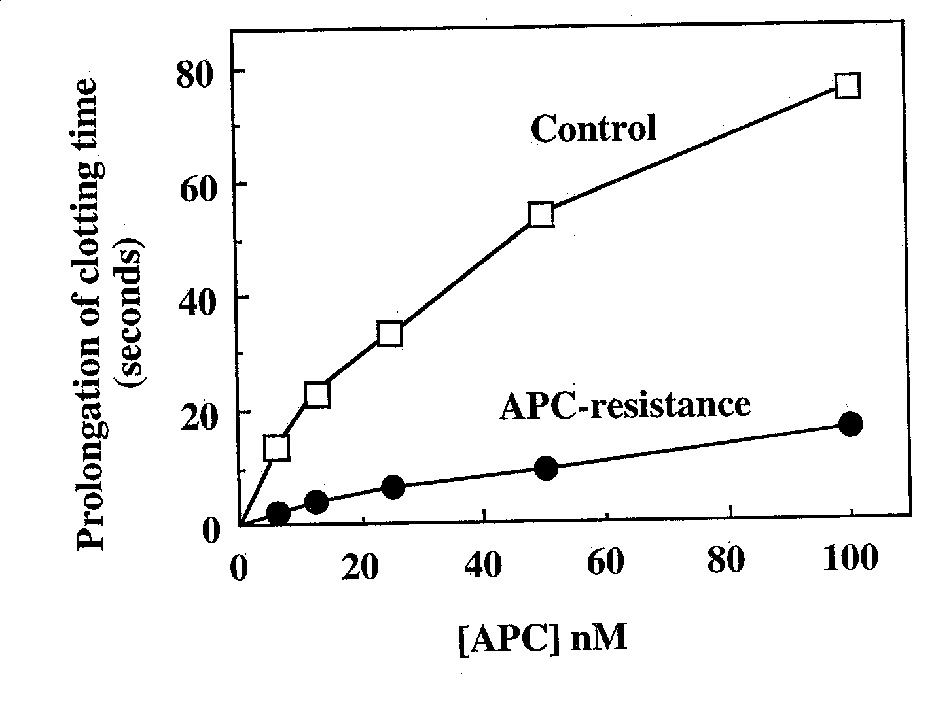
Poor response to APC (APC resistance) in plasma from a patient
with venous thrombosis (Dahlback et al PNAS, 90, 1004-1008, 1993)

Slide 13
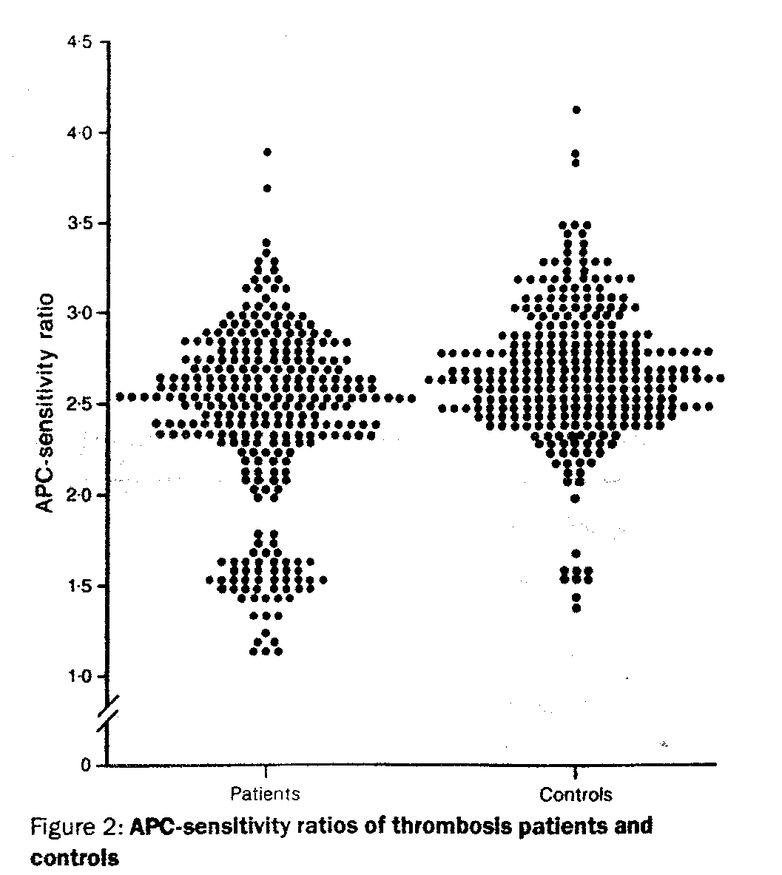
The Leiden Thrombophilia
Study Shows that APCR is
more common in patients
with venous thrombosis
(Lancet 342, 1503-1506, 1993)

Slide 14
Mutation in blood coagulation factor V associated with
resistance to activated protein C
Bertina et al Nature 369, 64-67, 1994
APCR mostly caused by a single polymorphism in the factor V gene,
FV 1691 G to A, coding for 506Arg to Gln (factor V Leiden).
Population prevalence ~4% in the Dutch.

Slide 15
APC
AAPC
APC Cleavage Inactivation of Factor Va Heavy Chain
(after Kalafatis et al, J Biol Chem 270, 4053-4057, 1995)
Normal
Factor V
Factor V
Leiden

Slide 16
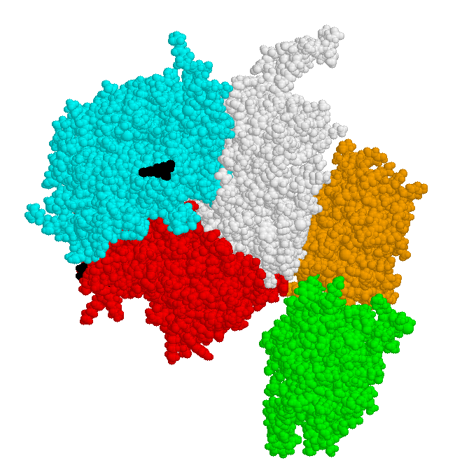
Factor Va
A2
A3
C1
A1
C2
membrane
Model of factor Va
Pellequer et al Thromb Haemost 2000;84,849

Slide 17
Factor Va
Arg506
Arg679
A2
A3
C1
A1
Arg306
C2
membrane
Model of factor Va
Pellequer et al Thromb Haemost 2000;84,849

Slide 18
Inactivation of Factor Va By APC
Arg506
Arg679
Activated
protein C
(APC)
A2
A3
C1
A3
C1
A1
A1
Arg306
C2
C2
membrane
Factor Va
Factor Vi
Inactivation occurs on the surface of anionic phospholipid
vesicles, activated platelets and endothelial cells

Slide 19
Inactivation of Factor Va By APC
Arg506
Rapid cleavage
Results in factor Va
with intermediate activity
BIPHASIC
A2
A3
C1
Arg306
A1
Slow cleavage
C2
Completely abolishes
factor Va activity
Factor Va

Slide 20
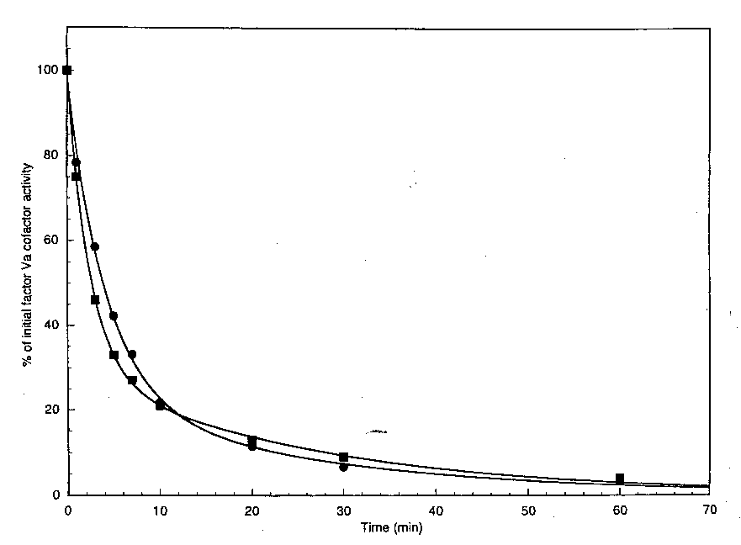
Inactivation of Factor Va By APC
Arg306 cleavage
Arg506 cleavage

Slide 21
Factor V Leiden (Arg506Gln)
Arg506Gln
Arg679
A2
A3
C1
A1
Arg306
C2
membrane

Slide 22
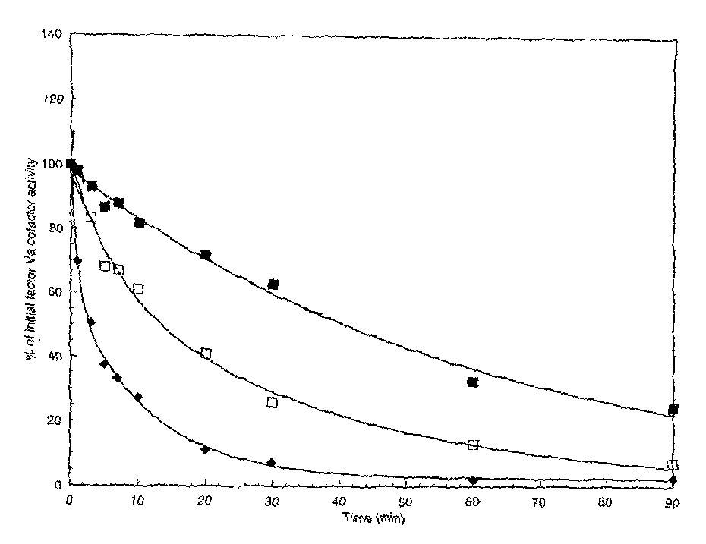
Inactivation of Factor V
Leiden (Arg506Gln) by APC
The rapid cleavage
at Arg506 is lost
Factor Va is still
inactivated by the
slow cleavage
at Arg306
Factor V
Leiden
Homozygous
Heterozygous

Slide 23
World Distribution of Factor V 1691A
(Rees BJH 1996)
No
Heterozyg Homozyg Allele Freq (%)
Europe
Greece 187 24 1 7.0
Sweden 101 10 1 5.9
Germany 1043 72 2 3.6
UK 381 26 0 3.4
Italy 1207 33 0 1.4
All Europe 3392 195 5 2.7
Asia/Middle East
Russia 156 10 2 4.5
India 203 5 0 1.2
Saudi Arabia 255 5 0 0.98
China 254 0 0 0
Japan 270 0 0 0
Indonesia 105 0 0 0
Africa 551 0 0 0
Australia (original) 73 0 0 0
American Indians 36 0 0 0

Slide 24
A Single Genetic Origin for Factor V 1691A*
Zivelin et al Blood 89, 397, 1997
Haplotype
Controls
1691G
Homozyg
1691A
Exon 2 4 9 11 13 16
Alleles
Fract
Allele
Fract
a - - - + + + 83 0.49 204 0.88
b + - + + + + 25 0.15 18 0.08
c - + + + + + 24 0.14 8 0.03
d - - + + - - 17 0.10 1 0.004
e - - + + + - 4 0.02 1 0.004
*Based on recombination events, single mutational
event occurred 21-34 000 yrs ago

Slide 25
Genetic Basis
of Evolution
13x10⁶ yrs
Cavalli-Sforza et al 1988
4.9x10⁶ yrs
Orangutan
Gorilla
Homo sapiens sapiens
Pygmy Common
Chimpanzee
140 000 yrs
African
SE Asian
NorthEurasian
70 000 yrs
Caucasoid
40-60 000 yrs
NE Asian
Pygmy
Bantu
Ethiopian
Pacific Isl
Indonesian
Malaysian
Japanese
Korean
Mongol
Amerind
Indian
Iranian
Lapp
European
FV 1691A 21-34 000yrs

Slide 26
Factor V Leiden interacts with other genetic risks
to cause thrombosis:

Slide 27
Interaction of FV Leiden with Protein C Deficiency
in 6 Families with Thrombophilia
(Koeleman et al, Blood 84, 1031-1035, 1994)
Symptoms of Thrombosis
Gene Mutation Present Absent
no (%)
no (%)
Protein C+FV Leiden 16 (73) 7 (27)
Protein C 12 (36) 22 (64)
F V Leiden 2 (10) 18 (90)
None 2 (7) 28 (93)

Slide 28
Odds Ratio
Odds of an event
Number of events/number of non events
Odds ratio
Odds in treated or exposed group/odds in control group

Slide 29
Odds Ratio
In a week
90/100 men have drunk beer
Odds 90/10
20/100 women have drunk beer
Odds 20/80
Odds Ratio 90/10 = 36
20/80

Slide 30
95% Confidence Interval (CI)
A 95% confidence interval is an interval generated by a process that is correct 95% of the time. It gives a measure of confidence to the mean.
If 95% CI crosses unity, result not “statistically” significant!
Compare OR (95% CI)
3.3 (1.6-7.0)
With 3.2 (0.8-12.3)

Slide 31
High Risk of Thrombosis in Patients Homozygous for FV Leiden
(Rosendaal et al, Blood 85, 1504-1508, 1995)
(65.8
unadjusted)

Slide 32
Factor V Leiden has been shown to be able to
interact with the following to increase
the risk of thrombosis:
Factor V Leiden
Protein C deficiency
Protein S deficiency
Antithrombin deficiency
Prothrombin G20210A (see later)

Slide 33
Factor V Leiden interacts with environmental risks
to cause thrombosis:

Slide 34
Risk of Thrombosis in OC Uses who are Carriers of FV Leiden
(Vandenbrouke et al, Lancet 344, 1453-1457, 1994)
Factor V Leiden Oral Contraceptives Odds ratio
- - 1.0*
- + 3.7
+ - 6.9
+ + 34.7
* reference category

Slide 35
Oral Contraceptives Alter Sensitivity of APC
Rosing et al Brit J Haematol 1997, 97, 233-238
Group n APCRsr
Men 25 0.96
Women
no OC 53 1.22
no OC, FVR506Q 17 3.10
no OC, FV506Q (homozyg) 5 4.75
Third generation OC 40 2.59
FVR506Q + third generation OC 31 5.41
Conclusion: OC cause acquired APC resistance and increases risk
of thrombosis

Slide 36
There are additional common genetic risks
for thrombosis:

Slide 37
Organisation of Prothrombin Gene
chromosome 11p11-q12
~21kb
Leader
+ Gla
Kringles
Catalytic domain
I II
V
VII
X
XIV
5’
3’
20210 G/A,
increased prothrombin level
(Degan & Davie Biochemistry 26 6165, 1987
Poort et al Blood 88 3698 1997)

Slide 38
LETS: Frequency and Thrombotic risk for the
20210 G/A Genotypes in the
Prothrombin Gene
Genotype
No of Patients
(%)
No of Controls
(%)
OR
GG 442 (93.8) 463 (97.7) 1.0
AG 29 (6.2) 11 (2.3) 2.8
AA
(Poort et al Blood 88, 3698-3703, 1996)

Slide 39
LETS: Thrombotic risk for Plasma Prothrombin
Levels
Prothrombin
level (U/ml)
No of Patients
(%)
No of Controls
(%)
OR
<0.95 85 (20) 134 (28) 1.0
0.95-1.04 107 (25) 125 (26) 1.3
1.05-1.15 102 (24) 118 (25) 1.4
>1.15 132 (31) 97 (20) 2.1
(Poort et al Blood 88, 3698-3703, 1996)

Slide 40
Prevalence of Genetic Risk Factors
Risk Factor General Population (%) Patients with VTE (%)
AT deficiency 0.02 1-3
PC deficiency 0.2-0.4 3-5
PS deficiency ? 1-5
FV Leiden 1-15 10-50
PT G20210A 2-5 6-18
“private”
mutations
poly-
morphisms
Polymorphisms can account for a much greater number of
thromboses than gene mutations in coagulation inhibitors

Slide 41
Relative Risks of Thrombophilic Defects
Martinelli et al, Blood 1998, 92, 2353-2358
Yes No OR
Venous thrombosis
No defect 9 312 1.0 (Ref)
AT deficiency 30 55 8.1
PC deficiency 16 45 7.4
PS deficiency 12 26 10.4
FV Leiden 30 165 4.6
(PT20210A ~2.0)
Risk associated with polymorphisms appears lower than risk associated with “private” mutations!

Slide 42
Venous Thrombosis is Multi-Causal Arising from Interacting Genetic
and Acquired Risk Factors
after Rosendaal, 1998
Odds
Ratio
Transient acquired
risk
Cumulative risk
Thrombotic
threshold
Risk from “ageing”
Genetic risk 2
Genetic risk 1
Age

Slide 43
Risk Factors for Venous Thrombosis
Inherited Acquired Mixed
Antithrombin deficiency
Protein C deficiency
Protein S deficiency
Factor V Leiden
Prothrombin G20210A
Dysfibrinogenaemia?
Oral contraceptives
Hormonal replacement therapy
Age
Previous thrombosis
Immobilisation
Major Surgery
Orthopedic surgery
Malignancy
Antiphospholipid syndrome
Myeloproliferative disorders
Polycythaemia vera
Long distance travel?
Hyperhomocysteinaemia
High factor VIII levels
High factor IX levels
High fibrinogen levels

