Slide 1
Balancing the risk in managing thrombosis

Slide 2
Learning objectives
Understand the risks associated with oral anticoagulant therapy
Understand the risks of recurrent thrombosis
Be able to assess the factors that modulate these risks and balance them against each other

Slide 3
When do we assess thrombotic risk?
WHEN?
WHY?
After VTE
Asymptomatic (eg family study)
Prior to risk
(eg: OCP, HRT, pregnancy)
Duration of a/c
A/c and prophylaxis
Assess risk and
prophylaxis

Slide 4
Balancing the risks of anticoagulation
Anticoagulation
No anticoagulation
Death - haemorrhage
v
Death -VTE
Major bleeding
Minor bleeding
Recurrence
Post phlebitic syndrome
Inconvenience
Anxiety

Slide 5
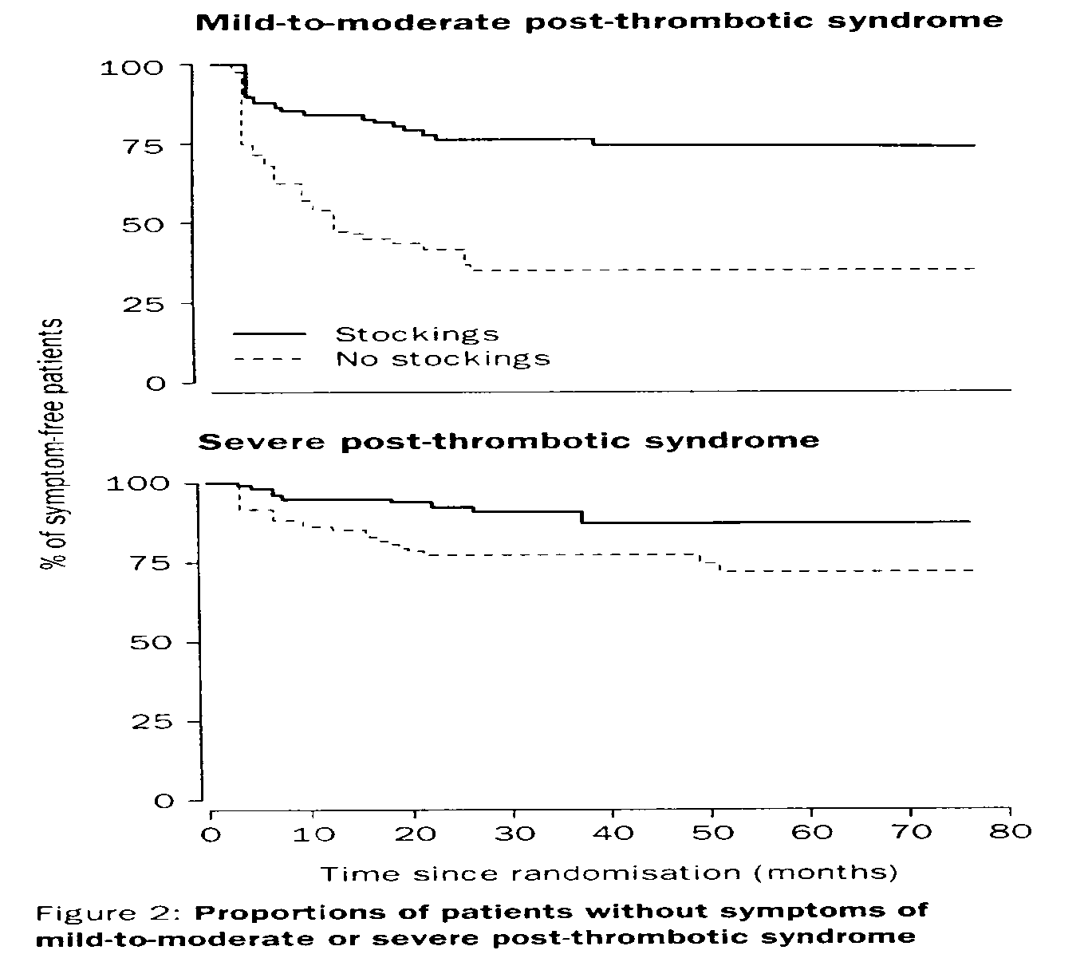
Post phlebitic syndrome after VT
RR 2.4 after ipsilateral recurrence
Prandoni 1997
Brandjes 1997

Slide 6
Anticoagulation: stratified risk
Haemorrhage (%pa)
Risk Modifier
Minor
Major
Fatal
Overall
6.2
1.1
0.25
Age (<50)
6.9
0
0
Age (50-69)
5.0
0.7
0
Age (≥70)
7.5
2.2
0.7
Arterial disease
9.8
2.2
0.45
Time <90days
9.2
1.6
0.18
Target <2.8
6.8
1.2
0.22
Palareti 1996

Slide 7
Anticoagulation problems
Bleeding - Marked age dependence
Decreases over time (ie people who bleed tend to bleed early in treatment)
Requires regular blood testing
Some lifestyle restriction
Complicates other treatments
Many drug interactions
Warfarin side effects (non haemorrhagic) very rare

Slide 8
Does warfarin provide the best balance?

Slide 9
Intensity of oral anticoagulation for VTE
Target INR
Recurrence
Haemorrhage
2.0-3.0
2%
4%
3.0-4.0
2%
22%*
n=96, *p=0.015
Hull et al 1982

Slide 10
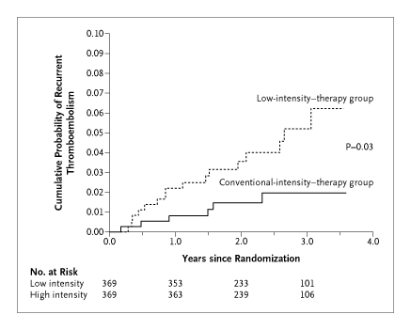
Low intensity warfarin and long term anticoagulation
INR
1.5-1.9
2.0-3.0
(no difference in bleeding)
Kearon 2003

Slide 11
Are new drugs better than warfarin?
DVT Treatment with Ximelagatran: an unmonitored, oral, direct thrombin inhibitor
Endpoint, analysis
approach
Enoxaparin/Warfarin
(n = 1249)
Ximelagatran
(n = 1240)
Recurrent VTE, ITT (%)
2.0%
(n = 24)
2.1%
(n = 26)
Recurrent VTE, OT (%)
1.5%
(n = 17)
2.0%
(n = 23)
Major bleeding, OT (%)
2.2%
(n = 25)
1.3%
(n = 14)
Thrive ISTH 2003

Slide 12
EINSTEIN trial outcomes
 | Rivaroxaban | LMWH + Warfarin | p
Recurrent VTE | 2.1* | 3.0 | <0.001
Bleeding
Major | 0.8 | 1.2 | 0.21
Clin rel non-major | 7.3 | 7.0 | ns
Death | 2.2 | 2.9 | 0.06
N Engl J Med 2010;363:2499-510.

Slide 13
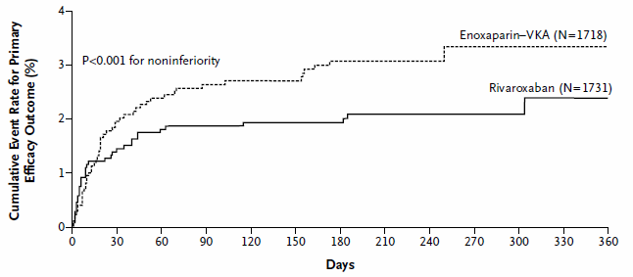
Rivaroxaban v Warfarin for DVT
Recurrent VTE
N Engl J Med 2010;363:2499-510.

Slide 14
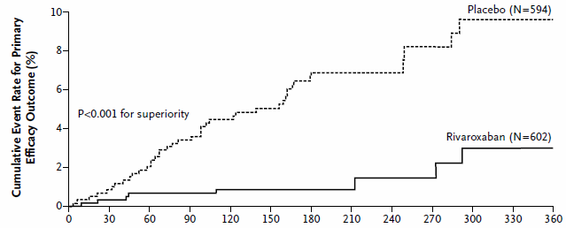
ENSTEIN- EXTENSION
Recurrent VTE in randomised groups
N Engl J Med 2010;363:2499-510.

Slide 15
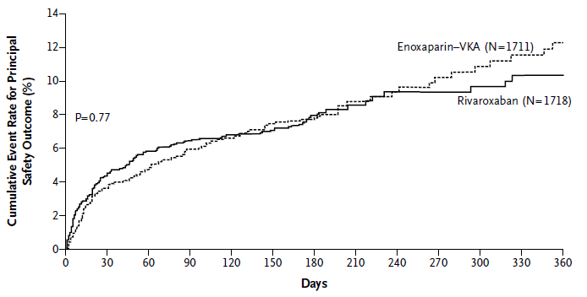
ENSTEIN- EXTENSION – safety outcome
Major bleeding and clinically relevant non-major bleeding p=0.77
N Engl J Med 2010;363:2499-510.

Slide 16
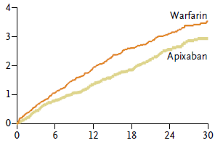
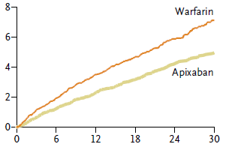
Apixaban v Warfarin for AF
Efficacy
Safety
N EnglJMed 365;23 2011

Slide 17
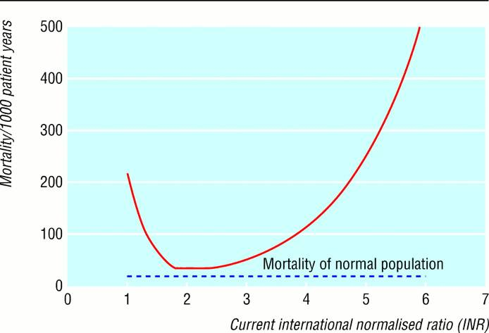
Warfarin, INR and Mortality
Oden, A. et al. BMJ 2002;325:1073-1075
Notes:
Swedish data. INR nearest to death. All causes of death, although if you take bleeding deaths alone, the shape of the graph is about the same as the right hand side and no increase down to 1.
May be confounded by patient illness effect on INR: but the risk was highest for high INR following dose increase (rather than spontaneous rise in INR).

Slide 18
Summary: risks of anticoagulation
Fatal haemorrhage 0.7% pa age related
Major haemorrhage 3% pa highest early
All haemorrhage 6-14% pa highest early
Roughly the same for all agents.
Precise dose and timing may be significant
N Engl J Med 2010;363:2499-510.

Slide 19
Anticoagulation and the asymptomatic thrombophilic
family member
Does identification of a thrombophilic trait
warrant anticoagulation?
Need to balance risk of first thrombosis against risks
of long term anticoagulation.

Slide 20
Thrombophilic traits and first thrombosis risk
Freq.
OR
Anticoagulant deficiency
Antithrombin
Protein C
Protein S
1-2%
2-4%
2-4%
25-50
10-20
Procoagulant excess
Factor V Leiden
Factor VIII (>1.5)
Prothrombin
Factor XI (>1.21)
Factor IX (>1.29)
20%
24%
6%
20%
20%
6.6 (3.6-12.0)
4.8 (2.3-10)
2.8 (1.4-5.6)
2.2 (1.5-3.2)
2.5 (1.6-3.9)
Fibrin
TAFI
Factor XIII (Val34)
Dysfibrinogenemia
14%
63%
1%
1.7 (1.1-2.5)
1.8 (1.2-2.6)
Uncertain mechanism
Lupus anticoagulant
Hyperhomocystinemia
10%
10%
2.5 (1.2-5.2)

Slide 21
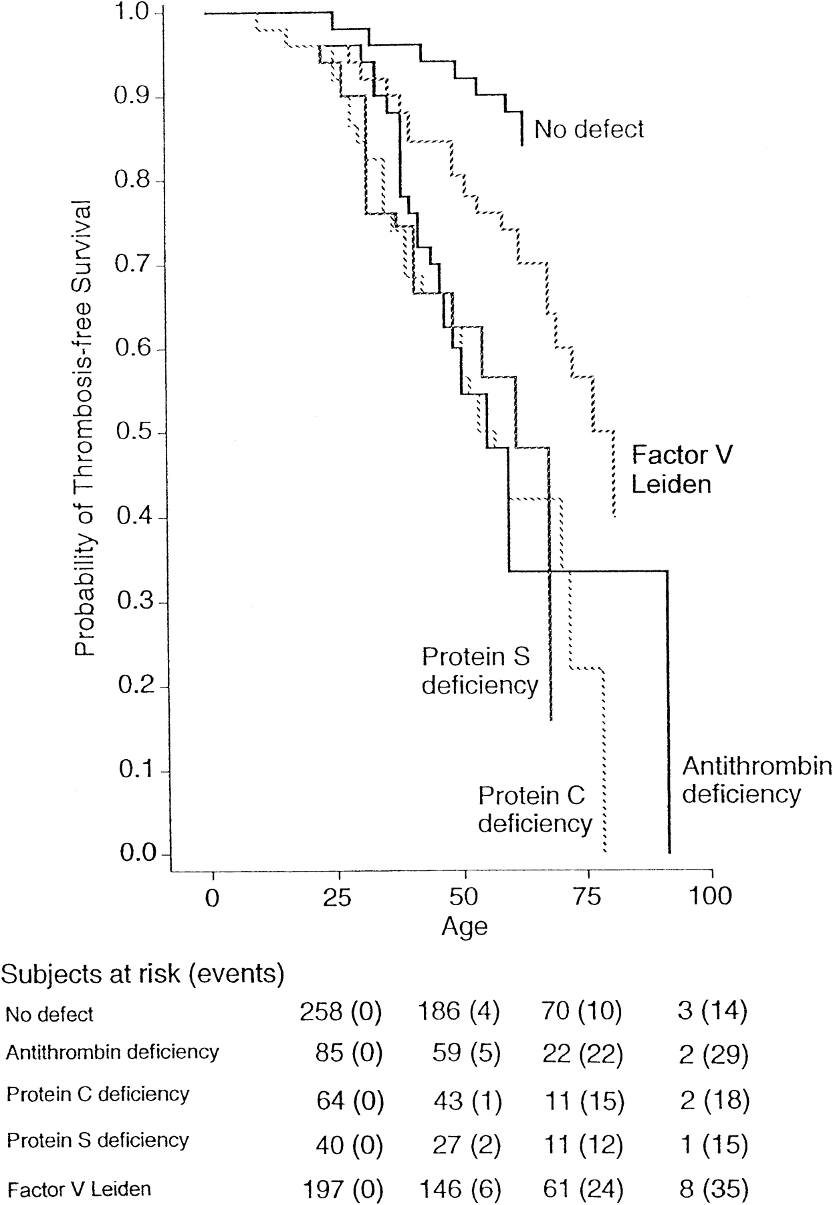
Thrombosis free survival
in family members with
thrombophilic traits
Martinelli 1998

Slide 22
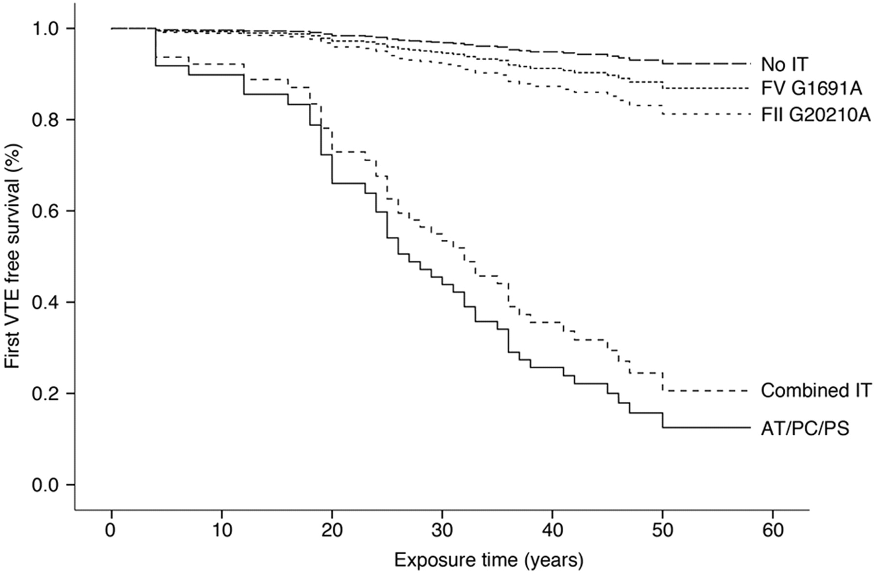
VTE event-free survival in relatives of pediatric patients with different types of IT.
Holzhauer S et al. Blood 2012;120:1510-1515
Notes:
VTE event-free survival dependent on IT. Freedom from VTE over time is shown for relatives of pediatric index patients stratified for different types of IT. This gives a more distinct cut oof althought the absolute risks are similar to previous data. Does the identification of thrombosis in paediatric patients select a group of families with particularly high thrombotic risk (either from the identified mutation or multiple other factors)?
64% of cases in this family cohort were associated with transient clinical triggers and so targeted thromboprophylaxis remains the appropriate strategy.

Slide 23
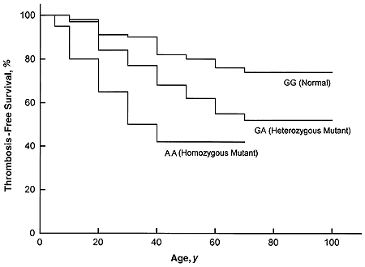
Thrombosis-free survival in persons with factor V Leiden.
Zoller 1994 .

Slide 24
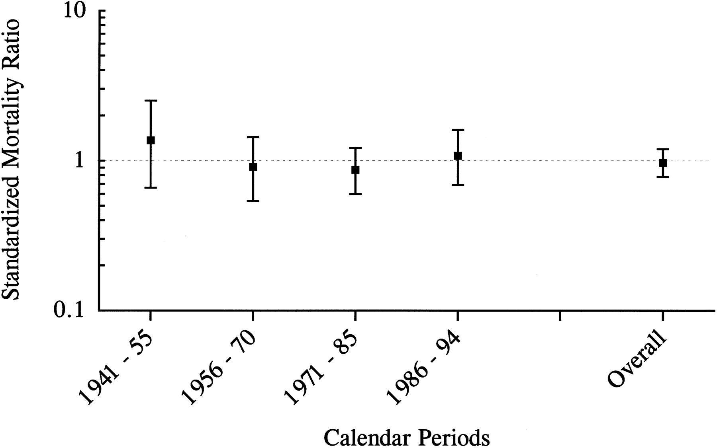
Retrospective analysis of mortality associated with Factor V Leiden
Elysee 1997

Slide 25
First VTE rates
Condition Rate pa
Antithrombin
Protein S 1%
Protein C
Factor V Leiden 0.3%
Prothrombin <0.3%

Slide 26
EVENTS IN ASYMPTOMATIC CARRIERS
OF ANTITHROMBIN DEFICIENCY
WARFARIN
NO WARFARIN
Event
Rate %pa
Event
Rate %pa
Major bleed
1-4
VTE
1%
Fatal bleed
0.2-0.8
Fatal PE
0.01-0.05%
Deaths/10yr
2-8
Deaths/10yr
0.1-0.5

Slide 27
1. Asymptomatic patient with thrombophilic trait
no need for anticoagulation
no evidence for impact on mortality
50% are precipitated
ensure prophylaxis when at increased risk
standard prophylaxis is sufficient

Slide 28
2. After a first episode of venous thrombosis

Slide 29
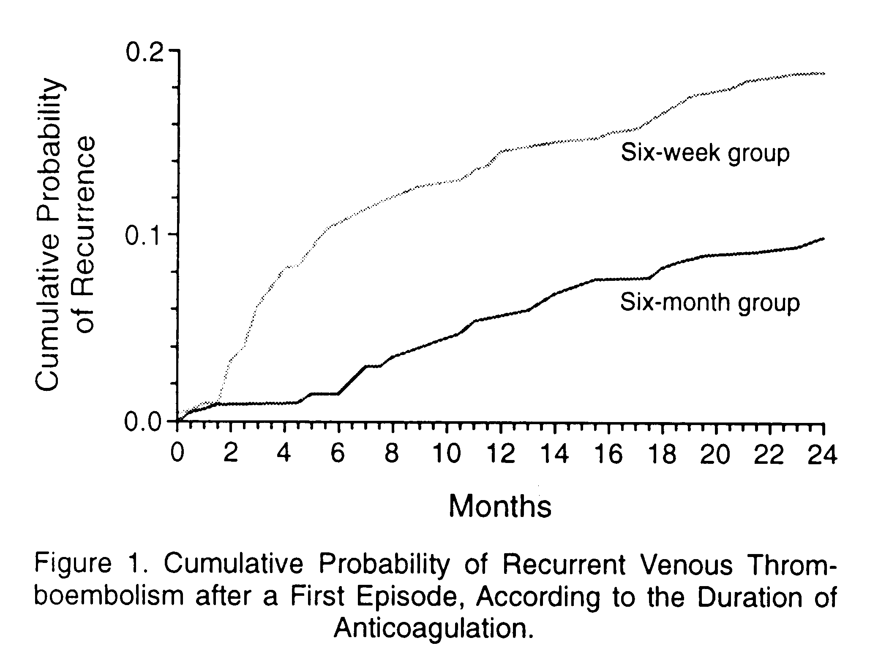
Schulman 1995

Slide 30
EVENTS AFTER 6 MONTHS WARFARIN
WITH OR WITHOUT CONTINUATION
WARFARIN
NO WARFARIN
Event
Rate %pa
Event
Rate %pa
Major bleed
1-4
Recurrence
1-5
Fatal bleed
0.2-0.8
Fatal PE
0.05-0.25
Deaths/10yr
2-8
Deaths/10yr
0.5-2.5

Slide 31
After a single episode of VTE
risk of recurrence not sufficient to warrant l/t a/c
  but is closely balanced
  target INR 2.0-3.0
lowering INR only increases risk of recurrence
increasing INR only increases bleeding
new drugs may slightly alter risk/benefit

Slide 32
Can we identify those at high risk of recurrence?
(ie high enough to warrant continuing anticoagulation)

Slide 33
Clinical categories of VTE (ACCP) affecting recurrence and management
First episode VTE after transient risk factor
First episode idiopathic VTE
VTE in association with cancer
First episode VTE and thrombophilic trait
Recurrent VTE
Notes:
Detailed examination of trial data has allowed this sub classification of patients who have different treatment requirements. We’ll come back to what these are later, but for the time being, note…

Slide 34
Clinical Risk Factors for Recurrence
IDIOPATHIC DVT POSTOPERATIVE DVT
Study No. of % No. of %
Patients Annualised Patients Annualised
Recurrence Recurrence
Prandoni et al 145 19 105 4
BTS 596 9.1/4.7 116 1/0
Pini et al 117 15 70 1
Levine et al 212 16 89 0
Schulman et al 553 12/6 344 4.8/3.4

Slide 35
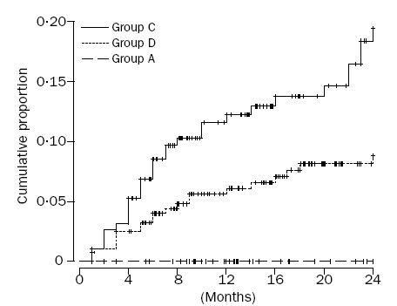
Recurrence and precipitants
Idiopathic
Non-surgical risk
Surgery
Baglin 2003

Slide 36
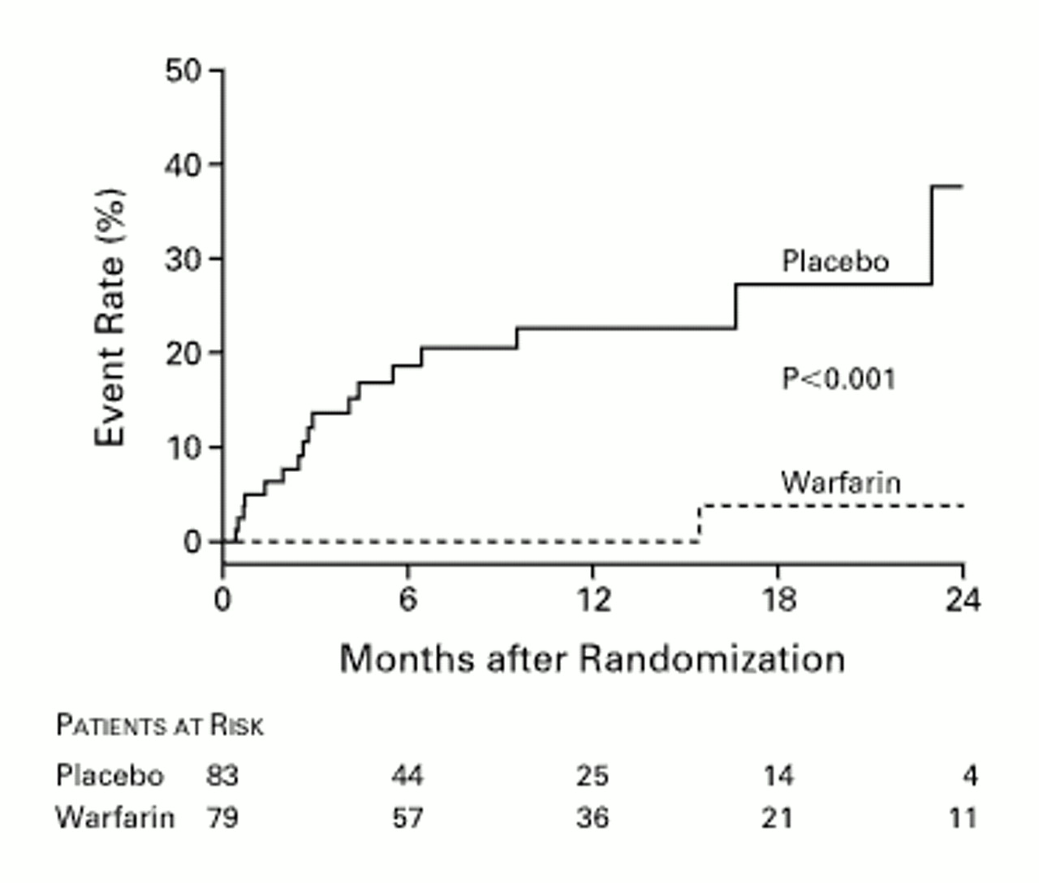
Long term anticoagulation for idiopathic VTE
Warfarin is very
effective
Major bleeding 3.8%
Kearon 1999

Slide 37
Long term anticoagulation for idiopathic VTE
Warfarin is very
effective
Major bleeding 3.8%
Kearon 1999

Slide 38
Clinical history is effective in identifying risk of future VTE

Slide 39
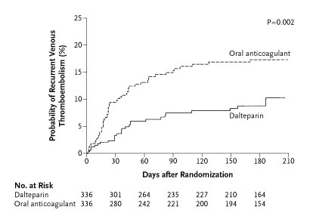
VKA versus LMWH for VTE in patients with cancer
Lee 2003

Slide 40
Cancer is associated with a high risk of recurrence even with warfarin.
LMWH is better.

Slide 41
Categories of VTE (ACCP) affecting recurrence and management
First episode VTE after transient risk factor
  3 months VKA
VTE in association with cancer
  LMWH for 3-6 months
First episode idiopathic VTE
  ?
First episode VTE and thrombophilic trait (s)
  ?
Recurrent VTE
  Indefinite VKA
Notes:
Guidelines emphasize that recommendations place a high value on preventing recurrence and lower value on avoiding bleeding and on cost.

Slide 42
Schulman 1995

Slide 43
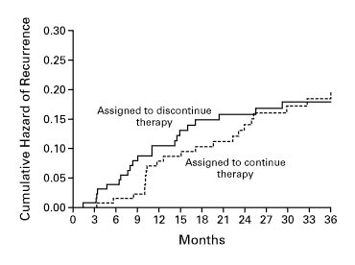
Rebound after 3 months anticoagulation for VTE
Agnelli 2001

Slide 44
Anticoagulation beyond 3 months has no further effect on recurrence rate after stopping

Slide 45
Categories of VTE (ACCP)
First episode VTE after transient risk factor
  3 months VKA
VTE in association with cancer
  LMWH for 3-6 months, then ? indefinite VKA if advanced
First episode idiopathic VTE
  VKA for 6-12 months (recommend)
  Consider indefinite (suggest)
First episode VTE and thrombophilic trait (s)
  ?
Recurrent VTE
  Indefinite VKA
Notes:
Guidelines emphasize that recommendations place a high value on preventing recurrence and lower value on avoiding bleeding and on cost.

Slide 46
Can laboratory tests of thrombophilia predict recurrence?

Slide 47
Immediate management of thrombosis
No evidence that immediate management should be altered by the presence of prothrombotic traits, or that intensity of anticoagulation should be increased.
Many coagulation tests are altered in acute phase and thrombophilia testing is best deferred.
Notes:
Like to reiterate a few general points before examining the long term management in detail.

Slide 48
Balancing risks of thrombosis and anticoagulation
1. Risk of bleeding on oral anticoagulants
Equivalent recurrence rate (5%†)
Age Major bleeding Fatal bleeding
(% pa) (%pa)
<40
40-49
50-59
60-69
>69
0.6
1.0
1.5
2.2
3.2
0.12
0.2
0.3
0.44
0.64
2.4
4.0
6.0
8.8
12.8
Notes:
So very simply we need to identify individuals whose risk of thrombosis and of dying from thrombosis is greater than these figures for each age group.
We will assume that case fatality of DVT recurrence is 5% and 25% for PE.
Assuming this then the recurrence rate we need to be able to identify is simply (for DVT) 20 times the fatality rate. We might also compare this non-fatal event rate with that of non-fatal bleeding and so we see that we have exceeded that too.
Note that in more recent trials (ELATE and PREVENT) the rate was even lower ~1%pa

Slide 49
How high a recurrence rate do we need to predict?
  ‘at an annual recurrence rate of 12%, the risk of death from recurrent thrombosis is balanced by the risk of death from anticoagulant mediated bleeding’
With long term recurrence rate of 4-5% this is a relative risk of ~2.5
Hirsh and Lee 2002
Notes:
Many factors come out with RR for rec of 2 -3 and this is true of Hcy,FVL, PT and Lp(a) etc. Even if true these are not enough to usually alter management.
Not tackled the difference between calf and proximal (lower rec for calf). Note that although the risk of recurrent thrombosis seems to fall off somewhat with time, so does the risk of bleeding.
This corresponds to an OR of about 4.

Slide 50
Patient selection: long term anticoagulation for idiopathic VTE
Major bleeding 3.8%
Kearon 1999
Notes:
The biggest difference can be made using clinical information. If we take out those with idiopathic or unprecipitated VTE:
First idiopathic episode of VTE. Excluded if known AT etc but testing discouraged. Only one rec in a/c group and that pt had stopped warfarin. 3.8% pa major bleeding in a/c group. This was lower (1%) in a subsequent study by this group and by Ridker. Only sub group with increased risk rec in placebo group was those with LAC. Conclude that idiopathic origin of VTE is good discriminator for recurrence? In that it defines treatment group.

Slide 51
Thrombophilic traits and first thrombosis risk
Freq.
OR
Antithrombin
Protein C
Protein S
1-2%
2-4%
2-4%
25-50
10-20
Procoagulant excess
Factor V Leiden
Factor VIII (>1.5)
Prothrombin
Factor XI (>1.21)
Factor IX (>1.29)
20%
24%
6%
20%
20%
6.6 (3.6-12.0)
4.8 (2.3-10)
2.8 (1.4-5.6)
2.2 (1.5-3.2)
2.5 (1.6-3.9)
Fibrinolysis
TAFI
Factor XIII (Val34)
Dysfibrinogenemia
14%
63%
1%
1.7 (1.1-2.5)
1.8 (1.2-2.6)
Uncertain mechanism
Lupus anticoagulant
Hyperhomocystinemia
10%
10%
2.5 (1.2-5.2)
Notes:
So we can do quite well with history alone. What factors might improve this? These factors all identified as risk factors for first episode thrombosis but of course not the same thing as recurrence.

Slide 52
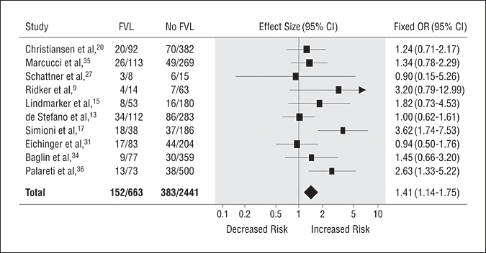
Risk of recurrent VTE and heterozygous FVL
1.41 (1.14-1.75)
Ho, W. K. et al. Arch Intern Med 2006;166:729-736.
Notes:
FVL examined many times and most easily because it is so prevalent. 20% of first episode thromboses will be associated with FVL. This meta analysis.

Slide 53
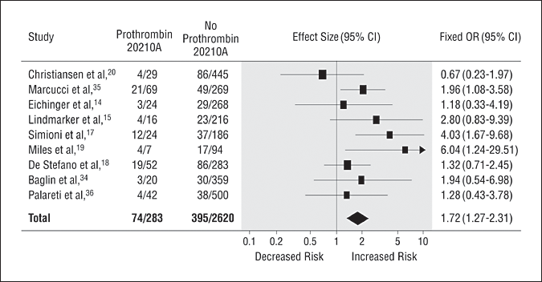
Risk of recurrent VTE and heterozygous prothrombin G20210A
1.72 (1.27-2.34)
Ho, W. K. et al. Arch Intern Med 2006;166:729-736.
Notes:
Similarly for the prothrombin polymorphism. Neither of these on their own predict a recurrence rate sufficiently high to outweigh the risks of long term anticoagulation.

Slide 54
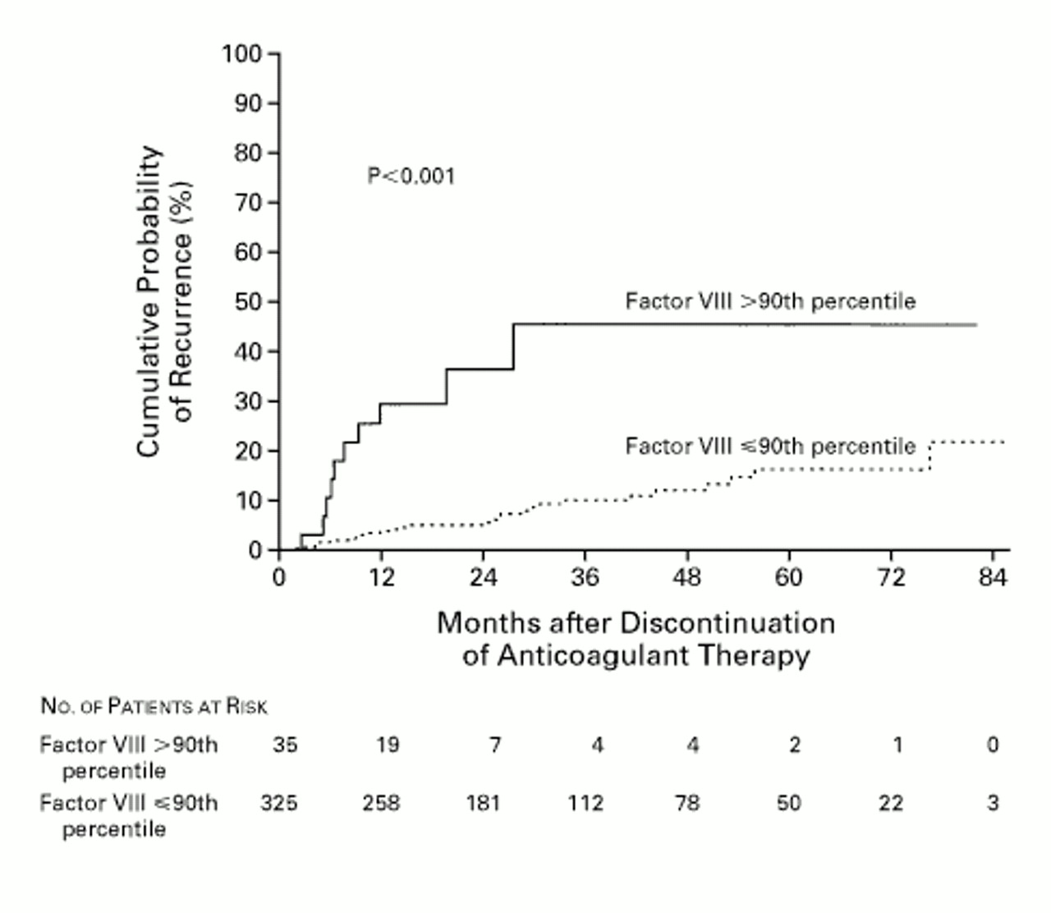
Factor VIII and recurrence of thrombosis
(>234 u/dl)
Kyrle 2000
Notes:
How does FVIII do? The problem is that we have least data for the period after 6 months.
360 patients with idiopathic VTE, treated for at least 3 months (average 8). FVIII taken>3 weeks after last a/c.
Risk was 1.08 per 10% rise in FVIII but actually showed a stepwise increase in risk above the 90th centile (>2.34)
So clearly reliable measurement of high FVIII levels is important.
Relationship was even stronger after adjustment for other risk factors such as FVL etc.
The recurrence rate for high FVIII is 37% at 24 months which is clearly very high. High enough to make a/c worthwhile. Beyond this is uncertainty ? Plateau but small numbers with this length of follow up so difficult to commit to long term (indefinite) a/c on these data. Poss could a/c for longer say 2yrs but would this just move the recurrence curve further down the line?
Kyrle concluded that ‘ the high prevalence of elevated levels of FVIII and the risk of recurrence associated with such high levels, warrant the measurement of FVIII during routine screening for thrombophilia’
Approx one third had PE, one third had distal veins, 40% of women took OCP.

Slide 55
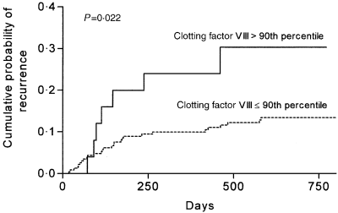
Factor VIII and recurrence of thrombosis
(>290 u/dl)
Legnani 2004
Notes:
More recent study.

Slide 56
Factor VIII screening after a first episode thrombosis
Elevated FVIII (prob >2.3iu/ml) identifies patients at high risk of recurrence after idiopathic VT.
Selection of proximal idiopathic may also identify a similarly high risk group for next 2 years.
Notes:
The argument about when screening should be done is likely to be held elsewhere in this meeting. If you do decide to test in relation to thrombosis then you should certainly include VIIIc as it does at least as well, and generally better, than anything else.
Measuring high levels is different from the way FVIII assays are usually set up.
What is pptated?

Slide 57
EVENTS AFTER 6 MONTHS WARFARIN
WITH OR WITHOUT CONTINUATION
WARFARIN
NO WARFARIN
Event
Rate %pa
Event
Rate %pa
All AT/VIII
Major bleed
1-4
Recurrence
5
10-20
Fatal bleed
0.2-0.8
Fatal PE
0.25
0.5-1.0
Deaths/10yr
2-8
Deaths/10yr
2.5
5-10

Slide 58
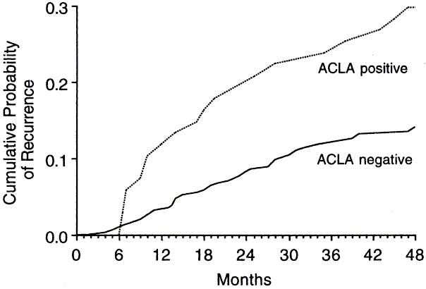
ACLA and recurrence
Cumulative probability of recurrent venous thromboembolism in patients after a first episode, anticoagulated for 6 months, by anticardiolipin antibody (ACLA) status. Schulman 1998
Notes:
This rate of recurrence is borderline. The thing that makes a difference for LAC is that arterial thrombosis also occurs:

Slide 59
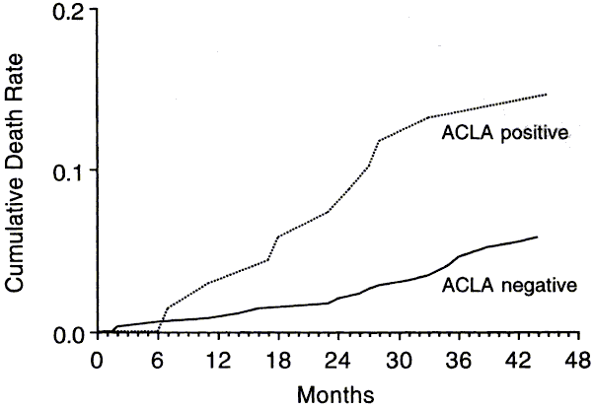
Mortality in patients with a first episode of venous thromboembolism, anticoagulated for 6 months, by anticardiolipin antibody (ACLA) status.
Schulman1998

Slide 60
Rarer thrombophilias and recurrence
Rec.
(%pa)
Factor
RR(CI)
FVL +/+ ?
FVL&PT 2.6
AT/PC/PS - >10%
Possibly predict high risk but rare
Notes:
Prevalence of FVP homozygotes must be approx 1 in 1600. AT is probably about 1 in 500 or more.

Slide 61
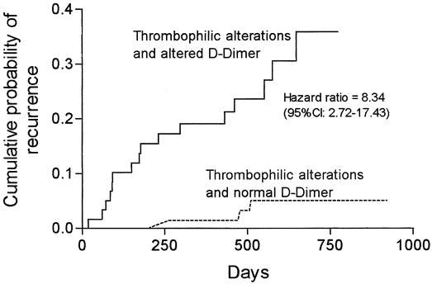
Probability of recurrent VTE in subjects with hereditary thrombophilic traits according to D-dimer (</>500 ng/mL) 1 month after stopping anticoagulation.
Palareti 2003
Notes:
47% of the 599 VTE were idiopathic. Approx 40% of pts had increased d-dimer after stopping a/c. d dimer was not useful when the VTE was precipitated or associated with cancer. In patients with thrombophilia the neg pred value is v high (95.8%). Elevated levels of FVIII not included among the thrombophilic traits. Is this combination of genetic and phenotypic assessment the way we should use thrombophilia testing? Elevated d dimer was not so predictive in idiopathic group as a whole (hazard ratio 2.43 vs 8.34 above). Confirmed in Eichinger study 2003. Utility under trial in PROLONG study.

Slide 62
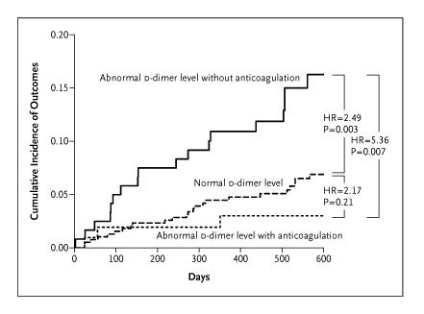
D-dimer and anticoagulation
Palareti 2006

Slide 63
ETP and risk of unprovoked VTE recurrence
ETP > 50th centile
HR 2.9 (1.3–6.6)
Besser 2008

Slide 64
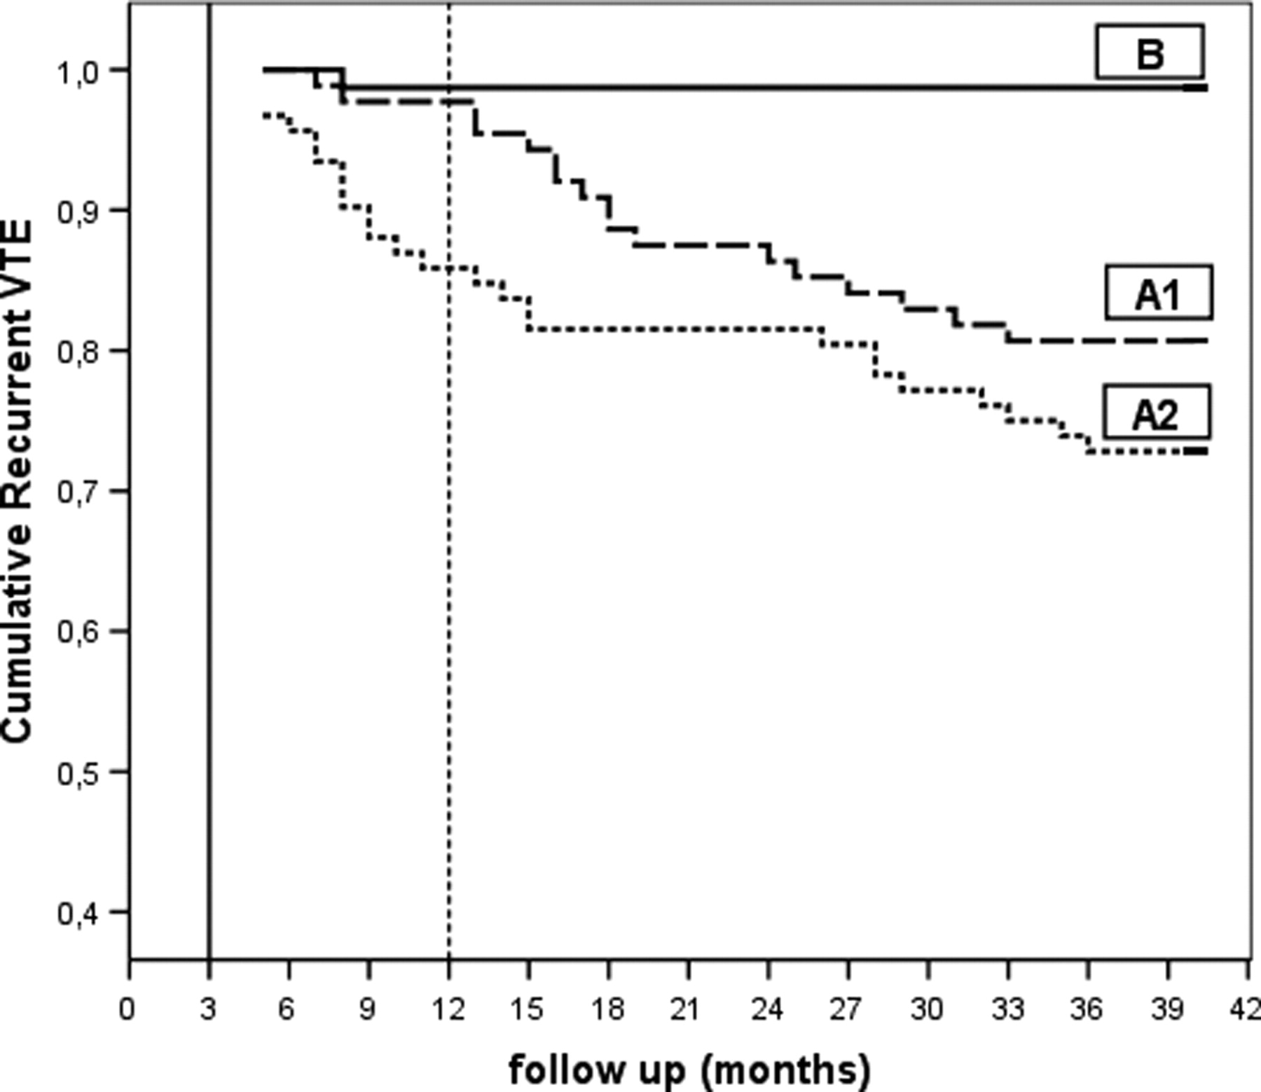
Residual vein thrombosis and anticoagulation
No RVT
RVT + a/c continued
RVT: a/c stopped at 3 months
Siragusa, S. et al. Blood 2008;112:511-515

Slide 65
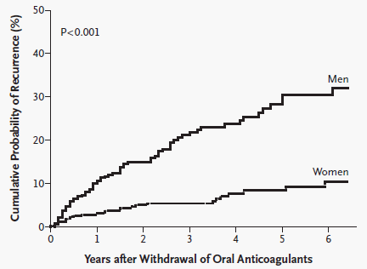
VTE recurrence in men and women
Kyrle NEJM 2004

Slide 66
Combining SNPs to predict recurrence
 |  |  | Individual HR (95% CI) | Sequential addition of SNPS HR (95% CI) |  |  |  |  | j
1 | FVII | 10976G/A | 1.3 (0.8–2.0) | 1.7 (0.8–3.6) | 2.7 (1.2–6.1) | 5.1 (0.7–36.9
2 | FVL | 1691G/A | 1.2 (0.8–1.9)
3 | MTHFR | 677C/T | 1.1 (0.8–1.6)
4 | FGB | −455G/A | 1.1 (0.7–1.6)
5 | HR2 | 4070A/G | 1.1 (0.7–2.0)
6 | TFPI | 874G/A | 1.1 (0.5–2.4)
7 | XIII | 100G/T | 1.0 (0.7–1.4)

Slide 67
Predicting recurrence: risk factors
PE for PE
Idiopathic
Male
Lupus anticoagulant
Thrombophilias – variable effect
Elevated d-dimer
Elevated ETP
Residual vein thrombus

Slide 68
Categories of VTE (ACCP)
First episode VTE after transient risk factor
  3 months VKA
VTE in association with cancer
  LMWH for 3-6 months
First episode idiopathic VTE
  VKA for 6-12 months (recommend)
  Consider indefinite (suggest)
First episode VTE and thrombophilic trait (s)
  VKA for 12 months (recommend)
  Consider indefinite (suggest)
Recurrent VTE
  Indefinite VKA
Notes:
Guidelines emphasize that recommendations place a high value on preventing recurrence and lower value on avoiding bleeding and on cost.

Slide 69
ACCP recommendations: first episode idiopathic VTE
Consider indefinite anticoagulation for idiopathic VTE and with severe thrombophilic traits
Factors favouring indefinite anticoagulation:
  PE
  Male sex
  ACLA/LAC TEST
  High FVIII TEST
  Anticoagulant deficiency
  Elevated d-dimer + thrombophilia ?TEST
  Residual thrombus (RR ~3)

Slide 70
Duration of anticoagulation
3-6 months
Stop
Lifelong
1. Calf vein DVT
Unprovoked proximal VTE
PE > DVT
2. Provoked DVT
+ low bleeding risk
3. Unprovoked proximal VTE
DVT> PE
Age < 75
INRs < 5.0
TTR > 50%
No previous bleed
+ high bleeding risk
Age > 75 yrs
INRs > 5.0
TTR < 50%
Previous bleed

Slide 71
These calculations may be change if the new anticoagulations have different therapeutic indices

Slide 72
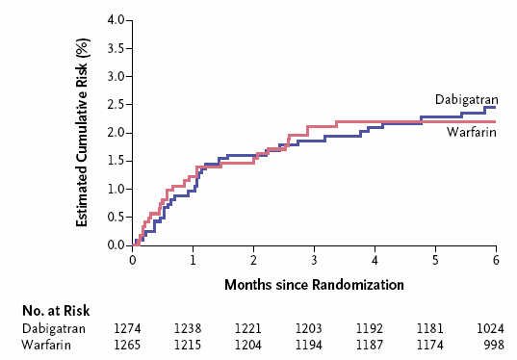
Dabigatran for acute DVT
Major bleeding 1.6% vs 1.9%
Schulman 2009

Slide 73
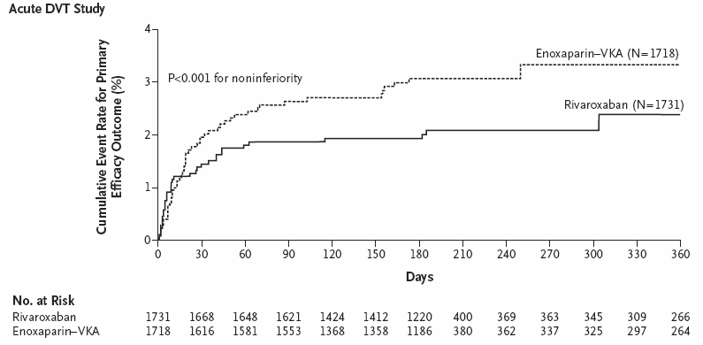
Rivaroxaban for acute DVT
HR 0.68
(0.4-1.04)
Major bleeding 0.7% vs 0
Einstein NEJM 2010

Slide 74
Summary
Testing for thrombophilia is generally not helpful in predicting recurrence
NICE recommends testing for antiphospholipid syndrome
Large studies to look at combinations of risk factors and global tests to be assessed

