Slide 1
Pregnancy, oestrogens and the coagulation system
Carolyn Millar
Department of Haematology
Imperial College London
c.millar@imperial.ac.uk

Slide 2
Learning Outcomes: By the end of the lecture you will:
Understand that pregnancy, cOCP and oral HRT result in a prothrombotic state
Describe the interaction between inherited thrombophilia and use of OCP/HRT
Understand the need to consider relative benefit-harm of hormonal therapies
Know that VTE is a leading cause of maternal death in UK that may be avoidable with appropriate risk assessment and appropriate thromboprophylaxis

Slide 3
Overview:
Coagulation and OCP
OCP interaction with thrombophilia
Coagulation and HRT
Pregnancy and coagulation
Obstetric management of inherited bleeding disorders

Slide 4
Combined Oral Contraceptive Pill (COCP)
Combines ethinyl estradiol (or mestranol) with a progestogen
Licensed for contraceptive use 1960
…First case of VTE reported 1961
(Lancet 1961;2: 1146-7)
Case report Myocardial Infarction 1963
~100 million women worldwide now using

Slide 5
Generations of COCP
Modification of oestrogen dosage and type of progestogen
Effect of oestrogen dose
ethinylestradiol (100-50-30-20-15 µg) (mestranol (150-100 µg))
Effect of progestogen content
1st : lynestrenol, norethisterone, norethynodrel
2nd : norgestrel, levonorgestrel,
3rd : desogestrel, gestodene : 1980s
‘4th’: drospirenone: antimineralocorticoid (2001)
cyproterone acetate: antiovulatory action (1988)

Slide 6
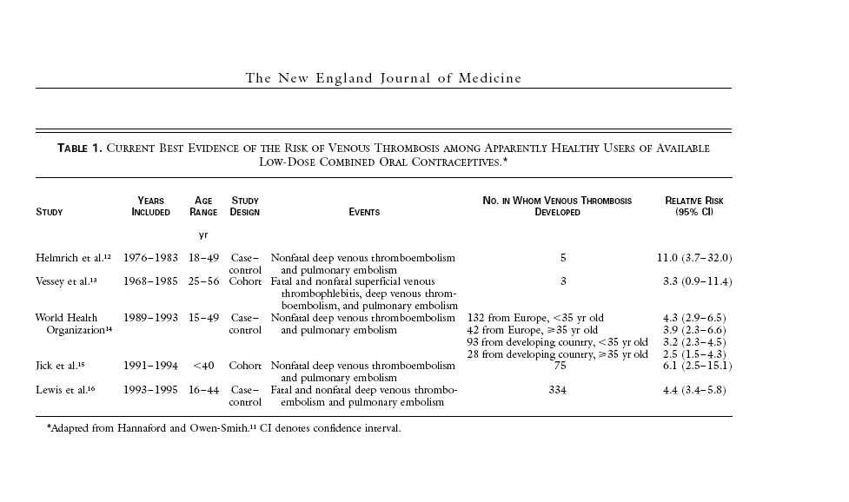
1st -3rd Generation COCPs and VTE Risk Vandenbroucke JP, N Engl J Med, Vol. 344, No. 20May 17, 2001

Slide 7
Generations of COCP
1st – 3rd generation COCP modifications aimed to reduce risk of arterial and venous disease
First generation COCP
>50mcg ethinylestradiol
(regardless of progestogen content)
Second generation COCP
<35mcg ethinylestradiol
+ progestogen e.g levonorgestrel
Third generation COCP
< 30mcg ethinylestradiol
+ gestodene or desorgestrel
‘Fourth’ generation: no VTE influence,
harnessing additional anti-androgenic benefit

Slide 8
Effect of Lower Oestrogen Dose on VTE risk
Oestrogen RR
LETS (1995) 30 µg 3.8
50 µg 3.4
Lowering of oestrogen dose from 100 to 50µg is associated with decreased risk of VTE
Evidence of dose-effect for doses of 50 µg or less is more limited, both for venous and arterial disease

Slide 9
Thrombotic Changes Associated with COCP
Anticoagulant
Procoagulant
Hep CoF II
Protein C
a-2 antitrypsin
Fibrinogen
FVII,VIII,IX,X,XI
VWF
APCR
Protein S (total +free)
Antithrombin
TFPI

Slide 10
Effects on Fibrinolytic System
Profibrinolytic
Antifibrinolytic
Plasminogen
FXII
Prekallikrein
FXIII
tPA
PAI-I

Slide 11
COCPs alter Resistance to APC
Group n APCR
Men 25 0.96
Women
no OC 53 1.22
no OC, FVR506Q 17 3.10
no OC, FV506Q (homozyg) 5 4.75
Third generation OC 40 2.59
FVR506Q + third generation OC 31 5.41
Conclusion: OCP causes acquired APC resistance and
increases risk of thrombosis
Rosing et al Brit J Haematol 1997, 97, 233-238

Slide 12
Third-generation pill scare 1995
International public health scare
Promotion of new 3rd generation COCP as less androgenic, fewer adverse cardiovasular and metabolic parameters
Increased VTE risk soon appeared
But not confirmed in all studies
‘Stimulated reporting’
Increased investigation of symptoms
Increased reporting of VTE events
Panic stopping of COCPs by millions of women
Abrupt resultant rise in unplanned pregnancies
Non-believers explained difference in risk by bias and confounding effects.

Slide 13
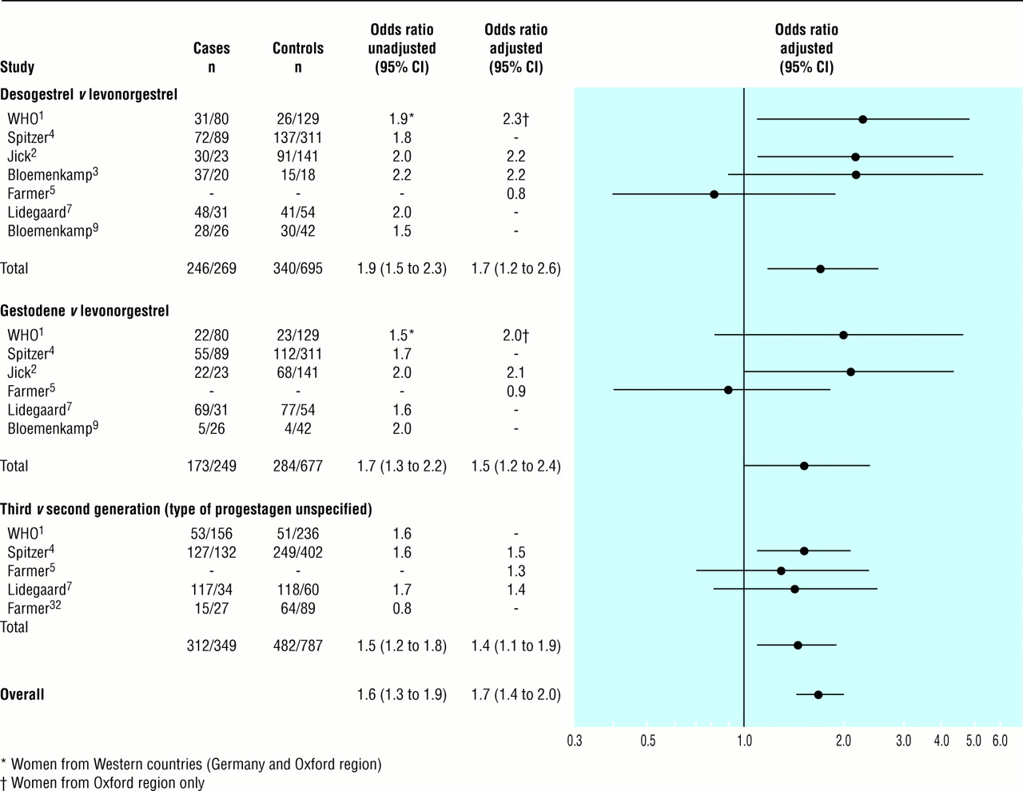
Large Meta-analysis 3rd Generation versus 2nd Generation COCP: Overall 1.7 odds ratio
©
Kemmeren J M et al. BMJ 2001;323:131

Slide 14
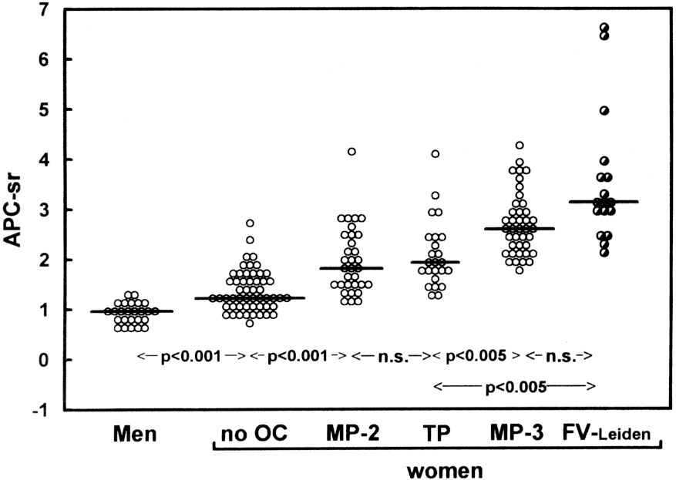
2nd and 3rd generation COCP effect on APCR
APCR been shown to parallel changes in Sex Hormone Binding Globulin
(SHBG)
Rosing 1997

Slide 15
Risk-benefit profile of COCP
Benefits
VTE Risk
Contraception
Avoid unplanned pregnancy
Non-contraceptive:
Regulation menstrual bleeding/dysmenorrhea
Control of PMS, migraine, acne, hirsutism
Long term:
Reduction in endometrial and ovarian malignancies
Baseline VTE risk
<30 years: 1/10 000 person yrs
30-40 : 2/10 000
VTE relative risk on OCP
<30 yrs: ~3
30-40 : 5
VTE risk in pregnancy
29/10 000 person yrs
(Pospartum ~300/10 000)
WHO Medical eligibility criteria for contraceptive use:
Adapted by RCOG: guidance on risk/benefit: www.fsrh.org/pdfs/UKMEC2009.pdf

Slide 16
OCP and VTE: where are we now? the MEGA study BMJ 2009;339:b2921
Type of progestogen | Thrombosis patients (n=1524) Numbers (%) | Controls (n=1760) Numbers (%) | Odds ratio (95%CI)*
Levonorgestrel | 485 (31.9) | 373 (21.2) | 3.6 (2.9-4.6)
Gestodene | 119 (7.8) | 67 (3.8) | 5.6 (3.7-8.4)
Desogestrel | 289 (19.0) | 108 (6.2) | 7.3 (5.3-10.0)
Lynestrenol | 44 (2.9) | 19 (1.1) | 5.6 (3.0-10.2)
Norethisterone | 11 (0.7) | 7 (0.4) | 3.9 (1.4-10.6)
Cyproterone acetate | 125 (8.2) | 62 (3.5) | 6.8 (4.7-10.0)
Norgestimate | 9 (0.6) | 4 (0.2) | 5.9 (1.7-21.0)
Drospirenone | 19 (1.2) | 14 (0.8) | 6.3 (2.9-13.7)
No oral contraceptive | 421 (27.7) | 1102 (62.8) | 1
Clear differences according to type of progestogen and dose of oestrogen
Note Drospirenone numbers very small (1.2% of all cases): FDA ‘unreliable’
* OR adjusted for age and period of inclusion

Slide 17
Higher Risk of Venous Thrombosis During Early Use of Oral Contraceptives in Women with Inherited Clotting Defects
Data from the Leiden Thrombophilia Study
Risk of thrombosis early versus late
Odds Ratio 1st 6 Months 1st Year
Overall Group 3.0 (0.6-14.8) 2.0 (0.6-6.1)
Thrombophilia 19.0 (1.9-175.7) 11.0 (2.1-57.3)
Defects found
Bloemenkamp KWM, et al. Arch Intern Med 160:49-52, 2000
Risk returns to baseline within few weeks of
discontinuation Lancet 1995; 346: 1582-8

Slide 18
OCP and Risk of Arterial Disease
WHO: 5-fold MI, 3-fold CVA, 4-fold PVD
No evidence that lowering oestrogen dose has reduced this risk
Some studies have not shown these associations
Despite improved lipid profile with 3rd generation OCP no convincing data that risk is reduced
Risk higher if smoker (36-fold PVD), hypertensive, diabetic

Slide 19
Progestogen-only contraceptive methods
‘Mini’ pill / POP does not result in increased VTE risk (Lidegaard et al, BMJ 2009)
(c.f. Progestogen-only preparations using higher doses)
Depot injectable progestogen: increased VTE risk reported (MEGA, WHO)
Levonorgestrel-releasing IUD (Mirena coil):
no VTE risk associated
Hormonal implant: Etonogestrel (active metabolite of Desogestrel): VTE risk not known

Slide 20
Summary OCP and Thrombosis
All COCP increase risk of VTE 4-6 fold
Against baseline risk in this population is 1-2/10 000 per year
Risk varies according to progestogen type and oestrogen dose
Increased risk 3rd versus 2nd generation
Risk highest during first few months of COCP use
All COCP increase risk of arterial thrombosis 2-3 fold
Personal history VTE should be considered a contraindication for COCP use
Consider trial design: determine level of risk through best evidence evaluation
Balanced and informed decisions: consider individual risk/benefit profile
No evidence of increased risk for progestogen only pill or levonorgestrel-containing IUD (Mirena coil)

Slide 21
Overview:
Coagulation and OCP
OCP interaction with thrombophilia
Coagulation and HRT
Pregnancy and coagulation
Obstetric management of inherited bleeding disorders

Slide 22
COCP and Interaction with Thrombophilia
Heterozygous FVL ~30-fold increase
PT 20210A carriers 16-fold increase
High FVIII ~10-fold increase
>90th percentile of FII, FVIII, FIX, FXI, FX confer 2-3 fold increase
AT, PC, PS deficiency – little data but some evidence of strong interactions
Degree of interaction is unpredictable
Prothrombin mutation and cerebral sinus thrombosis

Slide 23
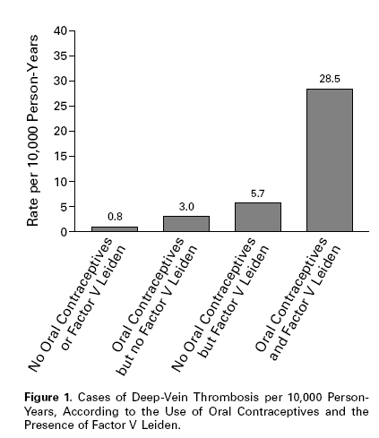
OCP, FV Leiden and the Risk of Thrombosis Vandenbroucke JP, et al N Engl J Med, Vol. 344, No. 20May 17, 2001

Slide 24
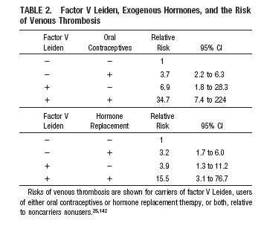
OCP, FV Leiden and the Risk of Thrombosis Rosendaal FR, et al. Arterioscler Thromb Vasc Biol. Feb 2002

Slide 25
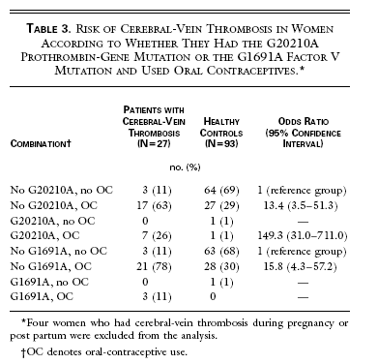
High Risk of Cerebral Vein Thrombosis in Carriers of a Prothrombin Gene Mutation and in users of Oral Contraceptives
Martinelli I, et al N Engl J Med 1998;338:1793-7

Slide 26
Venous Thrombosis, Oral Contraceptives and High Factor VIII Levels
Leiden Thrombophilia Study
155 premenopausal women compared with DVT vs. 169 controls, aged 15-49
Odds Ratio (95%CI)
No OCP/normal FVIII 1
OCP/normal FVIII 3.8 (2.4-6.0)
No OCP/High FVIII 4.0 (2.0-8.0)
OCP/High FVIII 10.3 (3.7-28.9)
Bloemenkamp KW, et al Thrombosis& Hemostasis 82(3) 1024-7, 1999

Slide 27
Should We Screen All OCP Users?
Population risk 1/10 000
OCP 3/10 000
FVL 7/10 000
FVL+OCP 28/10 000
Case fatality for VTE (<40yrs) ~ 2% max
Estimate that 400 000 - 2 000 000 women would have to
be screened to prevent one death.
Vandenbroucke 1999

Slide 28
How best to manage asymptomatic thrombophilia carrier
Counselling
Must balance risks against benefits
Obesity/ smoker/ age/ FH
Important to consider family history of VTE
Strong family history in absence of known inherited thrombophilic defect also warrants caution

Slide 29
Overview:
Coagulation and OCP
OCP interaction with thrombophilia
Coagulation and HRT
Pregnancy and coagulation
Obstetric management of inherited bleeding disorders

Slide 30
Hormone Replacement Therapy (HRT)
Until late 1990s HRT considered to improve cardiovascular risk factors, esp lipid profiles, protecting against postmenopausal rise in CHD
Refuted by large RCTs
May improve quality of life for women with hypo-oestrogenic symptoms: low dose, short term use.
Counselling is complex: multiple risks/benefits
Absolute excess risk (events per 10,000 person years) | Absolute less risk (events per 10,000 person years)
Coronary heart disease x 7 | Colorectal cancer x 6
Stroke x 8 | Hip fractures x 5
PE x 8
Invasive breast carcinoma x 8
WHI study, JAMA 2002; 288: 321-333

Slide 31
Relative Risk and Absolute VTE Risk: OCP and HRT
Baseline risk Relative risk Absolute risk
OCP 1 in 10,000 x 3 3 in 10,000
HRT 10 in 10,000 x 2-3 20-30 in 10,000
Higher impact of relative risk than COCP given age
Risk disappears with discontinuation of HRT
Effects on coagulation/fibrinolytic parameters as for COCP
Must balance risks against benefits conferred by HRT
Risk greatest in first year of use; likely to be due to presence of prothrombotic abnormalities
VTE risk not shown to be increased with transdermal HRT

Slide 32
HRT, FV Leiden and the Risk of Thrombosis Rosendaal FR, et al. Arterioscler Thromb Vasc Biol. Feb 2002

Slide 33
Clinical Implications
Translate relative risk to absolute risk for each patient
HRT used in population with 10-fold higher baseline risk than OCP population
HRT is contraindicated in women with previous VTE; discourage in asymptomatic women with thrombophilia
Transdermal route has reduced thrombotic risk
Consideration of other risk factors
Personal history/ Family history
Obesity, Hypertension, Smoker

Slide 34
Overview:
Coagulation and OCP
OCP interaction with thrombophilia
Coagulation and HRT
Pregnancy and coagulation
Obstetric management of inherited bleeding disorders

Slide 35
Pregnancy and VTE
Affects 1 in 1000 pregnancies
10x higher than in healthy non-pregnant women
25x higher in post partum period
>50% during pregnancy occur in first 2 trimesters
50% of deaths occur in first trimester
Almost 2/3 develop post thrombotic syndrome

Slide 36
Mortality in pregnancy
 | 1985-87 | 1988-90 | 1991-93 | 1994-96 | 1997-99 | 2000 - 2003 | 2003 - 2005 | 2006 - 2008
VTE | 32 | 33 | 35 | 48 | 35 | 30 | 41 | 18
Pre-eclampsia/ eclampsia | 27 | 27 | 20 | 20 | 15 | 14 | 18 | 22
Ectopic | 16 | 15 | 8 | 12 | 13 | 11 | 10
Haemorrhage | 10 | 22 | 15 | 12 | 7 | 17 | 14 | 9
Amniotic fluid embolism | 9 | 11 | 10 | 17 | 8 | 5 | 17 | 13
Genital tract sepsis | 9 | 17 | 15 | 16 | 18 | 13 | 18 | 26
All Direct deaths | 139 | 145 | 128 | 134 | 106 | 106 | 132 | 107
Confidential Enquiry into Maternal and Child Health:
http://cemach.interface-test.com

Slide 37
Coagulation Changes in Pregnancy
Summary of major changes
Factor VIII and vWF increase 3-5 fold
Fibrinogen increases 2 fold
Factor VII increases 0.5 fold
(Factor X)
Protein S falls to half basal
PAI-1 increase 5 fold
PAI-2 produced by placenta
HYPERCOAGULABLE
HYPOFIBRINOLYTIC

Slide 38
Coagulation Changes in Pregnancy
Net effects: a procoagulant state
Increased thrombin generation
Increased fibrin cleavage
Reduced fibrinolysis
Interact with other maternal factors
Increased rate of thrombosis

Slide 39
Thromboembolic disease : Deaths from Pulmonary Embolism in Pregnancy
3
2.5
2
Deaths per week
1.5
1
0.5
0
0 -13
14-26
27-40
40-46
Weeks gestation

Slide 40
Confidential Report on Maternal Deaths 2003 -2005
CEMACH 2007

Slide 41
Confidential Report on Maternal Deaths 2003 - 2005
CEMACH 2007

Slide 42
Thromboembolic disease: Factors increasing risk of thrombosis in pregnancy
All
Changes in blood coagulation
Reduced venous return
Vessel wall
Variable
Hyperemesis/dehydration
Bed rest
Obesity
- BMI>29 3x risk of PE
Pre-eclampsia
Operative delivery
Previous thrombosis/thrombophilia
Age
Parity
Multiple pregnancy
Other medical problems:
-HbSS, nephrotic syndrome
IVF: ovarian hyperstimulation

Slide 43
Thromboembolic disease: Factors increasing risk of thrombosis in pregnancy
All
Changes in blood coagulation
Reduced venous return
~85% Left DVT
(pressure on L common
Iliac from R iliac and ovarian
arteries)
Vessel wall
Variable
Hyperemesis/dehydration
Bed rest
Obesity
- BMI>29 3x risk of PE
Pre-eclampsia
Operative delivery
Previous thrombosis/thrombophilia
Age
Parity
Multiple pregnancy
Other medical problems:
-HbSS, nephrotic syndrome
IVF: ovarian hyperstimulation

Slide 44
Age and risk of fatal VTE in pregnancy (from UK CEMD 1985-90)

Slide 45
Confidential Report on Maternal Deaths:
Reduction in VTE mortality rates 2006 – 2008
Improved assessment of risk
Public health education: identify women at risk because of their weight, family history or past history to seek advice before becoming pregnant. RCOG guidelines 2004
Increased recognition of symptoms in early pregnancy - chest pain / SOB / leg pain
Diagnosis - Increased awareness that diagnostic tests (VQ / CXR / Venogram/ CTPA) are safe
Treatment
Wider use of thromboprophylaxis
Therapy should be given pending the results of further testing

Slide 46
RCOG Green-top Guidelines 2009
Antenatal Assessment & Management
(To be assessed at booking and
repeated if admitted)
Postnatal Assessment & Management
(to be assessed on Delivery Suite)
High Risk
Requires antenatal prophylaxis with LMWH
Refer to Trust nominated thrombosis in pregnancy expert / team.
High Risk
At least 6 weeks postnatal prophylactic LMWH
Intermediate Risk
At least 7 days postnatal prophylactic LMWH
Intermediate Risk
Consider antenatal prophylaxis with LMWH
Seek Trust nominated thrombosis in pregnancy expert / team advice.
NB If persisting or > 3 risk factors consider extending thromboprophylaxis with LMWH
2 or more risk factors
3 or more risk factors
2 or more if admitted
< 2 risk factors
<3 risk factors
Lower Risk
Early mobilisation and avoidance of dehydration.
Lower Risk
Mobilisation and avoidance of dehydration.
Obstetric Thromboprophylaxis Risk Assessment & Management

Slide 47
Thromboembolic disease: prevention in pregnancy
Women with risk factors should receive prophylactic heparin +TED stockings
Either throughout pregnancy
Or in peri-post- partum period
Highest risk get adjusted dose LMWH heparin
Mobilise early
Maintain hydration

Slide 48
Thromboembolic disease: treatment in pregnancy
Management
LMWH as for non-pregnant (unlicensed)
Does not cross placenta
RCOG recommend once or twice daily
Do not convert to warfarin (crosses placenta)
After 1st trimester monitor anti Xa
4 hour post 0.5-1.0u/ml
Stop for labour or planned delivery, esp. for epidural
Epidural: wait 24 hours after treatment dose, 12 hours after prophylactic dose

Slide 49
Thromboembolic disease: treatment in pregnancy/postpartum
6 months treatment in total
Safe to breastfeed on LMWH and warfarin
Class III stockings (25-35mmHg at ankle) should be worn for 2 years post diagnosis.
Halved the risk of post-thrombotic syndrome in non-pregnant population
Thromboprophylaxis in future pregnancies with close liaison between obstetrician and haematologist

Slide 50
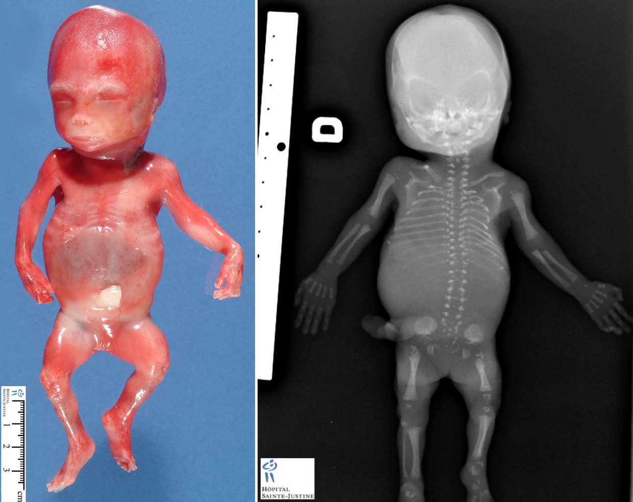
Chondrodysplasia Punctata
Abnormal cartilage and bone formation
Early fusion of epiphyses
Nasal hypoplasia
Short stature
Asplenia
Deafness
Seizures
Warfarin teratogenic in 1st trimester
May be given safely in 3rd trimester

Slide 51
Obstetric Management of Inherited Bleeding Disorders
General principles
Managed in haemophilia centre, close collaboration between obstetrician and haematologist
Preconception counselling
Antenatal counselling
Fetal sexing/ diagnosis if by U/S/ free fetal DNA/CVS/amniocentesis

Slide 52
Haemophilia A and B
Sexing –If male fetus 50% chance of being affected; females obligate carriers
Check maternal levels 1st and 3rd trimester; maintain >50IU/dL at delivery
Avoid instrumental delivery in affected male fetus or unknown
65% bleeding in these deliveries
If C/S ideally electively
Cord sample
Remember 1/3 spontaneous mutations
Low threshold for treatment if intracerebral bleed suspected
1-4% incidence intracranial haemorrhage
But weighed against risk of inhibitor formation 41% if <6/12
cranial U/S
Cord sample: level, oral vitamin K

Slide 53
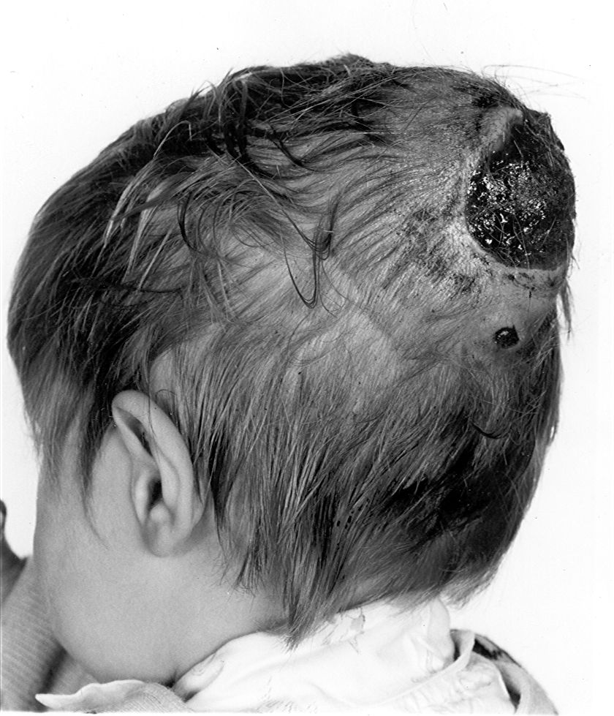
Cephalohaematoma

Slide 54
Summary You should now be able to:
Understand that pregnancy, COCP and oral HRT result in a prothrombotic state
Describe the interaction between inherited thrombophilia and use of OCP/HRT
Understand the need to consider relative benefit-harm of hormonal therapies
Know that VTE is a leading cause of maternal death in UK may be avoidable with appropriate risk assessment and appropriate thromboprophylaxis

