Slide 1

Post-translational modifications of coagulation factors
Dr Agata Nowak
Dep. of Haematology
12.01.2012

Slide 2
Learning objectives
- Explain terms post-translational modification, glycosylation
Describe types of glycans, examples of their function
Explain the role of glycosylation in VWF function
Describe the approach used to study the role of glycans

Slide 3
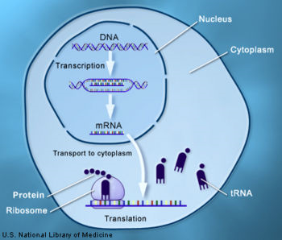
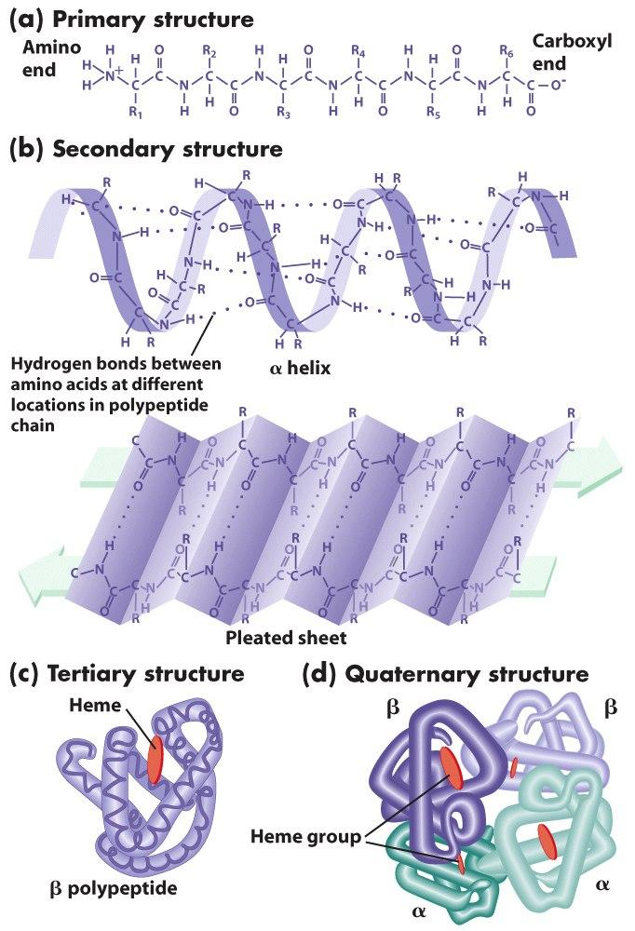
Post-translational modifications
A chemical modifications of protein which can occur at any stage of protein ‘life cycle’ following (or even during) translation.

Slide 4
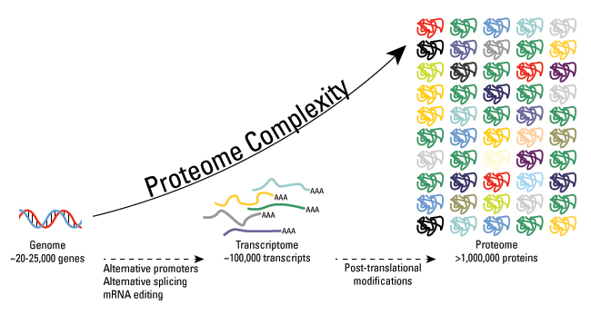
Post-translational modification
These modifications greatly increase the complexity of the proteome.
Examples of post-translational modifications:
glycosylation, phosphorylation, ubiquitination, s-nitrosylation, methylation, biotynylation, gamma-carboxylation, alkylation.

Slide 5
Protein glycosylation
Glycosylation - Covalent attachment of carbohydrate structures to the protein backbone.
Most frequent post-translation modification. Up to 70% of proteins may be glycosylated.
No single predominant role. Affects protein properties such as:
- folding,
- solubility, stability and charge,
- sensitivity towards protease,
- provides structural components: cell walls, endothelial cell matrix,
- mediates protein trafficking, cell adhesion and signalling.

Slide 6
Protein glycosylation
Glycosylation can depend on the cell type, which may enable the same protein to function in different ways depending on where it is being expressed.
Glycosylation of a protein can change during development and maturation.
Changes in glycosylation are observed for numerous pathological conditions e.g. cancer, rheumatoid arthritis and inflammation.

Slide 7
Types of glycans

Slide 8
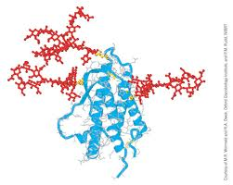
N-linked glycosylation (NLG)
Initiated upon translocation of the nascent protein into the ER lumen.
Occurs at asparagine residues in the motif Asn-X-Ser/Thr, where X is any amino acid except proline.
vast diversity of structures
N-glycosylation can be broken down into separate events:
- precursor glycan assembly
- attachment
- trimming
- maturation

Slide 9
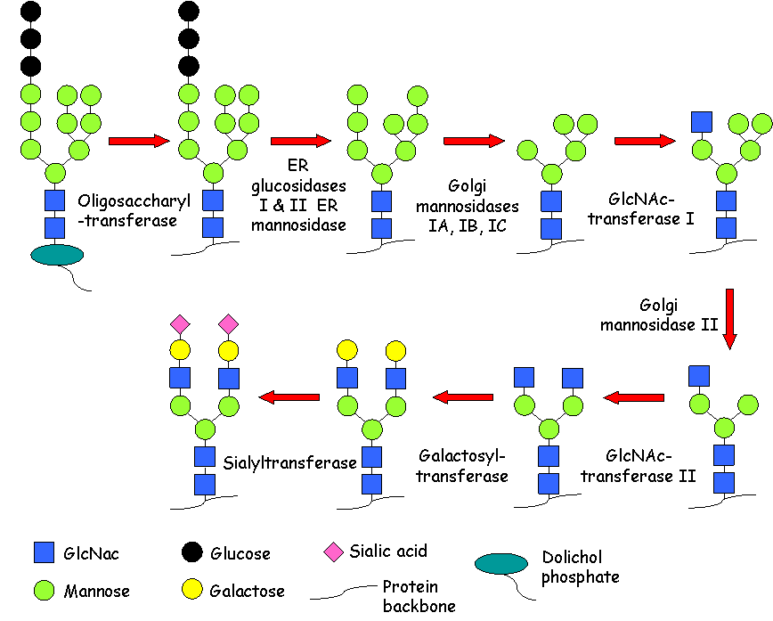
N-linked glycosylation

Slide 10
Functions of N-linked glycans
NLGs are important for:
protein folding,
disulphide bond formation,
thermal and kinetic stability,
solubility, preventing protein aggregation,
protection from proteolysis,
protein clearance,
indirectly in protein folding, through interaction with chaperones calnexin and calreticulin.

Slide 11
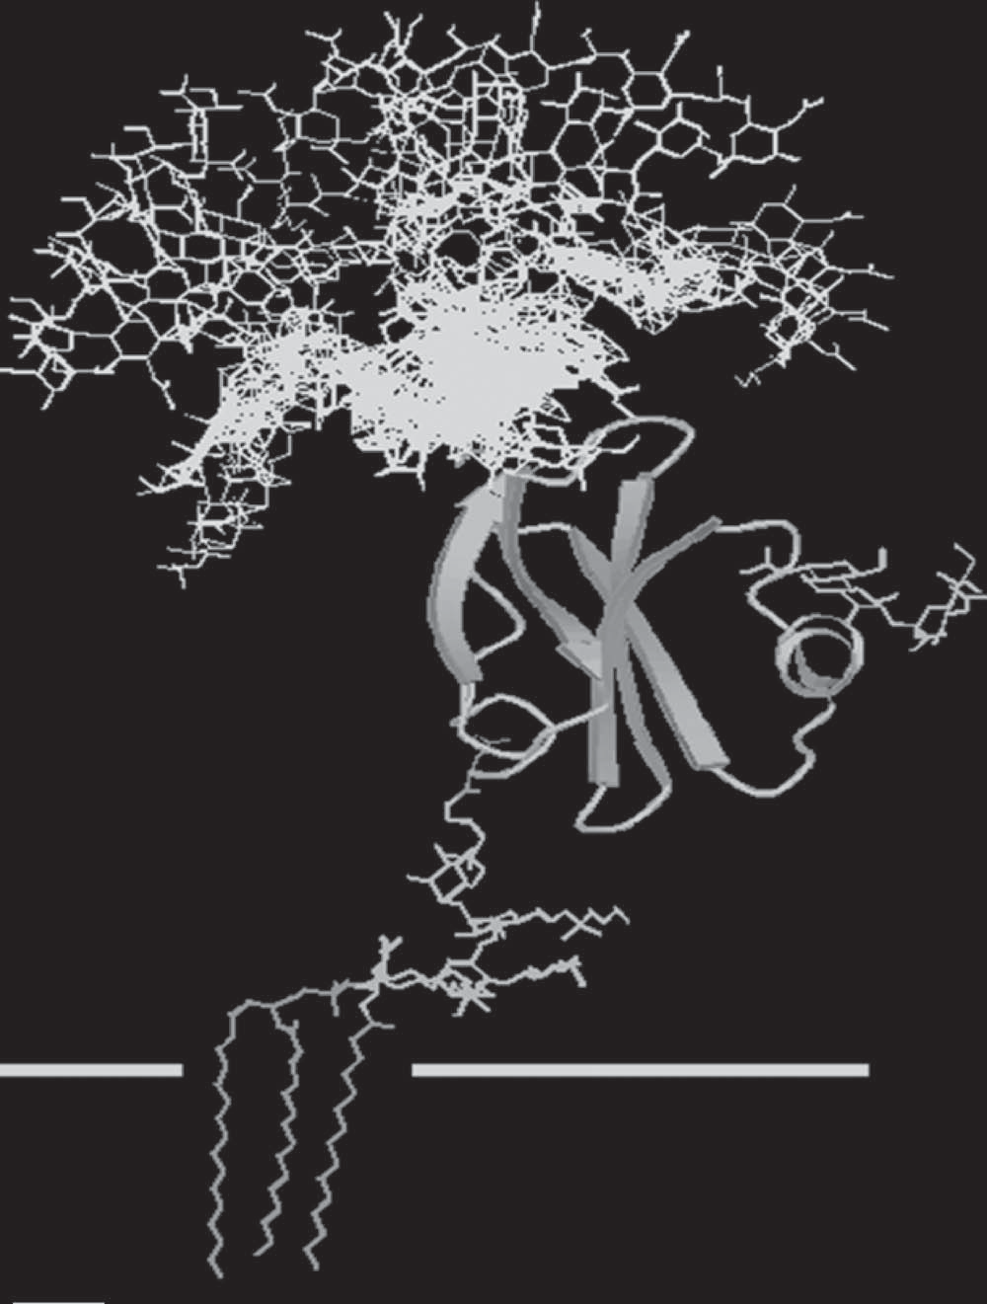
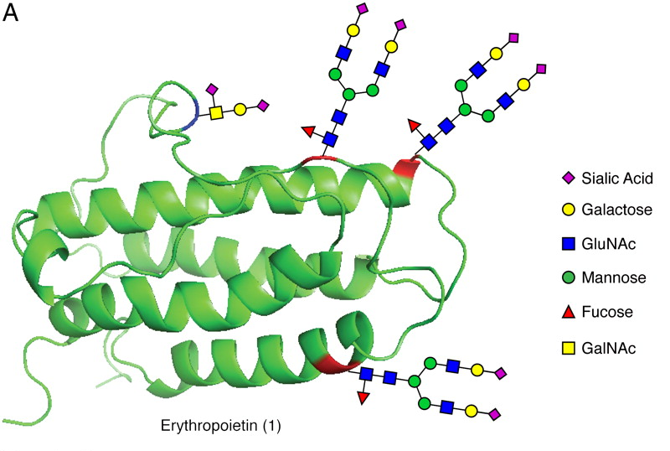
O-linked glycosylation
posttranslational modification in the Golgi apparatus
initiated by addition of GalNAc to a threonine (T) or a serine (S) residue
no consensus sequence determined.
N-glycan
N-glycans
O-glycan
O-glycan
GPI anchor
Cell membrane

Slide 12
O-linked glycosylation
Important for protein expression, processing and survival.
Mediate intracellular trafficking, signalling and functional recognition.
Blocks accessibility of the peptide backbone to proteases.
Introduce steric hindrance, providing a basis for rigid, extended conformations and protein stability.

Slide 13
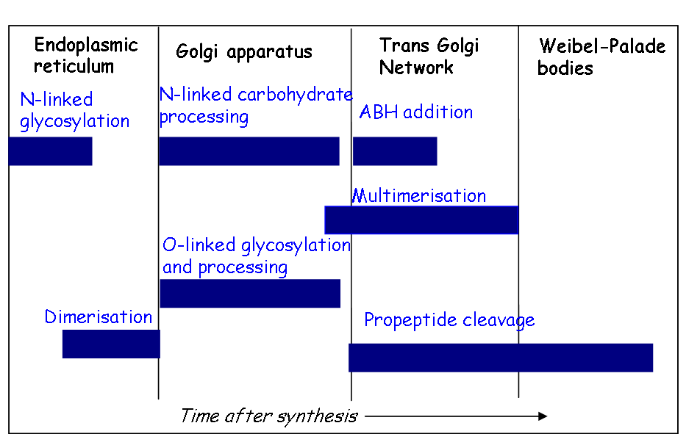
Posttranslational modifications of von Willebrand Factor (VWF)

Slide 14




Glycosylation of Von Willebrand Factor
glycans comprise ~18.7% of total VWF molecular weight
N-linked glycans
O-linked glycans
D1
D2
D’
D3
A1
A2
A3
D4
C1
C2
CK
B1-3
FVIII
P-Selectin
ADAMTS13
Collagen III
GPIbα
Collagen I,VI
Heparin

Slide 15
How do we study the function of VWF glycans in the laboratory? (1)
To study glycans of plasma-derived VWF, we isolate and purify VWF from commercial VWF concentrates or human plasma.
We then modify glycan composition of VWF by highly specific enzymes that remove definite structures:
To remove entire N-glycan chain, use PNGase F.
To remove terminal structures from both N- and O-glycans use respective enzymes i.e. neuraminidases to remove terminal sialic acid; β-galactosidase to remove terminal galactose.
Removal of is O-glycans generally unfeasible; sequential removal of monosaccharides sporadically works.

Slide 16
How do we study the function of VWF glycans in the laboratory? (2)
To produce recombinant (r) protein, we need DNA coding for VWF and cell based expression system.
DNA sequence is present in a DNA plasmid and can code for either wild-type or mutated VWF.
To determine the individual roles of VWF glycan chains, respective Asp (N-glycans) or Thr/Ser (O-glycans) residues are mutated into alanine to prevent glycosylation
The most suitable expression system for VWF are mammalian cell lines (preferably endothelial). Bacteria do not add glycans. Yeast or insect cells might produce considerably different glycan structures.

Slide 17
How do we study the function of VWF glycans in the laboratory? (3)
Fully functional wtVWF is secreted from mammalian cells following transfection of cells.
In order to modify all rVWF glycans, transfection and protein expression can be performed in the presence of various inhibitors:
Benzyl-α-GalNAc –inhibitor of O-glycosylation,
Tunicamycin- blocks the attachment of precursor N-glycan to the nascent protein,
Castanospermine- prevents initial glucose trimming,
Swainsonine- inhibits conversion of high mannose to complex glycans.

Slide 18
Analysis of VWF glycans function
Expression and secretion.
Binding assays: collagen, platelets, heparin, ADAMTS13, FVIII.
Susceptibility to ADAMST13 proteolysis.
Thrombus formation - flow assays.
Clearance - animal models.
Glycan structure and composition:
interaction with lectins (proteins that specifically recognise and reversibly bind carbohydrate moieties)
- mass spectrometric analysis (establishes masses and composition of samples and elucidates chemical structure of molecules).

Slide 19
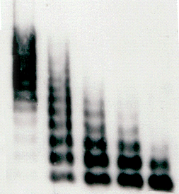
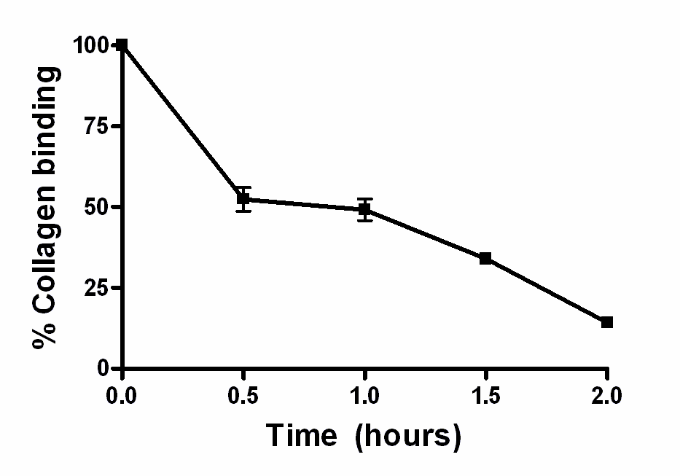
ADAMTS13 proteolysis of VWF
Extent of proteolysis analysed by:
Multimer gel
Collagen binding assay
time
ADAMTS13 +urea
Multimer size
Haemostatic potential

Slide 20
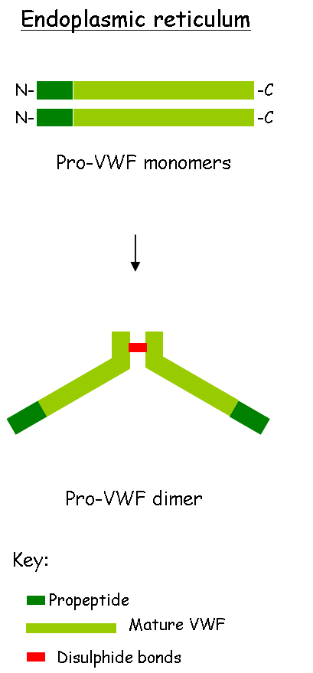


Function of VWF N-linked glycans
Indispensable for formation of dimers and multimers.
Inhibition of N-glycosylation (+TM -tunycomycin) results in retention of VWF monomers in the cell.
Secreted
Retained
HMWM
dimer
monomer
Tunycomycin - + - +

Slide 21
Function of VWF N-linked glycans
2. Modulate disulphide bond formation and putatively maintain the globular structure of VWF preventing exposure of buried unpaired cysteine residues.
Prevention of glycosylation at individual sites results in increase in VWF free thiols of unpaired cysteines.
MPB binding correlates with the amount of free thiols- unpaired cysteines- disulphide bond formation.

Slide 22
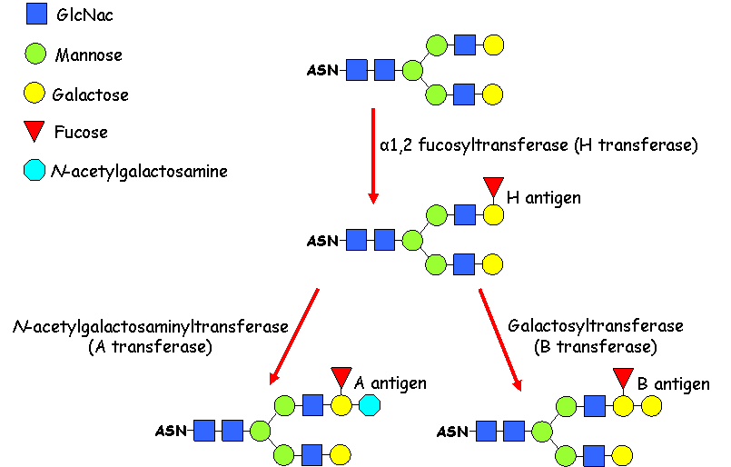
Function of VWF N-linked glycans
3. Present ABO group determinants which influence VWF plasma levels and susceptibility to ADAMTS1 3 proteolysis

Slide 23
Function of VWF N-linked glycans
3. Present ABO group determinants which influence VWF plasma levels and susceptibility to ADAMTS1 3 proteolysis
25% lower level of VWF in group O individuals
within non-O blood group VWF levels were highest in AB individuals, followed by group B then group A
lowest VWF levels in Bombay blood group (no H-antigen)
The Bombay followed by the O-blood group VWF are the most susceptible to ADAMTS13 proteolysis

Slide 24
Function of VWF N-linked glycans
4. Affect VWF susceptibility to proteolysis by ADAMTS13.
VWF devoid of N-glycans (PNG-VWF) has increased susceptibility to ADAMTS13 cleavage
Time 0h
Time 4h
Ctrl-VWF
PNG-VWF
Ctrl-VWF
PNG-VWF

Slide 25
Function of VWF N-linked glycans
Altered cleavage of VWF devoid of N-glycans could result form its altered binding to ADAMTS13.
PNG-VWF K_{D},_{app} = 4.3 ±0.8nM
2.4
1.8
Abs 492nm
Ctrl-VWF K_{D},_{app} = 90 ±10nM
1.2
0.6
0.0
0
50
100
150
200
250
[ADAMTS13]nM
n=7
By influencing VWF-ADAMTS13 interaction N-glycans regulate VWF size and as a result its haemostatic potential.
Presence of NLG chains protects VWF from cleavage in circulation.

Slide 26
Function of VWF O-linked glycans
T-antigen is a major tetrasaccharide structure of the VWF O-glycans (70%).
Variations in levels of VWF T-antigen are inversely correlated with VWF plasma levels.
Extent of O-glycosylation is linked to VWF half-life.
It has been implied that the O-linked glycosylation pattern of VWF stored in WPBs differs from VWF circulating in plasma.
Why is that important?

Slide 27
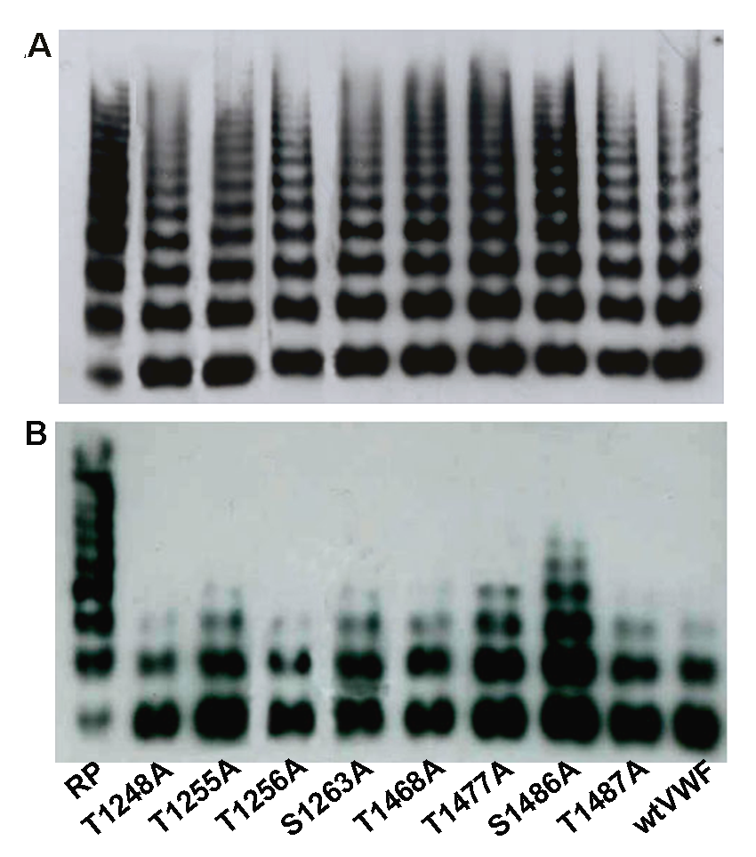
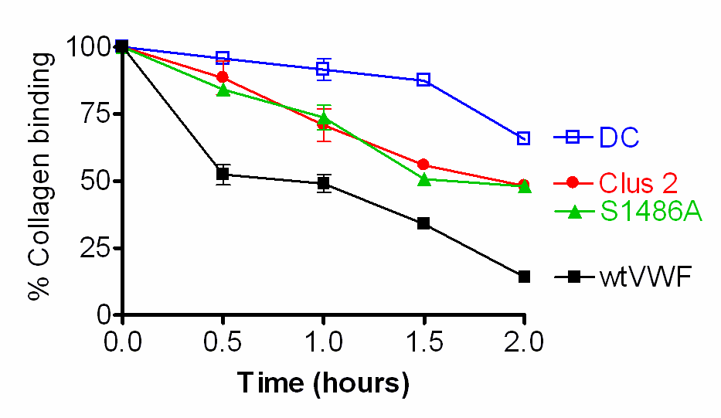
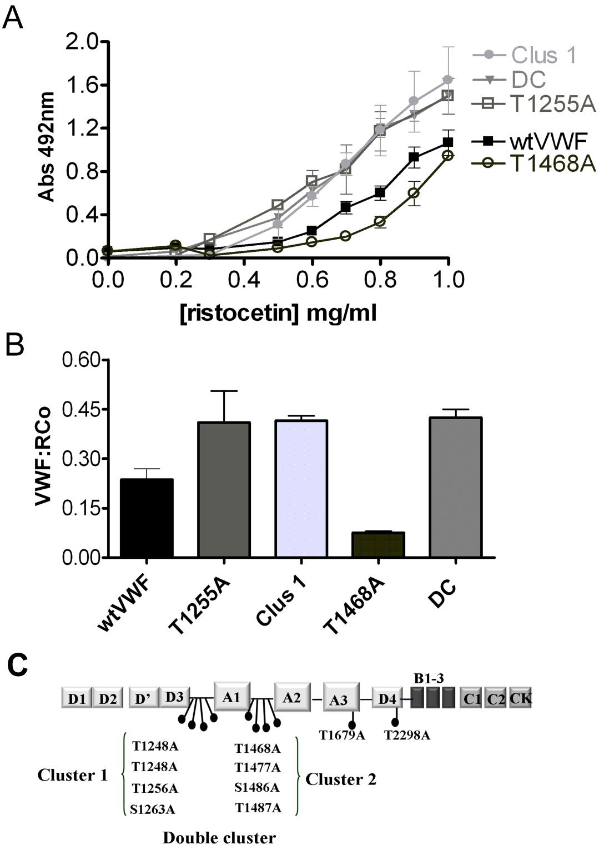
Function of VWF O-linked glycans
O-glycans in the linker region between the A1 and A2 affect VWF susceptibility to proteolysis by ADAMTS13
O hours
VWF +ADAMTS13 and urea
wtVWF
S1486A
2 hours
ADAMTS13

Slide 28
Function of VWF O-linked glycans
Absence of O-linked glycans increases VWF- platelet GPIbα receptor interaction.
GPIb
VWF:RCo VWF ristocetin cofactor activity assay – measures ability of VWF to agglutinate platelets in the presence of ristocetin.

Slide 29
Function of VWF O-linked glycans
Decreased VWF:RCo can result from altered interaction with ristocetin rather than platelets, which could lead to false diagnosis - need for better assays.
Flow assays were therefore developed to probe interaction under physiological conditions of shear flow in the absence of artificial modulators.
Platelets binding via GPIb and thrombus formation under a range of shear stresses can be observed in real-time using fluorescent microscope.

Slide 30
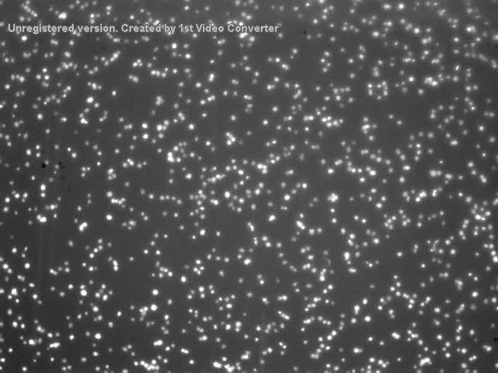
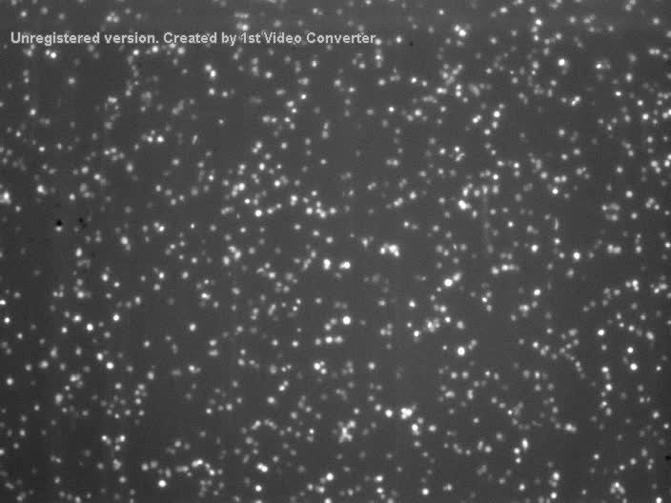
Function of VWF O-linked glycans
VWF-mediated platelet adhesion probed by perfusing VWF with platelets over low slides coated with collagen type III and at high shear stress.
wtVWF
No OLG-VWF
Increased platelets captured in the presence of VWF that are lacking O-linked glycans flanking the A1 domain, when compared to wtVWF.

Slide 31
Function of O-linked glycans
OLGs introduce steric hindrance and provide rigidity to peptide backbones. They can extend and stabilise otherwise flexible regions, thus stabilising protein conformation.
The removal of OLG(s) from the A1 flanking regions may change its flexibility, altering the A1 interaction with vicinal domains and accessibility of GPIb and ADAMTS13 binding site.
D’-D3
A2
A1
A1

Slide 32
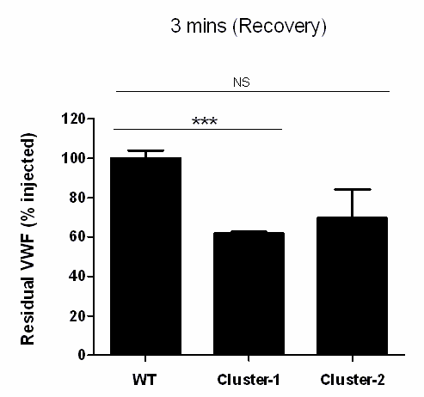
VWF clearance-role of carbohydrate
VWF without terminal sialic acid residues is cleared more rapidly from the circulation. It has increased affinity to ASGRP receptor, which is an important clearance receptor.
In a group of patients with bleeding disorder, reduced sialylation is linked to reduced plasma VWF levels.
Glycans are mediators of VWF interaction with Ashwell receptor (major clearance receptor of hepatocytes).
Absence of OLG flanking the A1 domain increases VWF clearance.

Slide 33
Glycosylation of Factor VII
Contains 2 N- and 2 O-linked sites
They are essential for normal secretion of FVII
Glycome of recombinant and plasma-derived FVII differ in part.
Expression of recombinant FVII in diverse cell types affects its activity. This is due to small differences in glycans structures.

Slide 34
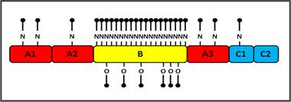
Glycosylation of Factor VIII
Both N and O-linked glycans present
Function varies with the number of glycans and protein size.
The aim is to produce recombinant FVIII with optimal function.
Recombinant FVIII with shortened B domain (8 N-linked glycan sites) exhibits best expression. This is due to optimal interaction with ER chaperons and proteins involved in transport to the Golgi.

Slide 35
Plasma-derived versus recombinant FIX
 | pdFIX | rFIX
γ-carboxyglutamic acid (GLA) | 100% | 60%
B-hydroxyaspartic acid | 37% | 46%
N-linked glycans | High heterogeneity Fully sialylated | Low heterogeneity < Fully sialylated
O-linked glycans Serine Serine Threonine | Xyl₁₋₂ –Glc NeuAcGalGlcMAcFuc Classical, partially filled | Xyl₁- Glc NeuAcGalGlcMAcFuc Classical, partially filled
Tyrosine 155 sulphation | >90% | >15%
Serine 158 phosphorylation | >90% | <1%

Slide 36
Plasma-derived versus recombinant FIX
In patients with haemophilia B, the in-vitro recovery of plasma-derived FIX concentrates is higher than that of recombinant FIX. As a result, higher doses have to be infused to achieve the same plasma level, although the clinical outcome may still be different.
These differences in recovery, activity and efficacy could be a result of differences in post-translational modifications between plasma-derived FIX and recombinant FIX.

Slide 37
Conclusions
N and O-linked glycosylation of coagulation factors have significant influence on their structure and function.
Changes in glycan status, or even glycan structure, can alter protein function.

Slide 38
Importance of glycobiology in haematology
Plasma-derived factors are more expensive. Recombinant protein production is cheaper, however certain cell lines produce different glycosylation patterns. Even slightchanges could potentially influence protein function, half-life, immunogenicity.
The knowledge of glycan composition and function gives the possibility to manipulate glycosylation (alteration of enzymes involved in glycans synthesis) in order to improve the therapeutic efficacy of the recombinant protein. e.g. Erythropoietin-α with an additional glycan has a greatly increased biological half-life.
Important to know ABO blood groups with regard to von Willebrand diagnosis.

