Slide 1
Platelet function and antiplatelet therapy

Slide 2
Normal Platelet Functions
Adhesion to Collagen
Adhesion to VWF
Formation of primary platelet plug
Auto-activation
Binding to adhesion molecules
Shape change and clot retraction
Membrane ‘flip’ and provision of phospholipid surface for coagulation
Inflammation, immunity and healing

Slide 3
Antiplatelet therapy
Normal platelet function
Mechanisms of platelet activation
Role of platelets in (arterial) thrombosis
Aspirin and COX inhibition
Clopidogrel and ADP blockade
Dipyridamole
IIbIIIa blockade
Combination therapy

Slide 4
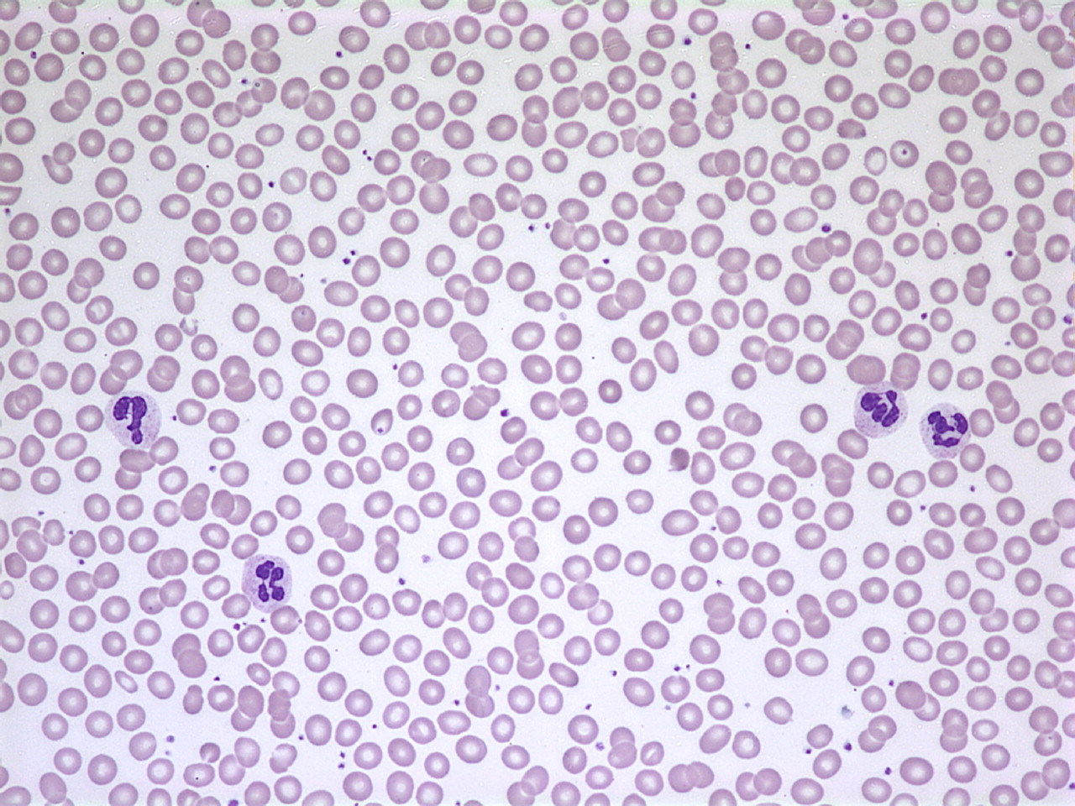
Normal peripheral blood
Peter Maslak, ASH Image Bank 2011; 2011-3666
Notes:
Granulocytes circulating in the blood of a patient with a normal peripheral smear.

Slide 5
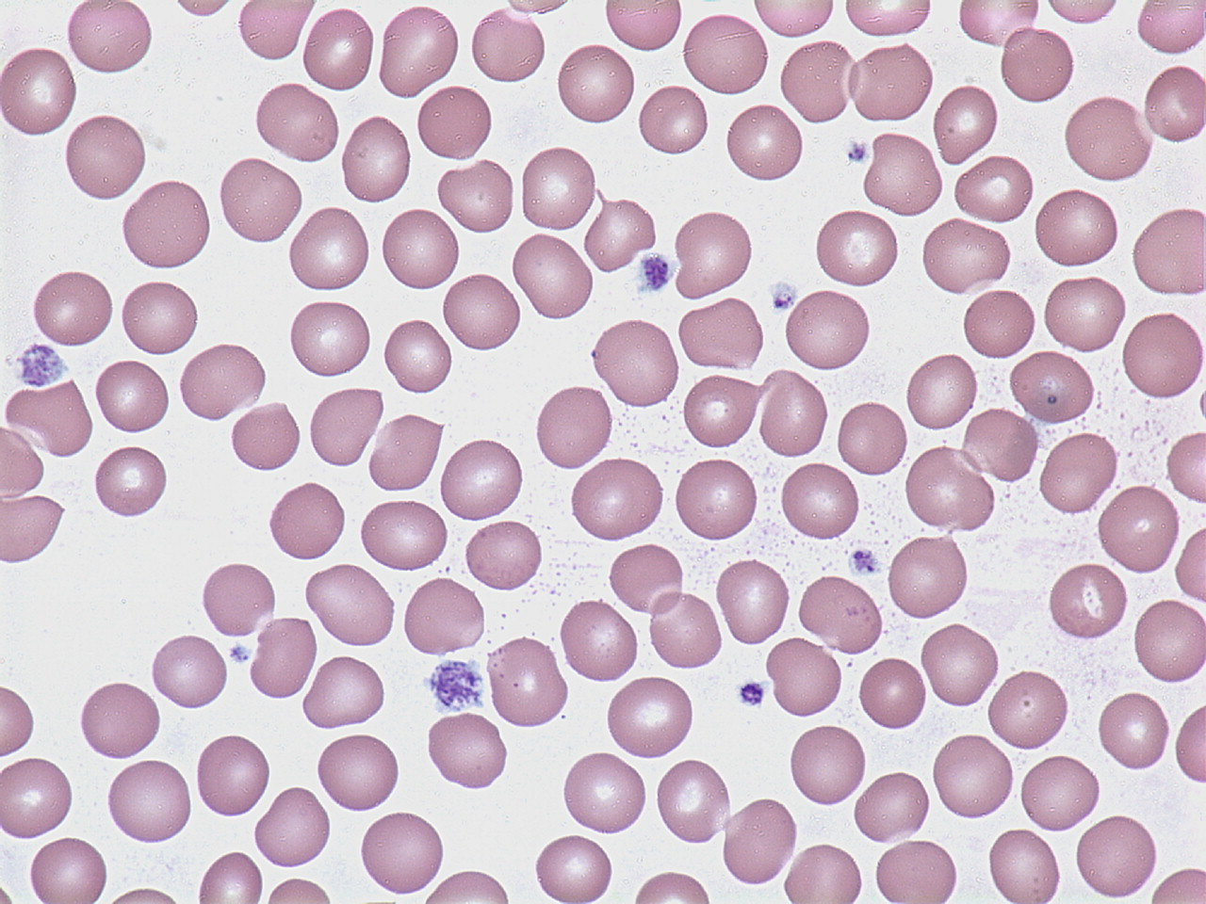
Normal Platelets
Peter Maslak, ASH Image Bank 2011; 2011-3783
Notes:
Platelets are the blue-gray granular structures in this peripheral smear. In this specimen, there is a variety of sizes.

Slide 6
Key features of platelet structure
PAR 1 & 4
P2Y₁₂
Thromboxane receptor
Lysosome
P2Y₁
Dense granule
PGI₂ receptor
Peroxisome
GPIIb
-IIIa
Alpha granule
GPVI complex
GP1bα
complex
GP1a-IIa

Slide 7
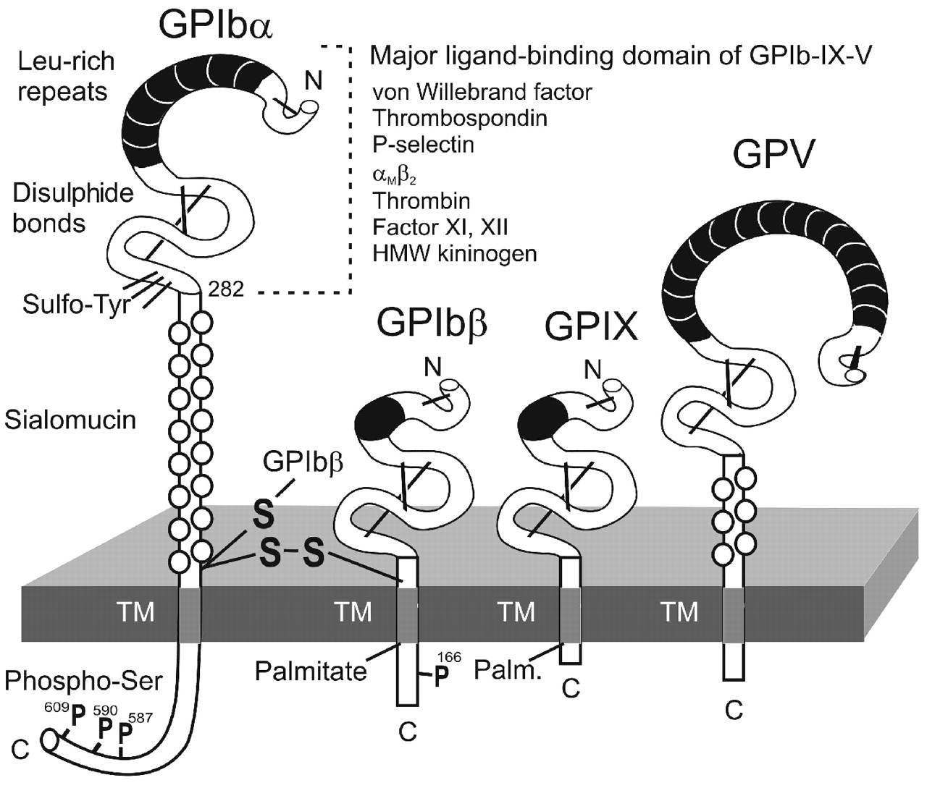
The GPIb - IX – V complex
Berndt M C Haematologica 2011;96:355-359
Notes:
The GPIb-IX-V complex composed of GPIbα disulphide-linked to two GPIbβ subunits, and noncovalently associated with GPIX and GPV. Disulphide bonds within domains either side of leucine-rich repeat domains are depicted as solid black bars. The position of sulphated tyrosine residues (Sulfo-Tyr at 276, 278 and 279 of GPIbα), phosphorylated serine residues (Phospho-Ser) and palmitylated Cys residues of GPIbβ and GPIX are indicated. C, C-terminus; N, N-terminus; TM, transmembrane domain.

Slide 8
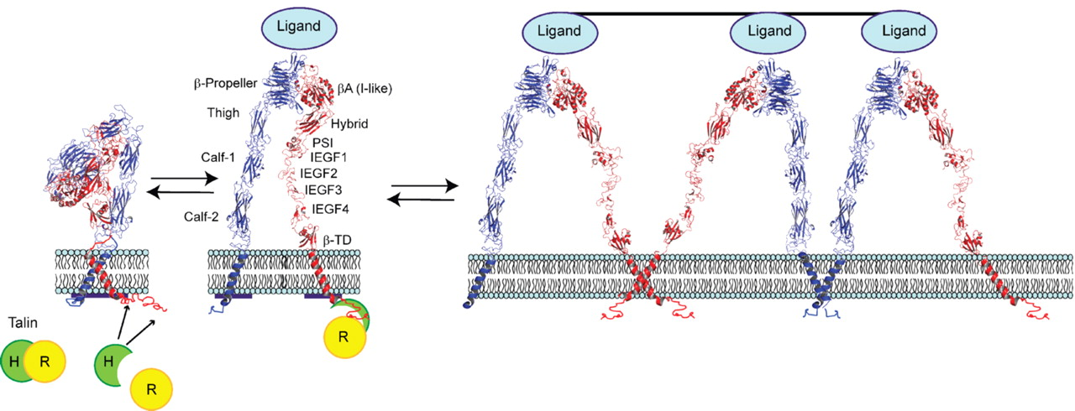
The αIIbβ3 integrin
(GPIIbIIIa)
Coller Blood 2008

Slide 9
Ultrastructural Features of the Platelet by EM (x30,000)
Microtubules &
actomyosin
(Surface glycoproteins:
GpIa, GpVI
GpIb
GpIIb/IIIa)
Glycogen
Dense granules:
ADP
ATP
Serotonin
Ca2+
Phospholipid
membrane
α granules:
growth factors
fibrinogen
factor V
vWF
Open cannalicular
system
(Receptors
for IIa, ADP
and thromboxane A2)
mitochondria

Slide 10
Platelet granule contents
Dense (δ) granules | α Granules | Lysosomal vesicles
ATP | PF4 | Galactosidases
ADP | VWF | Fucosidases
Calcium | Fibrinogen | Hexosaminidase
Serotonin | Factor V | Glucuronidase
Pyrophosphate | Thrombospondin | Cathepsins
Pselectin (CD62) | Fibronectin | Glycohydrolases
TGF beta | PDGF | +others
Catecholamines (Epi/Norepinephrine) | PAI-1
GDP/GTP | Histidine rich glycoprotein Α2 macroglobulin Antiplasmin Pselectin

Slide 11
Platelets
Numbers
  Normal 120-450 x10⁹l⁻¹
  Varies according to counting technique
    Impedance
    Light scatter
Mild thrombocytopenia well tolerated
  margination
Notes:
Newtonian laminar flow, the flow is fastet in the middle away from the wall and this is occupied by the larger cells, the majority of which are erythrocytes. The platelets are pushed aside so that the concentration on the wall, where they are needed, is 3-5 times higher than the centre. This explains in part firstly why we tolerate low platelet counts remarkably well down to 20 or so (in absence of bleeding) and also why a low haematocrit is itself associated with an increase in bleeding and a prolonged bleeding time.
Possibly some benefit from release of sequestered platelets from the spleen. This occurs in some animals but unclear in humans.

Slide 12
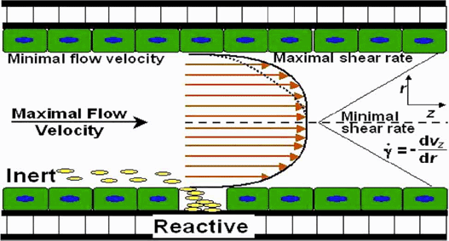
Platelet margination
Notes:
Newtonian laminar flow, the flow is fastet in the middle away from the wall and this is occupied by the larger cells, the majority of which are erythrocytes. The platelets are pushed aside so that the concentration on the wall, where they are needed, is 3-5 times higher than the centre. This explains in part firstly why we tolerate low platelet counts remarkably well down to 20 or so (in absence of bleeding) and also why a low haematocrit is itself associated with an increase in bleeding and a prolonged bleeding time.
Possibly some benefit from release of sequestered platelets from the spleen. This occurs in some animals but unclear in humans.

Slide 13
Platelet activity
Normally platelets are kept at rest by EC production of NO and PGI2
Petechiae formation in thrombocytopenia demonstrates that they are continually needed.
Vessel wall damage exposes platelet ligands
  Collagen (low shear; <500s⁻¹)
  VWF (high shear >500s⁻¹)
Notes:
Newtonian laminar flow, the flow is fastet in the middle away from the wall and this is occupied by the larger cells, the majority of which are erythrocytes. The platelets are pushed aside so that the concentration on the wall, where they are needed, is 3-5 times higher than the centre. This explains in part firstly why we tolerate low platelet counts remarkably well down to 20 or so (in absence of bleeding) and also why a low haematocrit is itself associated with an increase in bleeding and a prolonged bleeding time.
Possibly some benefit from release of sequestered platelets from the spleen. This occurs in some animals but unclear in humans.

Slide 14
How do platelets
become fully
activated?
See Jackson and Schoenwaelder
Nat Rev Drug Discov 2, 1-15, 2003
GP1bα
complex
collagen
VWF
VWF
VWF

Slide 15
Binding of GpIb under high shear
allows other binding interactions to take place
initiates activation
ADP
Alpha granule
TXA2
Dense granule
Ca²⁺ flux
PLA2
PKC
activated
GPIIb
-IIIa
DAG
IP3
GPIIb
-IIIa
fibrinogen
PLC-γ
GP1bα
complex
GPVI complex
GP1a-IIa
collagen
VWF
VWF
VWF

Slide 16
Positive feedback events
ADP release
Thromboxane A2 synthesis and release
VWF and fibrinogen release
Phospholipid ‘flip’ allows more thrombin generation
Platelet shape change, clot retraction

Slide 17
thrombin
thromboxane A₂
ADP
P2Y₁₂
Gi
Gq
Gi
Gq
G12/13
G12/13
Gq
P2Y₁
PLC-β
activated
GPIIb
-IIIa
Ca²⁺ flux
PKC
GPIIb
-IIIa
fibrinogen
PLC-γ
GPVI complex
GP1bα
complex
GP1a-IIa
collagen
VWF
VWF
VWF

Slide 18
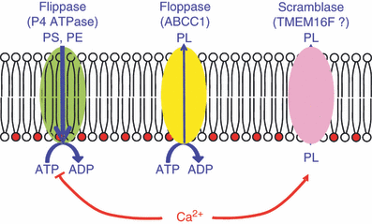
Maintaining phospholipid asymmetry
Lhermusier JTH 9: 1883 2011
Notes:
Phospholipid transport proteins of the platelet membrane. Under resting conditions, phospholipid transverse asymmetry is maintained through the action of two ATP‐dependent translocases (flippase and floppase). In the presence of μm calcium concentrations (for instance upon stimulation with thrombin plus collagen), the scramblase catalyzes the bidirectional transfer of phospholipids (PL), whereas inhibition of flippase contributes to PS exposure on the external surface. PS, phosphatidylserine; PE, phosphatidylethanolamine.
© This slide is made available for non-commercial use only. Please note that permission may be required for re-use of images in which the copyright is owned by a third party.

Slide 19
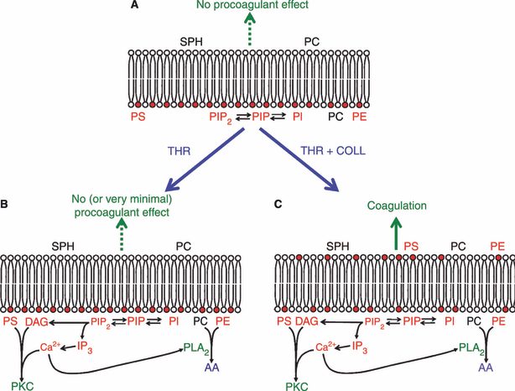
Loss of asymmetry & PE and PS exposure
Lhermusier JTH 9: 1883 2011
Notes:
Schematic view of phospholipid transverse distribution in the plasma membrane of resting and stimulated platelets. (A) In resting platelets, the external membrane surface consists almost exclusively of SPH and PC and exerts no procoagulant activity. In contrast, PS, PE and phosphoinositides are confined to the inner leaflet of the membrane (shown in red). (B) Upon relatively weak platelet stimulation with thrombin alone at low concentrations, a number of metabolic modifications involve phospholipids of the inner leaflet, including PIP2 hydrolysis by PLC and subsequent activation of PKC by PS, DAG and Ca²⁺, arachidonic acid (AA) liberation by PLA₂, as well as PIP3 production by phosphoinositide 3‐kinases (not shown). However, this calcium mobilization is not sufficient to promote phospholipid scrambling. (C) When platelets are strongly activated by a combination of thrombin and collagen, a large calcium influx occurs through specific channels (not shown) and promotes phospholipid scrambling, with the subsequent appearance of procoagulant phospholipids (mainly PS), on the external surface. PS, phosphatidylserine; SPH, sphingomyelin; PC, phosphatidylcholine; PE, phosphatidylethanolamine; PI, phosphatidylinositol; PIP, phosphatidylinositol monophosphate; PIP2, phosphatidylinositol bisphosphate; IP3, inositol trisphosphate; THR, thrombin; COLL, collagen; PLC, phospholipase C; DAG, 1,2 diacyl sn glycerol; PKC, protein kinase C; PLA2, phospholipase A2.
© This slide is made available for non-commercial use only. Please note that permission may be required for re-use of images in which the copyright is owned by a third party.

Slide 20
Mechanisms of platelet activation
Platelet agonists Platelet ligands
  Collagen GpIa/IIa, GpVI
  VWF Gp1b
  Thrombin PAR
  ADP PY2, PY12
  Thromboxane Thromboxane receptor
  Fgn, Fcn, Vcn, VWF GpIIbIIIa
All of these are therapeutic targets

Slide 21
Summary of platelet action
Adhesion
  GPIb complex to VWF
  GPVI and IaIIa to collagen
Activation of feedback loops (recruits nearby platelets)
  Granule release (ADP)
  TXA2 synthesis
  Flip-flop augments thrombin generation
GPIIbIIIa conformational change
  Platelet aggregation by fibrinogen
Platelet shape change
  Clot retraction

Slide 22
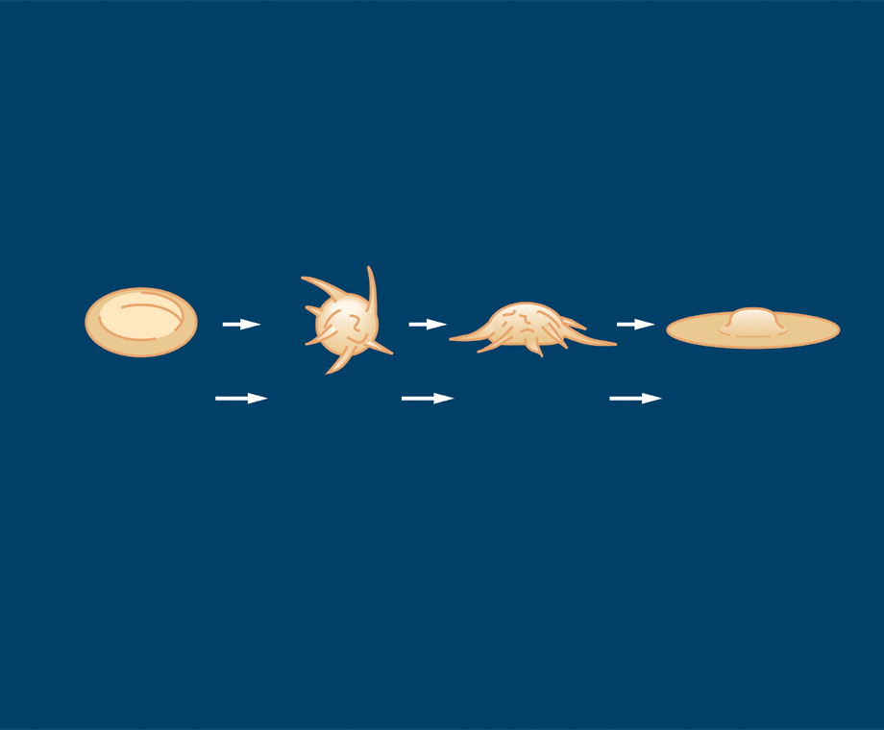
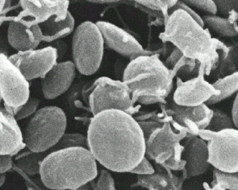
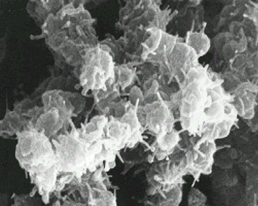
The platelet – shape changes upon adhesion, activation and aggregation
Platelet Aggregation
Flowing
disc-shaped
platelet
Rolling
ball-shaped
platelet
Hemisphere-shaped
platelet
Spreading
platelet
FIRM, BUT REVERSIBLE
ADHESION
IRREVERSIBLE
ADHESION
Scanning electron micrograph
of discoid, dormant platelets
Activated, aggregating platelets illustrating fibrin strands
Adapted from: Kuwahara M et al. Arterioscler Thromb Vasc Biol 2002; 22: 329–34.

Slide 23
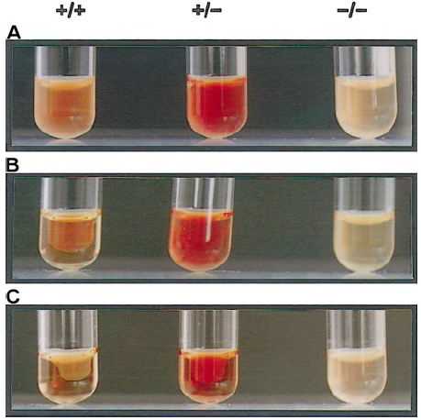
Clot retraction via GPIIbIIIa
αIIb
Roux Blood 2000

Slide 24
Analysis of platelet function

Slide 25
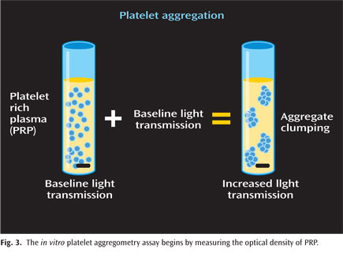
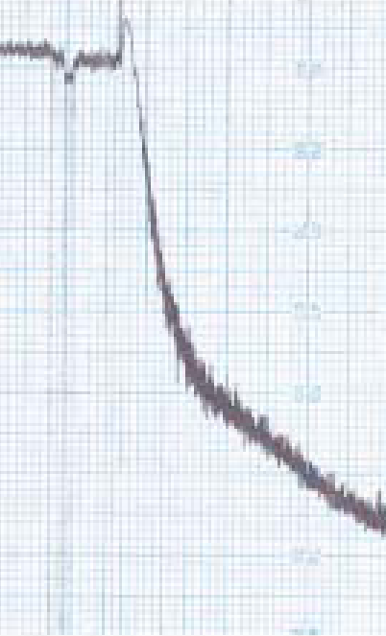
Platelet aggregation testing in platelet rich plasma
AGONIST
Light transmission
time
Notes:
PRP Prepared from citrated blood (200g and 1500g)
Do not adjust platelet count of PRP (unless >600) as this may cause artefactual inhibition. Needs to be >150
37 oc stirred by magnetic stirrer. Watch for lipaemic or icteric samples.
Calibrate curve with PRP and PPP

Slide 26
Platelet aggregation: agonists
ADP 1, 2.5, and 5 (10) μM
Epinephrine 0.5 - 10μM
Collagen (type 1) 1.25 and 4 μgmL⁻¹
Ristocetin 0.5 and 1.5 mgmL⁻¹
Arachidonic acid 500 μgmL⁻¹
+ TRAP, CRP, endoperoxide analogue U46619, calcium ionophore
Notes:
U46619 is a PGH2 analogue but appears to activate thromboxane receptors directly.

Slide 27
Single dose agonist panel
Studies suggest that a panel of agonists at a single concentration:
  ADP 2.5 μM
  Epinephrine 5μM
  Collagen 1.25 μgmL⁻¹
  Ristocetin 1.2 mgmL⁻¹
  Arachidonic acid 1.0 mmol
Is a sensitive screen which can be followed by higher agonist concentrations/other agonists as indicated
Notes:
Eg: could follow up neg to arachi by using endoperoxide
Or follow up neg to Risto by adding source of VWF or doing facs.
Platelets have PAR 1 and PAR 4 for which there are specific agonsits

Slide 28
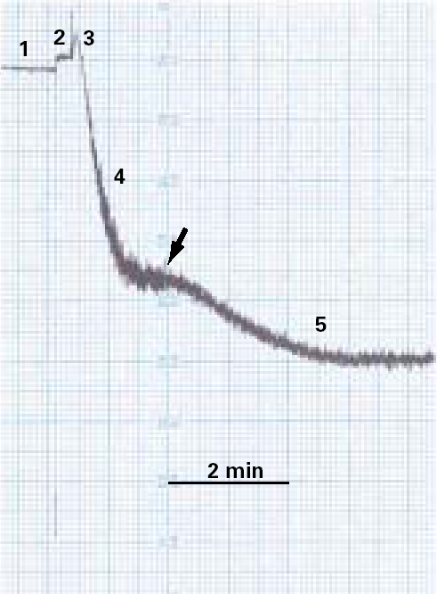
ADP & Epinephrine
Activate ADP or adreno-receptors
Low doses causes transient GPIIbIIIa activation
High doses cause granule release and TBXA₂ generation then sustained GPIIbIIIa activation
  Stable baseline
  Addition of agonist
  Shape change
  Primary wave
  Secondary wave

Slide 29
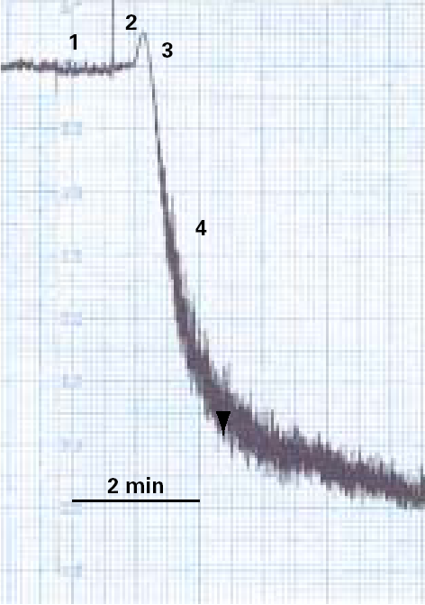
Collagen
Platelets bind collagen via GPVI and GPIaIIa
Causes granule release and TBXA₂ generation and then sustained GPIIbIIIa activation (delay)
  Stable baseline
  Lag phase after addition of agonist
  Shape change
  Single ‘secondary wave’

Slide 30
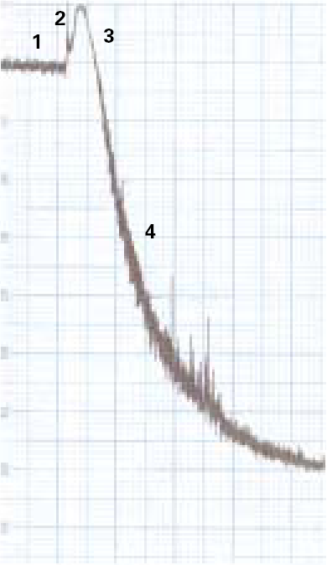
Arachidonic acid
Metabolised to TBXA2 within platelets
TBXA2 causes granule release and more TBXA2 generation and then sustained GPIIb/IIIa activation
  Stable baseline
  Addition of agonist
  Shape change
  Single secondary wave

Slide 31
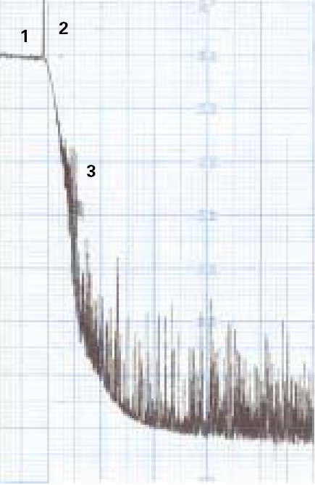
Ristocetin
Agglutinates platelets through VWF and GPIb
Auto-activation follows close platelet-platelet contact
  Stable baseline
  Addition of agonist
  Single agglutination/aggregation response
Notes:
Differences between live and fixed platelets as seen in Glanzmann’s versus RCo

Slide 32
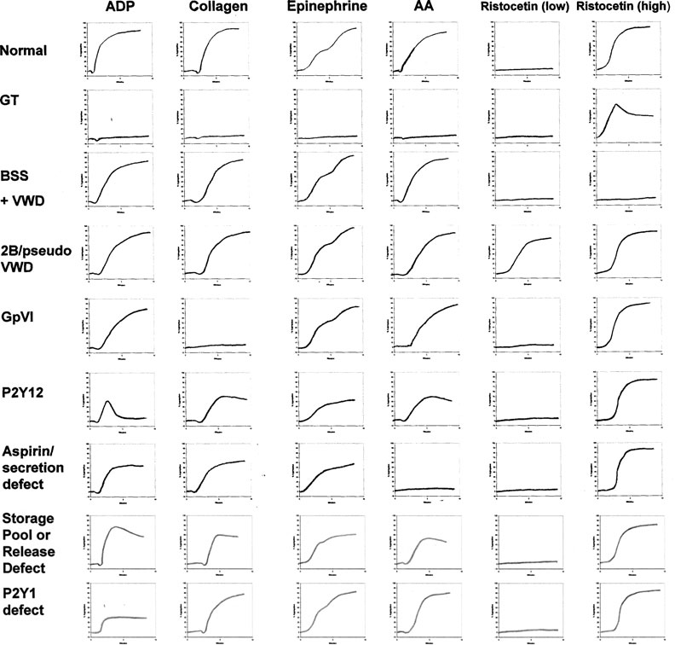
Harrison 2011

Slide 33
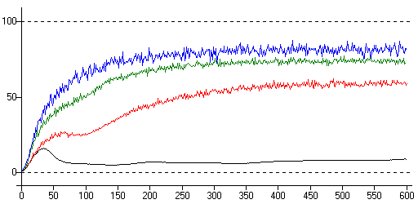
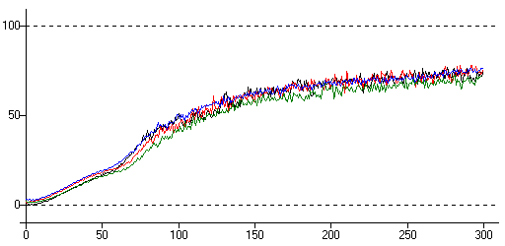
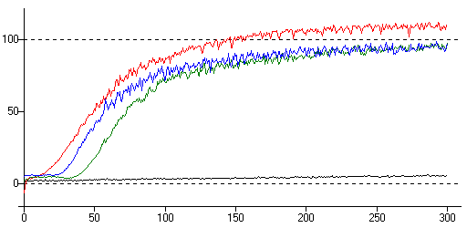
Normal Aggregation
Black ADP 0.5uM
Red ADP 1.0uM
Green ADP 2.0uM
Blue ADP 5.0uM
Black Epi 0.5uM
Red Epi 1.0uM
Green Epi 2.0uM
Blue Epi 5.0uM
Black Ris 0.75 mg/ml
Red Ris 1.5 mg/ml
Green Coll 5.0 ug/ml
Blue Coll 10.0 ug/ml

Slide 34
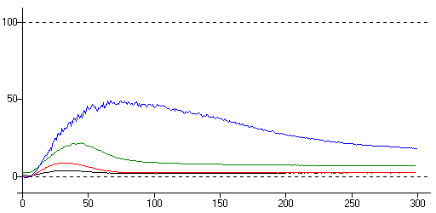
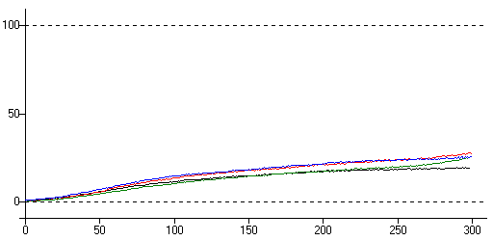
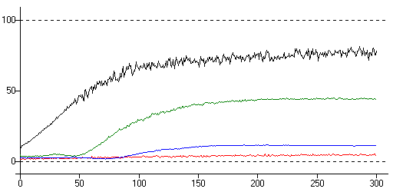
Abnormal Aggregation (1)
Black ADP 0.5uM
Red ADP 1.0uM
Green ADP 2.0uM
Blue ADP 5.0uM
Black Epi 0.5uM
Red Epi 1.0uM
Green Epi 2.0uM
Blue Epi 5.0uM
Black Ris 0.75 mg/ml
Red Ris 1.5 mg/ml
Green Coll 5.0 ug/ml
Blue Coll 10.0 ug/ml

Slide 35
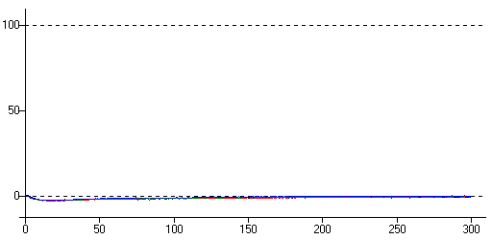
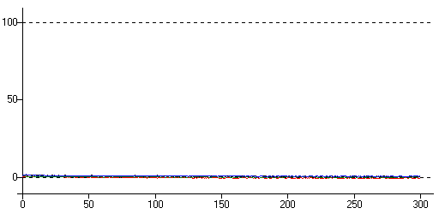
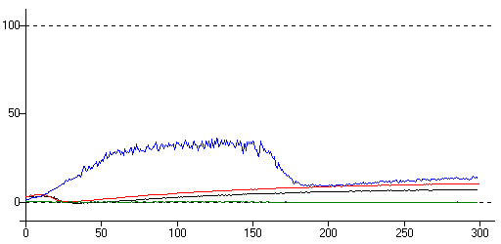
Abnormal Aggregation (2)
ADP
Epinephrine
Blue Ris 0.75 mg/ml
Red Ris 1.5 mg/ml
Green Coll 5.0 ug/ml
Black Coll 10.0 ug/ml

Slide 36
Storage pool and release
Aggregometry normal in ~30% of SPD/release defects
Measure release reaction
  Lumi-aggregometer
Assay of granule content
  ATP:ADP ratio
Electron microscopy

Slide 37
Lumi-aggregometry
Whole blood
Aggregation detected by impedance
  Whole blood
ATP release detected by luciferase

Slide 38
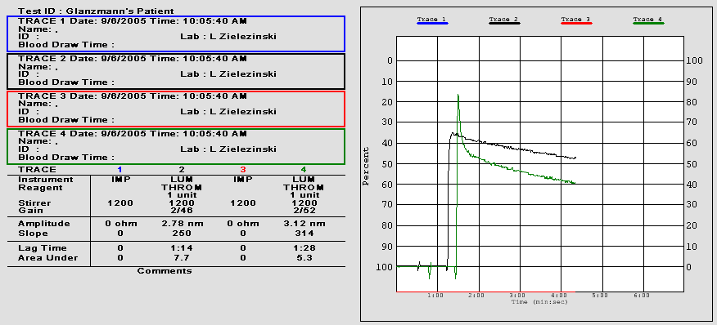
CASE STUDY - GLANZMANN’S
WHOLE-BLOOD LUMI-AGGREGOMETRY
with Thrombin @ 1 Unit
Normal Release
Ref: Children’s Hospital of the Kings Daughters, Norfolk, VA

Slide 39
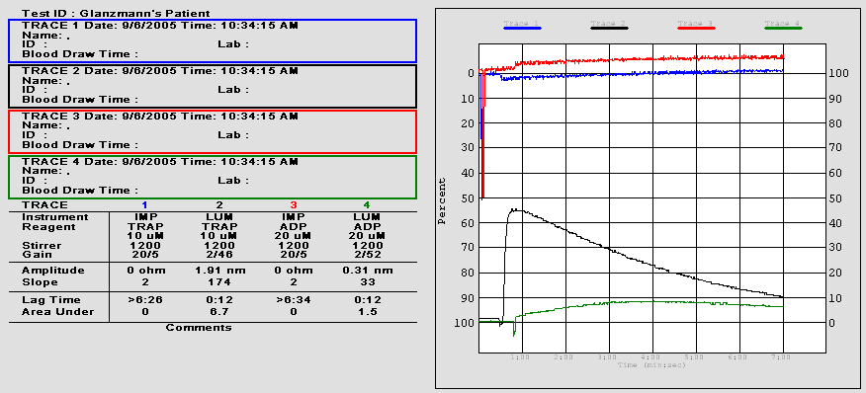
CASE STUDY - GLANZMANN’S
WHOLE-BLOOD LUMI-AGGREGOMETRY
with TRAP @ 10 uM and ADP @ 20 uM
Deficient Aggregation
Normal Release
Ref: Children’s Hospital of the Kings Daughters, Norfolk, VA

Slide 40
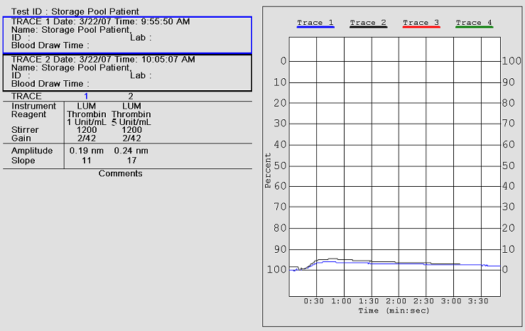
STORAGE POOL DISEASE - CASE STUDY
LUMI-AGGREGATION
with Thrombin @ 1 and 5 Units/mL
Reduced ATP Release
Compliments of Edward Masel, University of Rochester Medical Center, Coagulation Lab, Rochester, NY

Slide 41
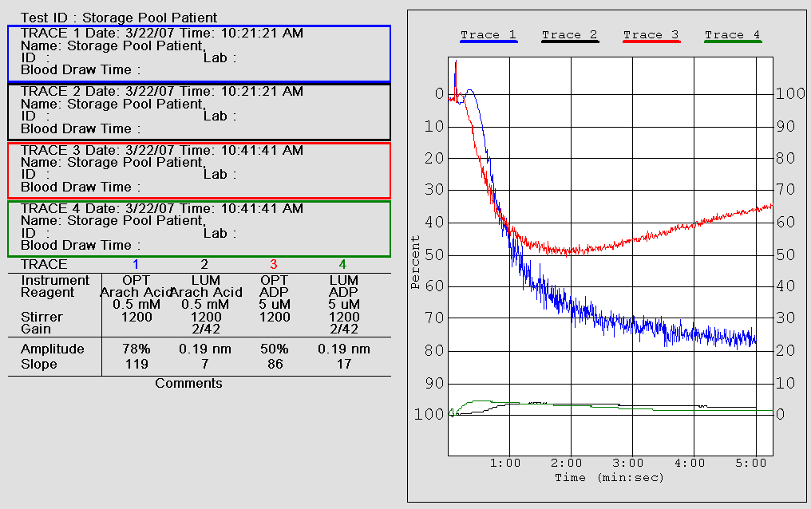
STORAGE POOL DISEASE - CASE STUDY
LUMI-AGGREGATION
with Arachidonic Acid @ 0.5mM and ADP @ 5uM
Reduced ATP Release
Compliments of Edward Masel, University of Rochester Medical Center, Coagulation Lab, Rochester, NY

Slide 42
Assay of storage pool
Platelet nucleotide pools
  Metabolic (mostly ATP) (40%)
  Storage (mostly ADP) (60%)
Storage pool assessed by ATP:ADP ratio
  lyse platelets
  convert half/all to ATP
  assay with luciferin- luciferase
ATP:ADP ratio normally <2.0
Notes:
Metabolic ATP:ADP = 8:1
Storage ATP:ADP = 2:3
Convert all to ATP using PKinase

Slide 43
Other approaches to platelets
Flow cytometry
  Useful for
    Platelet glycoproteins (BSS, GT)
    Collagen or thrombin receptors
    Annexin V (Scott syndrome )
  Requires small amount of blood and platelets
  Can identify heterozygote state
  Adaptable for platelet activation, PS expression
Genetics
  Limited applicability to date
  Can confirm MHY9 disorders
  Genetic counselling
Harrison 2011
Notes:
Some MHY9 disorders are reported to have reduced GpIb complex expression.

Slide 44
Anti-platelet therapy

Slide 45
Why pharmacological Inhibition of Platelets?
-Vascular Disease is the major cause of death in the West
-Thrombotic Occlusion is the terminal event
-At high shear rates platelets play a critical role in thrombus formation
-The presence of platelet-rich occlusive thrombi in severe clinical syndromes (e.g. Unstable angina and MI) has been shown by angiography, angioscopy and pathological studies
-Experimental studies show real time role of platelets in thrombi

Slide 46
Aspirin

Slide 47
Membrane phospholipid
PLA
Arachidonic acid
Leukotrienes
Cycloxygenase
COX-1 or COX-2
PGG and PGH2 (endoperoxides)
Tissue specific isomerases
Prostacyclin (PGI₂)
PG(E₂), PGD₂,F₂
Thromboxane A₂
Platelet activator Vasoconstrictor
Antiplatelet
Vasodilator
Notes:
47

Slide 48
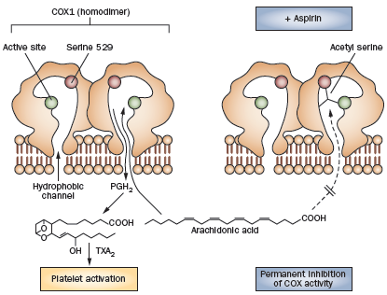
Aspirin inhibition of COX-1
Aspirin irreversibly inhibits COX-1 by acetylating a serine residue near the active site
Sweeney 2009

Slide 49
COX-1 and COX-2
COX-1
  Expressed constitutively in most tissues
COX-2
  Induced by inflammation and mitogens
COX-2 inhibitors
  Block inflammatory COX-2 activity
  Avoid effects on platelets and gastro - epithelium
BUT
  PGI2 is produced by COX-2 induced by shear in endothelial cells, hence always active as well as inducible
Notes:
49

Slide 50
Aspirin: mode of action
Irreversibly inactivates COX-1 and COX-2
  Acetylates serine residue and blocks access to catalytic site
Platelets
  cannot re-synthesise their COX-1
  Small daily dose will completely block COX dependent function of platelets (TXA2 synthesis)
In inflammatory tissues
  COX-2 is rapidly replaced after inhibition
100x more aspirin/day is needed for anti-inflammatory effect than for antiplatelet effect
Notes:
New platelets do have some COX-2.

Slide 51
Aspirin: kinetics
Platelet inhibition evident 1hr after ingestion
Plasma half life 15-20 minutes
Platelet inhibition lasts for the life of the platelet
  Mean life span of platelets 8-10 days (10-12% per day)

Slide 52
How does aspirin achieve benefit?
Aspirin irreversibly inhibits COX in platelets
Reduces platelet reactivity
Low dose aspirin inhibits platelets in portal circulation
Aspirin metabolised in liver (‘first pass’)
No circulating aspirin, no effect on prostacyclin production by ECs

Slide 53
Aspirin: complex effects
Effect on platelets is inhibitory and achieved at low doses
Effect on tissues is only manifest at higher doses
  Anti-inflammatory
  Reduces PGI₂ synthesis (actually mainly via COX-2)
Is PGI₂ synthesis important as antithrombotic?
  PGI₂-R knockout mice are thrombotic

Slide 54
Aspirin: indications and lowest effective dose
ACP 2008

Slide 55
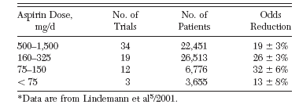
Higher doses of aspirin do not increase benefit- may be detrimental
ACCP 2008

Slide 56
The benefit of aspirin depends on the event rate in the study group
Rates are per 1000 per yr
Benefit = major vascular event prevented
Harm = major GI bleeding episode
ACCP 2008

Slide 57
Events prevented by aspirin according to risk
ACCP 2008

Slide 58
Aspirin benefits
Aspirin reduces further thrombotic events by ~25% in at-risk patients (post MI,CVA,TAI, UA)
Side effects:
  Bleeding
  GI haemorrhage
  Haemorrhagic stroke
Minimum effective dose matches that required for platelet inhibition
Side effects are related to increasing dose

Slide 59
Aspirin resistance
Some patients have thrombotic events despite aspirin therapy
Aspirin is not expected to be 100% effective
Distinguish aspirin resistance from treatment failure
Many studies show
  Failure to prolong PFA100
  Failure to suppress thromboxane synthesis
  Result in increased thrombotic events
  ? Resistance?

Slide 60
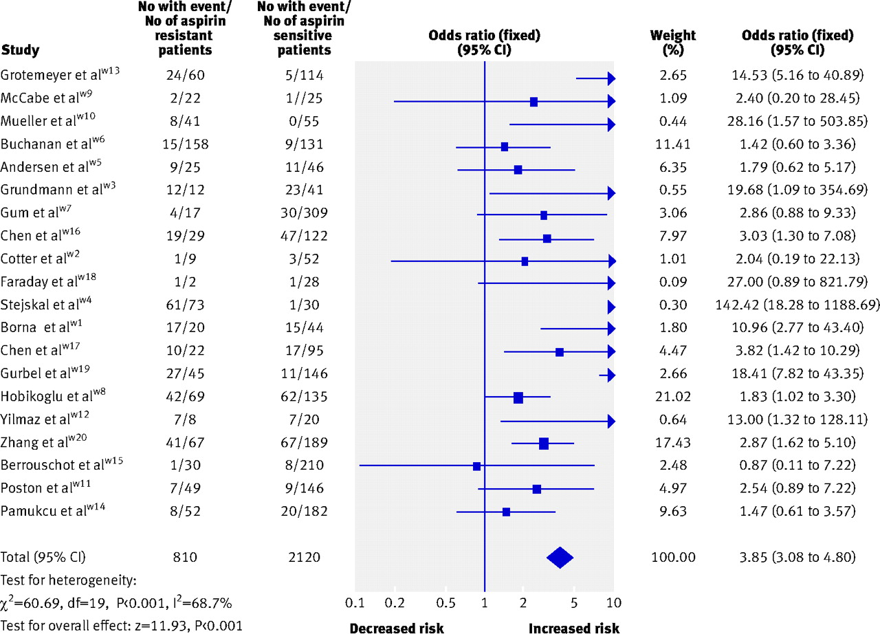
Risk of any cardiovascular event in aspirin resistant patients
Krasopoulos, G. et al. BMJ 2008;336:195-198

Slide 61
Mechanisms for continued TXA₂ production
Production by monocytes
High platelet turnover + COX-2 in new platelets
Interference by NSAIDs
Enteric coated aspirin – poor bioavailability
Reduced antiplatelet effect may also arise from:
  High levels of VWF
  Other platelet variables

Slide 62
Aspirin resistance?
190 patients on aspirin post MI
  Measured arachidonate induced platelet aggregation
Time % failure of inhibition
On treatment
9%
24hrs post observed dose of 325mg
<1%
Similar results in other studies

Slide 63
Aspirin resistance
True aspirin resistance is very rare
Not surprisingly lack of effect on platelets is associated with less benefit
Not clear from available data whether we can identify patients for whom a dose increase would be beneficial
Major advantage of antiplatelet therapy is lack of monitoring.

Slide 64
Selective COX-2 inhibitors
Analgesia and anti-inflammatory effects without GI symptoms or bleeding?
Vioxx, a selective COX-2 inhibitor licensed May 1999
By 2004 sales revenues $2.5 billion
Withdrawn by Merck
Notes:
64

Slide 65
VIOXX
VIGOR study:
  To compare Vioxx with Naproxen (tNSAID)
    reduced GI side effects.
  GI side effects reduced but excess of MI in Vioxx group
  WHY?
  2001 FDA requires warning on Vioxx labels
Notes:
65

Slide 66
Vioxx (2)
2001 APPROVE study
  Prophylaxis for colorectal polyps
  Trial terminated early due to excess of MI and CVA in Vioxx arm beginning at 18 months.
  Vioxx withdrawn.
  COX-2 dependent PGI2 production is clearly important
Notes:
66

Slide 67
ADP receptor blockade
Thienopyridines
  Ticlopidine (obsolete)
  Clopidogrel irreversible
  Prasugrel irreversible
Ticagrelor reversible

Slide 68
P2Y12 : ADP receptor target of anti-thrombotic drugs
Cys97 site of interaction of active metabolite
of clopidogrel
175
270
*
17
*
97
194
*
292
x
208
248
302
x
315
Inherited disease with absent or defective P2Y12 giving rise to a much
reduced and reversible response to ADP

Slide 69
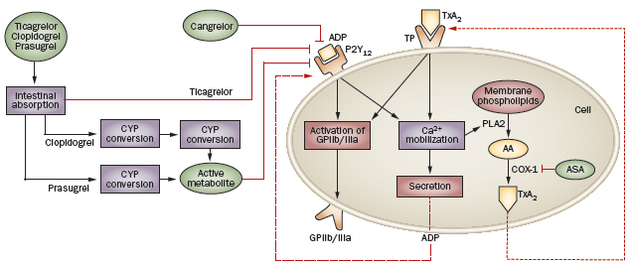
P2Y12 inhibitors
Paikin 2010

Slide 70
Clopidogrel
Prodrug- metabolised by liver CYP450 (CYP3A4 & CYP2C19)
  2 step activation process
Binds to P2Y₁₂ ADP receptor
Irreversible – effect lasts for several days
  Forms disulphide link to receptor
Achieves 50-60% inhibition of ADP induced aggregation
Bleeding time prolonged 1.5-2.0 fold
Notes:
70

Slide 71
Clopidogrel clinical benefit
1. monotherapy
CAPRIE study
  3 groups of vascular disease:
    CVA, MI and PVD
  8.7% RR reduction for vascular events
  Mostly in PVD group
  Greatest benefit in highest risk groups
  Similar bleeding rate (9.3%) to aspirin
Licensed but not recognised as superior to aspirin

Slide 72
Clopidogrel: efficacy modulators
(possible causes of resistance)
Compliance
Absorption - variable
Metabolism to active agent
  CYP3A4 polymorphisms (30% are heterozygous for loss of function polymorphism)
  Competition with other drugs (eg statins, PPIs)
ADP receptor (P2Y12) polymorphism/expression
ADP release variation
Platelet turnover
Some evidence that increased doses may be beneficial.
Possibly by overcoming poor absorption

Slide 73
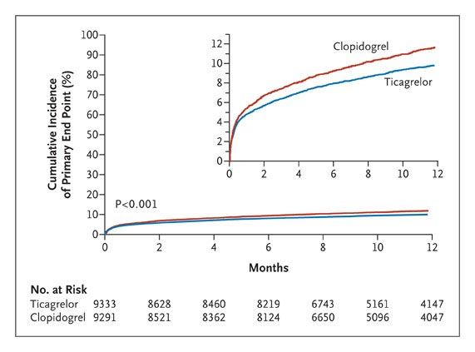
Ticagrelor: a reversible P2Y12 antagonist.
PLATO for ACS
Ticagrelor:
Reduced CV events
Reduced CV mortality
But
Did not increase bleeding
Increased non-CABG bleeding
Reduced overall mortality
Wallentin NEJM 2009

Slide 74
Dipyridamole: modes of action
Inhibits cellular reuptake of adenosine into platelets, red blood cells and endothelial cells
  Increases extracellular concentrations of adenosine.
  Platelets have many A2A (7-spanning, G-coupled) receptors
Inhibits adenosine deaminase causing further increased levels of extracellular adenosine.
  Adenosine binds adenosine receptors to increase cAMP via adenylate cyclase.
Inhibits phosphodiesterase which normally breaks down cAMP.
  Elevates cAMP level in platelets
Elevated cAMP impairs platelet aggregation and causes arteriolar smooth muscle relaxation.

Slide 75
Dipyridamole: efficacy
Original preparations had very variable absorption and old trial data unreliable
IV administration caused side effects
Modified release preparation of benefit in combination with aspirin post TIA or stroke
  22% risk reduction cf aspirin alone
  Little or no increase in bleeding
  Stopped 3x more frequently than aspirin
    Mainly due to headache

Slide 76
IIbIIIa blockade
The fibrinogen receptor

Slide 77
The αIIbβ3 integrin
(GPIIbIIIa)
Coller Blood 2008

Slide 78
IIb IIIa blockade
Abciximab – humanised Mab
  ~80000 receptors per platelet
  At 80% occupancy aggregation is abolished
  >90% occupancy bleeding time extremely prolonged
  Effect of Abciximab lasts 24 hours in most and <48 hours in all patients

Slide 79
IIbIIIa blockade
Tirofiban – nonpeptide tyrosine derivative
  Achieves >95% of ADP induced platelet aggregation
  Half life of effect <4 hours
Eptifibatide- synthetic cyclic heptapeptide
  Modelled on snake venom
  Achieves >95% of ADP induced platelet aggregation
  Half life of effect on platelet agg ~ 4 hours
  Bleeding time returned to normal 1 hour after infusion
All associated with increase in bleeding

Slide 80
Efficacy of IIbIIIa blockade
Licensed for ACS and PCI
  Most patients will also have Aspirin, Clopidogrel and heparin +/- fibrinolytic
  Early trials suggested additional benefit
  Later trials and meta-analyses suggest small incremental benefit – 2-9%
  Possible absolute 1% reduction in MI or death offset by 1% increase in major bleeding
Uncertain place in therapy

Slide 81
New targets for antiplatelet therapy
P selectin
CD40L
More potent/specific ADP blockade
GpIb –VWF blockade
Thromboxane receptor blockade
Notes:
Pselectin elevated in pts with coronary syndromes
CD40L released by platelets activates endothelial cells. Generates inflammatory response and TF expression.
Releases CAP and metalloproteinases from monocytes poss leading to plaque rupture.
ADP blockade reduces both coagulant function and inflammatory effects of platelets.
Different PY receptors are targets.

Slide 82
Combination therapy
Aspirin + Clopidogrel
  for 1yr post ACS
  for 1 yr with bare metal stent
  ≥ 1 yr with drug eluting stent
Aspirin + Dipyridamole
  Secondary stroke prevention (NICE)
Combination therapy further increases bleeding risk but yields a net benefit when the risk of thrombosis is high

Slide 83
Combination therapy
Warfarin + aspirin (38% of pts in USA)
  PCI plus AF
    No clear benefit and increases bleeding
    Poss benefit for metal VR (but old data)

Slide 84
Lessons from anti-platelet trials
Benefit of anti-thrombotic effect may be offset by bleeding
Likelihood of benefit depends on the level of risk/incidence in the study population

