Slide 1
Pathophysiology of
Von Willebrand Disease
Carolyn Millar
Imperial College London

Slide 2
Learning outcomes
By the end of this lecture the student should be able to:
Describe factors that affect VWF level
Understand why some properties of VWF make its measurement challenging
Describe the tests used to assess VWF level and functions
Explain how the principles and results of the tests allow von Willebrand disease to be classified and be familiar with the abnormalities found in each subtype
Describe basis of VWD inheritance and available treatment

Slide 3
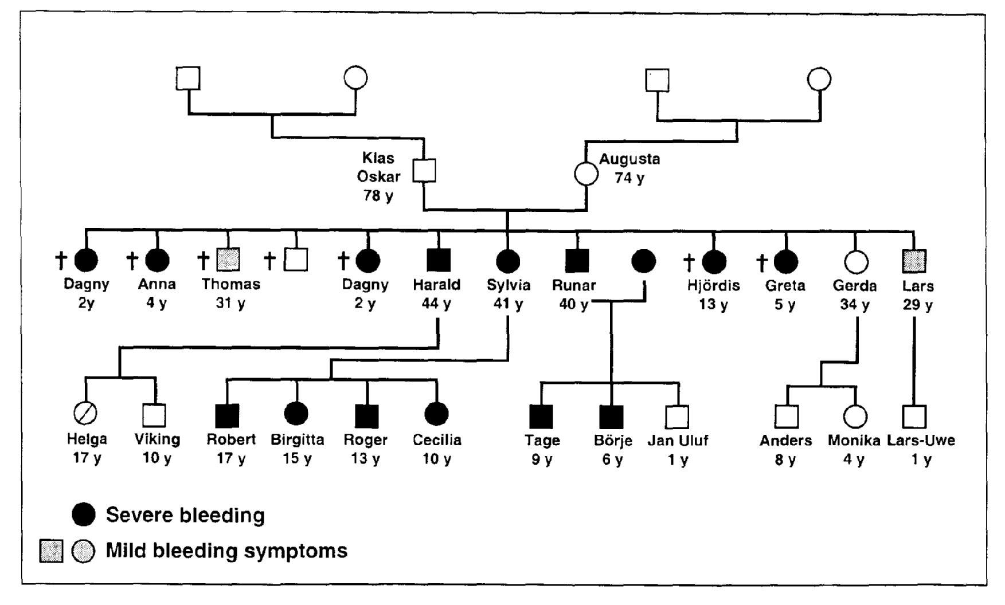
Von Willebrand Disease: Original kindred

Slide 4
Von Willebrand Disease
A quantitative or qualitative deficiency of VWF leading to an increased tendency to bleeding.
Defect of primary haemostasis
  Prolonged bleeding time, mucocutaneous bleeding
Reduced level of Factor VIII
  Coagulation defect – deep bleeding
Generally mild to moderate severity.
Most common inherited bleeding disorder in humans
  Population prevalence ~1%(Rodeghiero 1987)
  Prevalence of symptomatic VWD ~1 in 10 000(Bloom 1991)
  ~8000 patients registered in UK

Slide 5
VWF: recap on the basics
VWF functions
1. Form a bridge between damaged vessel wall
and platelets (under high shear)
2. Stabilise and protect Factor VIII

Slide 6
VWF is a multi-domain protein
Furin
ADAMTS13
Propeptide
VWF
SP D1 D2 D’ D3 A1 A2 A3 D4 B123 C1 C2 CK
FVIII
Heparin
GpIb
Heparin
Collagen
Collagen
GpIIb/IIIa
Multimer
Dimer
1. Multiple functional sites

Slide 7
VWF assembly
C
Cell
N
Plasma
ADAMTS 13

Slide 8
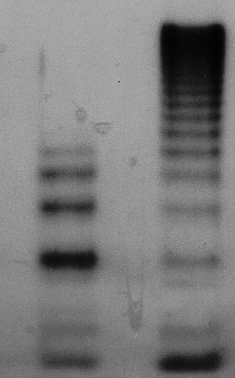
VWF function depends on multimeric composition
VWF
VWF multimeric size
UL-VWF
VWF
GpIb
&
Collagen
Binding
Affinity
VWF
monomer
2. Multimeric structure

Slide 9
Not all VWF is in the plasma
Plasma
Platelet α granules
Constitutive path (95%)
Weibel-Palade bodies
Regulated path (5%)
Golgi
ER
Sub endothelial
matrix
Ablumenal
3. Multiple pools of VWF

Slide 10
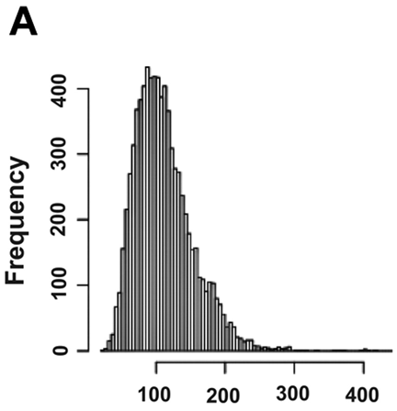
Wide normal range(s)
Normal values vary over approximately 6 fold range
VWF:Ag
Campos M et al. Blood 2011;117:5224-5230

Slide 11
VWF plasma levels
VWF plasma levels vary over a six fold range
  Normal range: 40 – 240 IUdL⁻¹
VWF levels are elevated at birth
  Fall to baseline levels by ~ 6 months of age
VWF levels rise slowly with age (~10 IUdL⁻¹ per decade)

Slide 12
Factors affecting VWF level
Genetic
Environmental/ Physiological
  Age
  Stress
  Exercise
  Pregnancy
  OCP/HRT
  Thyroid disease
  Venepuncture
  Inflammation
ABO blood group
20%
40%
40%
Ethnicity
?? Other modifiers

Slide 13
Influence of ABO blood group on VWF:Ag
VWF:Ag
Geometric mean
± 2SD
35.6 - 157.0
48.0 - 233.9
56.8 - 241.0
63.8 - 238.2
VWF :Ag
Geometric mean
74.8
105.9
116.9
123.3
ABO type
O
A
B
AB
n
456
340
196
109
Overall 100 50 - 200
Gill 1987

Slide 14
Problems with assessing VWF
Important?
Multiple binding interactions Yes
Multimeric structure Yes+/-
Not all VWF is in the plasma No
ABO group and normal ranges No
Effects of stress and age Yes
In vivo function is shear dependent No

Slide 15
Measuring VWF
Antigen (VWF:Ag)
Platelet binding (VWF:RCo)
Collagen binding (VWF:CB)
Factor VIII binding (VWF:FVIIIB)
Multimeric structure
Ristocetin sensitivity (RIPA)

Slide 16
VWF Quantitation: Antigen
Laurell rocket
ELISA
Immunoturbidimetric
Y
Y
Y
Y
Y
Y
Y
Y
VWF
Y
Y
Y
Y
Y
Y
Y
Y
Y
Y
Y
Y
Y
Y
Y
Y
Y
VWF:Ag assays
Accurate, sensitive, automated
Reliable, low CV
Basic information, useful for typing
No functional information

Slide 17
VWF:RCo - platelet dependent function
Test plasma (VWF)
Fixed washed platelets
Ristocetin A
Ristocetin A
Glycopeptide antibiotic
Nocardia lurida
Dimerises
Platelet
Platelet
Platelet
GPIb
VWF

Slide 18
VWF:RCo
Test plasma (VWF)
Fixed washed platelets
Ristocetin alters VWF configuration and makes A1 available for GPIb binding.
Platelets agglutinate (passive)
Agglutination measured in aggregometer as decreased turbidity
Platelet
Platelet
Platelet

Slide 19
VWF:RCo platelet dependent function
Ristocetin is an antibiotic; binds to VWF and platelets
Agglutinates platelets in presence of VWF; measured by aggregometer but can be automated
Requires HMWM with functional GPIb-binding site
Critical VWF binding function, but poor reproducibility
Performed with excess Ristocetin and dilutions of plasma

Slide 20
Ristocetin induced platelet agglutination (RIPA)
Test of sensitivity to ristocetin
Performed with undiluted plasma
Limiting concentrations of ristocetin
Diagnostic test for Type 2B VWD (or ‘platelet type’ VWD)

Slide 21
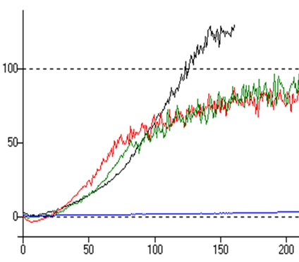
RIPA and Type 2B VWD
Ristocetin 0.5 mg/ml
Ristocetin 0.75 mg/ml
Ristocetin 1.5 mg/ml
Ristocetin 0.25 mg/ml
Agglutination at ristocetin 0.7mg/ml or less is abnormal

Slide 22
Collagen binding activity (VWF:CB)
VWF has two collagen binding domains
  A1 – binds Collagen types I, III and VI
  A3 – binds Collagen types I and III
VWF binds collagen at rest and under flow
  some binding only seen under flow conditions
Requires HMWM with functional collagen binding site

Slide 23
Collagen binding assay
APAAP conjugated
Anti-vWF antibody
Test vWF
Collagen bound to ELISA plate

Slide 24
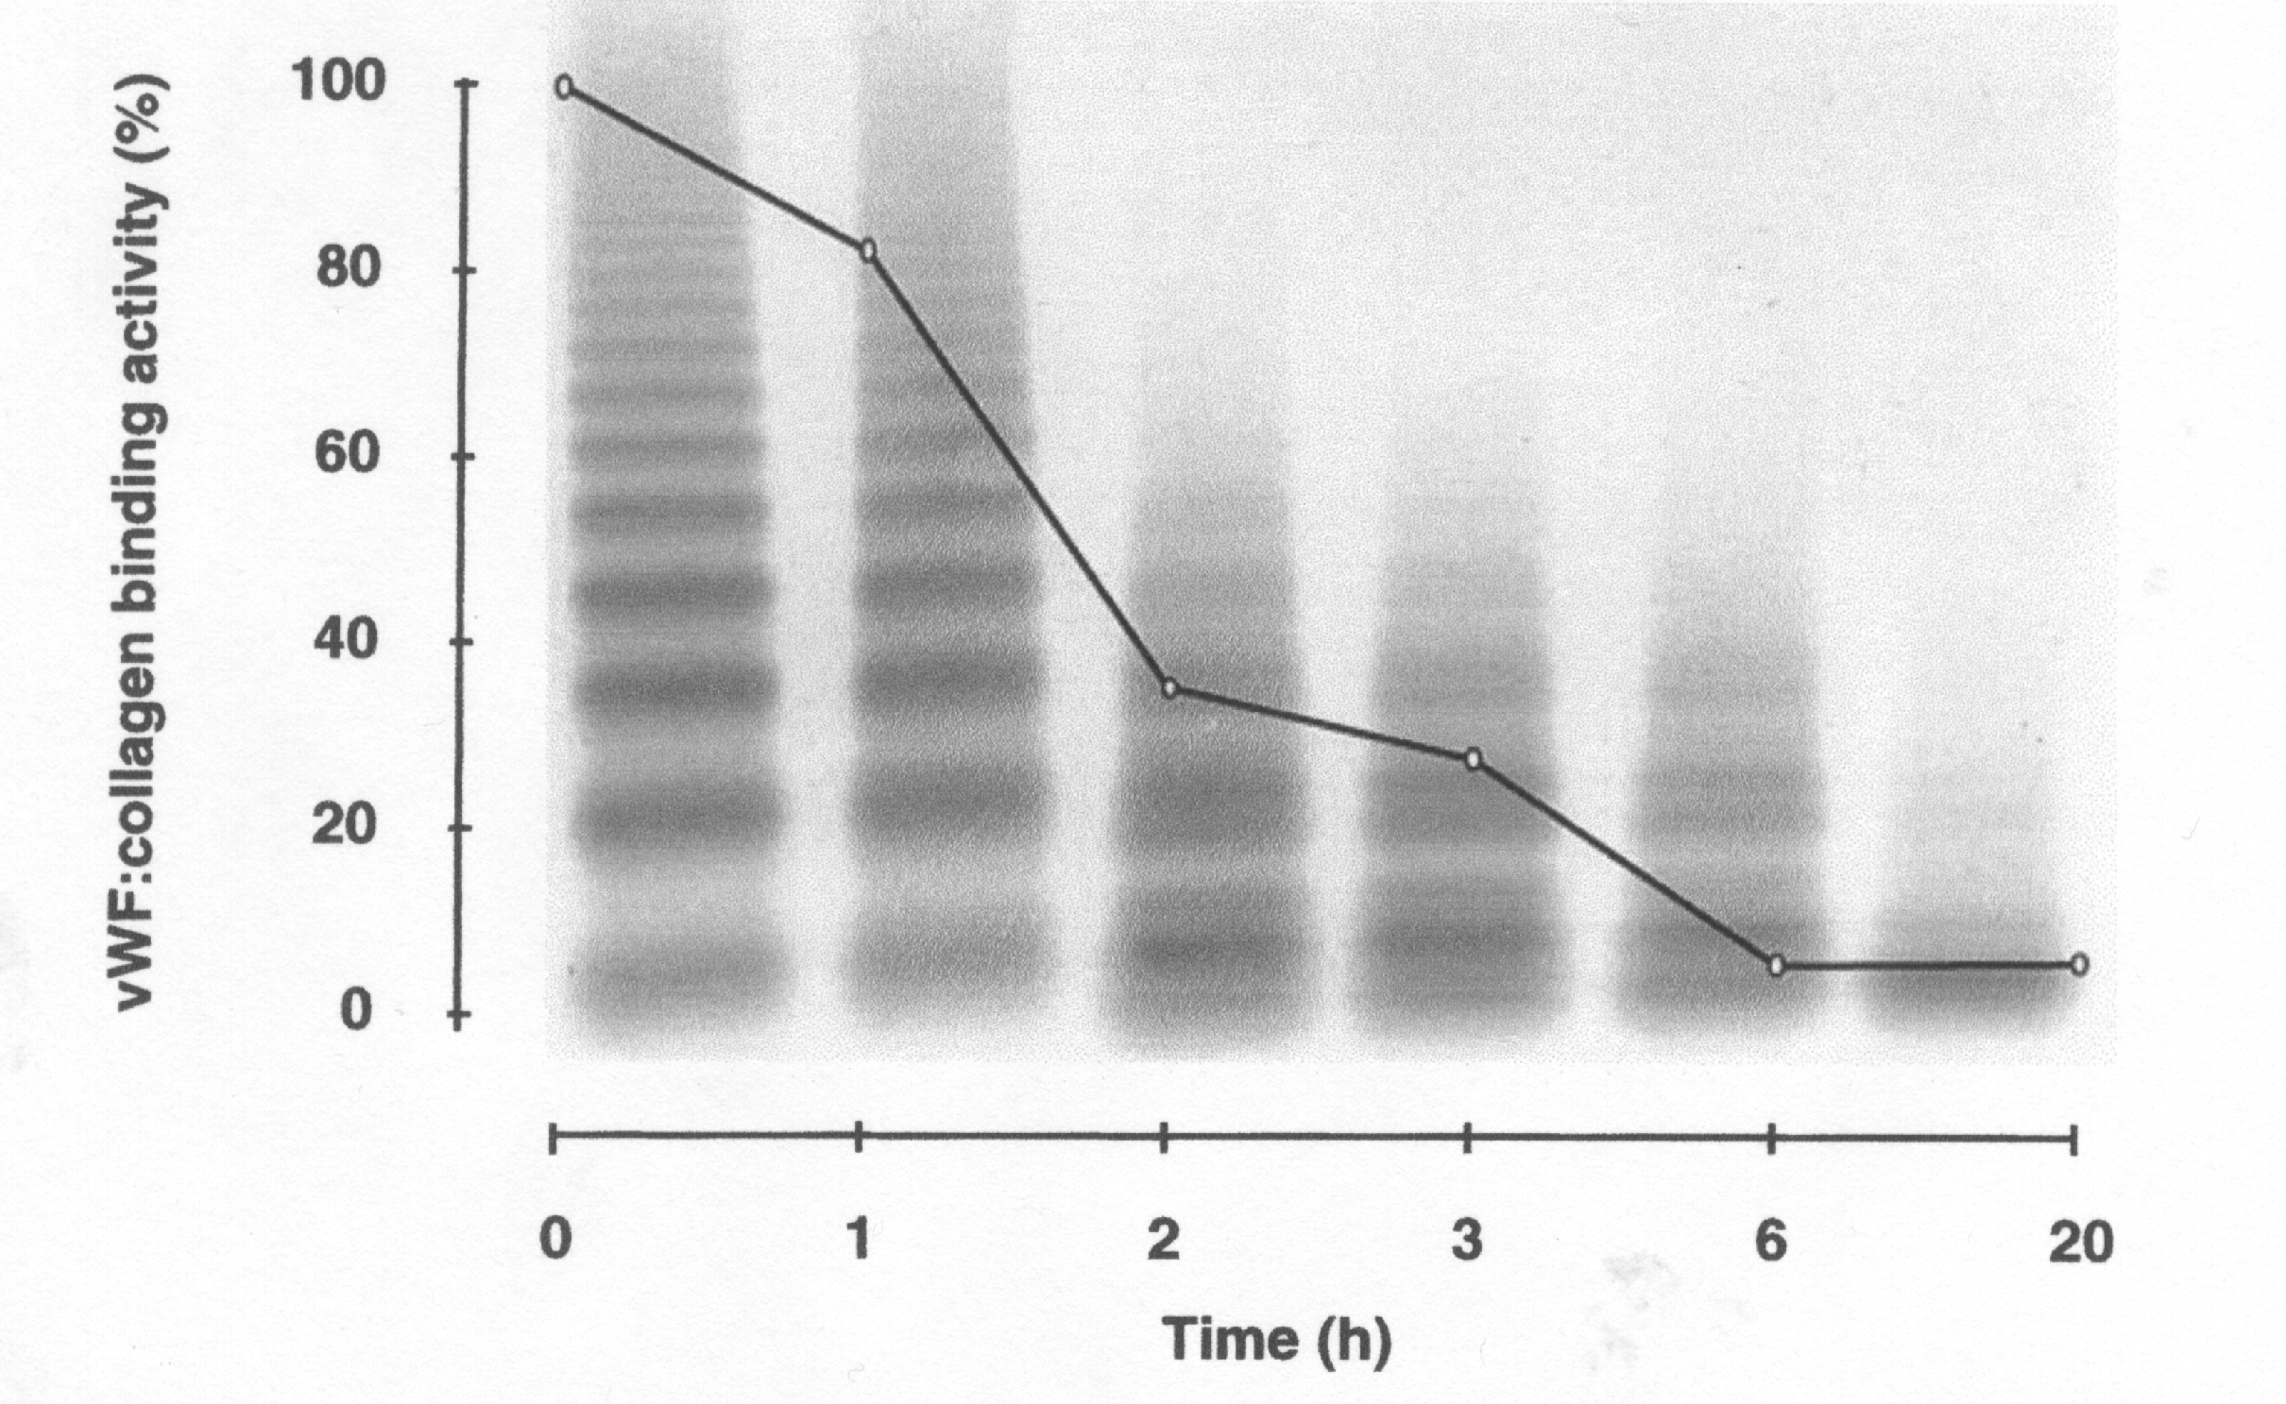
Collagen binding assay: sensitive to multimeric composition
Siekmann 1998

Slide 25
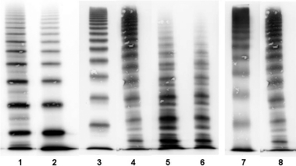
VWF: multimer analysis
Dimerisation Mulimerisation NP 2B 2A 2M (sm)
Budde 2008

Slide 26
Factor VIII binding capacity of VWF (VWF:FVIIIB)
FVIIIc APTT based assay
ELISA based binding assay:
Chromogenic assay for FVIII
Or
ELISA
Xa
Test VWF with endogenous
FVIII removed
rFVIII
Anti VWF

Slide 27
VWF Factor VIII binding (VWF:FVIIIB)
Diagnostic test for VWD Type 2N
Can identify heterozygotes
(Heterozygotes have normal FVIII)
Genetic tests may substitute
100 IUdL⁻¹ is ‘normal’ for both FVIII and VWF
  But VWF is in 50 fold molar excess
  FVIII often well maintained with minor reduction in VWF
NB

Slide 28
VWD: classification
Basic principles and results of Ag and function allow classification

Slide 29
Von Willebrand Disease: Hierarchical Classification
Primary Classification
  Type 1 (75 - 80%): quantitative deficiency Function = Antigen
  Type 2 (15 - 20%): qualitative deficiency Function < Antigen (0.7)
  Type 3 (<5%): virtual complete deficiency
Secondary Classification
  Types 2A, 2B, 2M and 2N

Slide 30
Type 1 VWD
Significant mucocutaneous bleeding
  2 symptoms, 1 symptom plus BT or 1 symptom x3, BS > 4
Appropriate laboratory results
  VWF:RCo and VWF:Ag < 2SD below pop and ABO adjusted mean
  VWF is normal (Function:Ag ratio ≥0.7)
  RIPA neg, VWF multimers normal
Positive family history or appropriate VWF mutation
  One first degree relative or ≥ 2 second degree relatives
Sadler 2005

Slide 31
Type 2 von Willebrand Disease
Secondary Classification
(Function < 0.7 Antigen)
2A: decreased platelet dependent function, absent HMW multimers
2B: increased affinity for platelet GpIb (RIPA), absent HMWM, (usually) thrombocytopenia.
2M: decreased platelet dependent function, NOT caused by absence of HMW multimers.
2N: decreased affinity for factor VIII

Slide 32
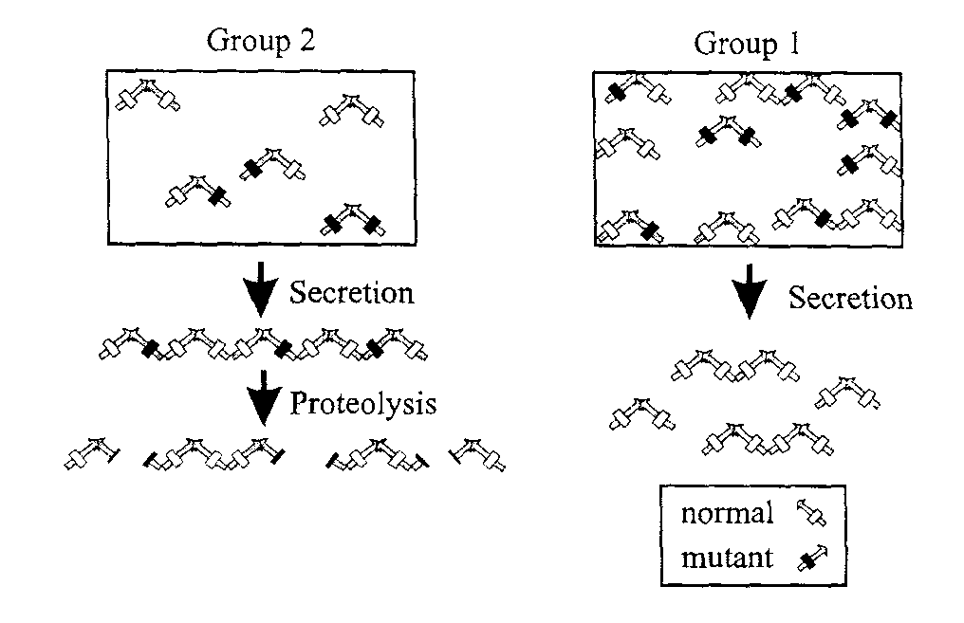
Type 2A von Willebrand disease
Other causes HMW deficiency:
Defects in dimerisation
Defects in multimerisation
intracellular proteolysis
Enhanced ADAMTS-13
-mediated proteolysis
1605-1606
↓
loss of large multimers
Intracellular processing defect
retention of VWF in ER
large multimers more likely to contain
mutant subunit: retained in ER
normal secretion of smaller multimers

Slide 33
Type 2A von Willebrand disease
Loss of platelet-dependent function with loss of HMW multimers
~60 mutations: missense
Autosomal dominant
ADAMTS cleavage
Multimerisation
Protein folding
Dimerisation
2A
2A
2A
2A
N
D1
D2
D’
D3
A1
A2
A3
D4
C1
C2
CK
C

Slide 34
Type 2M von Willebrand disease
Loss of platelet-dependent function (normal multimers)
  functional loss of VWF binding to GpIb
  Collagen binding function preserved
16 of the 18 reported mutations in A1 domain
Autosomal dominant
Type 2C – loss of CBA with normal multimers?
2M
2C
N
D1
D2
D’
D3
A1
A2
A3
D4
C1
C2
CK
C

Slide 35
Type 2B von Willebrand disease
Spontaneous VWF-platelet interaction in vivo
Platelet binding leads to:
  Thrombocytopenia
  Loss of HMWM
    Increased clearance with platelets
    Increased ADAMTS cleavage
Increased sensitivity to Ristocetin in vitro (RIPA +ve)
Autosomal dominant
2B
N
D1
D2
D’
D3
A1
A2
A3
D4
C1
C2
CK
C

Slide 36
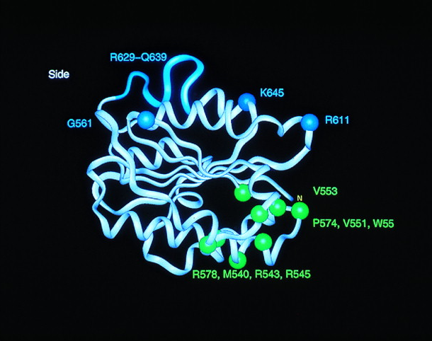
VWF A1 domain in VWD Type 2M and 2B
2M
2B
Jenkins 1998

Slide 37
Type 2N von Willebrand disease
Loss of Factor VIII binding function (FVIII<Ag)
  Normal multimers
  Normal adhesive (platelet, collagen) function
  FVIII – short half life (5-30 IUdL⁻¹)
  Looks like mild/moderate haemophilia A
Mutations in Factor VIII binding site of VWF
Autosomal recessive inheritance (males = females)
2N
N
D1
D2
D’
D3
A1
A2
A3
D4
C1
C2
CK
C

Slide 38
Type 3 von Willebrand disease
Absence of VWF
  FVIII is also low
Autosomal recessive trait
Rarely a diagnostic problem
Prevalence ~1 in 1 million/500,000

Slide 39
Type 3 von Willebrand disease
FVIII:C
VWF:Ag
VWF:RCo
FVIII:C
VWF:Ag
VWF:RCo
63 IUdL⁻¹
52 IUdL⁻¹
61 IUdL⁻¹
97 IUdL⁻¹
79 IUdL⁻¹
94 IUdL⁻¹
FVIII:C 4 IUdL⁻¹
VWF:Ag 0 IUdL⁻¹
VWF:RCo 0 IUdL⁻¹

Slide 40
Type 3 von Willebrand disease
Gene deletions
Gene insertions
Nonsense mutations
Splice site mutations
Missense mutations*
  *loss of cysteines: D3-domain, C-terminus
  Most cases compound heterozygotes
  Parents not usually affected (ie: heterozygous null mutations do not cause significant bleeding/VWD)
Null Phenotype

Slide 41
Molecular analysis of VWF gene
The Challenges
  178 kb, 9 kb coding sequence
  52 exons: Exons 2 – 18: Signal peptide, propeptide
  Partial pseudogenecopy (exons 23-34): 97% homology
Useful in clarifying VWD phenotype: targeted analysis
  Subtyping qualitative variants
  Distinguishing type 2M from type 1
  Distinguishing type 2N VWD from mild haemophilia A or carrier state
  Distinguishing type 2B from platelet-type (pseudo)
ISTH VWD Mutation Database:http://www.shef.ac.uk/vwf/

Slide 42
VWD: diagnosis
Does the patient have a significant bleeding disorder?
Is that disorder attributable to deficiency of VWF function?

Slide 43
Is bleeding due to VWD?
Are the VWF level and function abnormally low?
Is the VWF level and function low enough to cause a bleeding tendency?
Type 3 – obvious
Type 2 – usually clear
Type 1 - often unclear: ‘low VWF’ or ‘VWD’?

Slide 44
Is bleeding due to VWD?
Are the VWF level and function abnormally low?
Is the VWF level and function low enough to cause a bleeding tendency?
Type 3 – obvious: undetectable/v low VWF
Type 2 – usually clear: VWF function/Ag <0.7
Type 1 - often unclear: ‘low VWF’ or ‘VWD’?

Slide 45
Confusion of type 1 VWD
  Type 1 VWD is the most difficult to diagnose
Problems
  Many patients with VWF levels < normal range do not bleed
  Some do bleed
  Lower limit of normal is not the minimum required for effective haemostasis
  Should avoid burden of diagnosis
Paradox
  Broad distribution of normal VWF levels
  High prevalence of mild bleeding symptoms

Slide 46
Minor bleeding symptoms are common
Easy bruising 12%
Gum bleeding 7%
Frequent nosebleeds 5%
Bleeding after tooth extraction 2.5%
Post operative bleeding 1.4%
In women
Menorrhagia 23%
Post partum bleeding 6%
Family history 44%

Slide 47
History and Bleeding after tonsillectomy
non bleeding
%(228)
vWD/platelet disorder
%(31)
24
36
39
4
4.9
3.6
2.7
67
68
69
47
39
30
22
Easy bruising
Frequent bruising
Epistaxes
>10mins
Bruises >1 site
Large bruises
Haematomata
Nosek-Cenkowska 1991

Slide 48
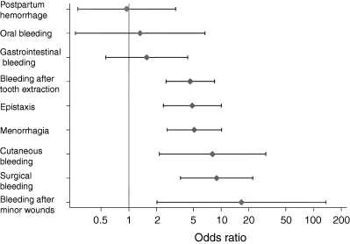
Bleeding symptoms and type 1 VWD
Tosetto 2005
(AFM vs UFM)
Notes:
.

Slide 49
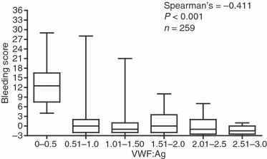
Standardised history: Bleeding score
Score | -1 | 0 | 1 | 2 | 3
Tooth extraction | no, trivial, none done | <25% of all procedures, no intervention | >25% of all procedures, intervention | Resuturing or packing | Blood transfusion, replacement therapy, desmopressin
Repeat for oral cavity, minor wounds, GI, epistaxis etc.
BS <4 is normal
Bowman et al. JTH 2008; 6: 2062-6,

Slide 50
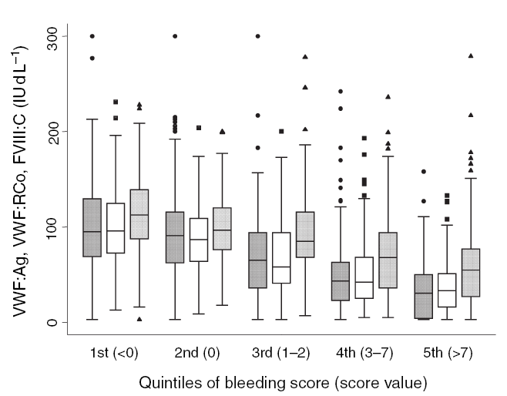
VWF level and Bleeding Score in Type 1 VWD
Tosetto 2006

Slide 51
European Type 1 study
VWF<30: likely to bleed, mutation likely
  = VWD
VWF>30 ;
  only 50% linked to VWF gene (41% in Canada study)
  Bleeding symptoms not significantly linked to VWF gene
  High proportion group O
  Do not routinely label as ‘VWD’
There is no definite threshold for bleeding/non bleeding

Slide 52
VWD: management
What is the appropriate treatment?

Slide 53
Choice of therapy for VWD
Nothing
Tranexamic acid
Desmopressin (DDAVP)
Replacement
  Intermediate purity FVIII-VWF concentrate
  High purity VWF
  Cryoprecipitate
  Platelets (VWF in α granules)
  (Recombinant VWF)

Slide 54
VWD therapy – desmopressin response
Type 1 - most except the most severe
- most combined (‘low VWF’) defects
Type 2 - limited or inadequate response
Type 3 - No

Slide 55
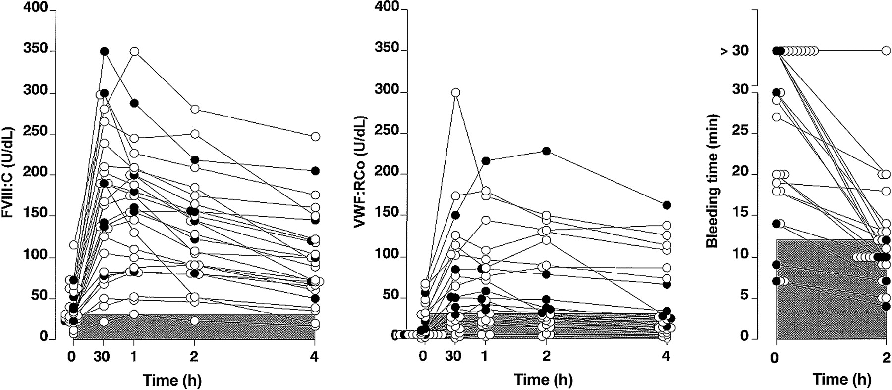
DDAVP response in Type 1 VWD
Federici 2004

Slide 56
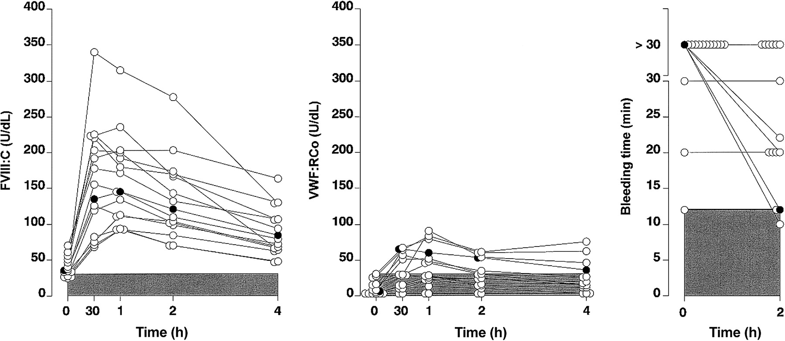
Response to DDAVP in type 2A VWD
Federici 2004

Slide 57
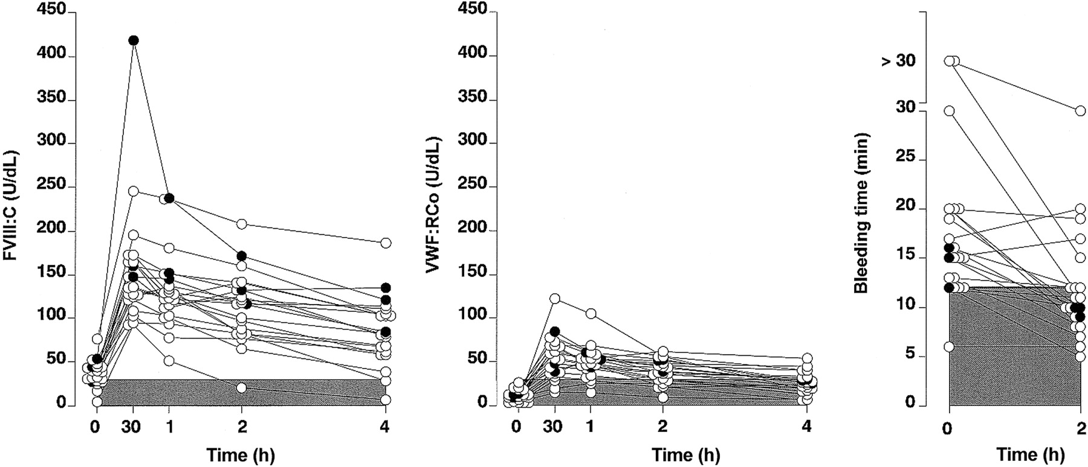
Response to DDAVP in type 2M VWD
Federici 2004

Slide 58
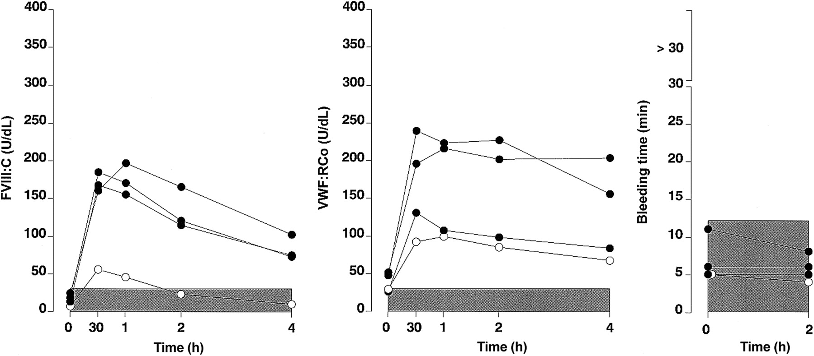
DDAVP response in Type 2N VWD
Federici 2004

Slide 59
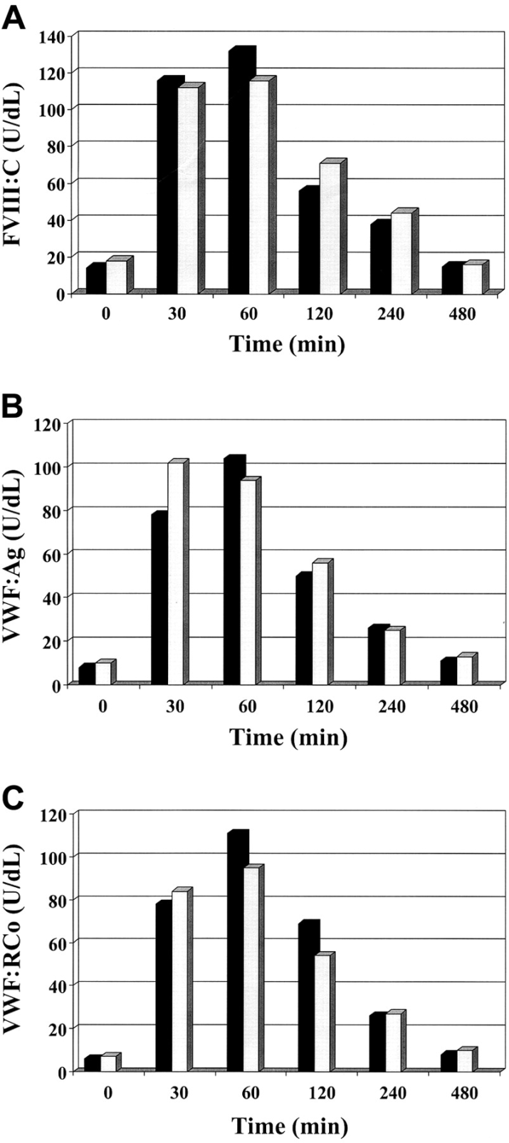
Problems with DDAVP
Response
  Variable
  Tachyphylaxis
  ‘Vicenza’ type VWD with rapid clearance
  Type 2N
Adverse events
  Hyponatraemia in young (<2)
  Thrombosis in elderly (>60 or with atherosclerosis)

Slide 60
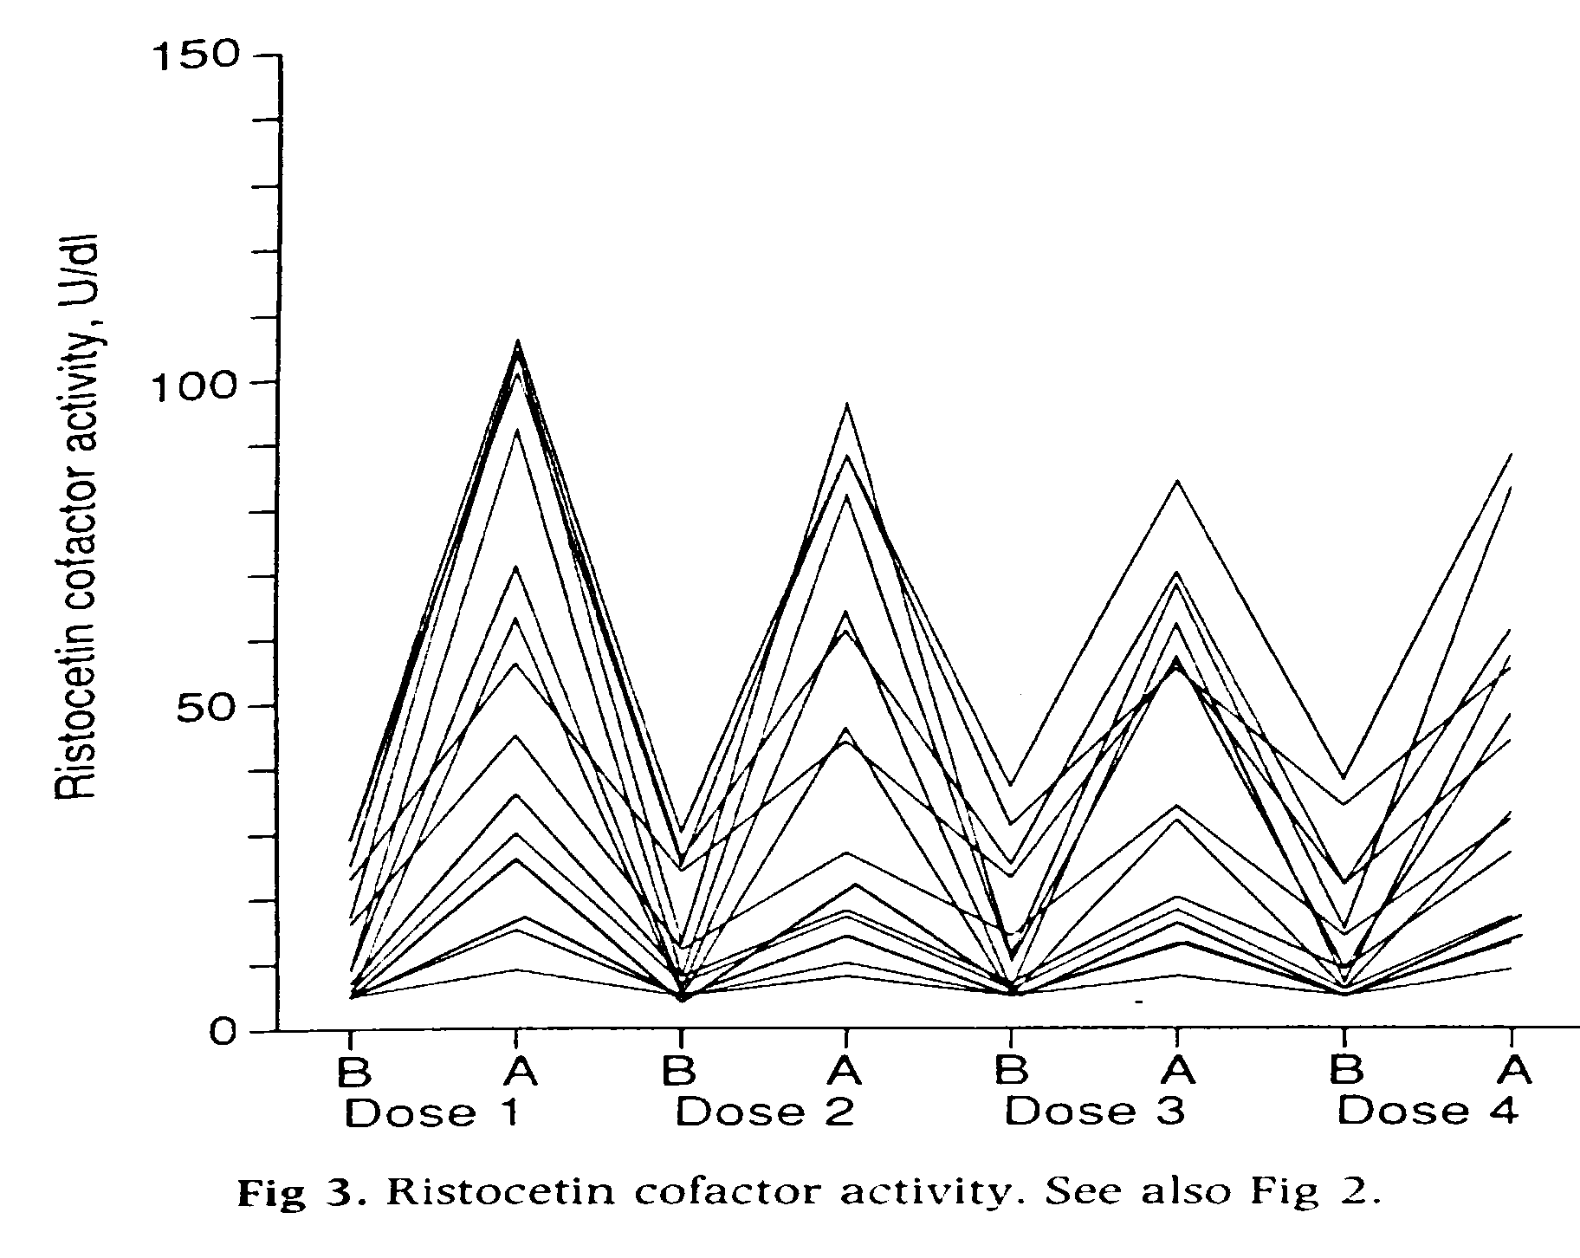
NB: Tachyphylaxis
Mannucci 1992

Slide 61
VWD: inheritance
What is the likelihood that other members of the family will be affected?

Slide 62
Will other family members be affected?
Type 1 Autosomal dominant
            Heritability varies with severity
            Interaction between mutant and normal subunits leading to VWF reduction of >50%: Dominant negative effect
            Recessive effect: co-inheritance with null allele
            Mild forms show non-segregation and incomplete penetrance
Type 2
  2A Autosomal dominant (occ. recessive)
  2B Autosomal dominant
  2M Autosomal dominant
  2N Autosomal recessive
Type 3 Autosomal recessive
            Not homozygous Type 1

Slide 63
Type 1 VWD
Incomplete penetrance
Highly penetrant
Heritability - LOW
Heritability - HIGH
Dominant negative
VWF mutations
VWF mutations
+
ABO blood group
+
VWF polymorphisms
+
Other genetic modifiers
50 IUdL⁻¹
VWF level
0 IUdL-1

Slide 64
Summary
The student should now be able to:
Describe factors that affect VWF level
Understand why some properties of VWF make its measurement challenging
Describe the tests used to assess VWF level and functions
Explain how the principles and results of the tests allow von Willebrand disease to be classified and be familiar with the abnormalities found in each subtype
Describe basis of VWD inheritance and available treatment

Slide 65
References and links
Pathophysiology and classification VWD
  JTH. 2006 Oct;4(10):2103-14.
Bleeding score:
  http://www3.interscience.wiley.com/journal/121429621/suppinfo
  JTH 2008; 6: 2062-2066
UKHCDO diagnostic guidelines:
  Haemophilia 2004 10 199-217, 218-231
USA guidelines
  http://www.nhlbi.nih.gov/guidelines/vwd/index.htm
  Haemophilia 2008 14 171-232
VWF database: http://www.vwf.group.shef.ac.uk/

