Slide 1
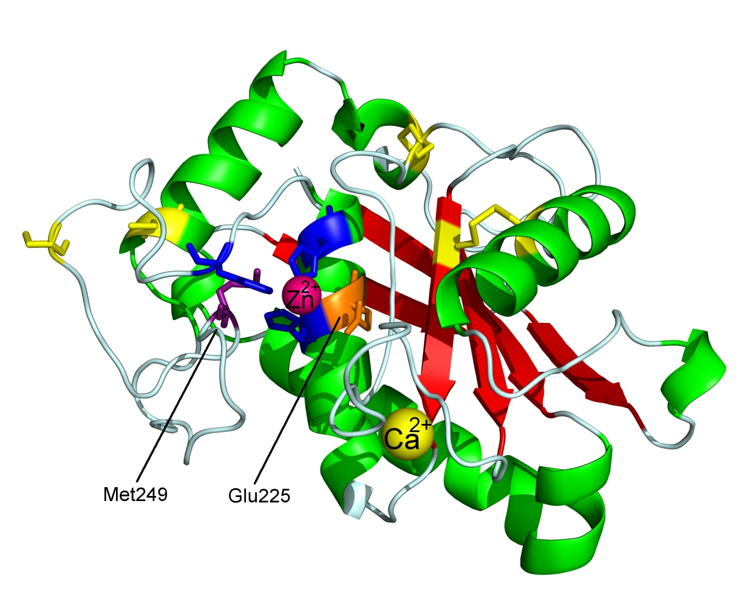

Molecular Modeling
Deriving and Visualising Protein Structures
Dr Rens de Groot
(r.degroot@ic.ac.uk)

Slide 2
Learning Objectives
Why protein structures are important
How protein structures are derived
What is being shown in protein molecular graphics pictures of different types
What you can do with molecular graphics
What you need to produce your own molecular graphics
To download a structure from the PDB Database and produce a graphic in Pymol.

Slide 3
Why are protein structures useful?
Understanding the effect of gene mutations
Understanding how drugs affect enzymes
Understanding research papers
Essential tool in research

Slide 4
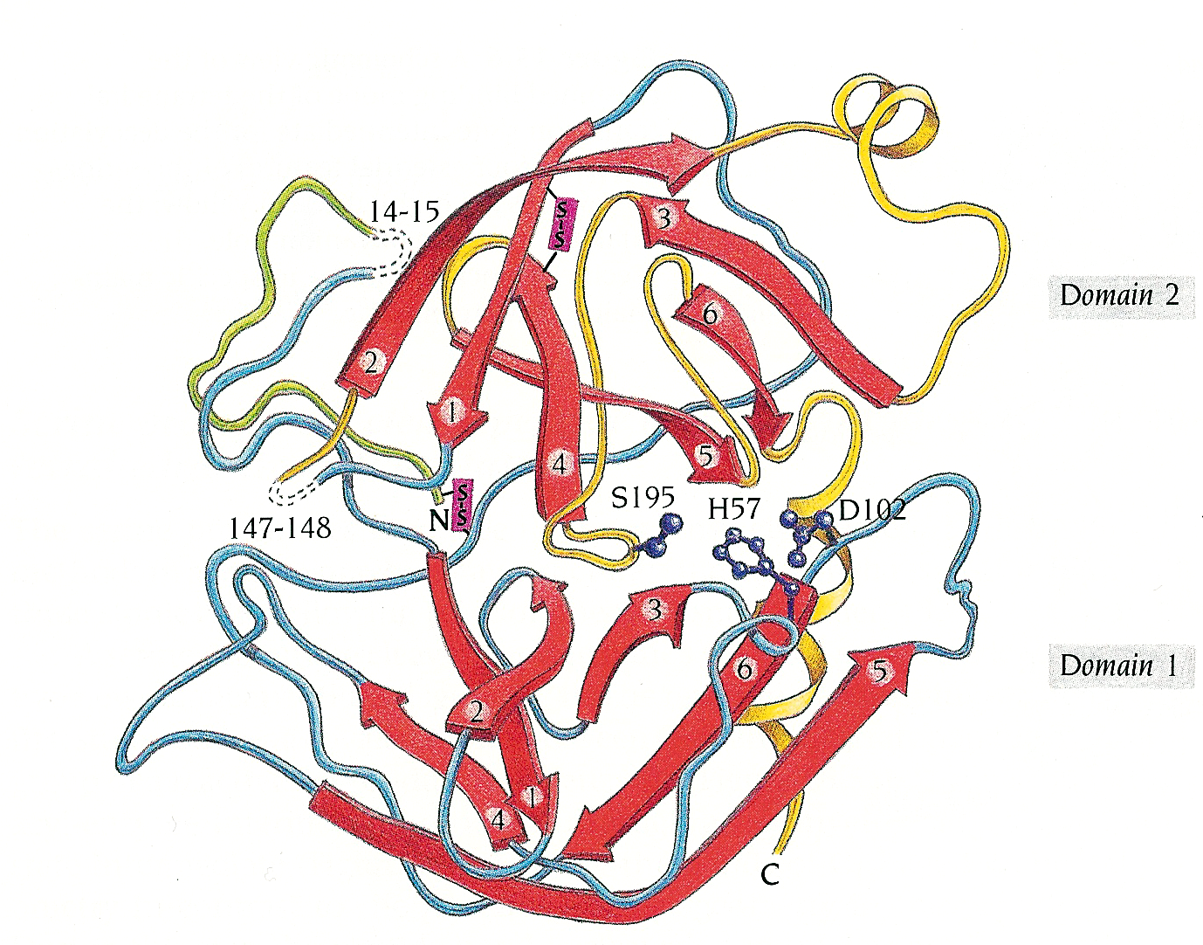
- Protein shape determines activity
For Example: the Serine protease domain
Factor IXa
Factor Xa
Factor VIIa
Thrombin
Activated Protein C

Slide 5
Explaining disease mutations
Protein structures allow you to see the location of a missense mutation.
A mutation in the core of a domain often leads to misfolding, a failure to secrete protein from the cell and therefore low plasma level. (Type I mutations: most common)
Some mutations cause disease because they are in a functionally important part of the protein (Type II mutations: less common).

Slide 6
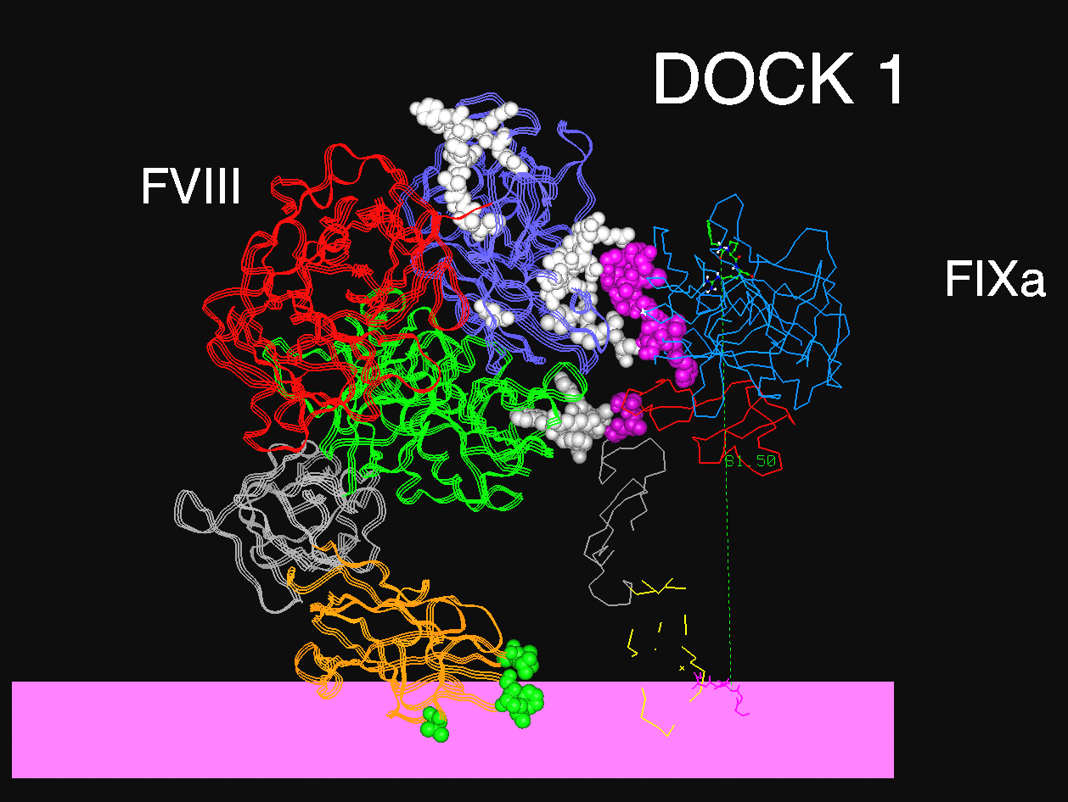
Explaining disease mutations
Haemophilia A
Haemophilia B
Haemophilia B
Haemophilia B
Haemophilia B
PD
EGF 1&2
GLA
Haemophilia B
Haemophilia A
Platelet membrane

Slide 7
What is
Molecular Graphics?
Simply: manipulating computer-generated images which ACCURATELY represent molecules of interest, in order to try and understand how the molecules function and interact

Slide 8
What can you do with Graphics?
Show representations of molecules (proteins most commonly) in different presentation styles, colours &c
Explain functional features (e.g. enzymatic activity or receptor binding) at molecular level
Qualitatively interpret amino acid substitutions (missense mutations) in disease states
Hypothesise about unknown structures or interactions
Explain functional features (e.g. enzymatic activity or receptor binding) at molecular level

Slide 9
Types of molecular representation
(simple >>> complex)
Ball and Stick
Secondary Structure
Spacefill
Surfaces

Slide 10
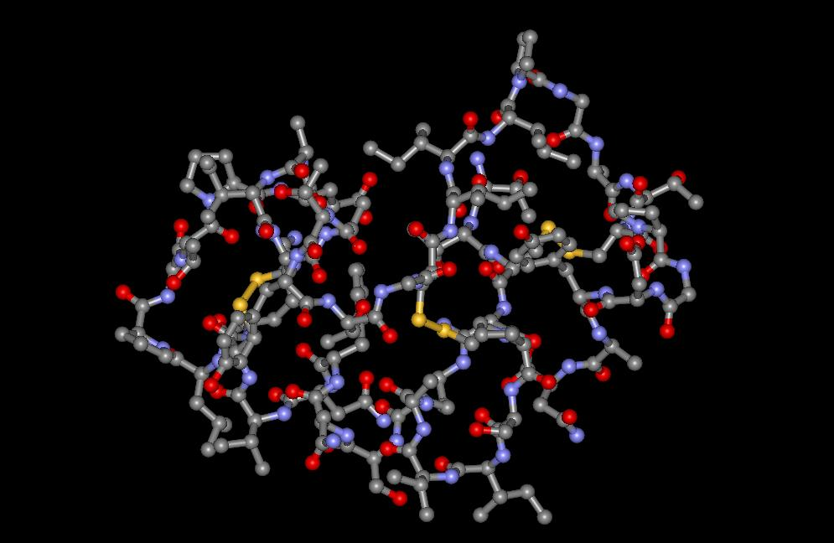
Ball and Stick: allows view of individual atoms within molecule
PRO: clear view of interior of molecule
ANTI: partial view only – important features may be completely ignored; no sense of “density”

Slide 11

Secondary structure (Cartoon)
Alpha-Helix
Beta strands (sheet)
PRO: Good global view of “domains”.
Universal representation style so viewer can orient easily
Genuine indication of rigid conserved regions of the structure
ANTI: no surface

Slide 12
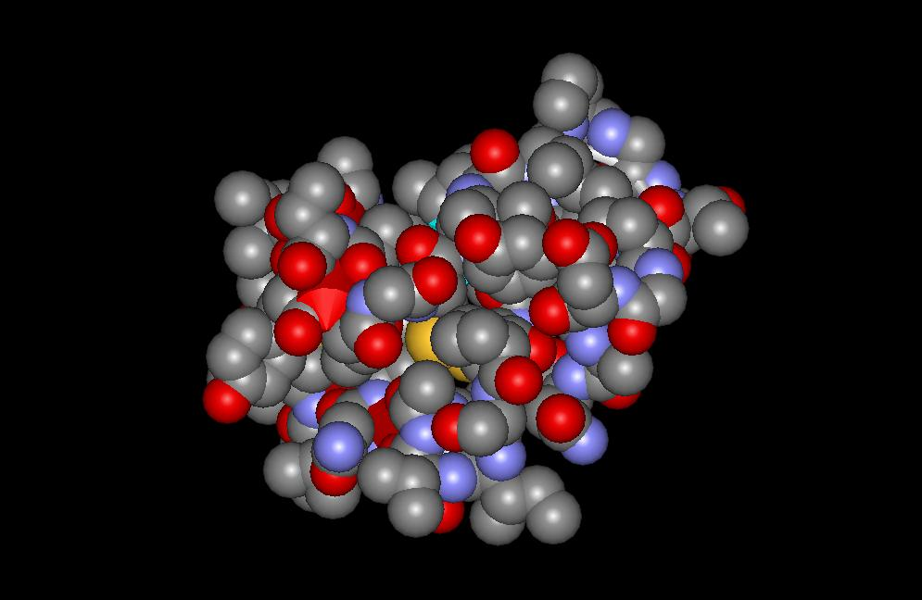
Spacefill: the atoms are shown as opaque spheres.
DS Viewer Pro 5.0 (PC)
PRO: Fairly accurate representation of overall “globular”
shape
ANTI: inner structure invisible

Slide 13
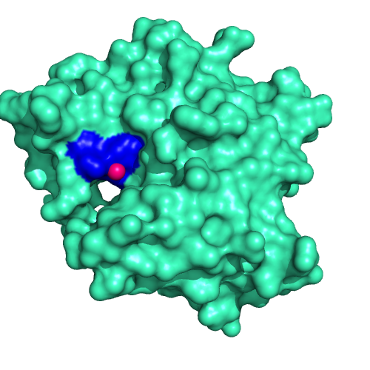
Surface representation
Very accurate and most “realistic”

Slide 14
Surface representation
One can show Charge (usually red for negative charge and blue for positive)
Also can plot surface hydrophobicity

Slide 15
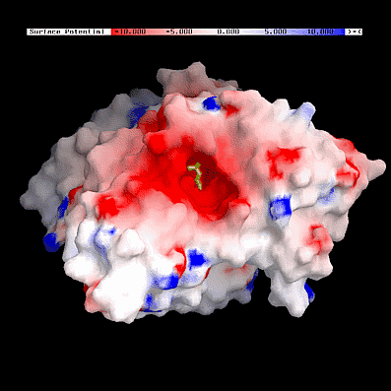
Surface Charge
RED – negative
charge
BLUE – positive
charge
Can genuinely explain strength of interactions resulting from charge & shape

Slide 16
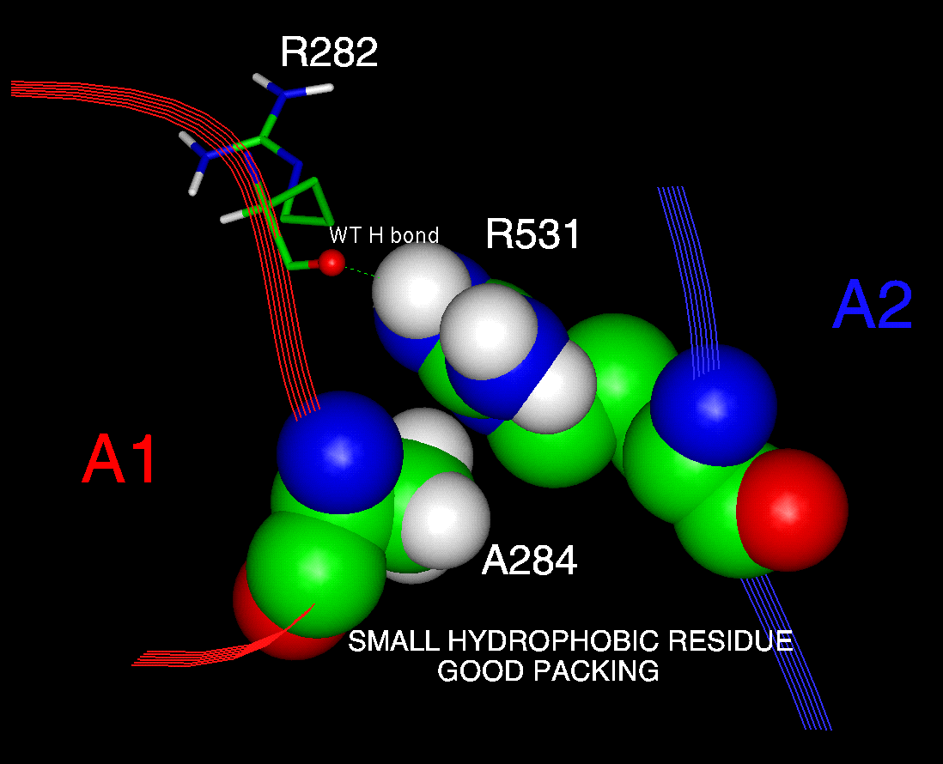
Styles can be mixed for optimum effect
INSIGHT II (Unix)
Ball & Stick
Spacefill
Ribbon

Slide 17
How are these structures derived?
X-ray crystallography
NMR (nuclear magnetic resonance) Spectroscopy
Homology modelling (prediction of structure)

Slide 18
X-ray crystallography
X-ray crystallography: very high resolution (<1A possible)
BUT: need large amounts of pure protein
BUT: may take thousands of trials before crystals are obtained – or never
BUT: gives static picture

Slide 19
NMR
NMR: high resolution
Protein only needs to be soluble (no crystals needed)
Gives mobility information as well
Need only medium amounts of pure protein
BUT: upper limit on molecular size and complexity – good for small domains

Slide 20
Homology modelling
Homology modelling: medium resolution only
No wet lab work required!
Automated webservers can deliver in minutes
BUT: structure of homologous protein needed
BUT: accuracy is limited and predictions can be flawed

Slide 21
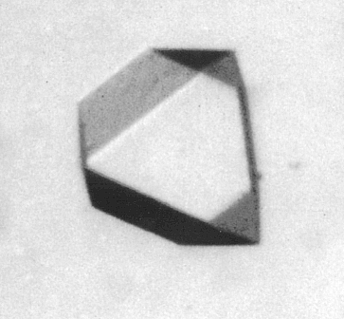
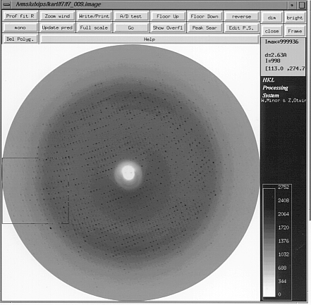
Crystallisation & X-Ray Crystallography
>100mg recombinant protein made and purified
>500 crystallisation trials
0.1mm crystals formed
Crystal exposed to X-Rays at synchrotron
Data collected to 2.3A
Structure solved and refined
6 months
6 months
6 months
6 months

Slide 22
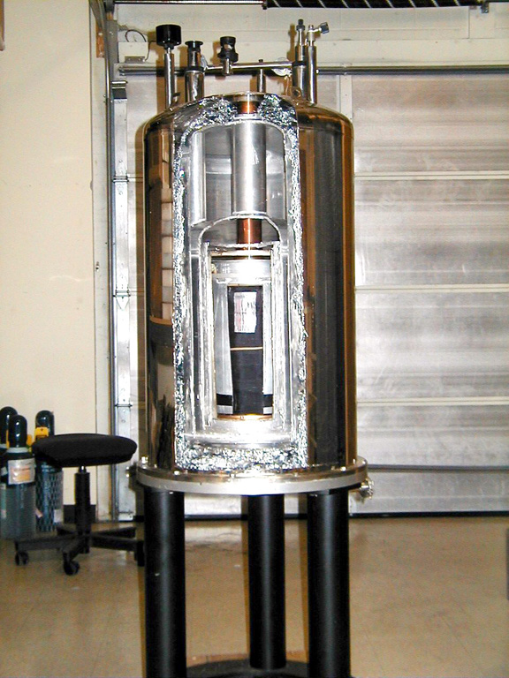
NMR Structure Solution
20mg labelled recombinant protein made and purified
NMR spectra acquired
Structure solved
3 months
3 months
6 months

Slide 23
Homology Modelling – if necessary!
Out of perhaps 35,000 human proteins, only 10% have been solved by X-Ray Crystallography or NMR
If you have the structure of a related protein, you can make a HOMOLOGY STRUCTURE instead – not as accurate, but still far better than nothing

Slide 24

What IS 3D Structure Information?
STRUCTURE FILES are simple text lists of 3D coordinates of all the atoms in a structure as derived by experiment or from homology modelling
Available freely as .PDB files from RCSB (http://www.rcsb.org/pdb)

Slide 25
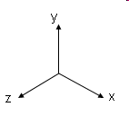
.pdb coordinates file
Atom(Nitrogen)
X Y Z
ATOM 1 N ILE A 16 10.082 14.718 31.067 1.00 28.05
ATOM 2 CA ILE A 16 10.677 13.944 32.203 1.00 30.11
ATOM 3 C ILE A 16 9.635 13.717 33.304 1.00 32.35
ATOM 4 O ILE A 16 8.993 14.657 33.769 1.00 33.31
ATOM 5 CB ILE A 16 11.878 14.683 32.845 1.00 27.74
ATOM 6 CG1 ILE A 16 12.881 15.142 31.760 1.00 29.21
ATOM 7 CG2 ILE A 16 12.534 13.769 33.863 1.00 26.70
ATOM 8 CD1 ILE A 16 13.594 13.952 31.003 1.00 30.23
ATOM 9 N VAL A 17 9.468 12.461 33.696 1.00 30.96
ATOM 10 CA VAL A 17 8.535 12.088 34.737 1.00 32.35
ATOM 11 C VAL A 17 9.405 11.884 35.954 1.00 32.99
ATOM 12 O VAL A 17 10.361 11.124 35.901 1.00 34.62
ATOM 13 CB VAL A 17 7.832 10.771 34.379 1.00 34.61
ATOM 14 CG1 VAL A 17 6.928 10.338 35.507 1.00 35.57
ATOM 15 CG2 VAL A 17 7.071 10.935 33.042 1.00 33.58

Slide 26
.pdb coordinates file
Amino Acid(Isoleucine)
X Y Z
ATOM 1 N ILE A 16 10.082 14.718 31.067 1.00 28.05
ATOM 2 CA ILE A 16 10.677 13.944 32.203 1.00 30.11
ATOM 3 C ILE A 16 9.635 13.717 33.304 1.00 32.35
ATOM 4 O ILE A 16 8.993 14.657 33.769 1.00 33.31
ATOM 5 CB ILE A 16 11.878 14.683 32.845 1.00 27.74
ATOM 6 CG1 ILE A 16 12.881 15.142 31.760 1.00 29.21
ATOM 7 CG2 ILE A 16 12.534 13.769 33.863 1.00 26.70
ATOM 8 CD1 ILE A 16 13.594 13.952 31.003 1.00 30.23
ATOM 9 N VAL A 17 9.468 12.461 33.696 1.00 30.96
ATOM 10 CA VAL A 17 8.535 12.088 34.737 1.00 32.35
ATOM 11 C VAL A 17 9.405 11.884 35.954 1.00 32.99
ATOM 12 O VAL A 17 10.361 11.124 35.901 1.00 34.62
ATOM 13 CB VAL A 17 7.832 10.771 34.379 1.00 34.61
ATOM 14 CG1 VAL A 17 6.928 10.338 35.507 1.00 35.57
ATOM 15 CG2 VAL A 17 7.071 10.935 33.042 1.00 33.58

Slide 27
.pdb coordinates file
Coordinates
X Y Z
ATOM 1 N ILE A 16 10.082 14.718 31.067 1.00 28.05
ATOM 2 CA ILE A 16 10.677 13.944 32.203 1.00 30.11
ATOM 3 C ILE A 16 9.635 13.717 33.304 1.00 32.35
ATOM 4 O ILE A 16 8.993 14.657 33.769 1.00 33.31
ATOM 5 CB ILE A 16 11.878 14.683 32.845 1.00 27.74
ATOM 6 CG1 ILE A 16 12.881 15.142 31.760 1.00 29.21
ATOM 7 CG2 ILE A 16 12.534 13.769 33.863 1.00 26.70
ATOM 8 CD1 ILE A 16 13.594 13.952 31.003 1.00 30.23
ATOM 9 N VAL A 17 9.468 12.461 33.696 1.00 30.96
ATOM 10 CA VAL A 17 8.535 12.088 34.737 1.00 32.35
ATOM 11 C VAL A 17 9.405 11.884 35.954 1.00 32.99
ATOM 12 O VAL A 17 10.361 11.124 35.901 1.00 34.62
ATOM 13 CB VAL A 17 7.832 10.771 34.379 1.00 34.61
ATOM 14 CG1 VAL A 17 6.928 10.338 35.507 1.00 35.57
ATOM 15 CG2 VAL A 17 7.071 10.935 33.042 1.00 33.58

Slide 28
Problems and Considerations
Molecules are highly complex – it will always be difficult to make your point simply without drowning in detail
There are many possible viewpoints of the same molecule – choose the best for your purpose
Need to rotate view in any direction – easy to get lost!
Different types of representation are commonly used –spacefill/cartoon/surface
Structures are 3D, while computer screens and printed figures are 2D – can use STEREO both on screen and on paper or movies in which the molecule moves

Slide 29
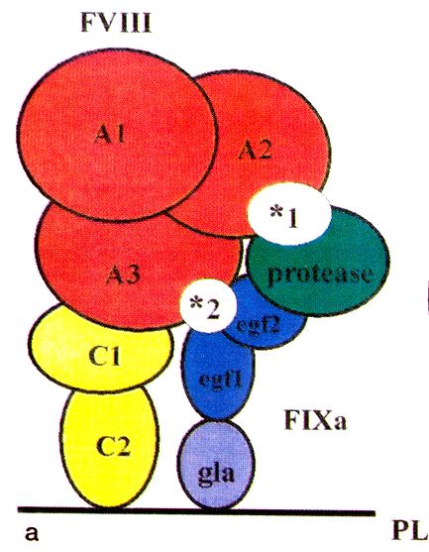
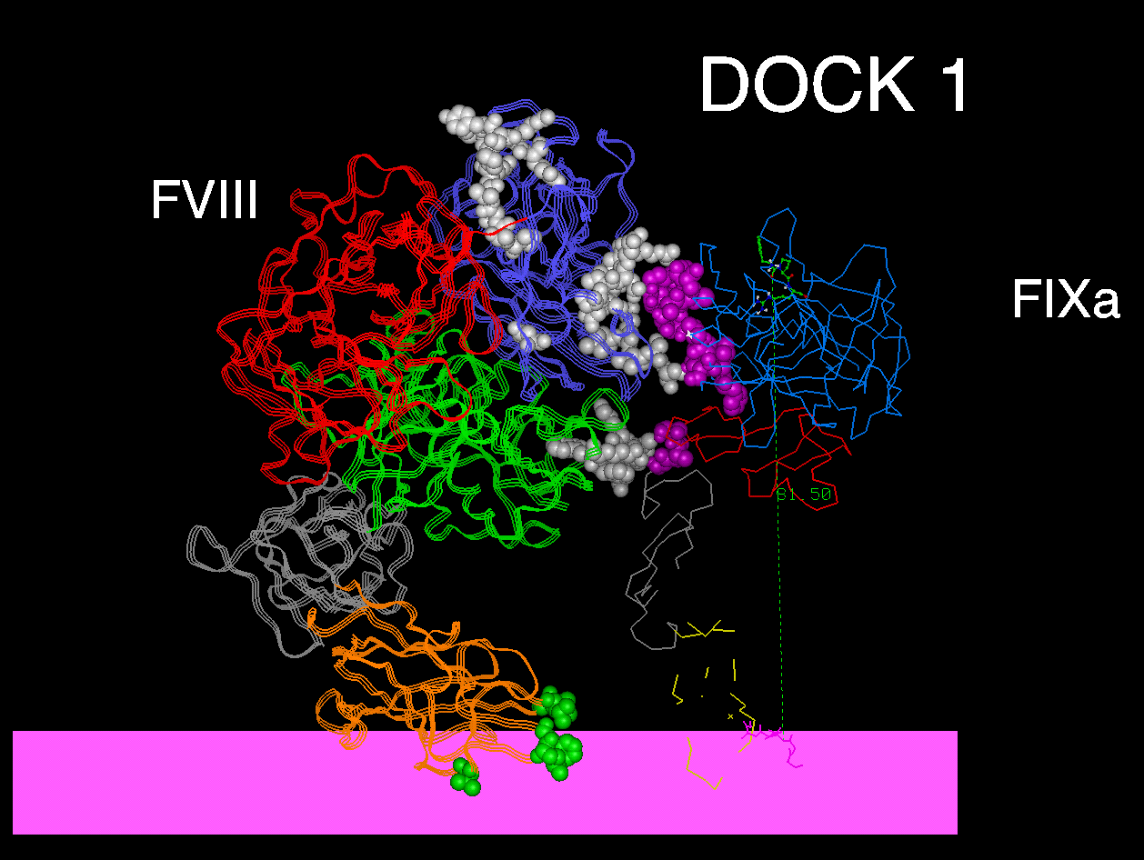
Which presentation is best for you?
cartoon
molecular graphics

Slide 30
Why is molecular graphics useful?
How
For example:
Molecular graphics can help you understand how oral anticoagulant Rivaroxaban works

Slide 31
Fxa activates prothrombin
Xa
Va
Prothrombin
thrombin (IIa)
Xa
Va
Protease
domain
Kringle
domains
Gla domain

Slide 32
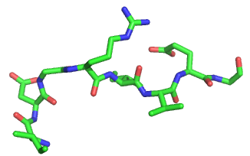
Fxa activates prothrombin
FXa cleaves two peptide bonds of Prothrombin
P4 P3 P2 P1 P1’ P2’ P3’ P4’
First after Arg320 : Ile/Asp/Gly/Arg/Ile/Val/Glu/Gly
Arg
Glu
Gly
Asp
Gly
Ile
Val
Ile

Slide 33
Fxa activates prothrombin
P4 P3 P2 P1 P1’ P2’ P3’ P4’
Then after Arg271 : Ile/Glu/Gly/Arg/Thr/Ala/Thr/Ser

Slide 34
Fxa activates prothrombin
P4 P3 P2 P1 P1’ P2’ P3’ P4’
Arg320: Ile/Asp/Gly/Arg/Ile/Val/Glu/Gly
Arg271 : Ile/Glu/Gly/Arg/Thr/Ala/Thr/Ser
P1 and P4 important for recognition by enzyme

Slide 35
FXa cleaves with: its serine protease domain
One of the amino acids in the active site is a serine
Hydrolyse polypeptides using a catalytic triad of
  - Ser, His, Asp

Slide 36
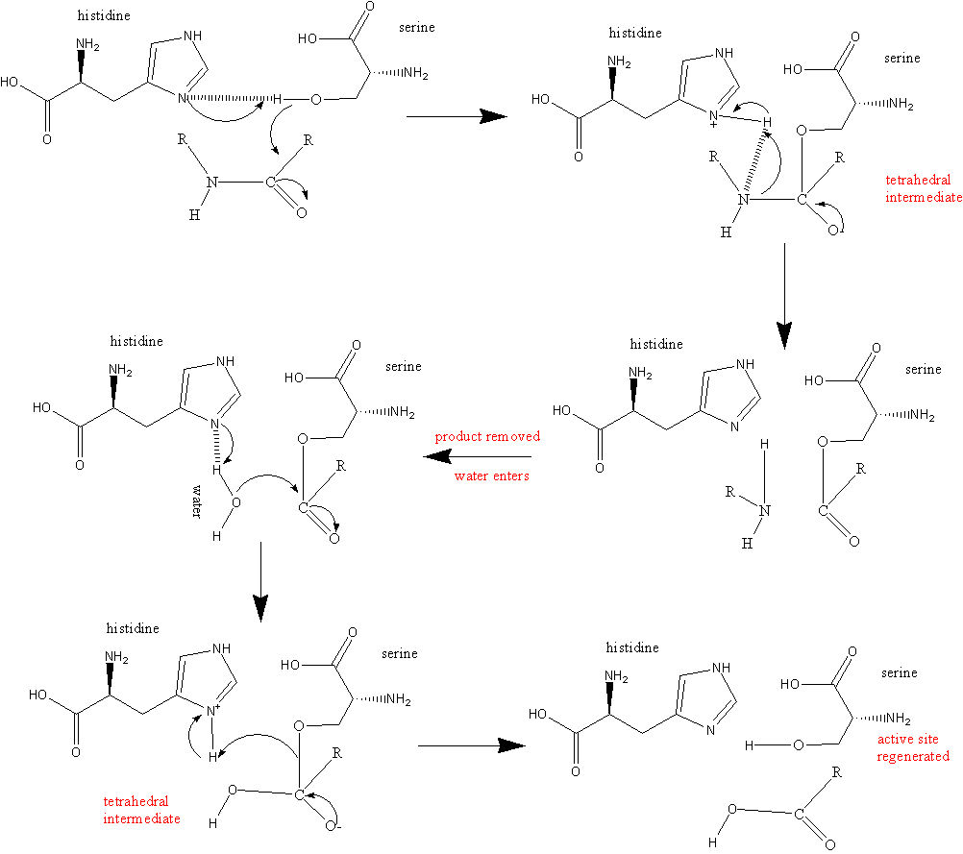
Peptide bond

Slide 37
Serine protease domain
Specificity determined by “specificity pocket” near active site
+ “exosites” (far from active site)

Slide 38
specificity pockets
Ile/Asp/Gly/Arg/Ile/Val/Glu/Gly
Ile/Glu/Gly/Arg/Thr/Ala/Thr/Ser
Substrate P4 P3 P2 P1 P1’ P2’ P3’ P4’
Enzyme pockets S4 S3 S2 S1 S1’ S2’ S3’ S4’

Slide 39
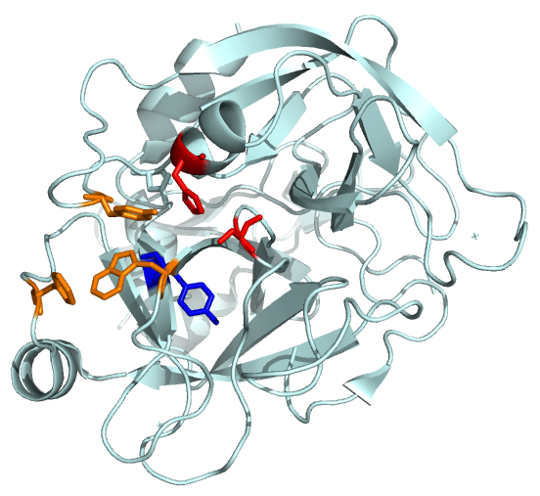
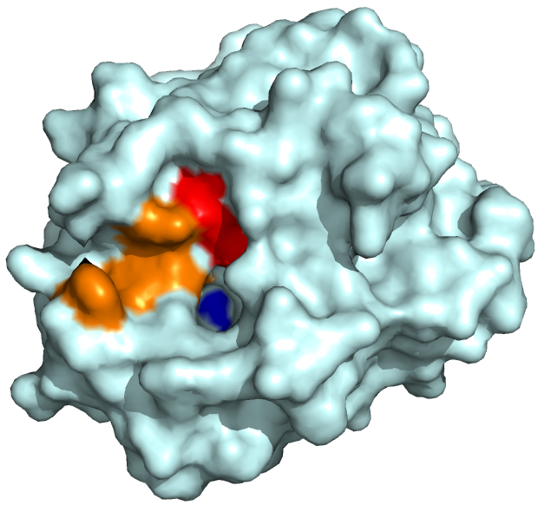
FXa
Ser
Ser
His
His
S4
S4
S1
S1
“cartoon view”
“surface view”

Slide 40
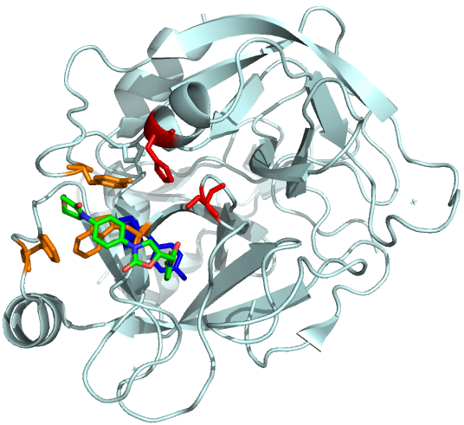
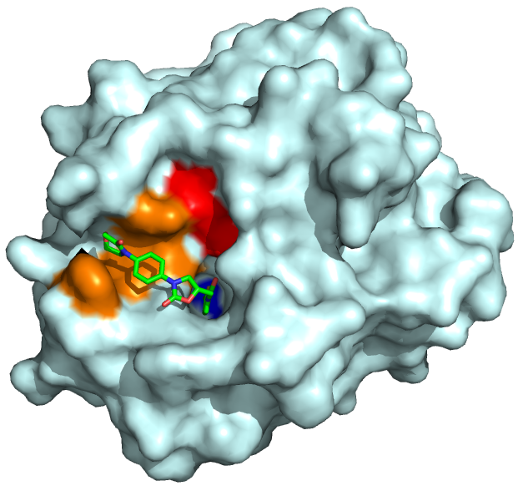
Rivaroxaban
Rivaroxaban binds to and occupies S1 & S4. Prevents prothrombin from entering active site!

Slide 41
and oral anticoagulant Dabigatran?

Slide 42
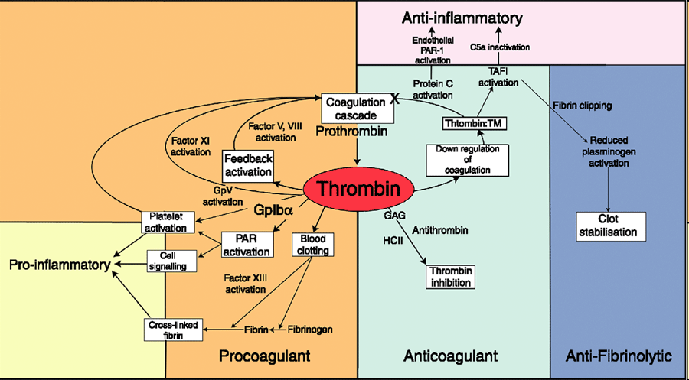
Thrombin cleaves many substrates

Slide 43
Some of the sites that Thrombin cleaves
GGVRGPRV Fibrinogen alpha chain
FSARGHRP Fibrinogen beta chain
LGIRSFRN FV R709
LSPRTFHP FV R1018
WYLRSNNG FV R1545
IQIRSVAK FVIII R372
IEPRSFSQ FVIII R740
RHQREITR FVIII R1649
QSPRFQKK FVIII R1689
P1
Specificity maintained due to (distal) exosites and co-factors

Slide 44
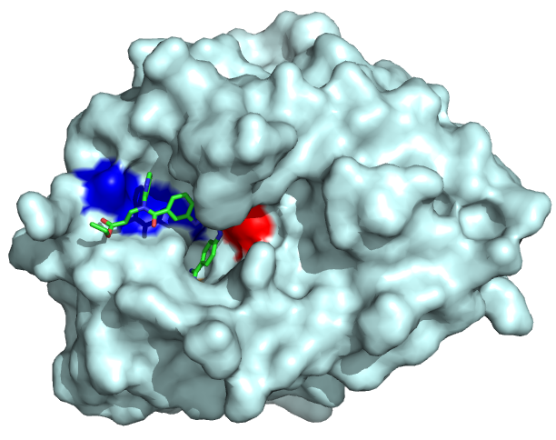
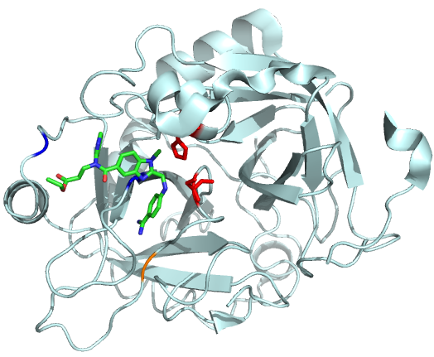
Thrombin inhibition by Dabigatran
Ser
His
Ser
S1
S1
Dabigatran occupies the S1 pocket of Thrombin preventing P1 residue of substrates (Arginine) to enter. Dabigatran further binds to pockets that are not substrate specificity pockets

Slide 45
Pro-drug
Dabigatran is very polar and permanently charged
Therefore not orally active (no absorption)
Solution: A prodrug (Dabigatran etexilate). Polar groups are masked. Masking groups are cleaved in vivo
Dabigatran:
Binds strongly to the active site (high affinity)
Binds specifically to Thrombin

Slide 46
S1
The S1 pocket that normally contains the Arginine (P1) of Thrombin’s substrates plays an important role in inhibition by Dabigatran.
Does S1 play a role in the effect of Heparin?

Slide 47
S1
The S1 pocket that normally contains the Arginine (P1) of Thrombin’s substrates plays an important role in inhibition by Dabigatran.
Does S1 play a role in the effect of Heparin?
Indirectly, Yes. Antithrombin also occupies the S1 by inserting the side chain of its Arg393 into S1.

Slide 48
What do you need for molecular graphics?
STRUCTURAL INFORMATION – e.g. Protein Databank Files, .PDB files most common (http://www.rcsb.org/pdb)
A COMPUTER
GRAPHICS SOFTWARE – e.g. Pymol or Swiss-PdbViewer (aka DeepView)
Download Pymol: http://bit.ly/Q7CBHD (For educational use only).

Slide 49
Demo: downloading and opening .pdb files
Downloading .pdb files
Opening in pymol
Choose representation mode
Show the amino acid sequence
Highlight amino acid sequence
Change colour

Slide 50
Pymol commands
Select residues & make transparant or color:
select test, (resi 186,250-256)
set transparency, 0.35, test
or to select all cysteins: select resn cys
or to colour all cysteins: color slate, resn cys

Slide 51
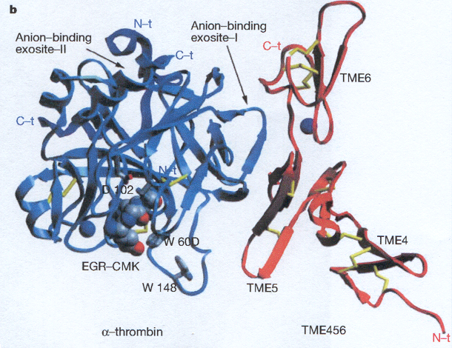
More examples: Thrombin-Thrombomodulin Complex
Fuentes-Prior et al (2000), Nature 404, 518-525

Slide 52
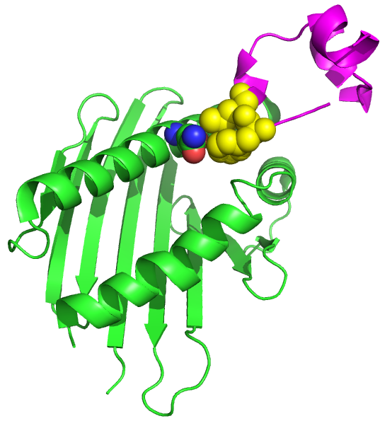
More examples: Gla domain Protein C-EPCR
Contact residues
Gla domain Protein C
EPCR

Slide 53
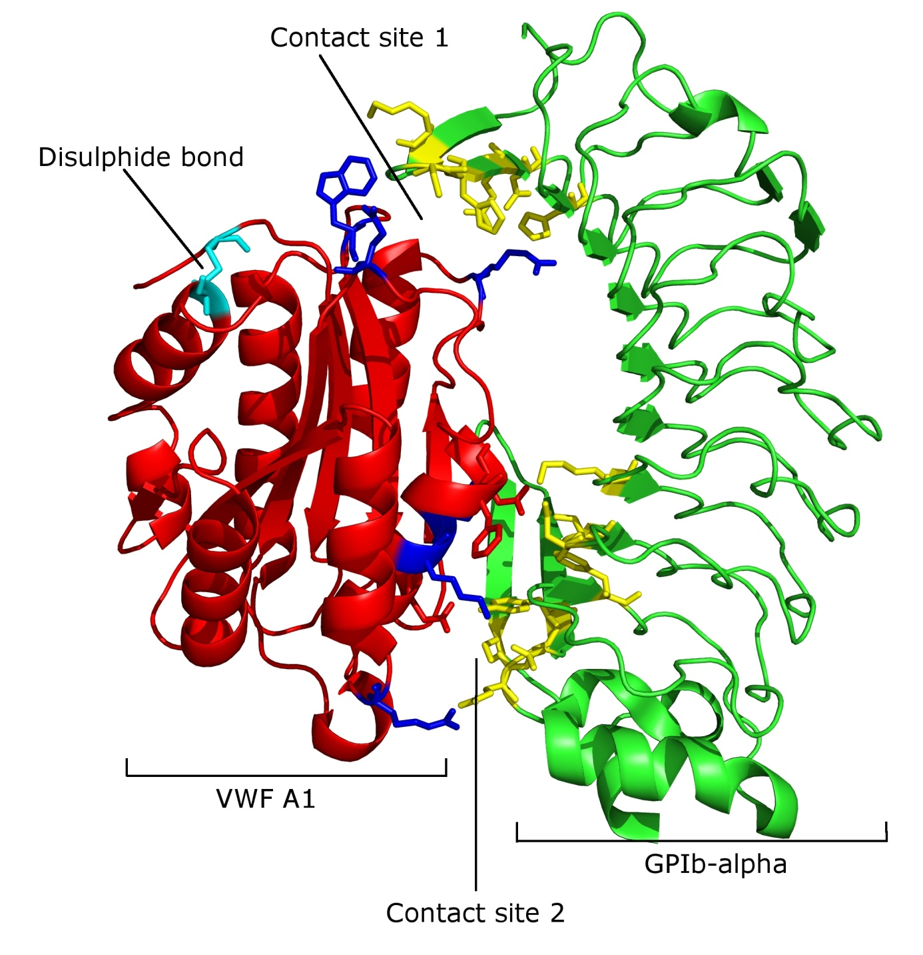
More examples: Structure of the VWF A1 domain in complex with GPIbα
Huizinga EG, Tsuji S, Romijn RA, et al.. Science. 2002;297:1176-1179.

Slide 54
What if no structure is available?

Slide 55
What if no structure is available?
Structural homology modelling

Slide 56
For example: ADAMTS13 Metalloprotease domain
ADAMTS13 is the Von Willebrand Factor Cleaving Protease:
Cleaves and regulates VWF
Absence or low activity cause Thrombotic Thrombocytopenic purpura (TTP)
Tues 18th Oct 13.30-14.30
VWF cleaving protease
J Crawley
SBS Seminar Room 1 & 2

Slide 57
ADAMTS13 Domains
Metalloprotease domain
Disintegrin-like domain
Thrombospondin like repeats (1-8)
Cysteine-rich domain
Spacer domain
CUB domains

Slide 58
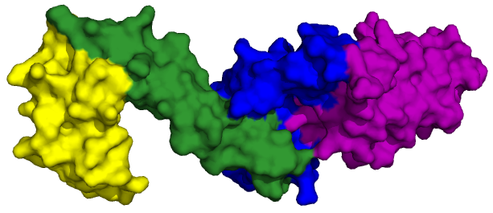
MP domain structure unknown
?
Crystal Structure

Slide 59
Homologous structures
The structure of the MP domain of similar enzymes is known:
ADAMTS1
ADAMTS4
ADAMTS5

Slide 60
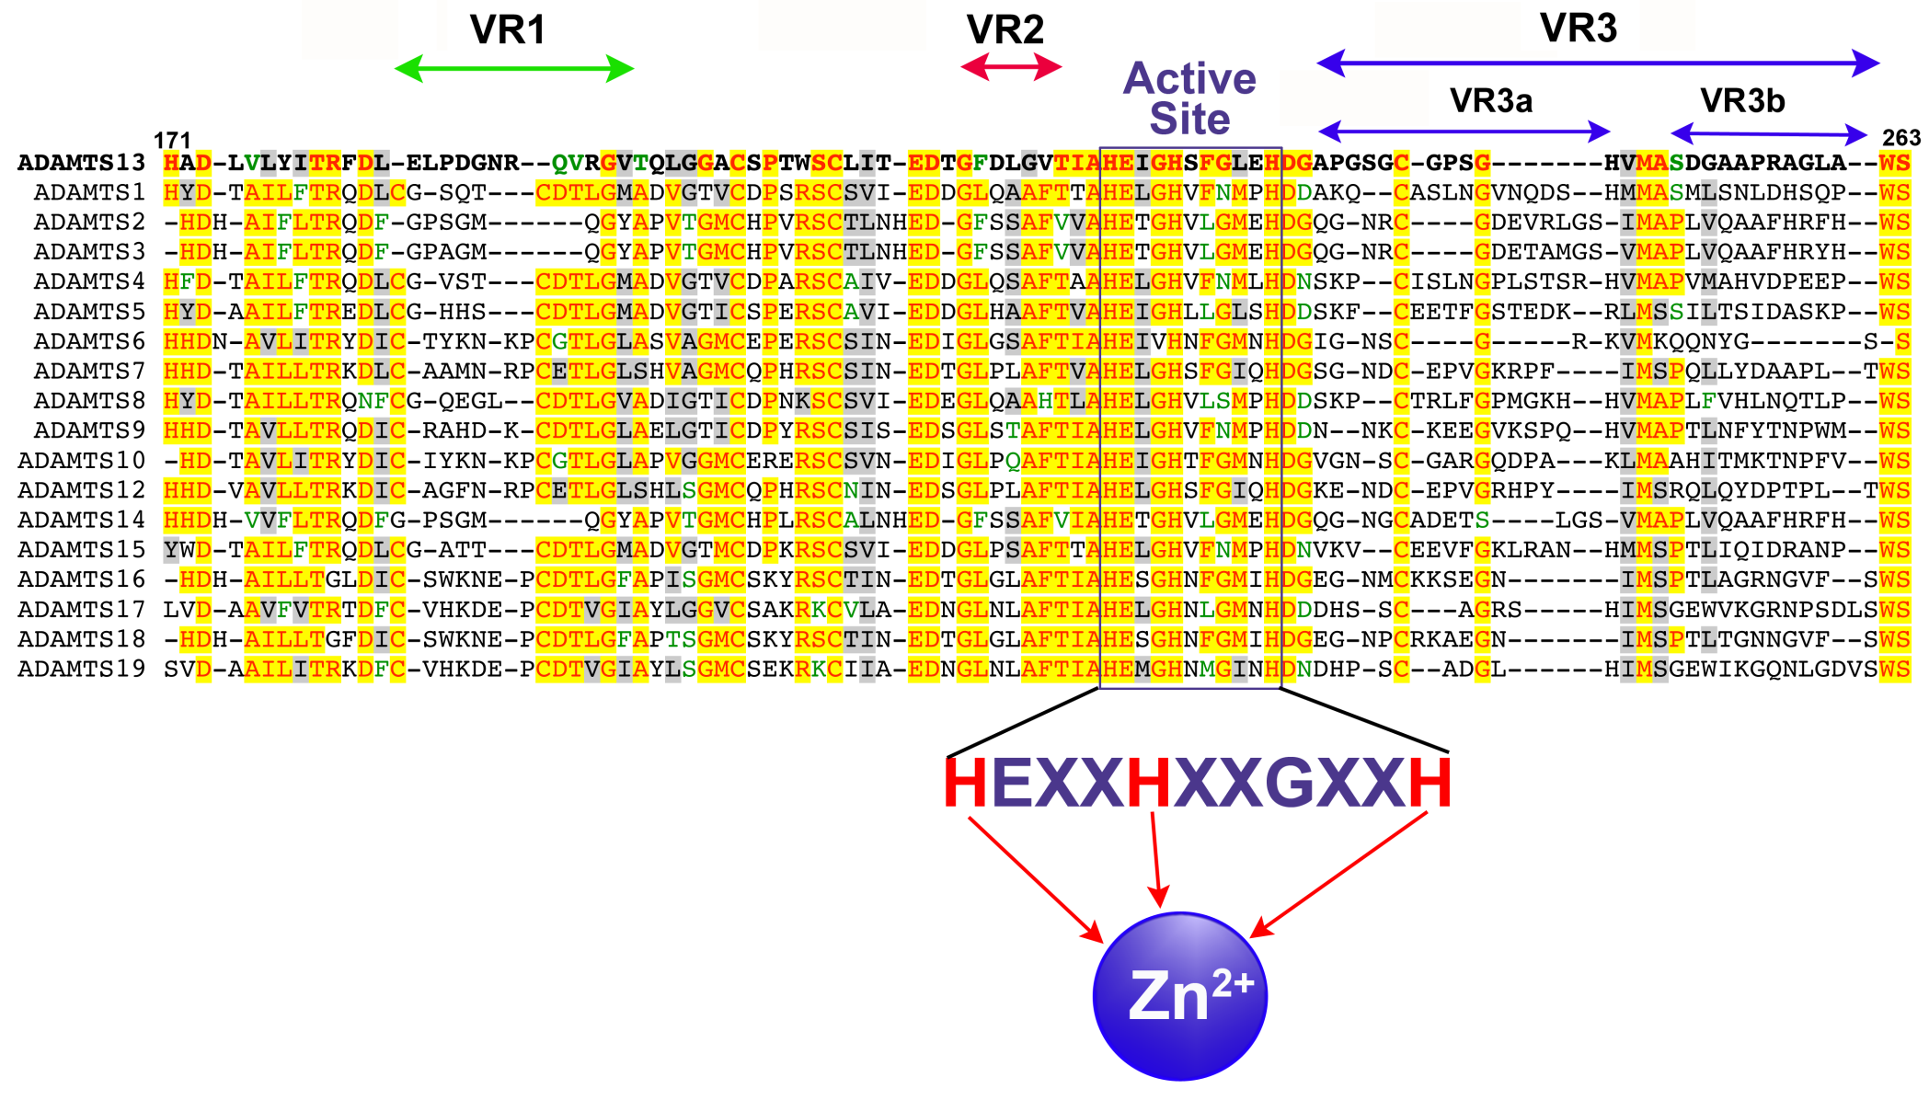
Homology modelling
1) The amino acid sequence of ADAMTS13 is aligned with the sequence of ADAMTS family members

Slide 61
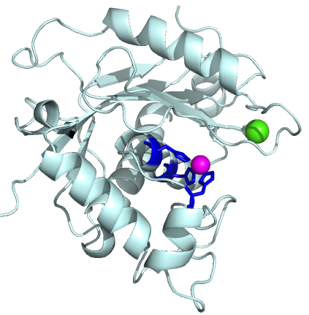
Homology modelling
2) The structures of ADAMTS1, ADAMTS4 & ADAMTS5 are used as a template. Amino acids that align in the sequence alignment are initially put in the same position.
But, this will lead to physically impossible “clashes” of atoms and energetically unfavourable situations

Slide 62
Structural prediction
3) Structural prediction algorithms & computational power (computer servers) are used to calculate and predict the positions of individual atoms.

Slide 63
The Software
For PC: Modeller (http://salilab.org/modeller/)
Websites (servers):
Fully automated.
Sequence of protein is uploaded
Sequence is automatically compared with sequence of proteins of which the structure is known
Sequence alignment is made
Structure is predicted
http://toolkit.tuebingen.mpg.de/hhpred
http://swissmodel.expasy.org/
http://zhanglab.ccmb.med.umich.edu/I-TASSER/
Prediction will contain inaccuracies. Some can be solved by manual inspection

Slide 64
The result: ADAMTS13 MP MODEL
This model was used to investigate which parts of the domain are important for its function and specificity

Slide 65
Practice!
Download .pdb files at: http://www.rcsb.org/pdb
Download example Pymol files at:
http://bit.ly/RKRZv2 (Available till 15/10/12)
Pymol is installed in the computer cluster room 3rd floor CWB (and possibly all other computers in college)
Install Pymol on your own computer: http://bit.ly/Q7CBHD (Available till 15/10/12)

