Slide 1
Laboratory tests of coagulation
Professor Mike Laffan
Department of Haematology
Hammersmith Hospital

Slide 2
LEARNING OBJECTIVES
Understand the ways in which haemostatic mechanism fail
Understand the principles of different laboratory tests in coagulation
Understand the limitations associated with laboratory tests in coagulation
Be aware of pre-analytical variables
Understand the principles of automation

Slide 3
Why do people bleed?
-Defects of procoagulant function
Too little protein (quantitative)
  Usually inherited specific assays
  Excess consumption global pattern
  Liver failure global pattern
  Drugs, antibody, hormonal specific assays
Defective function (qualitative)
  Usually inherited specific assays
Inhibited function
  Antibody present specific assays
  Drugs

Slide 4
Haemostatic Plug Formation: An Overview
Response to injury
Vessel constriction
Formation of an unstable platelet plug
-platelet adhesion
-platelet aggregation
Stabilisation of the plug with fibrin
-blood coagulation
Dissolution of clot and vessel repair
-fibrinolysis

Slide 5
Tests of the coagulation system

Slide 6
Coagulation: ‘Screening tests’
Prothrombin time (PT)
Activated partial thromboplastin time (APTT)
  Kaolin cephalin clotting time (KCCT)
  Partial thromboplastin time with Kaolin (PTTK)
Thrombin time (TT)
Fibrinogen assay
(Platelet count)

Slide 7
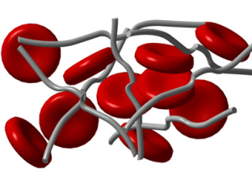
Blood or plasma
Surface Contact
Tissue thromboplastin
‘Clot’

Slide 8
Surface Contact
Tissue thromboplastin
Thrombin
Fibrinogen
Fibrin

Slide 9
APTT
Surface Contact
HMWK
PK
XII
PT
XI
Tissue thromboplastin
VIII
IX
VIIa
V
X
Thrombin
Fibrinogen
Fibrin

Slide 10
Classical model of coagulation
Two systems
  Intrinsic – contact activated
  Extrinsic – tissue extract activated
Systems give inconsistent results
  Tissue factor thought to initiate in vivo
  PT normal in haemophilia
  FXII gives very long APTT but no bleeding

Slide 11
Resolution of two systems
TF-VIIa activates both pathways:
  Factor X - extrinsic pathway
    Extrinsic path turned off by TFPI (in vivo)
  Factor IX – intrinsic pathway
    Intrinsic pathway then responsible for thrombin burst

Slide 12
Surface Contact
Tissue factor is the physiological initiator of coagulation
HMWK
PK
XII
XI
?
Tissue factor
VIII
IX
VIIa
V
X
Thrombin
Fibrinogen
Fibrin

Slide 13
Factor XI?
Final problem was FXI deficiency which is associated with a mild bleeding disorder.
Resolved by demonstration that thrombin can activate FXI directly on platelet surface
  Bind to GPIb-IX-V complex
Additional FXI dependent thrombin generation required for TAFI activation

Slide 14
Routine coagulation testing
Practical but unphysiological

Slide 15
HMWK
APTT
CONTACT
PK
XII
XI
VIIa
PT
TF
VIII
IX
V
X
TT
IIa
II
Fibrinogen
Fibrin

Slide 16
Coagulation: ‘Screening tests’
Prothrombin time (PT)
  Trigger: Thromboplastin (Tissue factor)
  Requires factors: VII, X, V, II, Fibrinogen
  Calcium

Slide 17
PROLONGED PT
HMWK
CONTACT
PK
XII
XI
VIIa
VIII
IX
TF
V
X
PT 22 (9.6-11.6)
APTT 28 (26-32)
TT 16 (15-19)
II
Fibrinogen
Fibrin

Slide 18
PROLONGED PT
HMWK
CONTACT
PK
XII
XI
VIIa
VIII
IX
TF
V
X
FVII deficiency
II
Fibrinogen
Fibrin

Slide 19
HMWK
APTT
CONTACT
PK
XII
XI
VIIa
PT
TF
VIII
IX
V
X
TT
IIa
II
Fibrinogen
Fibrin

Slide 20
Coagulation: ‘Screening tests’
Activated partial thromboplastin time (APTT)
  Trigger: contact activator:
    Kaolin, silica, elagic acid, glass
  Requires factors XII, PK, HMWK, XI, VIII, IX, X, V, II, Fibrinogen.
  Calcium

Slide 21
PROLONGED APTT
HMWK
CONTACT
PK
XII
XI
VIIa
VIII
IX
TF
V
X
PT 10.6 (9.6-11.6)
APTT 65 (26-32)
TT 16 (15-19)
II
Fibrinogen
Fibrin

Slide 22
PROLONGED APTT
HMWK
CONTACT
PK
XII
XI
VIIa
VIII
IX
TF
V
X
Deficiency of
Contact factor
(XII, PK, HMWK)
FXI, FIX, FVIII
II
Fibrinogen
Fibrin

Slide 23
HMWK
APTT
CONTACT
PK
XII
XI
VIIa
PT
TF
VIII
IX
V
X
TT
IIa
II
Fibrinogen
Fibrin

Slide 24
Coagulation: ‘Screening tests’
Thrombin time (TT)
  Requires: Fibrinogen
  (absence of inhibitors such as heparin)

Slide 25
PROLONGED TT
HMWK
CONTACT
PK
XII
XI
VIIa
VIII
TF
IX
V
X
PT 10.5 (9.6-11.6)
APTT 28 (26-32)
TT 33 (15-19)
II
Fibrinogen
Fibrin

Slide 26
PROLONGED TT
HMWK
CONTACT
PK
XII
XI
VIIa
VIII
IX
TF
V
X
Inhibitor of thrombin
(eg heparin)
Inhibitor of polymerisation
Abnormal fibrinogen
II
Fibrinogen
Fibrin

Slide 27
PROLONGED APTT AND PT
HMWK
CONTACT
PK
XII
XI
VIIa
VIII
TF
IX
V
X
PT 19.3 (9.6-11.6)
APTT 45 (26-32)
TT 16 (15-19)
II
Fibrinogen
Fibrin

Slide 28
PROLONGED APTT AND PT
HMWK
CONTACT
PK
XII
XI
VIIa
VIII
TF
IX
V
X
Deficiency
FV, FX, Prothrombin
OR
Multiple deficiencies
II
Fibrinogen
Fibrin

Slide 29
ALL TESTS PROLONGED
HMWK
CONTACT
PK
XII
XI
VIIa
TF
VIII
IX
V
X
PT 18.5 (9.6-11.6)
APTT 45 (26-32)
TT 27 (15-19)
II
Fibrinogen
Fibrin

Slide 30
ALL TESTS PROLONGED
HMWK
CONTACT
PK
XII
XI
VIIa
TF
VIII
IX
V
X
Fibrinogen deficiency
Abnormal fibrinogen
Multiple deficiencies
Combination (DIC)
II
Fibrinogen
Fibrin

Slide 31
Why coagulation screens?
Detect a bleeding tendency
Detect a cause for bleeding
Detect a systemic disease
Detect a thrombotic disorder
‘reassurance’

Slide 32
In fact they are reliable for none of these things
Coagulation screens are usually performed to detect a defect in haemostasis
- have limited sensitivity & specificity
Coagulation screens test a very limited portion of haemostasis

Slide 33
Sensitivity of the APTT
0.8
0.8
0.6
FVIII
0.6
concentration / iu/ml
FXII
0.4
0.4
FVIII
0.2
FXII
0.2
0
0
0
60
120
180
240
300
360
420
0
60
120
180
240
300
360
420
incubation/secs

Slide 34
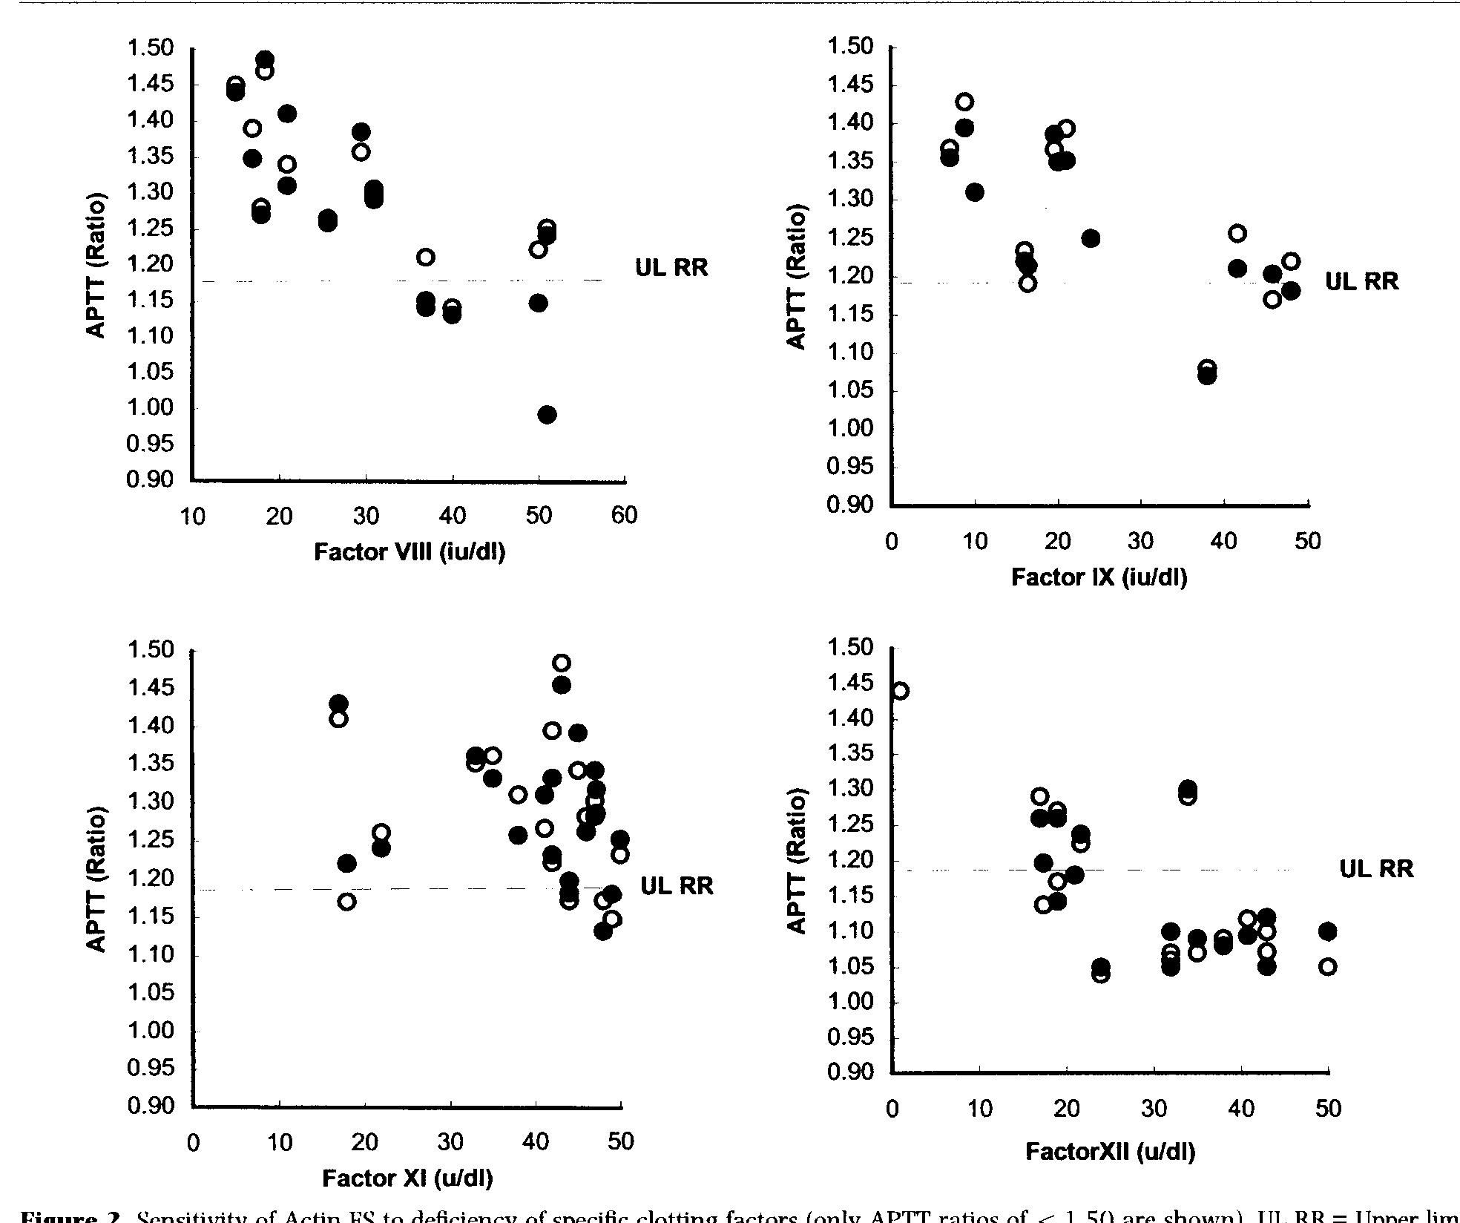
Actin FS sensitivity factor deficiency
Lawrie 1998

Slide 35
APTT sensitivity to coagulation factor deficiency
Sensitive to contact factor deficiency (irrelevant)
  False positives
What is appropriate level of sensitivity for VIII,IX, XI ?
  False positives and false negatives

Slide 36
Bleeding disorders not detected by
routine clotting tests
Mild factor deficiencies
von Willebrand disease
Factor XIII deficiency (cross linking)
Platelet disorders
Excessive fibrinolysis
Vessel wall disorders
Metabolic disorders (e.g. uraemia)
(Thrombotic disorders)

Slide 37
Screening tests for other elements of haemostasis
Platelet count
Bleeding time
PFA 100 analyser
Euglobulin clot lysis time
Global tests: TEG, ETP

Slide 38
Coagulation tests and factor deficiencies

Slide 39
Coagulation testing
Prolonged global clotting tests (screening tests)
Correction (mixing) tests
+
_
Specific factor assays
Inhibitor tests and assays

Slide 40
Assays of coagulation factors
1. Antigenic assays (usually ELISA)
not necessarily relevant
precise
not prone to interference

Slide 41
IMMUNOLOGICAL ANTIGEN ASSAYS
Immunological antigen assays give an indication of how much protein is present but not activity
a Enzyme immunoassays (ELISA)
b Immunoturbidimetric assays

Slide 42
ELISA assay
APAAP conjugated
detection antibody
Test molecule
Capture antibody bound to plate

Slide 43
LIA: immunoturbidimetric assay
Y
Y
Y
VWF
Y
Y
Y
Y
Y
Y
Y
Latex particles coated with anti-VWF

Slide 44
LIA: immunoturbidimetric assay
Agglutination measured turbidimetrically
Y
Y
Y
Y
Y
Y
Y
VWF
Y
Y
Y
Y
Y
Y
Y
Y
Y
Y
Y
Y
Y
Y
Y
Y
Y
Y
Latex particles coated with anti-VWF

Slide 45
LIA: immunoturbidimetric assay
Y
Y
Y
VWF
Y
Y
Y
Y
Y
Y
Y
Y
Y
Y
Y
Y
Y
Y
Y
Y
Y
Y
Y
Y
Y
Y
Y
Y
Y
Y
Y
Light source
Light detector

Slide 46
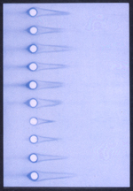
Laurell Rocket

Slide 47
Enzyme Linked ImmunoSorbent Assay
ELISA assay
MPO conjugated
detection antibody
Test molecule
Capture antibody bound to plate
Notes:
This is a sandwich type assay

Slide 48
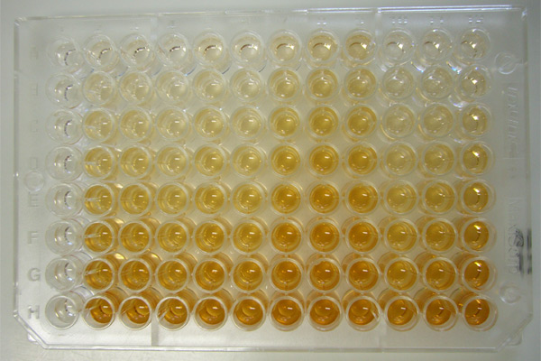
ELISA

Slide 49
Quantification
Use a series of dilutions made from the reference preparation
Create a ‘standard curve’
Modify as necessary to obtain a straight line with useful span and spread of values
Quantify your sample by comparison with the ‘standard curve’

Slide 50
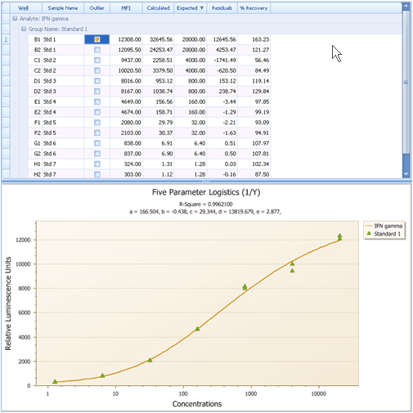
Limits of detection

Slide 51
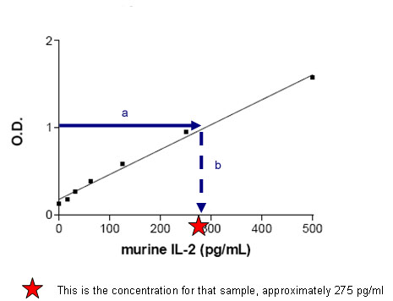
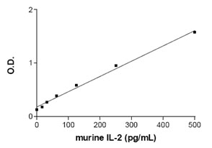
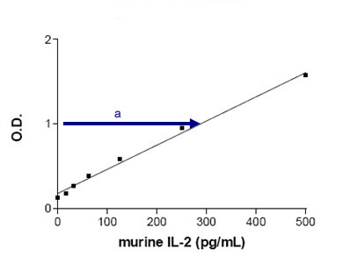
Quantitation of test sample

Slide 52
ELISA
Need one or more specific antibodies
  Mono- or poly-clonal Abs are both used
One antibody coupled to enzyme or a second enzyme-linked antibody can be used.
Need a calibrant of known concentration
Usually performed in a 96 well plate
Problems
  Background or non-specific binding
  Limit of sensitivity
  Relatively time consuming

Slide 53
Immunoturbidimetric assay
Antibody is bound to latex beads
Presence of antigen cross links binds
Agglutination causes increase in turbidity
Turbidity measured by light transmission
Need a calibrant of known concentration
Accurate, precise, easily automated
Problems
  Cross linking by Rheumatoid factor or autoantibody

Slide 54
LIA
Y
Y
Y
VWF
Y
Y
Y
Y
Y
Y
Y
Latex particles coated with anti-VWF

Slide 55
LIA
Agglutination measured turbidimetrically
Y
Y
Y
Y
Y
Y
Y
VWF
Y
Y
Y
Y
Y
Y
Y
Y
Y
Y
Y
Y
Y
Y
Y
Y
Y
Y
Latex particles coated with anti-VWF

Slide 56
LIA
Y
Y
Y
VWF
Y
Y
Y
Y
Y
Y
Y
Y
Y
Y
Y
Y
Y
Y
Y
Y
Y
Y
Y
Y
Y
Y
Y
Y
Y
Y
Y
Light source
Light detector

Slide 57
Coagulation factor assays
Antigenic assays
Bioassays
  Measure biological activity of the analyte
  Prone to interference by other factors
  Poor accuracy and precision (CV)
  Based on routine screening tests (Clot end point)

Slide 58
HMWK
APTT
CONTACT
PK
XII
XI
VIIa
PT
TF
VIII
IX
V
X
TT
IIa
II
Fibrinogen
Fibrin

Slide 59
Coagulation factor bioassay
APTT based assay for VIII, IX, XI, XII
PT based assay for VII, V, X, II
RVVT can also be used

Slide 60
Coagulation factor bioassay
Factor deficient plasma
Calibrant/reference plasma of known potency
Test plasma of unknown potency
APTT or PT reagent
Phospholipid and Calcium
Internal controls

Slide 61
Parallel line bio-assay
The one-stage clotting assay
  Dilutions of test plasma or reference standard are added to factor deficient plasma and the clotting times recorded (using PT or APTT)
Principle
  The test plasma behaves as a simple dilution of the standard
  Dilutions of test and standard can be plotted as parallel lines
Value for test is read off from standard curve

Slide 62
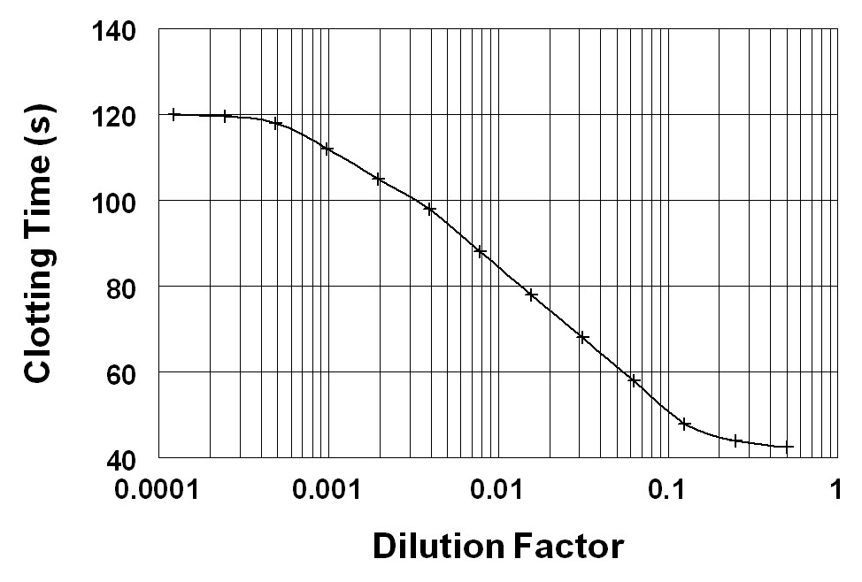
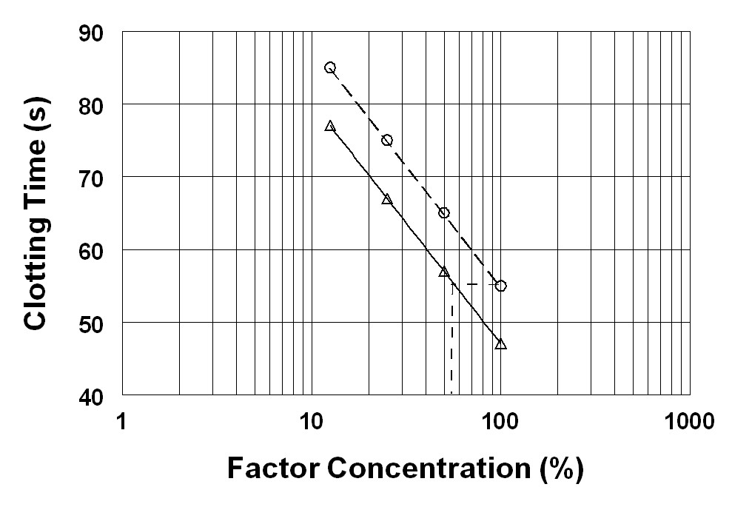
Test
Reference

Slide 63
Quantitation
Test
*55%
*55% of the standard
If standard is 0.9u/ml then 0.9 x .55 = 0.49 iu/ml

Slide 64
SNAKE VENOMS
Can be used as trigger for functional assays
Bothrops jacaraca (fibrinogen to fibrin)
Bothrops atrox (Reptilase, thrombin-like activity)
Oxyuranus scutellatus (Taipan venom, FII assay)
Vipera russeli (Russell’s viper, FX activation)
Agkistrodon contortrix (Protein C activation)

Slide 65
Chromogenic Assay
General Principle
Activator
Zymogen
Enzyme
Enzyme
PNA
Peptide
+
PNA
Peptide
(Substrate)
Colourless
Yellow colour develops
Proportional to enzyme concentration

Slide 66
CHROMOGENIC ACTIVITY ASSAYS
A chromogenic substrate is cleaved by the enzyme of interest and colour generation measured
Chromogenic activity assays are an alternative to clotting activity assays and may be more reproducible but are not always physiological.
Specific substrates are available for:
a Kallikrein
b Factor Xa
c Thrombin
d Activated Protein C
e Plasmin
f Urokinase.

Slide 67
Tests of primary haemostasis

Slide 68
Primary haemostasis
Vessel wall
Von Willebrand factor
Platelets
(some contribution from other adhesive molecules: fibrinogen, vitronectin, fibronectin)

Slide 69
The bleeding time
Can be standardised using a template
Now generally obsolete
  Poor sensitivity
  Poor specificity
  Poor reproducibility
  Poor predictive value
Possibly of use in suspected collagen disorder
Replaced by laboratory analysers eg: PFA 100

Slide 71
PFA100
Sensitive to:
  Platelet number
  Platelet function
  VWF adhesive function
  Haematocrit
Insensitive to
  Thrombin generation
  Mild platelet function defects
  Clopidogrel

Slide 72
Platelet function testing
Platelet number
  FBC
Platelet aggregation
  Measure aggregation in response to standard agonists.
Global tests
  Bleeding time
  PFA
Platelet granule contents
  ATP:ADP ratio

Slide 73
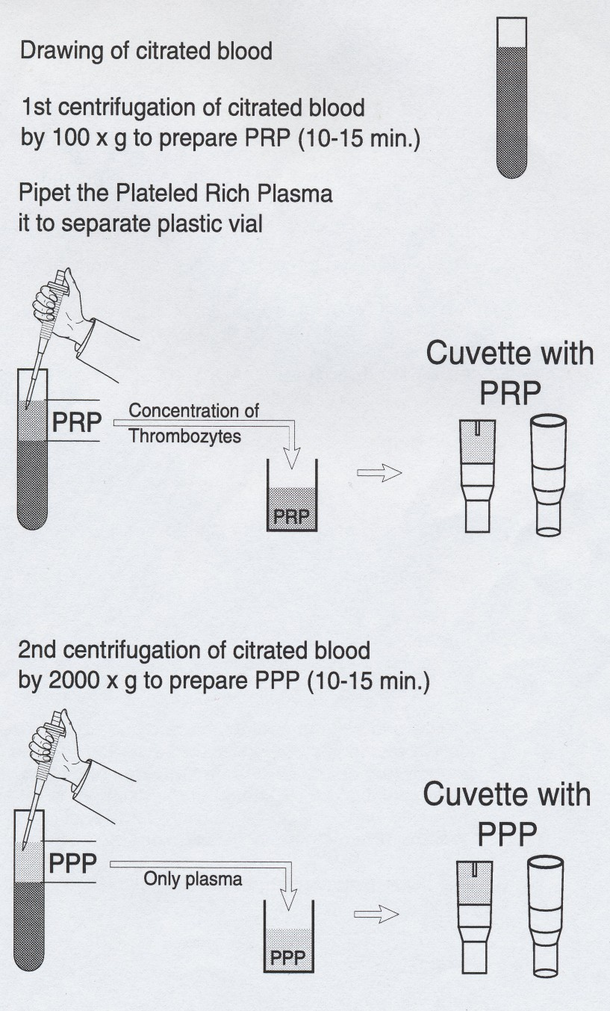
Preparation of PRP and PPP

Slide 74
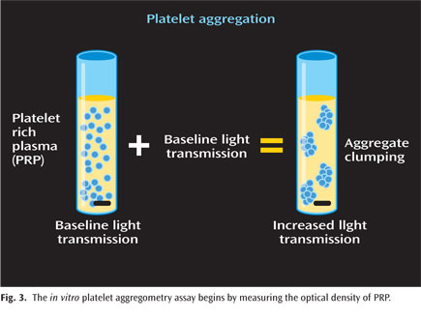
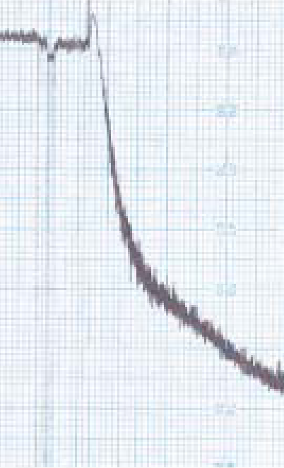
Platelet aggregation testing in platelet rich plasma
AGONIST
Light transmission
time
Notes:
PRP Prepared from citrated blood (200g and 1500g)
Do not adjust platelet count of PRP (unless >600) as this may cause artefactual inhibition. Needs to be >150
37 oc stirred by magnetic stirrer. Watch for lipaemic or icteric samples.
Calibrate curve with PRP and PPP

Slide 75
Platelet aggregation: agonists
ADP 1, 2.5, and 5 (10) μM
Epinephrine 10μM
Collagen 1.25 and 4 μgmL⁻¹
Ristocetin 0.5 and 1.5 mgmL⁻¹
Arachidonic acid 500 μgmL⁻¹

Slide 76
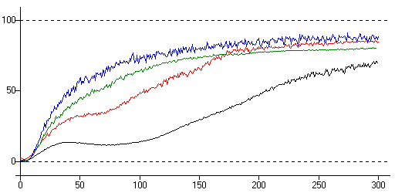
Platelet aggregation with ADP

Slide 77
Other factor assays
Most factors in anticoagulant and fibrinolytic pathways can be assayed.
Assays conform to previous types:
  Antigenic
  Functional clot based
  Functional chromogenic substrate

Slide 78
PRE-ANALYTICAL VARIABLES
How to ensure meaningful results
1 Effects of stress and exercise
Factor VIII & VWF rise with exercise
2 Blood sample collection
    a Venepuncture Technique
    b Blood sample containers
    c Choice of anticoagulant (Citrate)
    d Special inhibitors
    d Timing of collection
    Fibrinolysis has diurnal variation

Slide 79
PRE-ANALYTICAL VARIABLES
3 Sample transport to the laboratory
The in vivo half-life of FVIII is 10 hours
4 Centrifugation (Speed, temperature and time)
5 Storage of plasma (Temperature and time)

Slide 80
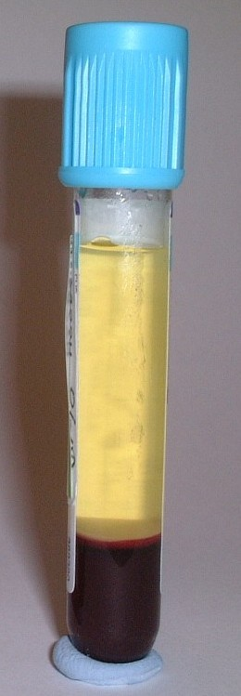
Normal centrifuged citrate sample
Platelet poor plasma
Buffy coat (plts and wbc)
Packed red cells

Slide 81
UNACCEPTABLE SAMPLES
1 Incorrect proportion of blood to anticoagulant
2 Haemolysed samples
3 Clotted or activated samples

Slide 82
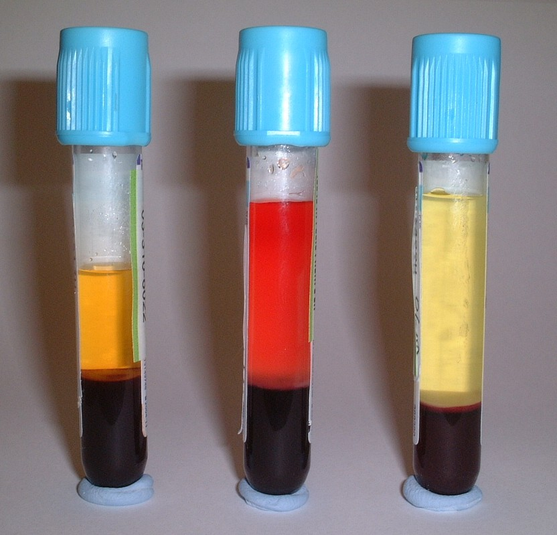
Underfilled, Haemolysed and a good quality citrate sample

Slide 83
AUTOMATION IN COAGULATION
Increase the throughput of samples
Increase precision
Relieve the strain of manual clotting
Types of End-Point detection
1 Electro-mechanical devices - impedance
2 Light transmission and light scatter
Clotting assays
Chromogenic assays
Immunological assays

Slide 84
AUTOMATION IN COAGULATION
Pros
  Very high throughput
  Multiple assays on single samples
  Good reproducibility (precision)
Cons
  Susceptible to end point errrors (lipaemia, jaundice, low fibrinogen)
  Introduce artefacts

Slide 85
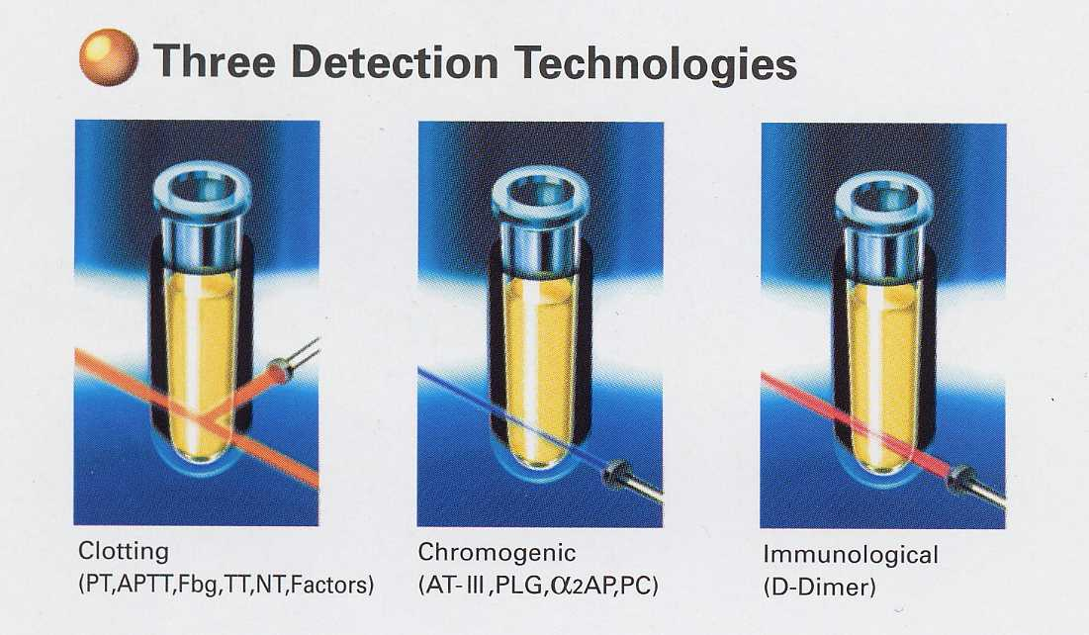

Slide 86
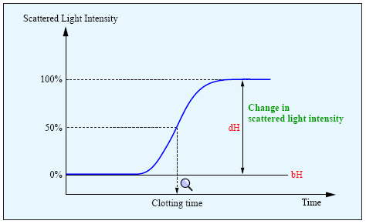
Endpoint detection
Endpoint
Absolute level
Change from baseline
Rate of change

