Slide 1
Novel methods of assessing haemostatic function

Slide 2
Learning objectives
Understand the benefits and limitations of global tests versus specific tests of coagulation
Be familiar with specific examples and their specific problems
Be aware of current applications of global tests.

Slide 3
Classic reductive approach to haemostatic disorders
Clinical problem of haemostasis or thrombosis
Abnormality of screening tests
Specific factor assays
Classification of deficiency or abnormality
Choice of appropriate therapy

Slide 4
Classic reductive approach to thrombophilic disorders
Thrombotic history or FH
Specific factor assays
Genetic analyses
‘Deficient’
Trait positive
Standard therapy

Slide 5
Pros and cons of reductive approach
Identifies major deficiencies or defects
Allows therapy targeted to the deficiency
Established, proven
Less satisfactory for mild and complex disorders
Many clinical problems are not attributable to a single factor:
  Eg: 50% of patients with thrombosis have no identifiable factor deficiency.
  Easy bruising rarely associated with single factor deficiency
  Individual problems associated with given deficiency vary
  Individual therapeutic response varies.

Slide 6
Global assays of haemostasis
Attractive because they assess the net function of many factors
Don’t identify a specific therapy
Give a more relevant measure of haemostatic function.
Never completely physiological

Slide 7
Global assays of haemostasis
Activation peptides
Enzyme-inhibitor complexes
D-dimer
The thromboelastogram/ROTEM
The endogenous thrombin potential
PFA and the bleeding time

Slide 8
Measures of haemostatic activity
Activation peptides
  Many enzymes release an activation peptide as part of the activation process
  Antibodies can distinguish this from the zymogen. eg: prothrombin F1+2
Enzyme-inhibitor complexes
  Antibodies can recognise the combination of an enzyme with its inhibitor eg:
    thrombin-antithrombin
    plasmin-antiplasmin.

Slide 9
Structure of Activated Coagulation Factors
+ AP
Factor IXa
+ AP
Factor Xa
Factor VIIa
+ AP
Activated Protein C
+
Thrombin
F1+2

Slide 10
Measures of Coagulation Activity
Bauer 1999

Slide 11
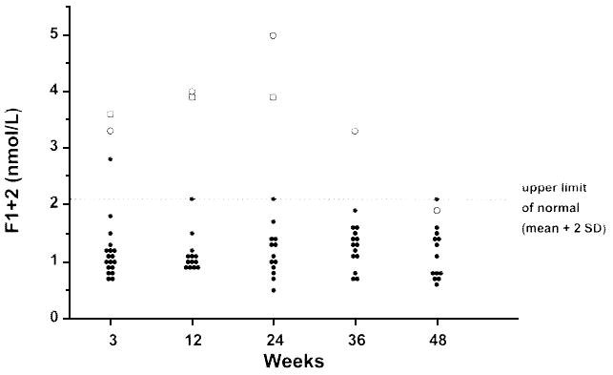
F1+2 levels in heterozygotes for the prothrombin G20210A polymorphism
Kyrle 1998

Slide 12
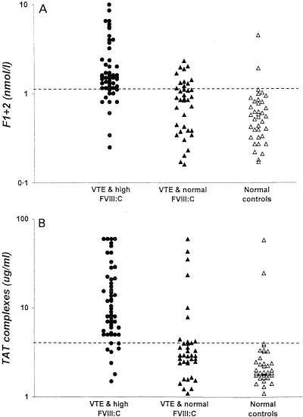
Thrombin generation, FVIII and thrombosis
O’Donnell 2001

Slide 13
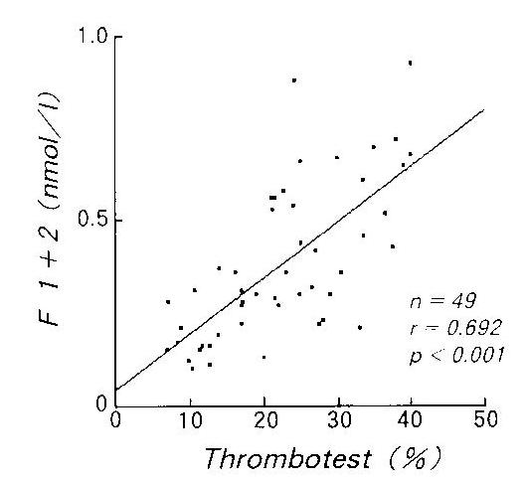
F1+2 and anticoagulation
Takahashi 1993

Slide 14
Problems with activation markers
Many difficult to measure
Limited sensitivity to thrombophilic states
  TAT/F1+2 normal in antithrombin
  TAT/F1+2 raised in 30% of PC defic, FVL
Ineffective in predicting thrombosis
Too cumbersome for anticoagulant control
Not in general use
Some research applications

Slide 15
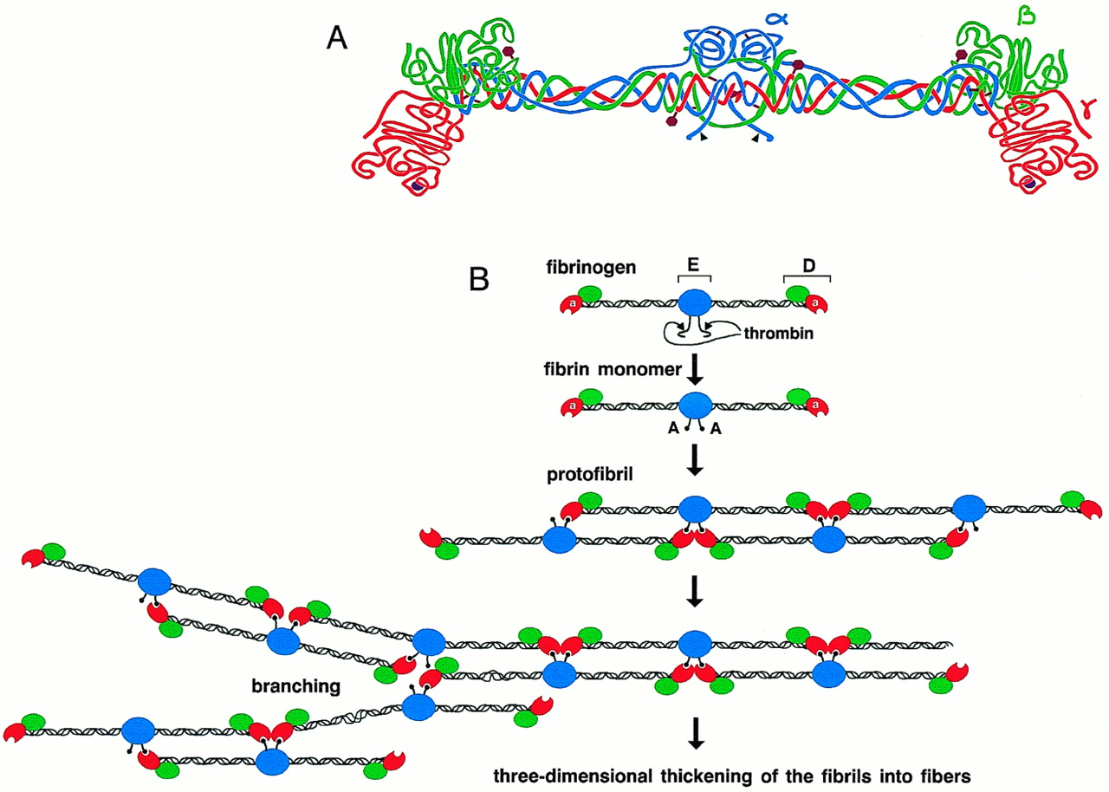
Characteristic degradation products of cross-linked fibrin (d-dimers)
D-D (D-dimer)
D-D-E (D-dimer E)
D-dimers are released by plasmin only when fibrin has been cross linked by FXIII

Slide 16
Applications of D-dimers
D-dimers are an indirect measure of thrombin generation (and fibrin formation)
Established use in excluding presence of thrombosis (ie if D-dimer is normal then thrombosis very unlikely).
May be a useful predictor of tendency to recurrence after first thrombotic episode.
Diagnosis of DIC

Slide 17
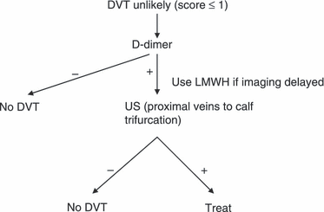
Application of D-dimer tests to exclusion of DVT
Clinical probability assessment (Wells score) | Pretest probability (%) | Post test probability if D-dimer negative (%)
High | 75 | 21
Moderate | 17 | 1.8
Low | 3 | 0.3
BCSH and Wells 2003

Slide 18
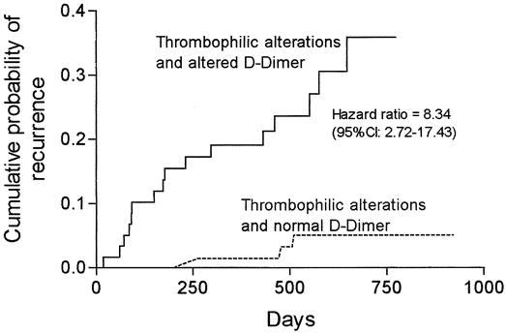
D-dimer and prediction of VTE recurrence
Probability of recurrent VTE in subjects with hereditary thrombophilic traits according to D-dimer (</>500 ng/mL) 1 month after stopping anticoagulation.
Palareti 2003
Notes:
47% of the 599 VTE were idiopathic. Approx 40% of pts had increased d-dimer after stopping a/c. d dimer was not useful when the VTE was precipitated or associated with cancer. In patients with thrombophilia the neg pred value is v high (95.8%). Elevated levels of FVIII not included among the thrombophilic traits. Is this combination of genetic and phenotypic assessment the way we should use thrombophilia testing? Elevated d dimer was not so predictive in idiopathic group as a whole (hazard ratio 2.43 vs 8.34 above). Confirmed in Eichinger study 2003. Utility under trial in PROLONG study.

Slide 19
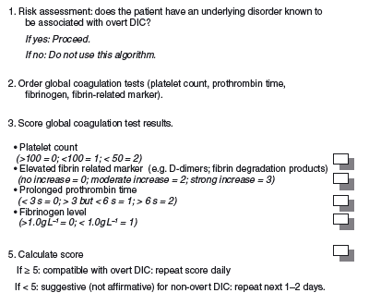
D-dimers and Disseminated intravascular coagulation
Appears in ISTH scoring system for DIC
If normal can effectively exclude DIC
Sensitive but poorly specific
Limited diagnostic use on its own
Toh 2006 JTH

Slide 20
D-dimers
Increasing clinical applications

Slide 21
Measures of coagulation potential

Slide 22
The thromboelastogram (TEG)
Whole blood in cuvette
Developed for use with celite activator
Measures changes in clot strength
Includes all phases of haemostatic mechanism including fibrinolysis.

Slide 23
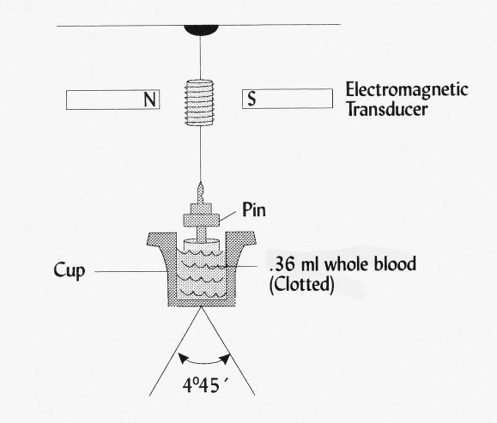
TEG sample cup design

Slide 24
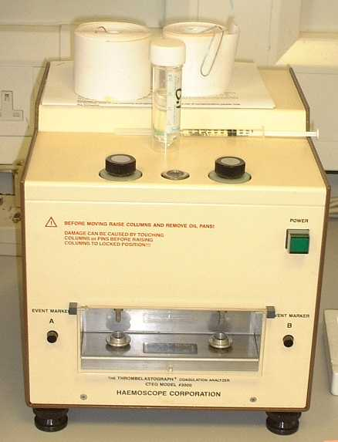

Slide 25
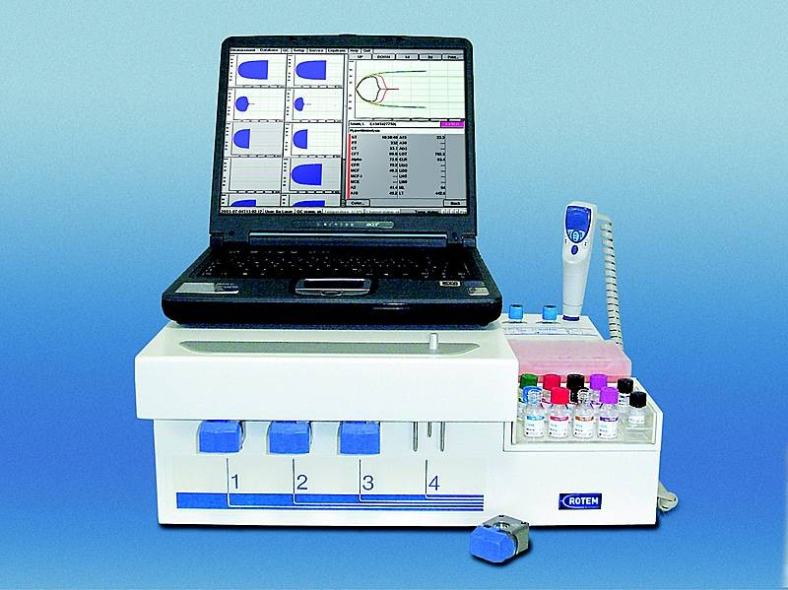
ROTEM

Slide 26
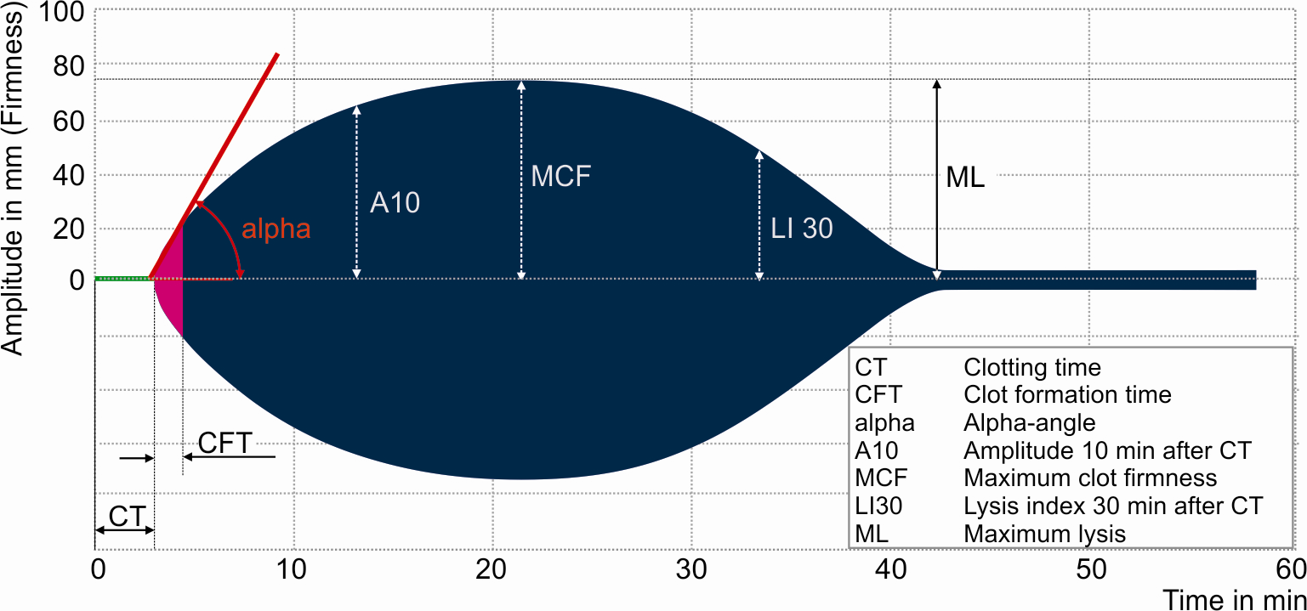
RoTEM trace
TEG
R
MA

Slide 27
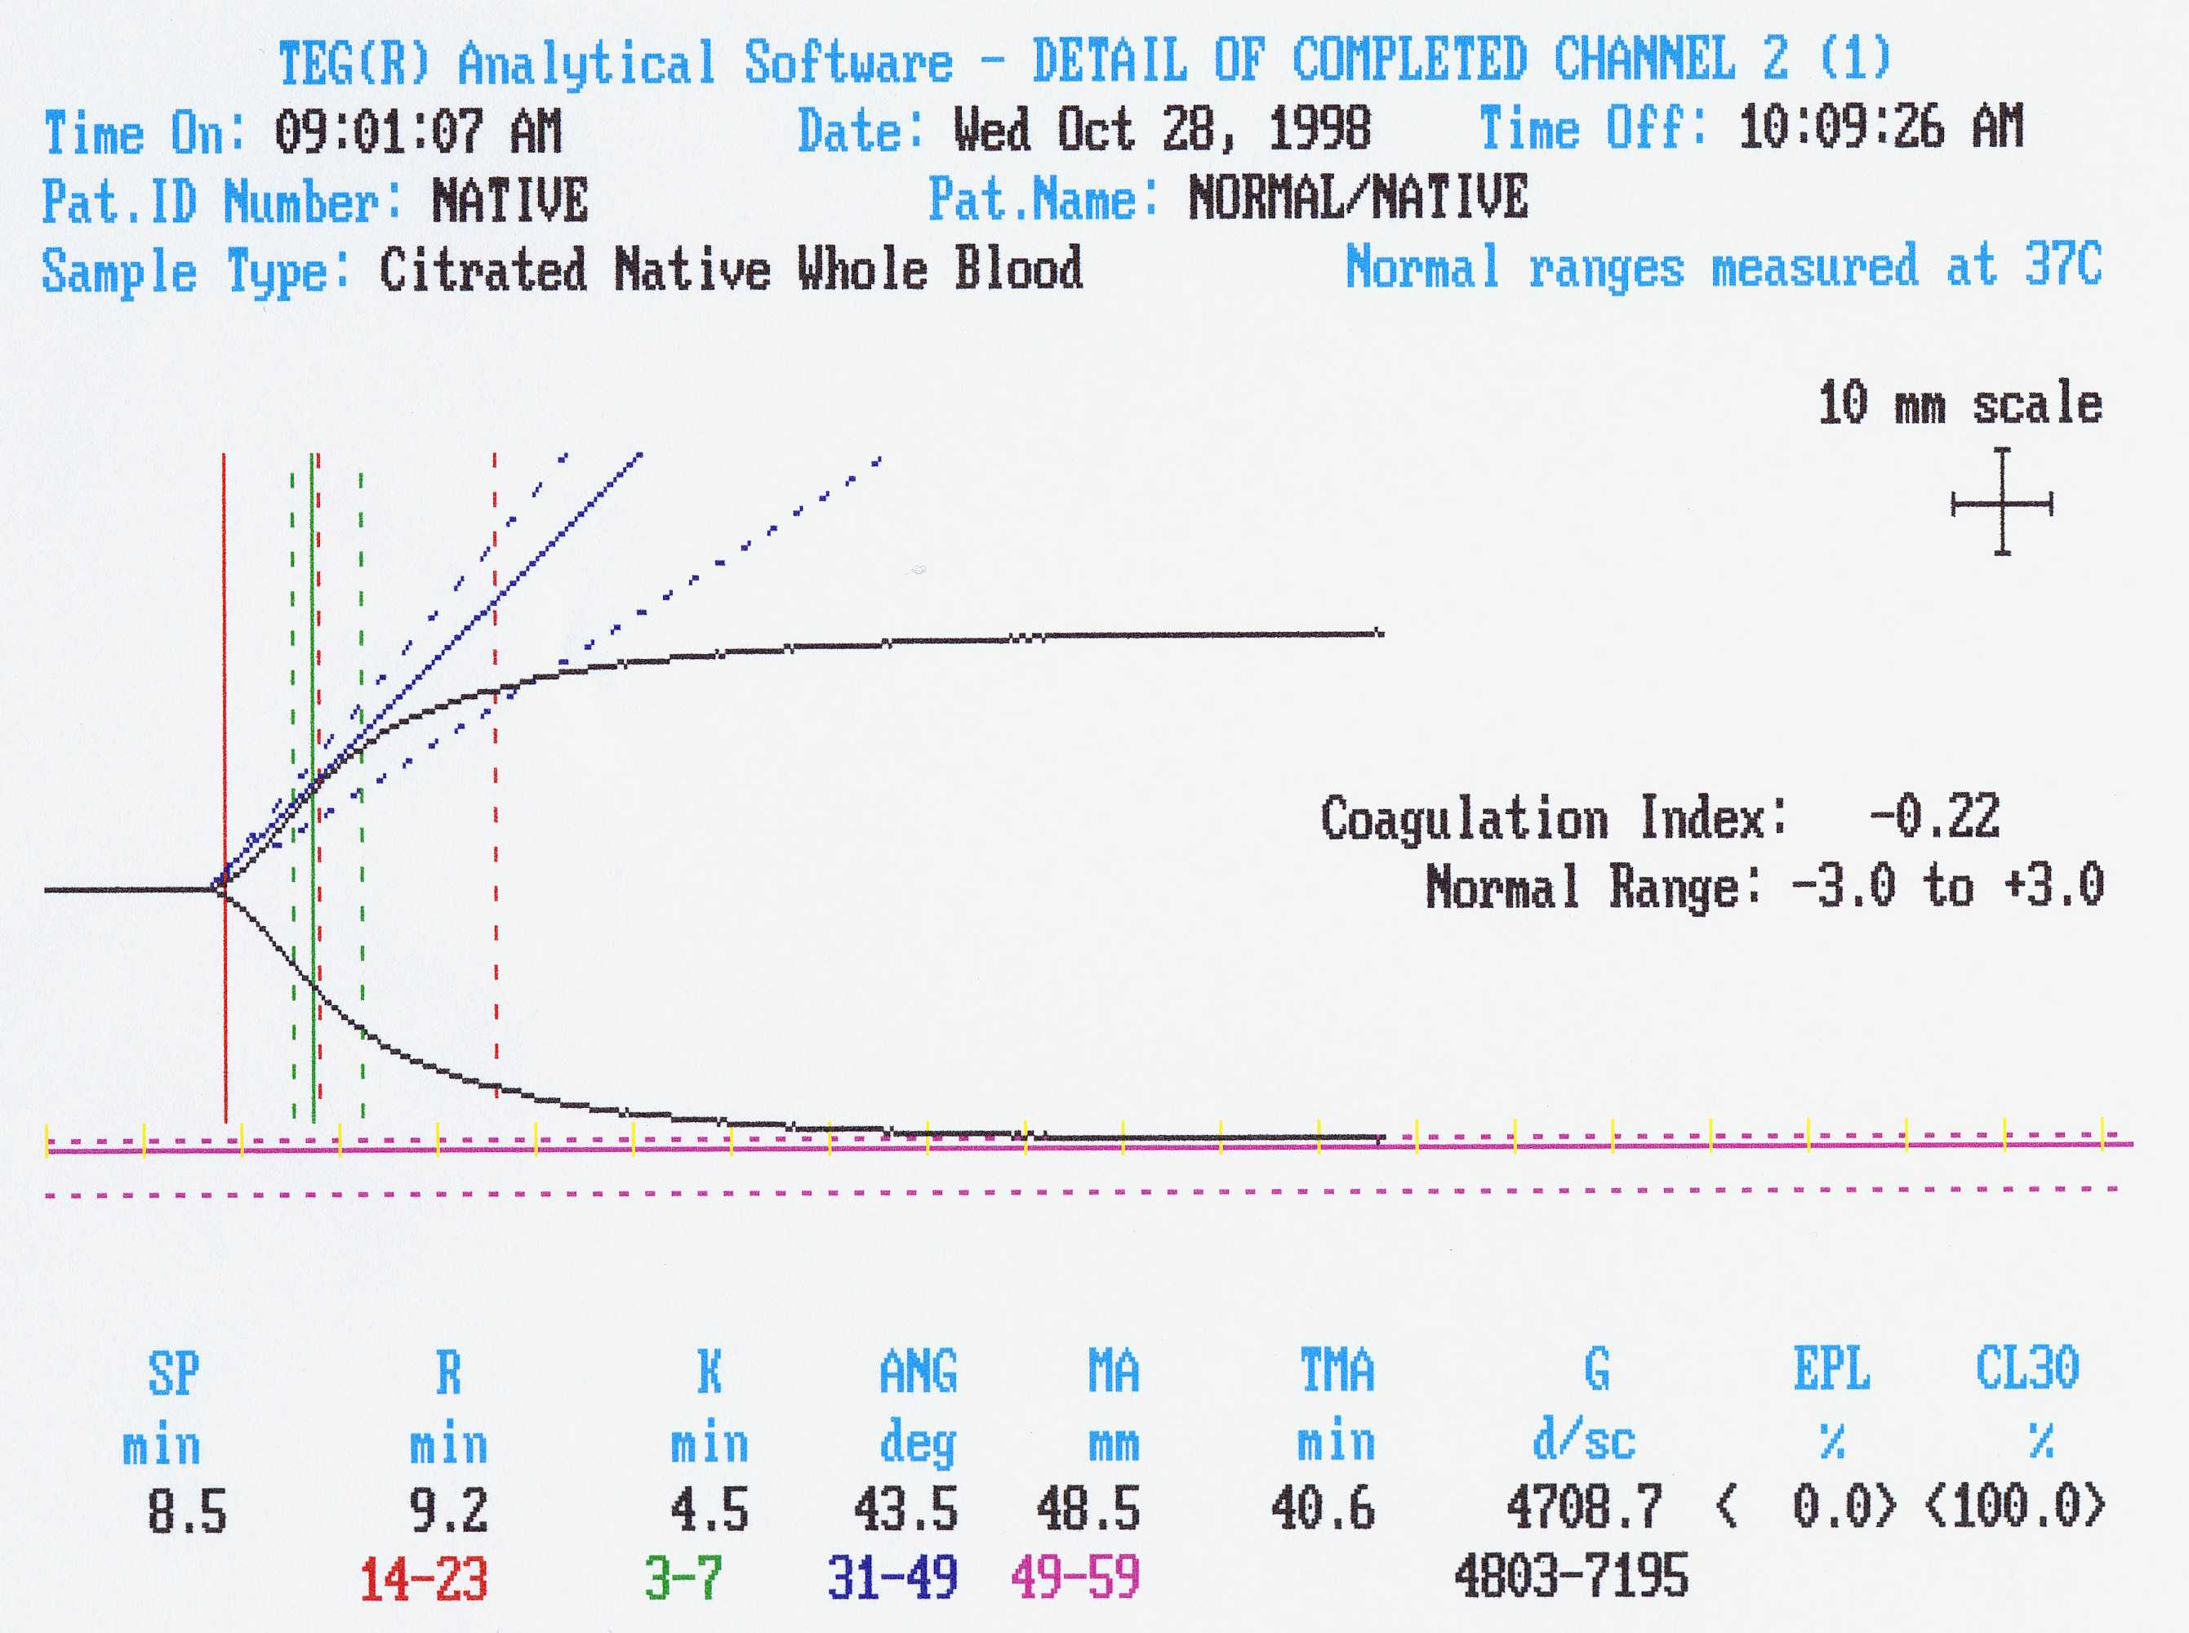

Slide 28
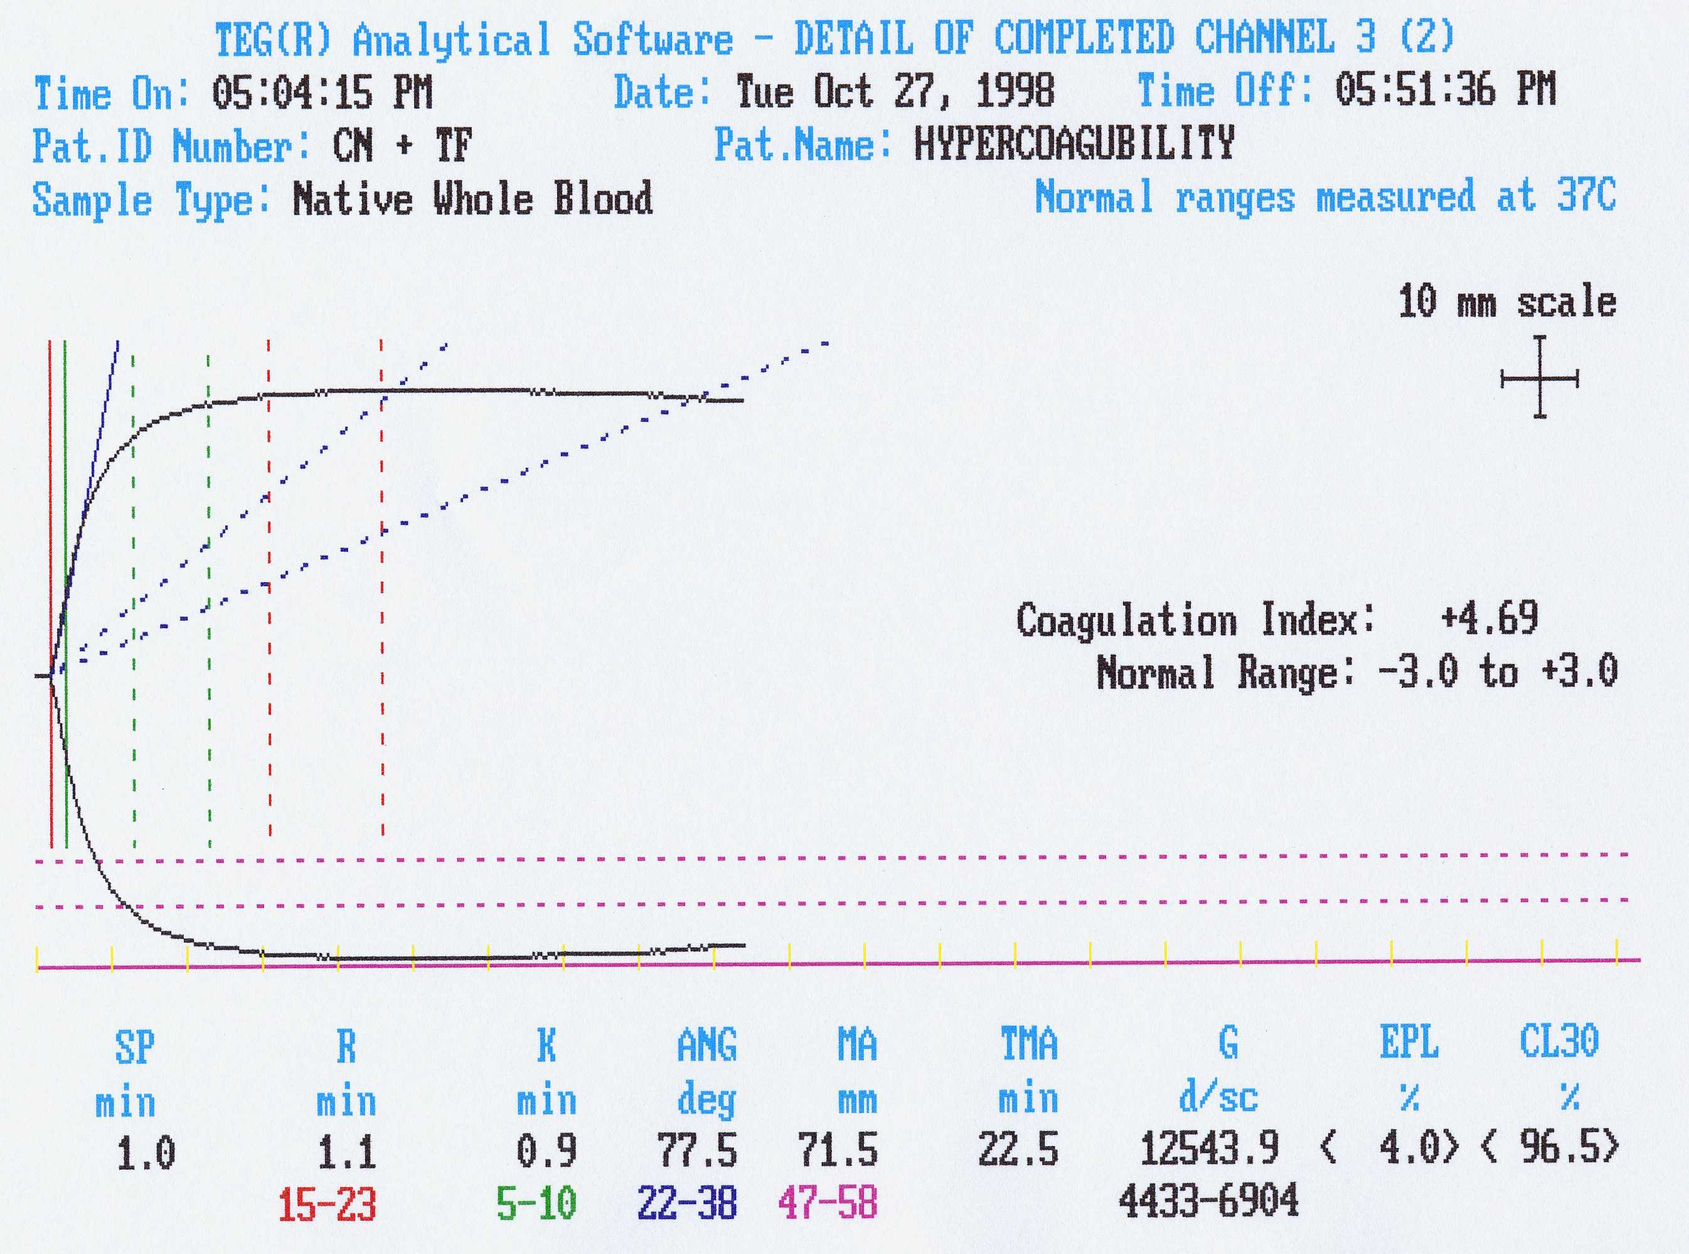

Slide 29
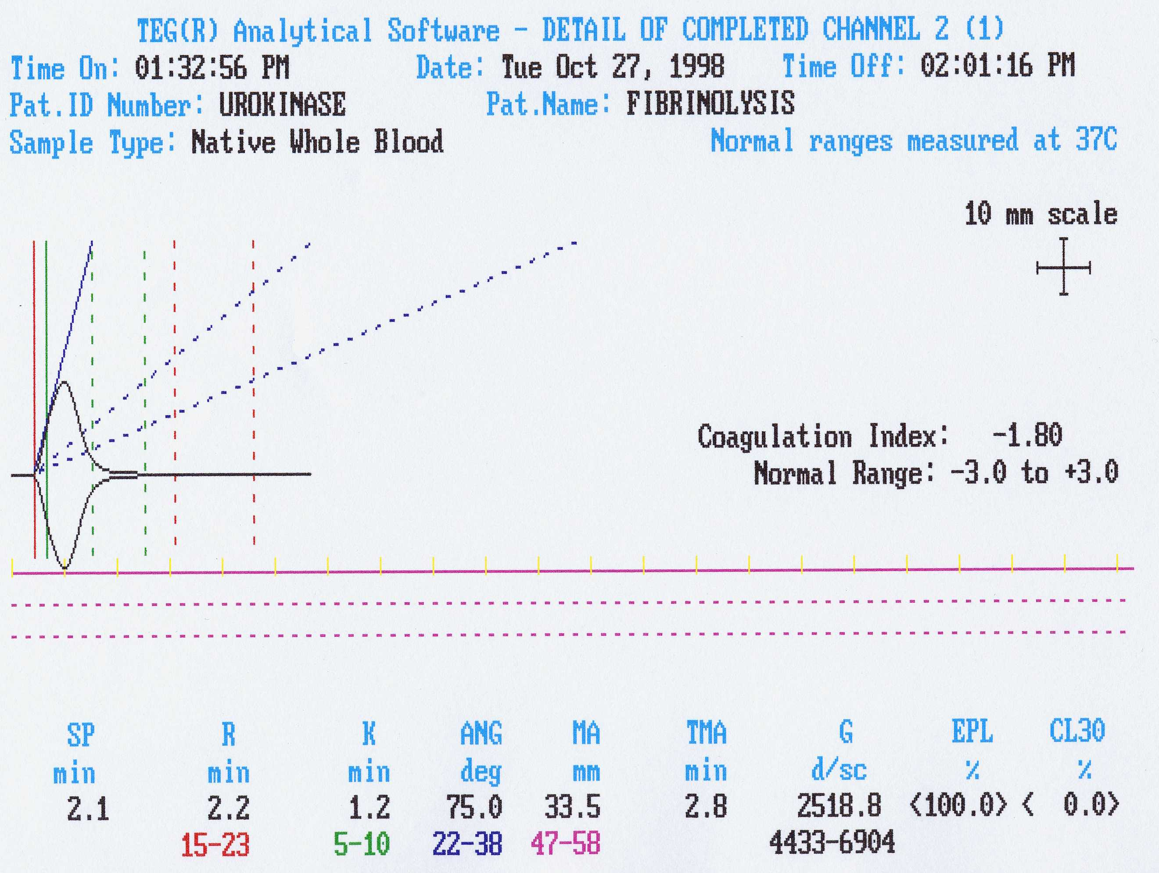

Slide 30
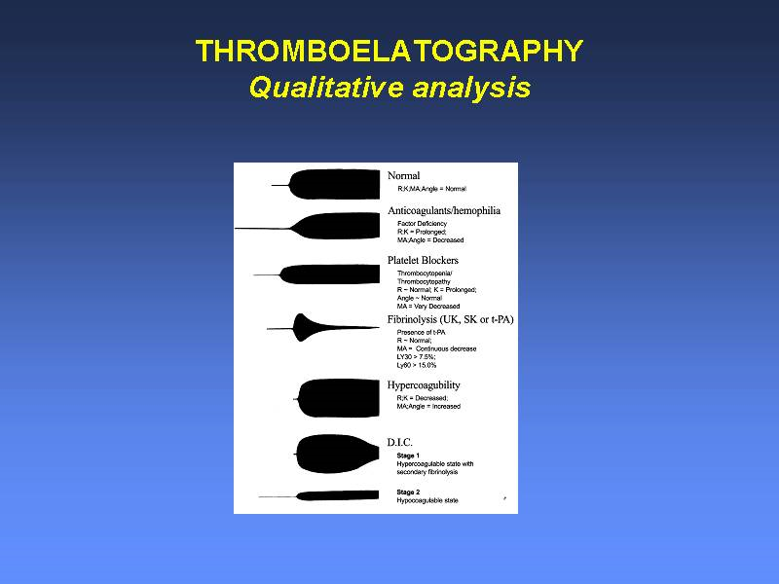

Slide 31
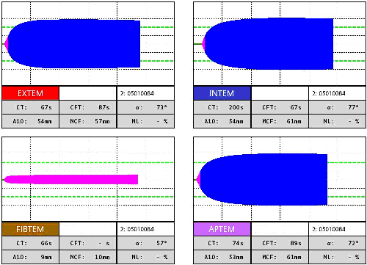
ROTEM Diagnosis: Normal

Slide 32
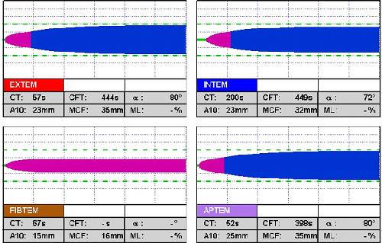
ROTEM Diagnosis: Platelet defect/deficiency

Slide 33
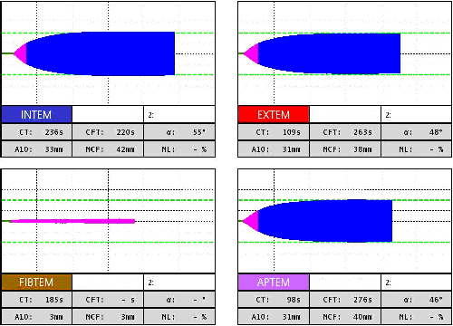
ROTEM Diagnosis: fibrinogen defic

Slide 34
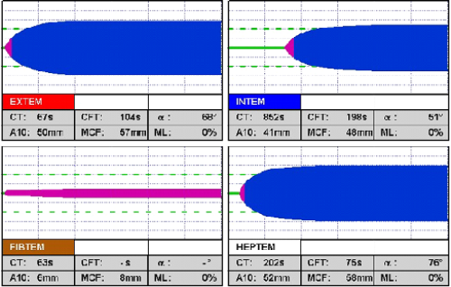
ROTEM Diagnosis: heparin

Slide 35
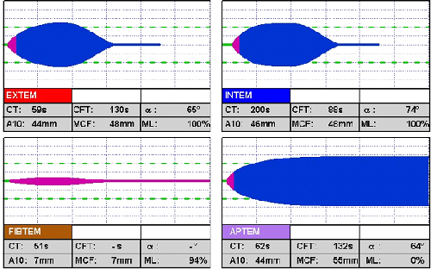
ROTEM Diagnosis: fibrinolysis

Slide 36
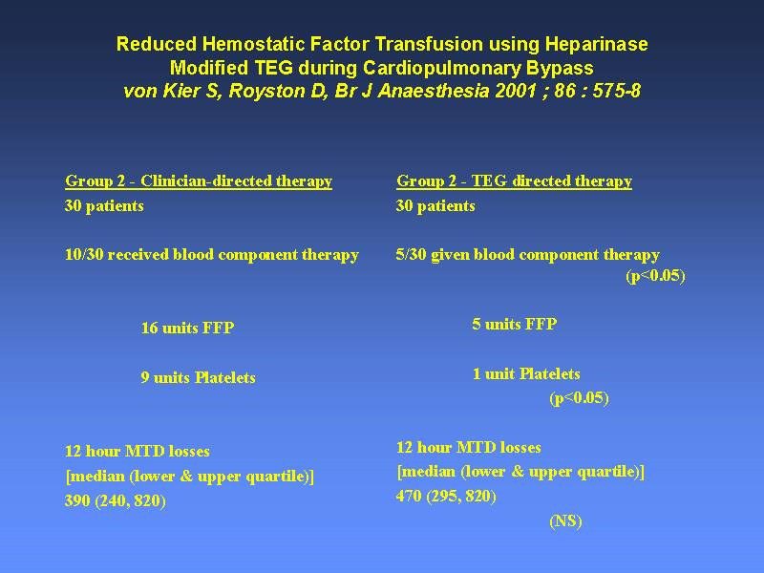

Slide 37
RoTEM - modifications
Test | Interpretation
INTEM | Ellagic acid trigger (contact). Therefore equivalent to APTT
EXTEM | Tissue Factor trigger. Therefore equivalent to PT
HEPTEM | Contains heparinase to break down heparin and allow assessment of coagulation
APTEM | Contains aprotinin to inhibit fibrinolysis
FIBTEM | Contains cytochalasin D which inhibits platelets from contributing to MCF. MCF then represents fibrinogen function.
ECATEM | Contains Ecarin (direct activator of thrombin). Sensitive to presence of direct (only) thrombin inhibitors.
NATEM | Recalcification only (native/classic TEM)

Slide 38
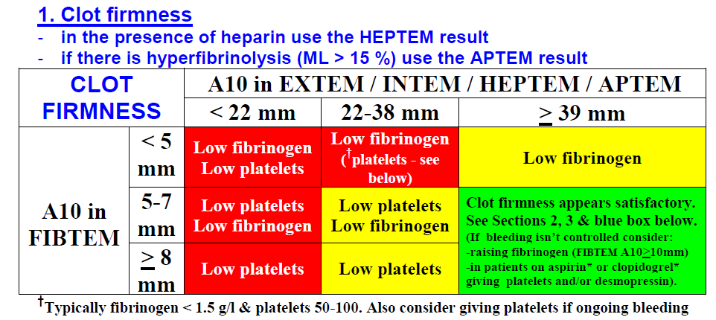
A TEG-based protocol for management of bleeding

Slide 39
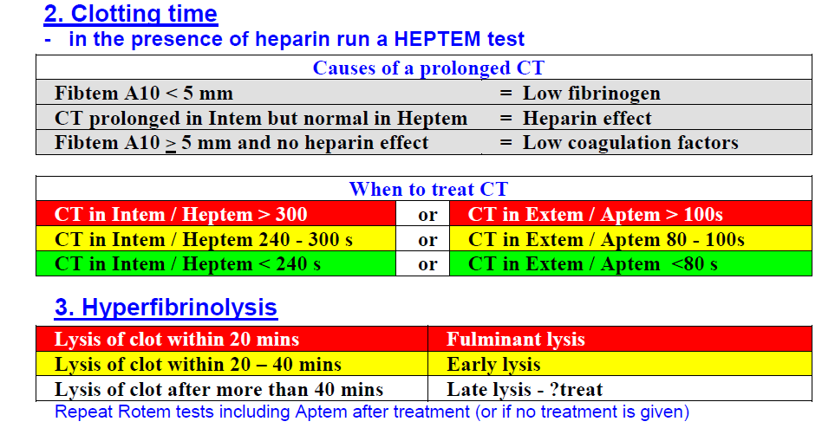
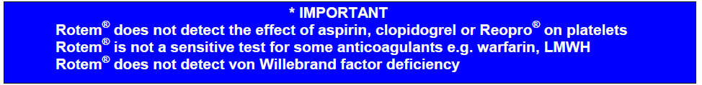

Slide 40
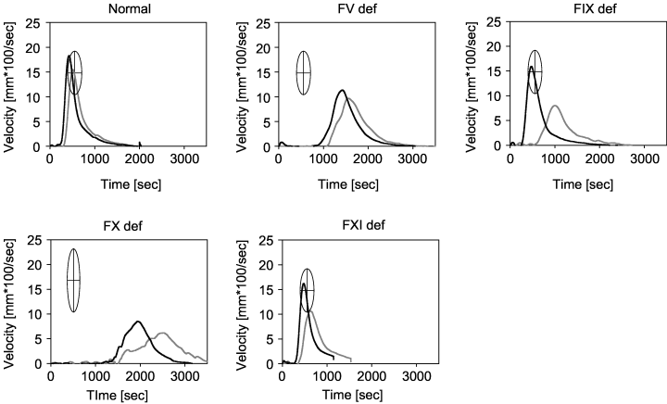
TEG and VIIa therapy
Sorenson 2004

Slide 41
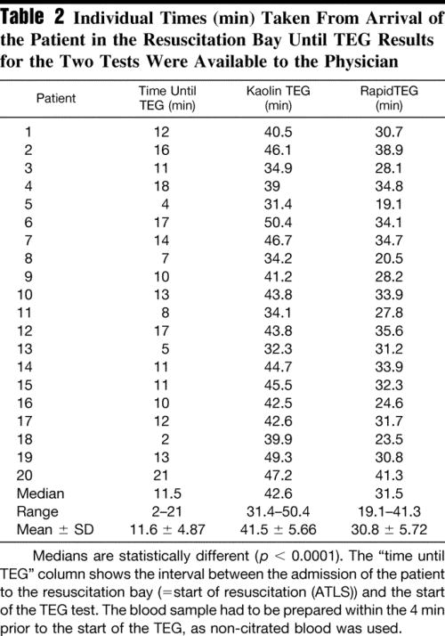
TEG and trauma patients
Jeger 2009

Slide 42
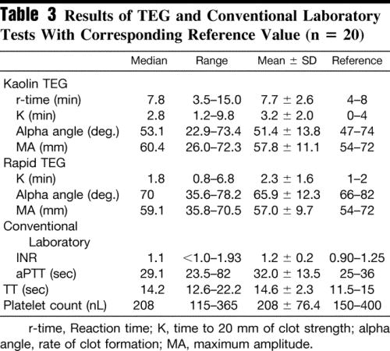
TEG and trauma patients
Jeger 2009
11/20
10/20
9/20
TEG is quicker and at least as sensitive assessment of coagulation
Notes:
42

Slide 43
TEG/RoTEM
Whole blood analysis – global haemostasis
Suitable for near patient testing
Very popular with anaesthetists in cardiac/liver surgery
Appears useful in guiding replacement therapy
No specific diagnosis
Unphysiological trigger (several alternatives)
Lack of clinical correlate data

Slide 44
The endogenous thrombin potential (ETP)
Real time thrombin generation
Fluorogenic substrate
Performed on PRP or PPP but not whole blood
Trigger is usually tissue factor
Not suitable for near patient testing at present
Largely unstandardised.

Slide 45
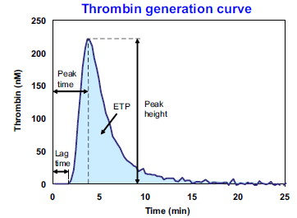
Which is the most relevant parameter?
TF
Clot

Slide 46
Thrombin generation: titration of TF
+10nM TM
Notes:
Thrombin generation in PPP titrated with TF. Shortening of lag time and increase of other parameters occurs with increasing TF.
Clearly we have to add TM if we are to see the effect of FVIII. This is because of the population association between FVIII and APCR and because we know that FVIII is a potential substrate for APC.

Slide 47
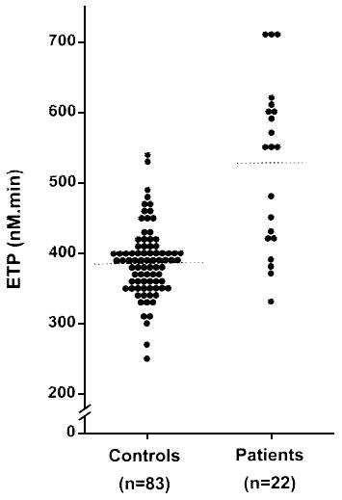
ETP in patients heterozygous for the prothrombin G20210A polymorphism
Kyrle 1998

Slide 48
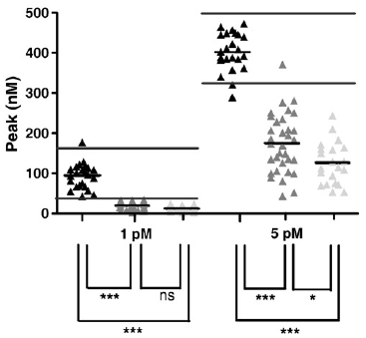
TG and patient phenotype
Cont Mild Severe
Van Veen 2008
Notes:
Sheffield study. Normal mild and severe. Peak thrombin. Differences are significant and the discrimination is best at 5pM because 1pM produces so little. At 1pM could not discrim between mild and severe. Often don’t complete. Lag time is not different.
Discrimination is better than with RoTEM.
However there is still considerable overlap between groups and could not absolutely discriminate on this basis.
There is a wide variation within groups, but of course these have been categorised into mild, mod and severe on the basis of their FVIII levels. The real question is whether TG correlates with bleeding phenotype.
In a sense this is encouraging since it suggest that this test may be assessing more than the FVIII level itself.

Slide 49
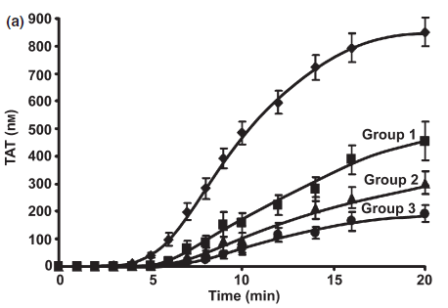
TG and bleeding phenotype in haemophilia A
Control
25% mod, 75% severe
BRUMMEL-ZIEDINS 2009
Notes:
This is whole blood CTI blocked, TF initiated and TG measured by TAT rather than TG but it illustrates the principle.
Scoring of groups is by frequency of haemarthrosis over 5 yrs and there was significant overlap of groups – so some moderates by FVIII weer in severe group by bleeding.
Included mild mod and severe patients.
Looking at the individual TG curves within groups there is still considerable variation.
Mann prefers the CTI because it avoids the recalcification.

Slide 50
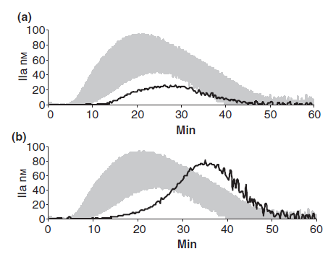
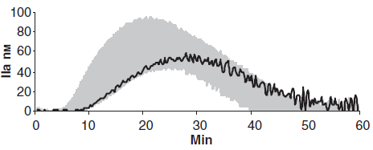
TG and FXI deficiency
Bleeding
Non -bleeding
FXI<1%
FXI = 1%
FXI = 40%
Rugeri 2010
Notes:
Group with FXI deficiency had marginal difference from normal.

Slide 51
Haemophilia A: TG capacity of patient plasma
1800
1600
1400
1200
ETP
1000
800
600
400
200
0
0%
20%
40%
60%
80%
100%
120%
FVIII
Notes:
11 patients with FVIII<1% had FVIII elevated to 50 and 100%. Note very great difference in effect achieved by treatment. Since these all had FVIII assay of <1% this implies that FVIII assays do not pick up all the difference in plasma effects of a given FVIIIc or perhaps are not accurate enough.

Slide 52
Genotype-phenotype in families
ETP
1 2 3 4 5 6 7 8 9
2500
0
2000
50
1500
100
1000
500
0
S M S L S S S S M S L L L S S L L L M M M S M
PEAK
1 2 3 4 5 6 7 8 9
600
0
400
50
100
200
0
S M S L S S S S M S L L L S S L L L M M M S M

Slide 53
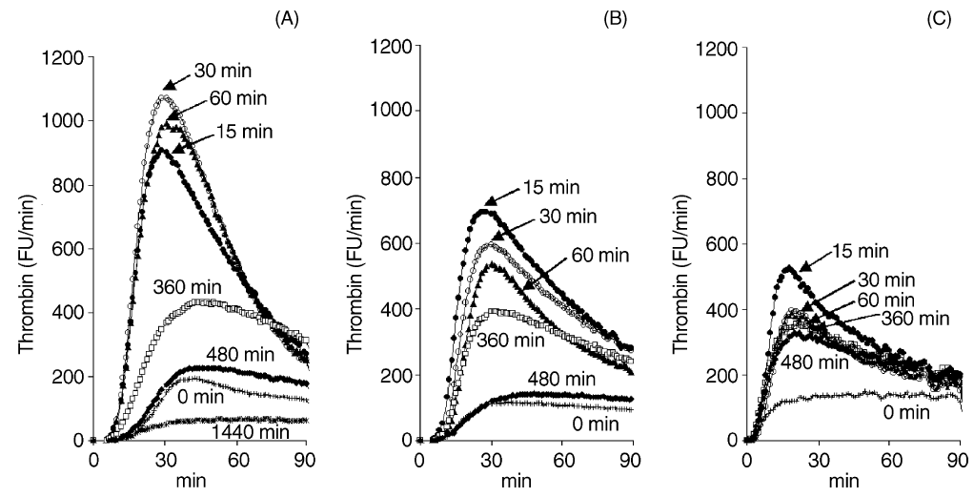
TG and FEIBA by-pass therapy
100 u/kg FEIBA
80 u/kg FEIBA
65 u/kg FEIBA
Varadi 2003

Slide 54
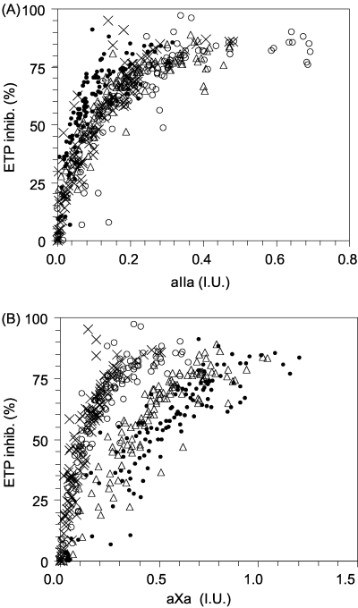
ETP and Heparin therapy
Al Dieri 2004

Slide 55
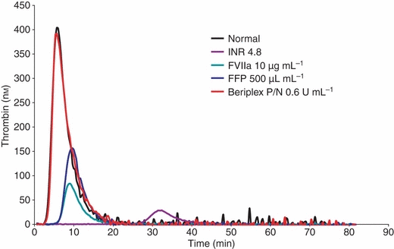
ETP and reversal of warfarin
Gatt 2009

Slide 56
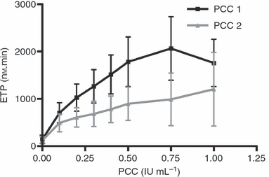
ETP and warfarin reversal
Dargaud 2008

Slide 57
ETP and risk of unprovoked VTE recurrence
ETP > 50th centile
HR 2.9 (1.3–6.6)
Besser 2008

Slide 58
Thrombin generation: applications
Primarily a research tool at present
Not yet standardised
May be useful for
  Assessing response to coagulation factor therapy
  Assessing response to by-pass therapy
  Assessing response to novel agents
  Titrating reversal of new anticoagulants
  Predicting thrombosis recurrence

Slide 59
Global assessment of primary haemostasis

Slide 60
PFA-100® Test Principle
In Vivo Haemostasis
PFA-100®
aperture
150µm
endothelial cell
- 40 mbar
collagen fibrils
epinephrine
or
ADP
membrane
collagen
vWF
vWF
erythrocyte
fibrinogen
platelet
platelet
FLOW
erythrocyte
capillary
200µm
lumen

Slide 61
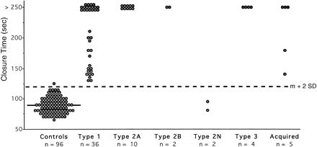
Measurement of CT with collagen-ADP cartridges in the PFA-100 in normal subjects and in patients withvWD. Each closed circle is the mean of duplicate testing in an individual. The solid line represents the mean value inthe normal subjects (89 seconds); the interrupted line across the figure represents the upper limit of normal (120 seconds), which was calculated as the mean (m) + 2 SD.
Fressinaud 1998

Slide 62
PFA100: detection of platelet disorders
Platelet Disorder | Patients | CT (sec)
 |  | ADP (<120) | Epi (<165)
Glanzmann thrombasthenia (n = 2) | 1 | >250 | >250
Pseudo ("platelet")-vWD (n = 3) | 2 1 2 3 | >250 >250 >250 >250 | >250 >250 >250 >250
Storage pool disease (n = 4) | 1 2 3 | >250 >250 >250 | >250 >250 >250
 | 4 | >250 | >250
Aspirin-like defect (n = 6) | 1 2 3 | 150 130 121 | >250 >250 >250
 | 4 | 115 | 228
 | 5 | 104 | 216
 | 6 | 81 | 210
Fressinaud 1998

Slide 63
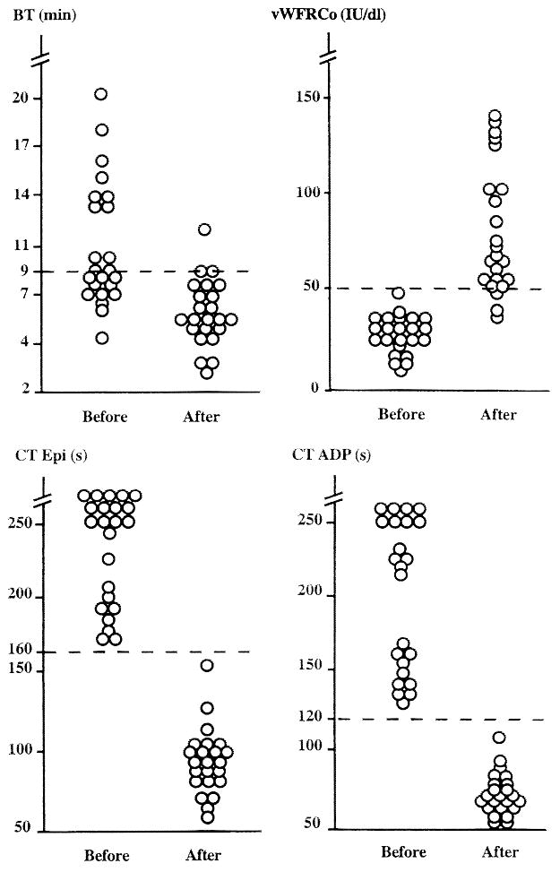
PFA response to DDAVP in Type 1 VWD
Fressinaud 1999

Slide 64
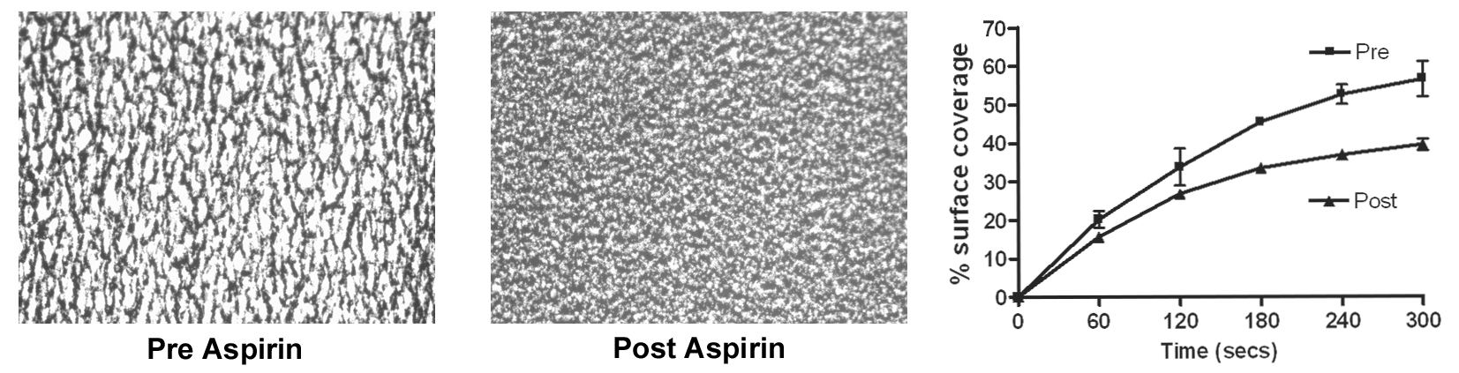
Flow based assessment of aspirin antiplatelet effect

Slide 65
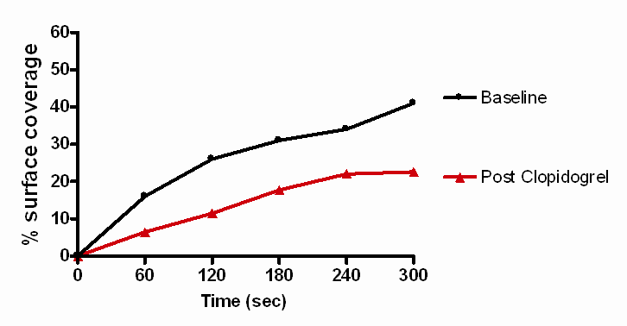
Flow based assessment of clopidogrel antiplatelet effect

Slide 66
Global assays
Attractive summation of numerous factors
Treat coagulation as integrated system
Few data on clinical correlation
  Theoretically could be better than specific factor assays
  Numerous new studies emerging
Some useful for NPT
D-dimer established use in thrombosis
May be useful in assessing therapeutic response
Limited ability to direct specific therapy

