Slide 1
Why do patients bleed?
Haemophilia
Professor Mike Laffan

Slide 2
What can go wrong with haemostasis?

Slide 3
Haemostatic Plug Formation: An Overview
Vessel constriction
Formation of an unstable platelet plug
-platelet adhesion
-platelet aggregation
Stabilisation of the plug with fibrin
-blood coagulation
Dissolution of clot and vessel repair
-fibrinolysis

Slide 4
Primary haemostasis
Formation of the platelet plug

Slide 5
lumen
platelet
platelet
VWF
Collagen
Tissue Factor
Primary Haemostasis

Slide 6
lumen
platelet
platelet
platelet
platelet
platelet
platelet
Collagen
Tissue Factor
Primary Haemostasis: platelet plug

Slide 7
lumen
Haemostasis: fibrin clot stabilising platelet plug

Slide 8
lumen
platelet
platelet
platelet
Collagen
Tissue Factor
VWD: failure of primary haemostasis

Slide 9
Primary haemostasis failure
Number or function of platelets
Quantity or function of VWF
Defects in Collagen or vessel wall

Slide 10
Coagulation
Generation of thrombin and hence the fibrin clot

Slide 11
Thrombin cleaves fibrinogen: formation of the fibrin clot.

Slide 12
T
T
T
T
Thrombin
T
T
T
T
VIIa
Fibrinogen
FPA & FPB
Tissue factor
Fibrin - the ‘clot’
Coagulation: fibrin formation

Slide 13
Fibrin mesh

Slide 14
lumen
Haemophilia: failure to generate thrombin and hence fibrin, to stabilise platelet plug

Slide 15
Termination of coagulation

Slide 16
T
AT
TM
AT
APC
AT
T
T
T
T
T
T
AT
PC
platelet
platelet
T T
T
EPCR
VIIa
Termination of Coagulation

Slide 17
Bleeding and excess anticoagulant function
Naturally occurring is rare
  AT Pittsburgh (actually an anti-trypsin)
Therapeutic
  Heparin
  Hirudin
  Activated protein C

Slide 18
tPA
Pgn
P
AP
TM
-
TAFIa
FDPs
platelet
T
platelet
TAFI
T
T T
T
VIIa
Fibrinolysis

Slide 19
Bleeding and disorders of Fibrinolysis
Disorders of fibrinolysis can cause abnormal bleeding but are rare
  Hereditary
    Antiplasmin deficiency
    PAI-1 deficiency
  Acquired
    Drugs such as tPA
    Disseminated intravascular coagulation
    Some tumours precipitate primary fibrinogenolysis

Slide 20
Haemostasis and Thrombosis: a Balance
Normal haemostasis: a state of equilibrium
Fibrinolytic factors,
anticoagulant proteins
Coagulation factors,
platelets

Slide 21
Bleeding
Coagulation factors,
platelets
Fibrinolytic
factors,
anticoagulant
proteins

Slide 22
Why patients bleed: Haemophilia
Understand the coagulation defect in haemophilia
Understand the pattern of bleeding in haemophilia (and other coagulation disorders)
Understand diagnosis and treatment and complications of treatment
Understand the inheritance and molecular genetics of haemophilia

Slide 23
lumen
Haemophilia: failure to generate fibrin to stabilise platelet plug

Slide 24
Why is there a failure of fibrin formation in haemophilia?

Slide 25
TF-
FVIIa
TF
+
FVII
Extrinsic Pathway
Notes:
1

Slide 26
Intrinsic Pathway
FIX
FIXa
Ca
++
PL
FX
FXa
TF-
FVIIa
FII
THROMBIN
TF
+
FVII
Extrinsic Pathway
Fibrinogen
Fibrin
Notes:
1

Slide 27
Intrinsic Pathway
FIX
FIXa
TFPI
FX
FXa
TF-
FVIIa
TF
FVIIa
FII
THROMBIN
TF
+
FVII
FXa
TFPI
Extrinsic Pathway
Fibrinogen
Fibrin
Notes:
1

Slide 28
Intrinsic Pathway
FIX
FIXa
TFPI
FX
FXa
TF-
FVIIa
TF
FVIIa
FII
THROMBIN
TF
+
FVII
FXa
TFPI
Extrinsic Pathway
Fibrinogen
Fibrin
Notes:
1

Slide 29
Intrinsic Pathway
Ca
++
PL
FIX
FIXa
FVIIIa
FVIII
Ca
++
PL
FV
TFPI
FX
FXa
FVa
TF-
FVIIa
TF
FVIIa
FII
THROMBIN
TF
+
FVII
FXa
TFPI
Extrinsic Pathway
Fibrinogen
Fibrin
Notes:
1

Slide 30
Intrinsic Pathway
FXI
FXIa
Ca
++
PL
FIX
FIXa
FVIIIa
FVIII
Ca
++
PL
FV
TFPI
FX
FXa
FVa
TF-
FVIIa
TF
FVIIa
FII
THROMBIN
TF
+
FVII
FXa
TFPI
Extrinsic Pathway
Fibrinogen
Fibrin
Notes:
1

Slide 31
Haemophilia
Intrinsic Pathway
FXI
FXIa
Ca
++
PL
FIX
FIXa
FVIIIa
FVIII
Ca
++
PL
FV
TFPI
FX
FXa
FVa
TF-
FVIIa
TF
FVIIa
FII
THROMBIN
TF
+
FVII
FXa
TFPI
Extrinsic Pathway
Fibrinogen
Fibrin
Notes:
1

Slide 32
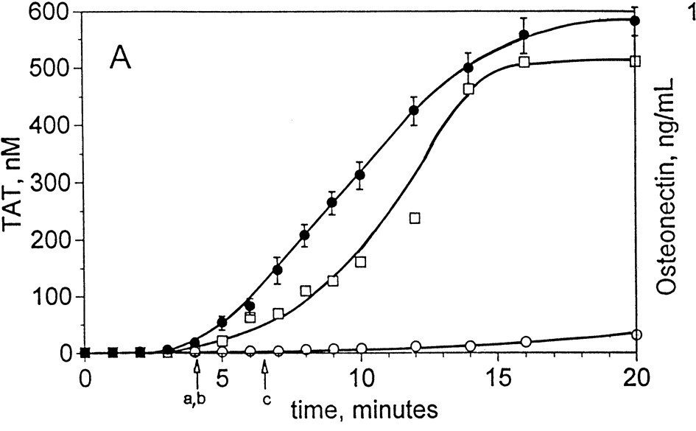
Thrombin generation in haemophilia

Slide 33
Thrombin generation and FVIII

Slide 34
Why a ‘burst’ of thrombin?
Clot formation occurs at end of initiation phase, but,
  Rapid thrombin generation produces a stronger, denser clot
  A large amount of thrombin is required to inhibit fibrinolysis (activation of TAFI)
Coagulation defects are characterised by a failure of thrombin burst

Slide 35
Secondary events securing haemostasis (1)
Factor XIII is activated by thrombin
FXIII
  Cross links fibrin monomers
  Cross links α2AP to fibrin
  Prevents dissolution of clot
  Inhibits fibrinolysis

Slide 36
Secondary events securing haemostasis (2)
Further thrombin is generated via FXI.
This thrombin appears to be important in activating TAFI (thrombin activatable fibrinolysis inhibitor).
Inhibits fibrinolysis by removing lysine binding sites for plasminogen on fibrin.
Depends on FVIII, IX as well as XI

Slide 37
Coagulation in haemophilia
Absence of thrombin burst results in:
  Unstable platelet aggregate
  Loose fibrin clot
    Susceptible to fibrinolysis
    Insecure
  Failure to activate TAFI
    Fibrinolysis not inhibited
Delayed bleeding

Slide 38
Disorders of coagulation
Failure of thrombin generation may result from deficiency of any coagulation factor
May be quantitative or qualitative
Severity depends on degree of deficiency and position in network
40% of most factors is sufficient for haemostasis
One functional allele is sufficient
Haemophilias are common because X linked

Slide 39
Disorders of coagulation: bleeding pattern
Bleeding often delayed (primary haemostasis normal)
Typically from deep structures
  Eg muscles and joints
Pattern varies with different deficiencies.

Slide 40
Factor VIII Deficiency
100
90
80
70
60
50
40
30
20
10
0
90%
81%
75%
75%
25%
15%
13%
16%
N.A
0%
Nose Uterus Haem- GI Joint Muscle CNS Cord Postop/ Oral
aturia part cavity

Slide 41
Coagulation factor deficiencies are not all the same
Factor VIII and IX (Haemophilia)
  Severe but compatible with life
  Spontaneous joint and muscle bleeding
Prothrombin (Factor II)
  Lethal
Factor XI
  Bleed after trauma but not spontaneously
Factor XII
  No excess bleeding at all

Slide 42
Blood coagulation
XII
XIIa
XI
XIa
Tissue factor
VIIa
(vessel damage)
Ca
2+
IX
IXa
VIIa
EXTRINSIC
PATHWAY
INTRINSIC
PATHWAY
VIIIa
Ca
2+
Pl
Ca ²⁺
X
Xa
X
Va
Pl
Ca
2+
COMMON
PATHWAY
Prothrombin
thrombin (IIa)
Fibrinogen
Fibrin
thrombin
XIIIa
XIII
Crosslinked
fibrin

Slide 43
Haemophilia A and B
Factor VIII and Factor IX deficiency are clinically indistinguishable
  pattern of bleeding
  severity
  coagulation screen results
  mode of inheritance

Slide 44
Diagnosis of haemophilia: prolonged APTT
HMWK
APTT
CONTACT
PK
XII
PT
XI
VIIa
TF
VIII
IX
V
X
PT 10.6 (9.6-11.6)
APTT 85 (26-32)
TT 16 (15-19)
TT
II
Fibrinogen
Fibrin

Slide 45
Classification of Haemophilia
Type Deficiency
Haemophilia A Factor VIII
Haemophilia B Factor IX
(Christmas disease)
Severity Factor level
Severe ≤1%
Moderate 2-5%
Mild 6-40%
Normal 40-150%

Slide 46
Bleeding in haemophilia
Severe (≤1%)
‘spontaneous’ bleeds
Joints and muscle
Easy bruising
Bleeding often delayed, but prolonged
Bleeding time normal
Moderate (2-5%)
Prolonged or excessive bleeding after minor trauma
Rarely bleeds into joints
Mild (6-40%)
Excessive bleeding only after major trauma or surgery

Slide 47
Thrombin generation and FVIII
FEDP 1 pMTF
1600
1400
50
1200
1000
10
ETP
800
5
600
2.5
400
1
200
0
0
0
10
20
30
40
50
60
FVIII %

Slide 48
Bleeding in haemophilia
Deep; muscle and joint
Delayed
Not from superficial cuts or small vessels (eg nosebleeds)

Slide 49
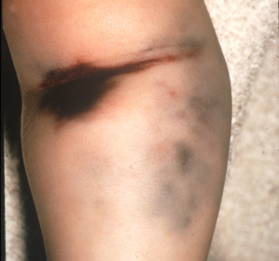
Taking blood samples is usually safe

Slide 50
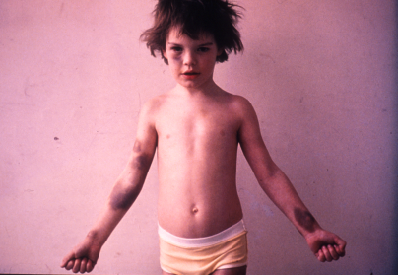
Do not mistake haemophilia for NAI

Slide 51
Cause of death recorded for 113 cases of Haemophilia
Carol Birch 1937

Slide 52
Bleeding in haemophilia
1. Haemarthrosis
begin at age approx 1 year
apparently spontaneous
may be preceded by ‘tingling’
blood fills joint cavity
rise in pressure is excruciatingly painful
pressure eventually stop bleeding
blood damages cartilage
joint becomes prone to recurrent bleeds

Slide 53
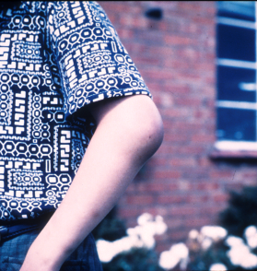
Haemarthrosis: the hallmark of haemophilia

Slide 54
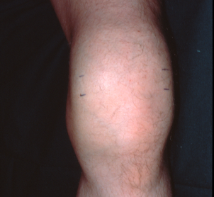

Slide 55
Target joints: a vicious cycle
Bleeding
Arthritis
Friable and expanded
synovium
Synovial hypertrophy

Slide 56
Joint deformation
caused by haemophilia A
Scar on right lower
thigh is site of
previously excised
pseudotumour.

Slide 57
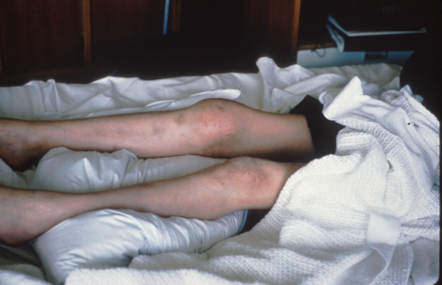

Slide 58
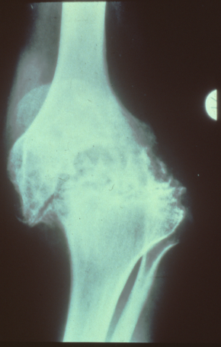
Haemophilic
arthropathy

Slide 59
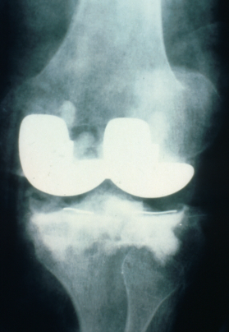

Slide 60
Bleeding in haemophilia
2. Muscle bleeds
often apparently spontaneous
may result from exertion
blood fills muscle capsule or compartment
‘compartment sydrome’ may result
pressure eventually stops bleeding
Psoas bleed is typical example

Slide 61
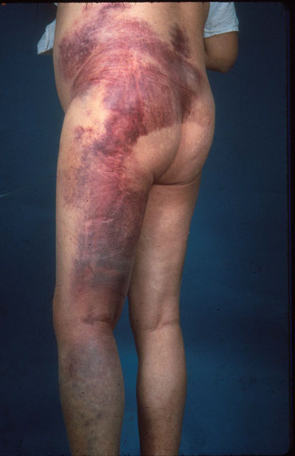
Intramuscular injections should be avoided

Slide 62
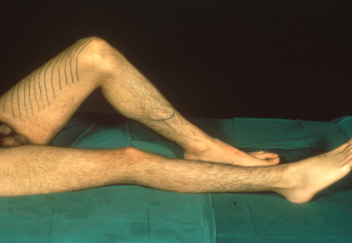
Bleeding into muscle: a psoas bleed

Slide 63
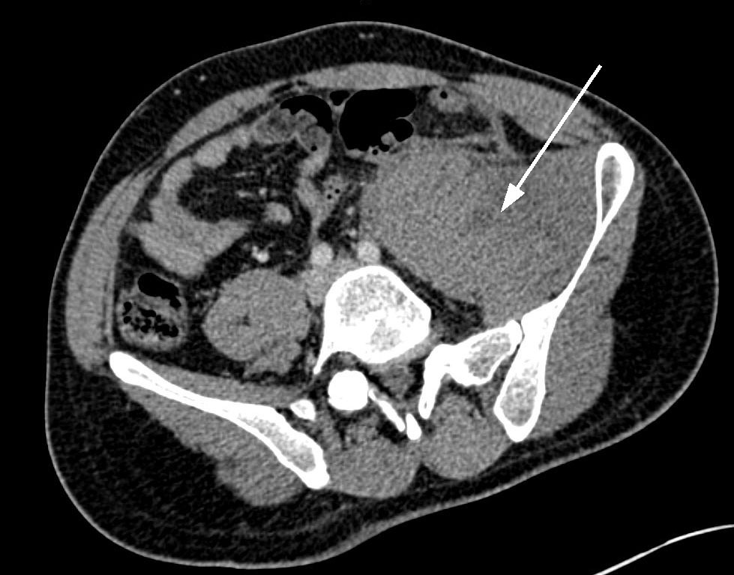
Psoas haematoma
JOL 2011

Slide 64
Treatment for haemophilia

Slide 65
History of haemophilia treatment
pre 1940 snake venom
1950’s whole blood, plasma
1960’s cryoprecipitate
1970’s factor concentrates
1984 factor VIII cloned
1990’s recombinant FVIII and FIX
2000 protein free production

Slide 66
Factor replacement – half lives
Factor VIII 8-12 hours
Factor IX 18-24 hours

Slide 67
Using factor replacement therapy
factor
level (%)
100
75
50
25
0
VIII
IX
0
12
24
24
36
48
96
60
time (hours)

Slide 68
Using factor replacement therapy 2
1: Treat bleeds as they occur “on demand” therapy
2: Treat before bleeds occur “prophylactic” therapy

Slide 69
Advantages of prophylactic therapy
no painful bleeds
treat when well and not in pain
no haemophilic arthropathy
less concern re-activity
less need to carry concentrate around
life approaches 'normal'
Disadvantages of prophylactic therapy
regular injections
need to start at early age
difficult in young children
may need portacath
relatively expensive (?)

Slide 70
Prophylactic regimens
25-40u/kg i.v.
Factor VIII 3 times per week
Factor IX 2 times per week

Slide 71
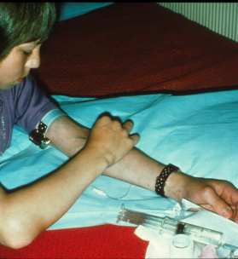

Slide 72
Age at start of prophylaxis
6
Time from bleed to prophylaxis
X-Ray Score
5
Orthopaedic score
4
Score/Age
3
2
1
0
Group 1
1974-9
Group 2
1980-5
Group 3
1986-990

Slide 73
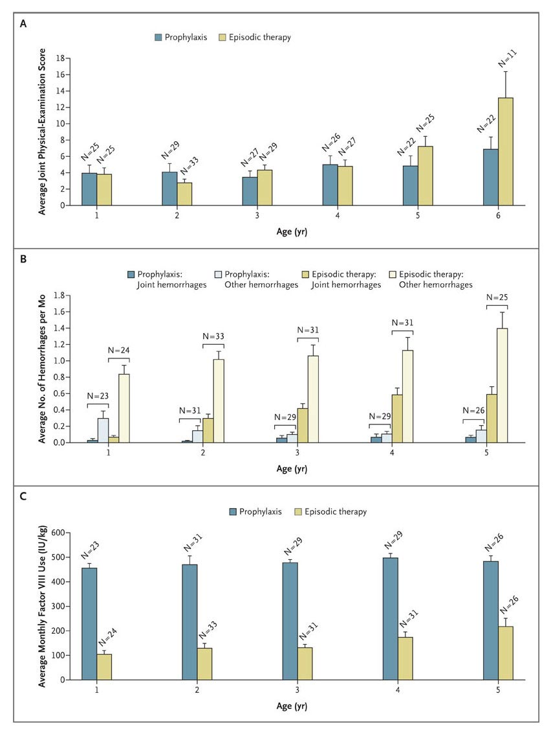
Prophylaxis versus on demand treatment for haemophilia
Manco-Johnson 2007

Slide 74
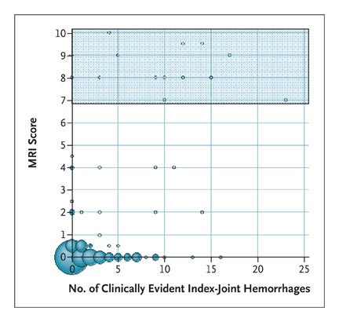
MRI score and joint bleeds
Manco-Johnson 2007

Slide 75
Secondary prophylaxis in adults
 | On demand | Prophylaxis | p
All bleeds | 20.5 (14-37) | 0 (0-3) | <0.001
Joint bleeds | 15.0 (11-26) | 0 (0-3) | <0.001
Spontaneous bleeds | 13.5 (7-29) | 0 (0-1) | <0.001
Traumatic bleeds | 2.5 (0-9) | 0 (0) | <0.001
Collins JTH 2009

Slide 76
Non-concentrate treatments
local measures
tranexamic acid
DDAVP

Slide 77
Tranexamic acid
Lysine derivative
Binds to plasminogen
Blocks binding to fibrin
Clot lysis is reduced
Widely distributed
Teratogenic
Intravenous: 0.5g tds
Oral: 1.5g tds
Mouthwash: 1g (10ml 10%) qds

Slide 78
Desmopressin (DDAVP)
Vasopressin derivative
Acts via V2 receptors
2-5 fold rise in VWF-VIII (VIII>VWF)
Dose
Peak response
0.3µg/kg i.v
30-60 mins
300µg i.n.
60-90 mins

Slide 79
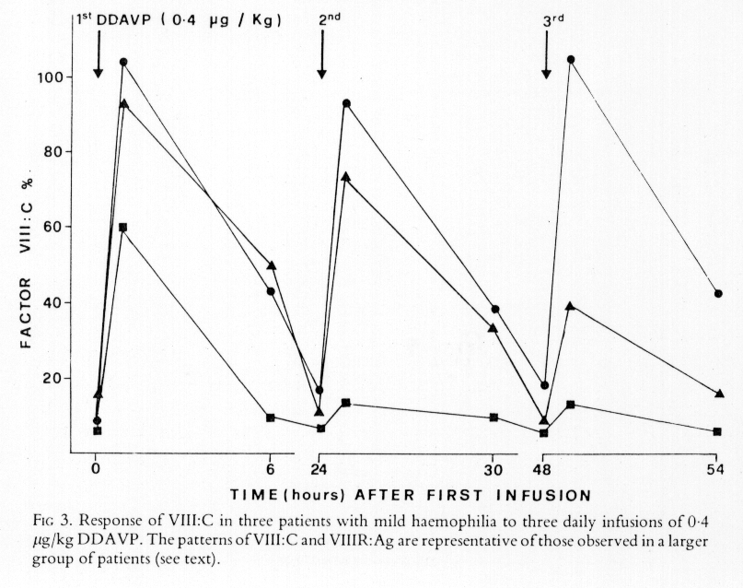
Mannucci 1981

Slide 80
Mortality in Haemophilia

Slide 81
Severe haemophilia
120
100
80
60
40
20
0
All patients
HIV +ve
HIV -ve
Standardized death rate per 1000
77 79 81 83 85 87 89 91 93
Year
Darby 1995

Slide 82
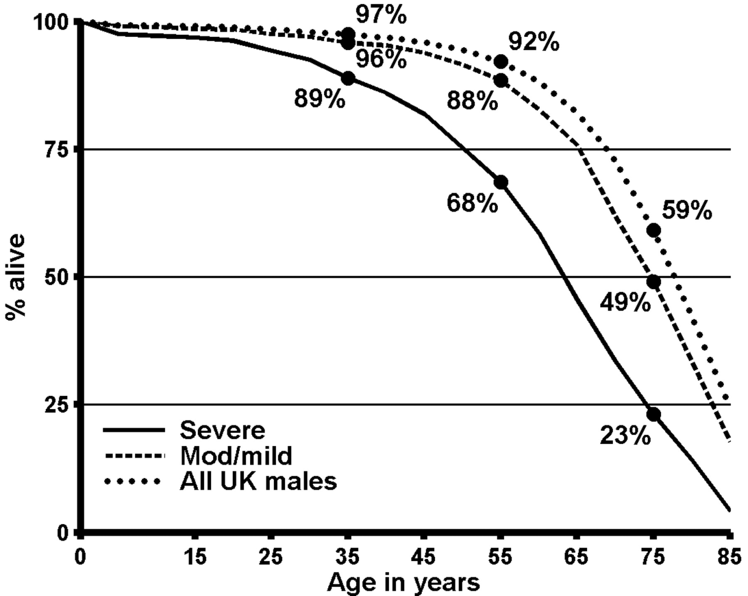
Survival of UK men with haemophilia (no HIV) in 1999.
Darby 2007

Slide 83
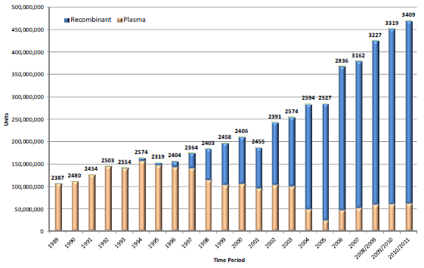
Factor VIII usage by UK centres 1989-2010

Slide 84
Complications of treatment
1. Infection
Hepatitis B
Hepatitis C
HIV
Prions?
2. Immune
Antibody production
(inhibitors)

Slide 85
Haemophilia A: genetics
Factor VIII and IX are both on the X chromosome

Slide 86
Inheritance of haemophilia
X
Y
X
X
X
Y
X
Y
X
X
X
X
X
Y
X
Y
X
Y
X
X
X
X

Slide 87
Inheritance of haemophilia
For a female heterozygote (carrier)
  Half of sons are affected
  Half of daughters are carriers
For a male haemophiliac:
  All daughters are heterozygotes
  All sons are unaffected
Approx one third are new mutations

Slide 88
Women and haemophilia
sex linked recessive
level in males is consistent
levels in heterozygotes is extremely variable

Slide 89
Factor VIII level in heterozygotes
Allele usage FVIII
Normal Deficient
50 50 50%
10 90 10%
20 80 20%
60 40 60%
80 20 80%

Slide 90
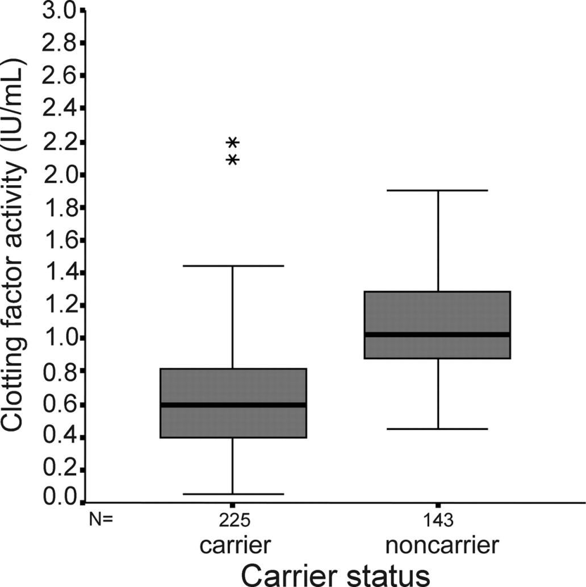
Factor levels in haemophilia carriers
Plug 2006

Slide 91
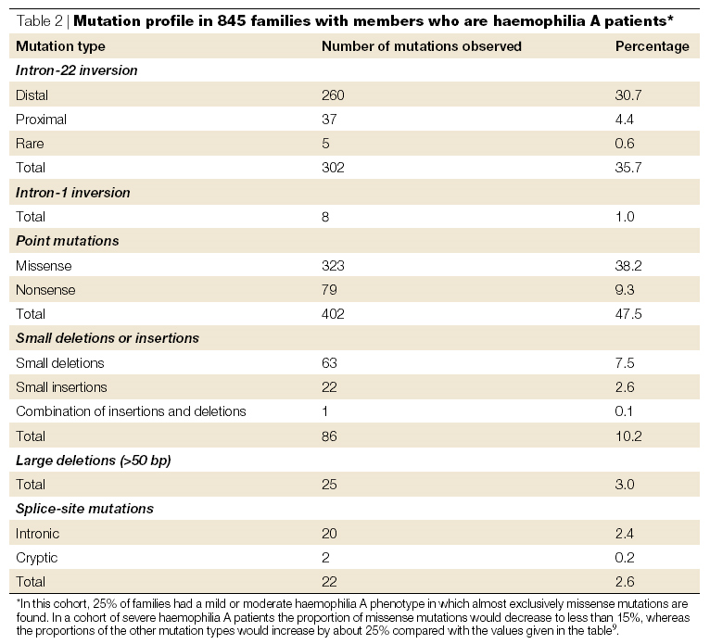
Severe
45%
15%
Graw 2005

Slide 92
Flipping the tip
Exons 26-23
22-1
F8
cen
Xqter
26-23
22-1
cen
Homologous
recombination
Xqter
26-23
1-22
cen
Xqter
disrupted
F8 gene
Nearly always occurs in spermatogenesis
Similar mechanism in intron 1

Slide 93
Haemophilia A Mutations
(excluding inversions)
Total Reports | 1104
Unique mutations | 622
Unique Deletions | 169
Unique Insertions | 28
Unique Splice variants | 42
Unique Point mutations (mis-sense + stop) | 383

Slide 94
Factor IX genetics
Factor IX deficiency is one-fifth as common as FVIII
No inversions
Otherwise the same range of mutations is seen

Slide 95
Inhibitors
antibodies to factor VIII/FIX
‘foreign’ molecule to severe patients
40-50% of severe haemophilia
~10-15% are persistent
High titre render FVIII/FIX treatment useless
Require by-pass therapy – partially effective

Slide 96
Developments in haemophilia
Antenatal diagnosis
Preimplantation genetic diagnosis (PIGD)
New delivery systems – infusion
‘Designer molecules’ rFVIII
  Longer half life
  Low immunogenicity/reactivity
Gene therapy

Slide 97
New approaches to haemophilia
FVIII molecules with increased activity/stability
  Eg by linking A1 and A2 domains
Prolonging half life of FVIII or IX
  Couple to liposomes
  Couple to PEG
  Polysialylation
  Couple to albumin
  Couple to Fc

Slide 98
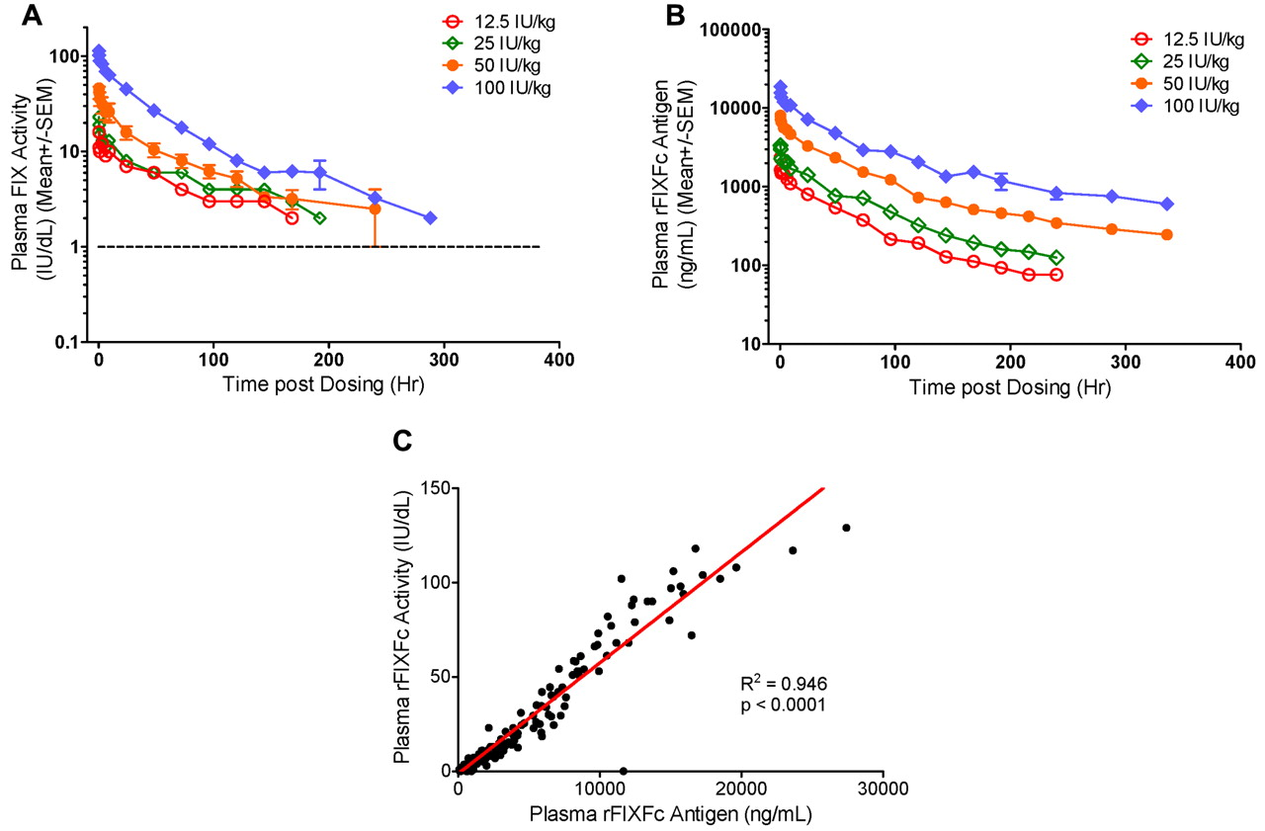
FIX-Fc pharmacokinetics
T1/2 = 60 hours
(cf 20)
Shapiro Blood 2012;119:666-672
Notes:
Dose-dependent PK profiles and correlation of rFIXFc activity and Ag in plasma. (A) Plasma FIX activity and (B) plasma rFIXFc Ag levels over time after a single intravenous infusion of 12.5 (n = 1), 25 (n = 1), 50 (n = 5), or 100 (n = 5) IU/kg rFIXFc. Results presented are group mean ± SEM. (C) Correlation between plasma rFIXFc activity and Ag levels in 12 subjects who received a single dose of 12.5-100 IU/kg rFIXFc. Samples were collected up to 336 hours after dosing.

Slide 99
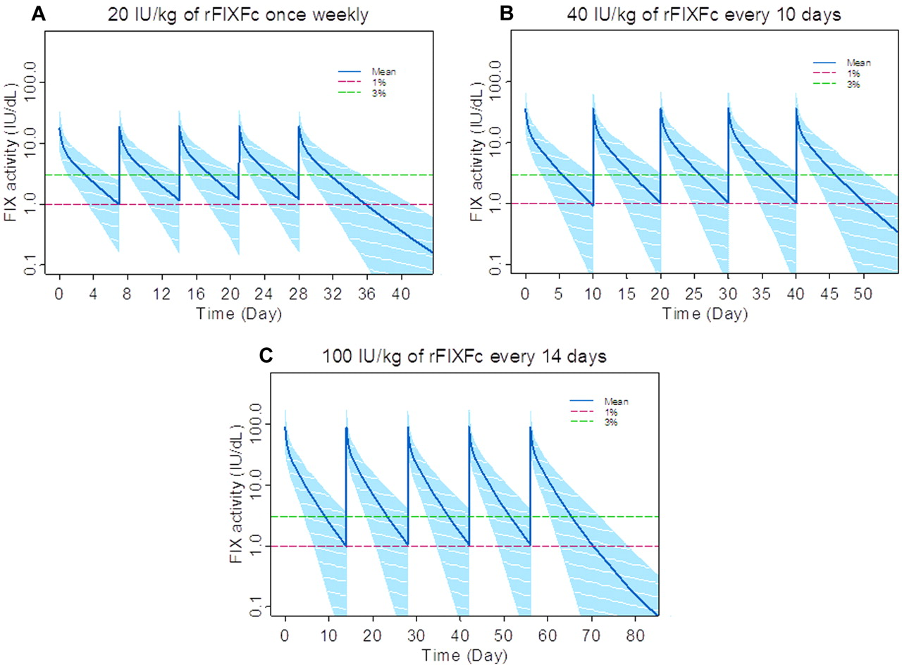
Dosing models for prophylaxis with rFIXFc
Shapiro Blood 2012;119:666-672
Notes:
Monte Carlo simulation for rFIXFc doses to achieve a trough of 1 IU/dL (1%) or 3 IU/dL (3%) above baseline. The rFIXFc dosing intervals considered were (A) weekly, (B) every 10 days, or (C) every 2 weeks. The mean population PK parameters and relevant intersubject and intrasubject variability were adopted from this phase1/2a study. On the basis of the simulated activity-time profiles, the mean and 95% CI of the activity-time profiles of the 1000 subjects was constructed graphically for different dosing regimens for a total of 5 dosing cycles when the steady state was achieved.

Slide 100
New approaches to haemophilia
Indirect effect on FVIII by prolonging half life of VWF
  Pegulation
  Polysialylation
Peptidomimetics
  Non-peptide molecules with FIX cofactor activity
  Allow different routes of administration
Antibody
  binds FX and FIX

Slide 101
Problems with new approaches
May increase immunogenicity (though could decrease too)
May be thrombogenic.
Cost

