Slide 1

Gene therapy: progress and prospects
Home
About NHSBT
News
Current Issues
Contact
Amit C Nathwani
UCL Cancer Institute and NHSBT
© NHS Blood and Transplant 2009
Accessibility
Site map

Slide 2
Gene therapy: Overview
Definition and introduction to vectors
Retroviral vectors (Integrating vectors)
  Immunodeficiency syndromes
    SCID-XI
    ADA deficiency
  Malignancies
    e.g. melanoma
  CARs (chimeric antigen receptors)
    e.g. CLL, ALL
rAAV vectors (non-integrating vectors)
    Congenital blindness
    Parkinson’s disease
    Lipoprotein lipase deficiency
Haemophilia B gene therapy

Slide 3
Gene therapy: Definition
Deliberate transfer of genetic material into cells for therapeutic purposes
Correction of Genetic deficiency
Add a new function
Mod/new gene
Normal
FIX gene
More or New Protein
Therapeutic levels of FIX
Sens to prodrug
Chemo resist
Correction/amelioration
of bleeding phenotype

Slide 4
Viruses as Gene Therapy Vectors
Wild type virus
Plasmid DNA
Viral genome
Disassemble the viral genome
Vector plasmid
Packaging plasmid
Accessory genes plasmid
Transfect plasmids into cells
Release viral particles
Eukaryotic cells as
“virus factories”
Recombinant viral vector

Slide 5
Gene therapy: Overview
Definition and introduction to vectors
Retroviral vectors (Integrating vectors)
  Immunodeficiency syndromes
    SCID-XI
    ADA deficiency
  Malignancies
    e.g. melanoma
  CARs (chimeric antigen receptors)
    e.g. CLL, ALL
rAAV vectors (non-integrating vectors)
    Congenital blindness
    Parkinson’s disease
    Lipoprotein lipase deficiency
Haemophilia B gene therapy

Slide 6
X-linked SCID gene therapy
Due to deficiency of the γc chain of the IL-2 receptor family
Profound deficiencies of lymphocytes due to a complete block in T±B cell development
Most children die within 12 months without R_{x}
Sibling allograft successful in 80%
MUD and Haplo BMT → higher TRM: Unrelated (37%) haploidentical (70%)
  Persistent B and NK cell function impairment post transplantation

Slide 7
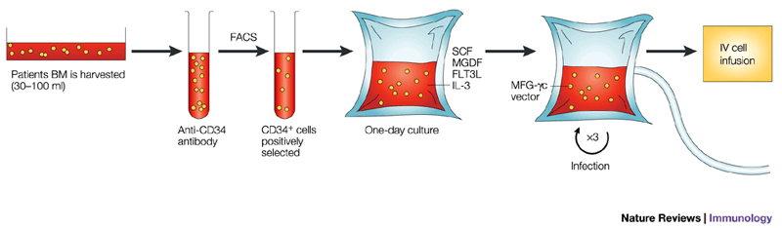
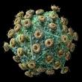
Results of gene therapy for immunodeficiency
Gene transfer procedure
2x10⁷ CD34
cells
CliniMAC
10 patients in the French study
10 patients in the ICH Study
  All except 2 patients have immune reconstitution
    Good T cell recovery
    Normal T cell responses to neoantigens
    Production of Immunoglobulin
    Detectable NK function
  Similar impressive data in ADA-SCID following minimal conditioning

Slide 8
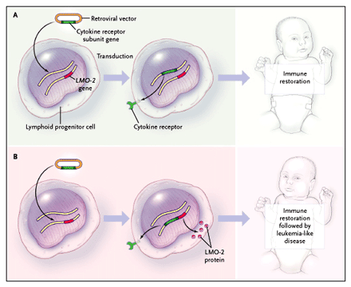
Gene Therapy of X-SCID and Oncogenesis
T-ALL developed in 5/20 children but only in X-SCID children
4/5 T-ALL children are alive and in remission
Over-all survival at 5 years = 95% compared
CW <50% for MUD or Haplo-transplantation.
New studies with safer Lentiviral vectors will begin in 6 months

Slide 9
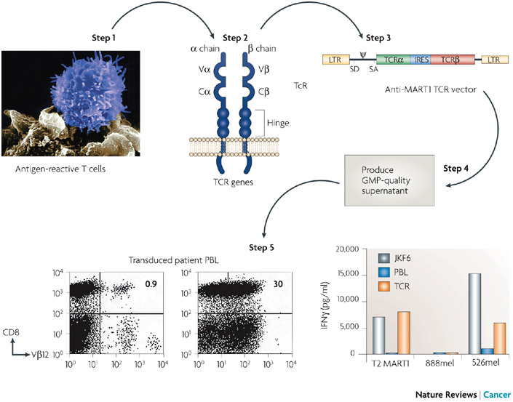
Immunotherapy of melanoma using high affinity T-cell receptors
Highly avid melanoma specific T cells
Objective responses seen in 13% (4/31) of patients
Problems of mispairing of α/ β chains
New strategies
Novel receptors with improved pairing
Chimeric artificial T cell receptors
Dudley, et al Science 2006
Notes:
To extend this approach further as TIL can only be isolated from 50% of the patients, this group has isolated the alpha and beta chains of the T cell receptor from patient with highly avid melanoma specific T cells and cloned these into a retroviral vectors which is used to transduce T cells from patients with refractory disease.
These T cells demonstrated appropriate MHC restricted killing of tumour targets in vitro and in in-vivo they have generated promising results.
In this example a single infusion of these gene modified autologous T cells resulted in a substantial reduction in size of tumour in multiple different sites that is sustained for a period of at least a year.
Over all objective responses were seen in 13% of patients.
This is lower than that observed after TIL infusion but highlights the difficulties associated with isolation of T cells that express TCR with high affinities and formation of mispaired matched heterdimers with the endogenous T cell receptor

Slide 10
CARs in CLL
B-cell neoplasms have CD19 an attractive therapeutic target
Lentivirus vector designed to express a Chimeric Antigen Receptor with specific affinity for CD 19 (B-cell antigen), CD137 (costimulatory receptor in T cells) and CD3-zeta (signal transducer)
3 patients with advanced, chemo-resistant CLL selected- T cells removed by apheresis and induced with vector
Cells returned- one patient suffered tumour lysis
At 10 months patients remain in CR or PR
Used also in other lymphomas and ALL

Slide 11
Gene therapy: Overview
Definition and introduction to vectors
Retroviral vectors (Integrating vectors)
  Immunodeficiency syndromes
    SCID-XI
    ADA deficiency
  Malignancies
    e.g. melanoma
  CARs (chimeric antigen receptors)
    e.g. CLL, ALL
rAAV vectors (non-integrating vectors)
    Congenital blindness
    Parkinson’s disease
    Lipoprotein lipase deficiency
Haemophilia B gene therapy

Slide 12

Recombinant adeno-associated viral vectors
Advantages:
  Non-pathogenic single stranded DNA based parvovirus
  Replicates only in the presence of Helper virus
  Easy rendered “Gutless” ∴ reduced risk of immune response to viral proteins
  Mediate stable long term transgene expression following a single administration of the vector into: → Muscle, Liver, Retina, Brain
      Episomal copies; Integration rare
  Multiple serotypes from different animal species : distinct tissue tropism and immunology
Disadvantages:
  Small packaging capacity (4.6 kb)
  Wt AAV-2 endemic in humans
Notes:
There is currently a great deal of interest in AAV vectors which is in part due to its great safety profile.
AAV is a small non-pathogenic single stranded DNA parvovirus that is endemic in humans but does not cause disease
An additional measure of safety is afforded by the fact that this virus cannot replicate unless the target cell si also infected with a helper virus such as adenovirus.
Therefore amongst vectors of viral origin, rAAV have the best safety profile
Equally important is the fact that rAAV can transduce a variety of cell types and it is in particular able to mediate stable long term transgene expression at following a single administration of the vector into a variety of from post mitotic tissues: → Muscle, Liver, Retina, Brain
This expression in large is mediated by episomally retained copies as rAAV integrates infrequently and at a rate comparable to that of DNA. Consequently the risk of vector mediated oncogenesis with this vector is low.
Multiple serotypes of AAV derived a variety of animal species have been isolated and characterized especially by Jim Wilson’s group who will be speaking latter today. These novel serotypes have distinct biological properties that have broadened the scope for this vector system
As with most vector systems rAAV has several disadvantages. Foremost amongst these is its small packaging capacity of 4.6kb which significantly limits the potential disease targets
Additionally the majority of us have been infected with wt-AAV2, especially serotype 2 which results in long-lasting humoral and cellular immunity that has the potential to limit efficient transduction with this vector

Slide 13
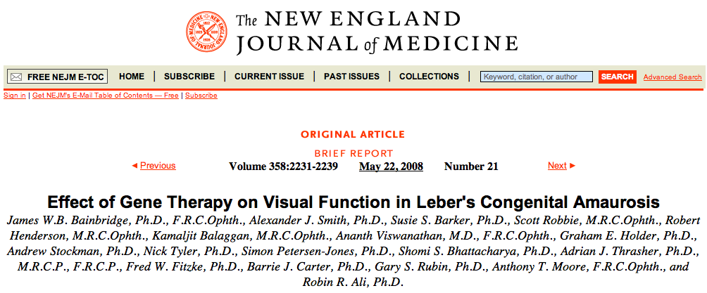
rAAV-2 and Leber's congenital amaurosis
Unilateral subretinal injections of 1x10¹¹vg of rAAV-RPE65 in 3 young adults with severe retinal dystrophy
  No serious adverse events
Significant improvement in visual function:
  Microperimetry,
  Dark-adapted perimetry and
  Visual mobility in one patient
Similar encouraging results in Lipoprotein lipase deficiency, Parkinson’s disease and myopathies
Notes:
Last year we heard about the remarkable success of rAAV serotype 2 vectors in the treatment of LCA following s single administration of a small quantity of vector in the subretinal space of 3 individual with a severe retinal dystrophy
The vector was delivered in conjunction with steroids to limit inflammation associated with vector admnistration in this closed space
No adverse effects were seen and in one patient there was objective as well as subjective improvement in visual function.
We will hear more about this from Robin Ali but the last two studies suggest that gene delivery …….

Slide 14
Haemophilia B
X linked recessive bleeding disorder → 1:30,000 males
Mutations in FIX gene → Serine protease critical for blood coagulation
Clinical manifestation:
  Frequent spontaneous haemorrhages
    Joints → Chronic debilitating athropathy
    Closed spaces →Fatal
Classified as severe, moderate or mild depending on levels of Factor IX

Slide 15
Haemophilia B : Current therapy
Plasma or Recomb FIX concentrates
  On demand or prophylactic → Highly effective
  Downside:
  Frequent IV administration because of short half life (every 3 days)
    Invasive and inconvenient
      Requires insertion of portacaths in children
  Expensive, £100,000/pt/year for prophylaxis
  Risk of bleeding not completely eliminated by prophylaxis (Rosendaal et al, 2004 and 2005)

Slide 16
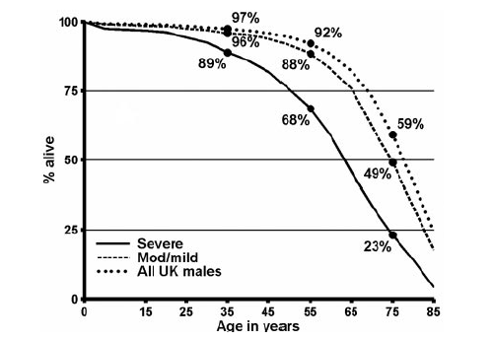
Reduced life expectancy
Darby, SC et al. Blood 110:815, 2007, Reduced life expectancy in HIV negative severe haemophilia patients
Mild (UK)
Normal UK males
Severe (UK)
Severe (Uganda)
80% of haemophiliacs have no or limited access to FIX concs

Slide 17
Haemophilia B- gene therapy
  Offers the potential for a cure
  Continuous, 24/7, endogenous expression of FIX protein at therapeutic levels following a single gene transfer manoeuvre
  Excellent model for gene therapy approaches
Single gene defect (deficiency of FIX gene)
Therapeutic goal modest; An increase in plasma FIX levels above 1% would be sufficient ameliorate the bleeding phenotype
Efficacy can be assessed by validated routine laboratory assay
Tight regulation not required
    Wide range of FIX levels are likely to be efficacious and non-toxic

Slide 18
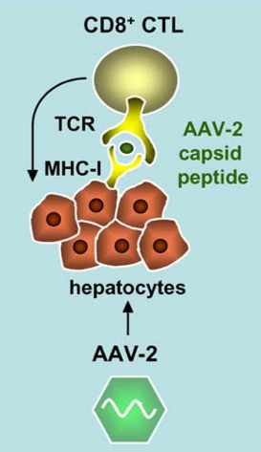
Previous haemophilia-B clinical trials with AAV2
1st study (High et al. Blood, 2003) IM delivery of vector:-No toxicity and no efficacy
2nd study (High et al. Nat Med 2006)
Intrahepatic artery delivery of AAV2 in 7 severe HB patient
Lower doses safe but not efficacious
High dose (2x10¹² vg/kg)
FIX decline→ memory T cell mediated immune response to AAV2 capsid →delayed subclinical hepatocellular toxicity
Notes:
We are not the first to attempt gene therapy for haemophilia B
Based on this impressive preclinical data 15 patients have received rAAV-2 vector encoding hFIX in the context of two phase I studies
The first study focused on intramuscular delivery of a rAAV2 in 8 patients with severe HB at 3 different dose levels
Intramuscular administration of vector was well tolerated with no major side effects and transduction of muscle was demonstrated in all patients by IHC or molecular analysis however therapeutic levels of hFIX were detectable transiently in the plasma of only one patient given the lowest dose.
The second study focused on liver targeted delivery of vector in 7 patients.
The low and intermediate dose of rAAV-2 vector proved to be subtherapeutic, but expression within the therapeutic range was observed in the two patients in the highest dose cohort of 5x1012 vg/kg
Expression declined in both subjects in a matter of weeks and in one of these subjects this was due to a memory cytotoxic T cell response to the AAV2 capsid expressed by hepatocytes after gene transfer. This was also observed in one of three patients treated at the intermediate dose level. Both this patients where HLA B072 positive
Additionally vector genomes were detected in the semen of all participants. However there was no evidence to support germ-line transmission of the rAAV2 genome.
These unexpected adverse events were not observed in murine or canine modells given a log higher vector particles calling into question the value of safety data generated in these animals which unlike humans are not natural host for AAV.

Slide 19
Our strategy:-1
Avoid immune response
  Focus on AAV-8 vectors
  Low pre-existing immunity in humans
    ~2.5% in NBS Blood donor (70% for AAV2)
    ~4.5% in adult HB patients at KD Haemophilia centre (59% for AAV2)
  Distinct biology
Notes:
The second important part of our strategy is that we have focused on AAV8 pseudotyped vectors instead of AAV2 primarily because of the substantially lower prevalence of pre-existing humoral immunity to this AAV serotype both in the general population as well as Haemophilia B patients as illustrated here by the results of our in-vitro and in-vivo transduction inhibition assays
This low seroprevalance rate offers us the luxury of excluding subjects with pre-existing immunity thereby reducing the potential for cellular immune response to the capsid of the type observed in the last clinical trial.
An additional potential advantage of AAV8 is that it has distinct biological properties which includes its ability to uncoat more rapidly than other serotypes leading to higher levels of hFIX expression in mice
More importantly AAV8 appears incapable of transducing human monocyte derived DC ex-vivo, unlike AAV2 vectors which are almost as efficient as adenovirus in transducing antigen presenting which further reduces the potential to evoke an immune response.

Slide 20
Our strategy:-2
Develop more potent vector systems by overcome limitation of AAV
ds transcriptionally active
rAAV genome
ss rAAV genome
Rate limiting
+
-
4.6 kb
Degraded
ITR
448 bp
ITR
co hFIX cDNA
co hFIX cDNA
scAAV LP1-FIXco
+
-
LP1
Δtrs
LP1
Intron
pA
pA
Intron
2150 bp
2150 bp
-
Transcriptionally active and stably retained
+
-
+

Slide 21


Our strategy:-3
  Vectors contained a liver specific codon optimised hFIX expression cassette packaged as self complementary genomes to improve potency
scAAV-LP1-hFIXco
co hFIX
co hFIX
+
-
LP1
LP1
  Vector administered in the peripheral circulation
  A simple mode of vector delivery that takes advantage of the strong tropism of AAV8 for the liver, the native site for FIX synthesis

Slide 22
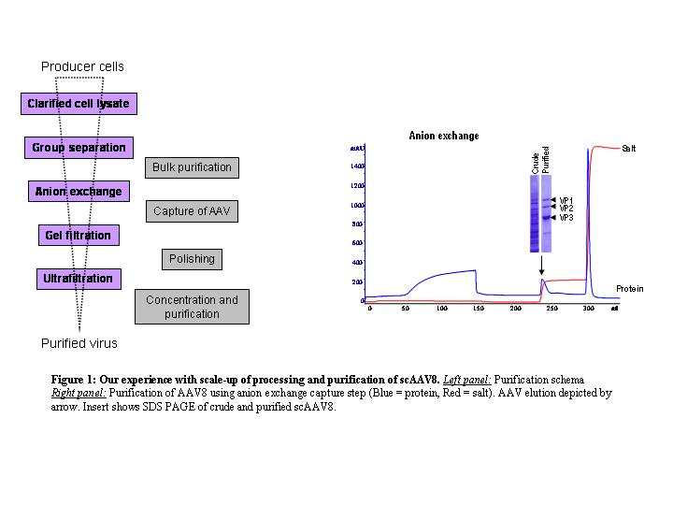
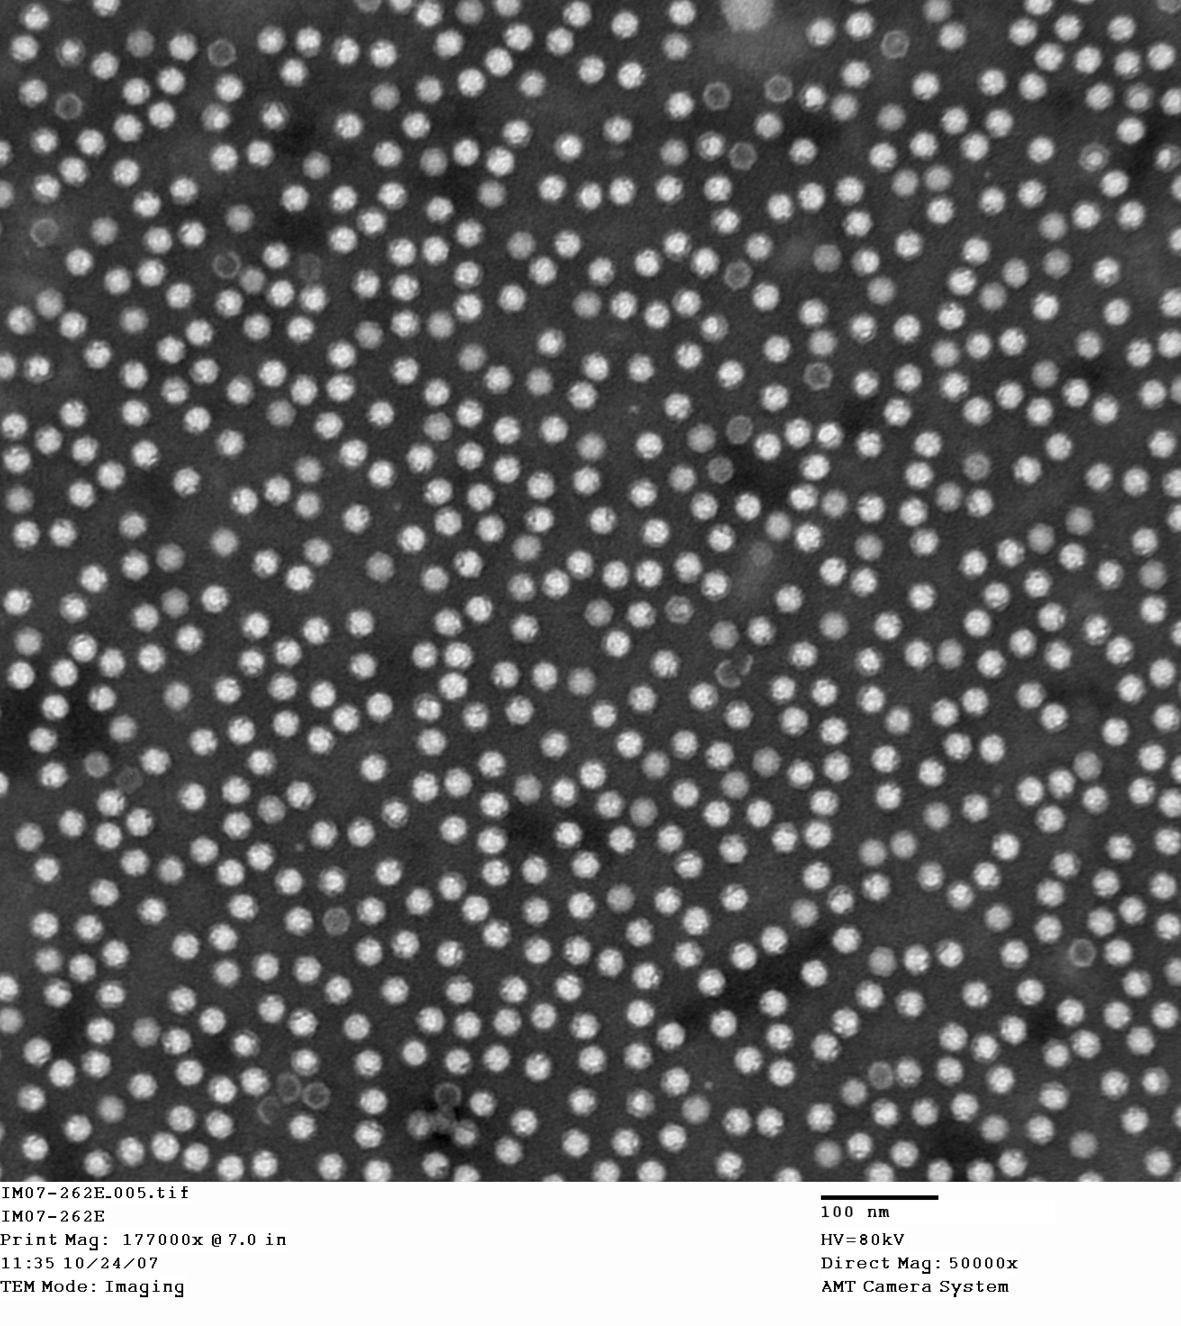
Scaled up AAV production at Children’s GMP
rAAV production
Purification schema
hFIX
ITR
Rep2
ITR
P2.8 Packager
pHelp +Vector
Cap8
EM
Transient transfection
293T cells in cell factories
Clinical lot 1:13 months to prepare (1x10¹⁴vg from 168 CF)
Clinical lot 2: 5 months to prepare (2x10¹⁴ from 216 CF)
Cost: :~£535K

Slide 23
Dose finding/Tox study with GMP vector
Dose finding study
Biodistribution: 2e12vg/kg

Slide 24
Brief outline of clinical trial
Primary objective: Safety
  Assess the safety and efficacy of a bolus peripheral vein infusion of our novel scAAV2/8-LP1-hFIXco in subjects with severe haemophilia B (<1% of normal, FIX:C)
  Without the administration of upfront immunosuppression and at 3 dose levels:
    Low (2x10¹⁰vg/kg)
    Intermediate (6.0 x 10¹⁰vg/kg)
    High (2.0 x 10¹¹vg/kg)
  Gradual cautious enrolment of a minimum of 2 patients at each dose level
Secondary Objective:
  Determine the dose of scAAV required to achieve stable expression of hFIX at levels in excess of 3% of normal
Vector Production: Children’s GMP, Memphis, TN, USA
3 Study sites: SJCRH, Stanford, UCL/Royal Free Hospital
Elaborate consent process
Notes:
Now I would like to briefly outline the key aspects of our upcoming clinical trial
The primary objective of this study is to assess the safety of systemic administration of a novel self complementary AAV (scAAV-LP1-hFIXco) vector in adults with severe haemophilia B over three different dosage levels, starting with the lowest dose of 2x1010vg/kg and then progressing to the intermediate and high dose levels
To minimise risk enrolment will be gradual with one patient being recruited at a time and monitored for a minimum of 6 weeks prior to recruiting the next patients. We plan to recruit a minimum of 2 patients at each of the dose levels with the possibility of expanding a group depending on depending on toxicity or efficacy
The secondary objective to establish the dose of vector required to achieve stable hFIX expression at levels in excess of 3% which would significantl ameliorate the bleeding diathesis in patients with severe HB
This study will involve three sites: that are listed here and will be sponsored by St Jude

Slide 25
Selection criteria
Inclusion criteria
  Adult males ≥ 18 years of age
  Severe HB resulting from a missense mutation
  No history of inhibitors to FIX protein
Exclusion criteria
  Pre-existing immunity to AAV8
  Evidence of active infection with Hepatitis B or C virus or are currently on antiviral therapy
  Biochemical evidence of liver dysfunction
  Patients with other concurrent illness or poor performance status (WHO score >1)
Notes:
Recruitment will be limited to adults (≥ 18 years) with a confirmed diagnosis of hemophilia B (HB), resulting from a missense mutation
Subjects with evidence of active hepatitis or anti-hFIX antibodies will be excluded as will those with evidence of previous exposure to AAV8 or abnormal liver chemistry.

Slide 26
Minimising the risks of the study
Germ line transmission:
    Limit recruitment to subjects willing to practice barrier contraception
    Offer sperm banking
Inhibitor formation:
    Exclude patients who have an inhibitor
    Only patients with missense mutation will be recruited
    Tolerance as they will have received numerous exposures to factor concentrates
Risk of oncogenesis:
    Real risk with all gene transfer approaches
    Wt AAV not known to cause tumours
    scAAV2/8 LP1-hFIXco does not increase incidence of tumour after in-utero gene transfer in mice or PV delivery in mice and NHP
Capsid induced inflammatory response
    Exclude subjects with immunity to AAV8
    Start with 100 fold low dose of vector
Notes:
Our extensive preclinical data suggests that the risks associated with this study are small how as with previous clinical trial there are several theoretical risks which will be carefully explained to the participants
Therefore though because of the potential for germ line and horizontal transmission we will limit recruitment to subjects willing to practice barrier contraception and will offer sperm-banking as a safe guard which can be used for artificial insemination in the event of germ line transmission.
Addition we plan to put the study on hold if vector genomes are detected in the semen of participants for >16 weeks.
latter in the have carefully explained the potential risks in the patient information brochure so that subjects who choose to participate do so in the full knowledge of known risk
A significant concern of this study, as with previous protocols, is that research subjects may develop an inhibitor to human FIX following administration of scAAV.
This complication occurs in a small number of HB patients on protein replacement therapy but has not yet been observed in humans in the context of gene therapy perhaps because of poor transduction efficiency
Despite the knowledge that most patients eligible for this study will have received numerous exposures to factor concentrates and are less likely to develop inhibitors we believe that it is prudent to
Exclude patients who have an inhibitor or a history of inhibitor after protein replacement therapy
In the event that an inhibitor develops in one subject after gene transfer the trial will be placed on hold
Treatment of bleeding episodes in this patient will be according to standard protocols involve infusion of high concentration of FIX or activated FVII
Insertional mutagenesis is a significant issue for all gene transfer strategies
Recently Mark Sands group has demonstrated that AAV can predispose to a malignant transformation
We believe this is mouse model specific and have not seen an increase in the incidence of tumours in our cohort of mice and nonhuman primate including mice that received LP1 in-utero and have been followed up for 2 years.
THE RAC suggested that participants be made aware of the reecnt death that occurred in the targted genetic trial although this death in an immunocompromised patient was due to histioplasmosis and not due to AAV administration

Slide 27
Patient characteristics
All patients recruited at Royal Free Hospital, UK
Patients | S1 | S2 | S3 | S4 | S5 | S6
Dose category | Low (2e11vg/kg) |  | Intermediate (6e11vg/kg) |  | High dose (2e12vg/kg)
Age | 31 | 64 | 43 | 29 | 32 | 27
Mutation | Missense | Null (frame shift) | Missense | Missense | Missense | Promoter
Prophylaxis | X2/week | X2/week | X2/week | X1/week | X2/week | X3/week
Spontaneous bleeds/year | 2-4 | 4-6 | 4-6 | 2-4 | 2-4 | 1-2
Target joints | Ankles Knees | Ankles Knees Elbow Shoulder | Ankles Knees shoulders | Ankles | Ankles Knees | Ankles

Slide 28
Safety assessments
Vital signs
Vector shedding
Plasma
Stools
Saliva
Urine
Semen
LFTs (Subjects 1-4, 6)

Slide 29
Low vector dose
Plasma FIX levels, Subject 1: 2x10¹¹vg/kg
FIX conc usage
down by 77%
Off prophylaxis for >24 months but no spontaneous haemorrhage

Slide 30
Other Low and Intermediate vector dose subjects
Summary of FIX expression
Subject | Vector dose (vg/kg) | Steady state hFIX:C level post gene transfer (% of normal) | Duration of expression (Months) | Prophylaxis | Reduction in annual FIX conc usage
2 | 2x10¹¹ | 1 | >24 | Reduced ~X1/week | 33%
3 | 6x10¹¹ | 2 | >24 | Reduced ~X1/fortnight | 50%
4 |  | 2 | >24 | Stopped | 85%
Patients with significant haemophilic arthropathy require higher transgene expression to enable discontinuation of FIX prophylaxis

Slide 31
High vector dose
Plasma FIX levels, Subject 5: 2x10¹²vg/kg
Pred
60mg
0
FIX conc usage down by 85%
Off prophylaxis for >14 months. No spontaneous bleeds.

Slide 32
High vector dose
Plasma FIX levels, Subject 6: 2x10¹²vg/kg
Pred
FIX conc usage
60mg
0
Off prophylaxis for >13 months.
Not required on-demand FIX treatment

Slide 33
Humoral response to AAV8 capsid
Consistent with a primary immune response to capsid protein

Slide 34
Cellular immune response
IFN-γ ELISPOT assay using AAV8 capsid peptide
S3
Intermediate dose
S4
S5
High dose
S6

Slide 35
Currents status: Expanding the high dose group
Questions:
    Will all subjects treated at the high dose level have an increase in ALT/AST levels?
    Will early treatment with steroids reduce the level of transaminitis and preserve stable expression of hFIX?
    Should all high dose subjects receive prophylactic steroids and if so when should this be started and for how long?
    This phase will be completed by December 2012

Slide 36
Next haemophilia B gene therapy trial
High purity (“fewer empties”) scAAV-LP1-hFIXco
Commence in Spring of 2013
Vector made and regulatory discussions underway
  Questions:
  Will this reduce the risk of transaminitis?
  Will hFIX expression improve?

Slide 37
Other FIX trials in the pipe line
Asklepios BioPharmaceutical Inc
PI: Samulski and Monahan
  scAAV vector pseudotyped with AAV8 capsid
  Codon optimised FIX cDNA containing a hyperactive FIX mutation
  Study is open to recruitment
CHOP study: PI= Kathy High
  ssAAV vector pseudotyped with AAV8 capsid
  Strong liver specific promoter: HCR-hAAT
  Study is not yet open to recruitment
Jichi medical school: Same approach as CHOP

Slide 38
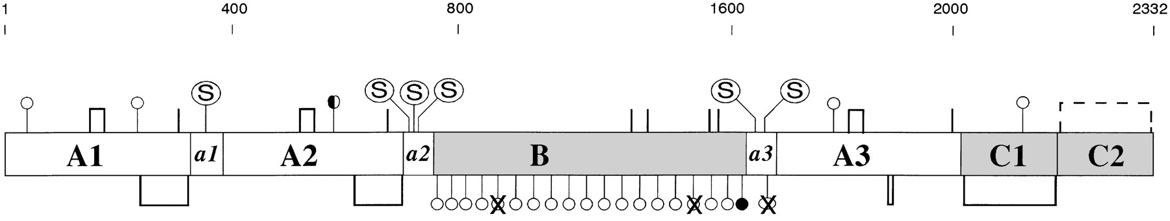
Haemophilia A
More common 1 in 4-5000 males affected
Mutations in Factor VIII gene
Classified as severe, medium and mild

Slide 39
Gene therapy for Haemophilia A using rAAV vectors
Challenges
Human FVIII cDNA much larger than hFIX and exceeds the packaging capacity of rAAV (4.6kb)
  hFVIII cDNA = ~7kb (hFIX cDNA= 1.5kb)
Lower expression of wild type FVIII when compared to other similarly sized proteins
  4 fold lower
    Inefficient transcription
    Interaction with endoplasmic reticulum
    Facilitated ER to Golgi transport needed
Notes:
Cellular processing of the wild type full length FVIII molecule is highly complex and expression is confounded by mRNA instability, interaction with endoplasmic reticulum (ER) chaperones, and a requirement for facilitated ER to Golgi transport through interaction with the mannose-binding lectin LMAN1.

Slide 40
New rAAV FVIII expression cassette mediates higher levels of expression
A. hFVIII levels
New rAAV-FVIII variants
5.9kb
LP1
BDD-FVIII
0.44kb
SV40pA
6.4kb
LP1
N6-FVIII-N6
6.4kb
LP1
Codop-FVIII-N6
B. Proviral copy number
5.7kb
HLP
Codop-FVIII-N6
Synth pA
0.26kb
rAAV vectors encoding codop-FVIII more potent than other FVIII variants

Slide 41
Future
Non-malignant disorders
Coagulation disorders
  Congenital FVII or X deficiency
Lysosomal storage disorders
  Gaucher's disease
  Fabry’s disease
Others
  Alpha-1-antitrypsin deficiency
  Crigler-Najjar Syndrome
Malignant disorders
B cell disorders
  lymphomas and ALL with CAR and AAVp
Solid tumours
  Hepatocellular carcinoma
  Neuroblastoma
  Glioblastoma

Slide 42







Acknowledgments
UCL/Royal Free Hospital: Amit Nathwani, Edward Tuddenham, Jenny Mcintosh, David Linch, Cecilia Rosales, Pratima Chowdary, Anne Riddell, Jun Pie, Chris Harrington, James O'Beirne
St Jude Children’s Research Hospital: Andrew Davidoff, Cathy Ng, Junfang Zhou, Yunyu Spence, Chris Morton, Ulrike Reiss, John Gray, Arthur Nienhuis
Children’s GMP: John Coleman, Jim Allay, Susan Sleep
Basingstoke Haemophilia Centre: Savita Rangarajan
CBC (Bristol): Keith Smith, David Anstee and Paul Lloyd-Evans
CHOP: Kathy High and Federico Mingozzi
Stanford: Mark Kay, Pradip Rustagi and Bert Glader
ALSAC

