Slide 1
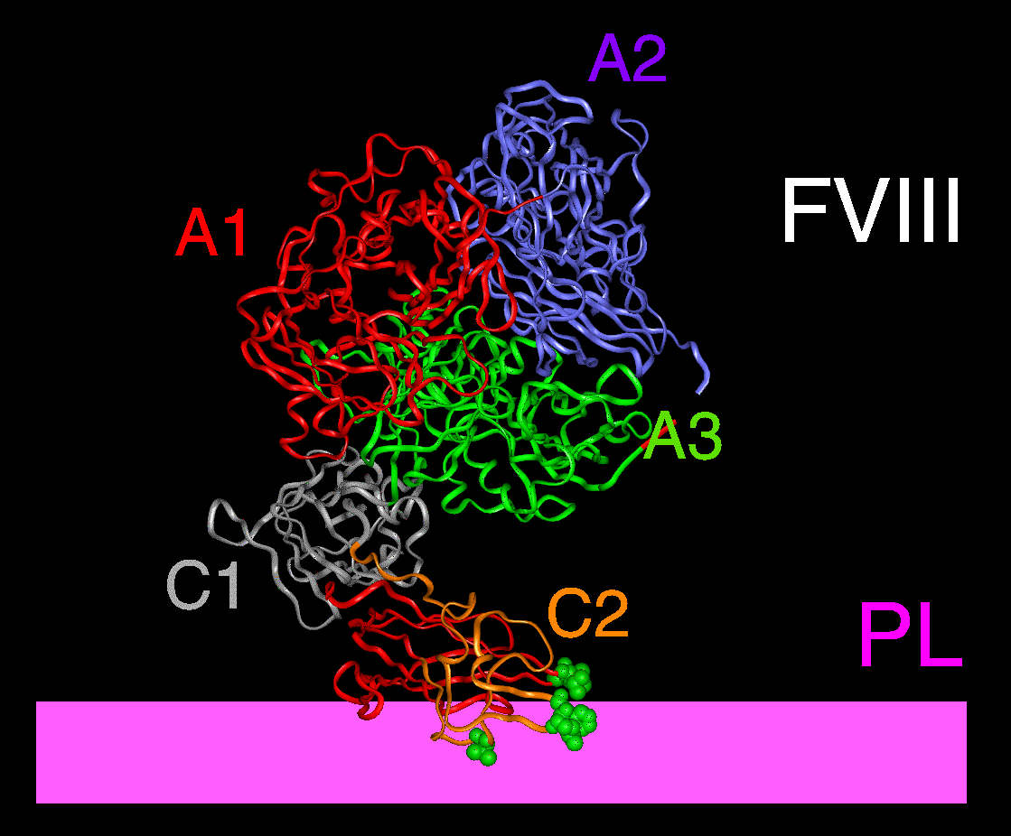
Factor V and Factor VIII

Slide 2
Learning Objectives
Why factors V and VIII are vital as COFACTORS in blood clotting
What the similarities are and where they end
The crucial need for proteolytic activation of “pro-cofactors” to active cofactors FVIIIa and FVa
The relationship between structure and function
The mechanisms by which active cofactor activity is lost, and the consequences if this fails

Slide 3
Why consider FV and FVIII together?
They have very similar structure
and presumably a common origin
They fulfil similar roles in coagulation
They have some parallel biology
Occur as combined deficiency
They have significant differences

Slide 4
Factor V and Factor VIII
Similar roles in coagulation

Slide 5
TF-
FVIIa
TF
+
FVII
Extrinsic Pathway
Notes:
1

Slide 6
Intrinsic Pathway
FIX
FIXa
Ca
++
PL
FX
FXa
TF-
FVIIa
FII
THROMBIN
TF
+
FVII
Extrinsic Pathway
Fibrinogen
Fibrin
Notes:
1

Slide 7
Intrinsic Pathway
FIX
FIXa
TFPI
FX
FXa
TF-
FVIIa
TF
FVIIa
FII
THROMBIN
TF
+
FVII
FXa
TFPI
Extrinsic Pathway
Fibrinogen
Fibrin
Notes:
1

Slide 8
Intrinsic Pathway
FIX
FIXa
TFPI
FX
FXa
TF-
FVIIa
TF
FVIIa
FII
THROMBIN
TF
+
FVII
FXa
TFPI
Extrinsic Pathway
Fibrinogen
Fibrin
Notes:
1

Slide 9
Intrinsic Pathway
Ca
++
PL
FIX
FIXa
FVIIIa
FVIII
Ca
++
PL
FV
TFPI
FX
FXa
FVa
TF-
FVIIa
TF
FVIIa
FII
THROMBIN
TF
+
FVII
FXa
TFPI
Extrinsic Pathway
Fibrinogen
Fibrin
Notes:
1

Slide 10
Intrinsic Pathway
FXI
FXIa
Ca
++
PL
FIX
FIXa
FVIIIa
FVIII
Ca
++
PL
FV
TFPI
FX
FXa
FVa
TF-
FVIIa
TF
FVIIa
FII
THROMBIN
TF
+
FVII
FXa
TFPI
Extrinsic Pathway
Fibrinogen
Fibrin
Notes:
1

Slide 11
Coagulation factor complexes
Serine protease
Cofactor
Substrate
Factor IXa
FVIIIa
Factor X
Factor Xa
Factor Va
Factor II
Protease
Substrate
Cofactor
Ca++
Ca++
Phospholipid

Slide 12
Importance of cofactors: 2 homologous complexes in coagulation
Ca²⁺
FIXa serine protease Ca2+
Intrinsic Tenase
+
PL
FVIIIa cofactor PL (platelet)
FX
Ca²⁺
FXa serine protease Ca2+
+
Prothrombinase
PL
FVa cofactor PL (platelet)
Prothrombin
Thrombin

Slide 13
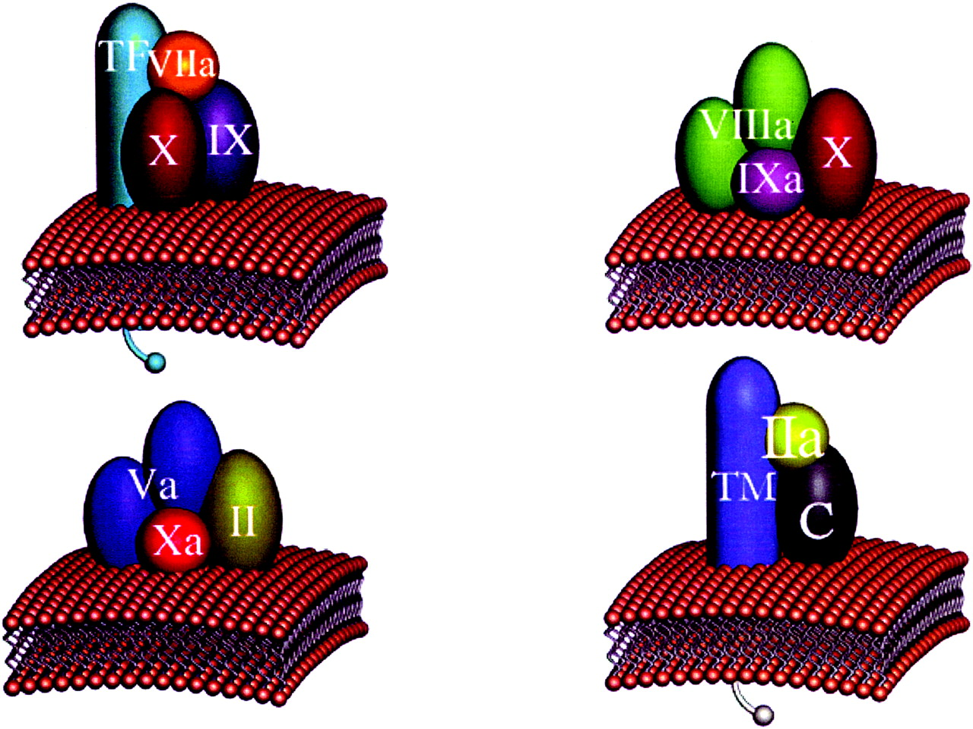
Complexes assemble on phospholipid surfaces
Mann, K. G. Chest 2003;124:4-10S

Slide 14
Factor V and Factor VIII
Similar structures

Slide 15
FV and FVIII Gene Structure
FV and FVIII share similar intron-exon gene structure and organization – this is FVIII
0 40 80 120 160 200kb
Factor V Chromosome 1q25
Factor VIII Chromosome Xq28
Suggests they are closely related in evolutionary terms, by some duplication event
Note VIII is X-linked and V is autosomal

Slide 16
Factors V and VIII Domain structure
a1
a2
a3
FVIII
A1
A2
B-fviii
A3
C1
C2
FV
A1
A2
B
A3
B-fv
C1
C2
A domains
40% homology
Protein-protein interactions
B domains
Similar size, but very low sequence identity between FV and FVIII
Both heavily N-glycosylated
No other sequences with significant identity in genome
Dispensable for procoagulant activity
C domains
Phospholipid binding
a domains
Small acidic peptides
Sulphated tyrosines
Only in FVIII
Protein binding: a3 contains VWF binding site
Thrombin cleavage
Notes:
Coagulation factor VIII (FVIII) is synthesized as a single chain polypeptide with domain sequence A1-A2-B-A3-C1-C2
Shares domain homology with factor V (FV)
Despite their structural similarities FVIII is 10-fold less efficiently expressed in comparison to FV.
B domains of FVIII and FV are divergent yet both are heavily glycosylated at consensus asparagine (N) residues.

Slide 17
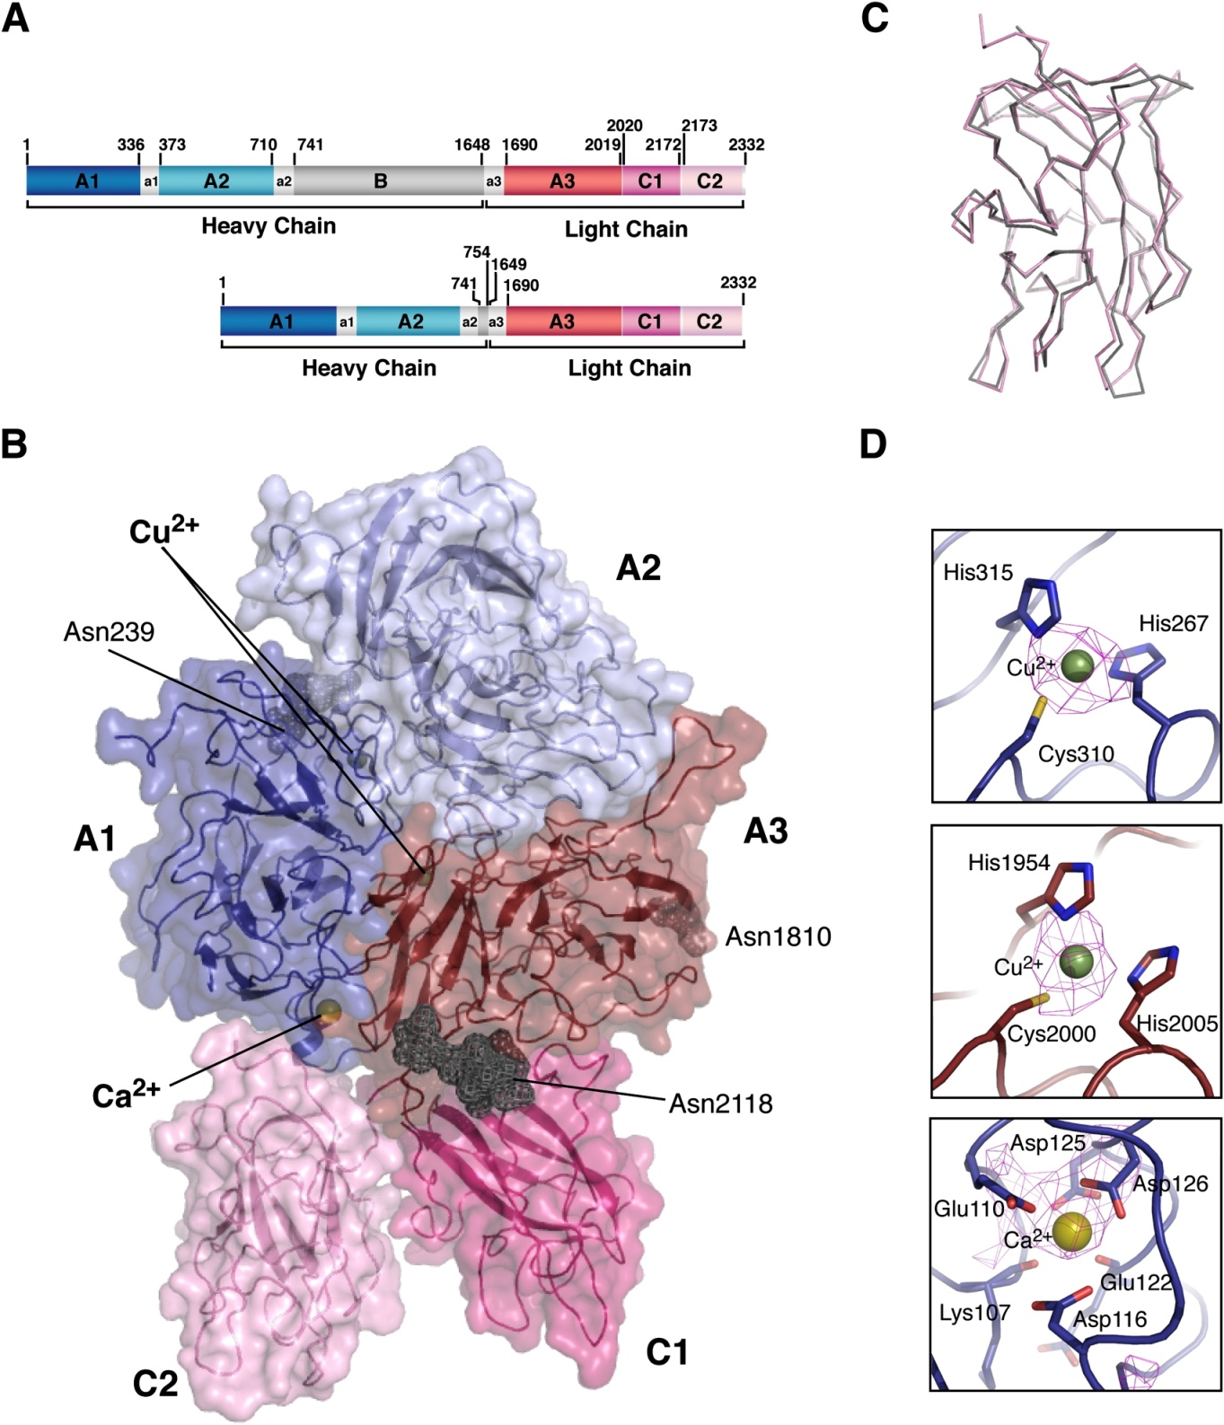
Factor VIII crystal structure
B
Ngo 2008

Slide 18
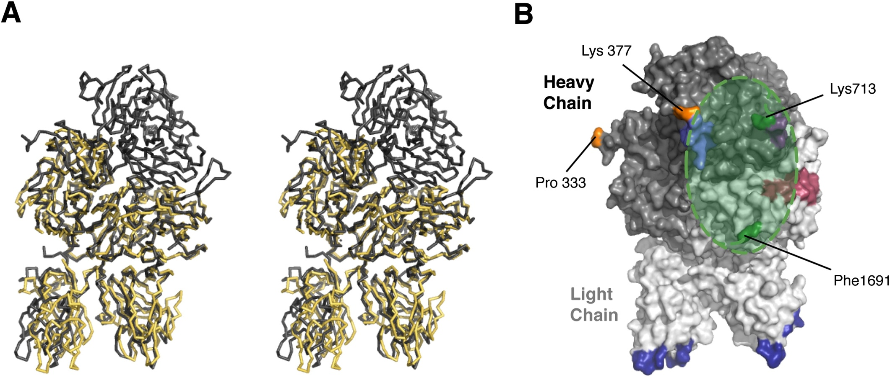
Factor V and Factor VIII structure
Ngo 2008
Factor VIII (BDD) and FVai (no A2) overlay

Slide 19
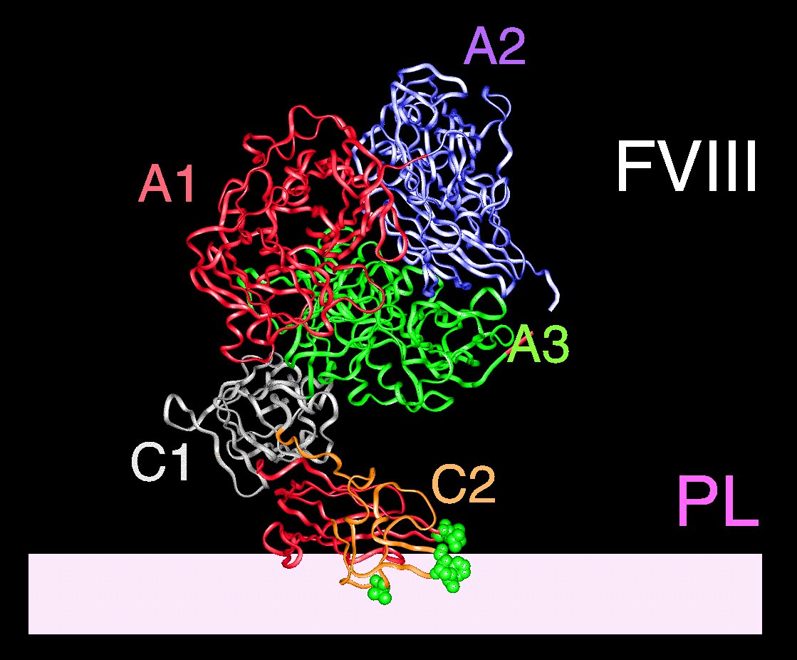
FV and FVIII Structure
A modular protein structure consisting of 6 domains (A1A2BA3C1C2).
Significant sequence identity with each other.
A domains have sequence identity with ceruloplasmin & hephastin that share the domain structure A1-A2-A3.
C domains are homologous to discoidin & milk-fat globule binding protein.

Slide 20
Factor V and FVIII
Synthesis
Factor V: Hepatocytes
Taken up by platelets (murine Mgk)
Factor VIII: Hepatocytes + endothelial cells + poss many others
Notes:
Nb liver transplant of haemophilic liver did not produce haemophilia

Slide 21
FVIII B Domain – a role in synthesis
There is inefficient secretion of B-domain-deleted (BDD) FVIII compared with full-length FVIII¹
deletion gives 17-fold increase in mRNA and 15-fold increase in primary translation product
BUT only 30% increase in secretion. Why?
ER chaperones interact with oligosaccharide structures within the B domain^{2,3}
CNX/CRT and LMAN1/LMAN2
facilitate folding, quality control and transport for protein folding
1. Pittman et al. 1994; Blood 84:4214
2. Pipe et al. 1998; J Biol Chem 273:8537
3. Cunningham et al. 2003; J Thromb Haemost 1:2360

Slide 22
Effects of B domains on synthesis
 | mRNA | Primary translation product | Secreted protein | Activity
FV/FVIII | 2.2 | 1.63 | 10
FVIII
wtFVIII | 1.0 | 1.0 | 1.0 | 1.0
FVIII-BDD | 17 | 15 | 1.3 | 1.3
FVIII-B5 | 1.9 | 2.0 | 2.0 | 2.1
Factor V
wtFV | 1.0 | 1.0 | 1.0 | 1.0
FV-BDD | 3.4 | 3.0 | 2.3 | 0.34
FV-B8 | 0.4 | 1.0 | 0.63 | 0.25
B domain
Pittman 1994

Slide 23
Trafficking of FVIII (or FV) from the ER
Cytosol
ER
ERGIC
Golgi
CNX
G
Degradation
LMAN
1 & 2
ER man I
Golgi
man
CRT
G
G
G
Glc II
Glc I/II
G
Folded
Glc II
COP II
Misfolded

Slide 24
Combined FVIII and FV deficiency
Rare (1 in 500 000)
Autosomal recessive
Variable levels of FV and FVIII but not severely deficient.
Cause was a puzzle for many years
Caused by mutations in LMAN1 or LMAN2
FV and FVIII affected because they both rely on B domain for secretion

Slide 25
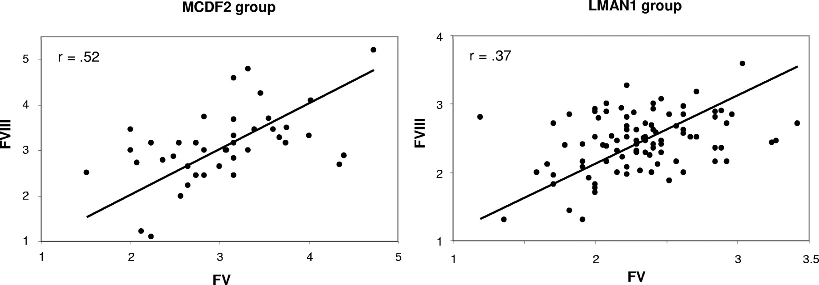
FV and FVIII deficiency: phenotype and genotype
Zhang, B. et al. Blood 2008;111:5592-5600

Slide 26
Factor VIII B domain and cofactor activity
FVIII exists in plasma as a mixture of heterodimers with B domains of varying length
B domain deleted FVIII
Has the same half life
Has the same cofactor activity

Slide 27
PK of FL and BDD FVIII
(plasma)
Kessler 2005

Slide 28
FVIII B domain: summary
Not necessary for cofactor function
Impairs transcription
Improves secretion
Explains combined V & VIII deficiency
Important commercially
Patent issues
More efficient synthesis of recombinant BDD protein
BDD FVIII easier to manipulate into vectors
Basis for novel recombinant molecules
Concern that BDD FVIII may be more immunogenic

Slide 29
The FV B domain
Divergent from FVIII B domain
But highly conserved in mammals and some vertebrates
Remains heavily glycosylated for intracellular transport
Also responsible for pathophysiology of combined FV and FVIII deficiency
Retained in circulating FV
Essential for regulation of cofactor function

Slide 30
Factor V B domain and FV cofactor activity

Slide 31
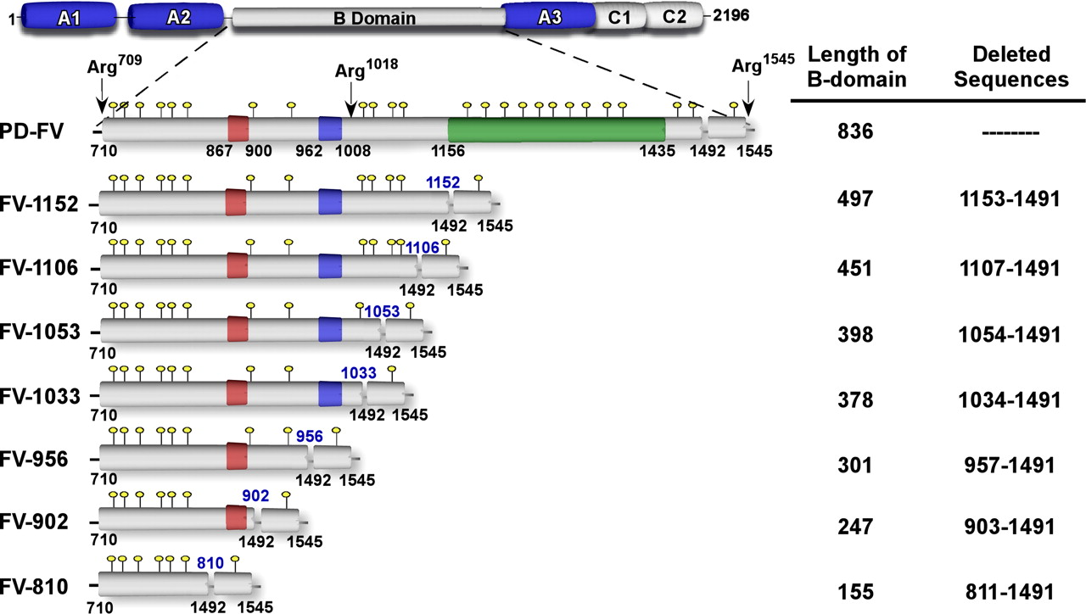
FV B domain deletion mutants
*
*
Zhu, H. et al. J. Biol. Chem. 2007;282:15033-15039
Notes:
B-domain-truncated FV derivatives. The B-domain is defined by residues 710–1545, which are
liberated following thrombin-mediated proteolysis. These cleavage sites are indicated above the expanded
B-domain. The size of the B-domain in each FV derivative is indicated along with the corresponding deleted
sequences (right). Yellow circles, potential N-linked glycosylation sites; green box, 31X-9 amino acid tandem
repeat region; red box, 2X-17 amino acid repeat region; blue box, residues 962–1008.

Slide 32
B domain determines FV cofactor activity
FV-902
FVa
FV-1033
FV
Zhu, H. et al. J. Biol. Chem. 2007;282:15033-15039

Slide 33
Factor V and Factor VIII structure
Factor VIII (BDD) and FVai (no A2) overlay
FVIII showing position of B domain and FIX interaction
Ngo 2008

Slide 34
FVIIIa and FIXa
Fay Blood Rev
18 2004, 1–15

Slide 35
Factor V and Factor VIII functional activity
Activation
Both FV and FVIII are activated by thrombin cleavage
Not phospholipid dependent
Inactivation
Factor V inactivated by APC
Factor VIII largely inactivated by dissociation but also a substrate for APC

Slide 36
Factor VIII- life
Synthesised
In hepatocytes
Some endothelial cells (eg lung)
Possibly also in lymphoid tissue
Endothelial FVIII is stored with VWF as releasable pool in Weibel-Palade bodies
Production increase in acute phase response

Slide 37
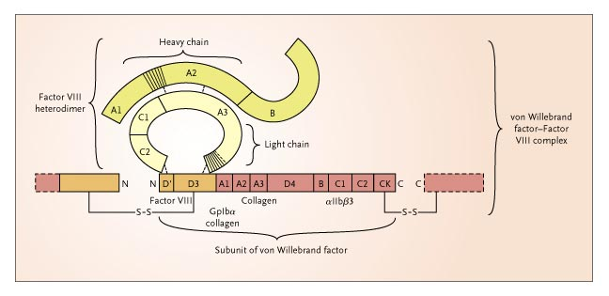
Factor VIII binding to VWF
Mannucci 2004

Slide 38
VWF and Factor VIII
Factor VIII and VWF circulate as a complex in plasma
Protects VIII from degradation
Prevents premature association with Factor X
Free FVIII half life ≈ 2 hours
VWF-bound FVIII half life ≈ 12 hours
50x excess of FVIII binding sites in plasma D,D3
Half time for complex ≈ 2 seconds
FVIII activation releases it from VWF

Slide 39
Plasma vWF:Ag and ABO genotype.

Slide 40
Plasma FVIII:Ag and ABO Genotype.

Slide 41
Factor VIII life
a1
a1
a2
a3
Translation
A1
A2
B
A3
C1
C2
Ca²⁺
Circulation
A1
A2
B
A3
C1
C2
Ca²⁺
VWF
A1
A2
A3
C1
C2
Activation
(IIa)
372
740
1689
Ca²⁺
Inactivation
APC/
dissociation
A1
A3
C1
C2
336
562

Slide 42
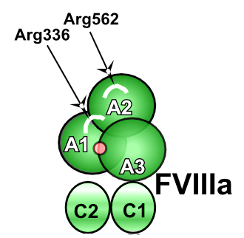
Inactivation of Factor VIIIa by APC
Factor VIIIa is structurally homologous to factor Va
A1
A2
A3
C1
C2
Ca
APC can cleave FVIII
There is an additional thrombin cleavage site between A1 and A2 domains
Consequently…. the A2 domain is only weakly ionically associated
Tends to dissociate rapidly

Slide 43
FVIII and APC
APC can cleave FVIII in vitro
PS and FVi are cofactors
APC cleavage of uncertain importance as route of inactivation in vivo
FVIIIa inactivation occurs primarily by dissociation of the A1-A2-A3C1C2 heterotrimer

Slide 44
Factor V - life
Synthesised
In hepatocytes
Released into plasma
Circulates as single chain molecule
Taken up by MgK in humans, glycosylated and partially activated
Released in active and APC resistant form by platelet activation
Binds to TFPI in circulation
(may explain surprisingly mild phenotype)
Not an acute phase reactant

Slide 45
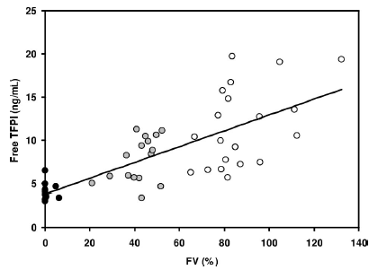
FV and TFPI
Duckers 2008

Slide 46
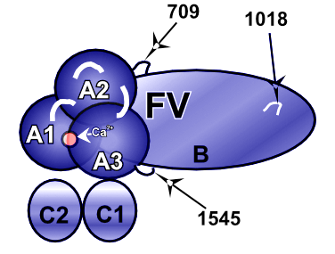
Factor V
~330kDa, expressed in liver, ~20nM in plasma
FV activated to FVa
A1
A2
B
A3
C1
C2
1
When activated, the B domain from FV is removed by specific proteolytic cleavages catalysed by thrombin

Slide 47
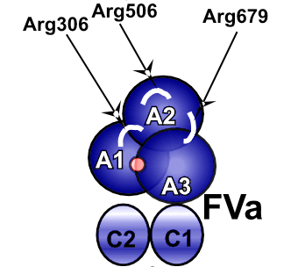
Factor V
~330kDa, expressed in liver, ~20nM in plasma
FV activated to FVa at sites of vessel injury
A1
A2
B
A3
C1
C2
Activation
e.g. Thrombin (& FXa)
A1
A2
A3
C1
C2
Ca
FVa is the co-factor to FXa in the prothrombinase complex
Enhances activity by ~300 000x
Prothrombinase converts prothrombin to thrombin

Slide 48
Factor V life
A1
A2
B
A3
C1
C2
Translation
A1
A2
B
A3
C1
C2
Circulation
Ca²⁺
A1
A2
A3
C1
C2
Activation
(IIa)
R709
R1018
R1545
Ca²⁺
A3
C1
C2
Inactivation
(APC)
306
506
679

Slide 49
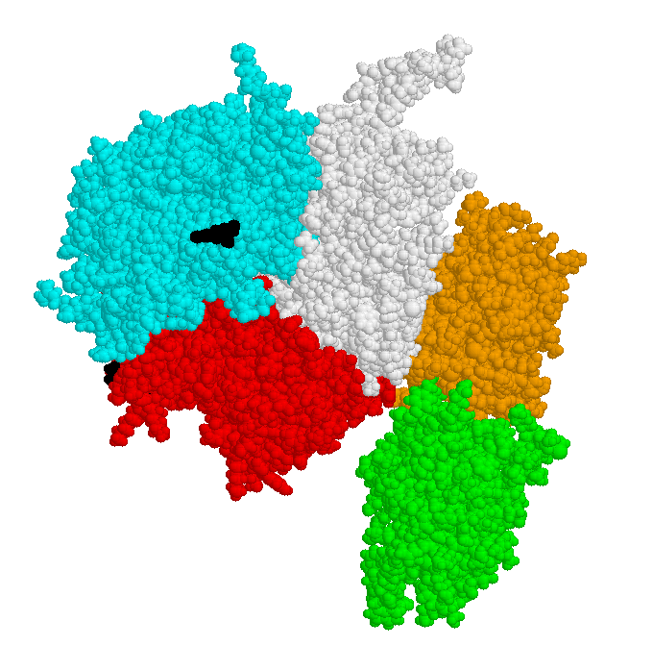
Factor Va
APC cleavage sites in FVa
Model of factor Va
Pellequer et al Thromb Haemost 2000;84,849

Slide 50
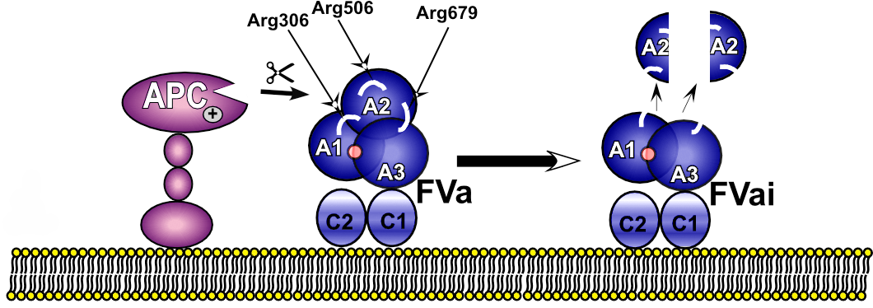
Inactivation of Factor Va By APC
FVai = inactivated FVa
Inactivation occurs on anionic phospholipid surfaces,
e.g. activated platelet and endothelial cell membranes AT THE EDGE OF THE INJURED AREA

Slide 51
Factor V Leiden (Arg506Gln)
FV Leiden (Arg506Gln)
mutation/polymorhism present in ~5% of white Caucasians
associated with “APC-resistance”
most prevalent genetic thrombophilia in people of European descent
Arg506Gln
APC generally cleaves after specific Arg residues
Arg->Gln substitution prevents proteolysis by APC at 506 site
i.e. it inhibits “fast” partial inactivation of FVa

Slide 52
Factor V and Factor VIII
How important is cofactor function?

Slide 53
Coagulation factor activation
125
100
75
50
25
0
II
V
VIII
% Activation
IX
X
0 30 60 90 120 150 180 210 240
50pm TF
Time (seconds)
Lawson 1994

Slide 54
Factor VIII: cofactor function
280 kd glycoprotein
Plasma concentration 0.4 nmol/l
Cofactor for factor IXa in tenase complex:
Km (nM) Kcat (s⁻¹)
FIXa 180 0.6
FIXa+PSPC 0.7 1.2
FIXa+PSPC+VIIIa 0.06 30000
FX
Protease
Protease
FIXa
domain
domain
A2
EGF2
EGF2
FVIIIa
A1
EGF1
A3
EGF1
Gla
Gla
C1
Phospholipid
C2
membrane
Notes:
The simplest illustration of FVIII cofactor activity in the intrinsic tenase is given here.
However, the assembly of the intrinsic tenase is determined by cellular and spatial factors also. For example in vivo it is likely that the platelet surface is the site of the intrinsic tenase.
According to Saenko FVIIIa binds FXa on pl surface and this FVIIIa-FX is the substrate for FIX.Therefore the intirnsic tenase assembles in a cooperative and coordinated manner.

Slide 55
Thrombin generation in haemophilia
Lawson 1994

Slide 56
Thrombin generation and FVIII

Slide 57
FVIII:C and thrombin generation
200
150
PEAK
100
50
0
10
20
30
40
50
60
FVIII %

Slide 58
Factor VIII and disease
Low levels
Haemophilia A
High levels
Increased risk of thrombosis

Slide 59
FVIII and thrombosis: Leiden study
Un
a
d
jus
t
e
d O
R*
Ad
ju
s
te
d OR°
B
l
o
o
d g
r
ou
p
2.0
(
1.4
-
2.9
)
1.5
(
1.0
-
2.2
)
v
W
F
Ag
<
1
.0
1
1
1.0
-
1.2
4
9
1.5
(
0.9
-
2.9
)
1.1
(
0.7
-
1.9
)
1.5
-
1.4
9
9
2.1
(
1.3
-
3.4
)
1.3
(
0.7
-
2.2
)
≥
1.5
3.0
(
1.8
-
4.9
)
1.2
(
0.6
-
2.1
)
F
VIIIc
<
1
.0
1
1
1.0
-
1.2
4
9
2.5
(
1.5
-
4.2
)
2.3
(
1.3
-
3.8
)
1.5
-
1.4
9
9
3.7
(
2.2
-
6.4
)
3.0
(
1.6
-
5.7
)
≥
1.5
6.2
(
3.4
-
11.
0
)
4.8
(
2.3
-
10.
0
)
* unaffected by smoking, DM, BMI
° adjusted for bg/vWF/VIII
Koster 1995
Notes:
Case controlled study, risk for FVIII was higher than for VWF and VWF was lost on multivariate analysis.
Note that there is a dose response effect. In fact the levels of FVIII seen in patients with thrombosis are frequently much much higher than 1.5 but this does not provide any data on how the risk changes above 1.5 and so we can’t adjust our assessment of risk any further.
Again, not the usual circumstance in which we are assessing thrombotic risk.

Slide 60
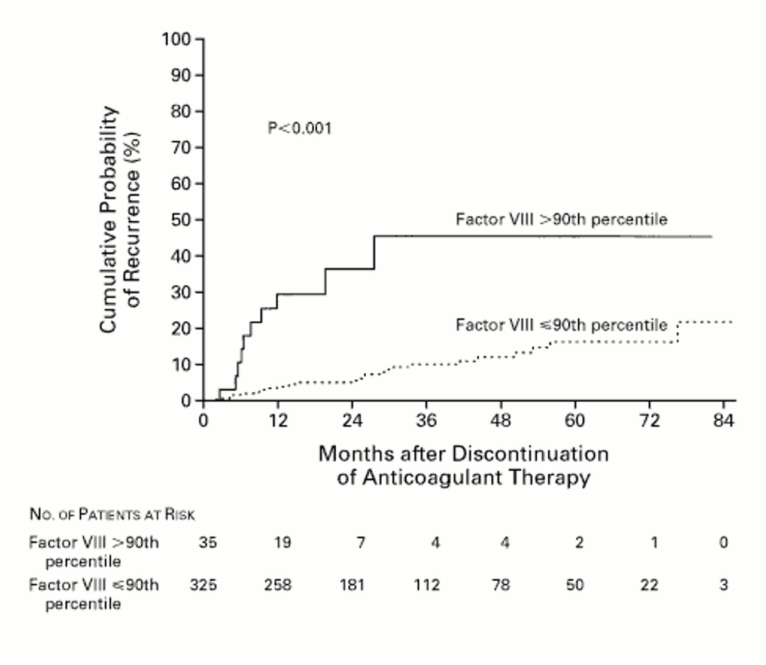
Factor VIII and recurrence of thrombosis
(>234 u/dl)
Kyrle 2000
Notes:
How does FVIII do? The problem is that we have least data for the period after 6 months.
360 patients with idiopathic VTE, treated for at least 3 months (average 8). FVIII taken>3 weeks after last a/c.
Risk was 1.08 per 10% rise in FVIII but actually showed a stepwise increase in risk above the 90th centile (>2.34)
So clearly reliable measurement of high FVIII levels is important.
Relationship was even stronger after adjustment for other risk factors such as FVL etc.
The recurrence rate for high FVIII is 37% at 24 months which is clearly very high. High enough to make a/c worthwhile. Beyond this is uncertainty ? Plateau but small numbers with this length of follow up so difficult to commit to long term (indefinite) a/c on these data. Poss could a/c for longer say 2yrs but would this just move the recurrence curve further down the line?
Kyrle concluded that ‘ the high prevalence of elevated levels of FVIII and the risk of recurrence associated with such high levels, warrant the measurement of FVIII during routine screening for thrombophilia’
Approx one third had PE, one third had distal veins, 40% of women took OCP.

Slide 61
FVIII in the population: Caerphilly heart study
40 -
30 -
20 -
10 -
0 -
Factor VIIIc n=1423
Mean = 99.05
Range = 7-261
Frequency
(%)
0 60 120 180 240 300 iu/dl
40 -
30 -
20 -
10 -
0 -
VWF Antigen n=1997
Frequency
(%)
Mean = 119.7
Range = 28-375
0 80 160 240 320 400 iu/dl
Rumley 1999
Notes:
Males only. In this study VIII and VWF were closely correlated and both showed an association with IHD. In several other studies this association was lost after correction for standard risk factors ? Implies that FVIII is a secondary marker of IHD risk.

Slide 62
Factor V and disease
Low levels
Parahaemophilia- similar bleeding pattern to haemophilia
Much rarer because autosomal
Complete deficiency lethal in mice
Some FV stored in platelet alpha-granules
High levels
Not an acute phase reactant: much less variable than FVIII
No increased risk of thrombosis

Slide 63
Factor V and thrombin generation
150%
100%
50%
Butenas 1999

Slide 64
Factor V Ag and thrombosis
OR 1 1.2 (0.8-1.7)
Kamphuisen 2000

Slide 65
Factor VIII
Mr 3000000
Concentration 0.4nM
Structure Circulates as heterodimer varying B chain
Synthesis Liver and some endothelium
Gene X chromosome
Distribution Plasma and some endothelium
Mouse ko Mod severe bleeding
Human – haemophilia A
(1 in 5000 males)
Plasma T1/2 8-12 hours (bound to VWF)
Activation thrombin cleavage – heterotrimer
Inactivation Dissociation ± APC
Acute phase/pregnancy Rises several fold
High levels Increased risk of thrombosis

Slide 66
Factor V
Mr 3300000
Concentration 20nM
Structure Circulates as single chain
Synthesis Liver and megakaryocytes
Gene Chr 1
Distribution Plasma and platelets (20%)
Mouse ko Lethal (parahaemophilia)
human variable but severe if absent
Aut rec. 1 in 10⁶
Plasma T1/2 20 hours (no carrier protein) ?TFPI
Activation thrombin cleavage – heterodimer
Inactivation APC cleavage
Acute phase/pregnancy No change
Elevated levels (unusual) no association with thrombosis.

Slide 67
Similarities between FV and FVIII
Gene structure
Protein domain structure
Absence of either causes bleeding disorder
Both require specific cleavages by thrombin to become active cofactors
B domains both highly glycosylated
Both active cofactors assemble into PL-located complexes with an active serine protease, to cleave another zymogen
Activated protein C cleavage switches them both off

Slide 68
Differences between FV and FVIII
High levels of FVIII associated with thrombosis but not FV.
Presence of acidic peptide sequences between domains in FVIII, not FV
Different proteolytic cleavages for activation
Completely different B domain sequences
Interaction of FVIII with carrier protein VWF
Different genetics and clinical prevalence (haemophilia A X-linked and much more common)

