Slide 1
Understanding Enzymes (in haemostasis)
BSC Haematology Module 1: 10 October 2012
Professor David Lane
Department of Haematology

Slide 2
Velocity of reaction depends on substrate concentration
Amount of
substrate
cleaved
Increasing substrate,
fixed enzyme concentration
Slopes used to calculate
velocity, v
time

Slide 3
Reaction rate of enzyme plotted against substrate concentration
Velocity , v
Enzyme is saturated
0.5
Substrate concentration [S]

Slide 4
Reaction rate of enzyme plotted against substrate concentration
Velocity , v
Fixed concentration of enzyme used here
V_{max},
Maximum
velocity
0.5
K_{m}, concentration of substrate giving 0.5 max velocity
Substrate concentration [S]

Slide 5
Increasing enzyme concentration increases V_{max}, not K_{m}
Velocity , v
V_{max 2}
Increase in enzyme
concentration
V_{max 1}
0.5
K_{m}
Substrate concentration [S]

Slide 6
Michaelis-Menten mechanism
K_{m}
E + S
E S
k_{cat}
E P
Rapid, reversible,
no chemical reactions
Slower, chemical reaction
takes place
k_{cat}, the turnover number
k_{cat} =V_{max}/[E]

Slide 7
Michaelis-Menten mechanism
K_{m}, is the dissociation constant of the
enzyme-substrate complex, a measure of affinity
k_{cat}, is the rate constant for the ES to EP reaction
often referred to as the turnover number
(the number of times the enzyme turns over/sec)
k_{cat}/K_{m}, is known as the specificity constant and is an
absolute measure of catalytic efficiency

Slide 8
Michaelis-Menten mechanism
practical considerations, replotting as Lineweaver-Burke plot
Velocity , v
1/v
Lineweaver-Burk
plot
1/K_{m}
0.5
1/V_{max}
Substrate concentration [S]
1/[S]
v = [E][S] k_{cat}
1
1
K_{m}
=
+
K_{m} +[S]
v
V_{max}
V_{max} [S]

Slide 9
Enzyme are made dramatically more efficient with surfaces and cofactors
Velocity , v
higher V_{max} and
therefore higher
k_{cat}
K_{m}
Lower K_{m}
means
increased
affinity
Substrate concentration [S]
k_{cat}/K_{m} increases dramatically

Slide 10
Blood coagulation
XII
XIIa
XI
XIa
Tissue factor
VIIa
(vessel damage)
Ca
2+
IX
IXa
VIIa
EXTRINSIC
PATHWAY
INTRINSIC
PATHWAY
VIIIa
Ca
2+
Pl
Ca ²⁺
X
Xa
X
Va
Pl
Ca
2+
COMMON
PATHWAY
Prothrombin
thrombin (IIa)
A case study,
prothrombin
activation by FXa
Fibrinogen
Fibrin
thrombin
XIIIa
XIII
Crosslinked
fibrin

Slide 11
Role of Platelet in Accelerating Blood Coagulation
FXa
FIXa
Ca ²⁺
Ca ²⁺
FIXa
FX
FVIIIa
Platelet membrane phospholipid
surface

Slide 12
Role of Platelet in Accelerating Blood Coagulation
thrombin
FXa
FIXa
Ca ²⁺
Ca ²⁺
Ca ²⁺
Ca ²⁺
FIXa
FX
FXa
FII
FVIIIa
FVa
FVa,
FVIIIa,
platelets
accelerate thrombin
generation 10, 000 fold
Platelet membrane phospholipid
surface

Slide 13
FXa activation of prothrombin
low affinity
K_{m} = 84 μM
low turnover number
k_{cat} = 0.011 s⁻¹
low efficiency
k_{cat}/K_{m} 0.135 x 10³ (M x s)⁻¹
+
+
FXa
prothrombin
thrombin
inactive
fragment

Slide 14
FXa activation of prothrombin with FVa
low affinity
K_{m} = 34 μM
high turnover number
k_{cat} = 6.22 s⁻¹
FAIRLY HIGH efficiency
k_{cat}/K_{m} 0.183 x 10⁶ (M x s)⁻¹
+
+
FXa
FXa
FVa
FVa
prothrombin
thrombin
inactive
fragment

Slide 15
FXa activation of prothrombin with phospholipids

Slide 16
FXa activation of prothrombin with FVa and phospholipids

Slide 17
How FXa activates prothrombin efficiently
FXa + FVa +
Prothrombin +
phospholipids
Velocity , v
FXa + FVa+
prothrombin
FXa + prothrombin
+ phospholipids
FXa +
prothrombin
Substrate concentration [S]
Diagram not to scale!

Slide 18
Summary of FXa activation of prothrombin
K_{m}
μM
k_{cat}
s⁻¹
k_{cat}/K_{m}
(M x s)⁻¹
Prothrombin activation
time secs
FXa + PT
84
0.011
0.135 x 10³
5382
FXa + FVa + PT
34
6.22
0.183 x 10⁶
4.07
10⁶ change!
FXa + PL + PT
0.058
0.038
0.647 x 10⁶
27.8
FXa +FVa + PL + PT
0.21
32.0
0.152 x 10⁹
0.036
PT, prothrombin; PL, phospholipids
Prothrombin activation time is time for 1 mol of FXa to activate
1 mol of prothrombin
Note: prothrombin concentration in plasma ~1.4μM
Adapted from Rosing et al J biol Chem 255:274-83, 1980

Slide 19
How tPA activates plasminogen
K_{m}
E + S
E S
k_{cat}
E P
fibrinolysis

Slide 20
How tPA activates plasminogen
fibrinolysis
plasma protein, zymogen
Plasminogen
Normally, no
interaction
tissue plasminogen
activator, tPA
plasma protein, proteinase

Slide 21
How tPA activates plasminogen
role of fibrin in plasminogen activation by tPA
When fibrin forms, tPA and plasminogen both bind to the
clot and there plasminogen is activated to plasmin
tissue plasminogen
activator, tPA
Plasminogen
Plasmin
Fibrin clot

Slide 22
How tPA activates plasminogen
role of fibrin in plasminogen activation by tPA
tissue plasminogen
activator, tPA
Plasminogen
Plasmin
Fibrin clot
Fibrin degradation
products, FDP

Slide 23
role of fibrin in plasminogen activation by tPA
How tPA activates plasminogen
Vmax
Fibrin reduces the K_{m} for plasminogen activation
K_{m} 80 μM -> 0.2 μM
Fibrin increases the V_{max} for plasminogen activation
k_{cat} 0.07 -> 0.28 s⁻¹
k_{cat}/K_{m} increases 1,600-fold to 1.56 x 10⁶ (Ms)⁻¹, resulting in faster, more efficient, plasmin generation, localised on fibrin
+fibrin
Rate of plasmin formation
Vmax
- fibrin
Km
Km
[Plasminogen]
Diagram not to scale!
Adapted from Zamarron et al J Biol Chem 259; 2080-2083, 1984

Slide 24
How antithrombin inhibits thrombin
K_{m}
E + S
E S
k_{cat}
E P
anticoagulation

Slide 25
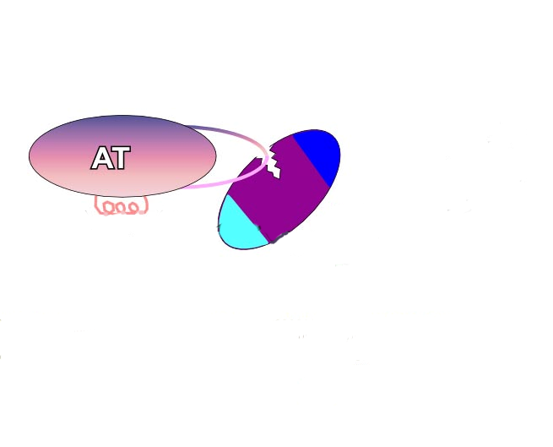
How antithrombin inhibits thrombin
Without HS
k_{cat}/K_{m}
1.4 x10⁴ M⁻¹s⁻¹
anticoagulation

Slide 26
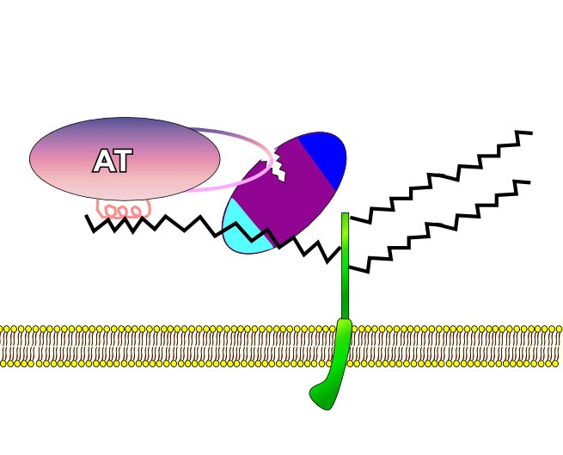
How antithrombin inhibits thrombin
the role of heparin or heparan sulphate
Without HS
k_{cat}/K_{m}
1.4 x10⁴ M⁻¹s⁻¹
With HS
k_{cat}/K_{m}
3 x10⁷ M⁻¹s⁻¹
HS, heparan sulphate
Lane et al Blood 106;1605-12, 2005

Slide 27
Understanding Enzymes (in haemostasis)
Summary:
The enzymes of haemostasis are made more efficient by surfaces and cofactors which modify the basic enzyme interaction with its substrate. This is reflected by decreases in K_{m}( increasing affinity), increases in k_{cat} (increasing turnover number), which leads to an increase in k_{cat}/K_{m}(catalytic efficiency).
The enhancing mechanisms are common to coagulation, to fibrinolysis and to anticoagulant pathways.

