Slide 1
Endothelial function
Beata Wojciak-Stothard
Department of Experimental Medicine and Toxicology
Imperial College London

Slide 2
Lecture plan
Introduction: definition and localization of the vascular endothelium
Endothelial function:
- regulation of vascular tone: vasorelaxants and
vasoconstrictors
- endothelial barrier function: types of endothelial junctions,
permeability factors
- endothelial repair and angiogenesis
- coagulation
Summary

Slide 3
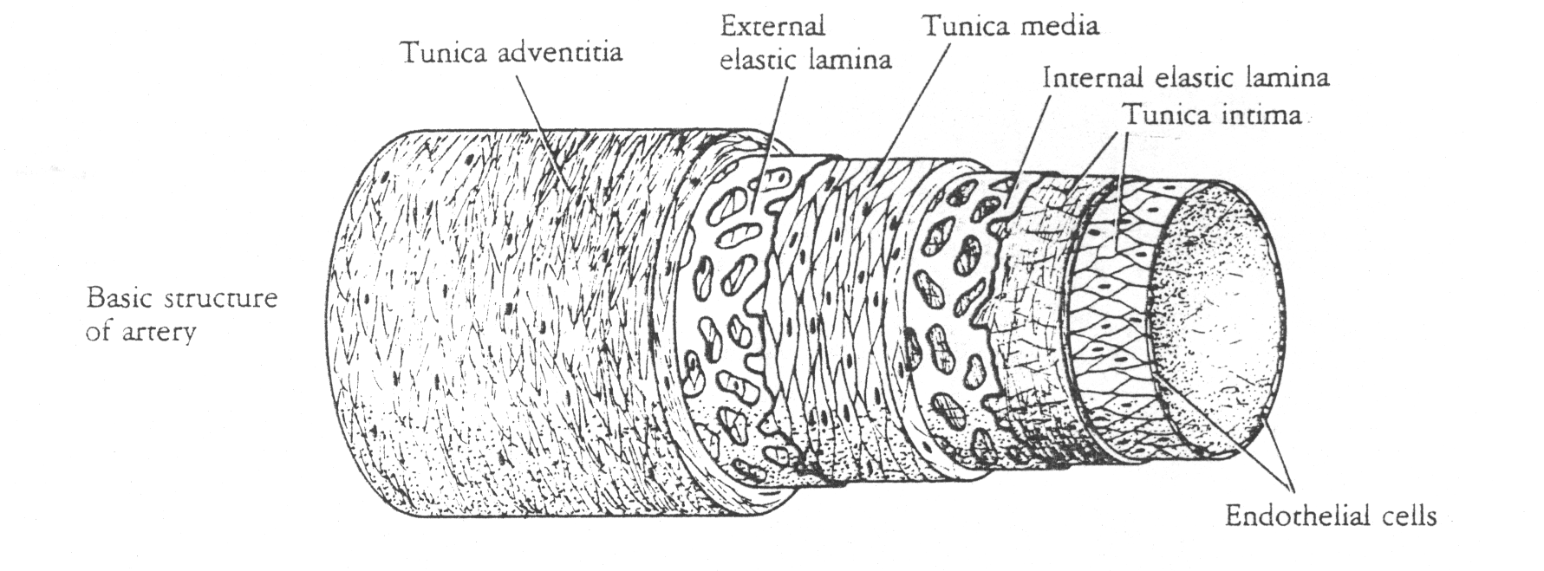
Basic structure of artery
ENDOTHELIAL CELLS

Slide 4
Endothelium –definition
The endothelium is the layer of thin, flat cells that lines the interior surface of blood vessels, forming an interface between circulating blood in the lumen and the rest of the vessel wall.
Endothelial cells line the entire circulatory system, from the heart to the smallest capillary. In small blood vessels and capillaries, endothelial cells are often the only cell-type present.
The endothelium is one of the largest organs in the human body, weighing about 1 kg and covering up to 7,000 m² of the surface area (W. C. Aird; T J Thromb Haemost 2005; 3: 1392–1406)

Slide 5
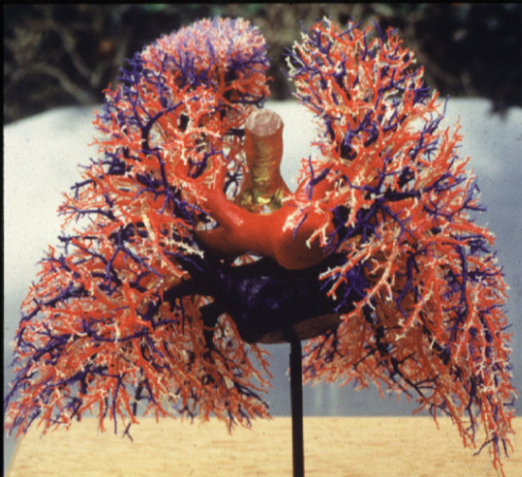
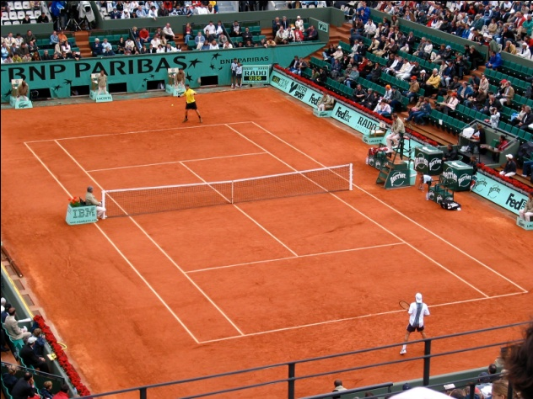
Example:
pulmonary endothelium has a surface ~ 70m²

Slide 6
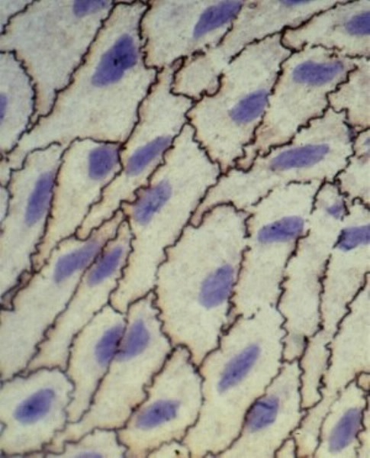
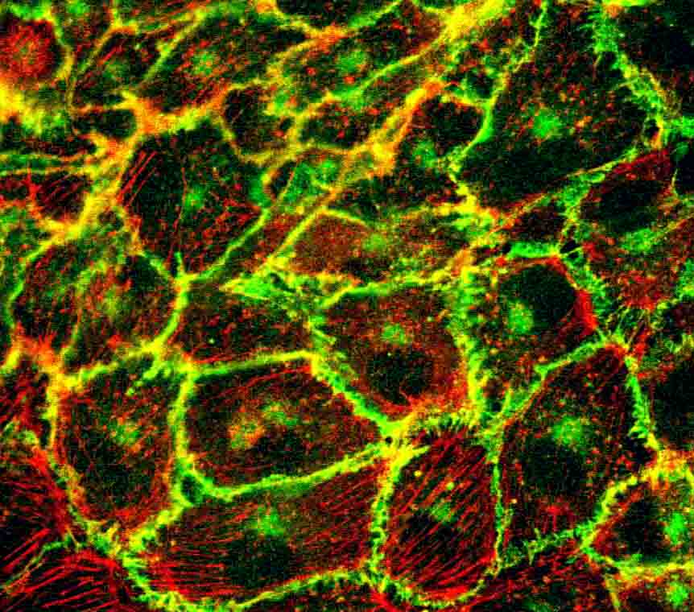
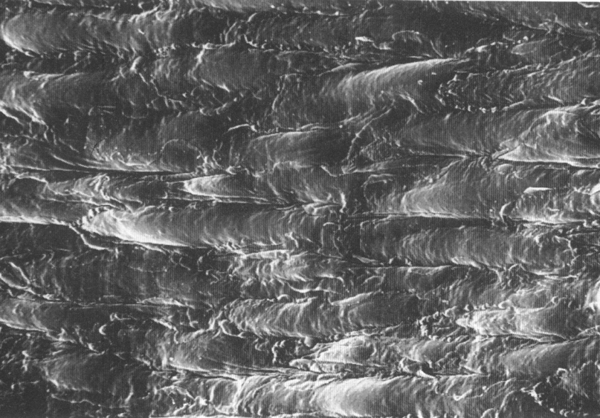
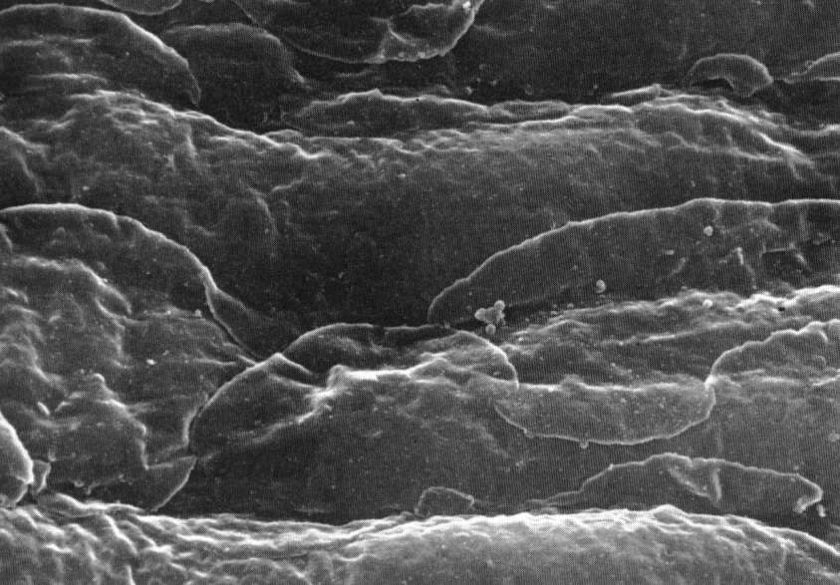
Endothelium- images
In vitro
In vivo:
rabbit aorta
From: Pathology of Atherosclerosis by N.Woolf, 1982

Slide 7
Endothelial function:
In response to changes in environmental factors such as oxygen tension, blood flow, circulating cytokines, and growth factors, the endothelium synthesizes and/or extracts many vasoactive mediators such as endothelin-1, norepinephrine, angiotensin 1, thromboxane, prostacyclin (PGI2), and the endothelial-derived relaxing factor nitric oxide (NO).
Using a complex language of chemical messages, the endothelium translates information about environmental changes to the underlying smooth muscle cells, to control their reactivity and regulate vascular tone.

Slide 8
Endothelial function, cont.
The endothelial layer also acts as a barrier, regulating the exchange of fluids and nutrients between blood components and the surrounding tissues.
In inflammatory conditions the endothelium regulates trafficking of blood cells to the sites of injury.
The endothelium regulates formation of new blood vessel formation (angiogenesis and vasculogenesis).
The endothelium controls blood fluidity by regulating coagulation process

Slide 9
Physical factors
Humoral factors
Inflammatory mediators
Acetylcholine
Bradykinin
Shear stress
Stretch Hypoxia
Histamine Thrombin TNFα
Paracellular permeability
adhesion
antithrombotic
neutrophils
sepsis
NO
caveolin
PGI₂
selectins
ICAM,VCAM
Transcytosis
Endothelium
PAF
vWF
NO
PGI₂
ET-1 TxA
PECAM
Fluid
myofilaments
Intercellular space
Matrix
dilatation
SMC
constriction
Barrier Function
Vascular tone
Host defence

Slide 10
Regulation of vascular tone

Slide 11

Normal is a balance between relaxation and vasoconstriction
Endothelial Cell
NO
PGI₂
ET-1
cGMP
cAMP
Smooth Muscle
Relaxation
Contraction
In balance

Slide 12
Endothelial mediators: Vasorelaxants
Nitric oxide (NO)
vasodilator produced from L-arginine by NOS (eNOS, iNOS and nNOS).
Inhibitor of inflammation and platelet adhesion
Prostacyclin (PGI₂)
-produced by endothelial and smooth muscle cells from arachidonic acid
by cyclooxygenase (COX) enzymes, NO-independent vasodilator
Inhibits blood coagulation by inhibiting platelet aggregation
Natriuretic peptides
-atrial natriuretic peptide (ANP), brain natruiretic peptide (BNP) and cell
natriuretic peptide (CNP) have NO-independent, vasodilatory effect

Slide 13
Nitric oxide signalling
NO is synthesized from L-arginine by NO synthases (NOS)
and causes vasodilatation via activation of soluble guanylyl cyclase generating cyclic guanosine monophosphate.
The endothelial NOS (eNOS) continuously produces NO,
which has a vasodilatory, anti-thrombotic and
anti-inflammatory effect.

Slide 14
Nitric Oxide Pathway
Endothelial cell
Endothelial barrier function
Motility
Angiogenesis
Inflammation
Thrombosis
eNOS
L-arginine
L-citrulline
NO
Smooth muscle cell
SMC relaxation
growth
Motility
Inflammation
Soluble guanylate cyclase (sGC)
S-nitrosylation
GTP
cGMP
Protein kinase G (PKG)
Phosphodiesterase
cGMP-gated ion channels
GMP

Slide 15
Vasorelaxant: nitric oxide
Shear stress
Increased O₂
Ventilation
vasorelaxants
Bradykinin
Acetylcholine
M
Endothelial Cell
eNOS
Ca⁺⁺
L-arginine
L-citrulline
+ NO
Click to add sub-title
NO
Ca⁺⁺
soluble guanylate cyclase
Smooth Muscle Cell
RELAXATION
cGMP
GTP
phosphodiesterase
Notes:
5

Slide 16
Vasorelaxant: prostacyclin (PGI₂)
PGI₂ is synthesized by cyclooxygenase (COX) enzymes in endothelium
PGI₂ elicits smooth muscle relaxation by activating specific cell-surface receptors (IP) that are G-protein-coupled to adenylyl cyclase and thereby elevate cyclic adenosine monphosphate levels. Activates potassium
channels causing membrane hyperpolarization and inhibition of intracellular calcium channels.
PGI₂ inhibits SMC proliferation and platelet aggregation (anti-coagulant)
PGI₂
K_{ATP} channel
Ca²⁺
hyperpolarisation
BKCa channel
X
IP
P_{i}
AC
Gs
P_{i}
K⁺
ATP
K⁺
cAMP
Notes:
There are two main consequences of activating the IP receptor in smooth muscle, one is relaxation, the other is inhibition of cell proliferation. Cellular responses are thought to occur primarily through cAMP-dependent activation of PKA, since AC and PKA inhibitors can reverse some of the effects of IP agonists. Substantial evidence suggests that K⁺ channels play a key role in mediating the effects of IP receptor. Depending on the vascular bed, either K_{ATP} channels or the large conductance K⁺ channel play a major role. Activation leads to membrane hyperpolarisation and the closure of voltage-gated Ca²⁺ entry, leading to a lowering [Ca²⁺]_{i}. In the lung both channels contribute to IP agonist induced relaxation, whereas in larger conduit vessels like aorta, BKCa channels appear to be the predominate K⁺ channel activated..

Slide 17
Vasorelaxants: natriuretic peptides
Natriuretic peptides are peptide hormones that are synthesized by the heart, brain and other organs. The release of these peptides by the heart is stimulated by atrial and ventricular distension, as well as by neurohumoral stimuli, usually in response to heart failure.
There a 3 main types of natriuretic peptides : Atrial natriuretic peptide (ANP; A-type), B-type NP (Brain natriuretic peptide) and C-type (produces in brain, chondrocytes and endothelial cells)
Natriuretic peptide receptors act as are transmembrane guanylyl cyclases, enzymes that catalyze the synthesis of cGMP. Induce vasorelaxation, counteract the effects of renin/angiotensin II system
Ref: Potter LR et al. Endocr Rev. 2006 Feb;27(1):47-72.

Slide 18

Natriuretic Peptides and cGMP: schematic diagram of signalling pathway
Blood vessel
lumen
BNP
ANP
Endothelium
CNP
NO
_{Particulate GC}
Fe
Soluble GC
GTP
cGMP
GTP
PDE
Smooth muscle cell
GMP
RELAXATION

Slide 19
Endothelial mediators: Vasoconstrictors
Endothelin-1
-endothelium-derived vasoconstrictor
Angiotensin II
-pro-inflammatory vasoconstrictor, part of renin/angiotensis system,
increases Reactive Oxygen Species (ROS ) generation
Thromboxane
arachidonic acid metabolite produced by platelets, vasoconstrictor. Increases ROS
production in endothelial cells and inhibits NO production.
Pro-coagulant, contributes to platelet activation (opposite effect to prostacyclin)

Slide 20
Activation of endothelin-1 (ET-1) signalling in PH
ET-1 contributes to vascular tone and regulates cell proliferation through activation of ETA and ETB receptors. Physical factors such as shear stress, or stimuli including thrombin, epinephrine, angiotensin II, growth factors, cytokines and free radicals enhance secretion of ET-1.
ET-1
Hypoxia, stretch, cytokines, endotoxin
ET_{B}
PreProET-1
Endothelial Cell
NO, PGI₂
Big ET-1
ET-1
ET_{B}
ET_{A}
Smooth Muscle
Vasoconstriction
Vasodilation
Vasoconstriction proliferation
Mazzuca MQ . Biochem Pharmacol.
2012 Jul 15;84(2):147-62

Slide 21
Angiotensin II signalling
Angiotensin is a peptide hormone that causes vasoconstriction and a subsequent increase in blood pressure. It is part of the renin-angiotensin system, which is a major target for drugs that lower blood pressure.
Angiotensin II receptors 1 and 2 (AT1R and AT2R) are expressed in
endothelium and their proportion determines vascular effects of
angiotensin II.
AT1R promotes vasoconstriction by enhancing endothein-1 release,
stimulating ROS production by NADPH oxidase and increases production
of prostanoid vasoconstrictors such as thromboxane.
Promotes coagulation by increasing release of tissue factor.
AT2R promotes vasodilation by increasing the release of bradykinin
which activates eNOS and increases NO levels.
A2R also increases the levels of vasorelaxant prostacyclin.
Ref: Muniyappa R, Yavuz S. Mol Cell Endocrinol. 2012 Jun 7.

Slide 22
Angiotensin II signalling
Bradykinin
Angiotensin II
BrR
AT2R
AT1R
TF
Endothelin-1
ROS
thromboxane
eNOS
prostacyclin
Endothelial
cell
NO
NO
vasorelaxation
coagulation
vasoconstriction

Slide 23
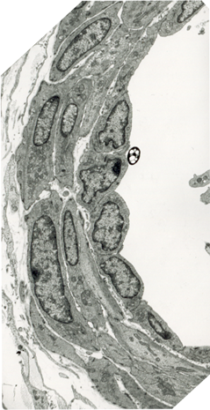
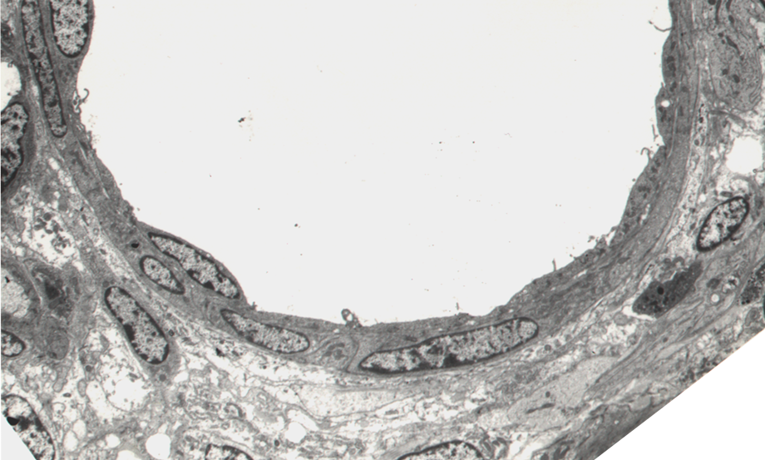
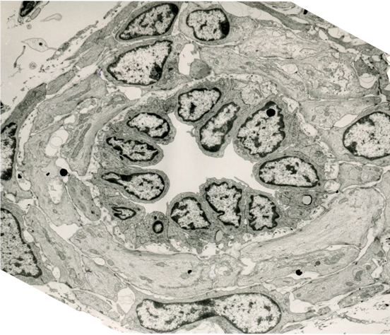
Example: regulation of the vascular tone during postnatal adaptation of small intrapulmonary arteries
stillborn
30 mins
Rapid postnatal ↑ lumen
diameter in large and small
pulmonary arteries
Change in cell shape and
cytoskeletal organisation
NO, Prostacyclin
Endothelin-1, angiotensin
1 week

Slide 24
Regulation of endothelial barrier function

Slide 25
Endothelial barrier function and junctional proteins
Endothelial barrier function depends on the integrity of
cell-cell junctions.
There are 3 types of endothelial junctions:
Adherens junctions (proteins: VE-cadherin, PECAM-1)
Tight junctions (occludin, claudins, JAMs)
Gap junctions (connexins 37, 40, 43)
Junctional proteins are associated with the submembrane
actin cytoskeleton
Junctional integrity is regulated by phosphorylation and
dephosphorylation of junctional proteins and their
association with the actin cytoskeleton

Slide 26
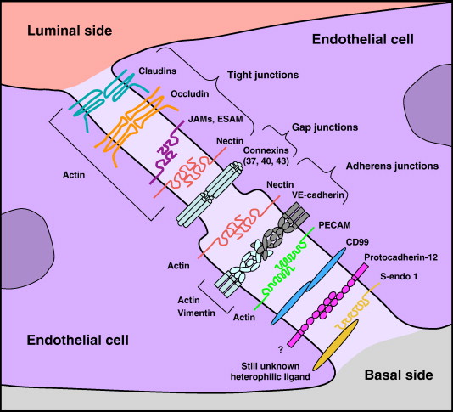
Wallez and Hubert BBA - Biomembranes Volume 1778, Issue 3 2008 794 - 809

Slide 27
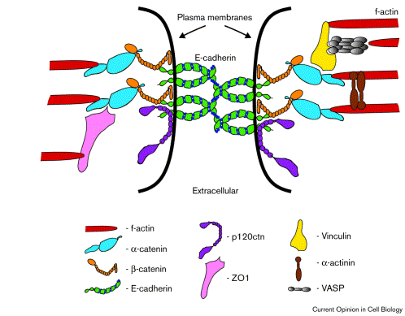
Example:
proteins associated with vascular endothelial (VE) cadherin
Plasma membrane
VE-cadherin
F-actin
p120ctn
vinculin
α-catenin
β-catenin
α-actinin
ΖΟ−1
VE-cadherin
Modified from Curr .Opinion in Cell Biology

Slide 28
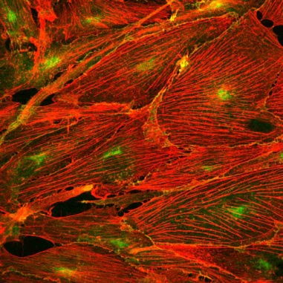
Endothelial barrier function is regulated by
contractile and tethering forces
Activated cells
Control cells
Thrombin, histamine, TNF-α
hypoxia
Sphingosine 1-phosphate
RhoA
Rac1
Actomyosin contractility
Tethering forces (adhesion)
Barrier dysfunction
Barrier integrity
RhoA and Rac1 are Rho GTPases, proteins involved in the regulation of actin dynamics

Slide 29
Contractile forces are generated as a result of myosin light chain phosphorylation
that allows the interaction between the actin filaments and myosin.
Ca²⁺
Calmodulin-Ca²⁺
RhoA
MLC kinase
Rho kinase (RoK)
MLC phosphatase
actin+myosin interaction
MLC-P
MLC
dissociated actin+myosin
contraction
Endothelial permeability
Vascular smooth muscle contraction
(calcium sensitization)
MLC – myosin light chain

Slide 30
Endothelial response to vasoactive factors
Vasoactive agents | Sources in vivo | Barrier function
Thrombin | Activated platelets
Histamine | Mast cells
Sphingosine -1 phosphate (S1P) | Activated platelets
TNF-α | Activated leukocytes, endothelium
Endothelin-1 | Endothelium
VEGF | Endothelium
Hepatocyte growth factor (HGF) | Several cell types
Lipopolysaccharide (LPS) | Gram-negative bacteria
Lysophosphatidic acid (LPA), oxLDL | Activated platelets
crosslinking adhesion molecules ICAM-1, VCAM-1) | Leukocyte adhesion
Ref: Wojciak-Stothard and Ridley Vasc Pharmacol 39 (2003) 187-199

Slide 31
Endothelial repair and angiogenesis

Slide 32
Angiogenesis: definition and mediators
Angiogenesis is the growth of blood vessels from
the existing vasculature. It is a multi-step process involving
breaking of cell-cell adhesions, basement membrane
degradation, cell migration and morphohenesis/coalescence
of new vessels
Endothelium-derived mediators: nitric oxide, vascular endothelial growth factor (VEGF; isoforms with121, 165, 189, and 206 amino acids), transforming growth factor-beta1 (TGFβ1), pleiotrophin, acidic and basic fibroblast growth factor (FGF), placental growth factor, and thymidine phosphorylase, PDGF (platelet-derived endothelial cell growth factor), GF receptors, integrins, adhesion molecules and extracellular matrix components

Slide 33
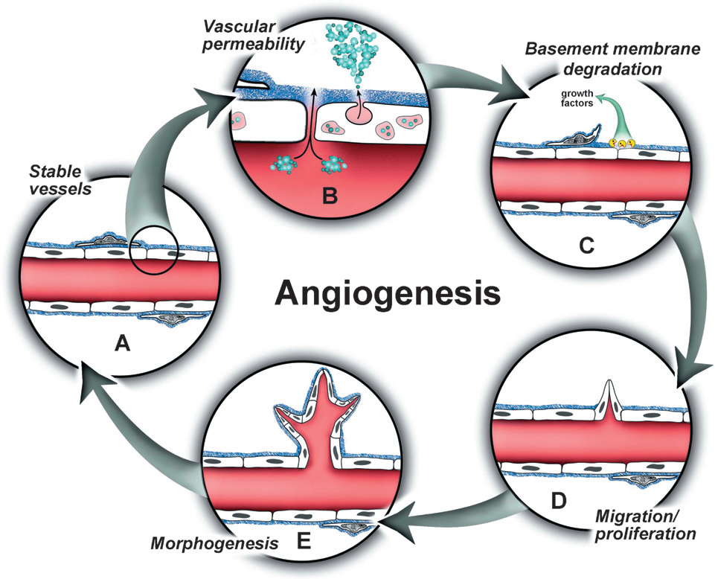
Ref. Bryan and d’Amore Cell.Mol.Life.Sci 64 (2007) 2053-2065

Slide 34
Regulation of coagulation pathway

Slide 35
Normal, healthy endothelium has anti-adhesive properties
and maintains blood fluidity by producing anti-coagulant factors
Activated endothelium shows increased production of
pro-coagulants and decreased production of anti-coagulants
NORMAL ENDOTHELIUM
ACTIVATED ENDOTHELIUM
ANTI-COAGULANTS
PRO-COAGULANTS
PRO-COAGULANTS
ANTI-COAGULANTS

Slide 36
Endothelial mediators: Anticoagulants
Prostacyclin
-inhibits platelet adhesion and activation
NO
-inhibits platel adhesion and aggregation; suppresses thrombin
production
Thrombomodulin
binds thrombin to initiate protein C activation
Protein S
-cofactor in protein C pathway, inhibits activation of
Factors VIII and X

Slide 37
Endothelial mediators: Anticoagulants, cont.
Heparan sulphate proteoglycans
-Bind and concentrate antithrombin on endothelial surfaces
Tissue plasminogen activator
-inactivates fibrinolysis
Annexin V
Compettive binding inhibitor of phospholipid-dependent coagulation factors
Tissue Factor Pathway Inhibitor
-inhibits TF/Factor VIIa complex
Ecto-ADPase
-inactivates ADP and inhibits platelet aggregation

Slide 38
Endothelial mediators: Procoagulants
Tissue Factor
-Released following endothelial injury/activation
Von Willebrand Factor
-forms bridges for platelet adhesion and aggregation
Plasminogen Activator Inhibitor-1
Inhibits fibrinolysis

Slide 39
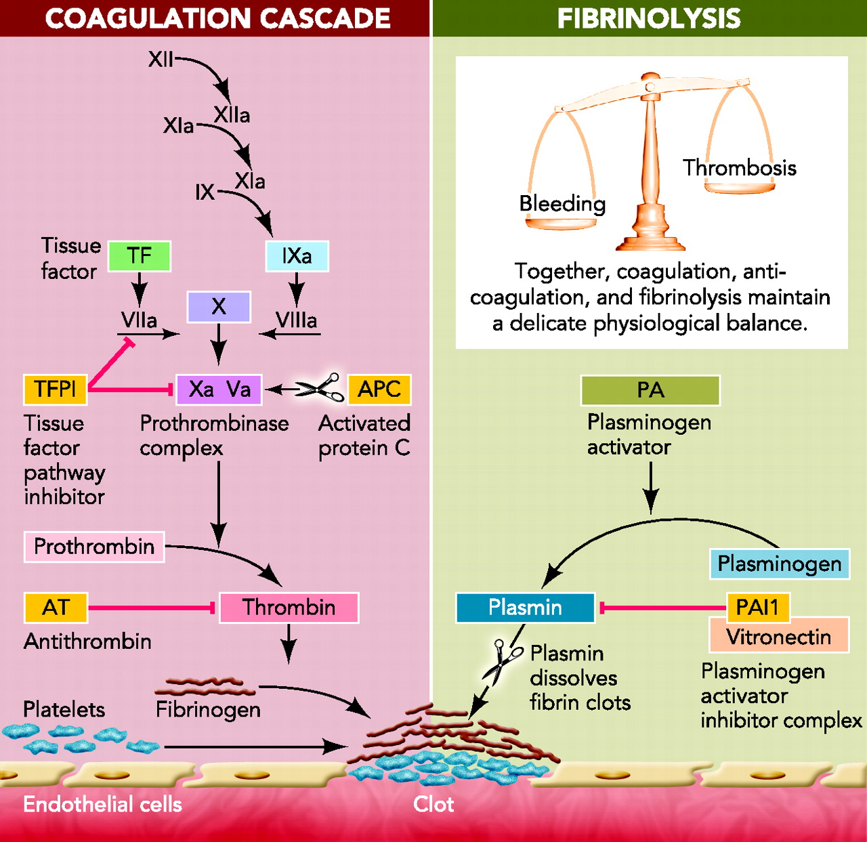
Sun H Physiology 2006;21:281-288
Notes:
Scheme of the coagulation-anticoagulation system. Activation of the coagulation system culminates in generation of thrombin, which cleaves fibrinogen to form fibrin clots with platelets on the site of vascular injury. The coagulation system is negatively regulated by tissue factor pathway inhibitor (TFPI), antithrombin (AT), and activated protein C (APC). Fibrinolytic system also regulates coagulation by generation of plasmin, which dissolves fibrin clots. Fibrinolytic system is negatively regulated by plasminogen activator inhibitor 1 (PAI-1). A delicate balance between coagulation and anticoagulation is necessary to prevent pathophysiological conditions such as excessive bleeding or thrombosis.

Slide 40
Anticoagulant
Procoagulant
Prostacyclin
Platelet
aggregation
vWF
NO
Thrombin, Fxa, FXIa, FIXa
Heparan sulphate proteoglycan
Blood coagulation
Thrombin
FXa
FX
FVIIa
Thrombomodulin
FFIXa
FIX
TF
Prothrombin
TF pathway inhibitor
TF-FVIIa, FXa
Plasminogen activator inhibitor 1
Fibrinolysis
Tisue type
Plasminogen activator
Endothelial cell
Endothelial cell

Slide 41
Examples of factors that influence
pro-coagulant/anti-coagulant balance
Inflammation
Mechanical injury of the endothelium (shear stress)
Metabolic stress leading to endothelial activation e.g.
low density lipoproteins (LDLs), advanced glycation end
products (AGEs), toxins
Oxidative stress (reactive oxygen species, ROS)

Slide 42
Example: activation of coagulation in inflammation
Pro-inflammatory cytokines (TNF-α , IL-1) suppress production
of anti-coagulant thrombomodulin and increase expression of
tissue factor and platelet activating factor (PAF) by the
endothelium. This increases platelet adhesion to the
endothelium. Pro-inflammatory cytokines also increase
expression of adhesion molecules for leukocytes.
Leukocyte adhesion triggers release of superoxide that
induces endothelial damage and increases endothelial
permeability. Superoxide also inhibits anti-coagulant nitric
oxide.
Blood components penetrate endothelial layer and gain
contact with collagen, a component of subendothelial
endothelial matrix. This triggers platelet activation and
adhesion.

Slide 43
Thrombosis in inflammation: good and bad
Thrombosis restricts spreading of infection. Some invasive bacteria
recruit plasmin to their surface, degrade complement components,
penetrate endothelium and invade extracellular matrix
(E.coli, Salmonella)
Streptococci use their own plasminogen activator,
streptokinase, to dissolve clots.
BUT
Increased thrombosis may lead to cardiovascular disorders such
as atherosclerosis, pulmonary embolism, pulmonary hypertension,
myocardial infarction, ischaemic cerebrovascular disease etc.

Slide 44
Summary
Vascular endothelium is strategically located at the interface between tissue and blood.
The endothelium secretes a number of substances important in the regulation of
-vascular tone
barrier function
vascular repair and angiogenesis
inflammatory cell recruitment and adhesion
coagulation process

