Slide 1
The contact activation system
Professor Mike Laffan

Slide 2
Learning objectives
Be familiar with the components of the contact activation system and the other systems with which it interacts
Understand the mechanisms of contact system activation
Understand the physiological role of the system
Be able to explain the role of the contact system in disease
Understand the features of contact system deficiency.

Slide 3
The contact activation system
“...has counteradhesive, profibrinolytic, inflammatory, prothrombotic and antithrombotic properties..”
“...but is not required for normal haemostasis..”

Slide 4
The contact activation system
C1 esterase inhibitor (C1-INH)
Factor XII
Prekallikrein (PK)
High molecular weight kininogen (HK)
Factor XI
Complement
Cells
Fibrinolysis

Slide 5
Components of CAS
Factor | Chrom | cDNA | aa | Mol wt | Plasma conc | synthesis
FXII | 5q33-qter | 2.4kb | 596 | 80kd | 375nM | Liver
PK | 4q35 |  | 609 | 85 & 88kd | 490nM | Liver
HK | 3q26 | 3.5kb | 626 | 120kd | 670nM | Liver and fibroblasts, platelets, EC
LK | 3q26 | 1.7kb | 427 | 68kd | 1300nM

Slide 6
CAS evolution
HK, FXII and PK-XI found only in later vertebrate development (cf thrombin)
FXII lost in birds and whales. Dp[joms
FXI and PK arose by gene duplication in early mammals.
Remain 58% homologous
Both bind to HK
Both on chromosome 4

Slide 7
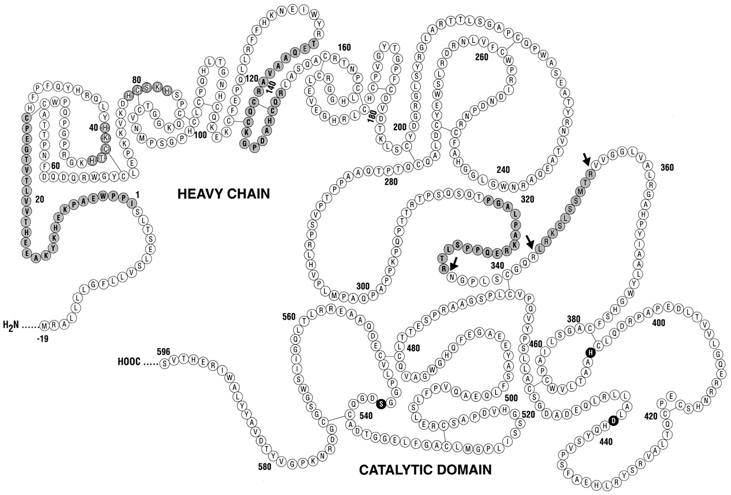
Factor XII (Hageman factor)
Activation
Heavy chain
Light chain
Fibronectin
Coll bindin
Fibronectin
Fibrin finger
Serine protease
Proline
rich
EGF
EGF
Kringle
Colman, R. W. et al. Blood 1997

Slide 8
Factor XII
Activation (1) – surface activation
Binding to negatively charged surfaces (+Zn⁺⁺) results in conformational change of FXI, autoactivation and PK cleavage
Cleavage at R353- V354 to 2 chain molecule α-FXIIa
α-FXIIa – principal activities
Can activate FXI on negatively charged surfaces
Can activate PK (leading to feedback)
What is the physiological negatively charged surface?
Poss. cell surface cerebroside
LPS
Some GAGs
Misfolded protein (amyloid, BJP )
RNA (from damaged cells)
Polyphosphate (platelet dense granules, bacteria)

Slide 9
Factor XII
Activation (2) –fluid phase
Plasma kallikrein
Successive cleavages to smaller forms
FXIIa and β-FXIIa
Smaller forms (FXIIf) cannot bind neg charged surfaces and can activate PK and C1 but not FXI

Slide 10
Factor XII
Additional activities
Down regulates FcR on monocytes
Promotes IL-1 and IL-6 from monocytes
Stimulates neutrophils
Neutralised
90% by C1-INH
A2 macroglobulin
Antithrombin (on platelets)
PAI-1

Slide 11
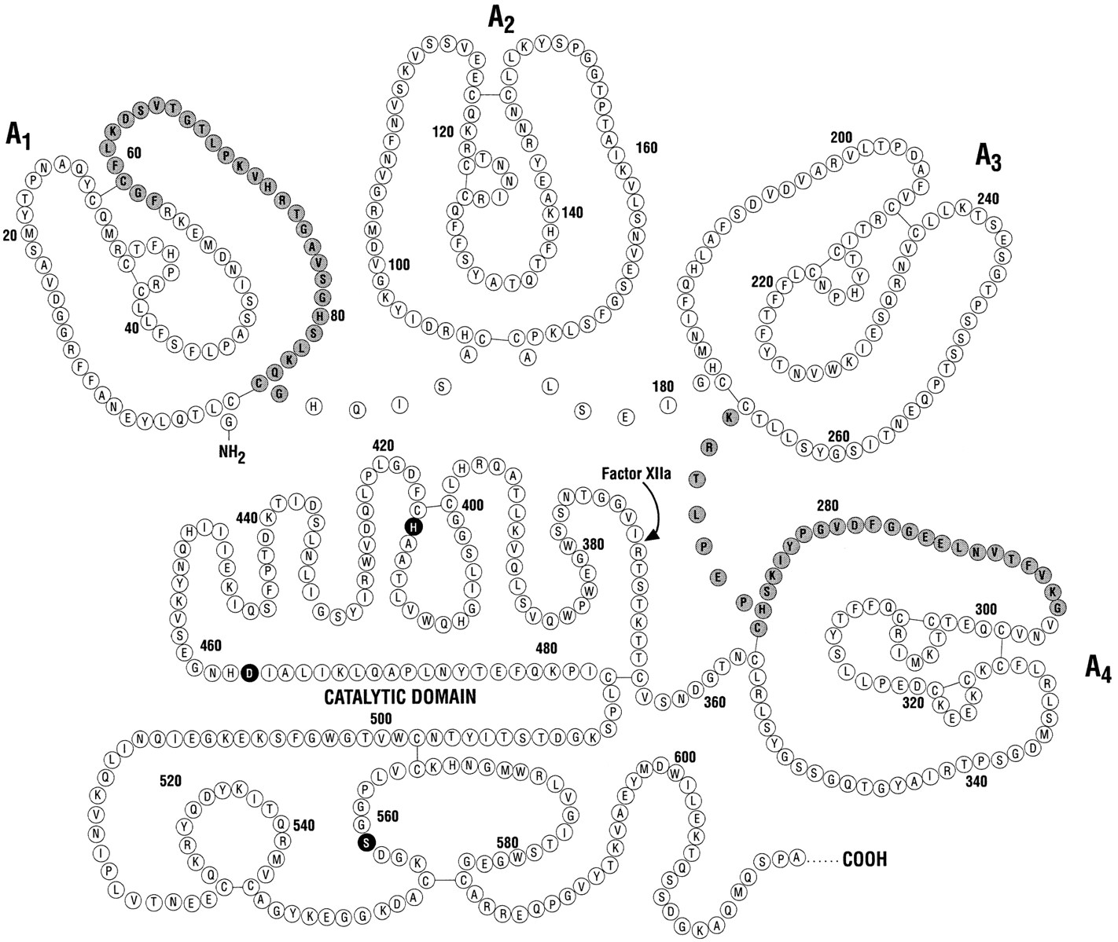
Prekallikrein
Binding to HK
Serine
protease
Apple
Apple
Apple
Apple
Colman, R. W. et al. Blood 1997

Slide 12
(Pre)Kallikrein (Fletcher factor)
FXI and PK probably arose from a duplication event.
Two glycoforms in plasma (85 and 88kd)
75% bound to HK 25% free
Activated by α-FXIIa on surface to which HK is bound or by FXII fragment (β-FXIIa) in fluid phase
Cleaved to two-chain form
Inhibited by C1-INH and α₂-macroglobulin (partial)

Slide 13
Kallikrein
Substrates:
XIIa, esp when bound to HK
HK – to release Bradykinin
Prourokinase

Slide 14
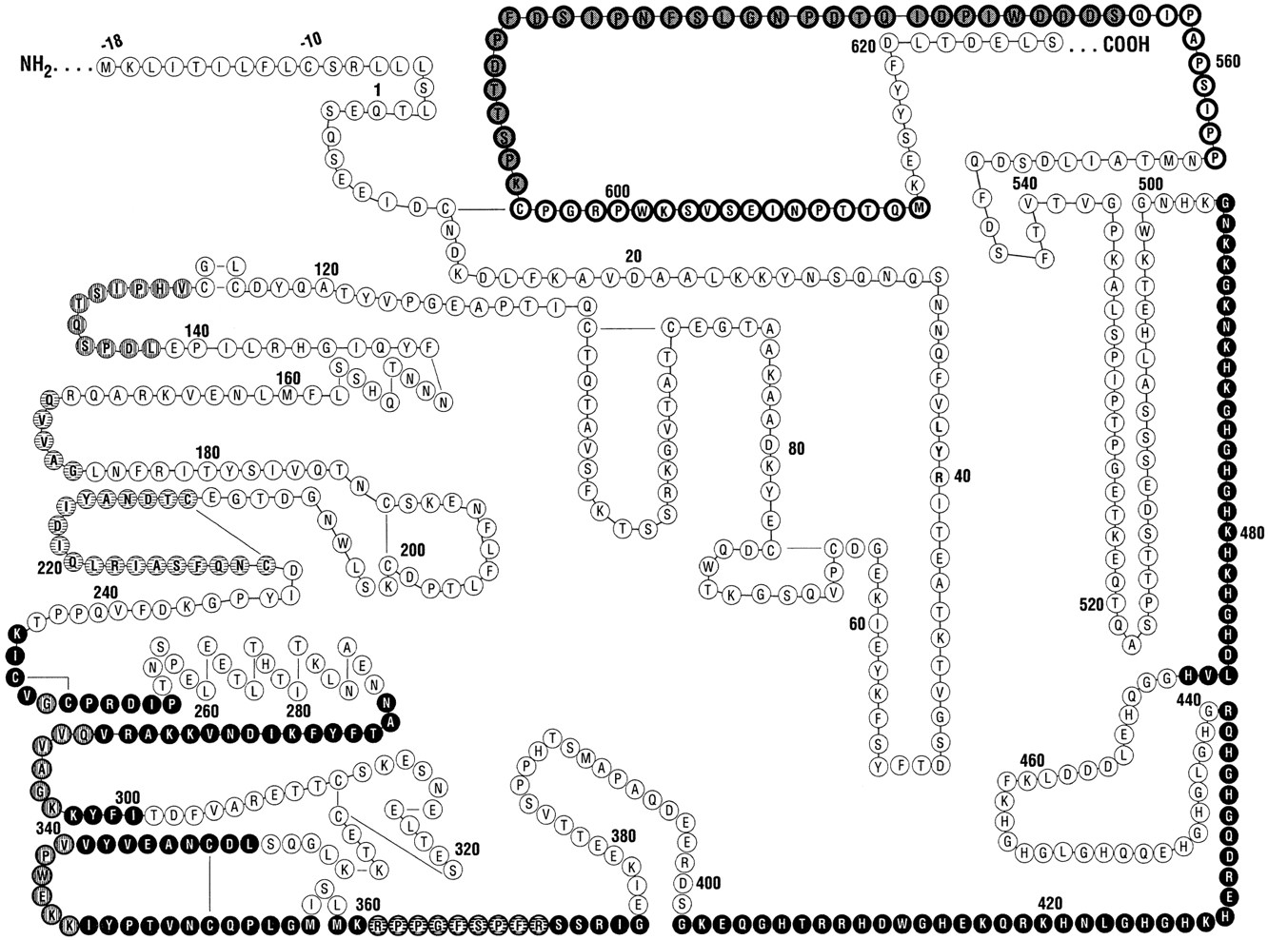
High molecular weight kininogen (Williams-Fitzgerald factor)
PK and FXI binding
Calpain & papain inhibition
Surface binding
Colman 1997

Slide 15
High molecular weight kininogen (Williams-Fitzgerald factor)
LK and HK produced from single gene by alternative splicing
Both contain bradykinin sequence (BK)
Cleavage by Kallikrein releases BK and produces conformational change
Present in platelets, granulocytes and EC.
Activation leads to release and surface binding of HK

Slide 16
High molecular weight kininogen
Inhibits adhesion of neutrophils
Enhances cellular fibrinolysis
Inhibits thrombin activation of platelets
Releases Bradykinin
Facilitates cleavage of PK (even in absence of FXIIa)

Slide 17
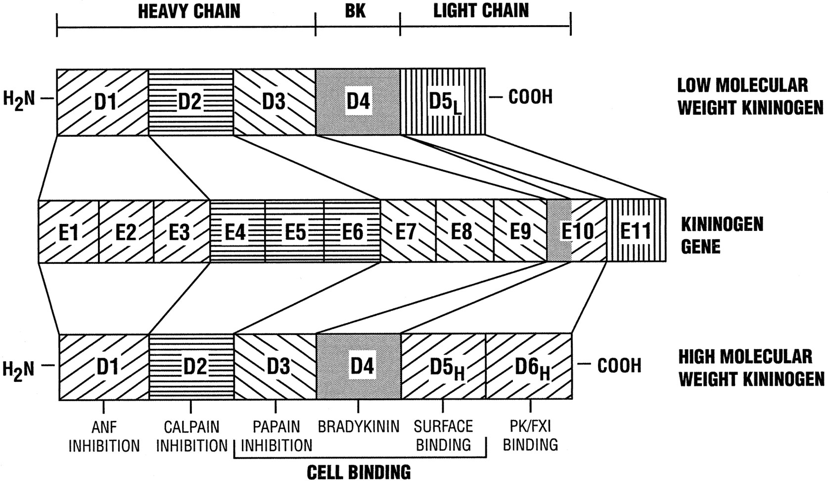
Domain structure of kininogens
Colman, R. W. et al. Blood 1997;90:3819-3843

Slide 18
High molecular weight kininogen
Kininogen domain | Activity | Biol function | Cell receptors | cells
1 | Inhibits atrial natriuretic factor | Antidiuretic
2 | Inhibit cysteine protease | Antithrombotic | Aggregin | platelets
3 | Block thrombin binding to platelets | Antithrombotic | GpIb-IX-V | Platelets
4(BK) | PGI2 and NO | Antithrombotic | B2 receptor | EC
4 (BK) | tPA | Antithrombotic | B2 receptor | EC
4 (RPPGF) | Blocks PAR-1 cleavage | Antithrombotic | PAR-1 | Platelets
5H | Blocks neutrophil adhesion | Antiadhesive | Mac-1 (α_{M}β₂ CD11b/18) | Neutrophils
5H | Displaces fibrinogen from surfaces | Antiadhesive | Mac-1 (α_{M}β₂ CD11b/18) | Neutrophils
5H | Blocks EC to vitronectin | Antiadhesive | uPAR | EC
5H | Inhibits proliferation & stimulates apoptosis | Antiangiogenic | uPAR | EC
6 | Binds PK | Profibrinolytic
6 | Bind K | Inflammatory

Slide 19
High molecular weight kininogen
HK and LK synthesised from same gene by alternative splicing
Increases in pregancy, oestrogen therapy
Surface receptors:
uPAR on neutrophils, monocytes
Cytokeratin on platelets, EC and granulocytes
CD11b/18 on neutrophils
Surface binding of HK requires Zn⁺⁺

Slide 20
High molecular weight kininogen
Binds to anionic surfaces via D5
Binds PK (D6) and facilitates cleavage
Binds FXI (D6) and facilitates cleavage
Cleaved by Kallikrein to release bradykinin
Then binds more tightly to anionic surface
Acts as inhibitor of adhesive interactions of other cells

Slide 21
Biological function of CAS
Bradykinin formation
Binds to B1 and B2 receptors (7 transmemb)
PGI2 (cAMP) and NO (cGMP) production increased:
Vasodilation and platelet inhibition
Inhibit smooth muscle proliferation (NO)
(but may promote hypertrophy and atherosclerosis after injury)
Pain
Complement activation
β−FXIIa cleaves C1
Kallikrein cleaves C3, C5

Slide 22
Biological function of CAS (2)
Thrombin inhibition
HK blocks thrombin binding to platelets
HK inhibits platelet calpain, released by thrombin
HK inhibits thrombin cleavage of PAR-1
Fibrinolysis
FXII and K cleave plasminogen (slowly)
K activates scuPA
BK promotes tPA release from EC
FXI important for TAFI activation

Slide 23
Biological function of CAS (3)
Antiadhesive interactions
HKa displaces fibrinogen from neg charged surfaces
HKa inhibits protein binding to cells
HKa inhibits cell binding to protein surfaces
Angiogenesis and wound repair
HK and FXII (zymogen) via uPAR on EC
ERK1/2 and Akt phosphorylated via β1 and EGFR
BK promotes homing of Endothelial progenitor cells
Activation of FXI
Biological importance uncertain

Slide 24
Overview of CAS
Schmaier 2008

Slide 25
Evidence that CAS is physiologically active

Slide 26
HMWK deficiency
Isolated prolonged APTT
No abnormal bleeding tendency

Slide 27
Prekallikrein deficiency
Isolated prolonged APTT shortens with prolonged incubation
No abnormal bleeding tendency.

Slide 28
Factor XII deficiency
Hageman died from a PE!
No defect in haemostasis (Isolated prolonged APTT)
No clear increase in risk of VTE
Possible:
Increased risk MI (RR for MI of 0.4 for highest quintile (SMILE))
increased re-occlusion after MI ?reduced fibrinolysis
Role in platelet based thrombosis?

Slide 29
HMWK
APTT
CONTACT
PK
XII
XI
VIIa
PT
TF
VIII
IX
V
X
TT
IIa
II
Fibrinogen
Fibrin

Slide 30
Factor XII deficiency : null mice
FXII -/- mice are less susceptible to thrombosis (FeCl₃ model)
FXI deficiency protects to a similar degree
Platelet aggregates are unstable
Also seen in baboons
Ischaemia-reperfusion injury is reduced
HK null mice also have reduced thrombotic response
B2 receptor mice not protected from ischaemia-reperfusion injury

Slide 31
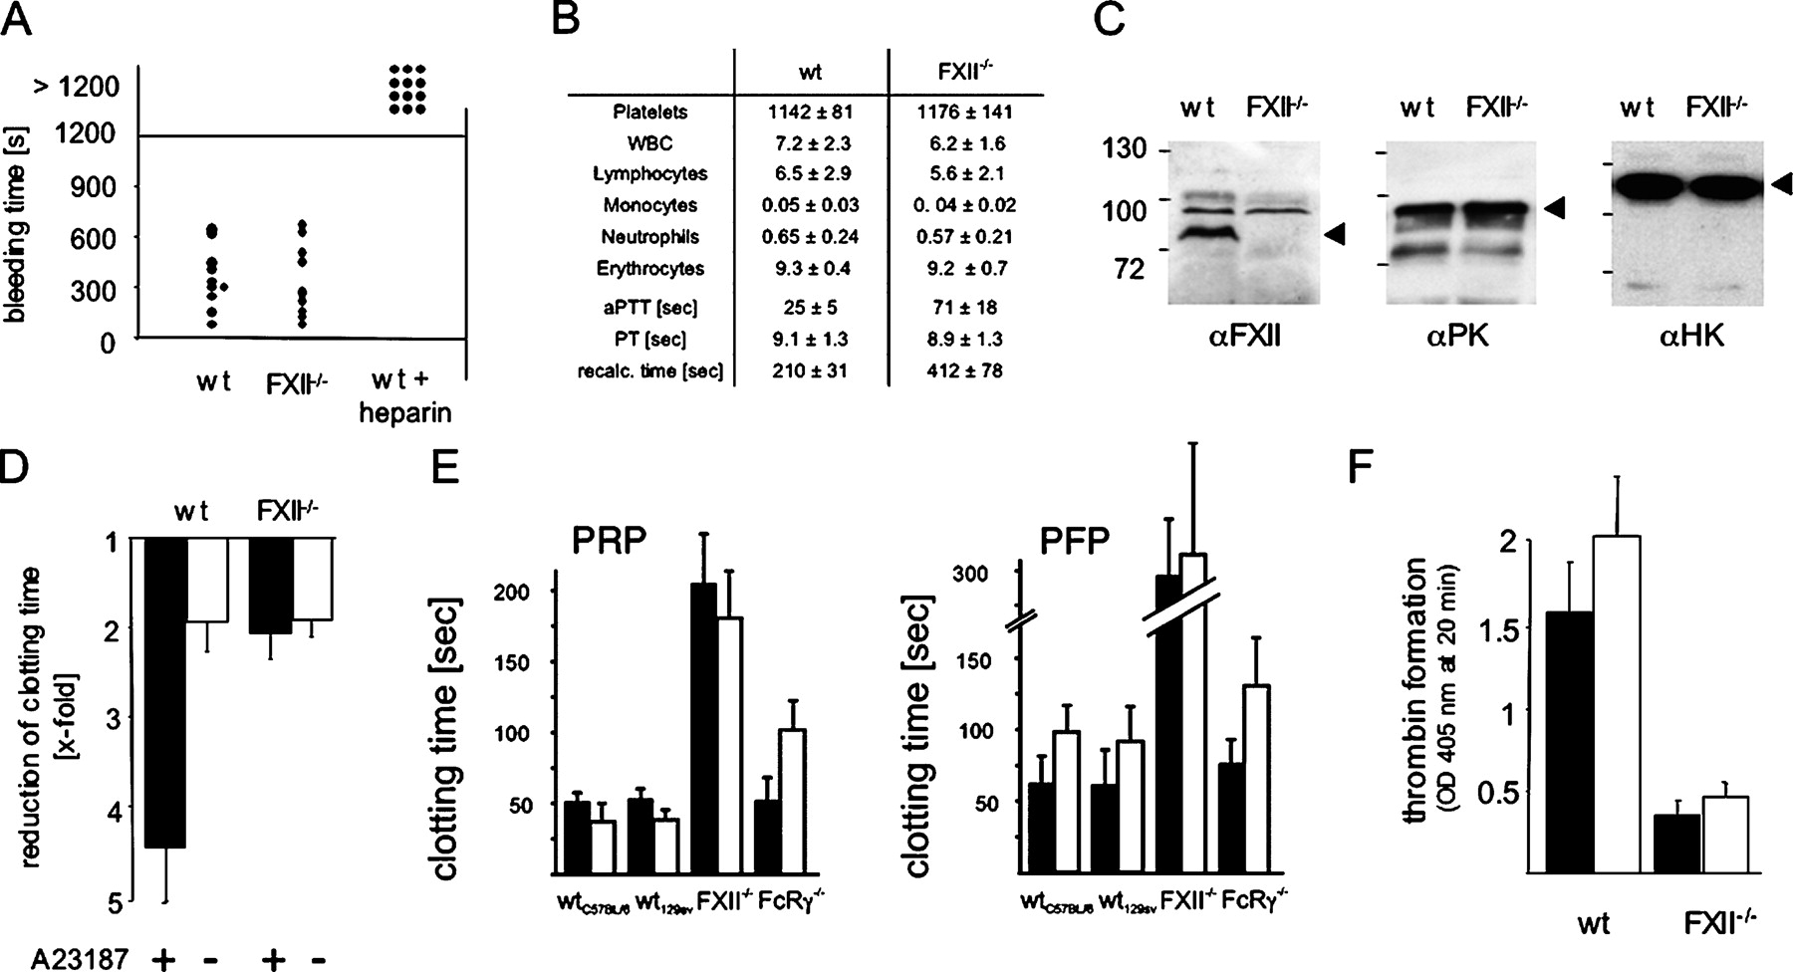
Hemostasis and coagulation in FXII deficient mice.
Renné T et al. J Exp Med 2005;202:271-281
Notes:
Hemostasis and coagulation in FXII deficient mice. (A) Tail bleeding times for wild-type (n = 12) and FXII−/− (n = 11) mice. Each symbol represents one individual. (B) Peripheral blood counts in thousands/microliter and coagulation parameters for FXII−/− and wild-type mice. Values are mean ± SD for 10 mice of each genotype. WBC, white blood cells; aPTT, activated partial thromboplastin time; PT, prothrombin time. (C) Western blots of wild-type or FXII deficient plasma (0.3 μl per lane) using primary antibodies recognizing the contact proteins FXII (αFXII), plasma kallikrein (αPK), and high molecular mass kininogen (αHK). The arrowheads point to FXII (left), plasma kallikrein (middle), and high molecular mass kininogen (right). Numbers indicate molecular mass standards. (D) Wild-type PFP or FXII-deficient plasma was reconstituted with platelets stimulated with calcium ionophore A23187 (+) or buffer (−), and recalcification clotting times were determined. Reduction of the clotting time is given relative to PFP substituted with buffer (n = 6). (E) Recalcification clotting times were determined in PRP (left) and PFP (right) from wild-type (129Sv and C57BL/6), FXII−/−, and FcRγ−/− mice after activation with kaolin (black bars) or collagen (white bars). Mean ± SD from six experiments is given. (F) Thrombin generation in PRP (white bars) and PFP (black bars) from wild-type and FXII−/− mice initiated by the addition of 30 μg/ml of collagen. Thrombin formation was analyzed using the chomogenic substrate S-2238, and absorbance was detected at a 405-nm wavelength after incubation for 20 min. Data shown are mean ± SD (n = 6).

Slide 32
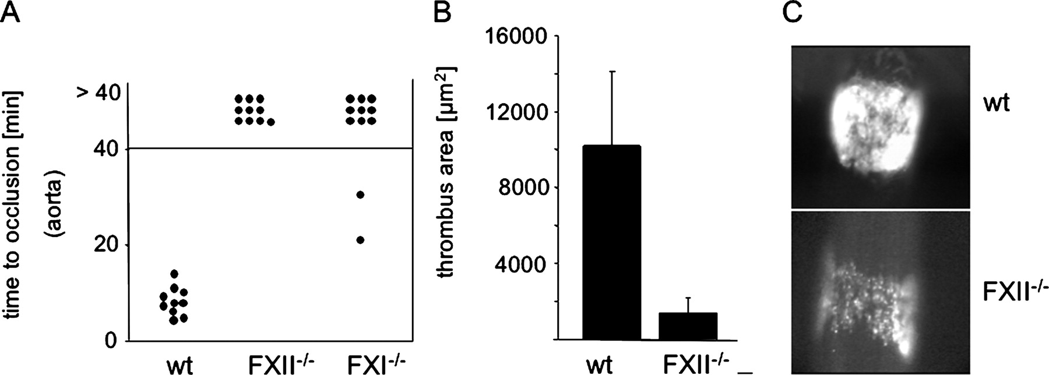
Defective thrombus formation in the injured aorta and carotid artery in FXII−/− and factor XI−/− mice.
Renné T et al. J Exp Med 2005;202:271-281
© 2005 Rockefeller University Press
Notes:
Defective thrombus formation in the injured aorta and carotid artery in FXII−/− and factor XI−/− mice. (A) Thrombosis was induced in the aorta of wild-type (n = 10), FXII−/− (n = 10), and FXI−/− (n = 11) mice by one firm compression with a forceps. Blood flow was monitored with a perivascular ultrasonic flow probe until complete occlusion. The experiment was stopped after 40 min. Each symbol represents one individual. (B) Mechanical injury to the carotid artery was induced by ligation with a surgical filament. 5 min after removal of the filament, thrombus areas (μm2) in wild-type and FXII−/− (n = 10) mice were measured and are expressed as mean ± SD. (C) The photomicrographs show representative images 5 min after injury.

Slide 33
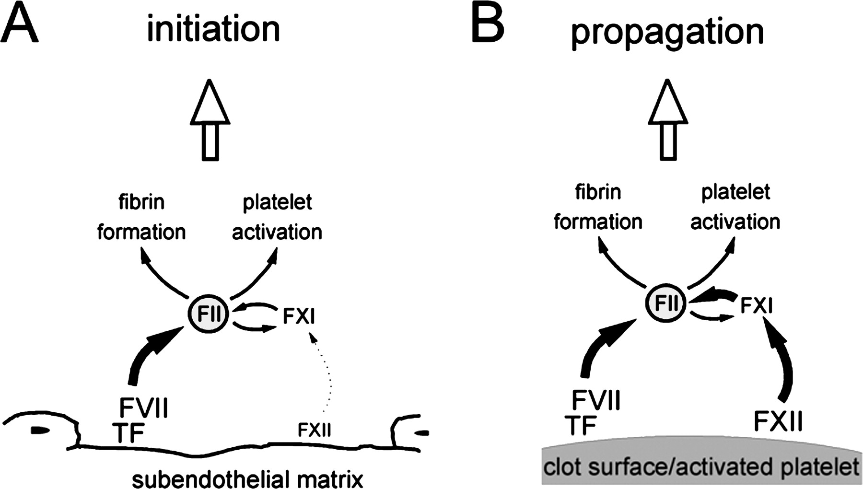
A model of arterial thrombus formation.
Renné T et al. J Exp Med 2005;202:271-281
© 2005 Rockefeller University Press
Notes:
A model of arterial thrombus formation. (A) Initiation of thrombus formation at sites of vascular lesions is predominantly caused by TF and collagens exposed in the subendothelial matrix. TF in complex with FVII initiates thrombin formation, which promotes fibrin formation and platelet activation. The contribution of FXII in this early phase of thrombus formation is minor. (B) FXII activity on the exposed surface of the thrombus contributes to thrombin generation and additional platelet activation, propagating thrombus growth. Accordingly, FXII, as well as factor XI, deficiency severely impairs thrombus formation.

Slide 34
FXII and venous thrombosis (LETS)
No association irrespective of cut-off
Koster 1994

Slide 35
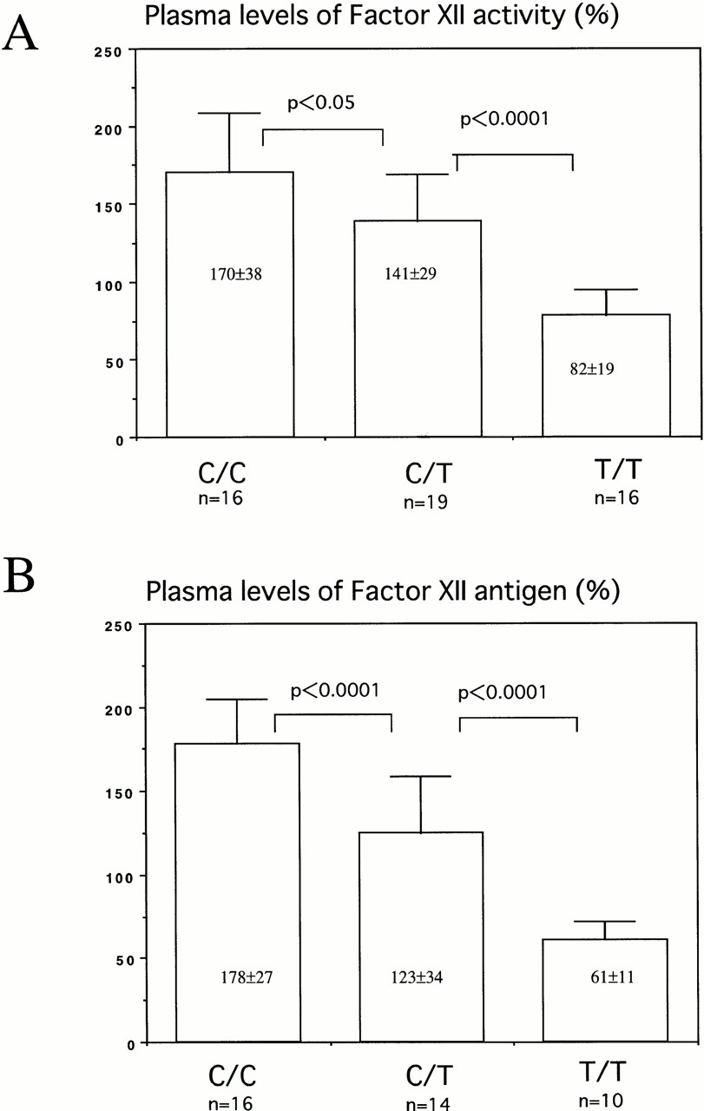
Plasma levels of factor XII activity (A) and antigen (B) of individuals with 46C/C, 46C/T, or 46T/T.
©1998 by American Society of Hematology
Kanaji Blood 1998;91:2010-2014
Notes:
Plasma levels of factor XII activity (A) and antigen (B) of individuals with 46C/C, 46C/T, or 46T/T. Thirteen Caucasians were included in C/C, 6 in C/T, and 1 in T/T group. The levels of plasma FXII activity and antigen were 150.0±30.3 (n = 20) and 155.4±36.1 (n = 20) in Caucasians, and 125.4±56.3 (n = 31) and 104.7±57.2 (n=20) in Orientals, respectively.

Slide 36
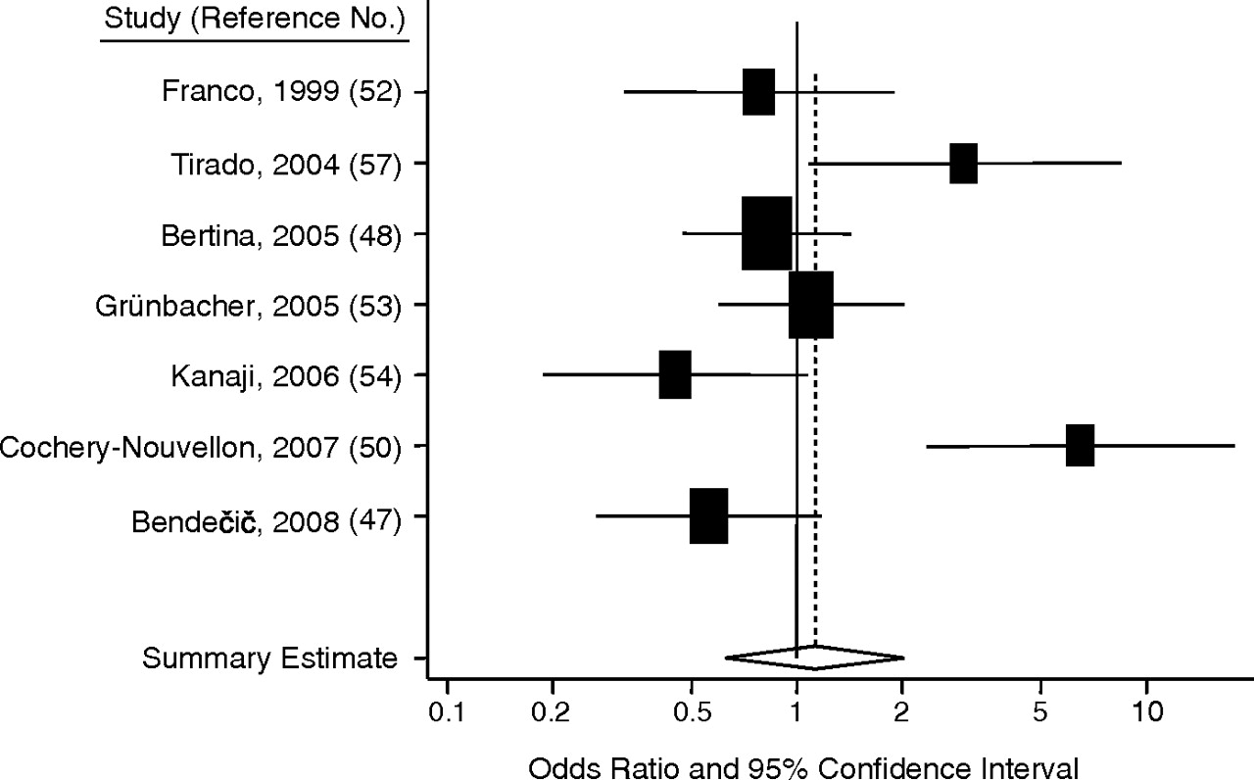
Meta-analysis of FXII −4C>T (46 C/T) polymorphism and venous thrombosis
TT v CC
Johnson Am. J. Epidemiol. 2011;173:136-144
Notes:
Results from a random-effects meta-analysis of the association between the factor XII (F12) −4C>T polymorphism and venous thromboembolism (TT genotype vs. CC genotype). The sample sizes are represented by the size of the squares. Bars, 95% confidence interval.

Slide 37
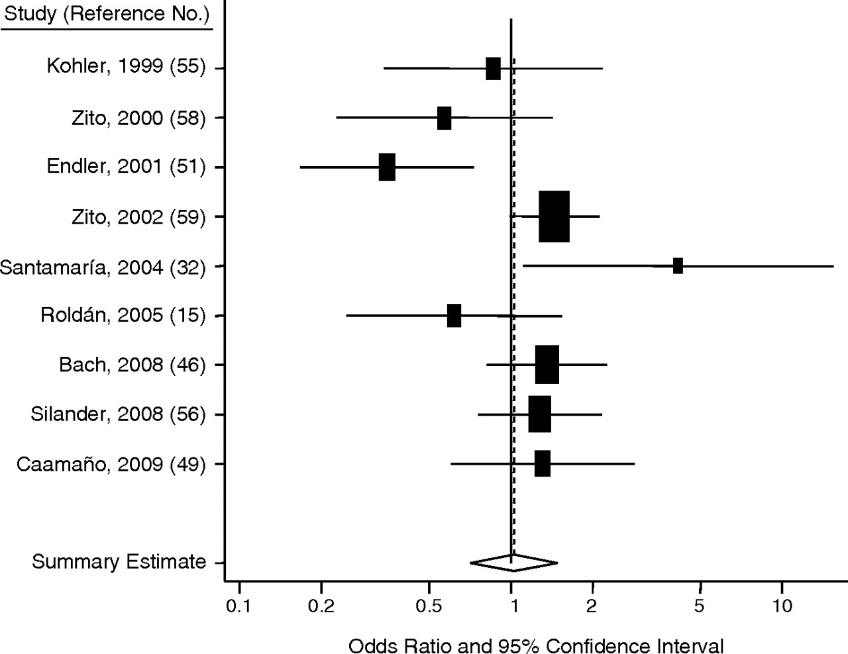
Meta-analysis of FXII −4C>T (46 C/T) polymorphism and MI
TT v CC
Johnson al. Am. J. Epidemiol. 2011;173:136-144
Notes:
Results from a random-effects meta-analysis of the association between the factor XII (F12) −4C>T polymorphism and myocardial infarction (TT genotype vs. CC genotype). The sample sizes are represented by the size of the squares. Bars, 95% confidence interval.

Slide 38
FXII and thrombosis
Interesting but relevance still uncertain in humans

Slide 39
Factor XII and mortality in a Viennese cohort
Marsik 2007
Notes:
These data for all cause mortality but the same relationship is seen when looking at only vascular mortality. 100% is the reference category. Note the results are opposite to expected from mouse. V low levels seems to return mortality to normal again. 46000 patient years of observation. 58 patients in the <10% group.

Slide 40
FXII and angioedema
Hereditary angioedema
Recurrent oedema, abdominal pain
C1-INH deficiency
Factor XII mutations
Thr309Lys and Thr309Arg: ↑ amidolytic activity
Mainly women
Recurrent skin, tongue & facial swelling, abdominal pain
Triggers
trauma, physical pressure, and emotional stress
oral contraceptives, pregnancy, HRT, ACE inhibitors

Slide 41
FXII-HAE
Bork 2009

Slide 42
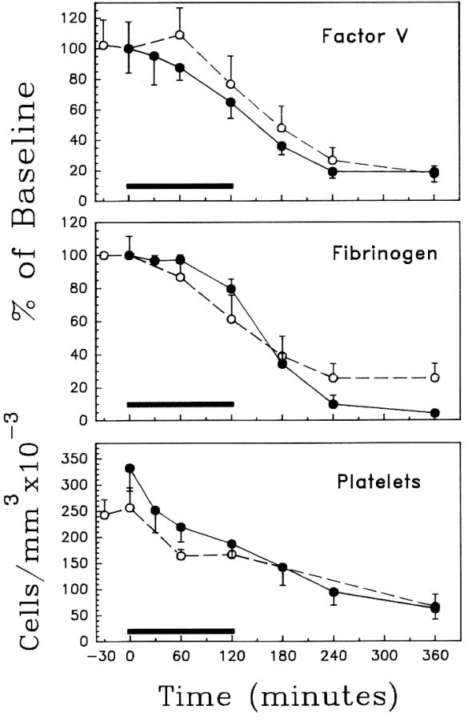
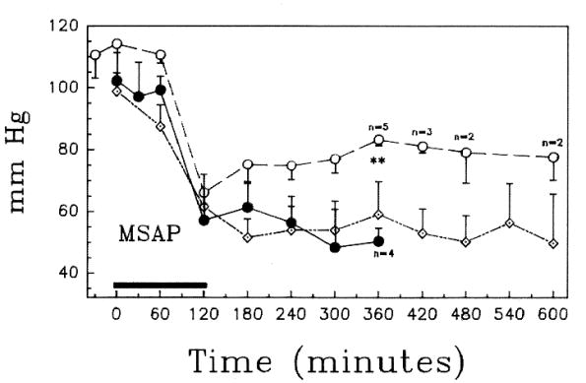
Lethal E Coli injection in baboons: role of contact system in septic shock
Coagulation
Y
Survival
Blood pressure
FXII blocked with mAb
Colman 1993

Slide 43
Evidence that the CAS is physiologically potent

Slide 44
Deaths following heparin administration reported to the FDA
Heparin recall

Slide 45
The contact system and contaminated heparin
Dramatic rise in heparin associated deaths
Hypotension, facial swelling, tachycardia, urticaria & nausea
Traced to heparin from Changzhou, China
Over sulphated chondroitin sulphate (OSCS) identified in implicated batches.
OSCS has high density of negative charge
Presence of OSCS caused Kallikrein activation (blocked by depletion of FXII)

Slide 46
Contaminated heparin and kallikrein generation in plasma
Kishimoto 2008
Notes:
Note concentration effect

Slide 47
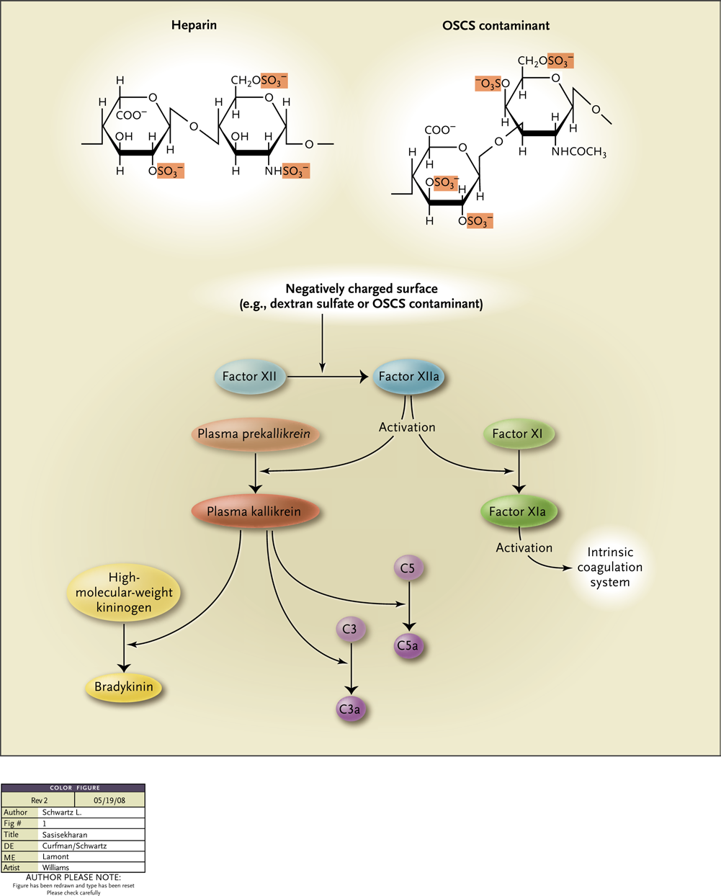
Schwarz 2008

