Slide 1
New anticoagulant agents: design and practice
Keith Gomez
Haemophilia Centre and Thrombosis Unit
Royal Free Hospital

Slide 2
Learning Objectives
Potential therapeutic targets for anticoagulation
Development of new agents
Status of new agents
Which drugs look most promising

Slide 3
Why do we need new anticoagulants?
25,000 avoidable deaths in England each year due to hospital acquired VTE
Total cost of VTE in 2005 in UK: £640 million
Risk of VTE in hospital 1,000 x risk due to flying
Limitations of current agents

Slide 4
Benefits of Anticoagulation
Coagulation
Thrombosis
Neovascularisation
Inflammation
Wound Healing
Sepsis
Cancer
Metastasis

Slide 5
Characteristics of an ideal antithrombotic
Efficacy
Safety
Convenience
Proven in arterial and venous thrombosis
Wide therapeutic window
Low bleeding risk
Predictable response
Oral with fixed dosing
Few drug or food interactions
Rapid onset and offset of action
Routine monitoring not required
Antidote

Slide 6
Features of current anticoagulants
Feature | Warfarin | Heparin | LMWH
Rapid onset of action | - | + | +
Predictable pharmacokinetics | - | - | +
Predictable anticoagulant response unaffected by diet/drugs | - | - | +
Rapid offset of action | - | + | -/+
Availability of a safe antidote | + | + | -
No off-target effects, such as hepatoxicity | + | - | -/+
Reasonable cost | + | + | +
Ease of administration (oral) | + | - | -

Slide 7
Problems with current anticoagulants
Non-specific action
Warfarin affects a wide range of proteins
Heparin acts at a number of points in coagulation
Narrowing the target specificity
More predictable effect
More controllable action

Slide 8
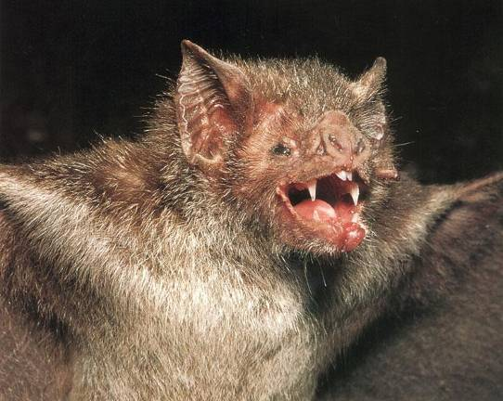
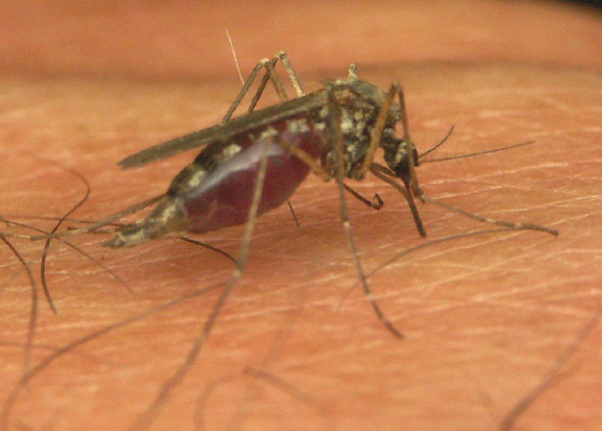
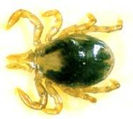
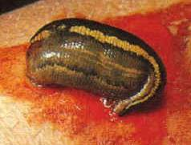
Naturally occurring anticoagulants

Slide 9
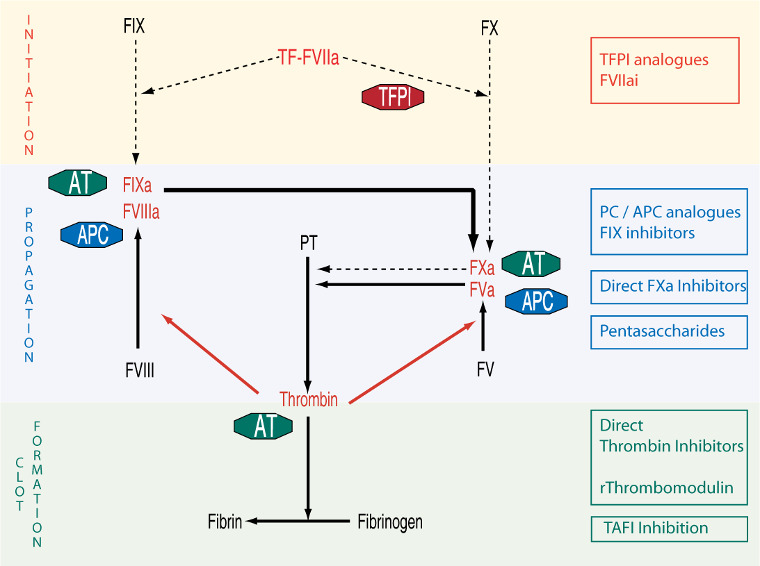
Potential targets

Slide 10
Synthetic Pentasaccharides
Fondaparinux (Arixtra)
Licensed for VTE prevention
Idraparinux
Hypermethylated derivative of fondaparinux
Very high affinity for antithrombin
T ½ 80 hours
Weekly administration
Inhibit FXa, too small to directly affect thrombin
Can be used in HIT
Reversal?

Slide 11
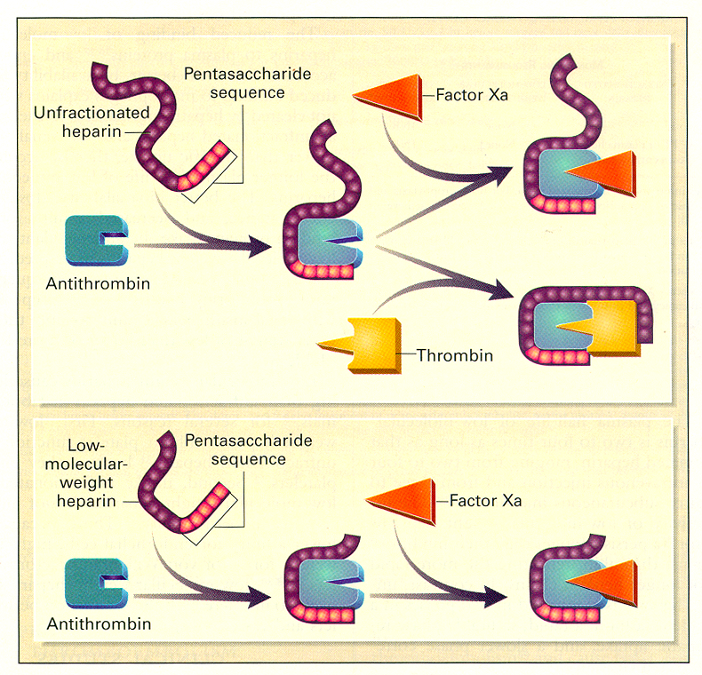
Action of pentasaccharides

Slide 12
Fondaparinux (Arixtra)
T½ 15-20 hours
Once daily s/c administration
Not metabolised, renally excreted
Phase III studies showed efficacy in
VTE thromboprophylaxis
Treatment of DVT & PE
CAD
Similar efficacy and to LMWH, less bleeding
Not reversible by protamine

Slide 13
Direct Factor Xa inhibitors
Factor Xa may be a better target than thrombin
Few functions outside coagulation
Wider therapeutic window in vitro
No evidence of rebound increase in thrombin generation
Efficacy of heparin-based anticoagulants improves as selectivity for FXa increases: UFH<LMWH<Fondaparinux

Slide 14
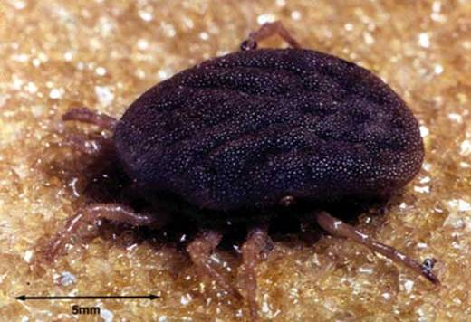
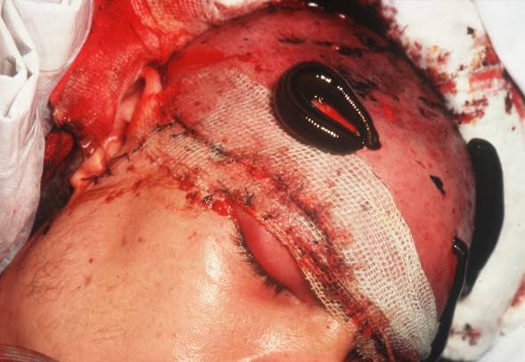
Natural direct FXa Inhibitors
Tick Anticoagulant Protein (TAP)
From Ornithodoros moubata
Antistasin
Various substances from Hirudo medicinalis
Reduce arterial thrombosis in animal models
Antigenic in humans

Slide 15
Action of direct FXa inhibitors

Slide 16
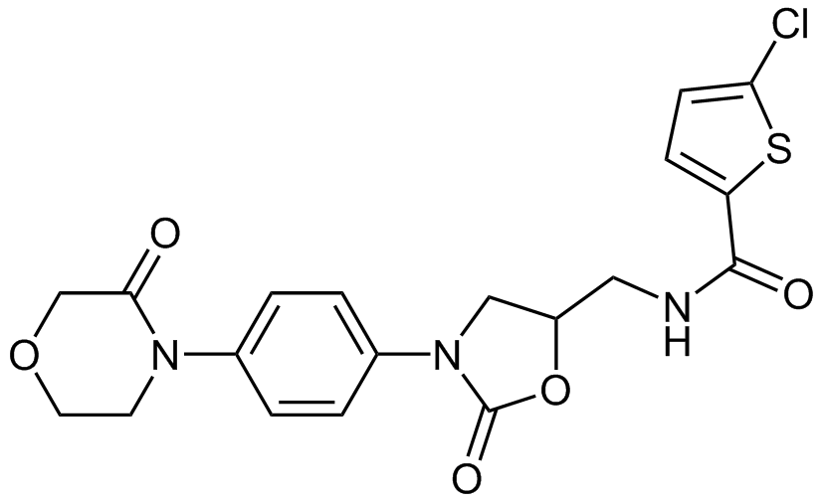
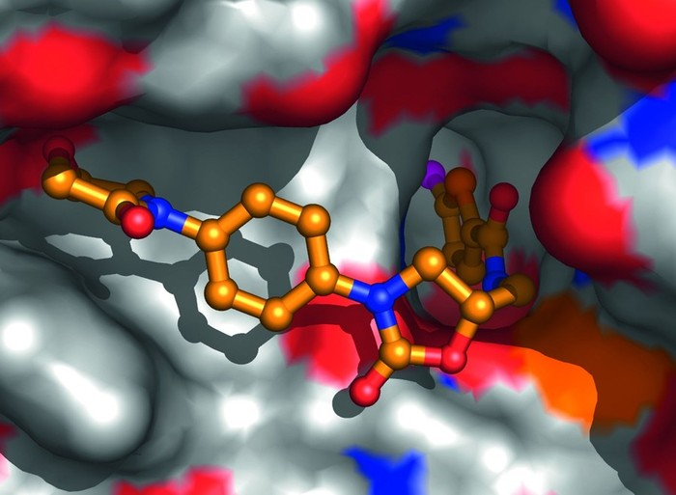
Rivaroxaban (Xarelto)
Direct, specific, competitive FXa inhibitor.
Inhibits free and fibirin-bound FXa activity and prothrombinase activity
Inhibits thrombin generation – acts early in the coagulation pathway
No direct effect on platelet aggregation
No antidote – consider rVIIa in severe bleeding

Slide 17
Rivaroxaban (Xarelto)
RECORD studies
Better than LMWH in orthopaedic thromboprophylaxis
Similar bleeding
No dose-response relationship, but bleeding risk related to dose
Licensed for orthopaedic prophylaxis in 2008
Licensed for Atrial Fibrillation in 2011
Licensed for VTE treatment in 2012

Slide 18
Rivaroxaban (Xarelto)
High oral bioavailability (80-100%)
Rapid onset (peak in 3 hours)
T½ 7-11 hours
Elimination
1/3 excreted unchanged by kidney
2/3 inactive metabolites in liver
Few interactions
Correlates with PT and anti-Xa
Prolongs APTT

Slide 19
Thrombin inhibitors

Slide 20
Ximelagatran (Exanta)
Orally active, lipophilic prodrug of melagatran
Directly binds to thrombin active site
Raised transaminases in 8% patients (2% with controls)
3 patients died with hepatic failure in Phase III
FDA refused license in 2004

Slide 21
Dabigatran Etexilate
Converted to active molecule dabigatran by hepatic esterases
Small molecule oral direct thrombin inhibitor (DTI)
Binds reversibly to both free and fibrin-bound thrombin with high specificity and affinity
Peak plasma levels 1.5 hours following oral ingestion
Bioavailability after gastrointestinal absorption is approximately 7%
T½ 8 (single dose) – 17 hours (multiple doses)
Allows once daily dosing

Slide 22
Dabigatran Clinical Use
80% renally excreted
Renal patients excluded from trials
Not measured by PT or anti-Xa
Prolongs APTT
Licensed for orthopaedic prophylaxis in 2008
Licensed for Atrial Fibrillation in 2011

Slide 23
New Anticoagulant Studies
Dabigatran and Rivaroxaban compared with standard treatments (warfarin or LMWH)
Generally superior (non-significantly) for thrombosis prevention
Similar risk of bleeding
BUT key patient groups tend to be excluded
Elderly
Co-morbidities: renal, liver

Slide 24
Anticoagulants Comparison
 | Dabigatran | Rivaroxaban | Warfarin | Enoxaparin
Time to Peak (hours) | 2-3 | 3 | 96 | 3-5
Bioavailability | 6.5% | 80-100% | 100% | 92%
Half-life (hours) | 8-17 | 7-11 | 14-17 | 4.5
Affected by Renal Dysfunction | Yes | Yes | No | Yes
Affected by Hepatic Dysfunction | No | Yes | Yes | No
Protein binding | 25-30% | 95% | 99.5% | 80%

Slide 25
Disadvantages of New Anticoagulants
Potential late hepatotoxicity
All three agents are renally excreted
Lack of antidote
Lack of monitoring tests
Limited experience in key patient groups
Pregnancy
Cancer
Heart valves

Slide 26
Protein C Modulation
Drotrecogin-α (Xigris)
Recombinant human APC
PROWESS showed superior survival in patients with multi-organ sepsis over best treatment alone
NICE recommends use in patients with at least 2 organ failure secondary to sepsis
If used as in PROWESS annual NHS cost ~ £50m
Soluble thrombomodulin

Slide 27
Cost of Drug Development
Cost of bringing new anticoagulant to market | £2 billion
Annual cost to NHS of treating VTE | £0.5 billion
Total annual NHS budget in 2007 | £90 billion

Slide 28
Summary
LMWH much better than UFH, but pentasaccharides may be even better
Oral direct thrombin inhibitors or direct Xa inhibitors are here but there role is unclear
More novel anticoagulants are likely

