Slide 1
Warfarin and Heparin: use and monitoring
Keith Gomez
Haemophilia Centre and Thrombosis Unit
Royal Free Hospital

Slide 2
Learning Objectives
Brief history of anticoagulation
Clinical indications for anticoagulation
Mechanism of action of warfarin and heparin
Laboratory and clinical monitoring

Slide 3
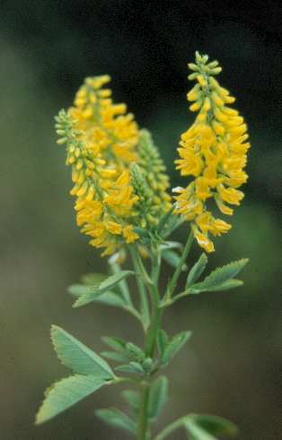
Discovery of Coumarins
1920s: cattle fed mouldy sweet clover die of bleeding
1930s: haemorrhagic cattle deficient in prothrombin
sterol (Vitamin K) cures similar disease in chickens
1939: Dicoumarol isolated from spoilt sweet clover in

Slide 4
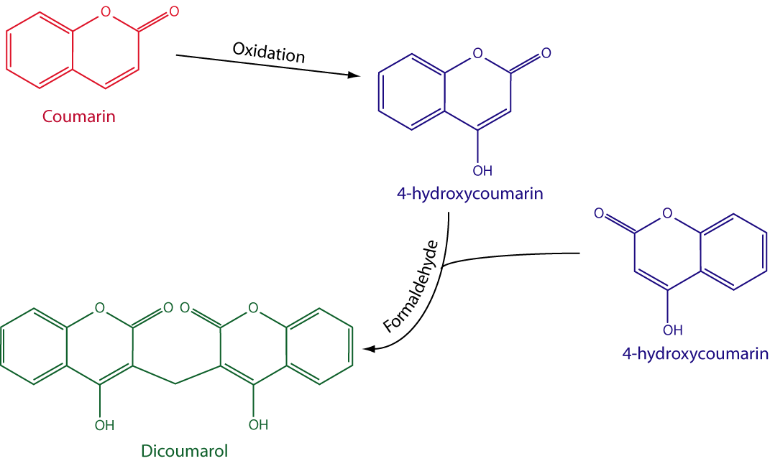
Formation of Dicoumarol

Slide 5
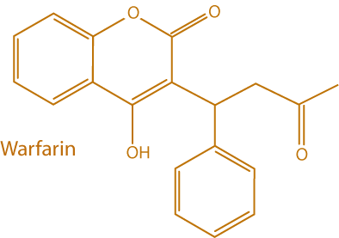
Early use of Warfarin
1940s - Dicoumarol effective in VTE and MI
- Warfarin (Wisconsin Alumni Research Foundation)
- Warfarin marketed as rat poison in 1948
1950s - Warfarin more effective anticoagulant than dicoumarol
- Eisenhower given warfarin for MI in 1955

Slide 6
Phospholipid binding
Binding to phospholipid membranes via Gla domains
Ca⁺⁺ dependant
Ca⁺⁺ bound via modified glutamate residues

Slide 7
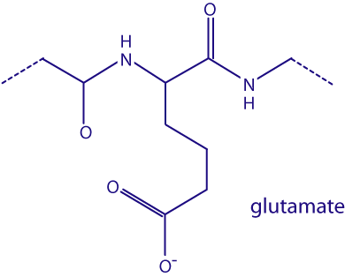
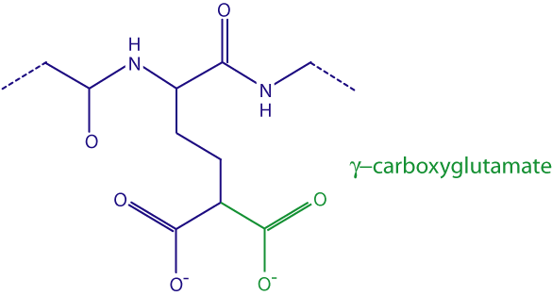
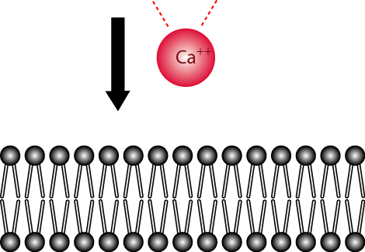
γ-carboxylation
Carboxylase
O₂ + CO₂ +
Vitamin K₂

Slide 8
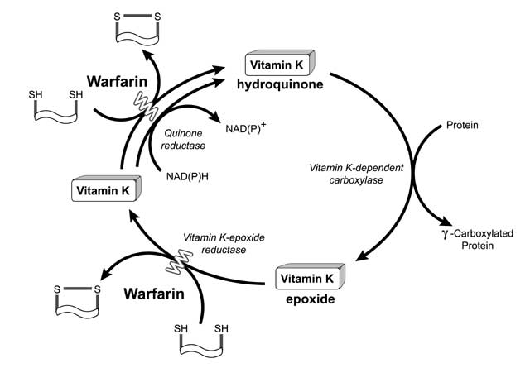
Warfarin: mechanism of action

Slide 9
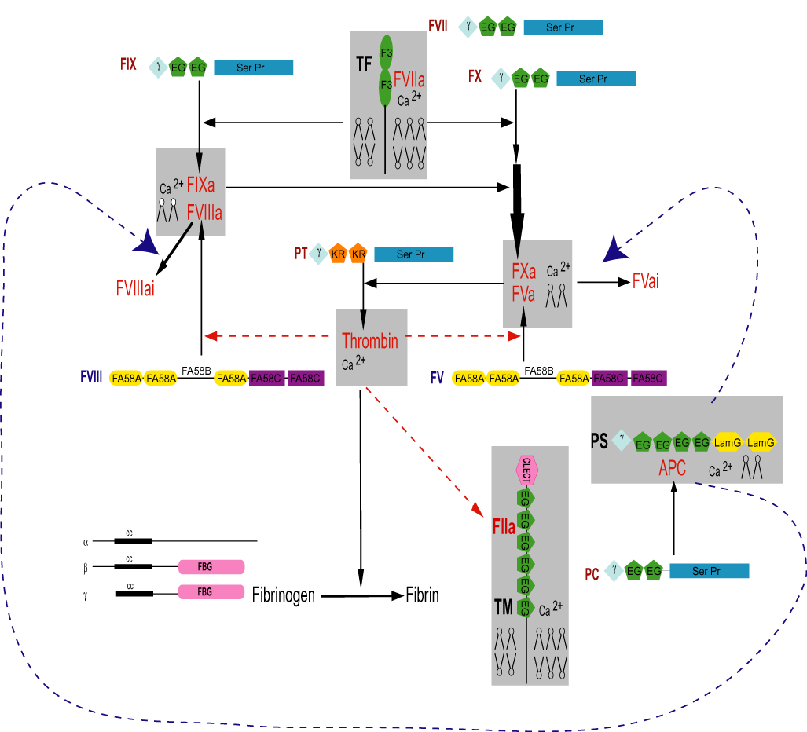
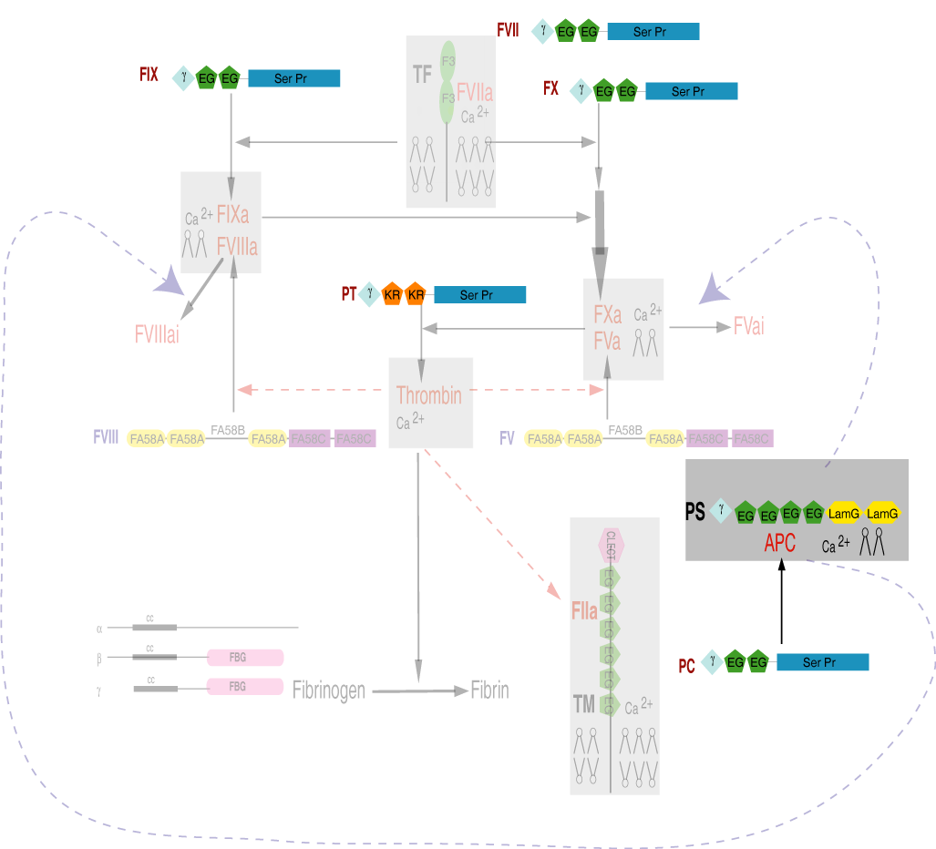
Effect of Warfarin
No γ-carboxylation of
Prothrombin
FVII
FIX
FX
PC
PS

Slide 10
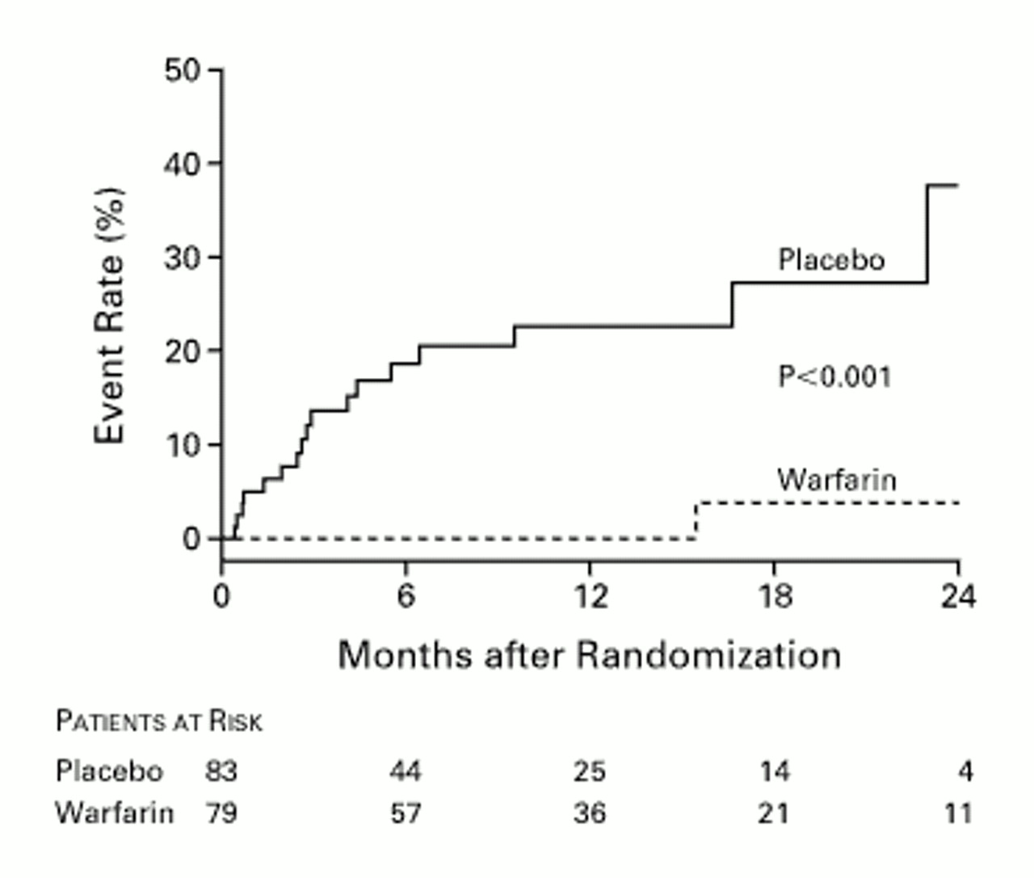
Efficacy of Warfarin in VTE
Kearon 1999

Slide 11
Warfarin Side-effects
Bleeding
Minor 5% pa
Major 1% pa
Fatal 0.25% pa
Skin Necrosis
Embryopathy – Chondrodysplasia punctata
Purple toe syndrome

Slide 12
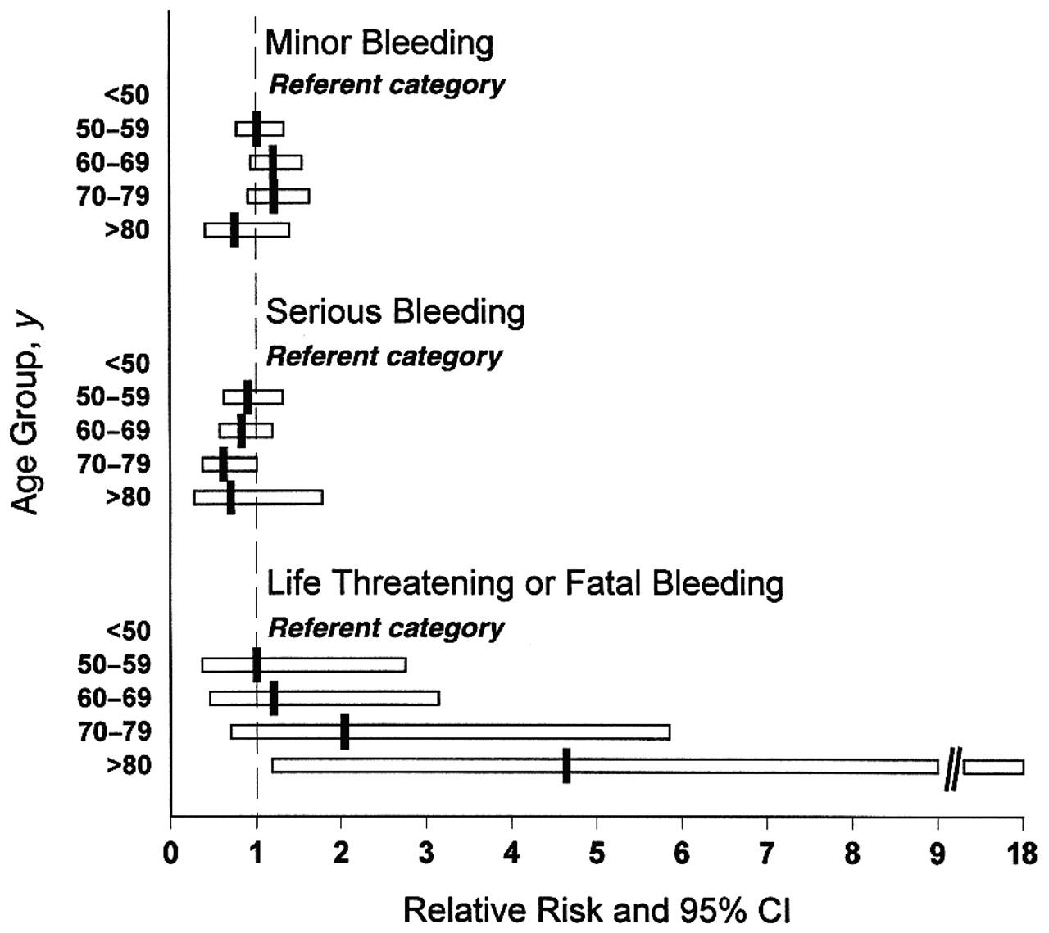
Bleeding risk and Age
Fihn et al
Ann Intern Med
1996

Slide 13
Warfarin Monitoring
INR (International Normalised Ratio)
ISI = International Sensitivity Index
Indicates sensitivity of particular thromboplastin for warfarin
Unanticoagulated normal INR = 1.0
What should be the target INR?

Slide 14
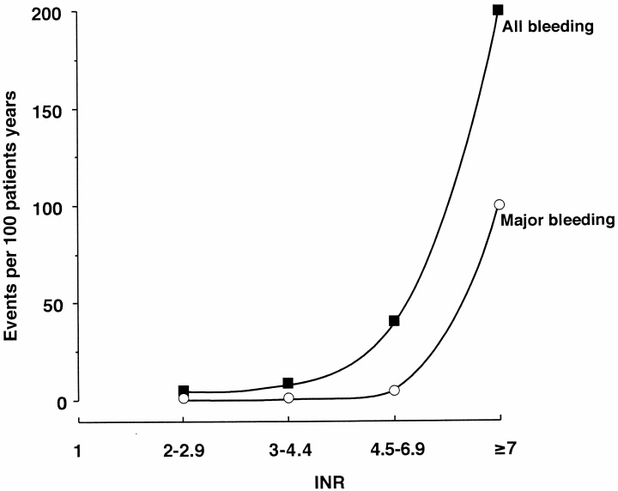
Bleeding risk vs. INR
Makris 2001

Slide 15
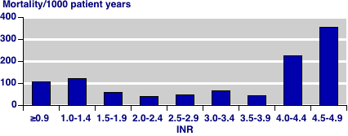
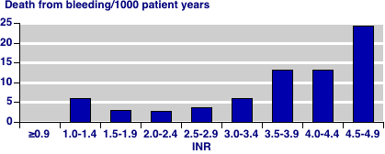
Optimal dose of Warfarin
Oden &Fahlen
BMJ 2002

Slide 16
Target INR
INR 2.0 – 3.0 suitable for most indications
First episode VTE
Atrial Fibrillation
Cardiomyopathy
Bio-mechanical heart valves
INR 3.0 – 4.5 indicated for high risk patients
Recurrent VTE
Mechanical heart valves
Some thrombophilias

Slide 17
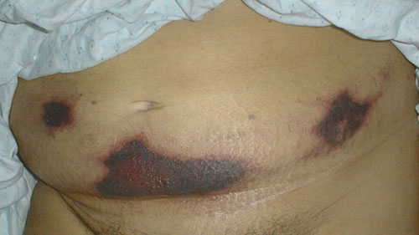
Skin Necrosis
Severe Protein C deficiency
2-3 days after starting Warfarin
Thrombosis predominantly in adipose tissues
Breast
Genitalia
90% ♀

Slide 18
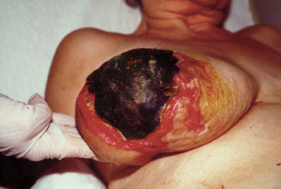
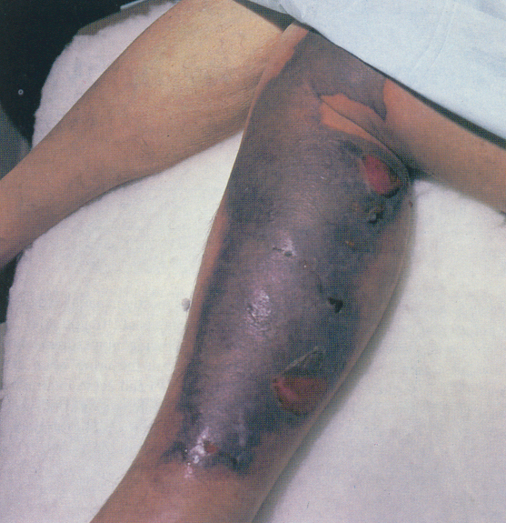
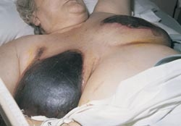
Skin Necrosis 2

Slide 19
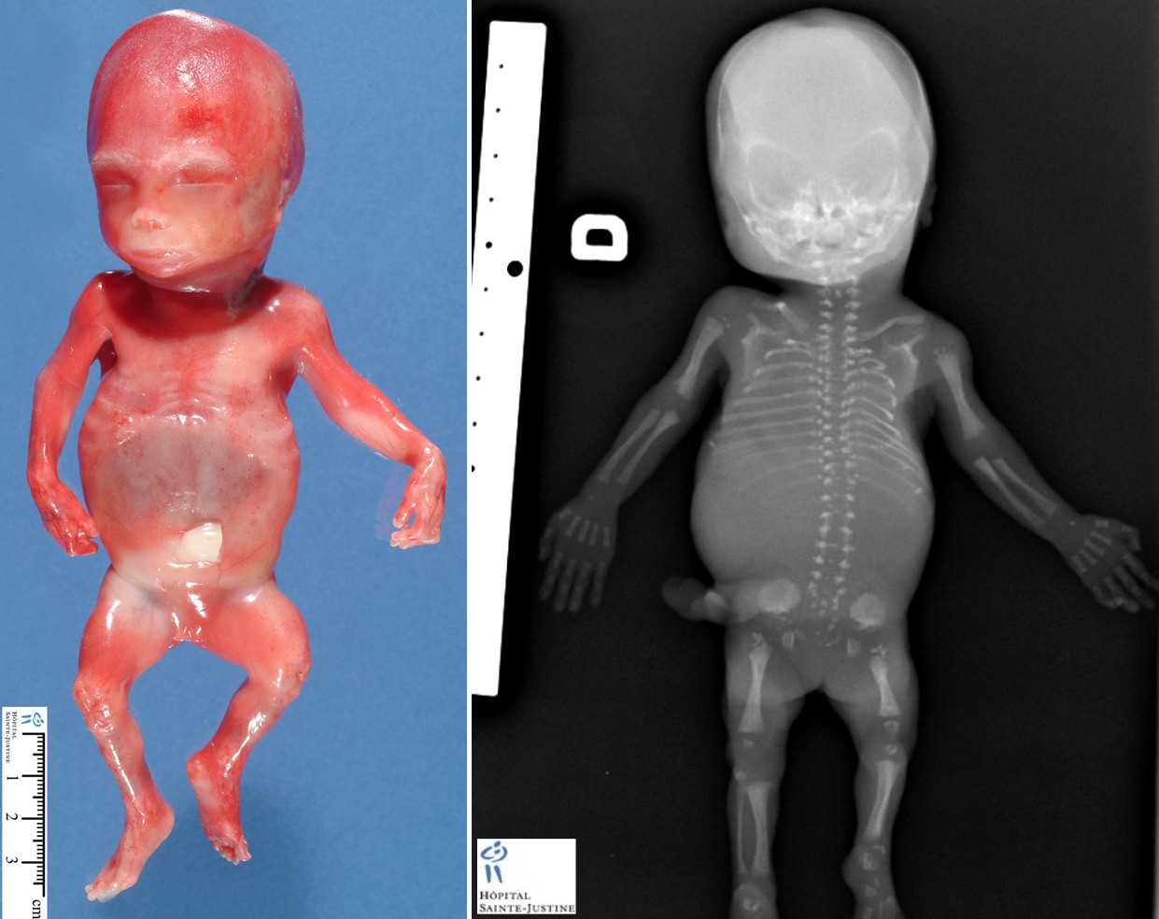
Chondrodysplasia Punctata
Early fusion of epiphyses
Warfarin teratogenic in 1st trimester
May be given safely in 3rd trimester

Slide 20
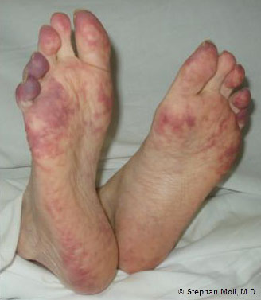
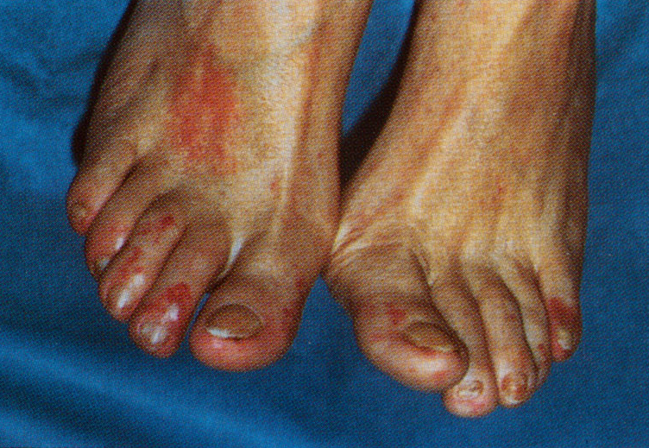
Purple Toe Syndrome
Disrupted atheromatous plaques bleed
Cholesterol emboli lodge in extremities

Slide 21
Reversal of Warfarin
In most cases just stop Warfarin, t½ 35 hours
If bleeding give Vitamin K
Takes 24-48 hours to work
If urgent reversal required replace clotting factors
FFP (Fresh Frozen Plasma)
PCC (Prothrombin Complex Concentrate)

Slide 22
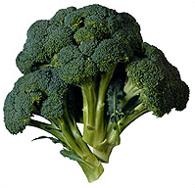
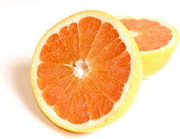
Resistance to Warfarin
Lack of patient compliance
Measure warfarin levels
Proteins Induced by Vitamin K Absence (PIVKA)
Diet, Increased Vit K intake
Increased metabolism Cyt P450 (CYP2C9)
Reduced binding (VKORC1)

Slide 23
VKORC1 mutations

Slide 24
Discovery of Heparin
1880 – anaphylactic dogs release anticoagulant from liver
1915 – heparphosphatide isolated from liver
1935 – purified heparin used to prevent post-op PE
1968 – Antithrombin III identified as heparin co-factor
from Ancient Greek word for liver = ηπαρ

Slide 25
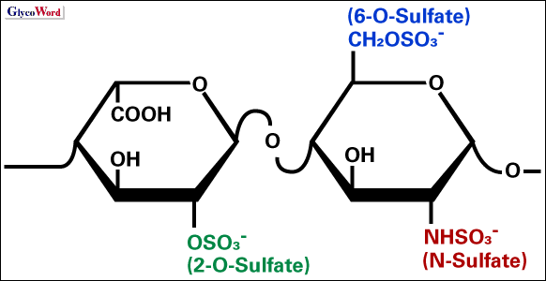
Structure
Glycosaminoglycans – heteropolysaccharide made from modified disaccharide repeats
N-acetylgalactosamine (GalNAc) or N-acetylglucosamine (GlcNAc)
+
uronic acid such as glucuronate or iduronate

Slide 26
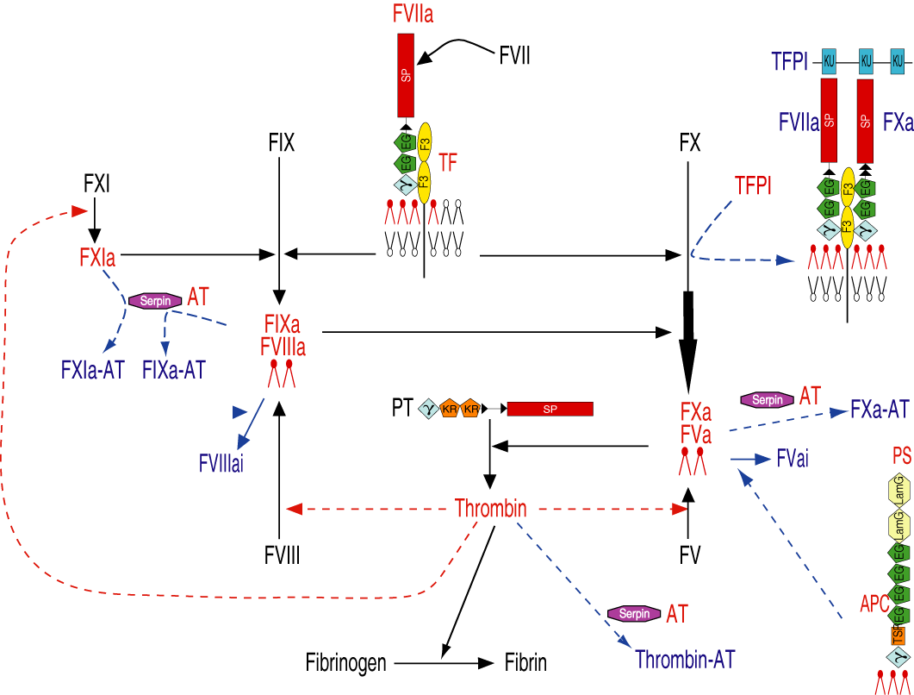
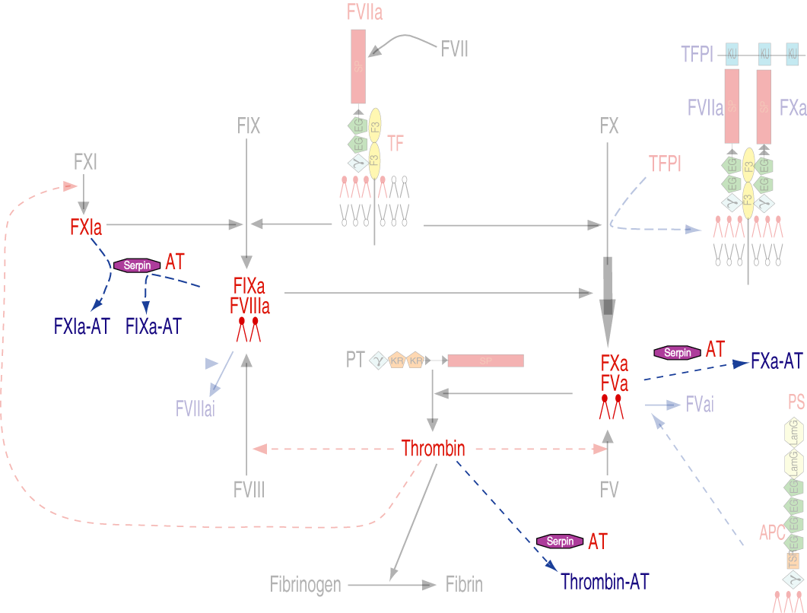
Sites of Antithrombin Action
Notes:
Fades cascade on mouse click

Slide 27
Actions of Heparin
Enhancement of Antithrombin
Inactivation of thrombin (Hep binds AT + Thrombin)
Inactivation of FXa (Hep binds AT only)
Inactivation of FIXa, FXIa
Release of TFPI from GAGs anchor on cell surface
Inactivation of thrombin by Heparin cofactor II
Binding to Fibrinogen
Various actions incl. platelet spreading, release of vWF
Inhibition of Thrombin Activatable Fibrinolysis Inhibitor (TAFI) activation?

Slide 28
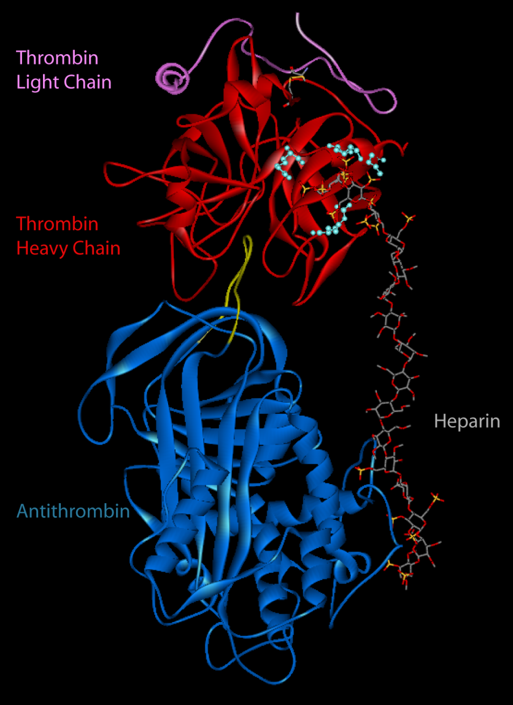
Thrombin-AT-Heparin Complex
Specific pentasaccharide binds AT
Non-specific oligosaccharide binds Thrombin
Thrombin trapped against AT
Heparin regenerated

Slide 29
Mechanism of Inhibition
http://www-structmed.cimr.cam.ac.uk/serpins.html

Slide 30
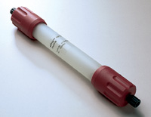
Heparin in Clinical Use
Unfractionated heparin (UFH) purified from bovine or porcine tissue
Metabolised and rapidly cleared
Generally requires continuous IV infusion or SC injection
Binds various proteins reducing efficacy
Requires frequent monitoring by measuring APTT
Aim for APTT ratio 2.0

Slide 31
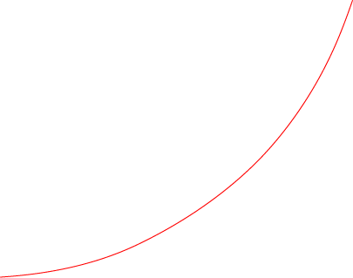
Heparin effect on APTT
Therapeutic Range
1.5 – 2.5
UFH

Slide 32
LMWHs
Much ‘cleaner’ preparation, but still contains various active ingredients
Contain pentasaccharide sequence for binding AT
Do not bind thrombin
Predictable dose response in most cases
Sub-cutaneous once/twice daily dose

Slide 33
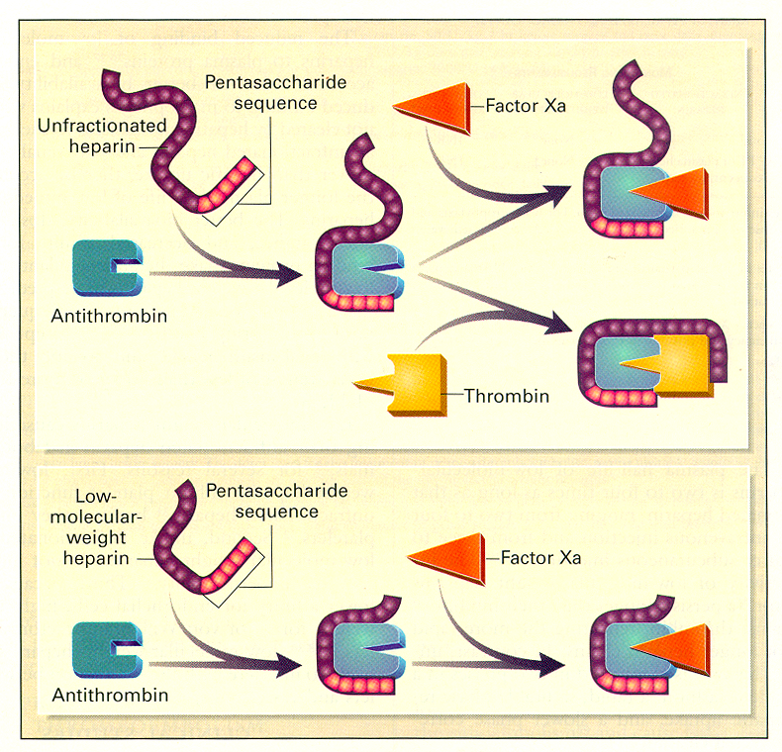
Action of LMWH

Slide 34
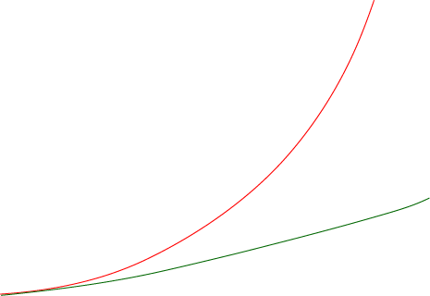
LMWH effect on APTT
UFH
Therapeutic Range
1.5 – 2.5
Normally don’t monitor
If required measure Anti-Xa
LMWH

Slide 35
Side-Effects of Heparin
Bleeding
Reverse with Protamine Sulphate
Heparin Induced Thrombocytopenia (HIT)
Hyperkalaemia (inhibition of aldosterone)
Osteoporosis with prolonged use
Alopecia

Slide 36
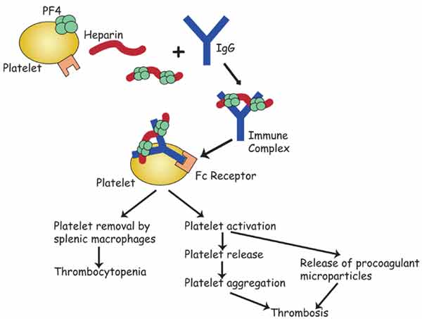
HIT Type II

Slide 37
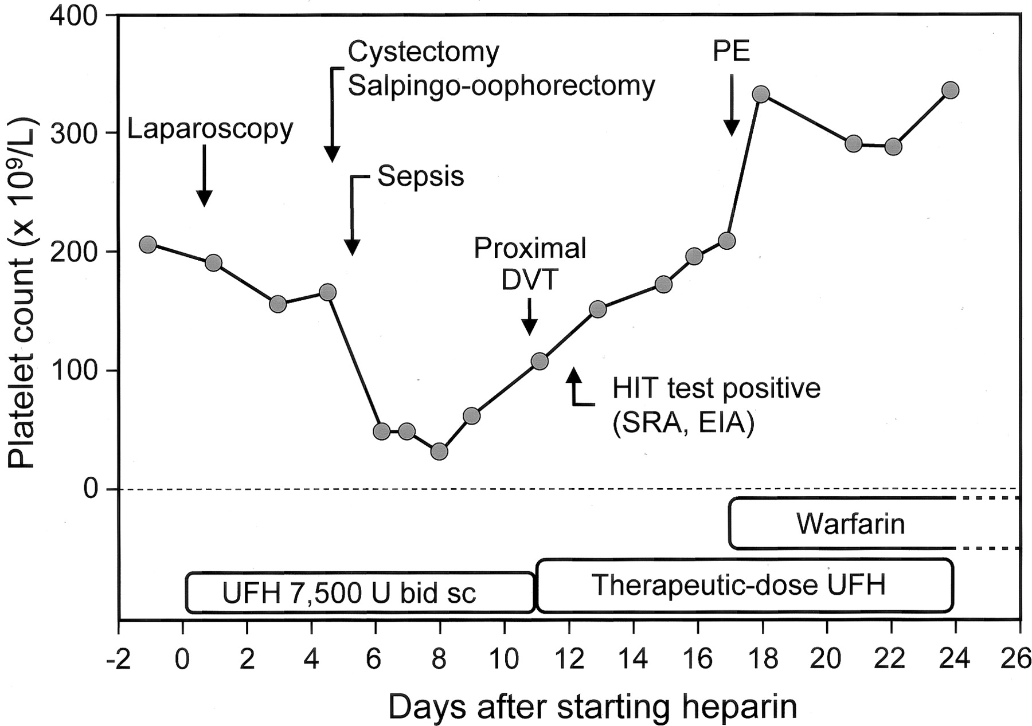
Thrombocytopenia in HIT

Slide 38
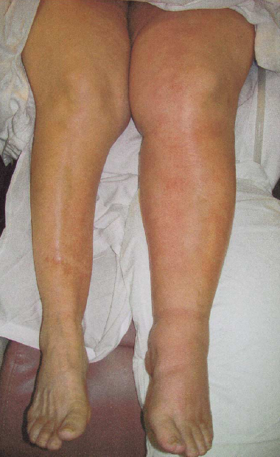
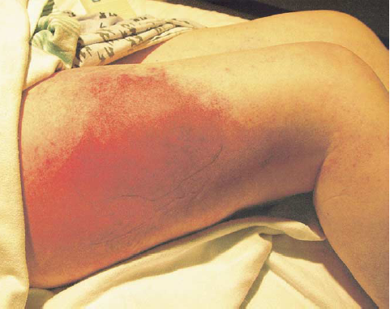
HIT Manifestations

Slide 39
References
Fihn SD, Callahan CM, Martin DC, McDonell MB, Henikoff JG & White RH (1996) The risk for and severity of bleeding complications in elderly patients treated with warfarin. The National Consortium of Anticoagulation Clinics. Ann Intern Med 124, 970-979.
Hirsh J, Warkentin TE, Shaughnessy SG, Anand SS, Halperin JL, Raschke R, Granger C, Ohman EM & Dalen JE (2001) Heparin and low-molecular-weight heparin: mechanisms of action, pharmacokinetics, dosing, monitoring, efficacy, and safety. Chest 119, 64S-94S.
Kearon C, Gent M, Hirsh J, et al. (1999) A comparison of three months of anticoagulation with extended anticoagulation for a first episode of idiopathic venous thromboembolism. N Engl J Med 340, 901-907.
Li W, Johnson DJ, Esmon CT & Huntington JA (2004) Structure of the antithrombin-thrombin-heparin ternary complex reveals the antithrombotic mechanism of heparin. Nat Struct Mol Biol 11, 857-862.
Makris M & Watson HG (2001) The management of coumarin-induced over-anticoagulation Annotation. Br J Haematol 114, 271-280.
Oden A & Fahlen M (2002) Oral anticoagulation and risk of death: a medical record linkage study. BMJ 325, 1073-1075.
Warkentin TE & Greinacher A (2004) Heparin-induced thrombocytopenia: recognition, treatment, and prevention: the Seventh ACCP Conference on Antithrombotic and Thrombolytic Therapy. Chest 126, 311S-337S.

