Slide 1
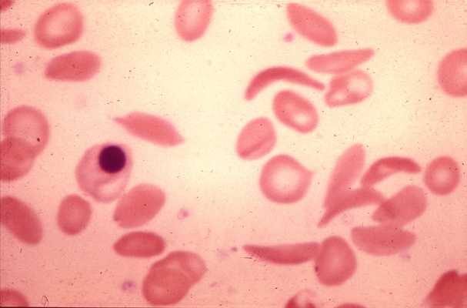
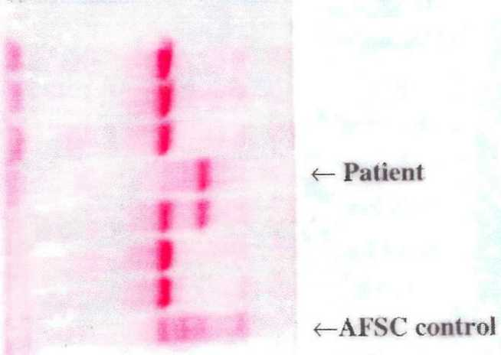
Case 1
A 23-year-old Afro-Caribbean male with
Hb 69 g/l
MCV 85 fl
Reticulocyte count 180 x 10⁹/l
Blood film
Cellulose acetate electrophoresis at alkaline pH
Write down all the abnormalities present and all the possible diagnoses before looking at the next sheet

Slide 2
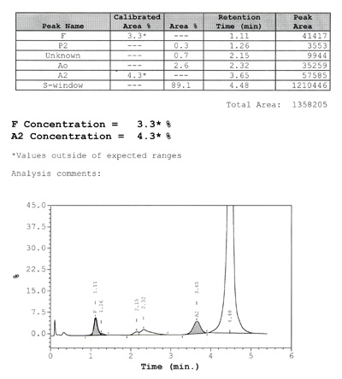
Case 1
HPLC
Now make a final diagnosis
© Wiley-Blackwell, from Bain, Wild, Stephens and Phelan, Variant Haemoglobins, 2012

Slide 3
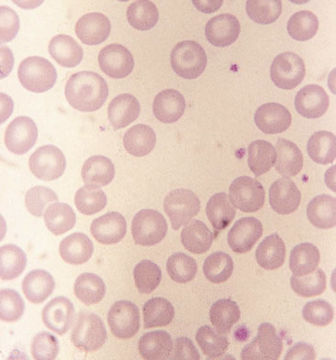
Case 2
A 32-year-old West African man
Blood film
© Wiley-Blackwell, from Bain, Interactive Haematology Imagebank, 2nd Edn, 2013
Cellulose acetate electrophoresis at alkaline pH
Write down all the abnormalities present and all the possible explanations before looking at the next sheet

Slide 4
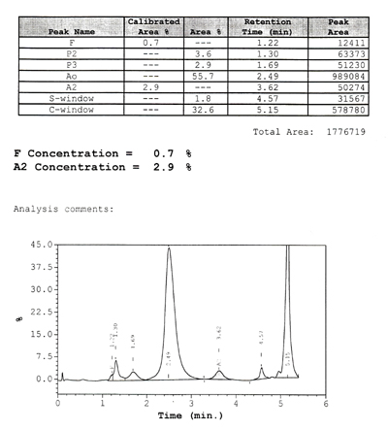
Case 2
HPLC
Now make a final diagnosis and explain what you would expect to see on acid agarose electrophoresis
© Wiley-Blackwell, from Bain, Wild, Stephens and Phelan, Variant Haemoglobins, 2012

Slide 5
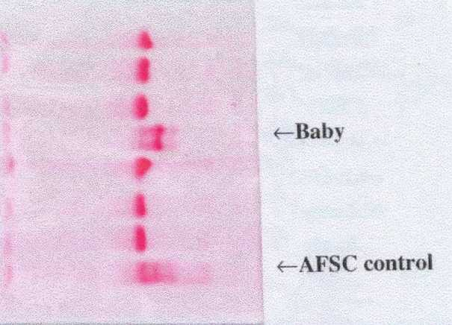
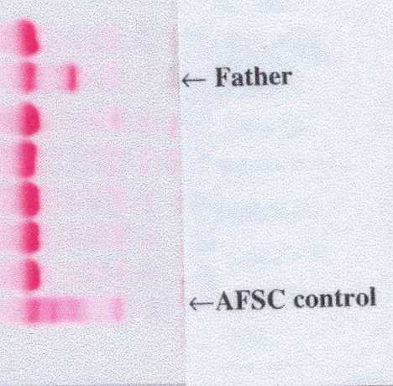
Case 3
      A newborn baby and its parents
      Both parents have a normal FBC and a positive sickle solubility tests
Cellulose acetate electrophoresis at alkaline pH
Cellulose acetate electrophoresis at alkaline pH

Slide 6
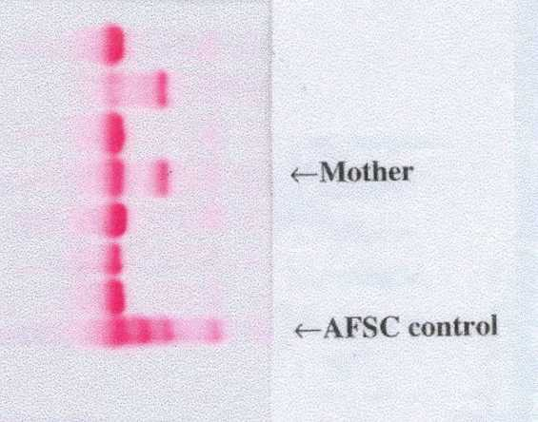
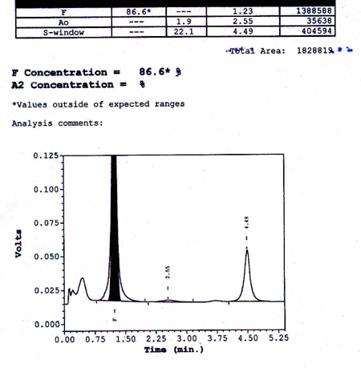
Case 3
Cellulose acetate electrophoresis at alkaline pH
Work out the diagnosis in baby, mother and father
Is the HPLC trace below compatible with this baby?
HPLC

Slide 7
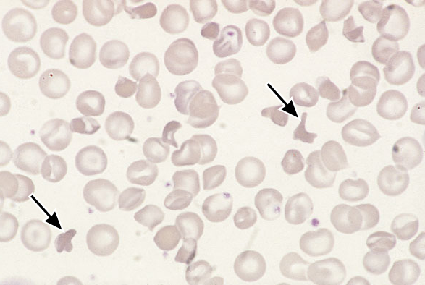
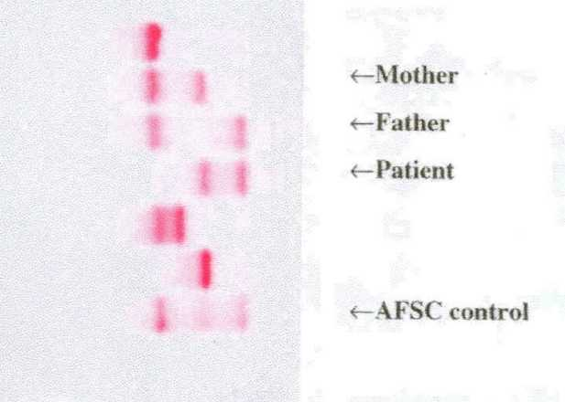
Case 4
A 17-year-old Afro-Caribbean patient with pains in the legs
Hb 102 g/l
Sickle solubility test positive
Both parents have normal blood counts
Blood film
Cellulose acetate electrophoresis at alkaline pH

Slide 8
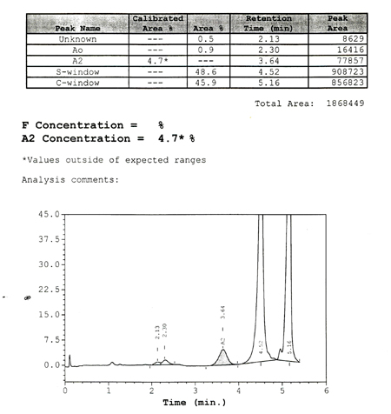
Case 4
HPLC
What is the diagnosis in each family member?

Slide 9
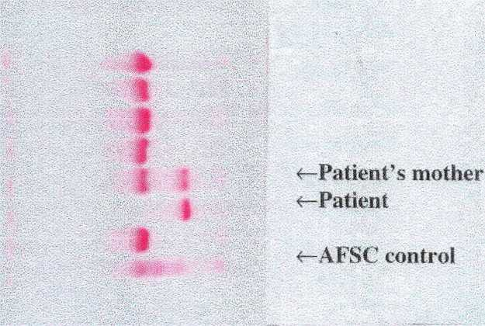
Case 5
A 13-year-old Nigerian boy with shortness of breath, mild jaundice and severe pain in chest and abdomen
Hb 63 g/l
MCV 90 fl
His mother has Hb 128 g/l, MCV 87 fl
Cellulose acetate electrophoresis at alkaline pH
What is the most likely diagnosis in the boy and his mother?
Is there any other possibility?

Slide 10
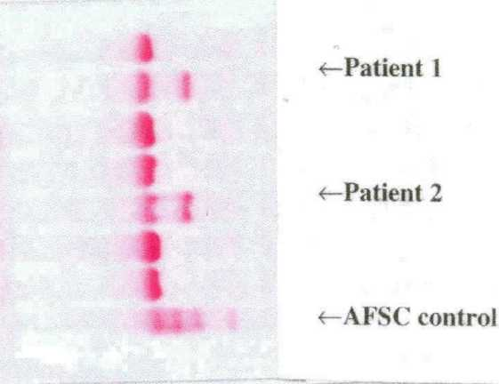
Case 6
Results of investigations of two Afro-Caribbean women presenting to Gynaecology OPD on the same day
Both require non-urgent surgery
Patient 1 has a positive sickle solubility test
Patient 2 does not
Cellulose acetate electrophoresis at alkaline pH

Slide 11
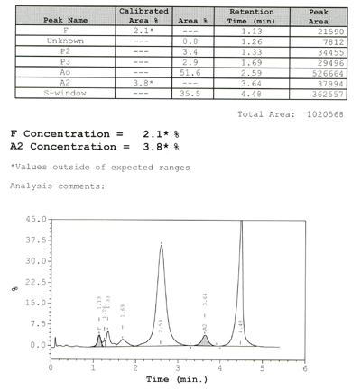
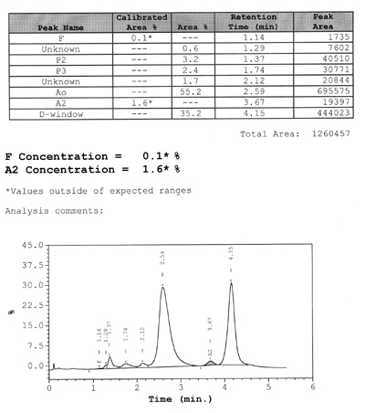
Case 6
HPLC
HPLC
What is the diagnosis in patient 1?
What is the most likely diagnosis in patient 2?

