Slide 1
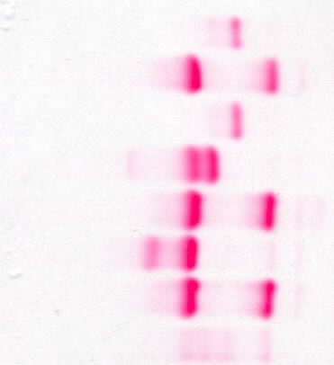
Data to aid in interpretation of practical exercises
Print this out for use in the data interpretation in the introductory course then keep it for module 3
Cellulose acetate electrophoresis at alkaline pH
S
A + C/E
S
Bart’s + A + F
A + C/E
J + A
A + C/E
AFSC (control)
A
S
C
F
Remember that haemoglobins S, D and G have the same electrophoretic mobility at alkaline pH
Haemoglobins C, E and A2 have the same electrophoretic mobility

Slide 2
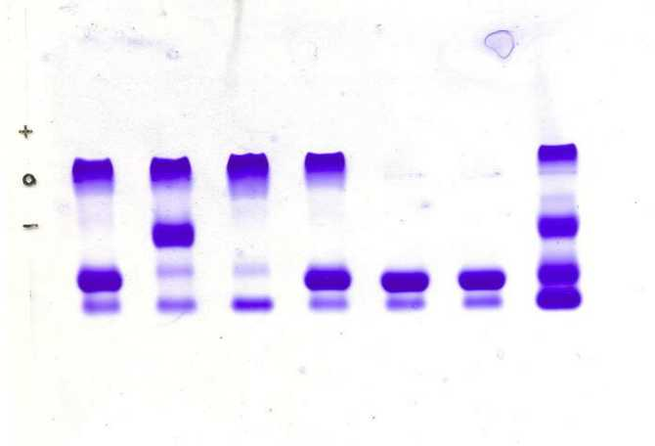
Agarose gel electrophoresis at alkaline pH
C
S
A/E/D/G/A₂
F
FAC
FSC
FC
FAC
FA
FA
FASC control sample

Slide 3
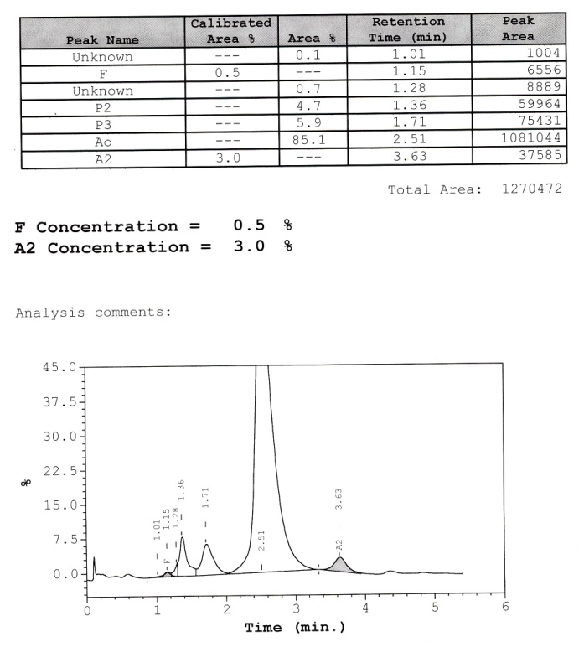
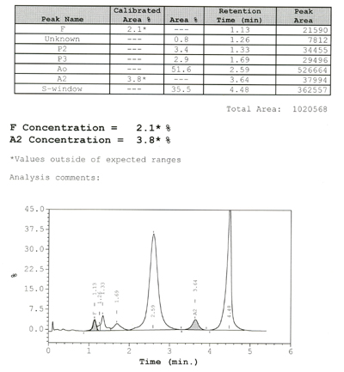
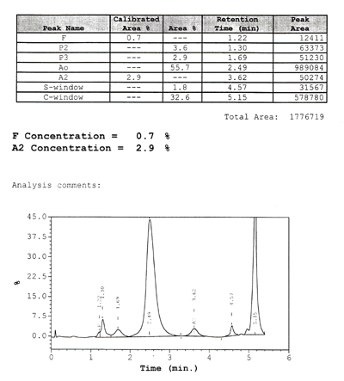
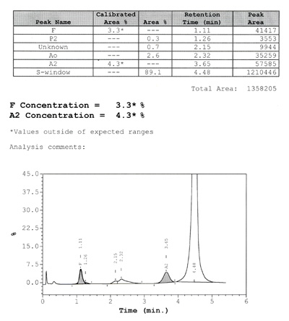
High performance liquid chromatography (HPLC) (Bio-Rad variant II)
Normal
Sickle cell trait
Haemoglobin C trait
Sickle cell anaemia
© Wiley-Blackwell, from Bain, Wild, Stephens and Phelan, Variant Haemoglobins, 2012

Slide 4
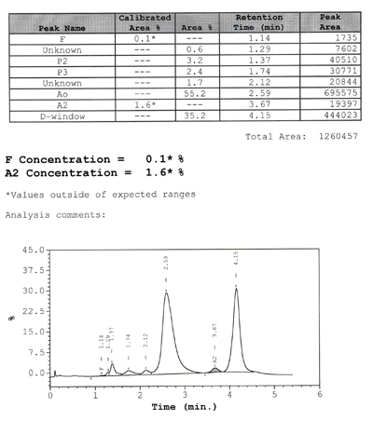
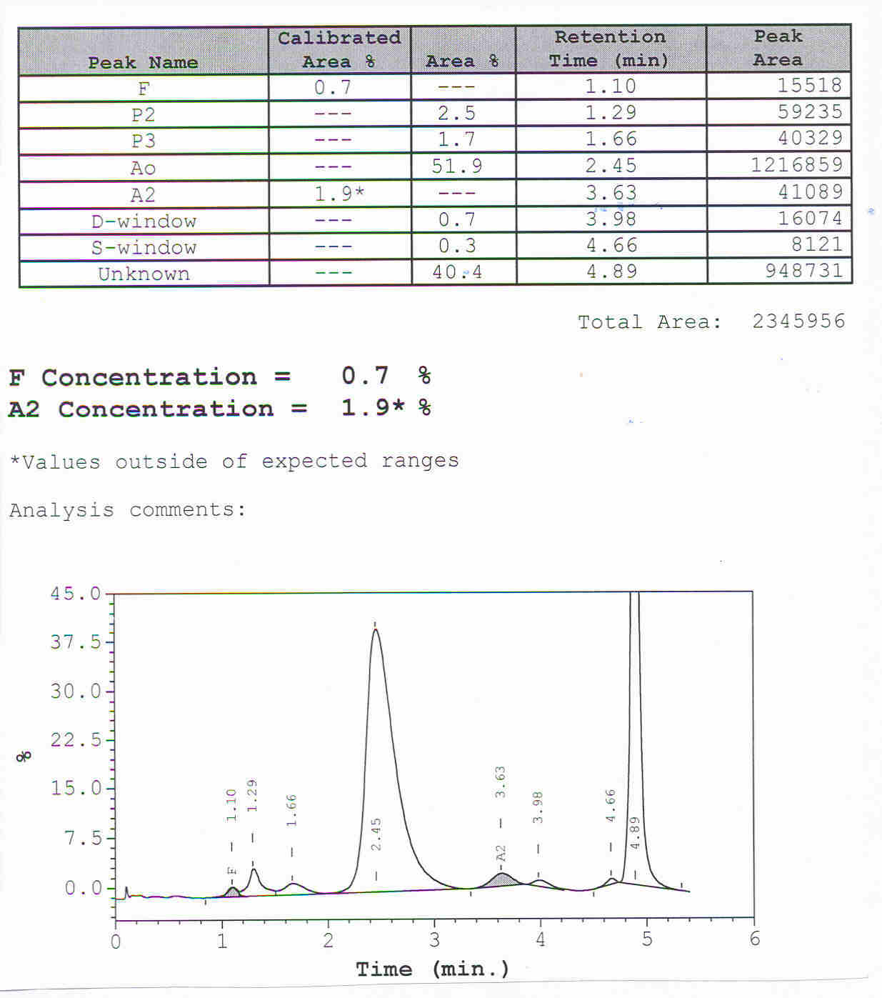
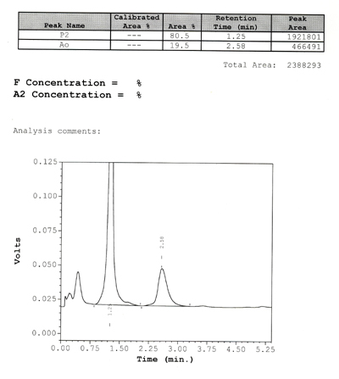
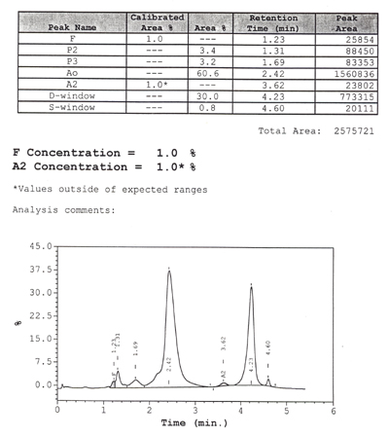
High performance liquid chromatography (HPLC) (Bio-Rad variant II)
Haemoglobin D-Punjab trait
Haemoglobin O-Arab trait
Normal neonate
Haemoglobin G-Philadelphia trait
© Wiley-Blackwell, from Bain, Wild, Stephens and Phelan, Variant Haemoglobins, 2012

Slide 5
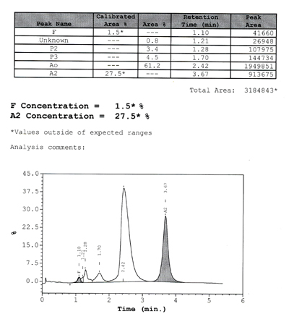
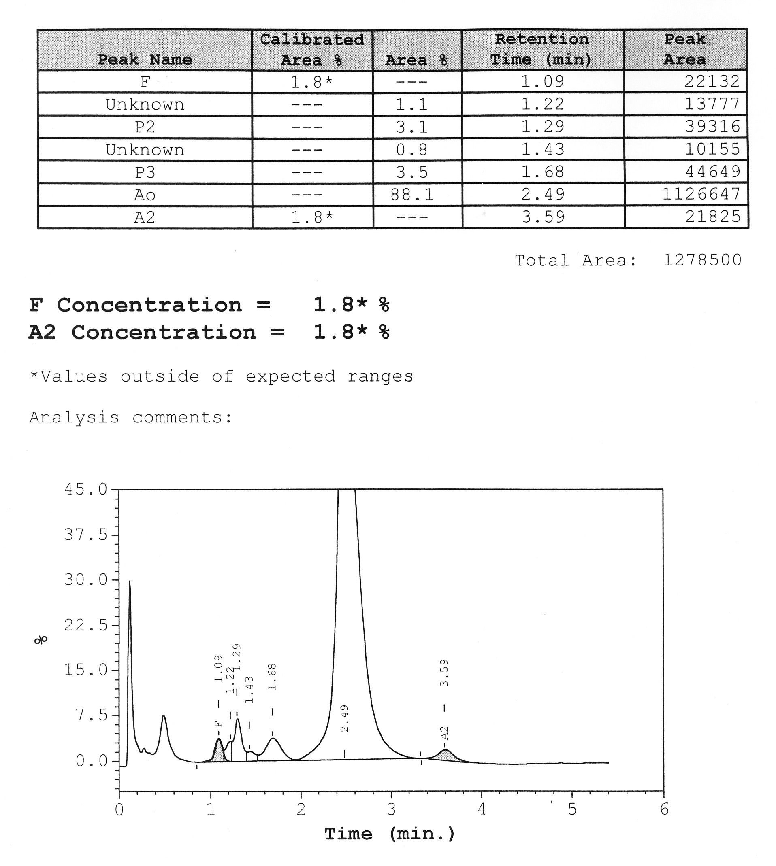
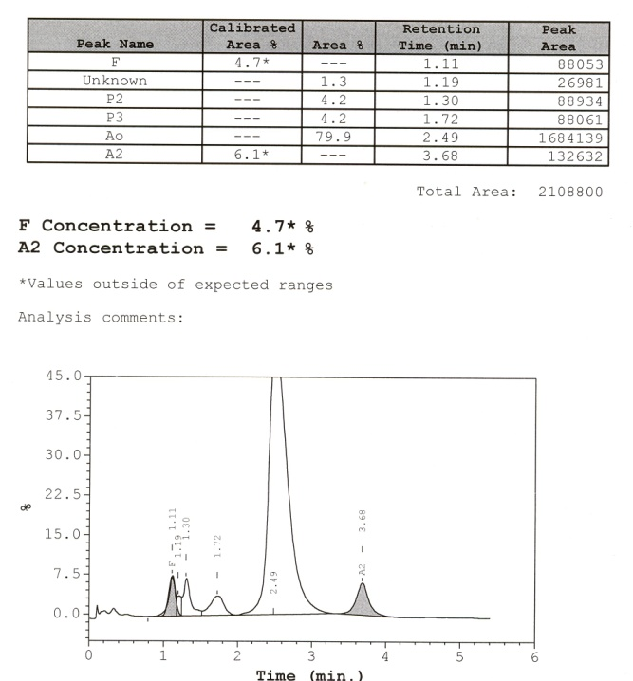
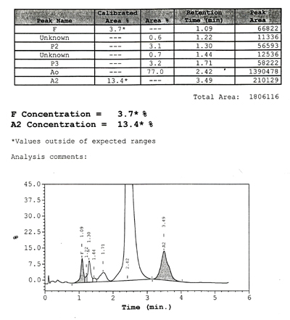
High performance liquid chromatography (HPLC) (Bio-Rad variant II)
Haemoglobin H disease
Haemoglobin E trait
Haemoglobin Lepore trait
β thalassaemia trait
© Wiley-Blackwell, from Bain, Wild, Stephens and Phelan, Variant Haemoglobins, 2012

