Slide 1
Introduction to flow cytometry
Dr Aris Chaidos MD PhD
Consultant Haematologist (Locum)
BSc Haematology Introduction Module 2012
a.chaidos@imperial.ac.uk

Slide 2
Flow Cytometry
A fascinating technology for the study of cells or other particles
Qualitative & Quantitative data
Multiparametric analysis
Analysis of large number of cells
Many applications in haematology and immunology

Slide 3
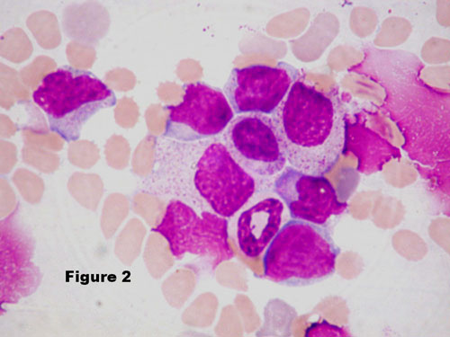
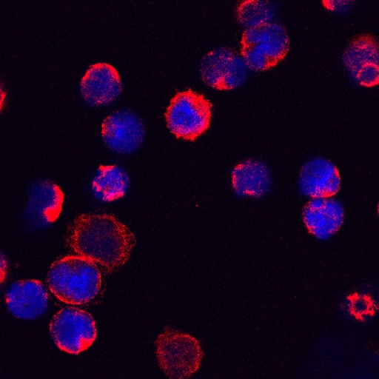
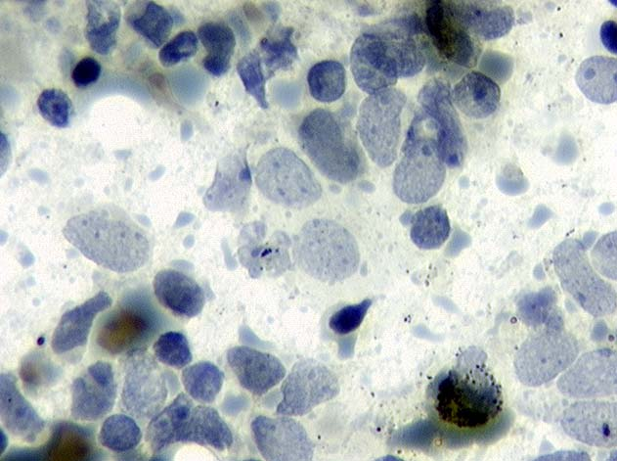
Historical aspects
Light microscopy:
cell-to-cell analysis
Fluorescence microscopy:
study of phenotypes

Slide 4
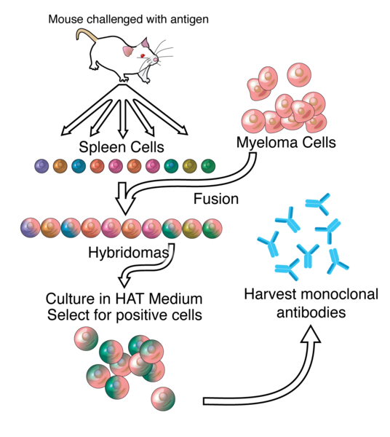
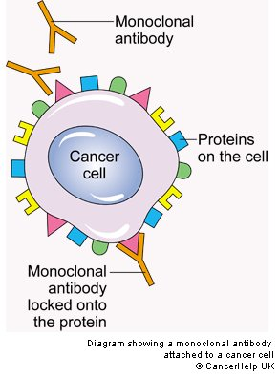
How it was made possible: the monoclonal antibodies (Mabs)
MAbs recognise a single antigen epitope
Kohler, Milstein and Jerne, Nobel Prize (1984)

Slide 5
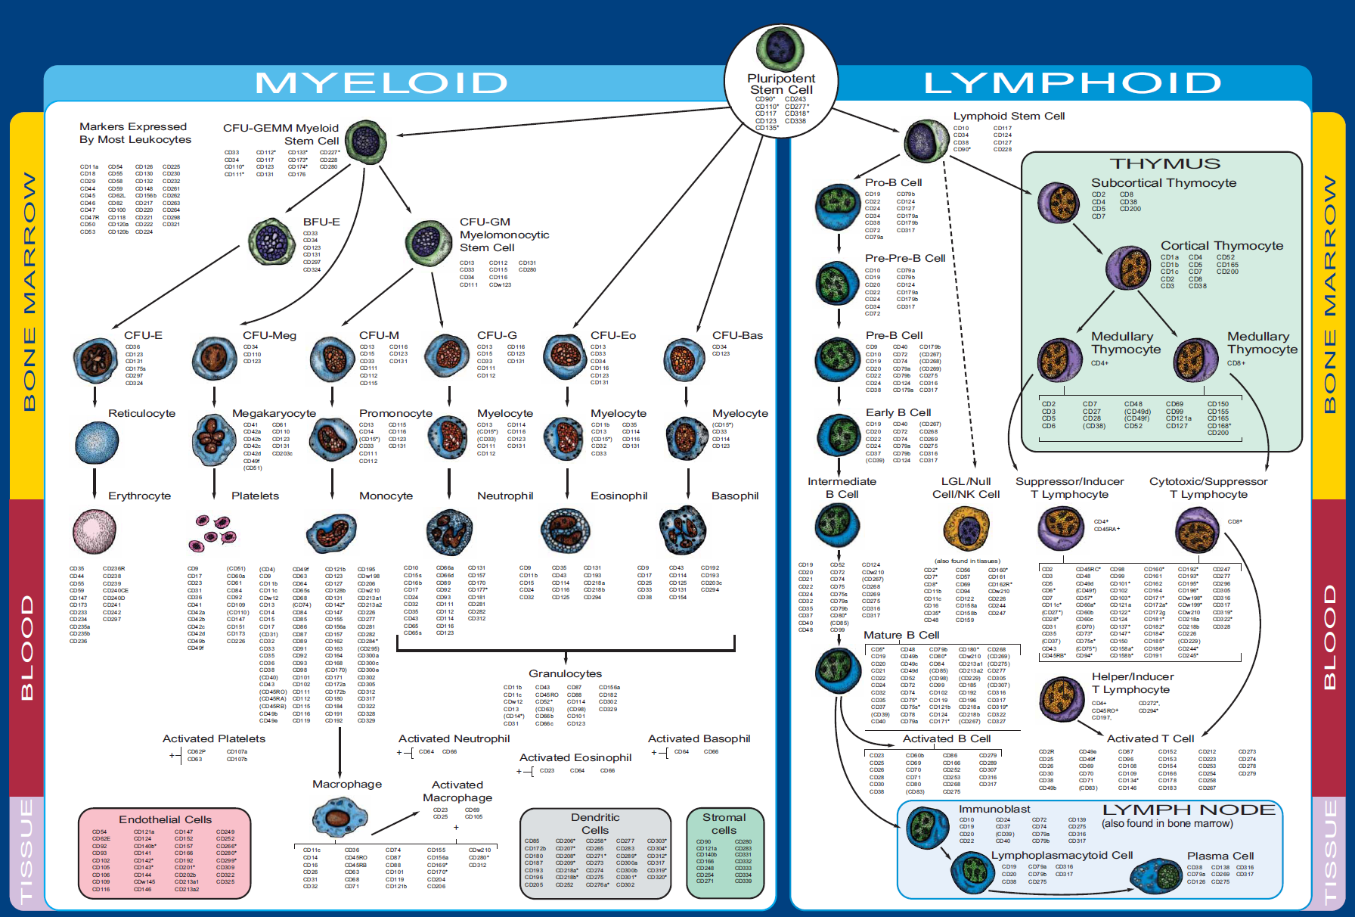
Cluster of Differentiation (CD) nomenclature

Slide 6
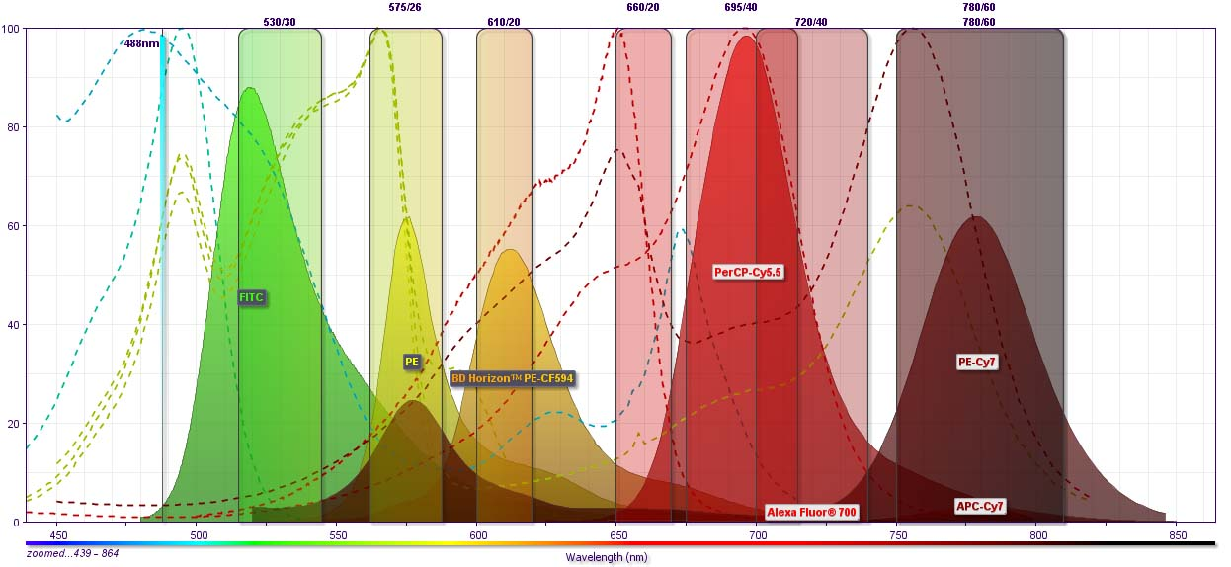
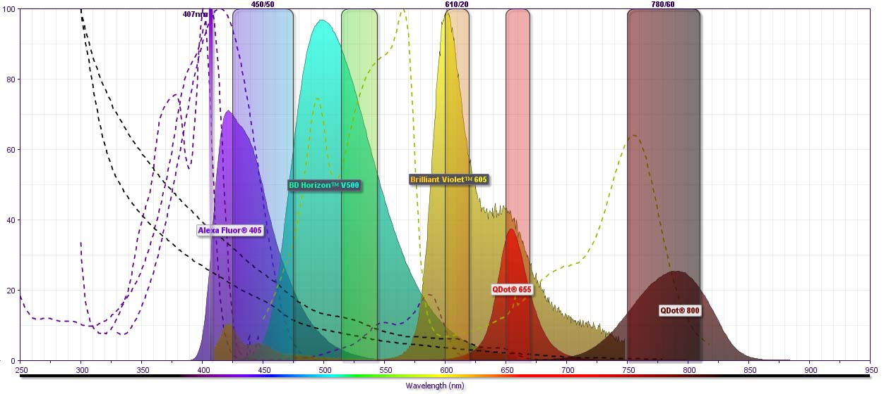
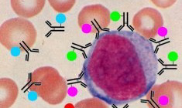
How it was made possible: the fluorochromes
LASER
488nm
Molecules that can absorb a LASER light (excitation) and release emitted light at different wavelengths (emission spectrum)
Fluorochrome-conjugated monoclonal Abs recognise different cell protein-targets
LASER
407nm

Slide 7
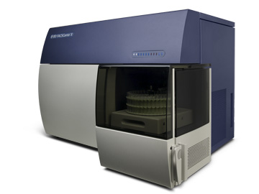
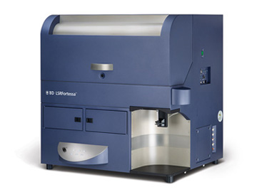
The Flow Cytometer: what is in the box…
Flucidics
a system of lines directs the fluid stream and centres the cells to the light beam
Computer
Data harnessing and analysis
Electronics
Light detectors
Signal processing
LASER beams
Optics
Light filters, mirrors and optic fibres

Slide 8
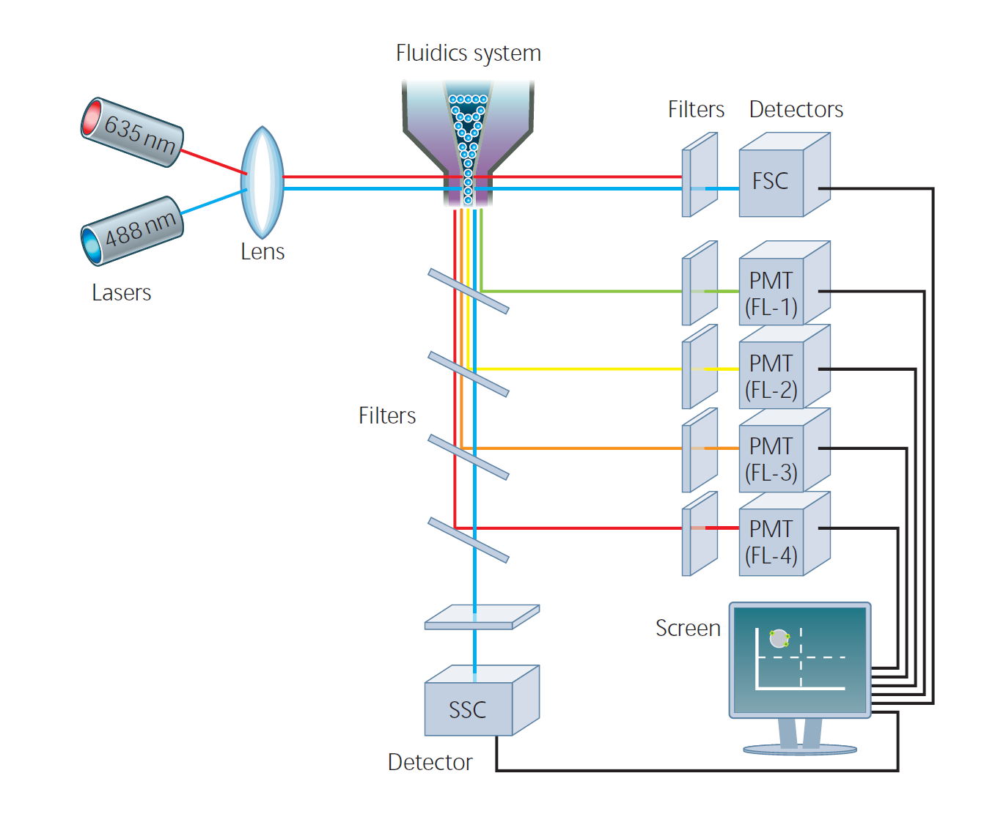
The Flow Cytometer: making signal from cells

Slide 9

material for analysis
single cell suspension
(WBC, RBC, PLT etc)
peripheral blood
bone marrow aspirate
Other body fluids
(ascites, CSF, pleural etc)
solid tissues!
(lymph nodes)
Cells
(50-100µl)
MAbs
Sample processing
Incubation 20min
wash of Mabs
excess in buffer
acquisition in the
flow cytometer

Slide 10
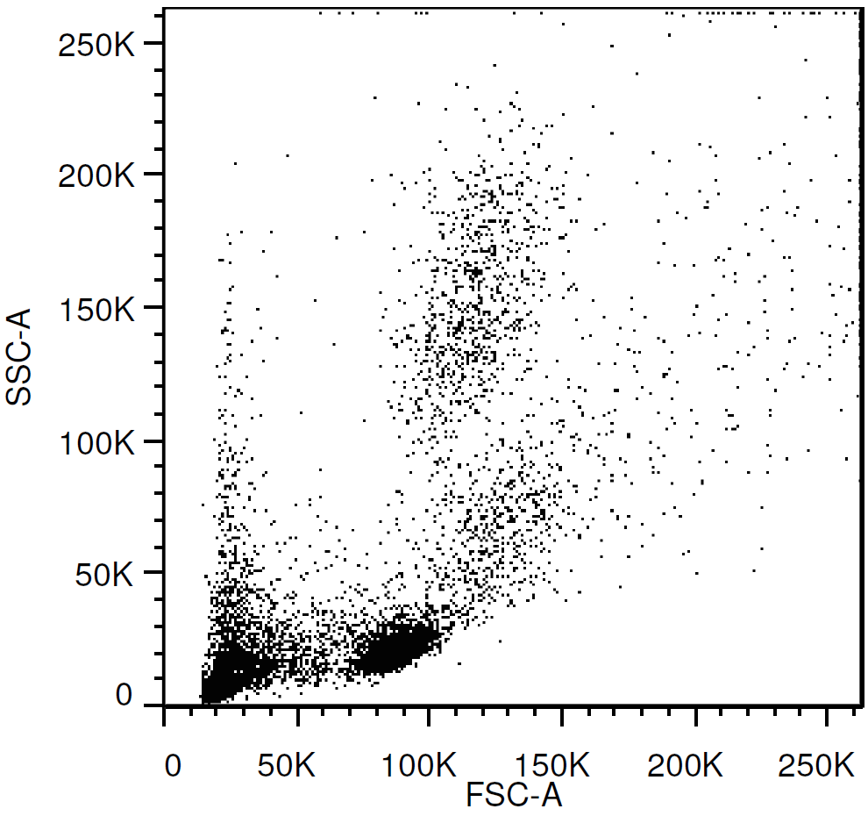
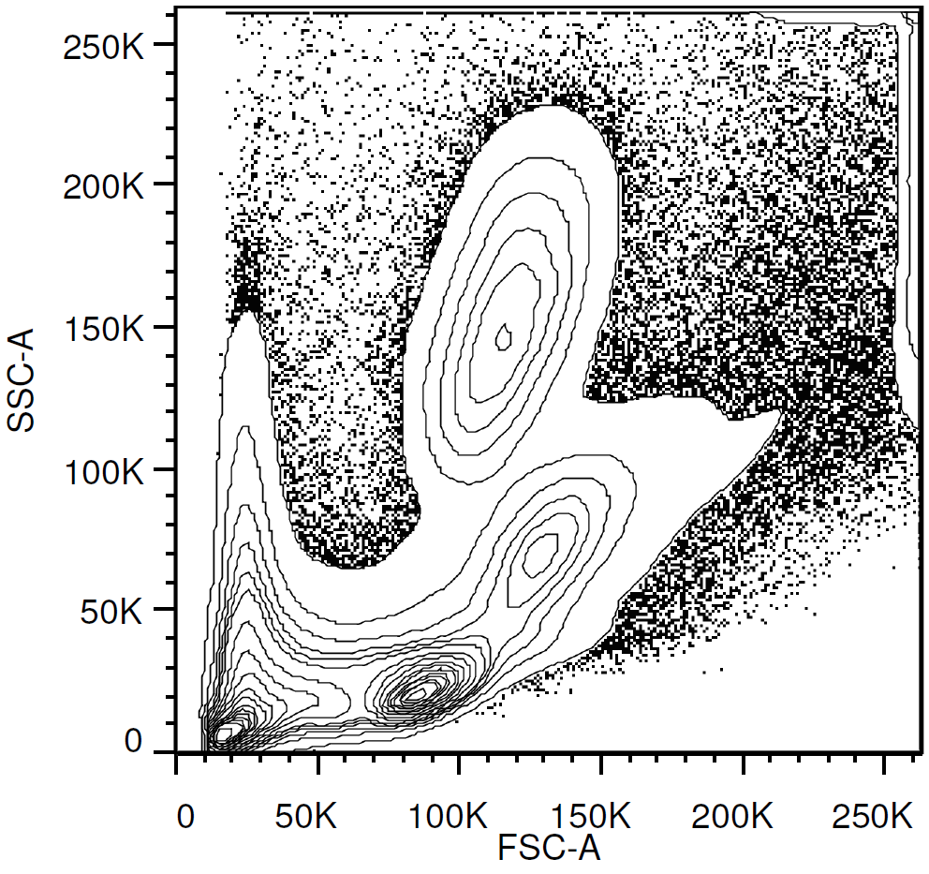
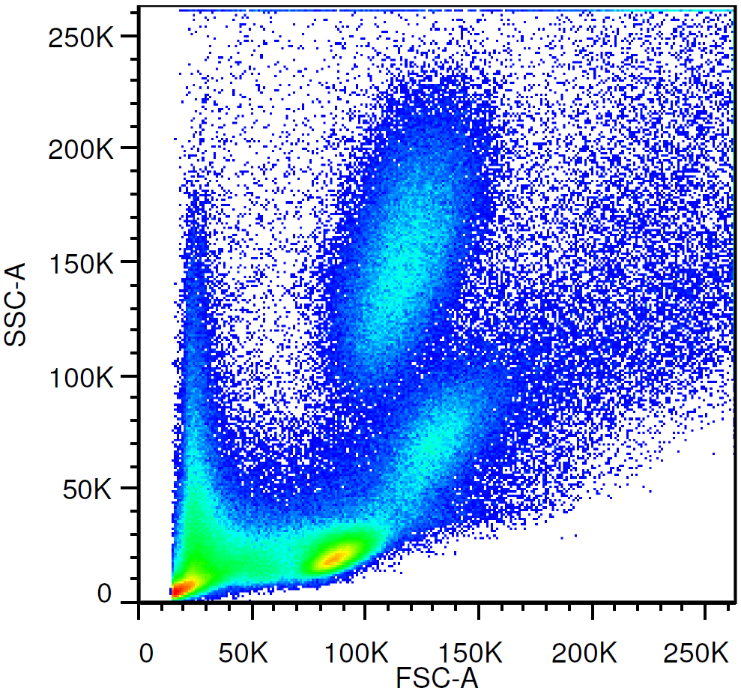
data presentation and analysis
normal peripheral blood
Dot plots
Contour plots
pseudocolour
neutrophils
monocytes
debris
lymphocytes

Slide 11
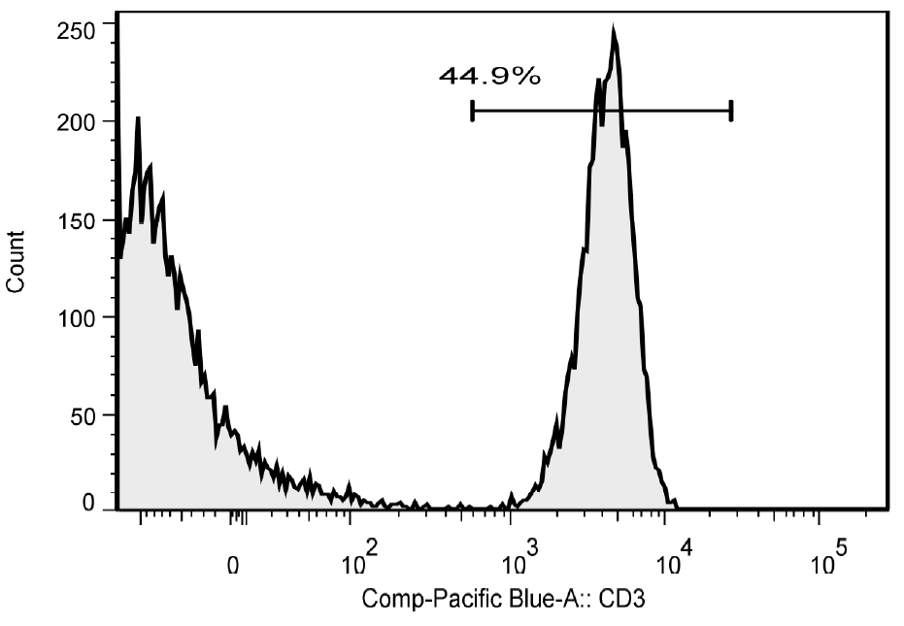
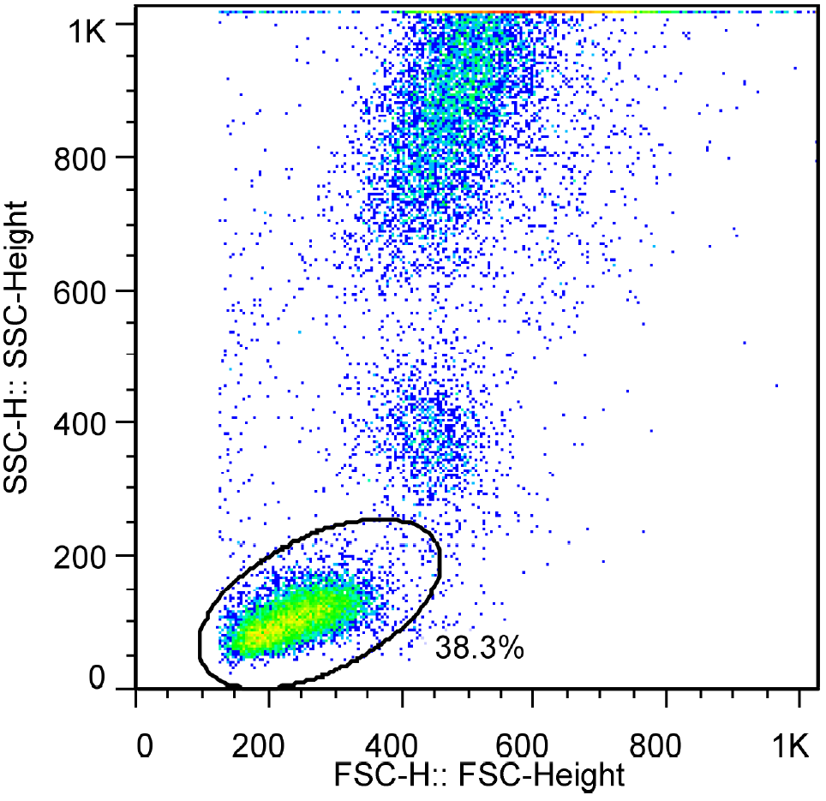
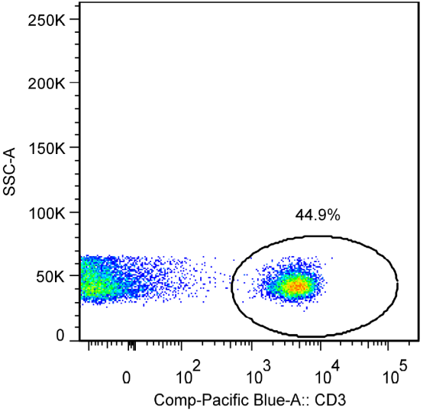
data presentation and analysis
gating
histograms
SSC = sideways scatter
FSC = forwards scatter

Slide 12
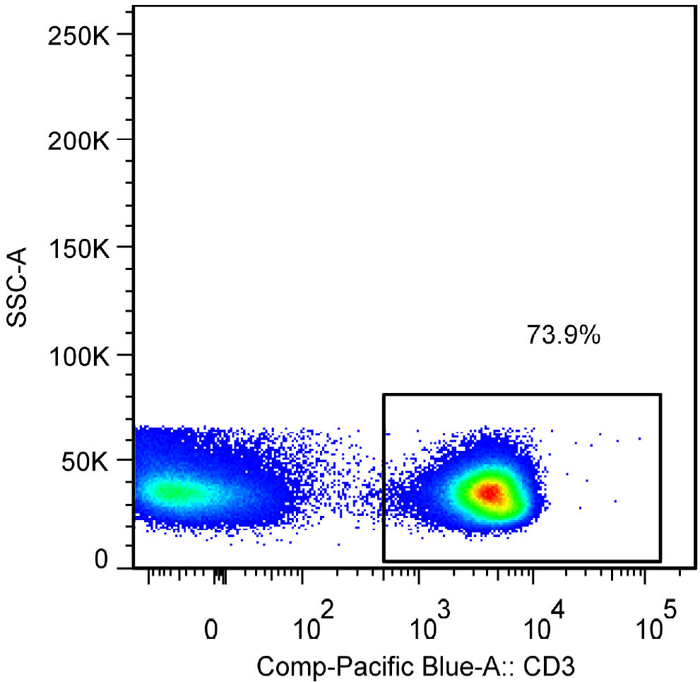
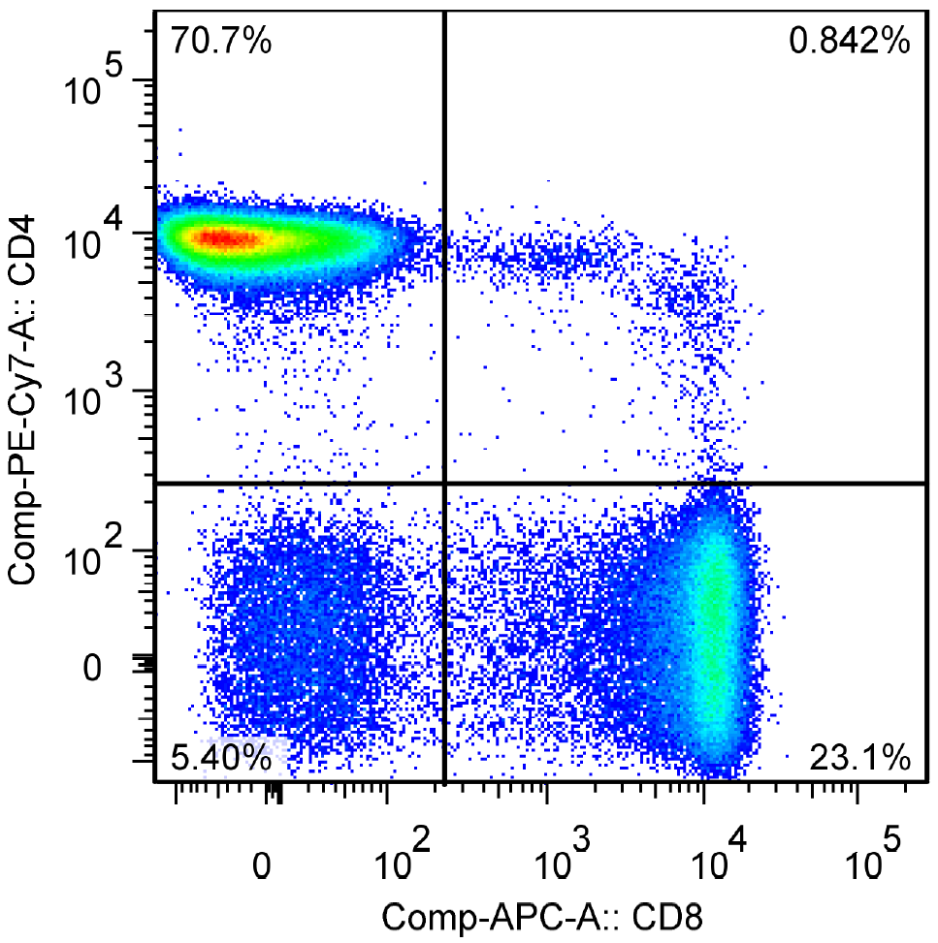
data presentation and analysis
gating

Slide 13
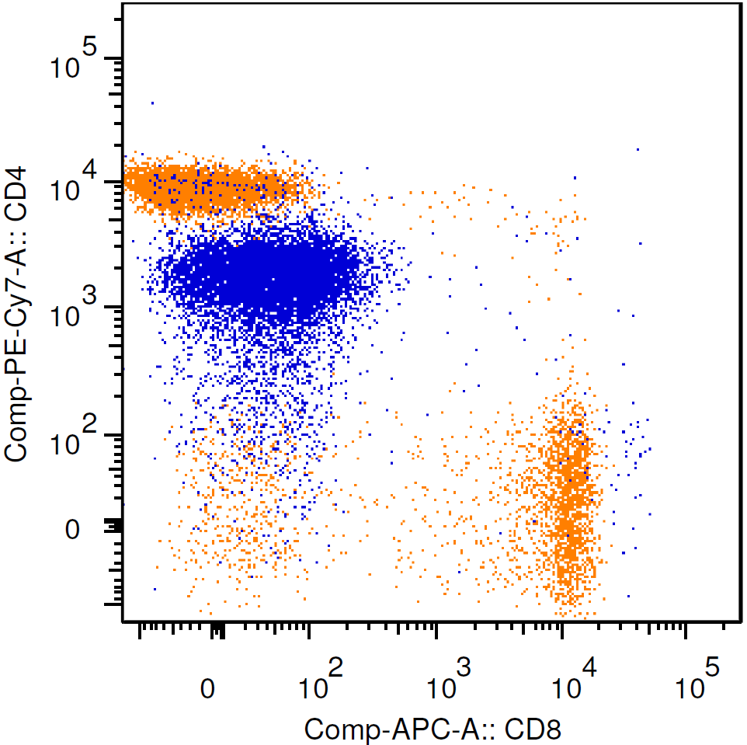
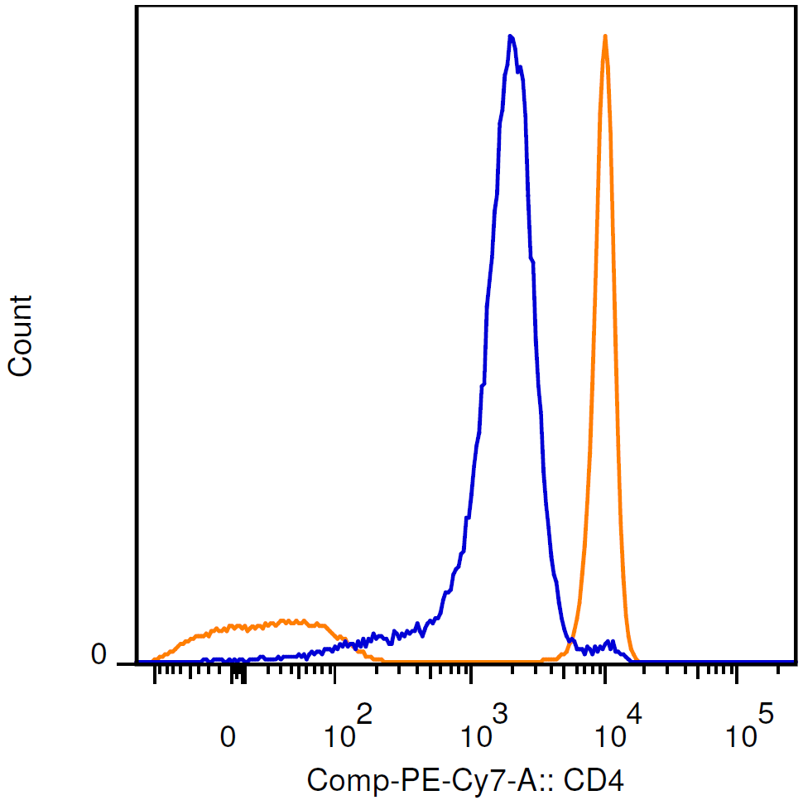
data presentation and analysis
staining intensity:
Median Fluorescence Intensity (MFI)
overlay
MFI
9177
MFI
1679
monocytes
T cells
monocytes
T cells

Slide 14
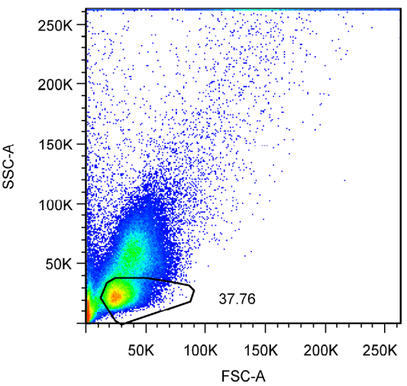
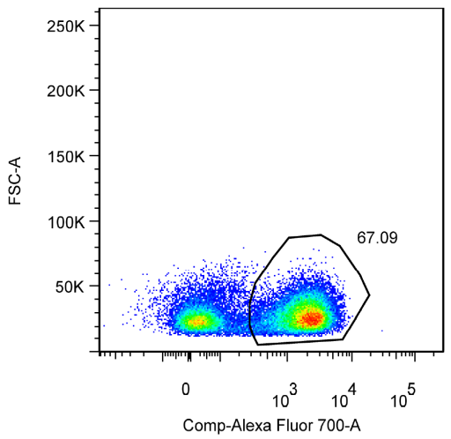
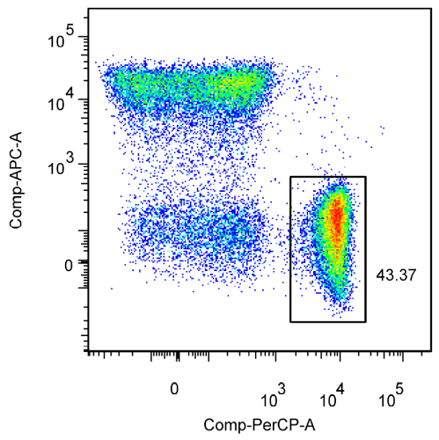
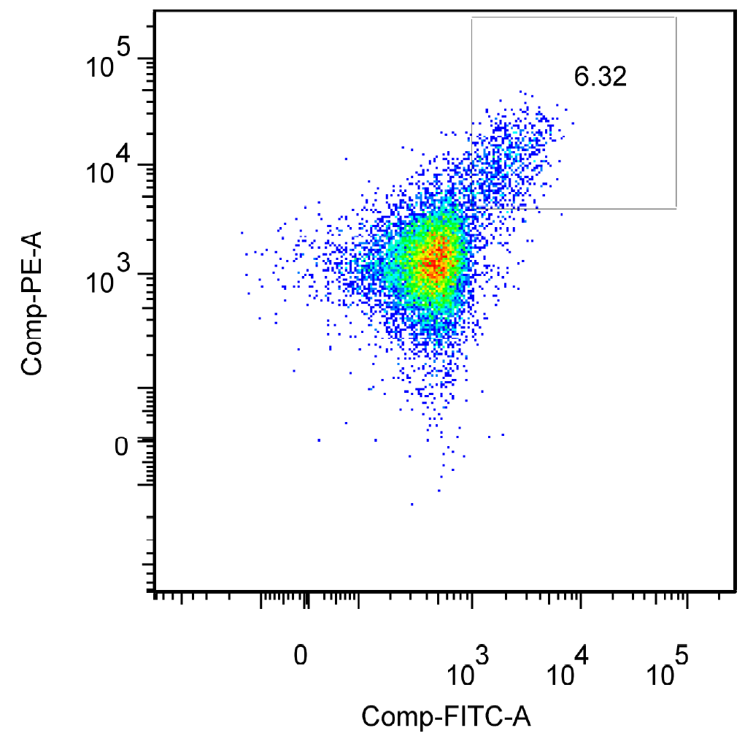
data presentation and analysis
Intracellular antigen flow cytometry:
the example of T regulatory cells
CD3+CD4+
CD3+ (T cells)
CD8
CD3
CD4
Tregs
CD3+CD4+CD25+highFoxP3+
CD25
FoxP3 (intracellular)

Slide 15
Applications in Clinical Haematology
Diagnosis & classification of leukaemias and lymphomas
Detection of minimal residual disease
Measurement of the absolute CD4+ T cells number
Measurement of CD34+ cells in bone marrow grafts
Assessment of lymphocyte clonality: kappa / lambda or TCR
Diagnosis of paroxysmal nocturnal haemoglobinuria (PNH)
Feto-maternal haemorrhage
Diagnosis of platelet disorders

Slide 16
Phenotyping normal vs malignancy
normal
leukaemia/lymphoma
Normal physical characteristics (FSC/SSC)
Normal blood cells gain or lose antigen expression during differentiation stages
Lineage specific markers
Normal patterns of antigen expression
Polyclonal
(B cells κ/λ or T cells TCRαβ)
Abnormal FSC/SSC pattern, predominant population
Immature phenotypes in great number in the periphery or marrow
Aberrant markers (lineage infidelity)
Aberrant combinations of CD antigens
Monoclonal

Slide 17
Acute myeloid leukaemia
classification, prognosis, minimal residual disease
Low SSC: hypogranularity
Non-lineage specific markers
  CD34 (stem cells)
  CD45 (most leukocytes)
  HLA-DR
Myeloid markers
  Myeloperoxidase (MPO)
  CD33
  CD117 (c-kit receptor)
  CD13
Aberrant expression
  CD2
  CD7
  CD56
Erythroid
  Glycophorin A
Megakaryocytic
  CD41/CD61

Slide 18
Acute myeloid leukaemia
Some expression patterns may indicate
certain genetic abnormalities
AML t(8;21)(q22;q22)
  CD19 and CD79b (B cell markers)
AML inv(16) or t(16;16)
  Strong expression CD34 & CD117
  Frequent CD2 (T/NK cell marker)

Slide 19
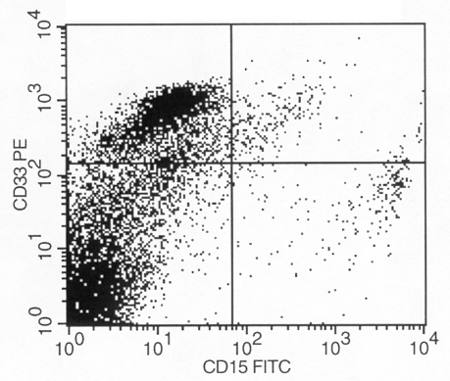
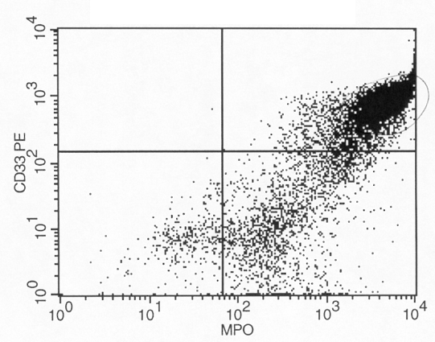
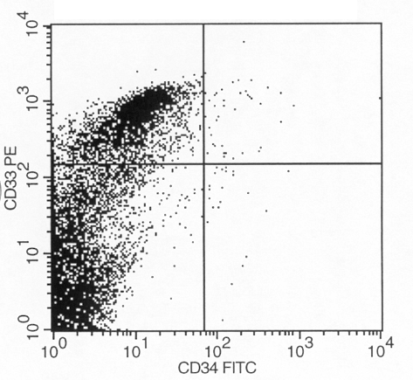
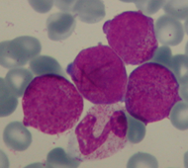
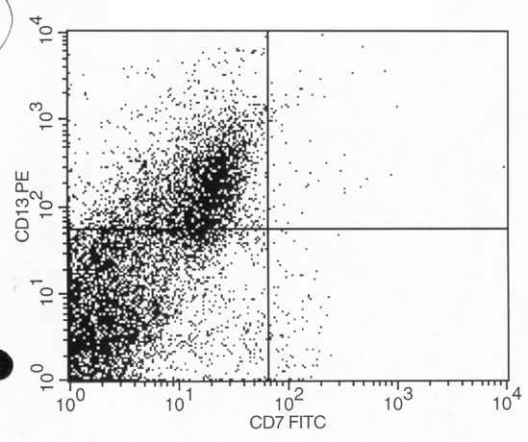
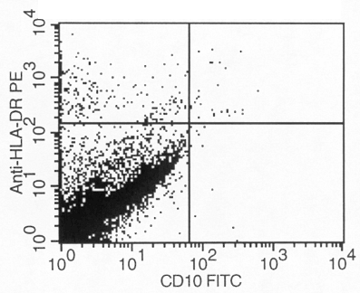
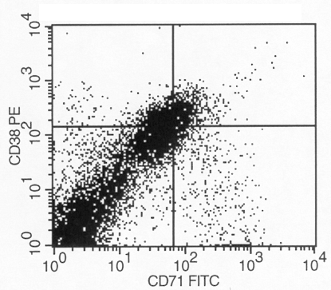
Acute promyelocytic leukaemia
t(15;17)(q22;q12);PML-RARA
CD34- HLADR- MPO++ CD33+ CD13+

Slide 20
Acute lymphoblastic leukaemia
classification, prognosis, minimal residual disease
B-ALL
  CD34
  CD19
  cytoplasmic CD79b
  cytoplasmic CD22
  Terminal deoxynucleotidyl transferase (TdT)
  CD10
T-ALL
  CD34
  TdT
  CD1a
  CD2
  CD3
  CD5

Slide 21
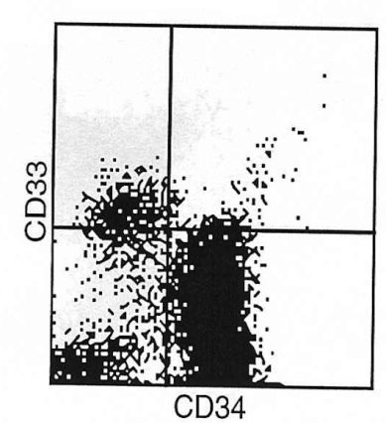
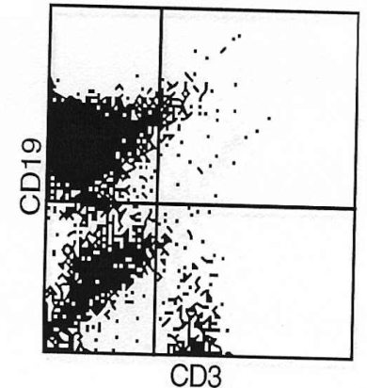
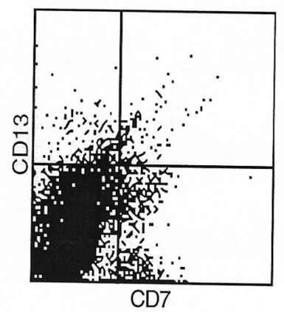
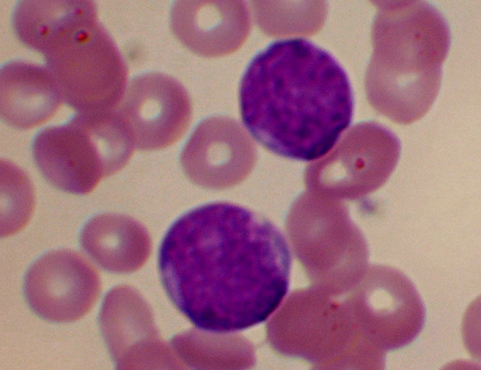
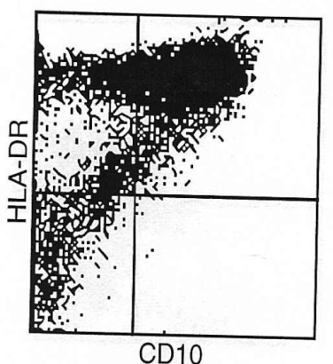
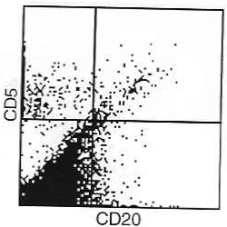
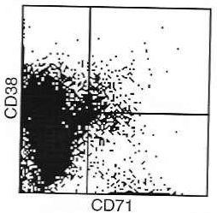
Acute lymphoblastic leukaemia
classification, prognosis, minimal residual disease

Slide 22
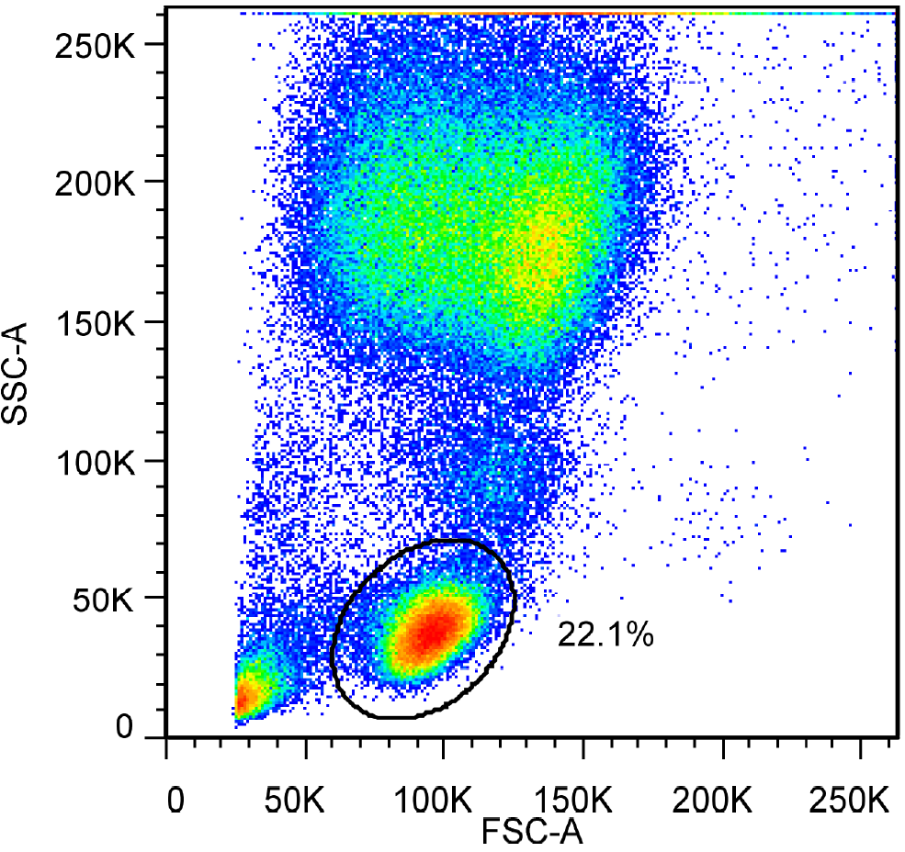
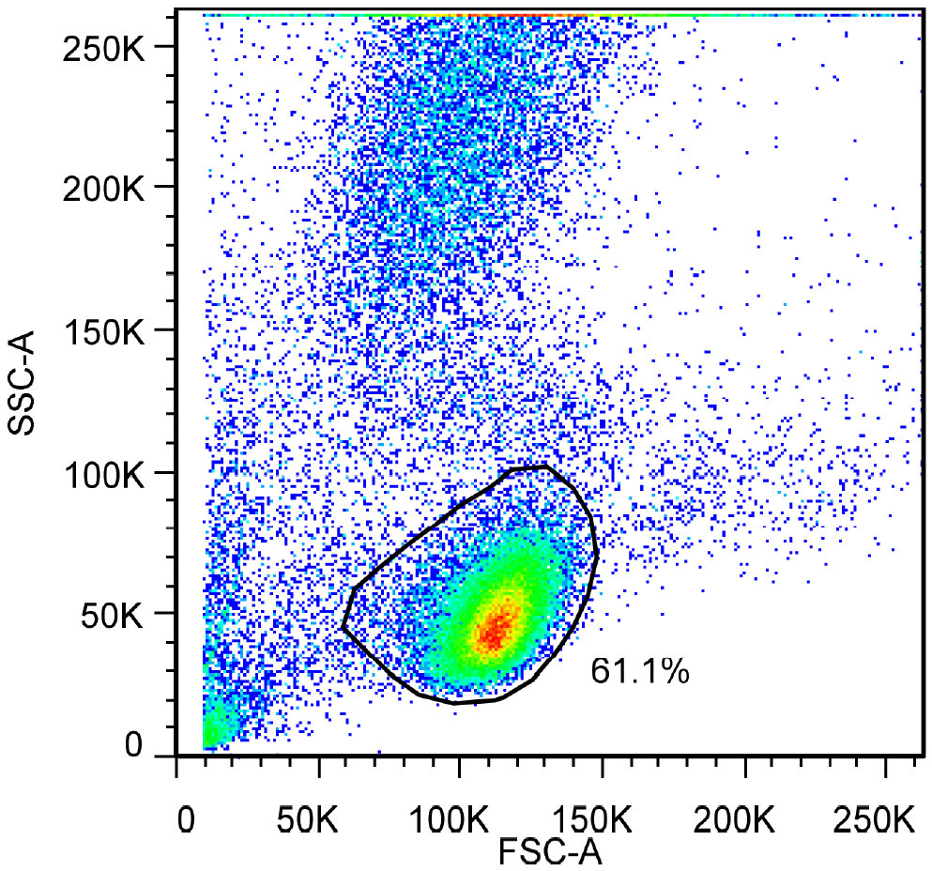
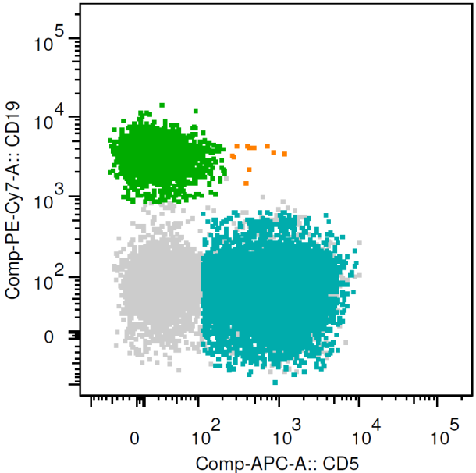
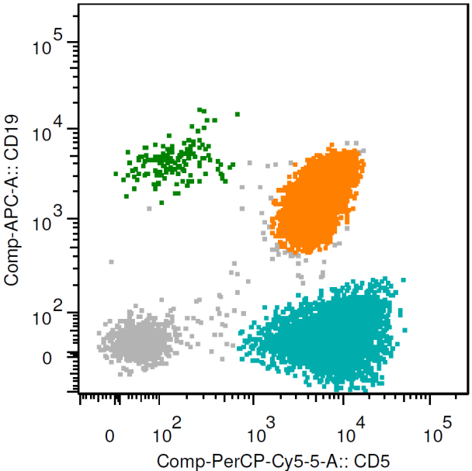
Chronic lymphocytic leukaemia (CLL)
normal
CLL
CLL score
  sIgM/IgD: weak
  CD5: +
  CD23: +
  CD79b/CD22: weak/-
  FMC7: -
B cells
B cells
CLL
CD19
CD19
T cells
T cells
CD5
CD5

Slide 23
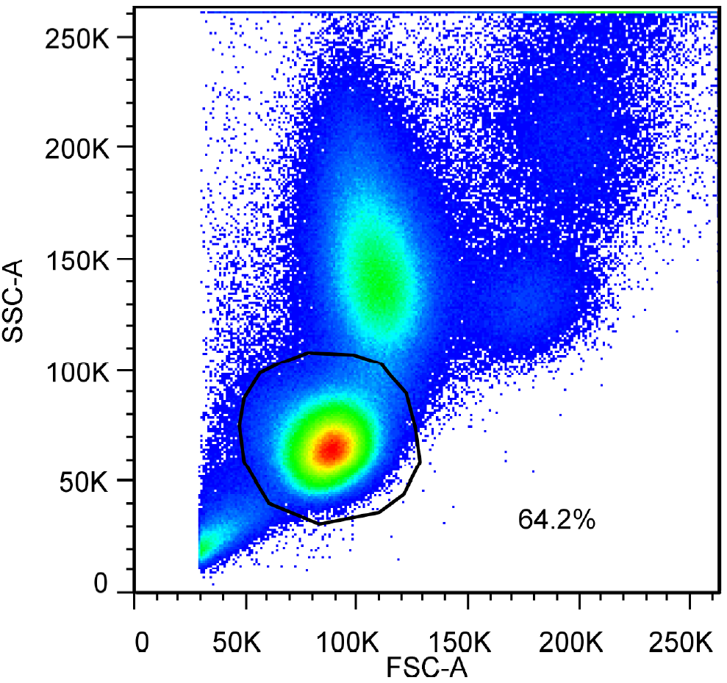
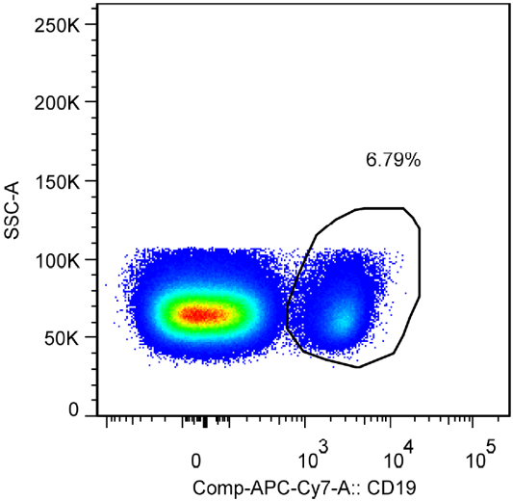
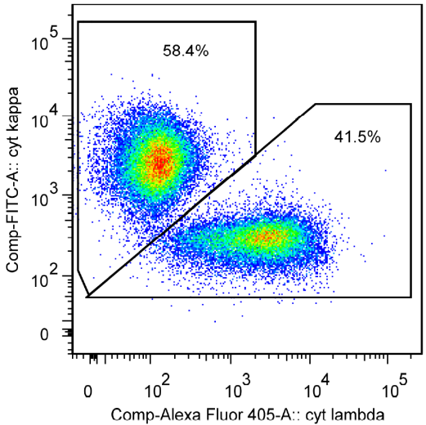
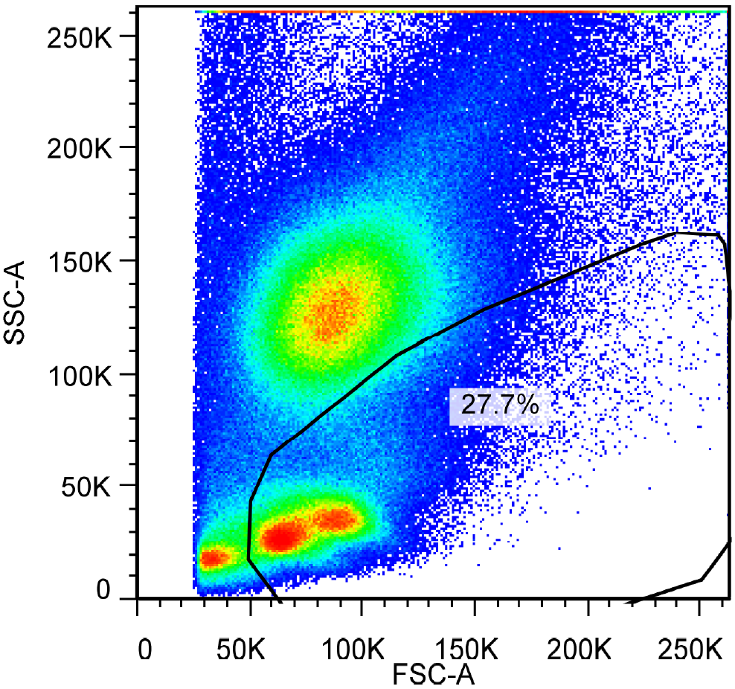
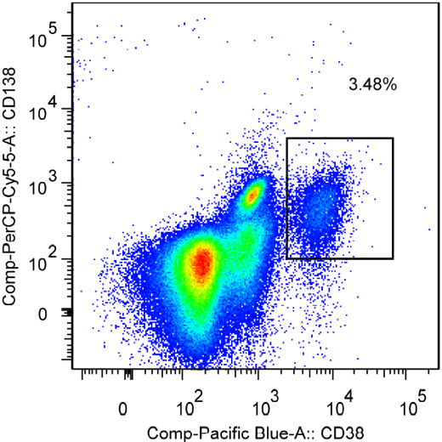
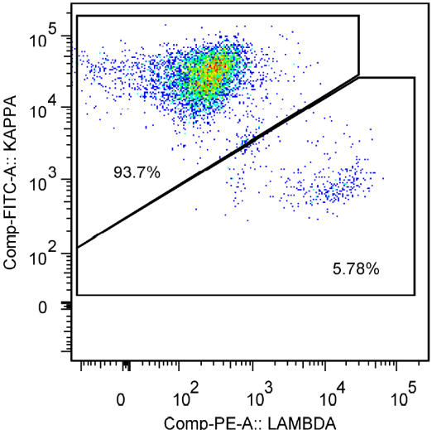
Clonality of B lymphocytes
normal leukocytes
polyclonal
58%
B cells
42%
cytoplasmic kappa
cytoplasmic lambda
MGUS marrow
kappa light chain restriction
Plasma cells
94%
cytoplasmic kappa
6%
cytoplasmic lambda

Slide 24



MRD: minimal residual disease
Detection of residual myeloma cells post treatment
normal
plasma cells
Plasma cells
myeloma marrow
0.4%
19%
myeloma
plasma cells
CD138
CD19
81%
CD38
CD56

Slide 25




Diagnosis of Red Cell disorders
Paroxysmal Nocturnal Haemoglobinuria (PNH)
  Rare disease, acquired mutation of PIG-A gene in stem cells
  Unable to produce glycosylphospatidylinositol (GPI)
  Loss of expression of several surface molecules e.g. CD59
control
normal
PNH
RBC
PNH
clone
PLT

Slide 26

Diagnosis of Red Cell disorders
Feto-maternal haemorrhage
Detection of fetal RBC using anti-HbF
Source: Trillium Diagnostics, LLC

Slide 27
Diagnosis of platelet disorders
Inheriting glycoprotein deficiencies & functional assays
  Investigate or confirm diagnosis of
    Glanzmann thrombasthenia: defect of Gp IIb/IIIa (CD41/CD61)
    Bernard-Soulier syndrome: defect of Gp Ib (CD42b)
    Scott syndrome (defect of phosphatidylserine translocation)
  Diagnosis of platelet storage pool diseases
  Monitoring of GpIIb/IIIa antagonist therapy

Slide 28


Diagnosis of platelet disorders
Glanzmann thrombasthenia
normal
Glanzmann thrombasthenia
Source: Practical-Hemostasis.com

Slide 29

Diagnosis of platelet disorders
Bernard-Soulier syndrome
transfused
platelets
CD42b-
platelets
Source: Practical-Hemostasis.com

Slide 30
Summary
  Flow cytometry is a powerful technology for the phenotypic and functional, multi-parameter analysis of large number of cells
  Many clinical application in haematology
    Diagnosis, classification and follow-up of leukaemias/lymphomas
    Minimal residual disease
    Transfusion and stem cell transplantation
    Haemostasis
  Immunophenotyping is essential component of the modern haematology diagnostics, along with morphology, cytogenetics and molecular diagnostics

