Slide 1
Clinical trials and the role of statistics in haematological research Statistics for the non-statistician
Professor BJ Bain

Slide 2
What is the role of statistics in haematological research?
Epidemiological research
Observation
Case control studies (looking backwards)
Cohort studies (looking forwards)
Recognition of prognostic factors
Assessment of treatment – clinical trials
All such research is based on empirical evidence

Slide 3
Learning objective
At the end of the Haematology BSc course you should be able to
Explain the role of statistics in medical research
Be able to explain the principles of common and important statistical tests
Be able to carry out common statistical tests
Interpret the results of clinical trials
Explain the pitfalls inherent in clinical trials and their interpretation
Interpret meta-analyses and systematic reviews
Explain the basis of an ethical trial

Slide 4
Examples of epidemiological research
Observation
Showed rising incidence of leukaemia following atomic bombs and subsequent decline
Case control studies
Established that cigarette smoking was an aetiological factor in AML
Cohort studies
Established that certain drugs are leukaemogenic
Established that long distance air travel is associated with a somewhat increased risk of DVT

Slide 5
How to we know if we are doing any better?
Clinical trials (ideal characteristics)
Controlled
Double-blind (if feasible)
Prospective and randomised
Adequately powered
Analysed appropriately
Registered in advance
Published (whether results are positive, neutral or negative)
Ethical
Systematic reviews
Meta-analysis

Slide 6
Empirical evidence
Empirical evidence is evidence that is based on observation
It is usually how a successful treatment is first discovered (from digitalis onwards)
It can give rise to a hypothesis that is capable of being verified or disproved through experiments and experience
Empirical evidence is the basis of the scientific method (rather than relying on dogma or belief)
It is the basis of clinical trials

Slide 7
Controlled trials
A new treatment is compared with something else – the control
If no effective treatment is known the control may be a placebo (or no treatment)
Why do you think a placebo might be better than a ‘no treatment’ arm?
If an effective treatment is known the control should be the best current treatment
Ideally, the control group and the patient group should be treated and studied simultaneously

Slide 8
Placebo
Sometimes a placebo may not be justifiable
The first controlled trial ever reported, that of streptomycin for pulmonary tuberculosis reported in 1948, did not use a placebo
Why not?

Slide 9
Placebo
Sometimes a placebo may not be justifiable
The first controlled trial ever reported, that of streptomycin for pulmonary tuberculosis, reported in 1948, did not use a placebo
Why not?
It would have meant the control group getting an IM injection 4 times a day for 4 months

Slide 10
Randomised trials
The best way to divide patients between a ‘new treatment group’ and a ‘control’ group is by randomisation
This avoids bias
Bias can be even more thoroughly avoided if the randomisation is double blind
However in leukaemia/lymphoma trials blinding may be impossible
Would you know if you were receiving a test drug or a placebo?
Would you know if you were receiving drug a or drug b?
Why not just allocate two treatments to alternate patients?

Slide 11
Why would anyone be biased?
A researcher may have a strong belief in a new treatment– he wants it to succeed
A patient may be holding out hope of a new treatment being successful
Placebo effect
Psychological effect of being in a trial
A pharmaceutical company may have a commercial interest in a treatment being successful

Slide 12
How are patients randomised?
After informed consent has been given
Techniques
Toss of a coin
Opening a sealed envelope or pack
Making contact with a central trial office by telephone or through e mail or a website
To avoid bias it is essential that the doctor requesting the randomization does not know what the allocation will be until after the patient has been registered for the trial

Slide 13
Why must the allocation not be known until after the allocation has been made?
Bias is otherwise introduced
In one trial, allocation to anticoagulants or not for myocardial infarction was on the basis of an odd or even day of the month, giving 589 treated and 442 controls
In another trial, allocation to pre-operative radiation or not for rectal cancer was on the basis of date of birth, giving 192 treated and 267 controls
Pocock SJ. Clinical trials. A Practical Approach, John Wiley, New York, 183, p 60.

Slide 14
Survival curves
Often actuarial survivals are calculated, i.e. survival is estimated while many patients are still alive – why?
Overall survival – ultimately important but if a disease is chronic it may takes decades to see a difference
Other types of survival that can be studied
Progression-free survival
Disease-free or relapse-free or failure-free survival
Event-free survival
Relative survival
Disease-specific survival

Slide 15
What are the characteristics of a clearly presented survival curve?
Appropriate vertical scale
Axes clearly labelled
Lines can be readily distinguished (preferably also when printed in black and white)
Number at risk at various time point is shown
Statistical data are on the graph
Standard error or confidence limits are shown

Slide 16
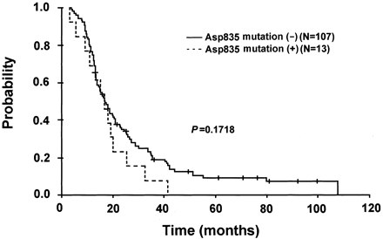
Overall survival
Usually expressed as an actuarial median survival – the time when half the patients are predicted to be alive and half dead
Kaplan-Meir plot – when death (or another event) occurs the line drops; vertical lines crossing the curve are patients who are still alive
Including some statistics on the graph is important in avoiding overestimation of any apparent difference by the reader
Survival curves are compared using a log-rank test or a hazard ratio
Shin et al. 2004 Clin Cancer Res, 10, 1326.

Slide 17
What is a hazard ratio?
A hazard ratio is the effect of a variable on an event
It is an estimate of the relative risk
For example, if administration of a drug is associated with a 20-fold increase in the risk of developing acute leukaemia, the relative risk or hazard ratio is 20
If a drug given as treatment lowers the risk of death the relative risk or hazard ratio might be 0.58 (CI 0.44-0.77) (see next screen)
The relative risk can be used in assessing randomised controlled trials and cohort studies

Slide 18
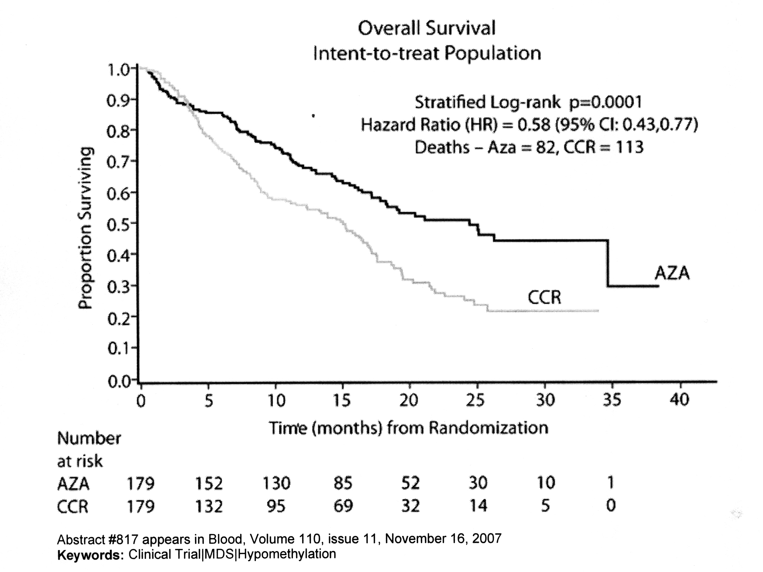
Overall survival
A comparison of azacitidine (AZA) and conventional care regime (CCR) showing a benefit for azacitidine whether analysed by log rank test or hazard ratio

Slide 19
What is an odds ratio?
Statistically, an odds ratio is not the same as a hazard ratio although for small samples it is similar
It is also a measure of the size of an effect or the strength of an association
An odds ratio is favoured for case-control studies and retrospective studies

Slide 20
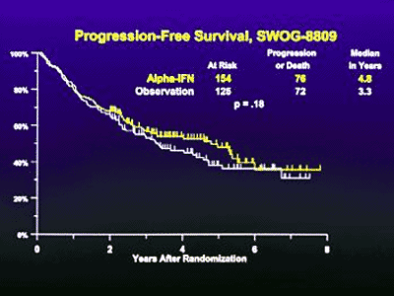
Progression-free survival
Patient may not be free of disease but the disease is not progressing and not evolving to a higher grade disease
For a chronic low grade neoplasm this may be a worthwhile achievement
These survival curves compare progression-free survival in lymphoma with or without interferon after initial intensive treatment (showing no difference)
Zelenetz et al (2001)
cme.medscape.com/viewarticle/416476_1

Slide 21
Kaplan-Meir curves can show events as well as survival
This is a study of 100 patients who received a haemopoietic stem cell tranplant (HSCT) for various conditions with non-myeloablative conditioning
OS = overall survival
PFS = progression-free survival
RRM = relapse-related mortality
TRM = transplantation-related mortality
Kornblit (2008) Bone Marrow Transpl, 41, 851

Slide 22
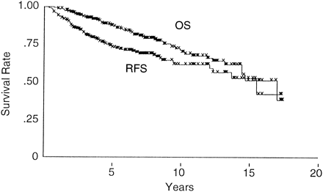
Relapse-free survival
Survival without the disease relapsing
Likely to be predictive of overall survival
Overall survival (OS) and relapse-free (RFS) survival in 257 patients with follicular lymphoma who initially achieved a complete remission
What do all the x’s mean?
Oh et al. (1999) Radiology, 210, 283

Slide 23
Event-free survival
Survival without a defined event having occurred
What is an ‘event’?
If you were studying the action of an anticoagulant or antiplatelet drug an event might be a deep vein thrombosis, a stroke or a myocardial infarction
If you were studying transfusion to try to prevent strokes in sickle cell disease an event might be a stroke, a transient ischaemic attack or a specified loss of cognitive function
If you were studying leukaemia an event might be a relapse but could also be a cytogenetic or molecular relapse or the need to change to alternative treatment because of toxicity

Slide 24
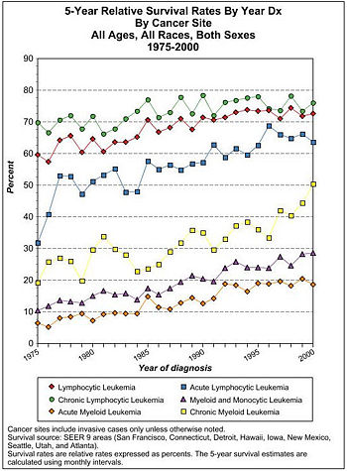
Relative survival
This is survival compared with age and gender matched control subjects
It is relevant in assessing the impact on survival of an illness that usually occurs in older patients
Standardization for ethnic origin, year of treatment or any other variable can also be done
en.citizendium.org

Slide 25
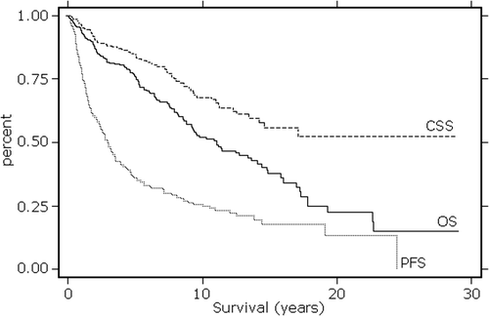
Disease-specific survival
Also known as cause-specific survival
This is survival that excludes unrelated deaths
Deaths due to treatment of the disease as well as the disease itself are included
281 patients with follicular lymphoma, median age 58 (range 21-92 years)
CSS = cause-specific survival
OS = overall survival PFS = progression-free survival
Conconi et al. (2010) Leuk Lymphoma, 51, 1028

Slide 26
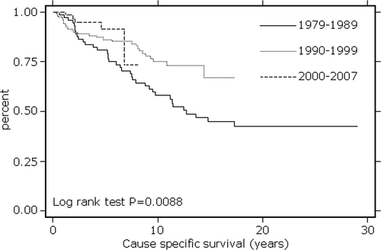
Disease-specific survival
Overall survival
Disease-specific survival
281 patients with follicular lymphoma, median age 58 (range 21-92 years)
Note how disease-specific survival is picking up the results of more effective treatment in later years although no difference is seen in overall survival
Conconi et al. (2010) Leuk Lymphoma, 51, 1028

Slide 27
Intention-to-treat analysis
This type of analysis includes all patients who are allocated to a specific treatment whether or not they started the treatment or withdrew prematurely
It is a method of preventing bias

Slide 28
If results are not plausible be suspicious
Survival after transplantation for CML, according to zodiac sign
Is this probable?
What could have gone wrong?
Szydlo et al. (2010) Trans Proc, 42, 3312

Slide 29
If results are not plausible be suspicious
Univariate analyses comparing all 12 individual star signs showed considerable
variation of 5-year probabilities of survival, 63% for Arians, to 45% for Aquarians, but
without significance (P .65). However, it was possible to pool together star signs likely
to provide dichotomous results. Thus, grouping together Aries, Taurus, Gemini, Leo,
Scorpio, and Capricorn (group A; n 317) versus others (group B; n 309) resulted in
a highly significant difference (58% vs 48%; P .007). When adjusted for known
prognostic factors in a multivariate analysis, group B was associated with an increased risk
of mortality when compared with group A (relative risk [RR], 1.37; P .005).
Conclusion. In this study, we show that, providing adequate care is taken, a significant
Survival after transplantation for CML, according to zodiac sign
Szydlo et al. (2010) Trans Proc, 42, 3312

Slide 30
Why is this relevant?
Research should have an a priori hypothesis that is tested
Analysis of subgroups decided in retrospect is prone to error

Slide 31
Statistical power
Big is beautiful
It is important to distinguish between “No evidence of difference found” and “evidence of of no difference found”
Only a big (adequately powered) trial will permit the second important statement to be made
Triallists should work out in advance how many patients are needed to show a clinically significant difference at a statistically significant level
http://www.freakingnews.com/Obesity-Pictures-6573.asp

Slide 32
Confidence intervals
All statistical results have confidence intervals
These tell you the probability that the true results lie within a specified interval
Usually a 95% confidence interval is used
Often the confidence interval (CI) of the mean value (2 SDs above and below) is shown as a bar on a graph (but beware – sometimes the bar is the standard error of the mean not 2SDs)
Confidence intervals can also be given as numerical values
If CI bars do not overlap the difference is highly significant (p<.006). If the gap between SE bars is greater than 1 SE the difference is significant (p< 0.035)
Pocock et al. (2008) BMJ, 336, 1155.

Slide 33
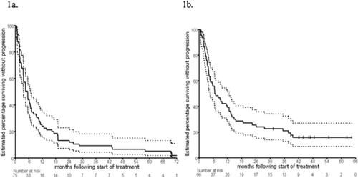
Confidence Intervals
Kaplan-Meir curves for progression-free survival with 95% confidence limits shown as dotted lines
Thalidomide ± interferon, recruited 1999-2001
Thalidomide ± celecoxib, recruited 2001-2003
Quach et al. (2009) Leuk Lymph, 50, 223
This trial in multiple myeloma also shows the risks of non-randomized non-controlled trials. The significant difference in outcome was due to different exclusion criteria (renal function) in these consecutive trials trials

Slide 34
Confidence intervals
This table shows confidence intervals numerically
A larger study would have given narrower confidence intervals
Annual stroke risk [Gage et al. 2001 JAMA, 285, 2864]
CHADS2 score | Stroke risk% | 95% confidence interval
0 | 1.9 | 1.2-3.0
1 | 2.8 | 2.0-3.8
2 | 4 | 3.1-5.1
3 | 5.9 | 4.6-7.3
4 | 8.5 | 6.3-11.1
5 | 12.5 | 8.2-17.5
6 | 18.2 | 10.5-27.4

Slide 35
Pooling data
Data from a number of trials can be pooled in two ways
Meta-analysis
Systematic review
A single analysis/article may do both
In meta-analysis the data from similar trials is pooled and re-analysed (introduced into UK by Richard Peto to study the benefits of aspirin in myocardial infarction) [Anonymous, Lancet, 1, 1172, 1980]
In systematic reviews a systematic search is made for all trials for comparison of findings

Slide 36
Meta-analysis
Results of meta-analysis are often shown as a Forest plot (box and whisker plot)
The vertical line shows no difference
The length of the horizontal line shows the 95% confidence limits
The diamond shows the pooled data
This is an analysis of the likelihood of DVT in women taking oral hormone replacement therapy (HRT)
Canonico, M. et al. BMJ 2008;336:1227-1231

Slide 37
Forest plot
primalperformancesolutions.com
A Forest plot can be used to show the results of meta- analysis
It can also be used for comparison of subgroups within a single trial
The name derives from the forest of lines of a typical plot

Slide 38
Risk of first episode of venous thromboembolism by study design and route of oestrogen administration
Here is the rest of the data comparing observational studies (12 case control and one cohort study) and randomised controlled trials for oral oestrogens (both show an increased risk)
Transdermal oestrogens do not have a significant effect
Canonico, M. et al. BMJ 2008;336:1227-1231
What is the clinical significance? 2.5 (1.9-3.4) DVTs instead of 1 per 1000 women per year
Consider together with stroke and breast carcinoma to make an informed decision
Copyright ©2008 BMJ Publishing Group Ltd.

Slide 39
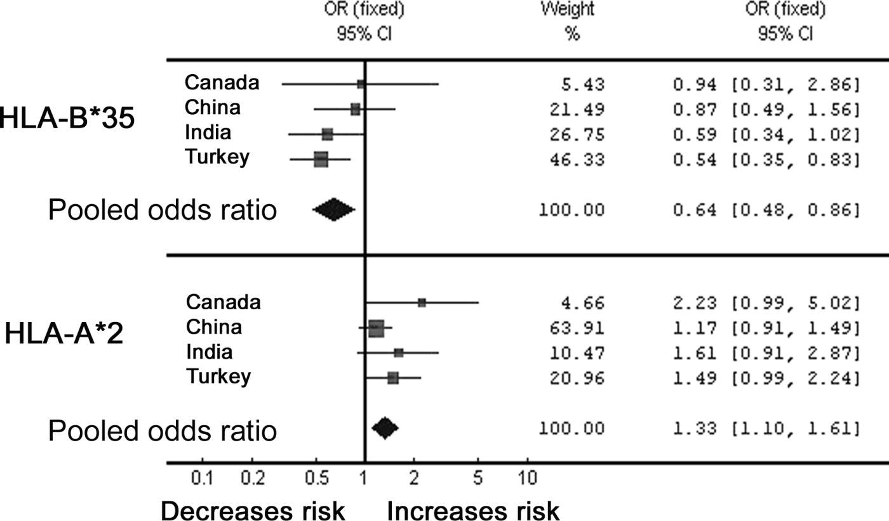
Meta-analysis
Another convention that can be used is that the size of the square indicates the number of observations
This is a meta-analysis of studies looking for an association between HLA type and CML (chronic myeloid leukaemia)
Naugler and Liwski (2010) Leuk Lymphoma, 51, 1288

Slide 40
Systematic review
Clearly defined search strategy
Published and unpublished trials included
Quality of trials assessed
Trials that are too dissimilar to be suitable for a meta-analysis can be compared

Slide 41
Ethical trials
Clinical trials must be ethical
Patients must be fully informed, make a free choice and be free to withdraw from the trial
If a known effective treatment is available it must be
Included as one arm of the trial OR
Included in both arms of the trial with a new treatment being added in one arm only
Interim analysis must be carried out by a data-monitoring committee so that the trial is terminated if it becomes clear that one treatment is superior

Slide 42
Ethical trials
Sometimes shortage of a drug can make it ethical to withhold an apparently effective drug from a control group (MRC streptomycin trial)

Slide 43
Ethical trials
Trials can also be terminated on the grounds of futility if it becomes clear that a meaningful clinical benefit is unlikely
Trials must be reported honestly and in a balanced responsible manner
Negative results should be reported, not just positive
Serious side effects must not be minimised
Pharmaceutical companies should not be in control of the data or able to block publication
The real clinical benefit and the likely toxicity and cost must be clear – the number needed to treat to achieve a benefit for one patient can be a useful concept (NNT)

Slide 44
Number Needed to Treat
Visual representation on NNT for warfarin therapy in stroke prevention in patients with atrial fibrillation (www.nntonline.net)
http://www.npci.org.uk/therapeutics/mastery/mast2/resources/pda_im2.pdf

Slide 45
Ethical trials
Confidentiality of individual patients must be assured
Possible risks must be proportionate to potential benefits
It is unethical to conduct trials that are poorly planned or poorly executed
Trials should be adequately powered
It is not ethical to use resources on trials that are not likely to have an outcome

Slide 46
Some light reading
Doll R (1998) Controlled trials: the 1948 watershed. BMJ, 317, 1217-1220.
Lewis S and Clarke M (2001) Forest plots: trying to see the wood and the trees. BMJ, 322, 1479.
Pocock S, Travison T and Wruck L (2008) How to interpret figures in reports of clinical trials, BMJ, 336, 1166-1169.

