Slide 1
BSc Introduction
Antiplatelet agents: evaluation of a paper
27 September 2012
Professor David Lane
Department of Haematology
(d.lane@imperial.ac.uk)

Slide 2
Some statistical and methodological points:
Odds ratios
95% confidence intervals
Relative risks
Kaplan Meier and other survival/event plots
Hazard ratios
Intention to treat analysis

Slide 3
Odds Ratio
Odds of an event
Number of events/number of non events
Odds ratio
Odds in treated or exposed group/odds in control group

Slide 4
Odds Ratio
In a week
90/100 men have drunk beer
Odds 90/10
20/100 women have drunk beer
Odds 20/80
Odds Ratio 90/10 = 36
20/80

Slide 5
95% Confidence Interval (CI)
A 95% confidence interval is an interval generated by a process that is correct 95% of the time. It gives a measure of confidence to the mean.
If 95% CI crosses unity, result not “statistically” significant!
Compare OR (95% CI)
3.3 (1.6-7.0) significant
With 3.2 (0.8-12.3) not significant

Slide 6
Use of Odds ratio and 95% Confidence Interval (CI)
In the following example, these are used in a study of risk factors for upper extremity thrombosis (Martinelli et al, Risk factors and recurrence rate of primary deep venous thrombosis of the upper extremities. Circulation 204; 110: 566-570):

Slide 7
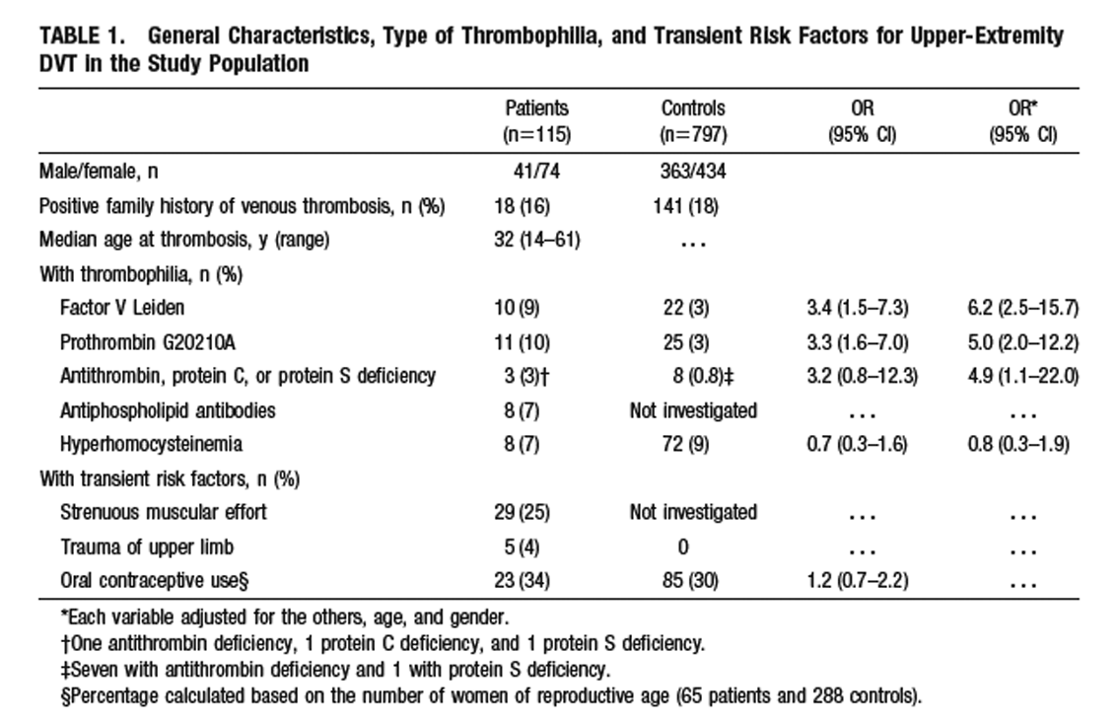
Example of OR calculation:
Factor V Leiden 10/105 = 3.35
22/775
(The adjusted results in last column cannot be derived simply)

Slide 8
Relative Risk
Relative risk is another common measure of risk.
RR= Probability of event in exposed group
Probability of event in non exposed group
RR is actually very similar to Odds Ratio, especially
when the probabilities are small.
In Clinical Studies, the Odds Ratio is favoured for
case control studies and retrospective studies.
Relative Risk is used in randomised controlled trials
and cohort studies.

Slide 9
Odds Ratio vs Relative Risk
In a week
90/100 men have drunk beer
Odds 90/10
20/100 women have drunk beer
Odds 20/80
Odds Ratio 90/10 = 36
20/80
Relative Risk 90/100 = 4.5
20/100

Slide 10
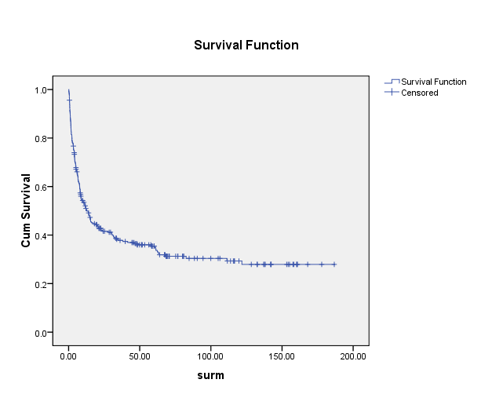
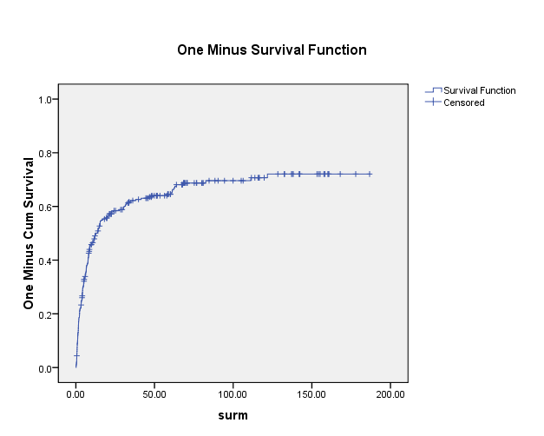
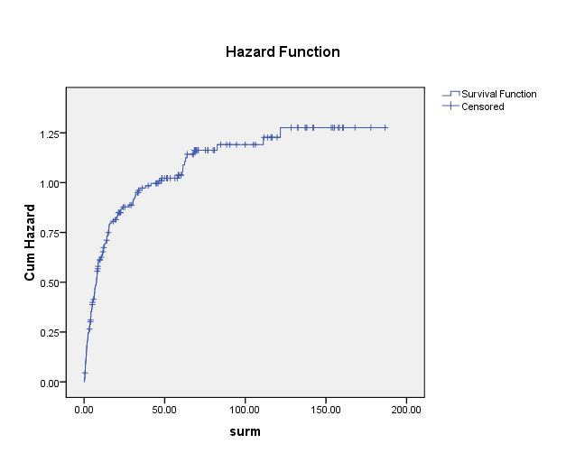
Kaplan Meier and other plots
Kaplan Meier plots show survival (often expressed as % or as fraction of 1.00) over time. Allows “censoring” of results when patients drop outs.
Cumulative Kaplan Meier plots are also often used, to show increase in events over time.
Cumulative hazard rate is an alternative way of plotting the rate of events, in the present case the first primary outcome.
Kaplan Meier
Cumulative Kaplan Meier
Cumulative Hazard Rate
Follow up
Follow up
Follow up

Slide 11
Hazard Ratios
Hazard ratio is broadly similar to Relative Risk. It is useful when the risk varies over time. The term is often used in connection with the Kaplan Meier survival plot (over time). If the overall RR of an event is half in one group, then HR is 0.5.

Slide 12
Intention to treat analysis
This is analysis based on the initial treatment plan, not on the treatment eventually administered. Everyone who begins the treatment is included in the analysis, regardless of whether they complete the treatment or not. It is a robust way of avoiding bias that can arise from dropouts from trials.

Slide 13
Antiplatelet agents: Clopidogrel and
cardiovascular disease
Aspirin is mainstay of antiplatelet treatment.
Clopidogrel is now used, mostly together with
aspirin:
Acute coronary syndromes
Percutaneous coronary intervention (stents)
Prevention of thromboembolism in peripheral
vascular disease
4. When antiplatelet agent required, but aspirin in
contrandicated

Slide 14
Acute coronary syndromes
ACS
Unstable angina ST –elevation MI
non-ST-elevation MI
Chest pain at rest
or new onset pain
Not ST elevation on
ECG
ST elevation on
ECG-occluded vessel

Slide 15
Acute coronary syndromes: current
UK treatment
ACS
Unstable angina ST –elevation MI
non-ST-elevation MI
Aspirin 300 mg
Clopidogrel 300mg
LMWH, +/- abiximab
(Complete coronary occlusion)
Aspirin 300 mg
Clopidogrel 600mg
+/- UFH, +/- abiximab
Patients usually immediately
scheduled for angioplasty

Slide 16
A pivotal trial that influenced
combined use of clopidogrel?
The CURE trial, cited more than
2000 times.

Slide 17
EFFECTS OF CLOPIDOGREL IN ADDITION TO ASPIRIN IN PATIENTS WITH ACUTE CORONARY SYNDROMES WITHOUT ST-SEGMENT ELEVATION
N Engl J Med, Vol. 345, No. 7 August 16, 2001
THE CLOPIDOGREL IN UNSTABLE ANGINA TO PREVENT RECURRENT EVENTS TRIAL INVESTIGATORS*

Slide 18
Background
Aspirin and heparin reduce cardiovascular events in
the acute coronary syndromes, but the risk of fatal
and non fatal events remains high.
Aims
To study the combination of aspirin with clopidogrel,
an ADP antagonist that independently inhibits
platelet function.

Slide 19
Study design
Randomised, double blind, placebo controlled trial,
comparing clopidogrel with placebo in patients
with acute coronary syndromes without ST elevation.
Patients
Eligible if hospitalised within 24 hours after onset
of symptoms: electrocardiographic or cardiac enzyme
changes. 482 centres in 28 countries.
Exclusions: high risk of bleeding; heart failure; oral
Anticoagulants; coronary revascularisation, etc

Slide 20
Outcomes
First primary outcome: composite of death from
Cardiovascular causes, non fatal MI, stroke.
Second primary outcome: composite of first primary
Outcome or refractory ischaemia.
Safety
Bleeding: life threatening, major, minor.
Adjudication
Independent.

Slide 21
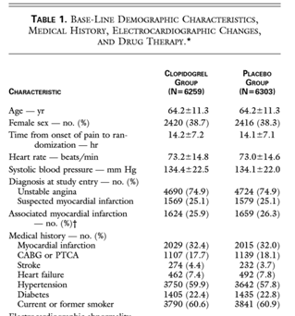
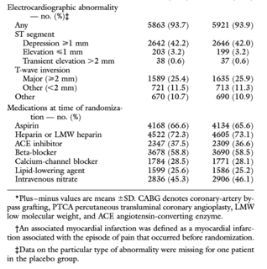

Slide 22
Cumulative Hazard Rate used here is preference to Cumulative Kaplan Meier,
as it emphasises early differences.

Slide 23
Calculating relative risk RR:
Prob of event in Clopidogrel group 582/6259=0.093
Prob of event in Placebo group 719/6303=0.114
RR = 0.093/0.110 = 0.81

Slide 24
Note spread of 95% CI!
When it crosses 1.0,
outcome is not
statistically significant

Slide 25
Calculating relative risk RR:
Prob of bleeding in Clopidogrel group 231/6259=0.037
Prob of bleeding in Placebo group 169/6303=0.027
RR = 0.037/0.027 = 1.37

Slide 26
Conclusions
Demonstrates the benefit of adding clopidogrel
to the regimen of treatment for patients with
acute coronary syndromes without ST-segment elevation who are receiving aspirin and other medications.
Treatment with clopidogrel reduced the risk of myocardial infarction and recurrent ischemia, with a trend toward lower rates of stroke and death from cardiovascular causes.

Slide 27
Conclusions
……The benefits were also observed in
those at low, medium, and high risk of cardiovascular
events and those who were receiving various proven
therapies such as aspirin, lipid-lowering drugs, angiotensin-
converting–enzyme inhibitors, and betablockers.
The benefits of clopidogrel were apparent
as early as the first 24 hours after randomization,
indicating that the oral loading dose was rapidly effective.
Thereafter, the differences between the two
groups were maintained until the end of the study.

Slide 28
Conclusions
Clopidogrel increased the risk of minor and major
bleeding episodes. For every 1000 patients treated
with clopidogrel, 6 will require a transfusion. However,
there was no excess in bleeding that caused strokes,
required surgical intervention or inotropic agents, or
caused permanent disability.
In Summary, clopidogrel significantly reduces the
risk of the composite outcome of death from cardiovascular
causes, nonfatal myocardial infarction, or
stroke, as well as a range of related ischemic events.
The use of the drug, in addition to aspirin, is associated
with an increased risk of bleeding.

Slide 29
Additional reading?
Wiviott et al. Prasugrel versus clopidogrel in patients with acute coronary syndromes. NEJM 357; 2001-15, 2007
-uses cumulative Kaplan Meir plot rather than cumulative Hazard rate.
Pare et al. Effects of CYP2C19 genotype on outcomes of clopidogrel treatment. NEJM August 29, 2010
-uses Kaplan Meier plots.

