Slide 1
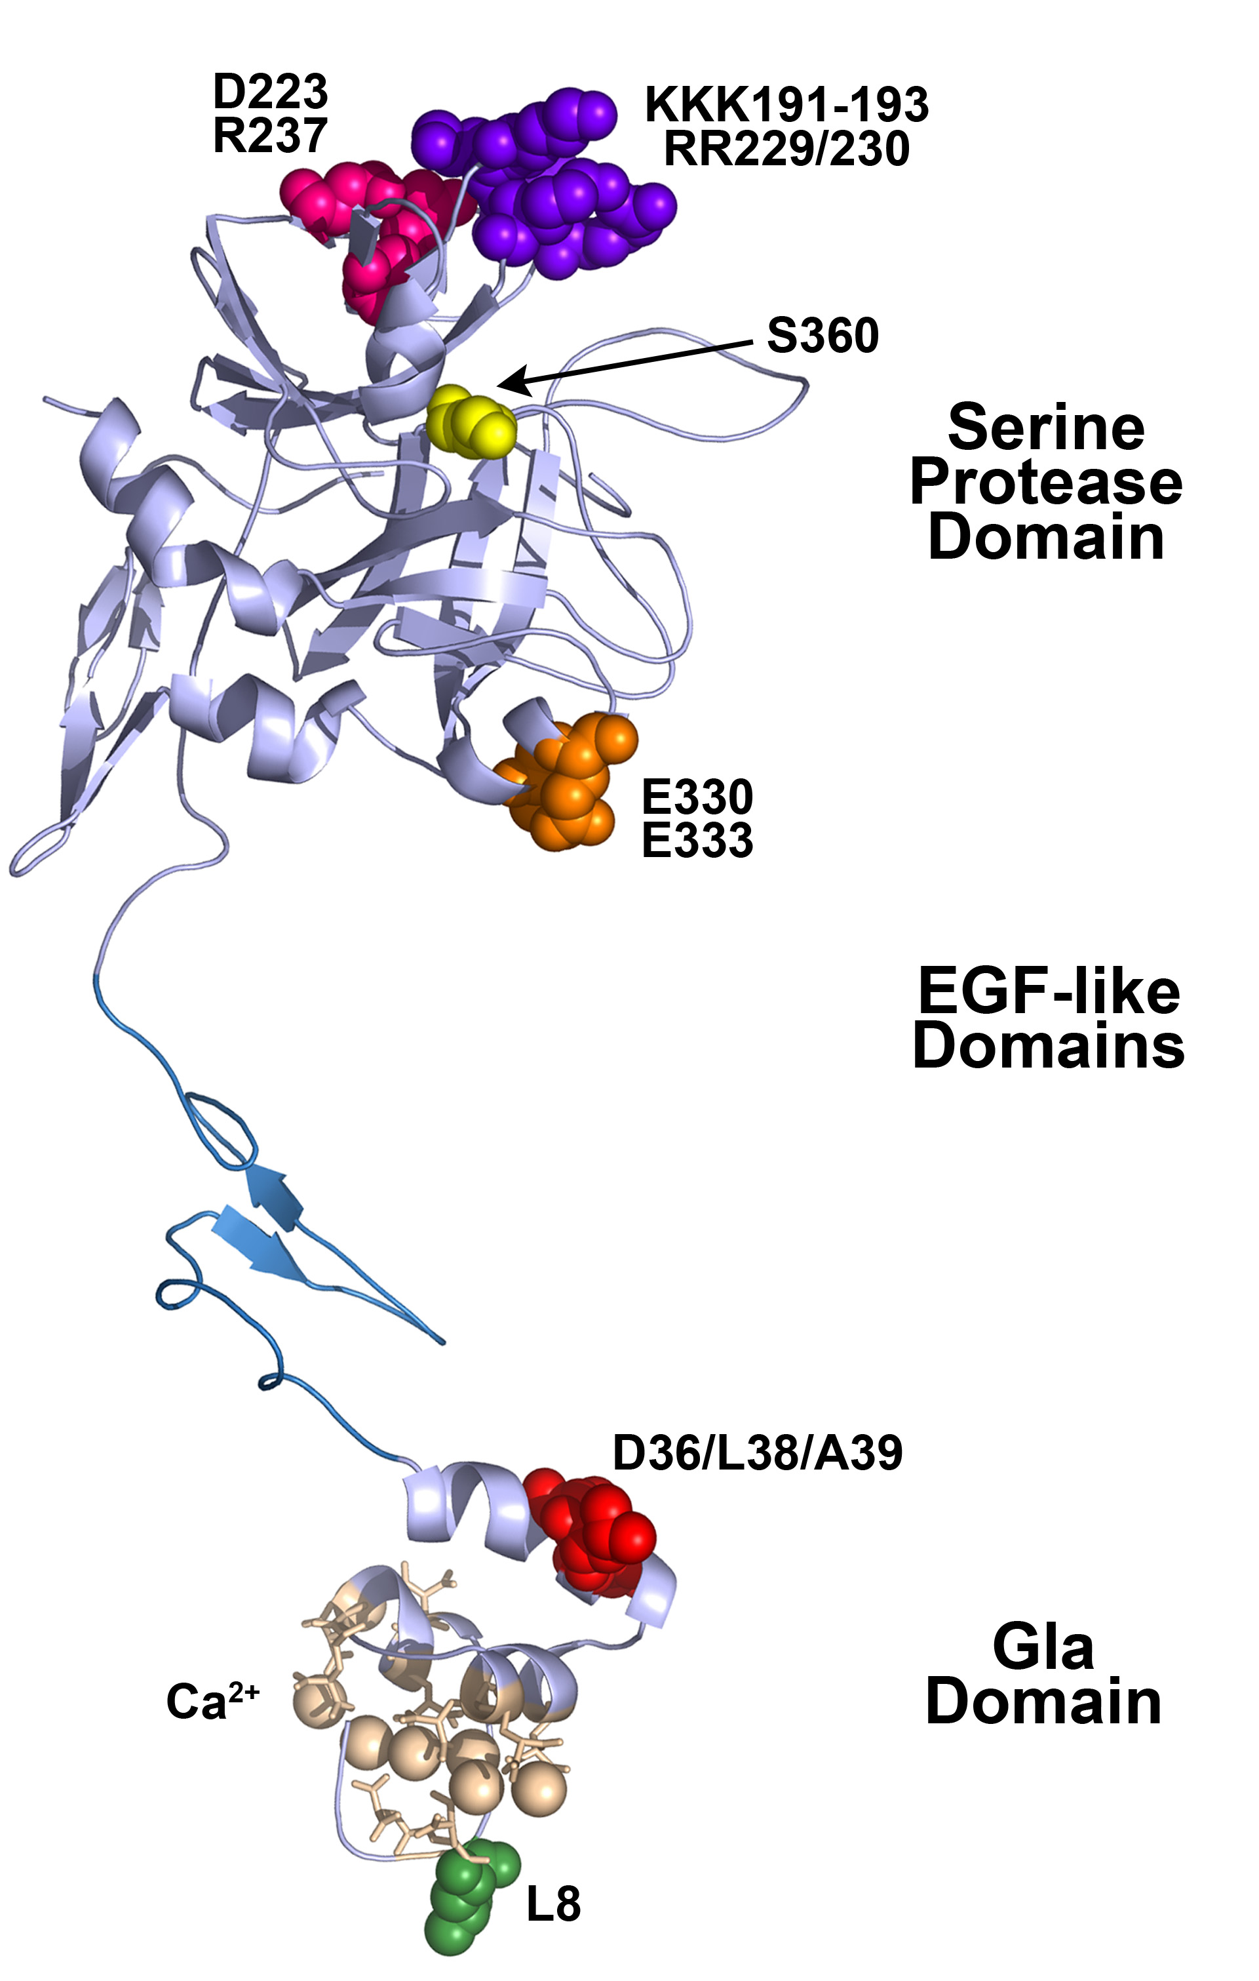
Haematology BSc
Introductory Course
Anticoagulant
Pathways
September 2012
Protein C
Dr Jim Crawley
Haematology Department
Imperial College London
j.crawley@imperial.ac.uk

Slide 2
Learning Objectives
Understand the different “stages” of coagulation
    i.e. initiation, propagation & termination
Understand how TFPI regulates the initiation of haemostasis
Understand how the protein C pathway regulates the propagation phase of coagulation
Understand how antithrombin regulates haemostasis
Understand why we need 3 different anticoagulant that target haemostasis in distinct ways

Slide 3
Haemostasis is a fine balance between pro- & anti-coagulant activities
Excessive procoagulant and/or inadequate anticoagulant function - thrombosis
Lo Anti Coag
Hi Pro Coag
Thrombosis
Notes:
3

Slide 4
Inadequate procoagulant and/or excessive anticoagulant function - bleeding
Lo Pro Coag
Hi Anti Coag
Bleeding
Notes:
4

Slide 5
Haemostasis is a fine balance between procoagulant and anticoagulant activities
Pro Coag
Haemostasis
Anti Coag
Thrombosis
Bleeding
Notes:
5

Slide 6
Haemostatic Plug Formation
Response to injury to endothelial cell lining
Formation of an unstable platelet plug
platelet adhesion
platelet aggregation
Limits blood loss + provides surface for coagulation
⇓
Stabilisation of the plug with fibrin
blood coagulation
Stops blood loss
⇓
Vessel repair and dissolution of clot
Cell migration/proliferation & fibrinolysis
Restores vessel integrity
Notes:
6

Slide 7
What are the requirements for the initiation of coagulation?
Fast (to rapidly prevent bleeding)
Specific (must only be activated upon requirement)
Regulated (must be controlled to prevent thrombosis)
Notes:
7

Slide 8
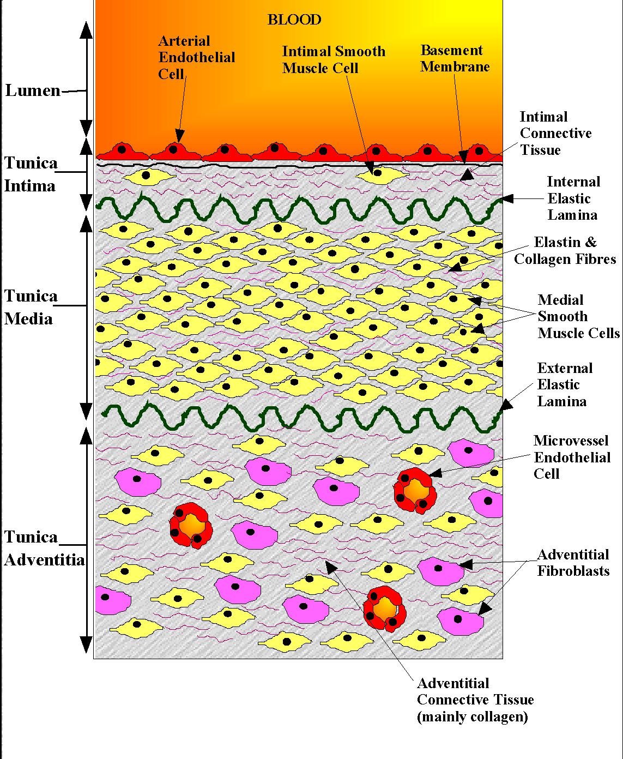
Lumen
EC - anticoagulant barrier
TM, EPCR, TFPI, GAG
Subendothelium - procoagulant
Basement membrane
Elastin, collagen
VSMC - TF
Fibroblasts - TF
Notes:
8

Slide 9
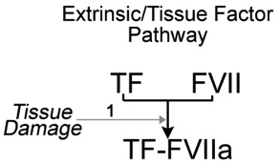
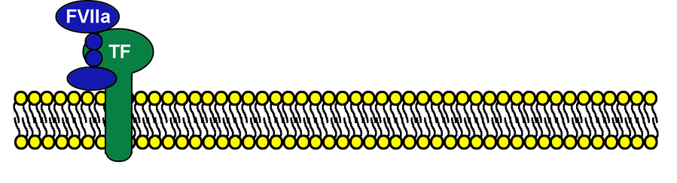
Initiation of Coagulation
FVII/FVIIa bind cell surfaces via Gla domain
All domains of FVII/FVIIa interact with TF
TF makes FVIIa 2x10⁶ times more active

Slide 10
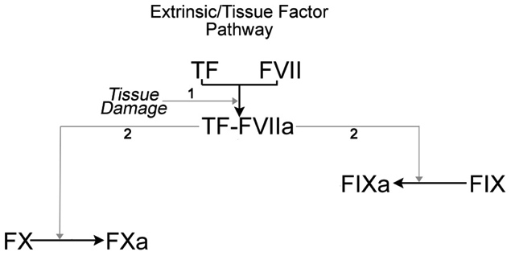
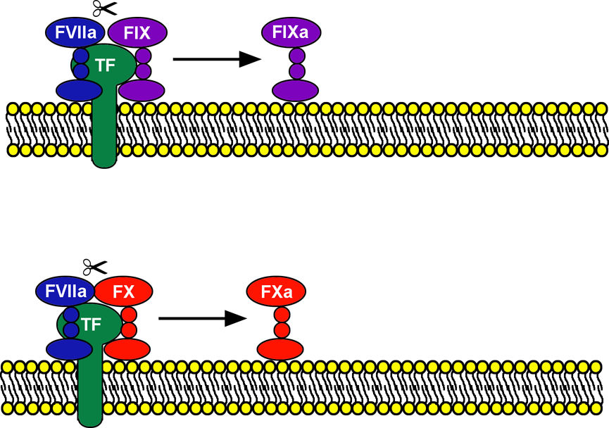
Initiation of Coagulation
TF-FVIIa proteolytically activates FX & FIX
Removes activation peptide to yield active enzyme

Slide 11
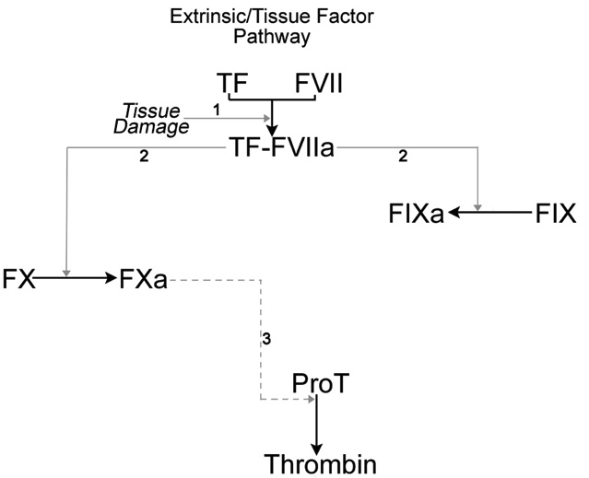
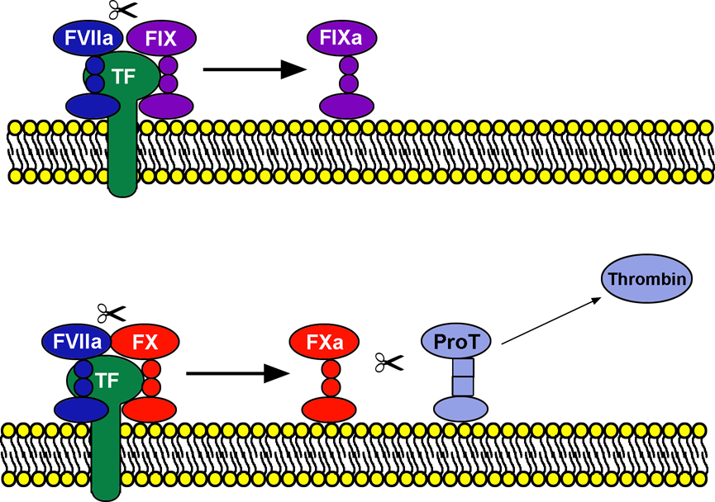
Initiation of Coagulation
FXa can activate prothrombin to generate thrombin
Activation is inefficient - only small quantities of thrombin are generated

Slide 12
Initiation of Coagulation
Initiation of Coagulation
FXa can activate prothrombin to generate thrombin
Activation is inefficient - only small quantities of thrombin are generated

Slide 13
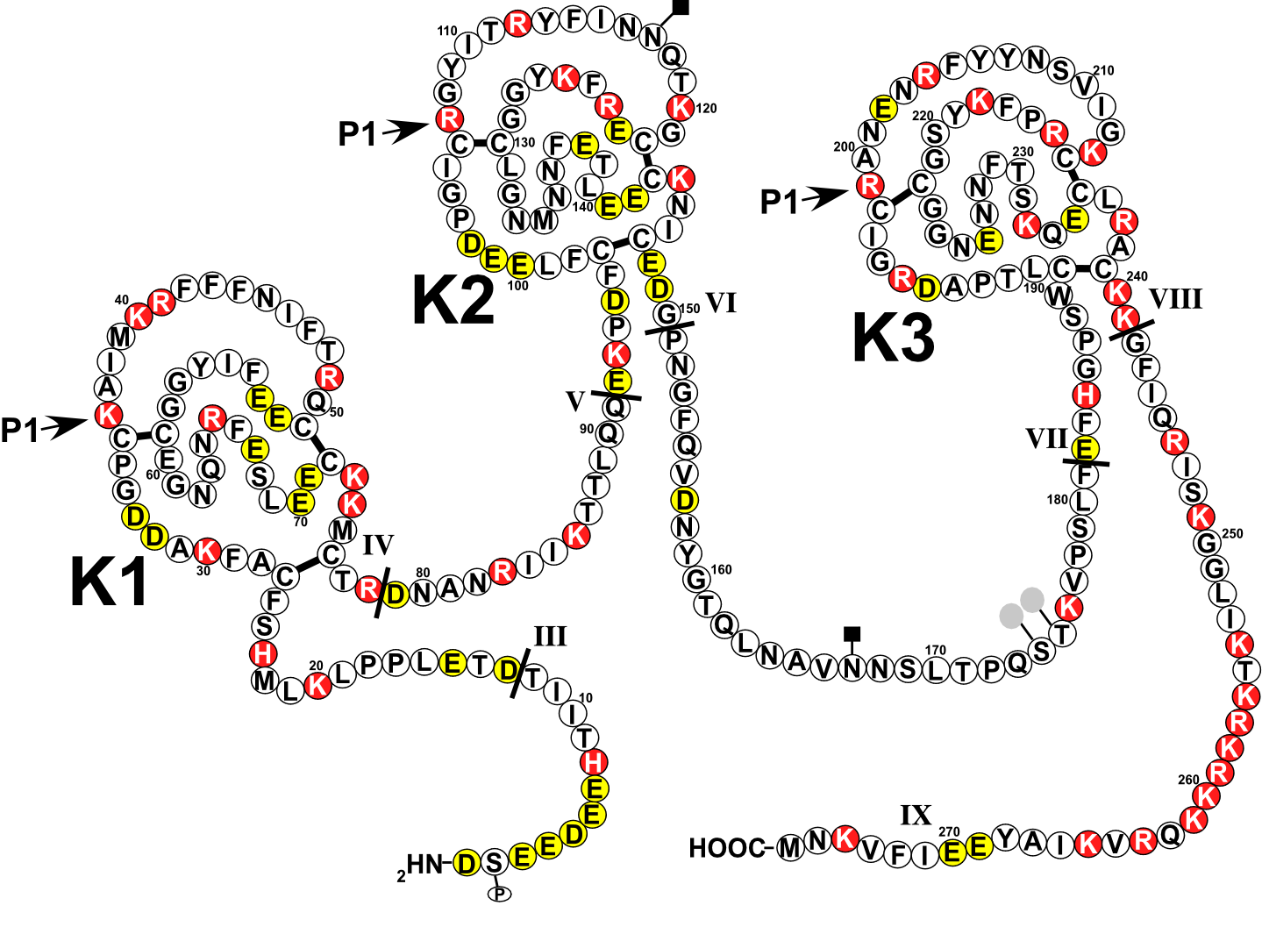
TFPI
43kDa Kunitz-type inhibitor
TFPI has 3x Kunitz domains
Basic residues
Acidic residues
Notes:
13

Slide 14
TFPI
TFPI inhibits TF-FVIIa in a FXa-dependent manner
Kunitz domain 2 binds and inhibits FXa
Kunitz domain 1 binds and inhibits TF-FVIIa
Inactive quaternary complex (TF-FVIIa/FXa-TFPI) has no procoagulant function
Notes:
14

Slide 15
Tissue Factor Pathway Inhibitor (TFPI)
Binds/inhibits FXa
Binds/inhibits TF-FVIIa
Basic residues
Acidic residues
Notes:
15

Slide 16
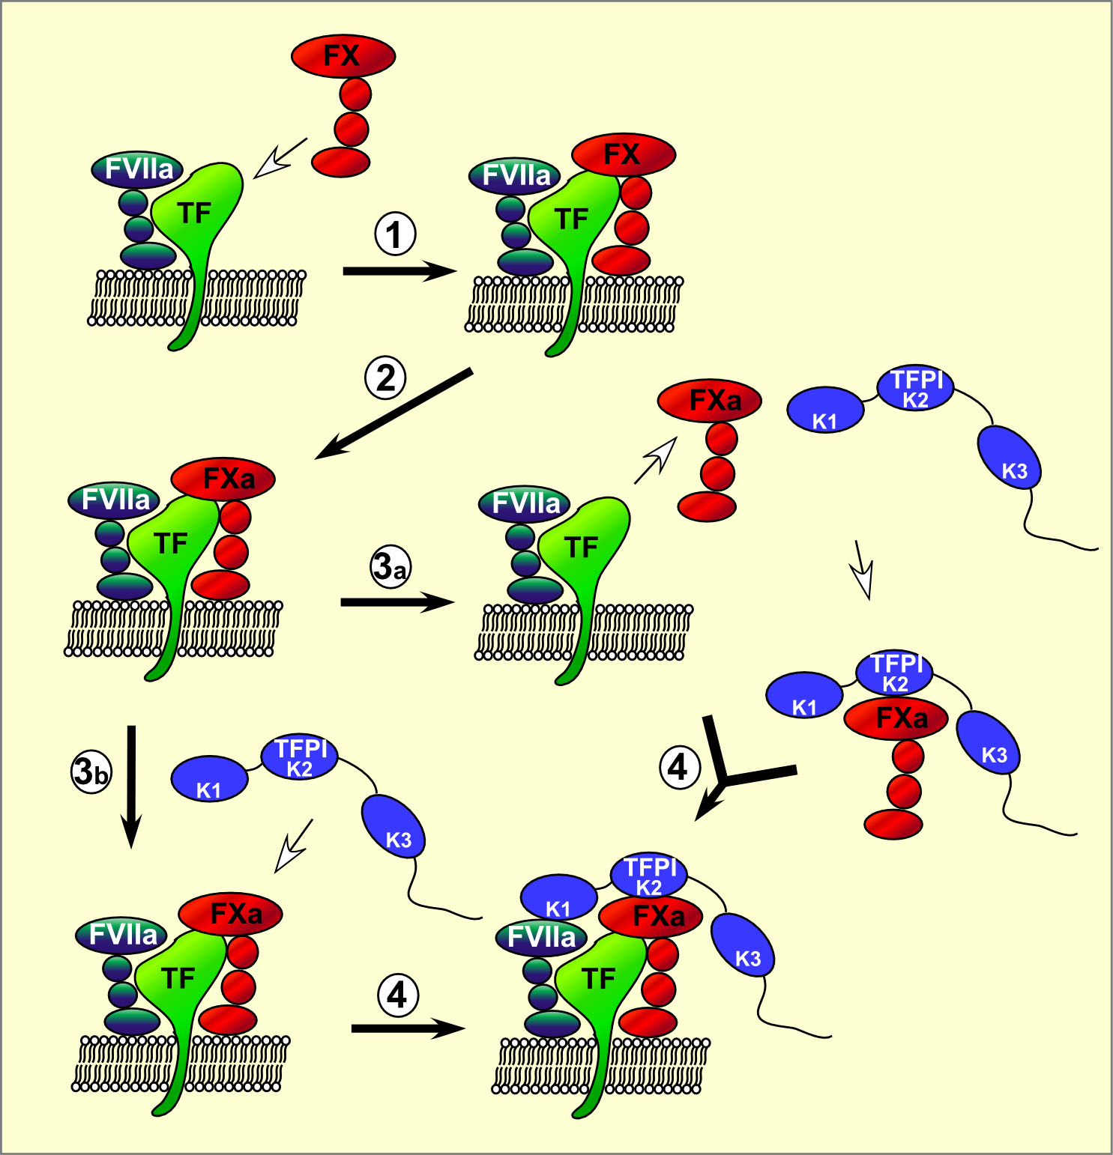
TFPI Function
TFPI-FXa can bind/inactivate TF-FVIIa active site via Kunitz domain 1 (K1)
Notes:
16

Slide 17
TFPI inhibits the initiation stage of coagulation
TFPI inhibits TF-FVIIa/FXa
TFPI threshold must be breached before coagulation can proceed efficiently
TFPI primarily influences the initiation of coagulation
Notes:
17

Slide 18
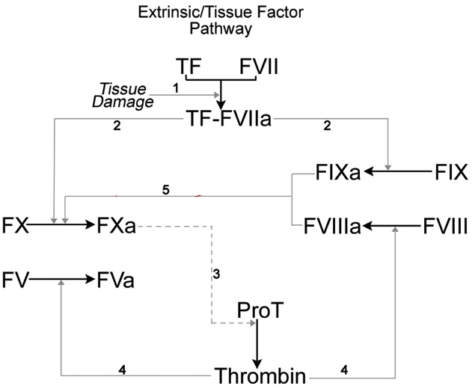
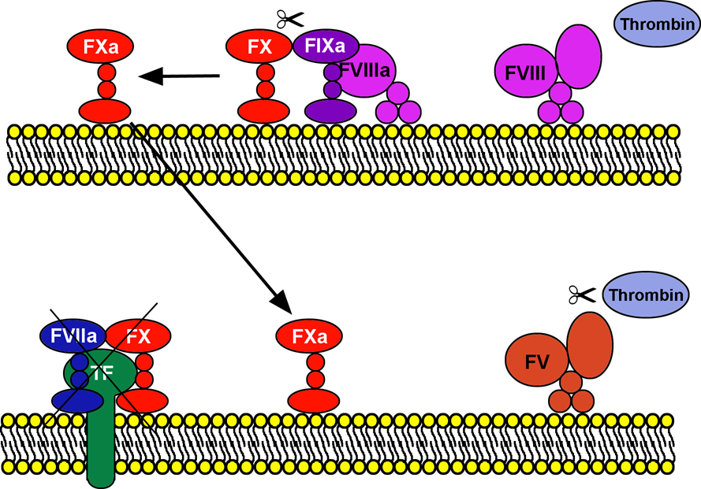
Propagation of Coagulation

Slide 19
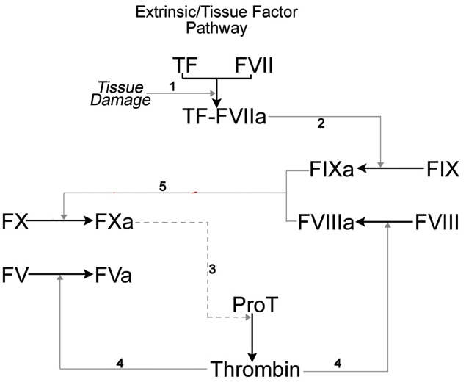
Propagation of Coagulation

Slide 20
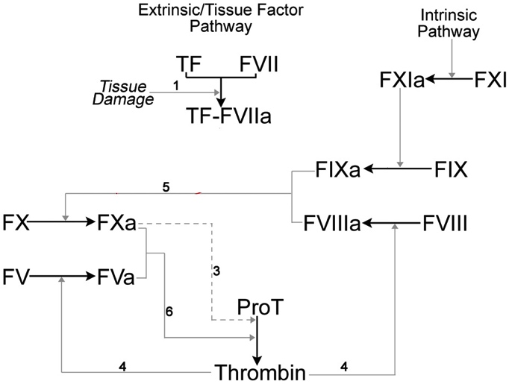
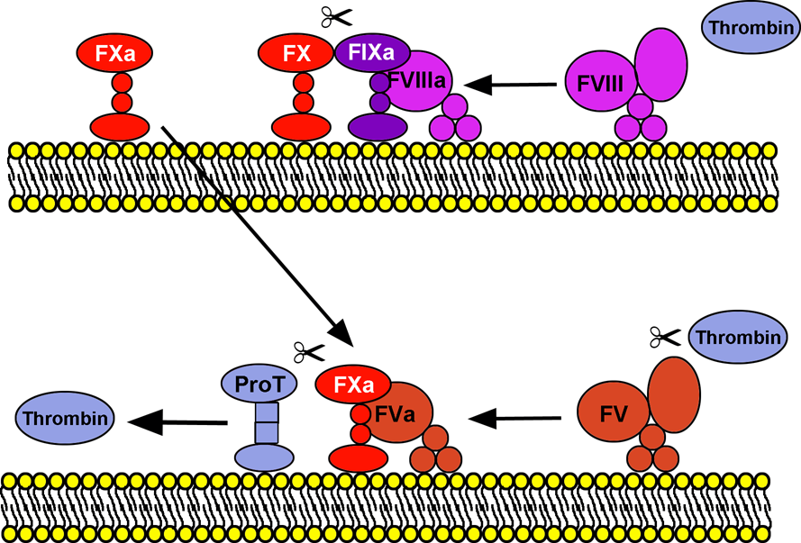
Propagation of Coagulation

Slide 21
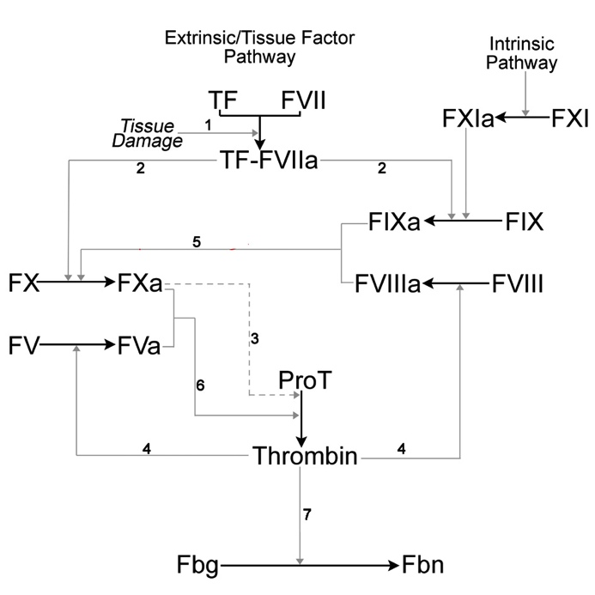
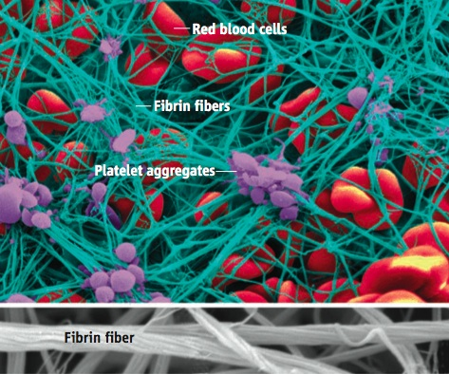
Propagation of Coagulation

Slide 22
Anticoagulant mechanism – 2 Protein C Pathway
Protein C pathway – Protein C is activated by thrombin-TM complex on EC
APC inhibits thrombin generation by proteolytically inactivating procoagulant cofactors FVa and FVIIIa
APC acts primarily upon the propagation phase of coagulation

Slide 23
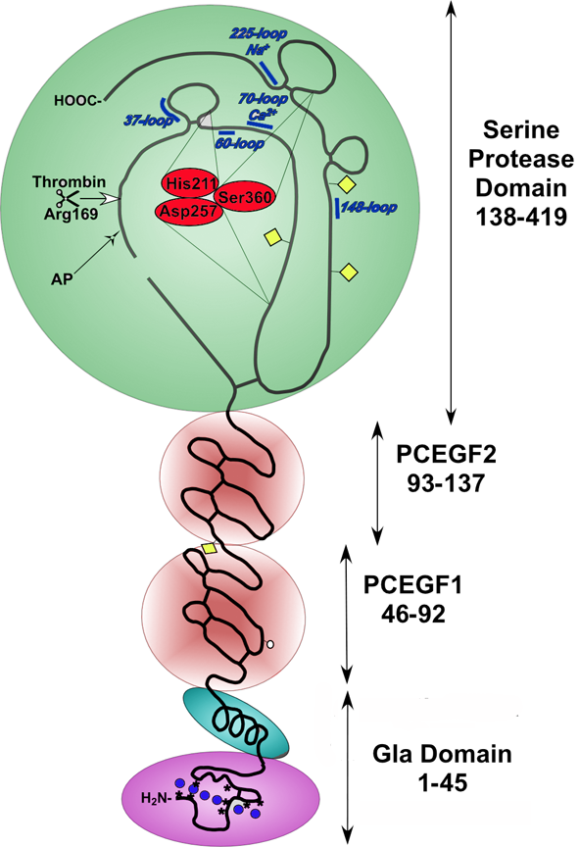
Protein C
Active
site
Vitamin K-dependent serine protease zymogen
Conserved domain structure with FVII FX, FIX
Expressed in the liver
Circulates in plasma (~65nM)
Activation peptide cleaved by TM-thrombin
Protein C is an inactive serine protease zymogen
Protein C requires activation before it can function as an anticoagulant
Gla domain binds PL, EPCR & protein S
Notes:
23

Slide 24
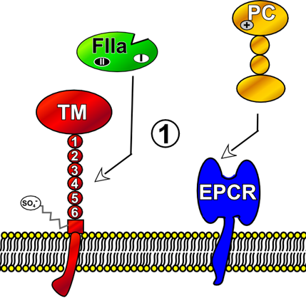
Protein C Activation
Serine protease
Cleaves fibrinogen to form fibrin
Notes:
24

Slide 25
Protein C Activation
Thrombin binds to TM with high affinity
Notes:
25

Slide 26
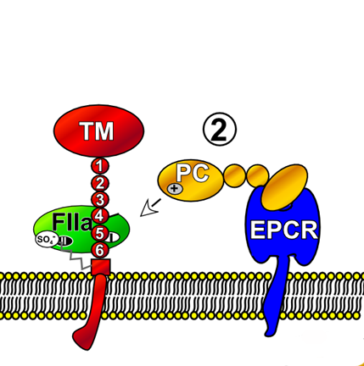
Protein C Activation
Serine protease
Cleaves fibrinogen to form fibrin
Activates protein C
Notes:
26

Slide 27
Protein C Activation
EPCR (endothelial cell protein C receptor)
Present on surface of endothelial cells
Protein C binds its receptor EPCR with high affinity
Notes:
27

Slide 28
Protein C Activation
Protein C localised to endothelial surface (where thrombin/TM are)
Notes:
28

Slide 29
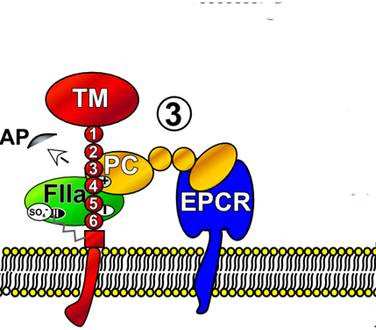
Protein C Activation
Thrombin cleaves protein C to release activation peptide
Activates protein C zymogen to APC (serine protease)
Notes:
29

Slide 30
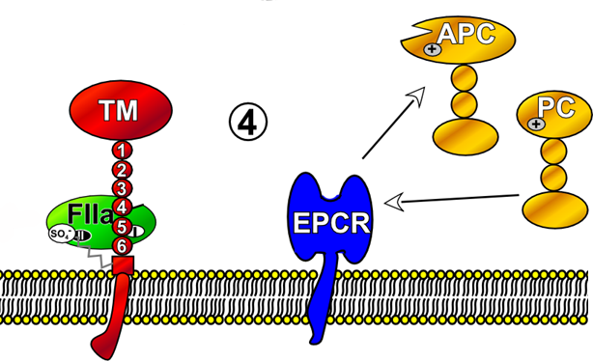
Protein C Activation
Notes:
30

Slide 31
How is does APC inhibit coagulation?
TF + FVIIa
FIXa
+
FVIIIa
FVIIIi
FX
FXa
+
FVa
FVi
Protein S
Activated Protein C
Protein C
Prothrombin
Thrombin
EPCR
Fibrinogen
Fibrin
Thrombomodulin

Slide 32
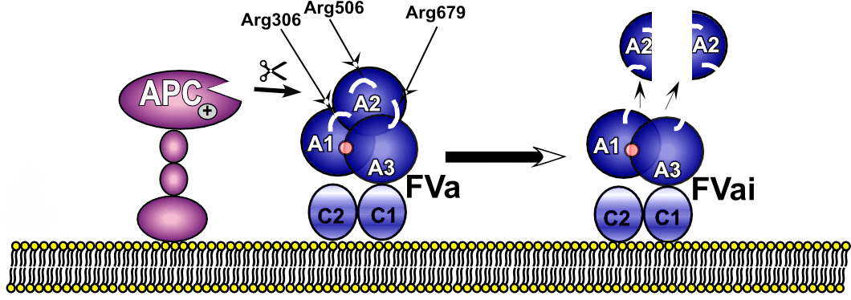
Inactivation of Factor Va By APC
FVai = inactivated FVa

Slide 33
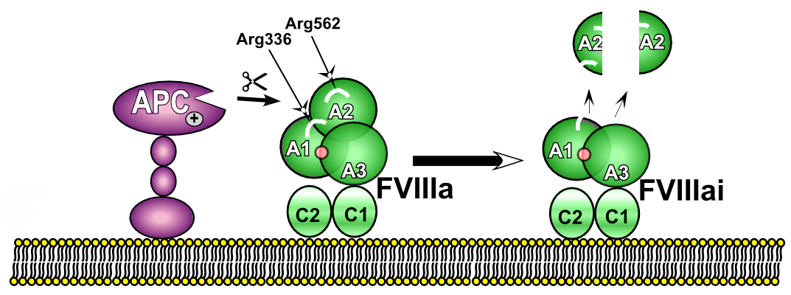
Inactivation of Factor VIIIa by APC
FVIIIai = inactivated FVIIIa

Slide 34
Protein S - APC cofactor
TF + FVIIa
FIXa
+
FVIIIa
FVIIIi
FX
FXa
+
FVa
FVi
Protein S
Activated Protein C
Protein C
Prothrombin
Thrombin
EPCR
Fibrinogen
Fibrin
Thrombomodulin

Slide 35
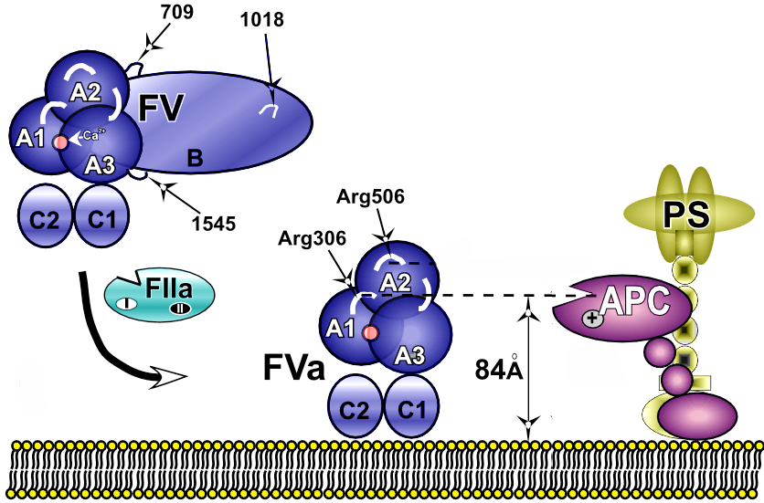
How Does Protein S Function?
Protein S binds to APC on platelet and endothelial cell surfaces and enhances inactivation of FVa (& FVIIIa)

Slide 36
Coagulation Cascade
TFPI regulates the initiation of coagulation
Protein C pathway regulates the propagation phase of coagulation by down-regulating thrombin generation – it does not inhibit thrombin
What happens to all the thrombin??
What stops coagulation occurring elsewhere??

Slide 37
Anticoagulant mechanism – 3 Antithrombin
Antithrombin (AT) is a 58kDa serine protease inhibitor (SERPIN)
AT circulates in plasma at high concentration (2.5mM)
AT inactivates many activated coagulation serine proteases (FXa, thrombin, FIXa, FXIa and FXIIa)
AT “mops up” and free serine proteases that escape the site of vessel damage.
AT is enhanced by GAGs/heparin
Thrombin is the most important/significant target

Slide 38
Anticoagulant mechanism – 3 Antithrombin
AT presents a “bait loop” to target proteases.
Bait loop contains “mock substrate”
Bait loop binds active site of target protease.
AT undergoes a conformational change that “locks” the target protease in an inactive complex
AT inhibits FREE proteases.
AT cannot inhibit proteases in complexes

Slide 39
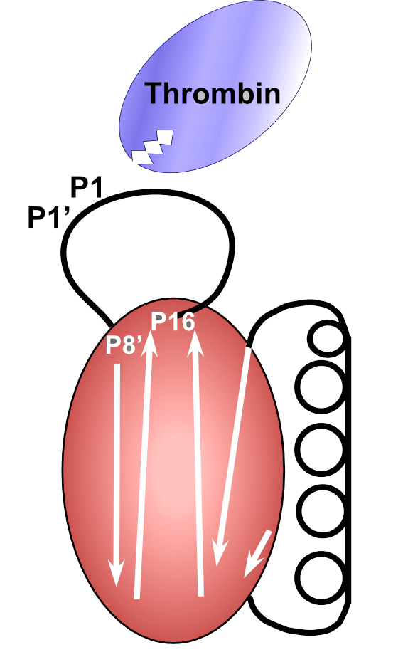
In the active conformation, AT presents the bait loop to protease

Slide 40
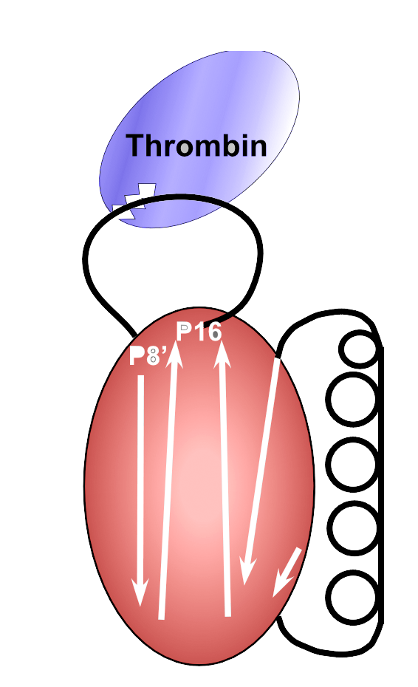
The bait loop (P1-P1’ residues) interact with the active site of the target protease

Slide 41
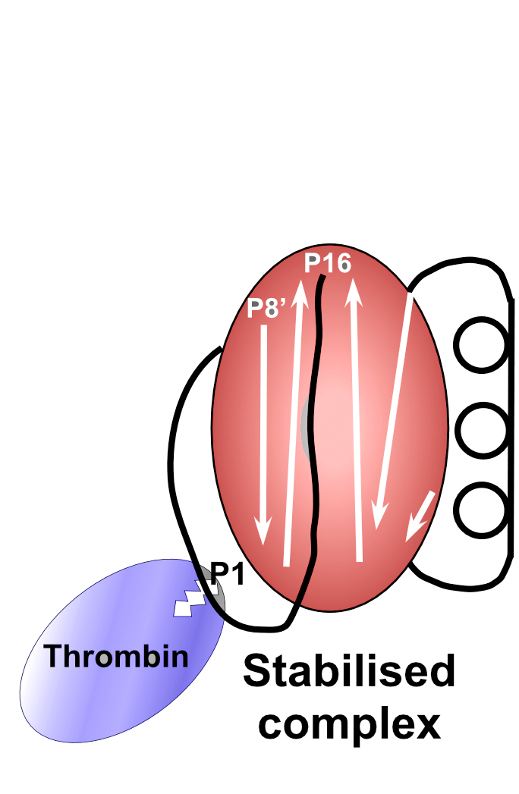
A large conformational change locks protease in an inactive 1:1 complex (T-AT)
During attempted proteolysis a covalent bond is formed with active-site serine

Slide 42
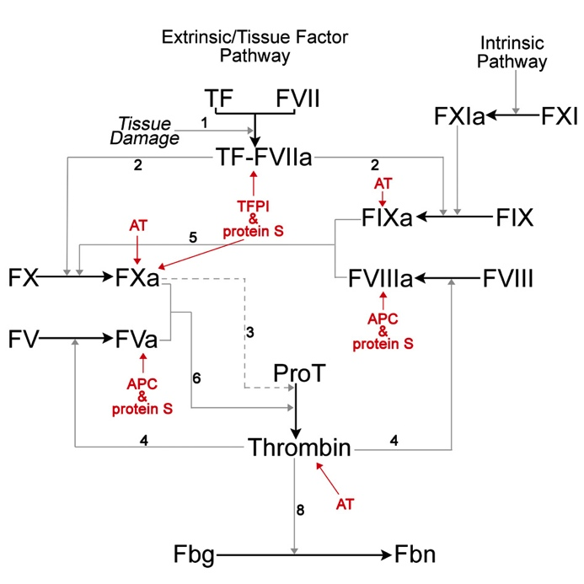

Slide 43
Inherited thrombotic disorders
FV Leiden
(1-5 in 100 caucasians)
Protein C deficiency
(3 in 1,000)
AT deficiency (1 in 2-5,000)
Protein S deficiency
(1 in 20,000)

Slide 44
Procoagulant therapies
TFPI inhibitor

Slide 45
Useful References
Review of TFPI
Crawley JT, Lane DA. The haemostatic role of tissue factor pathway inhibitor. 2007. Arterioscler Thromb Vasc Biol (In Press). Review
Review of the Protein C Pathway
Esmon CT; Biochimica et Biophysica Acta, 1477, (2000); pp349-360
Esmon CT; Chest, 124, (2003); pp26S-32S
Review of Antithrombin
Opal SM, Kessler CM, Roemisch J, Knaub S. Antithrombin, heparin, and heparan sulfate.
Crit Care Med. 2002 May;30(5 Suppl):S325-31. Review.

