Slide 1
BSc Gastroenterology & Hepatology 2012-13
Transcription and regulatory factors in GI malignancy
Friday 7 December 2012

Slide 2
Differentiation, Neoplasia
Normal Differentiation
Dysplasia
Metaplasia
Neoplasia

Slide 3
Gastrointestinal Cell Differentiation
What determines normal cell differentiation?
What specifies regional differences in the GI tract?
What changes lead to cancer?

Slide 4
Gene Expression
The human genome contains ~23,000 genes
Only a proportion are active at any time
Different subsets of genes are expressed

Slide 5
Differences in Gene Expression in Intestine
Tissues
  Large & small intestine: duodenum, jejunum & ileum
Cell types
  Mucosal, submucosal
Development
  Fetal, neonatal, adult
Differentiation
  Crypt / villus
  Normal, metaplastic & neoplastic
Physiology
  Fed, fasted & refed
Individual variations
  Dietary factors
  Genetic polymorphisms

Slide 6
Subsets of Genes Expressed in Different Cells
BASIC
METABOLISM
REPLICATION
EPITHELIAL
TRANSPORT
MOTILITY
HORMONE
SECRETION
ANTIBODY
PRODUCTION

Slide 7
Subsets of Genes Expressed in Different Small Intestinal Cells
CRYPT CELL
VILLOUS CELL
BASIC
METABOLISM
REPLICATION
EPITHELIAL
TRANSPORT

Slide 8
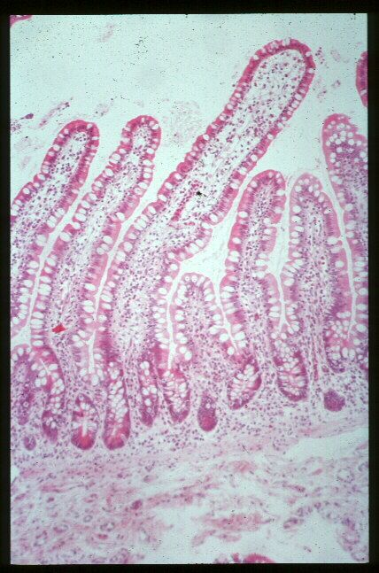
Cells of the Intestinal Mucosa
Enterocytes
Goblet cells
Enteroendocrine cells
Paneth cells
Stem cells

Slide 9
Rates of absorption of different nutrients along the small intestine
Duodenum
Jejunum
Ileum
Carbohydrates
Protein & Lipids
Iron & calcium
Bile salts
Cobalamin (B12)
Notes:
(AGA 12-45)

Slide 10
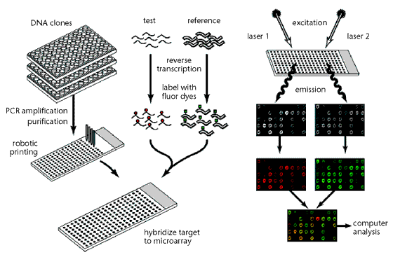
Expression Profiling using cDNA Microarrays
        David J Duggan et al. Nature Genetics 21, 10 – 14 (1999)

Slide 11
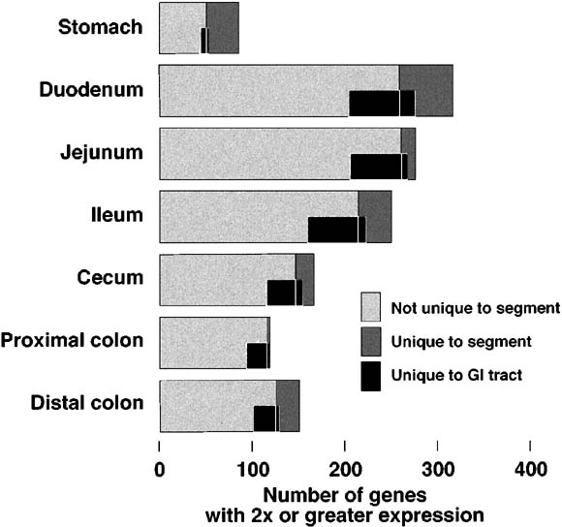
Microarray Study of Mice Gastrointestinal Genes
Bates et al. Gastroenterology 2002
Numbers of genes highly expressed in specific segments of the adult mouse GI tract.

Slide 12
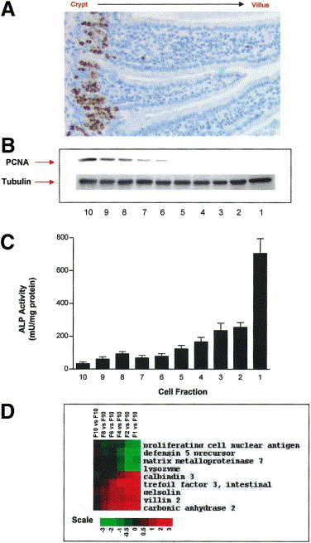
Microarray Study of Mice Intestinal Genes Expressed in Crypt and Villous Cells
Gene expression profiling of intestinal epithelial cell maturation along the crypt-villus axis
Mariadason et al. Gastroenterology 2005
14,685 unique genes
1113 differentially expressed genes
Changes demonstrated in genes for:
cell-cycle
RNA processing
cytoskeleton
Transport
Wnt pathway
(Myc ↓, MAD ↑, MAX↑ etc.)

Slide 13
Regulation of Gene Expression in the Intestine
Developmentally programmed transcription factors
Cellular Differentiation
  Cell age and position
Hormones & Receptors
  Membrane
    Kinase phosphorylation pathways
  Nuclear
    Steroid hormone family
    Orphan receptors
Direct Nutrient effects

Slide 14
Mechanisms of Regulation of Gene Expression
Chromatin structure
DNA methylation
Transcriptional activation
  Promoters / Enhancers
Post-transcriptional modifications
  Alternative splicing
  RNA stability
  Translational effects

Slide 15
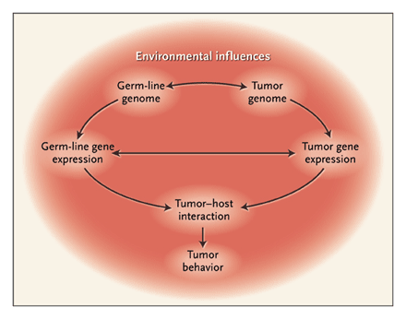
Molecular Origins of Cancer: Molecular Basis of Colorectal Cancer
S.D. Markowitz and M.M. Bertagnolli. N Engl J Med 2009; 361:2449-2460

Slide 16
Changes in Gene Expression in GI Neoplasia
Deletion / suppression of specific genes
Amplification / overexpression of specific genes
Microsatellite instability (MSI)
Chromosomal changes
  DNA aneuploidy
  Loss of heterozygosity

Slide 17
Genetic Abnormalities in Gastric Adenocarcinoma
ABNORMALITIES GENE APPROXIMATE FREQUENCY (%)
Deletion/suppression p53 60-70
FHIT 60
APC 50
DCC 50
E-cadherin <5
Amplification/overexpression COX-2 70
HGF/SF 60
VEGF 50
c-met 45
AIB-1 40
β-catenin 25
k-sam 20
ras 10-15
c-erb B-2 5-7
Microsatellite instability (MSI) 25-40
DNA aneuploidy 60-75

Slide 18
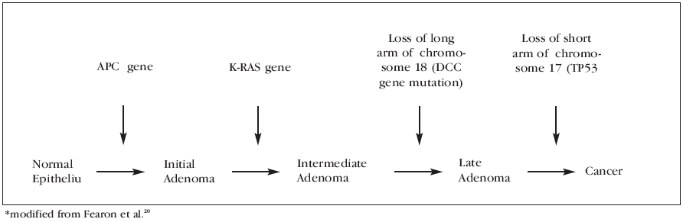
Genetic Abnormalities in Colorectal Adenocarcinoma
Classic ‘Vogelgram’

Slide 19
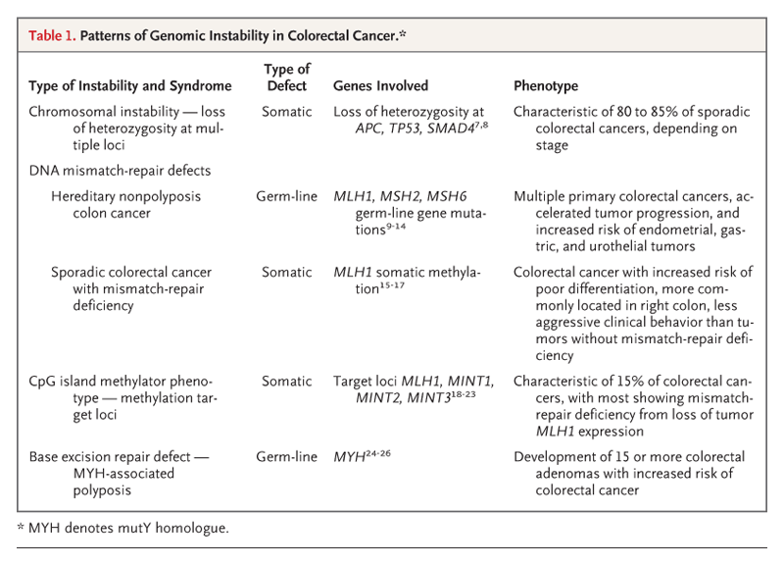

Slide 20
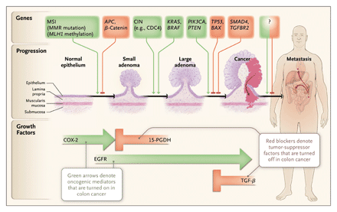

Slide 21
Genetic Abnormalities in Colorectal Adenocarcinoma
GENE | CHR | % | CLASS | FUNCTION
K-ras | 12 | 50 | Proto-oncogene | Encodes guanine nucleotide-binding protein that regulates intracellular signalling
APC | 5 | 70 MSS 25 MSI* | Tumour suppressor | Regulation of β-catenin* involved in activation of Wnt/TcF signalling (activates c-myc, cyclin D1); * regulation of proliferation, apoptosis. Interaction with E-cadherin (? cell adhesion)
DCC | 18 | 70 | ? Tumour suppressor | Netrin-1 receptor; caspase substrate in apoptosis; cell adhesion
SMAD4 (DPC4, MADH4) | 18 | ? | Tumour suppressor | Nuclear transcription factor in TGF-β1 signalling; regulation of angiogenesis; regulator of WAF1 promoter; downstream mediator of SMAD2
p53 | 17 | 75 | Tumour suppressor | Transcription factor; regulator of cell cycle progression after cellular stress, of apoptosis, of gene expression, and of DNA repair
hMSH2/hMHL1/ hMLH6 | 2/3/2 | 15 | DNA mismatch repair | Maintains fidelity of DNA replication
TGF-β1 RII | 3 | 55-90 | Tumour suppressor | Receptor for signalling in the TGF-β1 pathway; inhibitor of colonic epithelial proliferation, often mutated in tumours with MSI

Slide 22
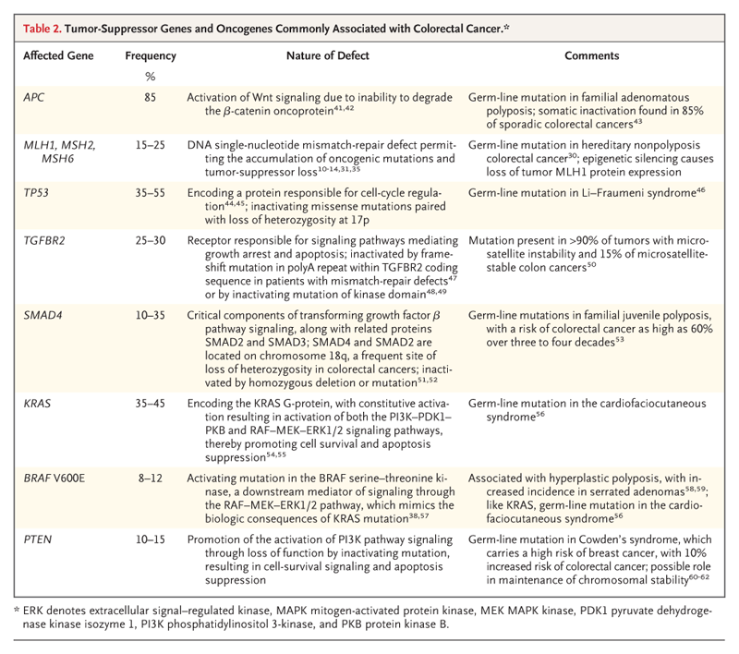

Slide 23
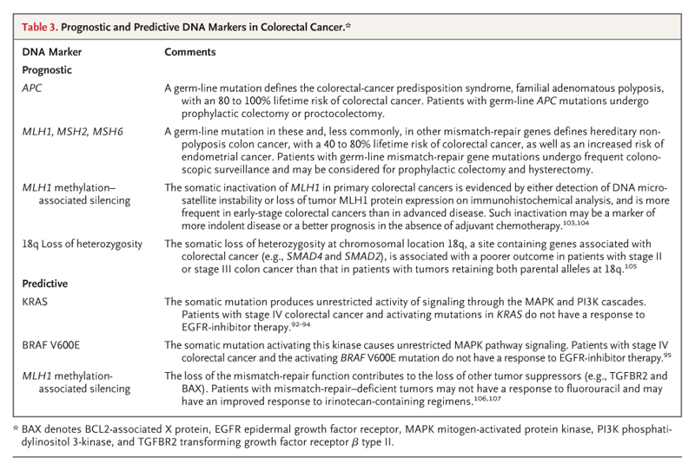

Slide 24
Regulation of gene expression
Critical role of transcription factors

Slide 25
Transcription Factors studied in Intestine
Zn-finger
  Steroid hormone family
    Glucocorticoid
    Thyroid
    Vitamin D
    Retinoid, RAR, RXR, etc.
  Orphan receptors
    HNF4
    FXR
    PPAR-γ, -δ
    Krüppel Like Factors
    GATA-4, -5, -6
Homeobox factors
  Hox
  Para-Hox
    Cdx2, Cdx1, Pdx-1. etc.
  HNF1
Others
  C/EBPα
  Winged helix factors
    Fork head homologue 6, 11
    HNF3
  Sp1, Sp3
  c-Fos, c-Jun
  TCF/SOX

Slide 26
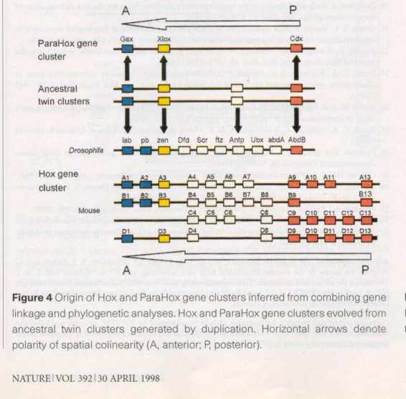
Hox and Parahox Gene Organization

Slide 27
STUDIES OF HOMEOBOX GENES
Roles in development
  Patterns of expression
    Segmental
    Developmental
  Key roles in the determination of regional cellular differentiation
Activation of Gene Transcription
  Identification of regulated genes
  DNA-binding sites
    TAAT motif as core element
  Co-activator requirements
Changes in metaplasia and neoplasia

Slide 28
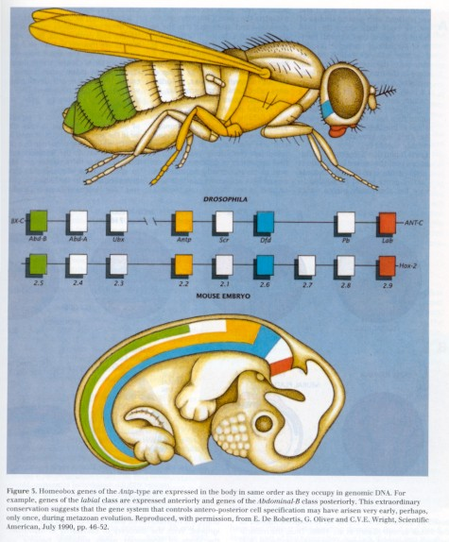
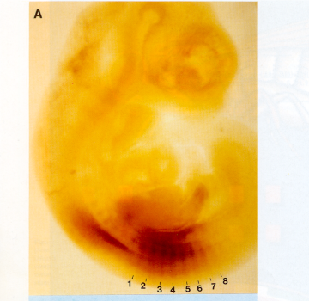
Hox Gene Expression in Development

Slide 29
CDX1
Roles in Development
  Homeotic transformation of vertebrae in KO mice
        Subramanian et al 1995
Gene Transactivation
  Hoxa-7
  Sucrase-isomaltase, intestinal phospholipase A
Expression in normal, metaplastic and neoplastic tissue
        Silberg et al 1997

Slide 30
Expression of CDX1 in normal Gastrointestinal tissues
A = Oesophagus
B =Stomach
C = Small intestine
D = Colon
From Silberg et al., Gastro 1997

Slide 31
Expression of CDX1 in Gastrointestinal Metaplasia
Barrett’s
Gastric
From Silberg et al., Gastro 1997

Slide 32
Expression of CDX1 in Colonic Neoplasia
A = Normal & adenoma
B = Adenocarcinoma
C & D = Juvenile polyps
From Silberg et al., Gastro 1997

Slide 33
CDX2: Intestinal Cell Differentiation
Expressed in villous cells in small and large intestine
Over-expression produces small intestinal phenotype
Knock-out in mice:
  Homozygous lethal
  Heterozygous: SI hamartomas
Colorectal carcinomas
  No clear association with genetic differences
        Sivagnanasundaram Br J Cancer 2001
  Absent in large cell minimally differentiated carcinomas
        Hinoi et al Am J Pathol 2001

Slide 34
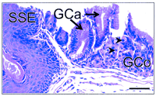
CDX2: Roles in Development
CDX2 knock-out mice:
  Homozygous lethal
  Heterozygotes
    Multiple intestinal tumours
    Intercalary growth in polyps
        Chawengsaksophak et al. Nature 1997
        Beck et al. PNAS 1999

Slide 35
CDX2: Differentiation
Differentiation effects in intestinal cell lines
    CDX2 expression in IEC-6, HT-29 & TC7 cells
    changes morphology, decreases growth
    increases sucrase, APC, E-cadherin, integrin b4, laminin, HOXA9 expression
    increase in extracellular matrix-mediated differentiation
        Suh & Traber MCB 1996
        Lorentz et al JCB 1997

Slide 36
CDX2: Changes in CRC Metaplasia and Neoplasia
Expression studies
    in adenoma-carcinoma sequence
    CRC cell lines
Mutated CDX2
    No clear association of CRC with SNPs
        Sivagnanasundaram Br J Cancer 2001
CDX2 is absent in large cell minimally differentiated carcinomas
        Hinoi et al Am J Pathol 2001
CDX2 expression downregulated by activated oncogenic ras
    Signalling via PKC activation, decreasing c-Jun
        Lorentz et al Oncogene 1999

Slide 37
CDX-2: Gene Transactivation
Experimental evidence for activation of transcription for these intestinal expressed genes :
  Sucrase-isomaltase
  Lactase-phlorizin hydrolase
  Carbonic anhydrase 1
  Apolipoprotein B
  Intestinal Phospholipase A / lysophospholipase
  Proglucagon
  Vitamin D receptor
  Calbindin-D9k
  Ileal bile acid binding protein

Slide 38
Hedgehog targets
Hedgehog
(Shh, Ihh)
Patched
Cyclopamine
Smo Gli
Many genes

Slide 39
Hedgehog pathway
Activation of Hedgehog pathway in many tumours
  Gorlin's syndrome (Patched receptor activation)
    skin, skeletal muscle, cerebellar tumours
  Digestive tract (increased SHH / IHH expression)
    oesophageal
    stomach
    pancreatic
    biliary
    (not colonic)
        Berman et al. Nature 2003
        Thayer et al. Nature 2003
Interaction of the Hedgehog, Wnt and BMP4 systems
  IHH in differentiated colonocytes
  downregulation of Tcf4 & β-catenin
        Van der Brink et al. Nat Genet 2004

Slide 40
APC, β-Catenin, Wnt, SOX9
APC targets β-Catenin for degradation
β-Catenin/TCF functions as transcription factor
Loss of APC increases Wnt pathway activity
Increased Wnt pathway activity in colorectal and other GI cancer
SOX9
  important intestinal crypt transcription factor
  increased in CRC cell-lines
  reduced CDX2 and MUC2 expression

Slide 41
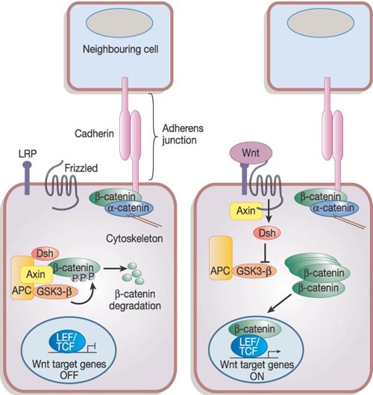
Wnt
Reya & Clevers. Wnt signalling in stem cells and cancer. Nature 2005; 434, 843-850
Canonical Wnt signalling pathway

Slide 42
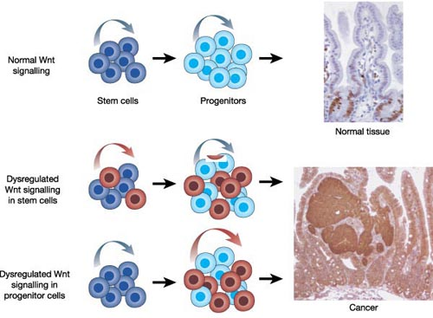
Wnt and CRC
Reya & Clevers. Wnt signalling in stem cells and cancer. Nature 2005; 434, 843-850
Activation of Wnt cascade in CRC
(mutations in APC or other genes in pathway)
Excess unregulated proliferation

Slide 43
Wnt targets in the intestine
Wnt
(4,6,11,14b, etc.)
Frizzled + LRP5/6 Dkk1
β-catenin APC
+
Tcf4 + Lef
Sox9
c-Myc EphB3 CDX2
MUC2
Many other genes

Slide 44
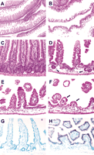
Effects of Overexpression of Dickkopf-1
Dkk1 is a secreted Wnt inhibitor.
Transgenic mice created which overexpress DKK1.
Wnt signals drive proliferation in crypts
Pinto et al. 2003
Dkk1 ectopic expression deleteriously affects crypt–villus organization.
Representative sections of the small intestine from wild-type (A,C) and transgenic (B,D–F) adult animals stained with hematoxylin/eosin.
The number and the size of crypts and villi are drastically reduced in the transgenic mucosa to rare residual crypt-like structures (arrowheads in D) or few residual villi (arrows in F).
In situ hybridization analysis of small intestine sections from wild-type (G) and transgenic (H) mice hybridized with a Dkk1 antisense RNA probe. Note that Dkk1 is only expressed in the transgenic epithelium.

Slide 45
Frequent epigenetic inactivation of DICKKOPF family genes in human gastrointestinal tumors
Sato et al. Carcinogenesis 2007
Summary of DKK methylation in cancer cell lines and primary tumors
 | DKK1 (%) | DKK2 (%) | DKK3 (%)
Cell lines
Colorectal | 3/9 (33) | 9/9 (100) | 5/9 (56)
Stomach | 6/16 (38) | 15/16 (94) | 10/16 (63)
Hepatocellular | 0/10 (0) | 3/10 (30) | 1/10 (10)
Pancreatic | 1/9 (11) | 4/9 (44) | 2/9 (22)
Primary tumors
Colorectal Cancer | 7/58 (12) | 45/58 (78) | 12/58 (21)
Colorectal adenoma | 1/29 (3) | 24/29 (83) | 7/29 (24)
Gastric Cancer | 15/31 (48) | 26/31 (84) | 12/31 (39)

Slide 46
Bone Morphogenetic Proteins
Bone morphogenetic proteins
(BMP2, BMP4)
Noggin
BMPRIa / BMPRIb + BMPRII
PTEN
Smad
(1,4,5,8)
PI3K
Akt
β-catenin
Many genes

Slide 47
Bone Morphogenetic Proteins
Part of TGF-β family
  BMP2 in colonocytes
BMP receptors act via Smad4 and PTEN
Mutations in BMPR1A, Smad4 and PTEN found in
  Juvenile Intestinal Polyposis syndromes
    (not FAP or Peutz-Jegher's syndrome)
BMPs control duplication of stem cells (prevent crypt fission)
Wnt required for stem cell activation and self-renewal
        He et al. Nat Genet 2004

Slide 48
Differences in Gene Expression in Intestine
Tissues
  Large & small intestine: duodenum, jejunum & ileum
Differentiation
  Crypt / villus
  Normal, metaplastic & neoplastic
Representative Transcription Factors
  Hox
  CDX1 / CDX2
Signalling pathways
  Hedgehog
  APC / β-catenin / Wnt
  BMP

