Slide 1
Serum markers in the assessment of liver disease
Sudeep Tanwar
Research Fellow & Specialist Registrar
UCL Institute of Liver & Digestive Health

Slide 2
Overview
Role of quantifying fibrosis in the assessment of CLD
“Problems” of the reference standard
Serum marker development
Assessing diagnostic accuracy
Use of diagnostic thresholds
Alternative uses of serum markers

Slide 3
Background
CLD now 5th commonest cause of death in UK
Due to:
            Obesity
            EtOH
            Viruses- HBV, HCV
            Autoimmune
            Metabolic
            Vascular
            Toxins

Slide 4
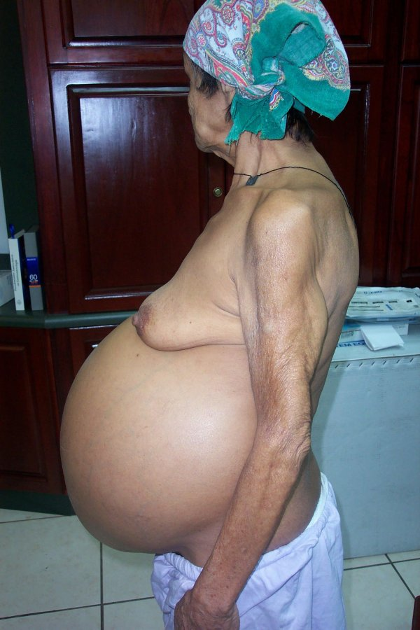
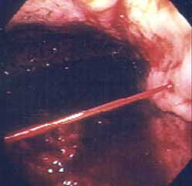
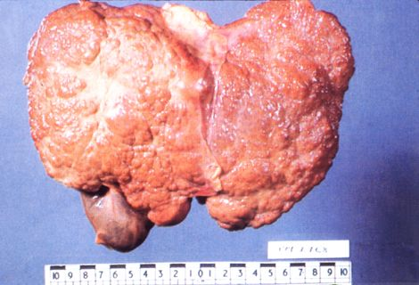
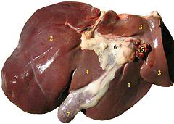

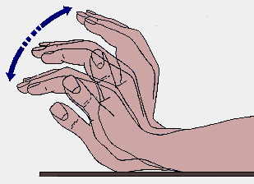
Mortality from CLD
Complications of Cirrhosis

Slide 5
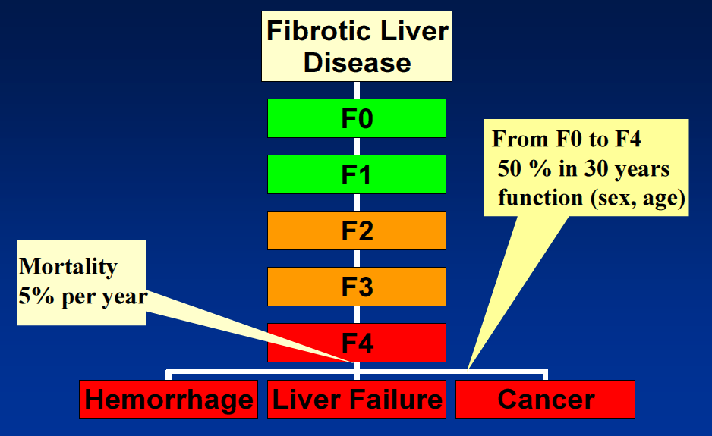
Fibrosis Progression

Slide 6
Assessment of Fibrosis
& Liver Biopsy
Detection of progressive fibrosis in chronic liver disease requires systematic testing of at risk individuals
Routine clinical criteria are insensitive (<20%)
Standard blood tests are insensitive (<20%)
Standard imaging e.g. CT, MRI, ultrasound are insensitive (<20%)
Reference test is liver biopsy

Slide 7
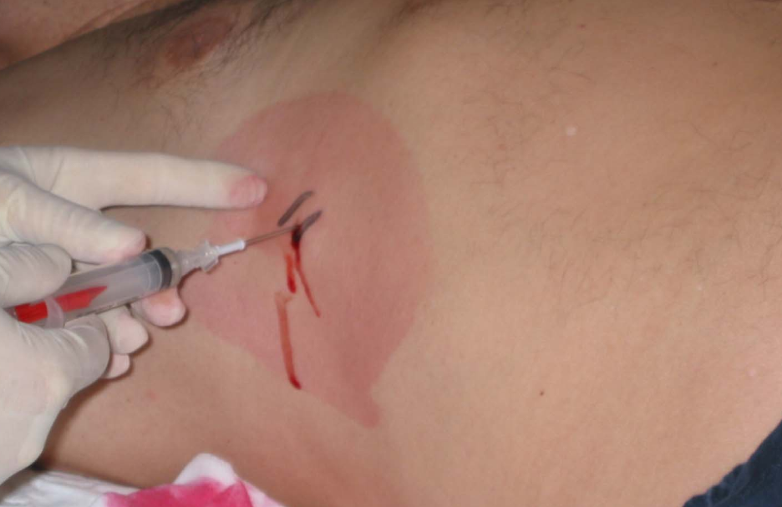

Slide 8
Liver biopsy – the process
The Problems

Slide 9
Complex and Costly
Admit the patient
Imaging
Obtain the biopsy
  Hepatologist or radiologist
Transport the biopsy
  Porters
Processing and staining
  Pathology technicians
Examine and score
  Pathologists
£1500-£2000

Slide 10
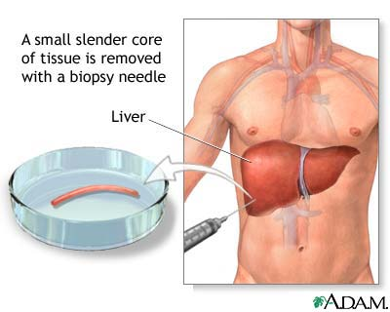
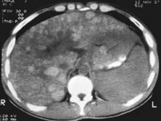
Sampling error
Focal Fatty Sparing
1/50,000 of the Liver

Slide 11
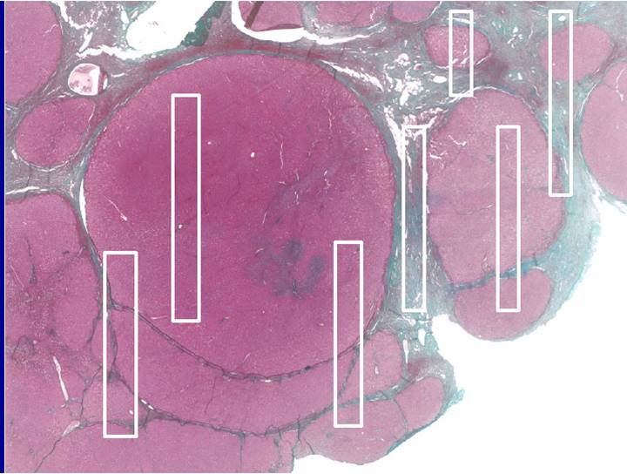
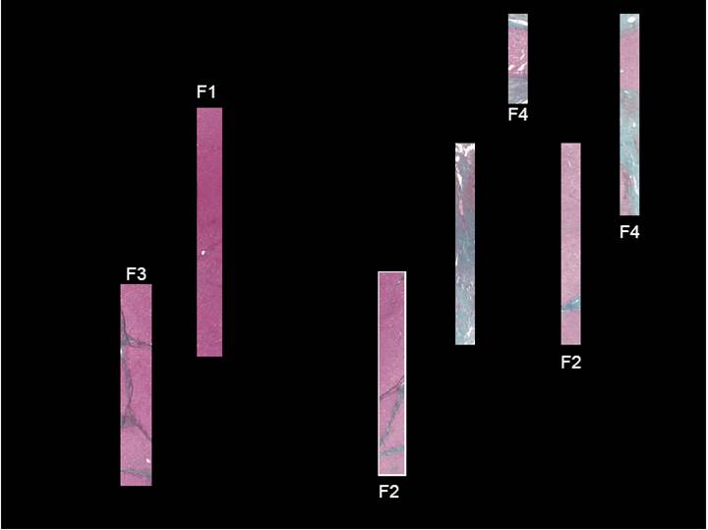
Sampling error

Slide 12
Complications of liver biopsy
Pain 0.056-22%
Haemorrhage 0.03-0.7%
Biliary peritonitis 0.03-22%
Lung biopsy 0.001-0.014%
Gall bladder biopsy 0.034-0.117%
Kidney biopsy 0.096-0.29%
Haemothorax 0.18-0.49%
Mortality 0.008-0.3%

Slide 13
Agreement between Histologists
Expertise counts
  Experts v “Routine Pathology” K=0.48 v 0.15
Experience counts
  Senior v Junior experts K=0.6 v 0.5
  Rousselet MC Hepatol 2005 41:252-64
Size matters
  65% correct classification of stage with 15mm
  75% correct with 25mm
  Bedossa P Hepatology 2005 38:1356-8
Errors in NAFLD
  30% by >2 Stages
    Ratziu Gastro 2005 128:1898-1906

Slide 14
Staging Systems
Mild
Moderate
severe
Ordinal categorical variables
Categories are not evenly distributed

Slide 15
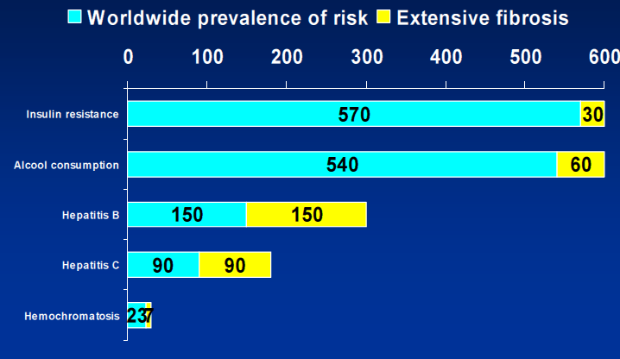
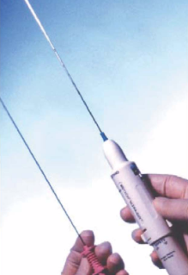
Population at Risk of Liver Fibrosis, Cirrhosis and HCC

Slide 16
The Ideal Test
Safe
Accurate assessment of the whole liver
Reproducible
Repeatable
Generates a continuous variable
Remote from specialist and patient
Cheap

Slide 17

Non-Invasive Tests for Liver Fibrosis
Imaging e.g. Elastography
  Accurate
  Time consuming
  Fails in 10-20% of cases
  Not widely available or
  systematically applied
Blood tests
  Non –invasive serum markers

Slide 18
Non-invasive serum Marker Discovery
Candidate Approach
  Identifying targets known to be involved in the biological process in question
    Indirect e.g. AST, Billirubin, INR
    Direct e.g. HA, Collagen
Discovery Approach
  Aims to identify novel markers by techniques such as MR spectroscopy
  Little clinical success thus far

Slide 19
Indirect Biomarkers
Cheap
Composed of Standard Demographic and Laboratory variables
Can be calculated without the need for expensive & patented assays
Examples:
APRI (ALT /PLT x 1000)
Fib-4 (age [yr] x AST [U/L]) / ((PLT [109/L]) x (ALT [U/L])1/2)

Slide 20
Direct Biomarkers
More Expensive
Composed of measurement of proteins involved in hepatic fibrogenesis
Assays more expensive and formulae often patented
Examples:
  Hyaluronic Acid (HA)
  ELF (HA,TIMP1, PIINP)
  Fibrospect II (HA, TIMP1, A2M)

Slide 21
Diagnostic Targets

Slide 22
Diagnostic Targets in
Clinical Practice
Requires dichotomising the diagnostic target:
  Detection of any fibrosis: F0 Vs. F1-F4
  Detection of mild fibrosis: F0-1 Vs. F2-4
  Detection of advanced fibrosis: F0-2 Vs. F3-4
  Detection of cirrhosis: F0-3 Vs. F4
In truth these categories are artificial as liver fibrosis is a continuous phenomenon

Slide 23
Assessment of Test Performance
Marker Result | Truth State
 | Positive | Negative
Positive | A | B
Negative | C | D
Ideal situation: e.g. 100 patients tested for cirrhosis
50 with cirrhosis and 50 without
A=50, B=0, C= 0, D=50
Terminology:
True Positive=A False Positive=B
True Negative=D False Negative=C

Slide 24
Assessment of Test Performance
Marker Result | Truth State
 | Positive | Negative
Positive | A | B
Negative | C | D
Sensitivity: A / (A+C)
  The ability of the test to detect the target condition in patients with the disease
Specificity: D/ (D+B)
  The ability of the test to exclude the target condition in patients without the disease
Positive Predictive Value: A/(A+B)
  The proportion of patients who test positive who really are positive in the population studied
Negative Predictive Value: D/(C+D)
  The proportion of patients who test negative who really are negative in the population studied

Slide 25

Positive and Negative Predictive Values
PPV:
  Proportion of Positive Results that are true positive
NPV:
  Proportion of Negative Results that are true negative
Dependant on:
  sensitivity and specificity of biomarker
  Prevalence of condition in a population

Slide 26
PPV & NPV are influenced by the Prevalence of Disease
Examples:
Biomarker with 80% Sensitivity and 80% Specificity:
  Prevalence of condition 10%:
  PPV 31%, NPV 97%
  Prevalence of condition 50%:
  PPV 80%, NPV 80%

Slide 27
What is a Positive Marker Result?
Non-invasive serum markers are reported as continuous variables
E.g. 2,5,6,3,1,7,8,9,5,7,5,6....
Not as a binary outcome like the presence of cirrhosis:
E.g. Cirrhotic, Cirrhotic, Non-cirrhotic ....

Slide 28
Assessing Diagnostic Performance
AUROC
Area under receiver operating characteristic curve
Sensitivity Vs. False Positive Rate (1-Specificity)
Value Between 0-1
Value of 0.5 = no better than chance
Aim of test is to have AUROC = 1

Slide 29
Example AUROC curve
AUROC 0.858
Can determine threshold for clinical use
To ‘rule out’ disease:
Need threshold with higher sensitivity
To ‘rule in’ disease:
Need threshold with higher specifity
Threshold | Sensitivity | Specificity
0.240 | 79% | 79%
0.909 | 42% | 95%

Slide 30
Interpretation of AUROC values
AUROC | Interpretation
<0.7 | Poor
0.7-0.8 | Fair
0.8-0.9 | Good
>0.9 | Excellent

Slide 31
Determining Diagnostic Thresholds

Slide 32
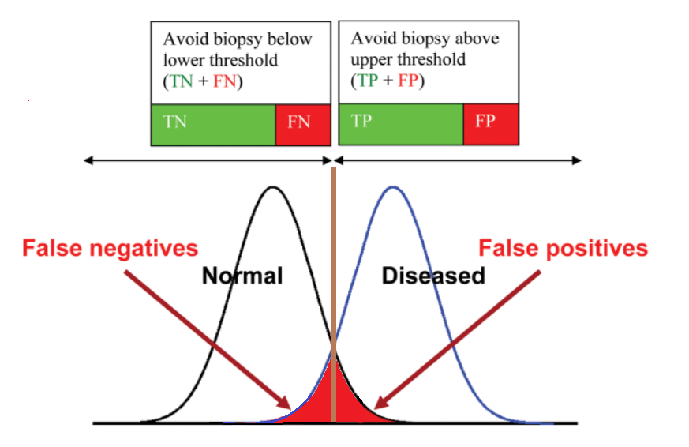
Non-invasive Tests:
Categorical Conversion 1
Guha et al. 2008 Hepatology

Slide 33
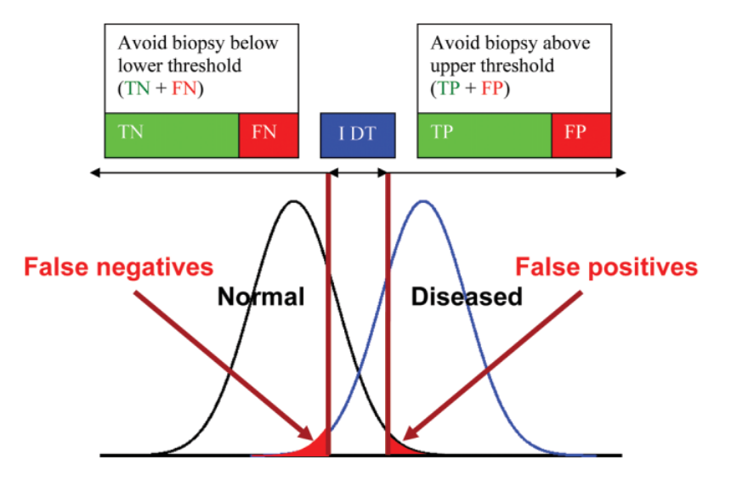
Non-invasive Tests:
Categorical Conversion 2
Guha et al. 2008 Hepatology
Notes:
Nevertheless whilst the presence or absence of advanced fibrosis is a binary outcome, most non invasive tests are reported as a numerical value i.e. a continuous variable.
In order to act as a surrogate for liver biopsy findings, non invasive tests results can be converted into a binary outcome by defining diagnostic thresholds.
To maximise diagnostic accuracy, this is achieved by the use of 2 thresholds: a lower one with higher sensitivity to rule out disease and an upper one with higher specificity to rule in disease with values lying between these 2 thresholds deemed indeterminate.
It is important to emphasise that minimising the number of indeterminate results whilst maximising diagnostic accuracy is an integral part of developing non-invasive tests for clinical practice

Slide 34
How do serum Markers Compare?
Test | F0 v F1-4 AUROC | F0-1 vs F2-4 AUROC | F0-2 vs F3-4 AUROC | F0-3 vs F4 AUROC
Fib4 | 0.69 | 0.78 | 0.83 | 0.85
APRI | 0.70 | 0.72 | 0.78 | 0.81
NAFLD Fibrosis Score | 0.67 | 0.75 | 0.83 | 0.85
CDS | 0.58 | 0.58 | 0.63 | 0.63
BARD | 0.64 | 0.61 | 0.73 | 0.73
HA | 0.71 | 0.80 | 0.88 | 0.91
ELF | 0.75 | 0.81 | 0.89 | 0.93
Tanwar et al. DDF Annual Meeting 2012

Slide 35
ELF and Fibroscan
Bantel et al Hannover Mixed CLD
n=104 | AUROC 95% CI | AUROC 95% CI | AUROC 95% CI
Ishak Stage | ELF | Fibroscan | ELF&F/S
1,2,3,4,5,6 | 0.735 0.640,0.830 | 0.737 0.642,0.833 | 0.776 0.687,0.865
2,3,4,5,6 | 0.793 0.694,0.893 | 0.869 0.802,0.936 | 0.860 0.786,0.935
3,4,5,6 | 0.856 0.766,0.947 | 0.887 0.810,0.964 | 0.905 0.833,0.976
4,5,6 | 0.936 0.889,0.983 | 0.944 0.878,1.00 | 0.957 0.913,1.00
5,6 | 0.923 0.867, 0.980 | 0.939 0.858,1.00 | 0.952 0.898,1.00

Slide 36
Summary of Fibrosis Biomarkers
Numerous problems associated with reference standard
Serum markers more suited than biopsy as the primary method to assess fibrosis
Better performance at detecting advanced fibrosis ≥F3
Poorer performance at detecting minimal fibrosis
Comparable performance with imaging modalities e.g. fibroscan

Slide 37
Can Serum Markers Replace Biopsy?
Serum markers fibrosis markers do not offer information on:
  Inflammatory grade
  Aetiology
    The relative contribution of 2 pathologies
  Coexisting pathology e.g. iron overload
  Portal Hypertension e.g. HVPG

Slide 38
Other uses of Serum Markers of Liver Disease

Slide 39
Prognostication
Serum markers can be used to provide prognostic information
Analogous to serum cholesterol for the prediction of cardiovascular risk

Slide 40
Liver Biopsy: LRE at 7 years
Survival
1.0
Ishak Stage
0 - 1
Mild
0.8
2 - 4
Moderate
0.6
4 - 6
Severe
0.4
0.2
0.0
0.00
2.00
4.00
6.00
8.00
Time (years)

Slide 41
ELF - liver related events at 7 yrs
Survival
1.0
n=500
0.8
1 .0 ELF score <8.4
0.6
2.0 ELF score 8.4 – 9.5
3.0 ELF score >9.5
0.4
4.0 ELF score >12.5
0.2
0.0
0.00
2.00
4.00
6.00
8.00
Time years

Slide 42
Monitoring anti fibrotic therapy
Serum markers could be used to monitor the outcome of ant fibrotic therapy instead of relying on serial liver biopsy
Less success thus far particularly because of the absence of reliable and robust anti-fibrotic therapies

Slide 43
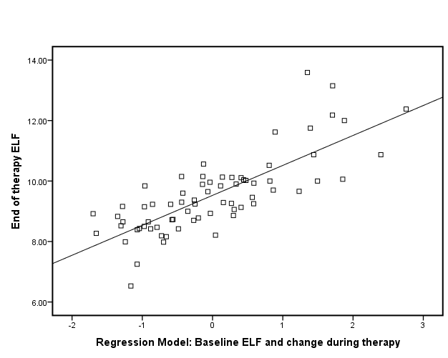
Monitoring anti fibrotic therapy
70 Patients treated with IFN with or without Silymarin in RCT for 24 months:
∆ ELF₀₋₂₄
=0.882+0.882(ELF₀)+0.707(∆ELF₀₋₁₂)
R=0.626, p-value<10⁻⁸
↑ ELF- AUC 0.81-0.85
↓ ELF- AUC 0.80-0.85
Tanwar et al. EASL 2011

Slide 44
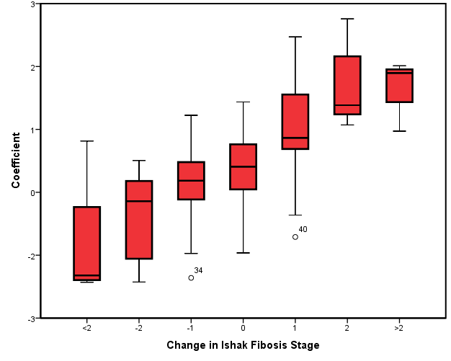
Monitoring anti fibrotic therapy
70 Patients treated with IFN with or without Silymarin in RCT for 24 months:
∆ Ishak₀₋₂₄
=-5.786-0.601(Ishak₀)+0.762(ELF₀)+ 0.665(∆ELF₀₋₁₂)
R= 0.645, p-value< 10⁻⁸
↑ Ishak- AUC 0.86-0.91
↓ Ishak- AUC 0.81-0.84
Tanwar et al. EASL 2011

Slide 45
Alternative Diagnostic Targets
Inflammation
Important for prognostication
Important in liver diseases as the patients with inflammation will inevitably develop progressive fibrosis
The alternative approach to detect minimal and mild fibrosis is less successful

Slide 46
Natural History of NAFLD
100%
Steatosis
6%
NASH & Progressive Fibrosis (F0-2)
3%
Advanced Fibrosis (F3-4)
HCC
Decompensation
Liver Failure
Adams et al 2005. Gastroenterology
Notes:
The diagnostic targets of these non-invasive tests have been both NASH with progressive fibrosis and that of advanced fibrosis.
Whilst both targets are important, attempts to non invasively detect advanced fibrosis have been more successful with superior diagnostic performance.

Slide 47
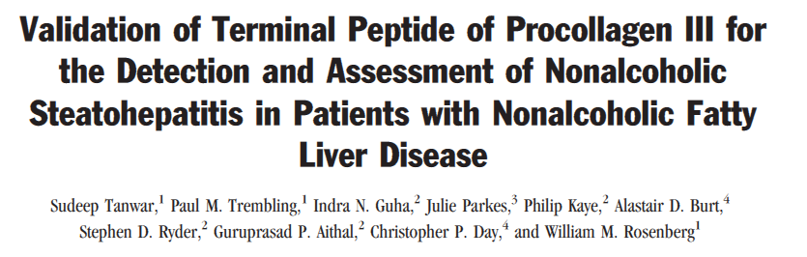
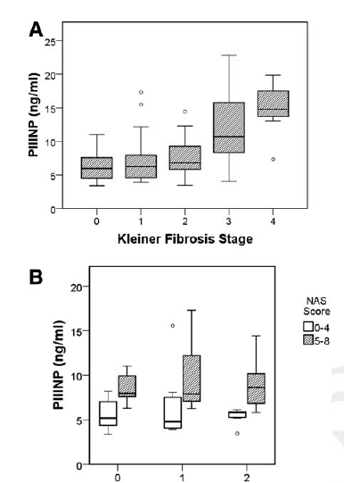
HEPATOLOGY
in press
177 Patients
Derivation and Validation Cohort
Population | Discrimination | AUROC
F0-2: | Simple Steatosis vs. NASH | 0.77-0.82
F0-3: | Simple Steatosis vs. NASH | 0.82-0.84
F0-4: | Simple Steatosis or F0-2 vs. NASH or F3-4 | 0.85-0.87

Slide 48
Summary
Serum markers developed over past decade
2 types: direct and indirect
Differential price
Better performance in detection of advanced fibrosis than mild fibrosis
Direct markers more accurate than indirect
Complex models more accurate
Comparable performance to imaging modalities e.g. fibroscan

Slide 49
Summary
Diagnostic performance related to the prevalence of underlying disease
Use of 2 thresholds increases performance
Other uses:
  Prognostication
  Monitoring anti-fibrotic therapy
Alternative targets:
  Inflammation

Slide 50
Conclusions
Increasing development of serum markers predominantly in research setting
Offer information that is complementary to that obtained from liver biopsy
Uses:
  Primary care: “rule out” disease
  Secondary Care: “rule in” disease
Dedicated studies in these settings are currently ongoing

