Slide 1
Pancreatic neoplasms
Dr R Ahmad

Slide 2
Solid neoplasms
Cystic neoplasms
Intraductal Papillary Mucinous Neoplasm (IPMN)
Pancreatic Endocrine Neoplasm

Slide 3
Solid neoplasms
Conventional infiltrating pancreatic ductal adenocarcinoma
Undifferentiated carcinoma with osteoclast like giant cells
Acinar cell carcinoma
Pancreaticoblastoma

Slide 4
Cystic neoplasms
Serous cystadenoma
Mucinous cystic neoplasms
Intraductal papillary mucinous neoplasms
Solid pseudopapillary neoplasms

Slide 5
Endocrine neoplasms
Well differentiated EN
Poorly differentiated EN

Slide 6
Tumours of the Ampulla of Vater
Adenoma
Non-invasive papillary Ca
Intestinal & pancreatobiliary type adenoCa

Slide 7
Invasive Ductal AdenoCa
>90% of pancreatic neoplasms of ductal origin
80-90% are invasive ductal adenoCa
unusual variants - foamy gland pattern
- large duct pattern
- vacuolated pattern
- lobular Ca-like pattern

Slide 8
Conventional Ductal AdenoCa
most common type
most fatal of all human cancers
incidence rate 11/100,000
4th leading cause of cancer death
60-80yr age group
presentation
- jaundice (caused by invasion and obstruction of CBD)
- back pain
- LOW

Slide 9
Conventional Ductal AdenoCa
Risk factors
- smoking & high dietary fat intake
- acquired chronic pancreatitis & diabetes
- hereditary chronic pancreatitis
most sporadic
10% familial
genetic basis for most familial cases (80%) unknown
heritable genetic syndromes - BRCA2, FAMMM, P-J syndrome, familial pancreatitis, HNPCC

Slide 10
Conventional Ductal AdenoCa
>75% solid tumours
60-70% in head of pancreas
typically involve surrounding structures, especially CBD and duodenum
tail cancers spread to spleen, kidney, stomach & colon
80% unresectable at time of diagnosis
encasement of major mesenteric vessels
metastases to liver, peritoneum or other distant site
often disseminates very early

Slide 11
Conventional Ductal AdenoCa
Pathologic features
solid firm infiltrative tumour
gritty or slightly gelatinous cut surface
gross areas of necrosis may be present
often difficult to distinguish from adjacent areas of fibrosing
chronic pancreatitis
direct invasion of CBD & duodenum common - HOP
recognition that centre of tumour is located within HOP is
helpful in distinguishing ductal adenoCa from primary Ca of
CBD, duodenum or ampulla

Slide 12
Notes:
Gross appearance of ductal adenoCa. The tumour is solid, white to yellow, and ill-defined, occupying much of the head of the gland.

Slide 13
Conventional Ductal AdenoCa
Microscopic features
proliferation of small tubular structures lined by cuboidal
cells within abundant desmoplastic stroma
well differentiated growth pattern closely mimics non-
neoplastic ductules of chronic pancreatitis
malignant glands with haphazard growth pattern
stratification & irregular papillae of lining epithelium
abundant cytoplasm generally containing mucin
clear cell change is common

Slide 14
Notes:
Ductal adenoCa. The tumour consists of variably sized, well formed glands surr by abundant desmoplastic stroma.

Slide 15
Notes:
W-d ductal adenoCa. Some infiltrating Ca’s consist of remarkably well formed glands & exhibit relatively minimal cytologic atypia, mimicking benign ductules.

Slide 16
Notes:
M-d ductal adenoCa. The nuclei show variability in size, shape & location within the cells.

Slide 17
Notes:
P-d ductal adenoCa. The tumour exhibits minimal gland formation, instead growing as clusters and individual cells with mkd cytologic atypia.

Slide 18
Conventional Ductal AdenoCa
Microscopic features
loss of nuclear polarity typical
nuclei vary in size, shape & intracellular location
>4x variation in nuclear size (4:1 rule)
PNI & VI common & diagnostically useful (not commonly
detected in core needle bxs)
invasion into peripancreatic fat common
immediate juxtaposition of gland with adipose tissue without
intervening stroma (‘naked glands in fat’ sign)

Slide 19
Notes:
Comparison between atrophic chronic pancreatitis and w-d ductal adenoca.
LP of chronic pancreatitis shows retention of lobular architecture of the gland with larger dilated central ducts surr by smaller round ductules. The stroma separating each lobule is somewhat more dense than the intralobular stroma.

Slide 20
Notes:
In contrast, adenoCa shows a haphazard arrangement of neoplastic glands & lacks a lobular configuration.

Slide 21
Notes:
Findings diagnostic of ductal adenoCa. Perineural invasion is virtually diagnostic of invasive Ca provided the epithelial structures are gland forming.

Slide 22
Notes:
Immediate juxtaposition of glands to adipocytes is also a very helpful finding.

Slide 23
Notes:
Pancreatic atrophy with aggregation of islets. The endocrine cells in this focus exhibit a trabecular configuration, suggesting they originated from the diffuse islets located in the post HOP. The pseudoinfiltrative nature of these endocrine cells may simulate an invasive Ca.

Slide 24
Conventional Ductal AdenoCa
Microscopic features
invasion of CBD, duodenal mucosa or native pancreatic
ducts
colonization of basement membrane may simulate pre-
invasive neoplasm – duodenal adenoma or PanIN
continuity with frankly invasive elements supports
colonization
chronic pancreatitis often present in adjacent pancreas
lining of native pancreatic ducts may show PanIN

Slide 25
Conventional Ductal AdenoCa
Microscopic features
Kloppel’s current grading scheme (endorsed by WHO)
- glandular differentiation
- mucin production
- mitoses
- nuclear atypia
AJCC staging parameters for ductal adenoCa - TNM
Royal College of Pathology minimum data set - TNM

Slide 26
Conventional Ductal AdenoCa
Primary tumour
TX – primary tumour cannot be assessed
T0 – no evidence of primary tumour
Tis – Ca in situ (PanIN 3)
T1 – tumour limited to pancreas, < or = 20mm
T2 – tumour limited to pancreas, >20mm
T3 – tumour extends directly into any of the following:
duodenum, bile duct, peripancreatic tissues
T4 – tumour extends into stomach, spleen, colon, adjacent
large vessels

Slide 27
Conventional Ductal AdenoCa
Regional LNs
NX – cannot be assessed
N0 – no regional LN mets
N1 – regional LN mets
N1a – mets in a single group of regional LNs
N1b – mets in multiple groups of regional LNs
Distant Metastasis
MX – cannot be assessed
M0 – no distant mets
M1 – distant mets

Slide 28
Conventional Ductal AdenoCa
IHC labelling
CK7, 8/18, 19 – most express (90-100%)
(most endocrine tumors & acinar neoplasms are CK7 -ve)
CK20 - <20% (most CRC CK20+/CK7-)
CEA, CA19.9, CA125 – useful in distinguishing infiltrating
adenoCa & PanIN 3 from reactive glands

Slide 29
Conventional Ductal AdenoCa
IHC labelling
MUC 1 (panepithelial mucin) – most express
MUC 5AC (gastric foveolar mucin) – most express
MUC 6 (pyloric gland mucin) - ~25% express
MUC 2 (intestinal mucin) - <10% express
(majority of IPMN & MCN express MUC 2 but not MUC 1)

Slide 30
Conventional Ductal AdenoCa
IHC labelling
loss of DPC4/SMAD4 – 55% show complete loss
(almost all benign pancreatic processes express SMAD4)
p53 labelling occurs in 50-75%
loss of p16 in >90%

Slide 31
Molecular genetic features
Structural rearrangement (or loss) of genes located on 1p, 3p, 6p, 8p and 17p often found
Mutation and/or accumulation of P53 (~50%)
Mutation of K-ras oncogen (over 90%)
Inactivation of P16 (over 95%)
Overexpression of HER2/neuoncogen (~50%)
DPC4 suppressor is inactivated in ~50% of cases

Slide 32
Other Pancreatic Carcinomas of Ductal Origin
Colloid carcinoma / mucinous Ca
Medullary Ca
SCCa
Adenosquamous Ca
Hepatoid Ca
Undifferentiated Ca - anaplastic giant cell Ca
- carcinosarcoma
Undifferentiated Ca with osteoclast-like giant cells

Slide 33
Notes:
Colloid Ca (mucinous non cystic Ca). The tumour is composed of large stromal mucin lakes in which are suspended relatively scanty strips and clusters of cells with individual cells having a signet ring configuration.

Slide 34
Notes:
Medullary Ca the tumour is poorly differentiated, lacks gland formation & has a pushing growth pattern at the periphery. The tumour cells are large & appear syncytial. There is a lymphocytic infiltrate between tumour cells.

Slide 35
Notes:
Adenosquamous Ca – the tumour contains neoplastic glands resembling conventional ductal adenoCa
As well as large nests of cells with squamous differentiation.

Slide 36
Notes:
Undifferentiated Ca with enormous tumour cells growing in solid sheets & having mkdly atypical nuclei

Slide 37
Pancreatic Intraepithelial Neoplasia
precursor of ductal adenoCa
series of increasingly proliferative changes within the epithelium of pancreatic ducts
early lesions with minimal cytologic atypia are now regarded as early neoplastic change
more recent molecular data -> most are neoplastic
proportion of mucinous metaplasia or mucous cell hypertrophy harbour clonal mutations in K-ras oncogene
whole spectrum is referred to as PanIN
graded as PanIN 1A, 1B, 2 & 3

Slide 38
Pancreatic Intraepithelial Neoplasia
PanIN 1A – tall columnar mucinous cells with well polarized nuclei but without atypia, loss of polarity, papillary or micropapillary formation (previously called mucinous neoplasia or mucous cell hypertrophy)
PanIN 1B – characterized by slight nuclear stratification at basal aspect & presence of papillary or micropapillary projections

Slide 39
Notes:
PanIN 1A – small ductules are lined by tall columnar mucinous epithelial cells without loss of polarization or nuclear atypia

Slide 40
Notes:
PanIN 1B is cytologically similar to PanIN 1A but has papillae and micropapillae.

Slide 41
Pancreatic Intraepithelial Neoplasia
PanIN 2 – prominent nuclear stratification (full thickness) associated with focal loss of polarity & mild nuclear atypia (previous atypical hyperplasia / moderate dysplasia)
PanIN 3 – significant loss of polarity, tufting of cells into the lumen, marked irregularity of nuclei, increased mitotic figures & necrosis (previously called Ca in situ or severe dysplasia)
most molecular abnormalities in inv ductal Ca also in PanIN

Slide 42
Notes:
PanIN 2 also shows tall columnar cells but in addition exhibits full-thickness nuclear pseudostratification & mild to mod nuclear atypia.

Slide 43
Notes:
PanIN 3 exhibits more substantial cytoarchitectural abnormalities including complete loss of nuclear polarity with budding of unsupported epithelial tufts into the gland lumen. Mkd nuclear atypia is also present.

Slide 44
Pancreatic Intraepithelial Neoplasia
relatively frequent incidental finding
50% of older adults have foci of PanIN 1
higher grades of PanIN more common in inv ductal Ca
natural history unknown
foci of PanIN 2 & 3 should be reported, particularly in cases lacking inv Ca

Slide 45
Pancreatic Intraepithelial Neoplasia
PanIN 1 extremely common – very low risk of progression
negligible clinical significance
detection of PanIN 3 would provide opportunity for cure
PanIN should be distinguished from w-d invasive ductal
adenoCa & IPMN
most IPMNs are larger than PanIN & involve cystically dilated ducts at least 10mm in diameter
distinction may be nearly impossible in some cases
both may be present within the same pancreas

Slide 46
Pancreaticoblastoma
Most common form of pancreatic neoplasia in childhood
Isolated cases reported with Beckwith-Wiedemann syndrome and FAP of colon
Bimodal age distribution (2.4, 33 years)
No sex predilection
Mean tumour size 10 cm
Prognosis favourable in infants

Slide 47
Cystic Tumours
less common than ductal adenoCa
5-10% of all pancreatic neoplasms
either benign or low grade (indolent) malignant neoplasms
detected more commonly owing to increased use of sensitive imaging techniques
2 types:
- serous cystic neoplasm / serous cystadenomas
- mucinous cystic neoplasm (MCN)

Slide 48
Serous Cystic Neoplasm
most common type of ‘true’ cystic neoplasm
usually microcystic (microcystic adenoma)
numerous small cysts 1-10mm in size
forming a well-delineated tumour mass
relatively large tumour mass (up to 250mm)
mostly in body / tail
predominantly females
66yr mean age

Slide 49
Notes:
Gross appearance of microcystic serous cystadenoma. The lesion is well circumscribed & composed of small cysts, each measuring <1cm, separated by thin translucent septa

Slide 50
Notes:
Gross appearance of macrocystic serous cystadenoma. The cysts are much larger than those of the microcystic counterpart.

Slide 51
Serous Cystic Neoplasm
Macroscopic features
Well circumscribed lesion composed of small cysts
Each <10mm
Separated by thin translucent septa
Microscopic features
cysts lined by flattened to low cuboidal epithelium
clear cytoplasm & well defined cytoplasmic borders
small round uniform nuclei with dense homogenous chromatin
accumulation of glycogen (PAS+, DPAS -)

Slide 52
Notes:
Microcystic serous cystadenoma at LP each small cyst is lined by a flattened layer of epithelium

Slide 53
Notes:
Cytologically the lining cells show clear cytoplasm and small uniform hyperchromatic nuclei

Slide 54
Mucinous Cystic Neoplasm (MCN)
macrocystic
almost exclusively in females
5-6th decades of life
tail of pancreas
Macroscopic features
single multilocular cyst
surrounded by thick fibrotic capsule
mean size >10cm
do not communicate with pancreatic ductal system
septa between cysts are thin

Slide 55
Notes:
Gross MCN – circumscribed tumour involves tail of pancreas & contains numer large 1-5cm cysts – septa are fibrotic & show no gross evid of solid tumour nodules in this eg.

Slide 56
Notes:
MCN – LP lesion is surr by thick fibrous capsule. The large cysts are lined by mucinous epithelium & stroma of the septa is hypercellular

Slide 57
Mucinous Cystic Neoplasm (MCN)
Macroscopic features
cyst contents often mucoid
solid areas may harbour invasive component
degenerative changes with haemorrhage
Microscopic features
similar to ovarian mucinous neoplasm
tall columnar cells with abundant apical mucin
bland with uniform, basally oriented nuclei
minimal architectural complexity

Slide 58
Notes:
MCN – epith lining is composed of tall columnar mucin-containing cells. In this region there is no significant nuclear atypia, loss of polarity or architectural complexity (MCN, LGD). The subepith stroma is hypercell resembling the stroma of the ovary.

Slide 59
Mucinous Cystic Neoplasm (MCN)
Microscopic features
some exhibit abundant papillary formations, pseudostratified
hyperchromatic nuclei
cribriform architecture severe epithelial atypia - may be focal
consistent distinctive subepithelial hypercellular spindle cell
stroma (ovarian-like) – must be present for diagnosis
stroma often contains nests of epithelioid cells suggestive of
luteinization
stromal cells express oestrogen & progesterone, as well as
inhibin (intense in epithelioid lutea-like cells)
Notes:
Foetal pancreas – similar hypercellular stroma surrounding developing ducts – recapitulation of fetal periductal mesenchyme

Slide 60
Notes:
MCN – HGD may be focal with an abrupt transition from bland mucinous epith. In this case there is mkd nuclear atypia & complete loss of polarity but no inv ca (MCN HGD)

Slide 61
Notes:
Stroma of MCN. In addition to the hypercellular spindle cell component there may be clusters of epithelioid cells resembling the luteinized stroma of the ovary

Slide 62
Notes:
IHC for inhibin – positive in the epithelioid cell nests

Slide 63
Mucinous Cystic Neoplasm (MCN)
Microscopic features
epithelium expresses keratin, CEA, CA19.9
MUC 5AC (diffusely)
MUC 2 (only scattered goblet cells)
MUC 1 only in invasive Ca that arise within these tumours
degree of dysplasia - low, moderate or high grade
presence or absence of invasive Ca should be reported

Slide 64
Mucinous Cystic Neoplasm (MCN)
Microscopic features
MCN with LGD = mucinous cystadenoma
MCN with HGD= cystadenoCa in situ
MCN with invasive CA = mucinous cystadenoCa (less aggressive than ductal adenoCa)
even benign appearing MCNs have latent malignant potential
overall rate of malignancy is ~10%

Slide 65
Notes:
MCN with inv Ca. Within a septum of this tumour there is a component of undifferentiated anaplastic giant cell Ca, one of several types of inv Ca that may arise in MCN.

Slide 66
Intraductal Papillary Mucinous Neoplasm (IPMN)
very distinctive clinical & radiographic findings
readily treatable by surgery
radiographically cystic
distinction from true cystic neoplasm can be difficult
spectrum of neoplastic progression
clinically detectable unlike PanIN lesions
excellent model of preinvasive neoplasia

Slide 67
Intraductal Papillary Mucinous Neoplasm (IPMN)
characterized by intraductal proliferation of mucinous cells
usually arranged in a papillary pattern
microscopic or macroscopic papilla forming nodular masses
intraluminal mucin deposition
cystic dilatation of ducts
mucin extrusion through the ampulla diagnostic
multilocular cystic mass or abundant papillary nodules

Slide 68
Intraductal Papillary Mucinous Neoplasm (IPMN)
accounts for 5% of all pancreatic neoplasms
more common than previously recognized
7th – 8th decade
nonspecific symptoms
80% occur in HOP
Diagnostic features:
endoscopic finding of mucin extrusion through the ampulla
radiographic finding of ectatic ducts

Slide 69
Intraductal Papillary Mucinous Neoplasm (IPMN)
2 Main types
Main duct type
involves major pancreatic duct
greater likelihood of intraductal or invasive Ca (~35%)
Branch duct type
involves secondary ducts
particularly in uncinate process, body & tail

Slide 70
Notes:
Gross – intraduct papill mucinous neopl (IPMN) – pancr ducts are signific dilated – gross papilla form can be seen – with extens involv of main PDs and cystic dilatation of branch ducts.

Slide 71
Notes:
Intraduct papillae are inconspicuous, the lesion appearing largely as cystic dilat of branch ducts.

Slide 72
Intraductal Papillary Mucinous Neoplasm (IPMN)
localized, multicentric or entire ductal system (rarely)
cystic ducts filled with variably complex papillary projections
lined by mucinous cells with various degrees of atypia
3 different papillary patterns:
- intestinal type (50%) – CK20+; MUC2+; CDX2+
- gastric foveolar type (35%)
- pancreatobiliary type (15%) – MUC1 +
low grade, moderate or high grade dysplasia

Slide 73
Notes:
IPMN – at LP ducts are filled with variably complex papillary projections lined by tall columnar mucinous epith cells.

Slide 74
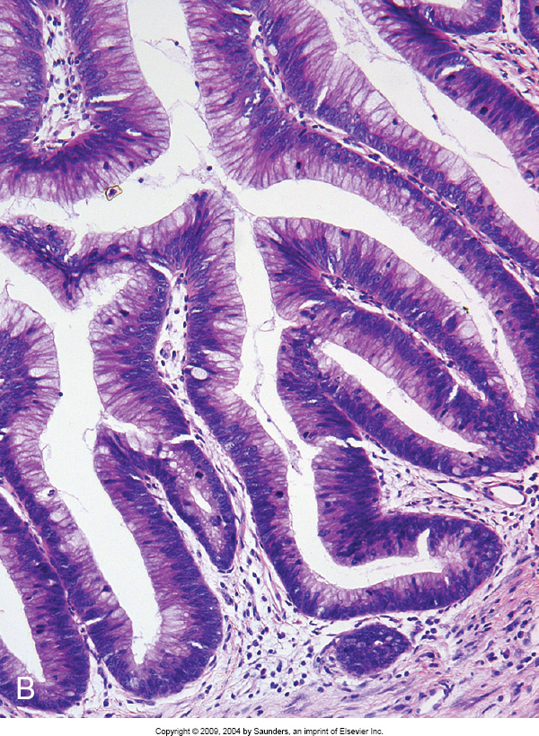
Notes:
IPMN – different types of papillae may be found. A. gastric foveolar type papillae have uniform columnar cells with abund apical mucin. B. most cases exhibit intestinal type papillae which resemble VA

Slide 75
Notes:
Pancr-biliary type papillae in which the lining epith shows mkd architect complexity with cribriforming & micropapillae form & nuclei are round & lack signif pseudostratific.

Slide 76
Notes:
IPMN with assoc inv Ca. Two distinct types of inv Ca may arise – A. colloid ca consist of paucicell stromal mucin pools with stips & clusters of floating epith cells.

Slide 77
Notes:
In other cases the inv component is of tubular type resembling conventional ductal adenoCa

Slide 78
Intraductal Papillary Mucinous Neoplasm (IPMN)
overall 5yr survival rate relatively good
>75% free of disease after 5 yrs
even with associated invasive Ca good prognosis
particularly if colloid type or small focus
most managed by conservative resection
may recur because of tumour multicentricity

Slide 79
Intraductal Papillary Mucinous Neoplasm (IPMN)
Differential Diagnosis
PanIN – incidental, microscopic lesions <5mm
IPMN – macroscopic masses or cysts >10mm
MCN – middle aged F, tail, do not communicate with ductal
system, cellular ovarian-like stroma highly specific
IPMN – both sexes, older age group, predominantly HOP,
involvement of ducts, absence of ovarian-like stroma

Slide 80
Solid Pseudopapillary Tumour
Most cases found in young women
Most common clinical sign palpable abdominal pain
Grossly: large and often contains areas of haemorrhage and necrosis
Most cases surrounded by well-developed capsule
Some cases are predominantly cystic

Slide 81
Solid Pseudopapillary Tumour
Microscopically: very cellular, can simulate ET
Pseudopapilla covered by several layers of epithelial cells
Nuclei ovoid and folded
Hyaline globules and foamy macrophages
Thick fibrovascular stroma with mucinous change
IHC: CK, CD10, PgR, beta-catenin
Genetically: almost always exhibit beta-catenin mutation
Treatment is surgical and prognosis is excellent

Slide 82
Tumours of Ampulla of Vater
conflunce of CBD & main PD at the ampulla
ampullary tumours can obstruct 2 major organs
relatively early onset of symptoms
biliary obstruction and pancreatitis
better prognosis
anatomy of ampulla varies considerable
CBD & main PD join to form a common channel in most, <3mm in length within duodenal wall surrounded by thin fascicles of smooth muscle, termed sphinctre of Oddi

Slide 83
Tumours of Ampulla of Vater
small intestinal type epithelium (major and minor ampulla) on duodenal surface
transitions to pancreato-biliary type epithelium similar to CBD & PD in the common ampullary duct
because of close proximity of these structures often difficult to distinguish distal CBD, periampullary (duodenal), HOP and true ampullary tumours
primary ampullary tumours are centred on this structure

Slide 84
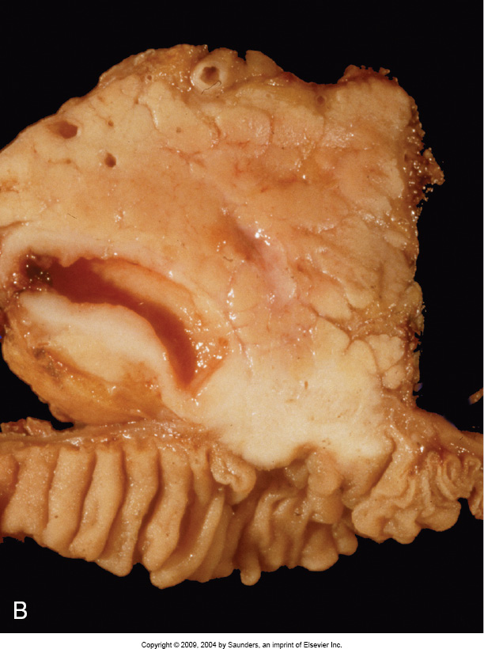
Notes:
inv adenoca of ampull arising in adenoma – may prod an indurated polypoid lesion which on slicing obstructs the bile duct

Slide 85
Tumours of Ampulla of Vater
intra-ampullary - smooth duodenal mucosa covering papilla
exophytic - protruding into duodenum
periampullary - centred in duodenum adjacent to ampulla
presence of intestinal type adenoma suggests origin from duodenum

Slide 86
Adenoma of Ampulla of Vater
most ampullary Ca develop from precursor neoplasm
95% intestinal type adenomas
comprise 55% of small intestinal adenomas
25% arise within peri-ampullary duodenum
most sporadic
most common site of extra-colonic adenomas in FAP
TA, VA & TVA
VA tend to be larger & more likely to -> Ca
involve duodenal epithelium covering major ampulla or intra-duodenal portion of ampulla

Slide 87
Notes:
VA of ampulla – these lesions may appear as ‘carpet’ adenomas composed of velvety papillary & polypoid excrescences surr ampull OR

Slide 88
Notes:
exophytic or smooth nodule or bulge beneath mucosa of major papilla

Slide 89
Adenoma of Ampulla of Vater
more likely to harbour inv Ca than similarly sized colorectal adenoma
LGD or HGD
IHC -> intestinal differentiation (CK20+; CDX2+; MUC2+ & often CK7+)

Slide 90
Notes:
Gross ampull adenoma – A. luminal aspect – ampulla is prominent and granular in this pt with FAP. There are also multiple small polyps in the surr duod mucosa.

Slide 91
Notes:
B. thickened granular adenomatous mucosa extends from the duod surf of the papilla into the common channel.

Slide 92
Notes:
Adenoma of the ampulla – low power of TVA with complex branching pattern extending into the dilated ampullary lumen.

Slide 93
Notes:
Cytologic features are typical of intestinal type adenomas with pseudostratified elongated nuclei.

Slide 94
Adenoma of Ampulla of Vater
Differential Diagnosis
involvement of peri-ampullary glands with dysplastic epithelium can simulate inv Ca because of irregular muscle bundles of sphinctre of Oddi
vice versa underlying inv Ca of pancreas or CBD can colonize the ampullary epithelium closely mimics primary adenoma
reactive atypia with associated inflammation
- lacks nuclear elongation & pseudostratification of adenomas
- nuclei may show more atypia, enlargement & macronucleoli
than adenomas with LGD

Slide 95
Notes:
Adenoma of the ampulla – there is ext of adenomatous epithelium into peri-ampullary glands, simulating inv into muscle. Note adj uninvolved ductules.

Slide 96
Notes:
Ampullary mucosal colonization by underlying invasive ductal adenoCa of the pancreas. The malign cells are growing along the bm, resembling the pattern of a prim ampull adenoma.

Slide 97
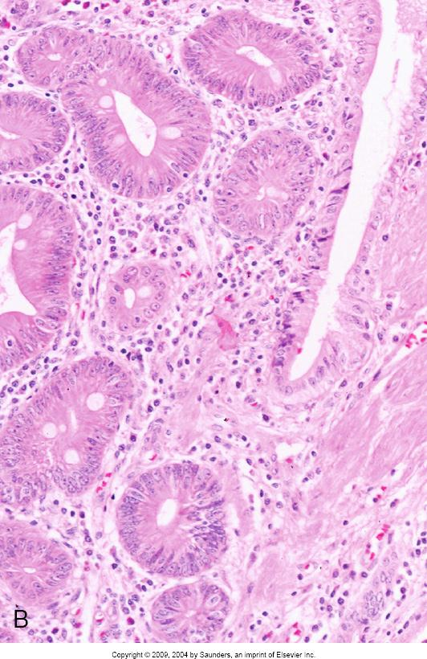
Notes:
AMPULL ADENOMA INVOLV PERI-AMPULL GLANDS. A. adenomatous epith extends into underlying peri-ampull glands which are enmeshed in smooth muscle. B. at HP there is admixt of adenomatous glands & non-neopl periampull glands assoc with a rim of LP

Slide 98
Notes:
Regener epith changes second to biliary stenting – LP – duod crypts appear crowded & surf epith cells are mucin depleted.

Slide 99
Notes:
HP duod epith – cells with enlarged hyperchrom nuclei & numerous mitotic figs.

Slide 100
Ampullary AdenoCa
ampulla most common site of small intestinal adenoCa
~5% of all GI Ca arise from ampulla
mean age 62 yr
more common in men
FAP ampullary adenoCa younger mean age (47 yr)
symptoms of biliary obstruction
jaundice accompanied by Courvoisier’s sign (palpable distended gallbladder)
often measure <2cm at time of diagnosis

Slide 101
Notes:
Ampull adenoca – rel small ca invades thru spinctre of Oddi into submucosa

Slide 102
Ampullary AdenoCa
intra-ampullary or peri-ampullary duodenal or mixed pattern
exophytic or ulcerated
residual polypoid adenoma components may be found
invade through the muscle of sphinctre of Oddi into duodenal muscularis & underlying pancreas & peri-pancreatic tissues
microscopically reflects origin from both intestinal & biliary epithelium
70% intestinal type resembling CRC
30% pancreato-biliary type resembling pancretic & bile duct Ca

Slide 103
Notes:
Amull adenoca intest type – glandular pattern with abund necrosis, resembling CRC

Slide 104
Notes:
HP nuclei are pseudostrat, glands are complex & modest amt desmopl stroma.

Slide 105
Notes:
Ampull adenoca pancr-biliary type – rel simple glands lined by single layer of cells with rounded nuclei – glands have abund mucin cytopl and are remarkably well formed.

Slide 106
Notes:
Ampull adenoca pancr-biliary type – abund desmopl stroma – this pattern resembles Ca of pancr & bile ducts.

Slide 107
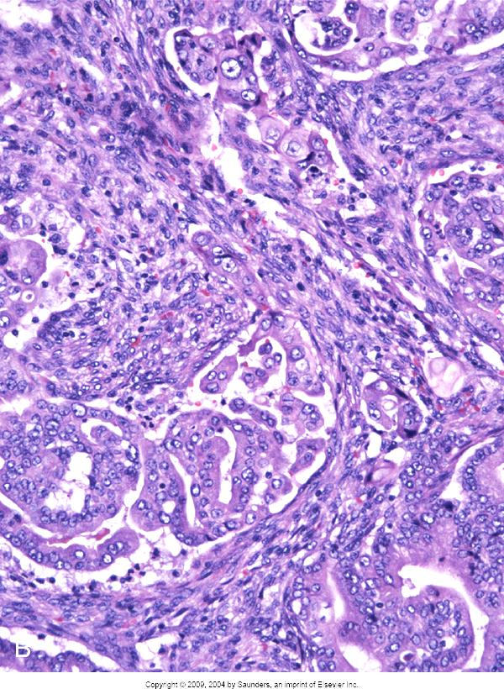
Notes:
Inv adenoca ampulla. A. Intestinal type adenoca – infiltr glands reminiscent of intest Ca (CRC). – the malignant glands contain cells with enlarged hyperchromatic nuclei and luminal necrosis. B. Pancr-biliary type Ca are often HG lesions showing a greater degree of cytologic atypia and less glandular differentiation with single infiltrating cells.

Slide 108
Notes:
Pancr-biliary type ampullary adenoca – infiltr small angulated glands resembling those of pancreatic adenoCa present in the mp of the ampulla

Slide 109
Notes:
HP view of some of the infiltr glands – mod cytologic atypia

Slide 110
Ampullary AdenoCa
Differential Diagnosis
gross evaluation is critical in determining primary origin
most tumours expand uniformly from their site of origin
presumed that centre of neoplasm likely represents true primary site
careful examination of the luminal aspect of the duodenum
along with identifying the ampulla on the axial slices
helps outline the relationship of the tumour to the normal anatomic structures

Slide 111
Ampullary AdenoCa
median survival 23 months
5yr survival rate 50%
amenable to complete surgical resection
better survival rates than pancreatic adenoCa
detected at earlier stage
more favourable outcome

Slide 112
Pancreatic Endocrine Neoplasm
5-8% of pancreatic tumours
majority w-d, low to intermediate grade tumours
exhibiting well-developed endocrine differentiation
rarely p-d (high grade) – simil to small & large cell endocrine Ca

Slide 113
Pancreatic Endocrine Neoplasm
Well differentiated PEN
55-60yr
functional & non functional categories
presence or absence of para-neoplastic syndrome
based on type of hormone secretion (insulinoma, gastrinoma)
greater proportion non functional
most non functional reveal biologic evidence of peptide or bioamine production by serologic or IHC assays
non-syndromic (better term)

Slide 114
Pancreatic Endocrine Neoplasm
Well differentiated PEN
usually present with non-specific symptoms related to mass lesion
biliary obstruction & jaundice may occur if in HOP
may present with symptoms of metastatic disease
variety of different classification schemes to help separate benign from malignant cases
tumour size – important prognostic factor

Slide 115
Pancreatic Endocrine Neoplasm
Well differentiated PEN
usually present with non-specific symptoms related to mass lesion
biliary obstruction & jaundice may occur if in HOP
may present with symptoms of metastatic disease
Assessment of malignancy
variety of different classification schemes to help separate benign from malignant cases
tumour size – important prognostic factor

Slide 116
Pancreatic Endocrine Neoplasm
Significant prognostic factors
tumours < 5mm max diameter -> benign
tumours < 20mm -> low risk malignant behaviour
mitotic rate
necrosis
venous invasion
extra-pancreatic tissue invasion

Slide 117
Notes:
Endocrine microadenoma – 0.3cm endocrine neoplasm cytoarchitecturally similar to larger endocrine neoplasms but is defined as a microadenoma based on size <0.5cm

Slide 118
Pancreatic Endocrine Neoplasm
Royal College Minimum Data Set
mitotic rate & Ki67 index to assess tumour grade
G1 - 2 mitoses/10 HPF, Ki67 index < or = 2%
G2 - 2-20 mitoses/10 HPF, Ki67 index >2-20%
G3 - >20 mitoses/10HPF, Ki67 index >20%

Slide 119
Pancreatic Endocrine Neoplasm
Royal College Minimum Data Set
Size to assess local invasion
- < 5mm benign – microadenoma
- pT1 - < 20mm & limited to pancreas
- pT2 – 20-40mm & limited to pancreas
- pT3 - > 40mm & limited to pancreas or invading duodenum
or CBD
- pT4 – tumour invading wall of adjacent vessels (coeliac axis
or SMA), stomach, spleen, colon, adrenal

Slide 120
Pancreatic Endocrine Neoplasm
malignant tumours show metastases to regional LNs & liver
slowly progressive indolent tumours
once metastases occur, rarely curable
survival for many yrs (even decades)
chemoRx limited success
functional tumours – surgical resection, embolization of mets,
or Rx with somatostatin analogues

Slide 121
Pancreatic Endocrine Neoplasm
W-D PEN
well-circumscribed homogeneous tumours
soft consistency
proliferation of round uniform cells with moderate cytoplasm
‘salt & pepper’ / stippled chromatin
distinct nests separated by small thin-walled bv’s
trabeculae, gyrae, pseudo-rosettes or glandular pattern
minimal to abundant hyalinised stroma
minimal nuclear pleomorphism & indistinct nucleoli
sparse mitotic figures

Slide 122
Notes:
Gross appearance of PEN – relatively well circumscribed exhibiting lobules of soft tan homogeneous tissue.

Slide 123
Notes:
Nested pattern

Slide 124
Notes:
Trabecular pattern of relatively uniform epithelial cells separated by scant fibrovascular stroma.

Slide 125
Notes:
Typical salt & pepper chromatin pattern – mitoses and necrosis are inconspicuous.

Slide 126
Notes:
PEN with lumina. Gland formation is not uncommon and often consists of multiple lumina within larger nests of tumour cells, each lined by endocrine cells indistinguishable from those in solid regions of the tumour.

Slide 127
Pancreatic Endocrine Neoplasm
W-D PEN
chromogranin & synaptophysin usually positive
NSE & CD56 also generally expressed
staining for peptide hormones should be done
however, functional tumours defined clinically & not by IHC

Slide 128
Pancreatic Endocrine Neoplasm
P-D PEN
rare
large cell endocrine Ca – large pleomorphic nuclei
small cell Ca
diffuse infiltrative growth pattern
numerous mitotic figures (>10/10HPF)
abundant tumour necrosis
highly aggressive
arly dissemination & rapidly fatal course

Slide 129
Notes:
PEN with nuclear pleomorphism – enlarged bizarre in cells with abundant cytoplasm. No increase in mitotic rate to suggest that the tumour is high grade. Prognosis is similar to conventional w-d PEN.

Slide 130
Notes:
P-d endocrine Ca – this tumour shows monotonous small cells cytologically resembling small cell Ca. There is abundant necrosis & innumerable mitotic figs.

