Slide 1
Tumours of bile ducts
Rob Goldin
r.goldin@imperial.ac.uk

Slide 2
Cells of the liver
Hepatocytes
Cholangiocytes
Endothelial cells
Kupffer cells
Stellate cells

Slide 3
LIVER TUMOURS: BENIGN
1) liver cell adenoma
2) focal nodular hyperplasia
3) bile duct adenoma
4) haemangioma

Slide 4
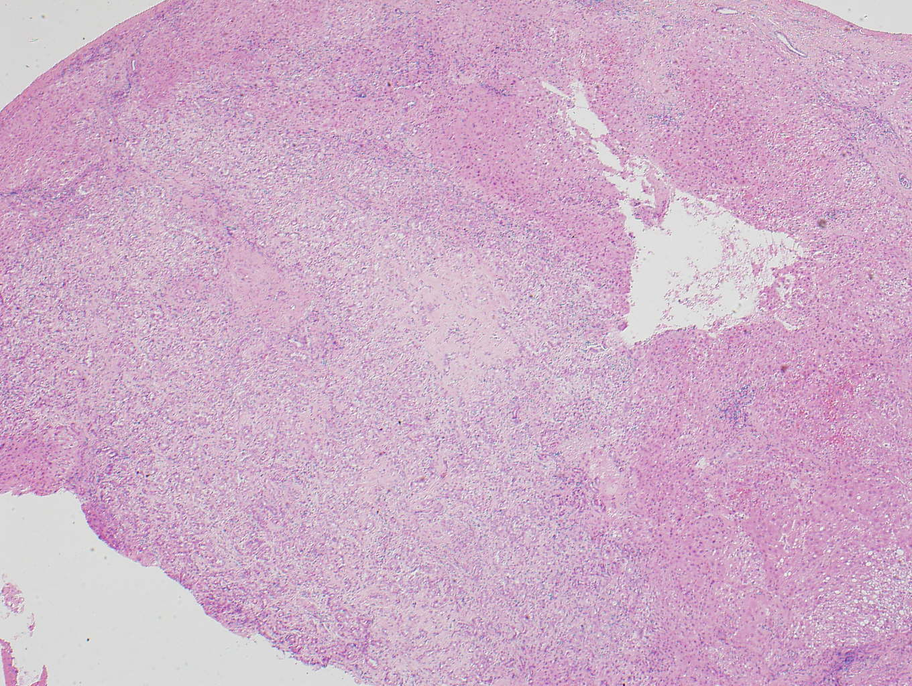
Bile duct adenoma

Slide 5
LIVER TUMOURS:
MALIGANT
1. secondary tumours
2. primary tumours

Slide 6
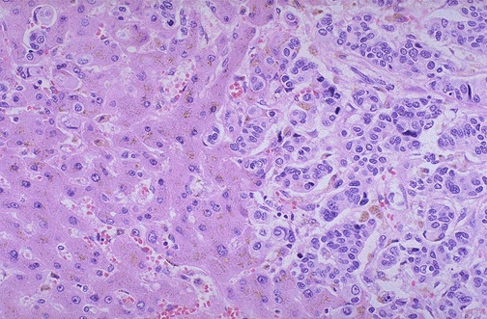

Slide 7
LIVER TUMOURS:
MALIGANT (PRIMARY)
1. hepatocellular carcinoma
2. hepatoblastoma
3. cholangiocarcinoma
4. haemangiosarcoma

Slide 8
Pathology
95% adenocarcinomas
adenosquamous
squamous
clear cell
signet ring
papillary
small cell

Slide 9
Risk factors
Definite
Primary Sclerosing Cholangitis (PSC)
Liver flukes ( e.g. Clonorchis sinensis)
Intra-hepatic biliary stones
Fibropolycystic liver disease
Viral hepatitis / Cirrhosis
Implicated
Chemical carcinogens
BSEP mutations
Genetic susceptibility
Thorotrast
Bile duct adenoma
Biliary papillamatosis
Bile acids
Oxysterols
Notes:
Life time risk for CCA in PSC is 15-20%
In fact Thailand has the highest incidence worldwide 96/100,000 men. Liver flukes cause chronic biliary inflammation.
Hepatolithiasis common in Taiwan
Caroli’s disease (fibro-ploycystic disease) 7% lifetime risk CCA
Chemical carcinogens PAHs, PCBs entered food chain half long half life stored in adipose tissue also excreted in bile, lipophilic and enter cell bind to Arylhydrocarbon receptor and dimer DRE elements DNA. Adducts and mutations
Children with BSEP mutations develop PFIC type 11 have developed CCA age 4 and 7.
Weak association in polymorphisms in phase 11 drug metabolizing enzymes

Slide 10
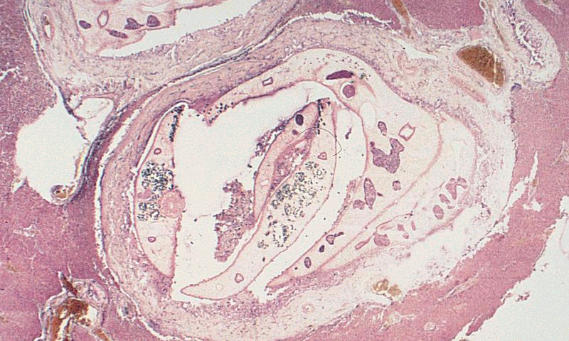
Parasitic Infection

Slide 11
Cholangiocarcinoma
usually well differentiated adenocarcinoma with marked fibrosis
may see dysplasia
haematogenous and lymph node metastases relatively common
the prognosis is very poor

Slide 12
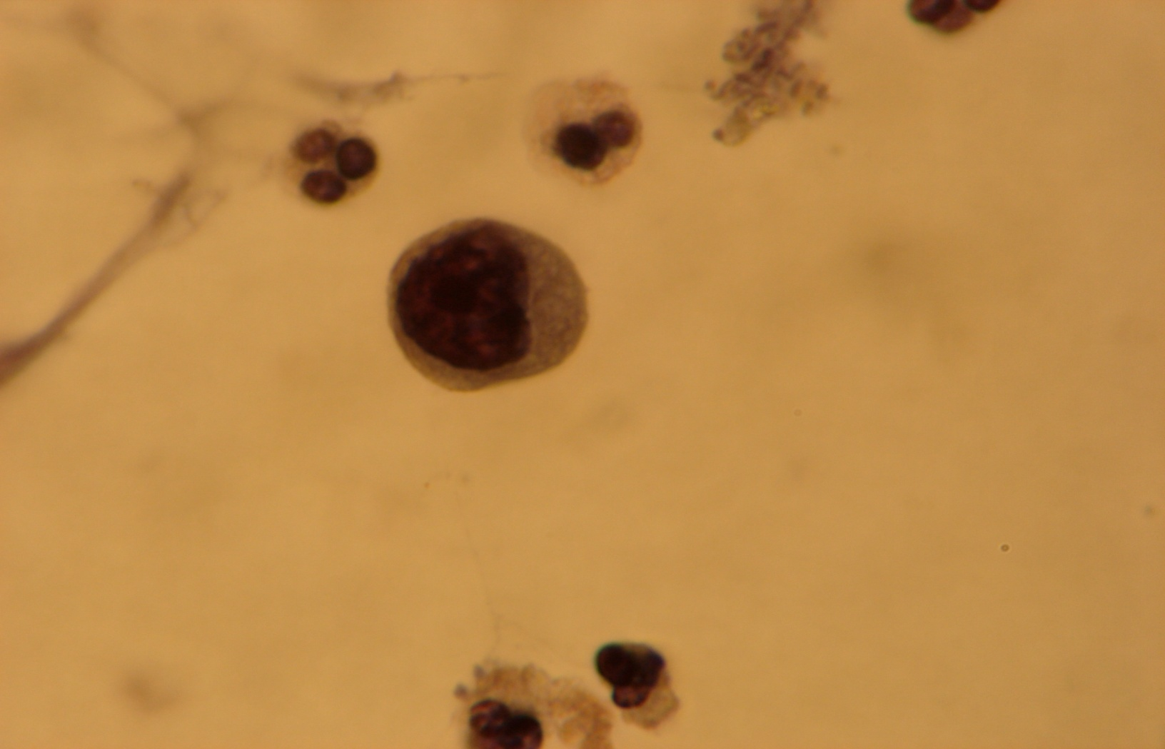
Cholangiocarcinoma Cytology
Notes:
Bile cytology
A cytology preparation from bile fluid showing a dissociated cell with a hyperchromatic nucleus and prominent nucleolus on a background indicating tissue necrosis. These features are highly suggestive of an invasive cholangiocarcinoma.

Slide 13
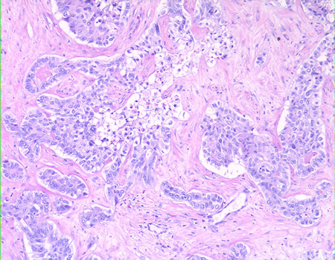
Cholangiocarcinoma

Slide 14
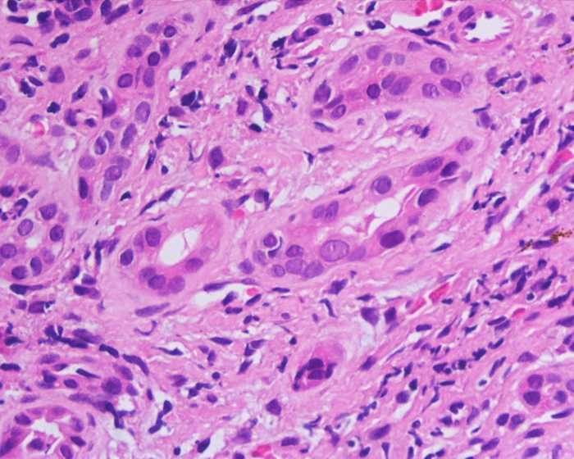
Biliary Dysplasia

Slide 15
Chlangiocarcinoma
Immunohistochemistry
CK19
CK7 and CK19 positive,
CK20 negative

Slide 16
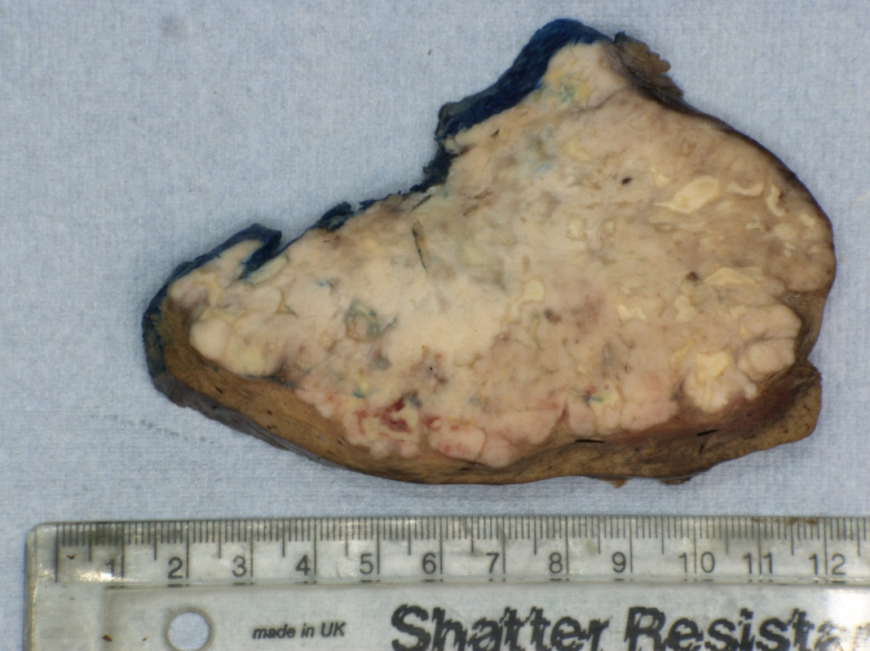
Cholangiocarcinoma

Slide 17
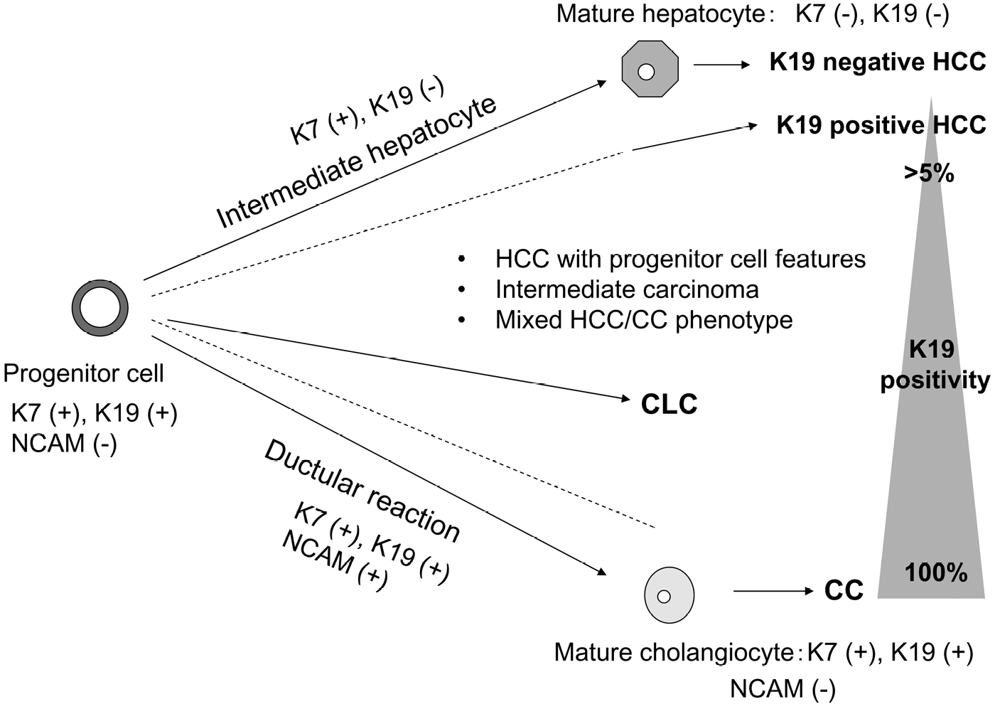
HEPATOLOGY 2008;47:1544-1556.

Slide 18
Classification
Intrahepatic Cholangiocarcinoma
1 = peripheral cholangiocarcinoma
2a,b = right and left hepatic ducts
3 = confluence of right and left hepatic ducts (perihilar, Klatskin tumours)
Extrahepatic
4 = common hepatic duct
5 = gall bladder
6 = cystic duct
7 = common bile duct
Notes:
It is classified into intrahepatic and extrahepatic as depicted in this schematic diagram. ICCs present as a mass lesion in the liver. 20-25% ICC
75-80% ECC- 60% Klatskin, 20% distal
5% multi-focal
Worldwide ICC account 25% of all primary liver cancer
Further classification on tumour morphology, mass forming, periductal infiltrating and intraductal growing type
Also extrahepatic extra classification nodular, sclerosing or papillary
Hilar lesion 60% CCA further classified by Bismuth

Slide 19
Cholangiocarcinoma
Distribution:
20-25% ICC
75-80% ECC (60% Klatskin, 20% distal)
5% multi-focal
Classification on ICC
mass forming,
periductal infiltrating or
intraductal growing
Classification of ECC
nodular,
sclerosing or
papillary

Slide 20
Age-Specific Mortality Rates of Intrahepatic Cholangiocarcinoma (males), England and Wales, 1968-1996
Taylor-Robinson et al 2001

Slide 21
Macroscopic findings
Mass forming
Periductal infiltrating

Slide 22
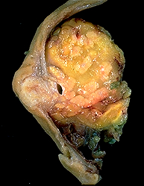
Macroscopic findings

Slide 23
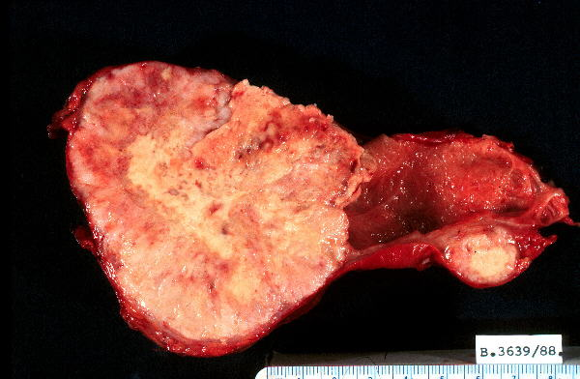
Gall bladder cancer

Slide 24
Gall bladder cancer

Slide 25
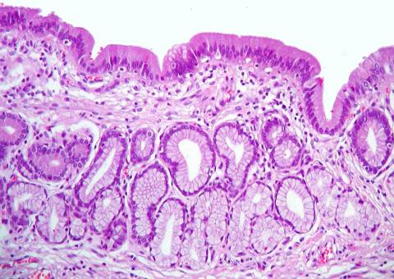
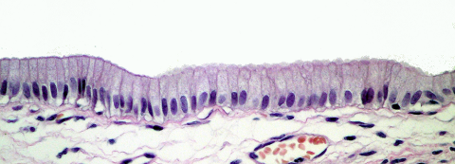
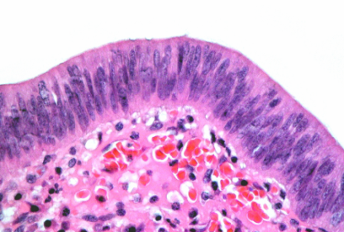
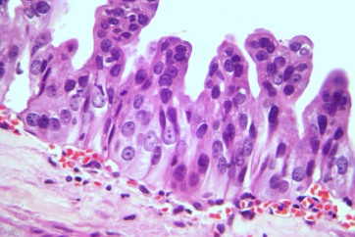
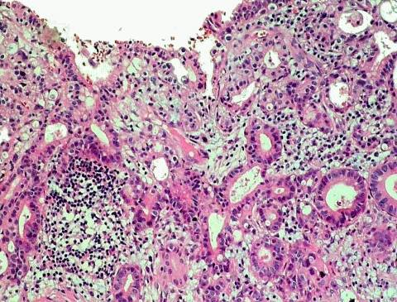
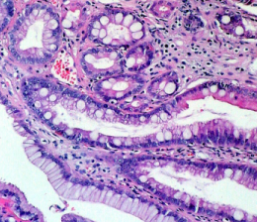
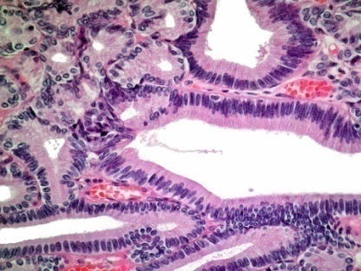
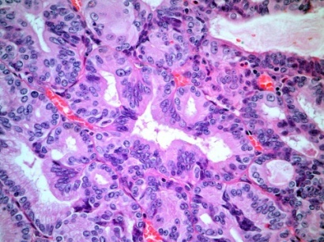
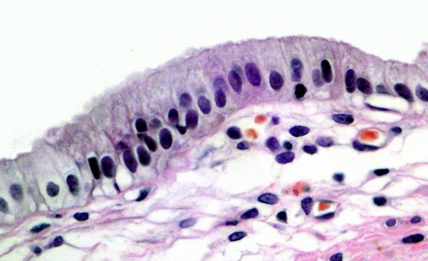
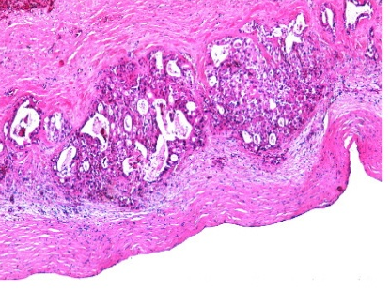
1.- Sequence Metaplasia-Dysplasia-Carcinoma.
Pseudopyloric
metaplasia
Chronic Cholecystitis
mucosa
Dysplasia
Carcinoma
In situ
Invasive
carcinoma
Intestinal
metaplasia
2.- Sequence Adenoma-Carcinoma.
Normal
mucosa
Invasive
carcinoma
Adenoma
J Surg Oncol. 2006 Jun 15;93(8):615-23.
Roa JC 2007 Novaeditorial

Slide 26
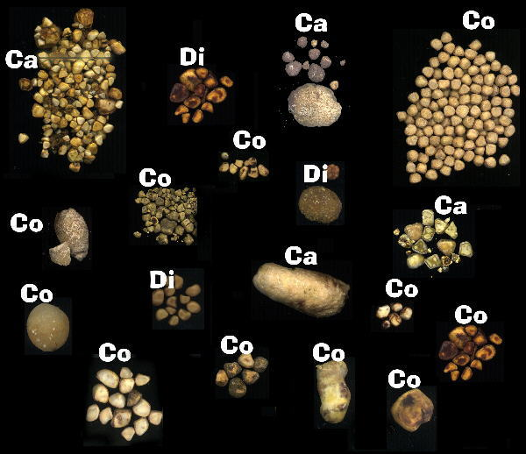

Slide 27
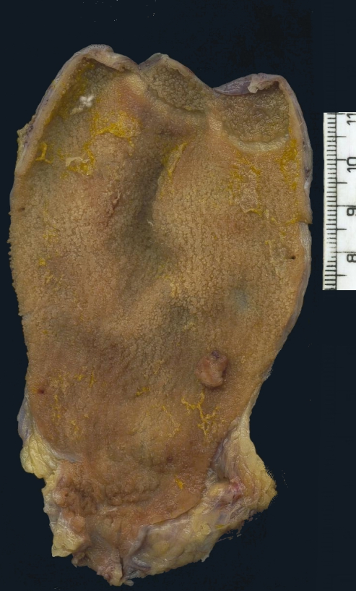
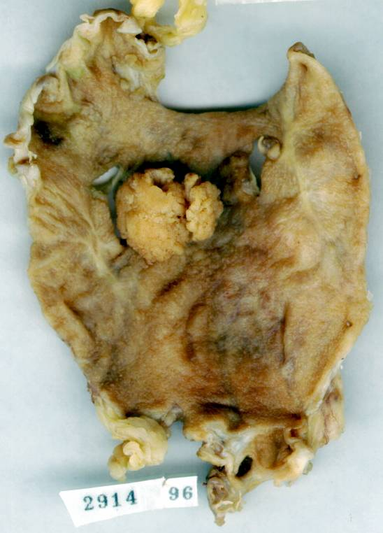
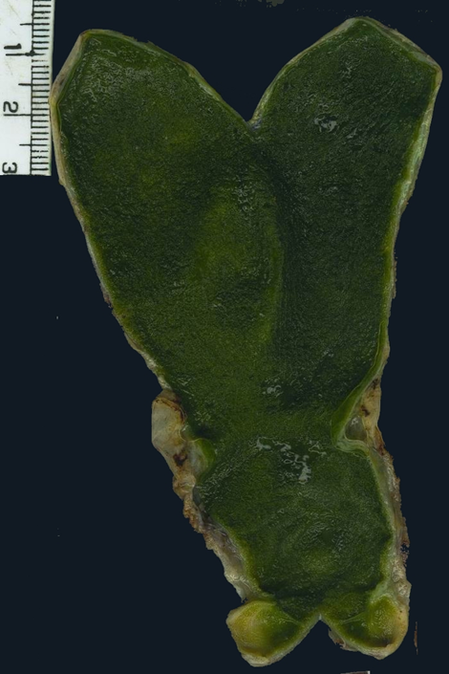
Adenoma-carcinoma: Sequence
Adenoma
Adenocarcinoma
Normal

Slide 28
Tumours of Bile Ducts
Rob Goldin
r.goldin@imperial.ac.uk

