Slide 1
Critical care of liver failure
Dr Harry Antoniades
Lecturer and Consultant in Hepatology
(Dr Ameet Dhar
Consultant in Hepatology)

Slide 2
Format of talk
Main indications for critical care in Hepatology:
Acute on chronic Liver failure
Other indications:
Variceal Bleeding
Hepatic Encephalopathy
Acute liver failure
Notes:
This figure describes the clinical concept of ACLF to distinguish it from chronic decompensated cirrhosis. The red line describes the course of a patient with chronic decompensation of cirrhosis that during evolution of their liver disease will at some point develop organ dysfunction. This is usually in association with advanced liver disease where the only option for treatment is liver transplantation and the chances of reversibility of liver disease are very limited. This is contradistinction to the patient with acute-on chronic liver failure (depicted by the blue line) who may often have good liver reserve and can deteriorate acutely over a short period usually in association with a precipitating illness that results in organ failure and high risk of death. The patient may also have advanced liver disease but be stable and deteriorate acutely following a precipitating event and progress to organ failure. By contrast, this patient has a potential for reversibility and recovery to the state the patient was in prior to the acute event

Slide 3
Introduction
Approx 26,000 patients with cirrhosis per year require ITU admission in the USA
> 50 % mortality in this patient group
This has remained unchanged in last 20 yrs.
Olson et al, Hepatology 2011
Notes:
This figure describes the clinical concept of ACLF to distinguish it from chronic decompensated cirrhosis. The red line describes the course of a patient with chronic decompensation of cirrhosis that during evolution of their liver disease will at some point develop organ dysfunction. This is usually in association with advanced liver disease where the only option for treatment is liver transplantation and the chances of reversibility of liver disease are very limited. This is contradistinction to the patient with acute-on chronic liver failure (depicted by the blue line) who may often have good liver reserve and can deteriorate acutely over a short period usually in association with a precipitating illness that results in organ failure and high risk of death. The patient may also have advanced liver disease but be stable and deteriorate acutely following a precipitating event and progress to organ failure. By contrast, this patient has a potential for reversibility and recovery to the state the patient was in prior to the acute event

Slide 4
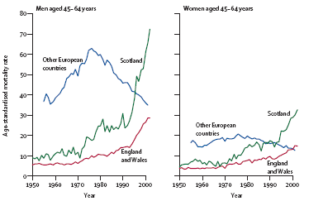
UK trends: cirrhosis related mortality increasing
Leon et al Lancet 2006;367:52-56

Slide 5
Introduction: ACLF
Majority of these patients have acute on chronic liver failure (ACLF)
ACLF = acute deterioration in liver function in patients with cirrhosis, either secondary to superimposed liver injury or due to extrahepatic precipiting factors leading to end organ dysfunction.
Unregulated inflammation is thought to be a major contributing factor.
Jalan et al, Journal of Hepatology 2012
Notes:
This figure describes the clinical concept of ACLF to distinguish it from chronic decompensated cirrhosis. The red line describes the course of a patient with chronic decompensation of cirrhosis that during evolution of their liver disease will at some point develop organ dysfunction. This is usually in association with advanced liver disease where the only option for treatment is liver transplantation and the chances of reversibility of liver disease are very limited. This is contradistinction to the patient with acute-on chronic liver failure (depicted by the blue line) who may often have good liver reserve and can deteriorate acutely over a short period usually in association with a precipitating illness that results in organ failure and high risk of death. The patient may also have advanced liver disease but be stable and deteriorate acutely following a precipitating event and progress to organ failure. By contrast, this patient has a potential for reversibility and recovery to the state the patient was in prior to the acute event

Slide 6
Acute on chronic liver failure
(cirrhosis + organ failure)
Variceal bleeding
Sepsis/SIRS
Acute severe alcoholic hepatitis
Others: Direct hepatic injuries/ Extra hepatic injuries
Not mutually exclusive – i.e. in many patients > 1 precipitants have occurred

Slide 7
Acute on chronic liver failure vs chronic hepatic decompensation ?
AoCLF: yellow line
Presence of a precipitating factor
Potential for recovery
High risk for MOF
Is alcoholic hepatitis different to sepsis is different to varices
Acute insult
Recovery/Re-compensation
Liver function (%)
CHD: red line
Absence of a precipitating factor
Relentless deterioration of underlying chronic liver disease
Low probability of revovery
Only treatment option is OLT
Threshold for organ failure
Failure to recompensate/death
Months
Jalan R et al. J Hep 2012
Laleman W et al. Expert Reviews Gastro & Hepatology 2011
Notes:
This figure describes the clinical concept of ACLF to distinguish it from chronic decompensated cirrhosis. The red line describes the course of a patient with chronic decompensation of cirrhosis that during evolution of their liver disease will at some point develop organ dysfunction. This is usually in association with advanced liver disease where the only option for treatment is liver transplantation and the chances of reversibility of liver disease are very limited. This is contradistinction to the patient with acute-on chronic liver failure (depicted by the blue line) who may often have good liver reserve and can deteriorate acutely over a short period usually in association with a precipitating illness that results in organ failure and high risk of death. The patient may also have advanced liver disease but be stable and deteriorate acutely following a precipitating event and progress to organ failure. By contrast, this patient has a potential for reversibility and recovery to the state the patient was in prior to the acute event

Slide 8
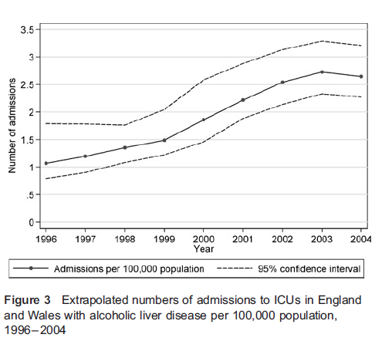
Who: Aetiology of ACLF in ITU
353 ACLF First Admissions to LITU, Kings College Hospital,
1999-2004
Welch et al J Health Science Research & Policy 2008;13S2:40-44

Slide 9
Who: Aetiology of Cirrhosis in ITU
ICU series of consecutive patients
n=143 Hepatology 2001:34;255-61
n=420 Chest 2004;126;1598-03
n=312 Ali Pharm Ther 2006:23;883-93
n=111 J Clin Gast 2003;37:251-7

Slide 10
ACLF in ICU; Prognosis
Study Year n Mortality
Zimmerman et al 1996 117 63%
Hepatology 1996;23:193-1401
Zauner et al 1996 198 52%
ICM 1996;22:559-63
Wehler et al 2001 143 46%
Hepatology 2001;34:255-61
Aggarawal et al 2001 582 49%
Chest 2001;119:1489-97
Tsai et al 2003 111 65%
J Clin Gastro;37:251-257
Arabi et al 2004 129 74%
E J Gastro Hep 2004;16(3):333-9
Gildea et al 2004 420 44%
Chest 2004;96(4):1232-6
Cholongitas et al 2006 312 65%
Alim Pharm Ther 2006;23:883-893
Fang et al 2008 111 81%
Neph Dial Trans 2008;23(6):1961-9
Junea et al 2009 104 42%
J Crit Care 2009;24(3):387-93

Slide 11
Pathophysiology
Not fully understood
Important to understand to allow for best interventions and improve prognosis
Multisystem disorder
Hepatic - reduction in liver synthetic function, raised bilirubin
- histologically : cell death, loss of cellular actin
- raised portal pressures (especially in sepsis, AH)
Baseline hyperdynamic circulation with effective intravascular depletion
Activation of R-A-A/ADH

Slide 12
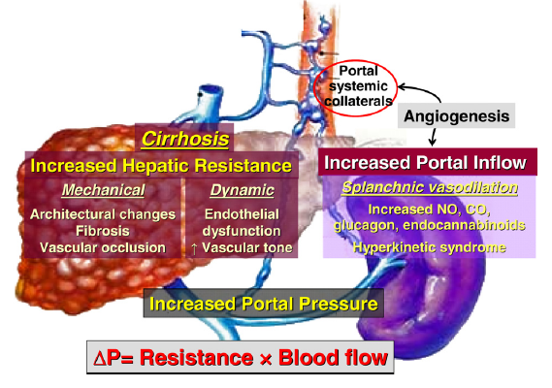
Pathogenesis: Increased Portal pressures
Bosch et al , J hepatology ‘08
Notes:
Increased intrahepatic resistance: incorporates both static and dynamic factors
The initial event leading to PH is – increased vascular resistance to portal blood flow at the hepatic microcirculation. Increased hepatic vascular resistance is not only –mechanical consequence of hepatic architectural distortion casued by fibrosis, regenerative nodules, sinusoidal remodelling and vascular occlusion that is characteristic of a cirrhotic liver.
Increasingly recognised is a dynamic component: that is thought to account for a 1/3 of increased resistance to portal blood flow
Active contraction of portal/septal myofilbroblasts
Activated hepatic stellate cells/vascular smooth muscle cells
Hepatic endothelial cell dysfunction
- These events are believed to reflect an imbalance between endogenous vasocontrictors and vasodilatory mediators
Second factor contributing to PH: increased blood inflow through portal venous system due to splanchnic arteriolar
Vasodilatation
Splanchnic vasodilatation - occurs due to increase in levels of vasodilators e.g. NO, glucagon etc. This results in the hyperkinetic/hyperdynamic circulatory syndrome that we will discuss shortly.

Slide 13
Inflammation and SIRS
SIRS= systemic inflammatory response
Associated with poorer survival in ALF
Elevated levels of pro-inflammatory cytokines in ACLF

Slide 14

Increased permeability
Smalll bowel overgrowth
Oxidative damage
Small bowel
Bacterial, DNA, LPS, GPS
Gut failure
Portal vein
SIRS activation
Hepatic haemodynamics
Systemic
bacteraemia
Multiple organ failure/dysfunction
Circulatory dysfunction
Adrenal insufficiency
Cirrhotic cardiomyopathy
Impaired vascular responses
Impaired Kuppfer cell/RES activity
Notes:
Conversely, the development of multiorgan failure in is characterized by significant
alterations in systemic and hepatic hemodynamics and to worsening of liver function.
Bacterial translocation plays an important role both in the transition of patients from
compensated to decompensated cirrhosis and together with bacterial infection are
the most frequent precipitants of such deterioration via systemic inflammatory
response.

Slide 15
Other organ involvement in ACLF:
Renal Dysfunction
Brain Dysfunction
Cardiac Dysfunction
Adrenal Dysfunction
Coagulation
Immune dysregulation further predispostion to infection (immune paresis).

Slide 16
Management
Investigate for and manage any potential precipitating factors
Investigate for and manage any potential effects/ sequalae on other organs to prevent multi-organ failure

Slide 17
Precipitating factors
ACLF results from a precipitating event on the background of cirrhosis
Deterioration could be a superimposed combination of:
Direct Liver Injury:
-Alc. Hepatitis
-DILI (drug induced liver injury)
-Viral hepatitis
-PVT (portal vein thrombosis)
-Ischaemic injury
Extra- hepatic insult:
- Infection
- Variceal bleed
- Surgery
- Trauma

Slide 18
Precipitating factors
Prompt identification of precipitating factor
Prompt treatment (if applicable) of any precipitating factor:
- Rapid control of bleeding secondary to varices
- Treatment of infection
- Treatment of Alcohol Hepatitis
- Cessation of drug in DILI

Slide 19
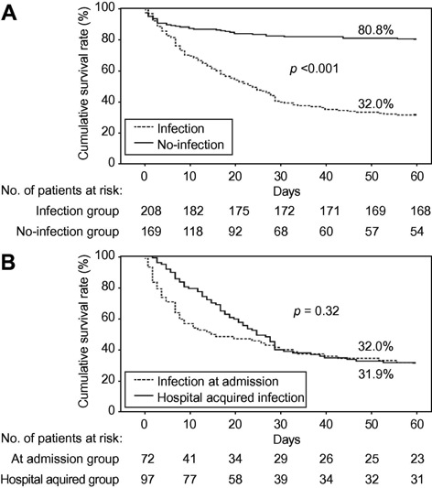
ACLF precipitating factors: Infection
Common in ACLF
40-50% hospital admissions of
cirrhotics
20-40% develop nosocomial
infections
SIRS criteria for sepsis unreliable
in cirrhotic patients
(present in 57-70% infected patients)
Infection confers poor outcome
Levesque E et al. J Hepatology 2012, n = 377

Slide 20
Sepsis in cirrhotic patients
Infection Frequency
SBP* 25%
UTI* 20%
Pneumonia† 15%
Bacteraemia† 12%
Culture negative (50%)
* gram negative organisms (E.Coli)
† gram positive organisms (S.pneumoniae/Staphylococci)
Others: pseudomonas, enterococci spp.

Slide 21
Bacterial translocation: “culture negative sepsis”
Bacterial translocation (detection of bacterial DNA in blood)
Role in circulatory dysfunction in non-infected cirrhotics
Predisposing factors:
Intestinal bacterial overgrowth
Reduced small bowel motility
Increased intestinal mucosal permeability
(structural, functional, oxidative damage)
Higher incidence of bacterial translocation in advanced cirrhosis
(Cirera et al, J Hepatol 2001)
Bacterial DNA +: low MAP, SVR, ↑ pro-inflammatory cytokines, PRA
renal dysfunction
(Frances et al Hepatology 2008; Bellot et al Hepatology 2010)
Notes:
Presence of bacterial DNA, a marker of bacterial translocation, is associated with aggravation
of peripheral vasodilation and with worsening of intrahepatic endothelial dysfunction

Slide 22
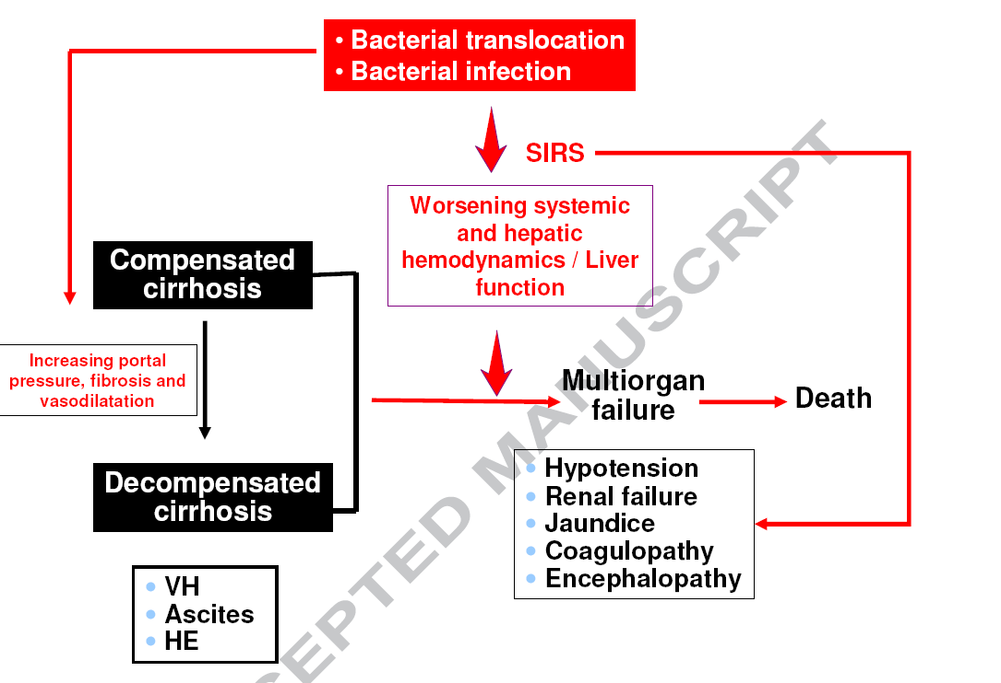
Notes:
In the
transition from compensated to decompensated cirrhosis (marked by the
development variceal hemorrhage, ascites and/or hepatic encephalopathy)
increasing portal pressure and liver fibrosis play a predominant role, while
vasodilatation (and the resultant hyperdynamic circulatory state) is not as prominent.
Conversely, the development of multiorgan failure in is characterized by significant
alterations in systemic and hepatic hemodynamics and to worsening of liver function.
Bacterial translocation plays an important role both in the transition of patients from
compensated to decompensated cirrhosis and together with bacterial infection are
the most frequent precipitants of such deterioration via systemic inflammatory
response. VH = variceal hemorrhage; HE = hepatic encephalopathy

Slide 23
Infection & variceal bleeding
High incidence of infections in cirrhotics with variceal bleeding
(20% at admission; 50% during first few days)
Meta-analysis reduction in infection (45% vs 14%) and mortality (24% vs 15%) with antibiotic prophylaxis (Bernard et al, Hepatology ‘99)
Infection is associated with failure to control bleeding & variceal re-bleeding (Goulis et al Lancet 1999; Hou et al Hepatology ‘04)
Antibiotic prophylaxis associated lower incidence early variceal re-bleeding (Hou et al, Hepatology ‘04)
Cochrane analysis : evidence base for antibiotics
8 trials (864 cases)
Significant decrease mortality (RR 0.73) and incidence of bacterial infection (RR 0.4)

Slide 24
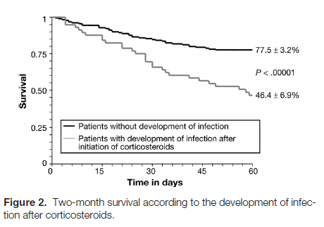
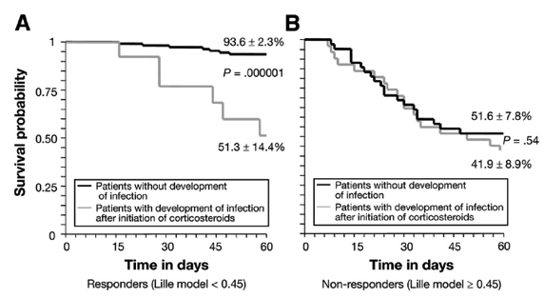
Infection and Alcohol Hepatitis:
Infection increases mortality in AH
Louvet et al. Gastroenterology 2009
Notes:
Patients with infection following initiation of corticosteriods had a worse prognosis compared to those without infection

Slide 25
Management of ACLF
Exclude sepsis and consider broad spectrum antibiotics

Slide 26
Treating Multi-organ involvement in ACLF:
Aim to try and pre-empt organ failure, or if not possible provide good organ support:
Renal Dysfunction
Brain Dysfunction
Cardiac/ Respiratory Dysfunction
Adrenal Dysfunction
Coagulation
Immune dysregulation further predispostion to infection

Slide 27
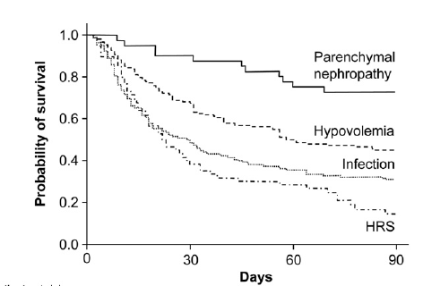
ACLF: Renal failure
Most data extrapolated from advanced cirrhotics;
emerging data in ACLF
Causes: multifactorial
Infection (46%)
Hypovoloameia (32%)
HRS (13%)
Parenchymal nephropathy (9%)
Drug-induced (7.5%)
Creatinine >133
n=562
Cause | 3 month survival
Intrinsic renal disease | 73%
Hypovoloaemia | 46%
Infection | 31%
HRS | 15%
Martin-Llahi et al, Gastro ‘11
Notes:
In patients with cirrhosis and ascites – proability of development of HRS @ 1yr is 20% & 50% @ 3-5years.

Slide 28
Non-SBP related sepsis and renal failure
106 cirrhotic patients with non-SBP related sepsis
27% had associated renal failure at or during admission
21% reversible renal failure (55% 3 month MR)
6% non reversible renal failure (100% MR)
Admission MELD score predicted poor outcome
Terra et al, Gastro ‘05

Slide 29
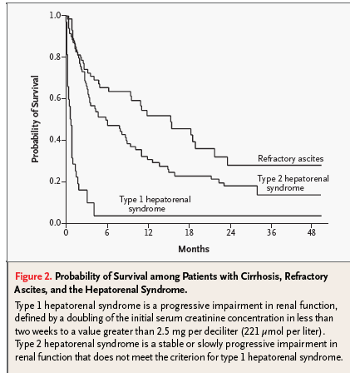
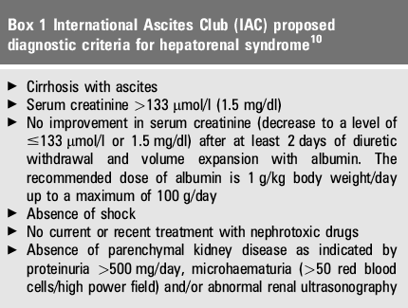
Hepatorenal syndrome
HRS: functional disorder secondary to circulatory dysfunction with splanchic vasodilatation, low BP, renal vasoconstriction, and marked activation of sympathetic and neurohormonal systems.
Or - the kidneys are essentially underperfused with no evidence of intrinisic kidney disease.
Notes:
Problems with serum creatinine as marker of renal dysfunction in cirrhosis: single measurement is inaccurate at defining the severity of renal failure, but repeated measures define the variations in GFR during evolution of disease.
Serum Cr may overestimate GFR due to reduced creatinine production/reduced muscle mass
New definitions are required- akin to acute kidney injury definiton:
abrupt (2 days) reductionin renal function (increase in Scr by >23mcmol/L; increase of >50% from baseline; u/o<0.5ml/Kg/hr for >6hours)

Slide 30
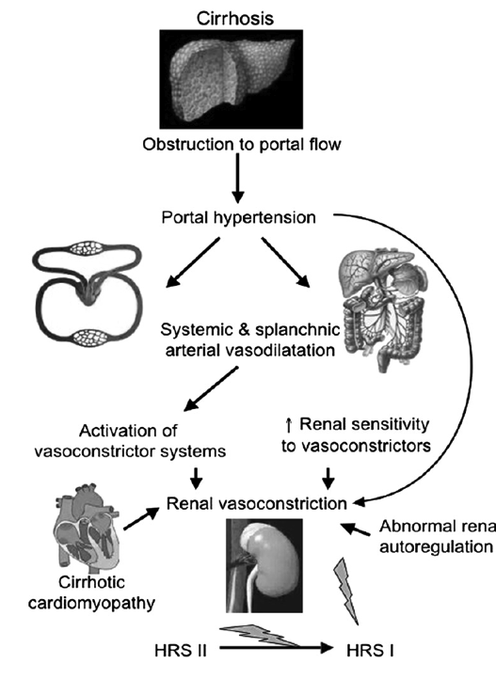

Slide 31
Non-SBP related sepsis and renal failure
106 cirrhotic patients with non-SBP related sepsis
27% had associated renal failure at or during admission
21% reversible renal failure (55% 3 month MR)
6% non reversible renal failure (100% MR)
Admission MELD score predicted poor outcome
Terra et al, Gastro ‘05

Slide 32
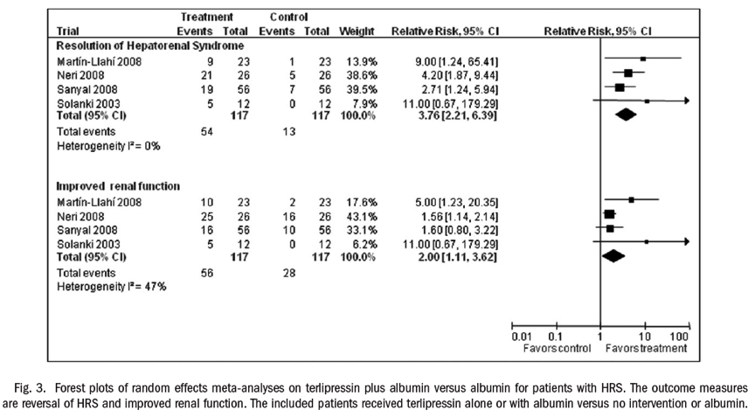
Current therapies for HRS
Treatment for HRS:
Terlipressin + albumin
Predictors of response
Only 1/3 patients respond
Increase in MAP>5mmHg at day 3*
Bilirubin <117mcmol/L*
Baseline Creat <381 mcmol/L
Sagi et al ; J Gastroenterol Hepatol ‘10
* Nazar et al, Hepatology ‘10; Boyer et al Journal of Hepatology ‘11
Notes:
Sagi meta analysis: From the available data terlipressin therapy along with albumin administered for a minimum of 3 days and maximum of 14 days appears safe, well tolerated and effective in reversing HRS type 1 in patients with cirrhosis. It can be used to bridge patients waiting for liver transplantation. Future studies are needed to determine the optimal dose and duration of terlipressin. The effect ofHRSreversal on overall survival and post transplant outcomes need to be studied.
Nazar study: hepatology 2010- spanish study n=39; responders (46%) were associated with increase in MAP >5mmHg at day 3, suppression of R-A-A and SNS system. Arterial pressure did not respond in those who were non-responders to Rx. MELD score, urine volume, leucocyte count associated with non response.
Boyer study: journal of hepatology ‘11: n=112
Baseline serum creatinine, presence of alcoholic hepatitis, and Child-Pugh score were also predictive of survival on multivariate analysis. Patients most likely to benefit from terlipressin have earlier onset renal failure (i.e. serum creatinine <5.0mg/dl-381mcmol/L)
The rise in mean arterial pressure (MAP) following terlipressin administration was not predictive of HRS reversal. However, in those who achieved HRS reversal from terlipressin, there was a significant rise in MAP from beginning to end of treatment

Slide 33
Management of ACLF
Exclude sepsis and consider broad spectrum antibiotics
IV Fluids to correct any intravascularly volume depletion
Consider teriplessin if evidence of Hepatorenal syndrome
Consider renal replacement therapy (filtration) if well filled and no improvement with teriplessin with continuing fluid/electrolyte/ acid-base imbalance.

Slide 34
ACLF: Brain Dysfunction
Hepatic encephalopathy is a common manifestation
Multifactoral:
Hyperammonemia
Inflammation
Cerebral oedema
Can be precipitated in particular by sepsis / electrolyte disturbances.

Slide 35
Management of ACLF
Broad spectrum antibiotics
IV Fluids to keep patient intravascularly filled
Consider teriplessin if evidence of Hepatorenal syndrome
Consider renal replacement therapy (filtration) if well filled and no improvement with teriplessin
Measures to prevent/ treat encephalopathy (Lactulose via NG if need be / enemas). Intubation if GCS < 8.

Slide 36
Adrenal insufficiency & ACLF
Relative adrenal insufficiency described in septic shock & acute liver failure (Harry et al, Hepatology 2002)
Detected in 51-77% of critically unwell cirrhotics (severe sepsis/septic shock)
Adrenal insufficiency in critically unwell cirrhotics:
- haemodynamic instability (80% vs 37%)
- renal failure; MELD score; vasopresssors need, higher MR
Hydrocortisone replacement:
- Resolution of shock
- Reduction in vasopressor requirements
- No effect on MR
Large European multicentre study in progress to assess clinical impact of stress dose hydocortisone
(Tsai et al; Hepatology ‘06; Fernandez et al, Hepatology ‘06; Arabi et al, CMAJ ’10)

Slide 37
Management of ACLF
Exclude sepsis and treat with broad spectrum antibiotics
IV Fluids to keep patient intravascularly filled
Consider teriplessin if evidence of Hepatorenal syndrome
Consider renal replacement therapy (filtration) if well filled and no improvement with teriplessin
Measures to prevent/ treat encephalopathy (Lactulose via NG if need be / enemas). Intubation if GCS < 8
Consider IV hydrocortisone if evidence of adrenal insufficiency

Slide 38
Cardiovascular complications
Cirrhotic cardiomyopathy:
impaired ventricular responses to physiological, pharmacological and surgical stress
↓ Δ HR, CI, systolic and diastolic dysfunction
Repolarisation defects (prolonged QTc)
Cardiac dysfunction (↓CO) plays a pathogenic role in development of HRS following SBP* , following TIPS insertion & post OLT
Changes in CO during ACLF vs CLD remain unstudied
Moller et al, Gut ’08, * Ruiz-del-Arbol et al, Hepatology ’03

Slide 39
Pulmonary complications
Acute respiratory failure:
pneumonia
acute lung injury
pleural effusions
Consequences of cirrhosis
Porto-pulmonary HT (hyperdynamic circulation)
Hepatopulmonary syndrome (shunting hypoxemia)
Olson et al, Hepatology 2011

Slide 40
Management of ACLF
Exclude sepsis and consider broad spectrum antibiotics
IV Fluids to keep patient intravascularily filled
Consider teriplessin if evidence of Hepatorenal syndrome
Consider renal replacement therapy (filtration) if well filled and no improvement with teriplessin
Measures to prevent encephalopathy (enemas etc).
Consider IV hydrocortisone if evidence of adrenal insufficiency
Invasive monitoring of cardiac status to guide fluid replacement and use of inotropes (noradrenaline).
Intubation/ ventilatory support if respiratory failure

Slide 41
Coagulopathy in ACLF
Routine coagulation markers often abnormal but bleeding rates are less than expected
Thrombin production in stable cirrhotics is actually normal.
In sepsis – endogenous heparinoids produced (role of antibiotics in variceal bleeding)
Defective platelet function also apparent
Further studies of benefits of clotting products required.
Jalan et al, J Hepatol 2012

Slide 42
Management of ACLF
Exclude sepsis and consider broad spectrum antibiotics (often tazocin)
IV Fluids to keep patient intravascularily filled
Consider teriplessin if evidence of Hepatorenal syndrome
Consider renal replacement therapy (filtration) if well filled and no improvement with teriplessin
Measures to prevent encephalopathy (enemas etc).
Consider IV hydrocortisone if evidence of adrenal insufficiency
Invasive monitoring of cardiac status to guide fluid replacement and use of inotropes
Correction of coagulation only if actively bleeding (not evidence based).

Slide 43
Nutritional support
Caloric requirements go up in sepsis
Correct any vitamin deficiencies (Thiamine, Zinc)
Ideally feed enterally – however if ileus risk of increased bacterial translocation
Maintain adequate glucose control – consider insulin sliding scale
Low protein diets have no role in improving outcome in HE.
Olsen et al, 2011

Slide 44
ACLF: Other treatment options
Liver assist devices:
Like dialysis for the liver
Rationale was to offer an intervention to
bridge to transplant
No improvement in survival

Slide 45
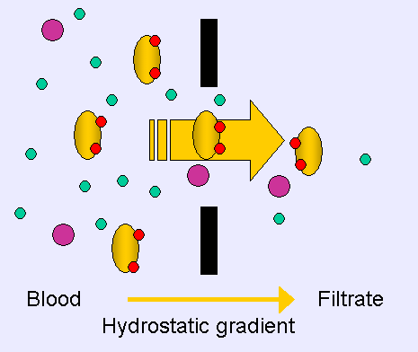
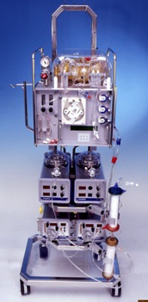
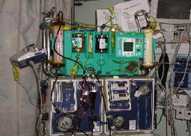
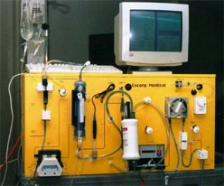
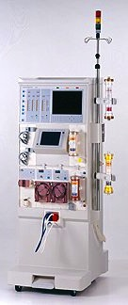
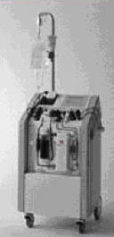
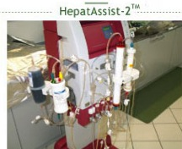
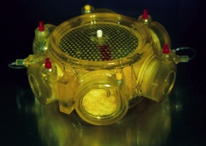
Liver assist devices

Slide 46
RELIEF (MARS) study : presented EASL 2010 n=185
Fall in creatinine (p=0.02) and bilirubin (p=0.01)
Improvement in HE from II/IV at inclusion to 0-I, 56 vs 39%
28 day survival 40 vs 40.8%
1.0
ITT population
1.0
PP population
0.8
0.8
  reduces toxins
  improves hepatic coma
  improves hemodynamic instability
0.6
0.6
0.4
0.4
0.2
SMT
SMT +MARS
0.2
SMT
SMT +MARS
Log-rank test: p=0.79
Log-rank test: p=0.88
0.0
0.0
0
5
10
15
20
25
30
0
5
10
15
20
25
30
Overall 28 days mortality:
SMT: 39.3 %
SMT + MARS: 41.4 %
Overall 28 days mortality:
SMT: 40 %
SMT + MARS: 41.2 %
Notes:
46
This slide shows the effect of MARS therapy on 28 days transplant-free survival. As you can see there were no differentes between both arms either in ITT population or in PP population. Overall mortality was about 40 % in both groups and populations
46

Slide 47
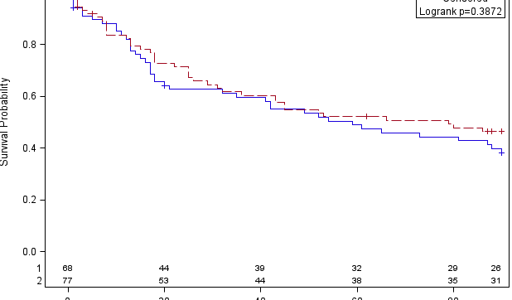

Effect of PROMETHEUS on survival
EASL 2010
Day 21
Diff.~10%
Day 28
SMT+FPSA: 66%
SMT: 63%
Diff. ~ 3 %, NS
Day 90
SMT+FPSA : 47%
SMT: 38%
Diff. ~ 9%, NS
reduces toxins
effective in certain sub-groups
Improved outcome at 3 months for MELD > 30 and HRF type 1
Notes:
47
The study has not sufficient power, number of patients needed - 760

Slide 48
Introduction ACLF: How we decide who goes to ITU?
Acute on chronic liver failure
(cirrhosis + organ failure)
Variceal bleeding
Sepsis/SIRS
Acute severe alcoholic hepatitis
Futility
Salvage to transplantation
Reversibility
Improved outcomes
High mortality rate

Slide 49
ICU admission for ACLF
  Primary aetiology: Alcohol
  Increasing burden of disease
  High resource use and cost
  ICU Mortality high
  Post ICU mortality high
  But:
  Any different from other chronic disease state?

Slide 50
ICU admission for ACLF
Why admit to ICU?
  It’s not (always) futile
  Some patients will benefit
  Case selection is key
    Which patients?
    How to identify?

Slide 51
ICU admission for ACLF
Who to admit: avoiding futility
  Admission and level of support available
  Standard ICU considerations
    Age
    Co morbidity
    Functional / nutritional state

Slide 52
ICU admission for ACLF
  Severity of underlying liver disease
  Will transplant be an option if they improve?
  MELD/ UKELD score / CP score (score severity of liver disease)
  Any contraindications to OLT?
  Severity of acute illness
  SOFA or APACHE score: better for determining survival
  if multi-organ failure than MELD/UKELD/CP
  Number of organs failing

Slide 53
Organ failure in cirrhosis and outcome
Higher MR – higher the incidence of organ failure
3 organ failure (>3/7 in ICU)- MR 89%
ACLF- most imp determinant of outcome is organ failure
Survival
1 organ 21%
2 organ 55%
3 organ 89-100%
Important to identify early and Rx with goal directed therapy (as in sepsis) may improve outcome
Rx prior to or to offset the progression of organ failure
(Das et al Crit Care med ‘10)

Slide 54
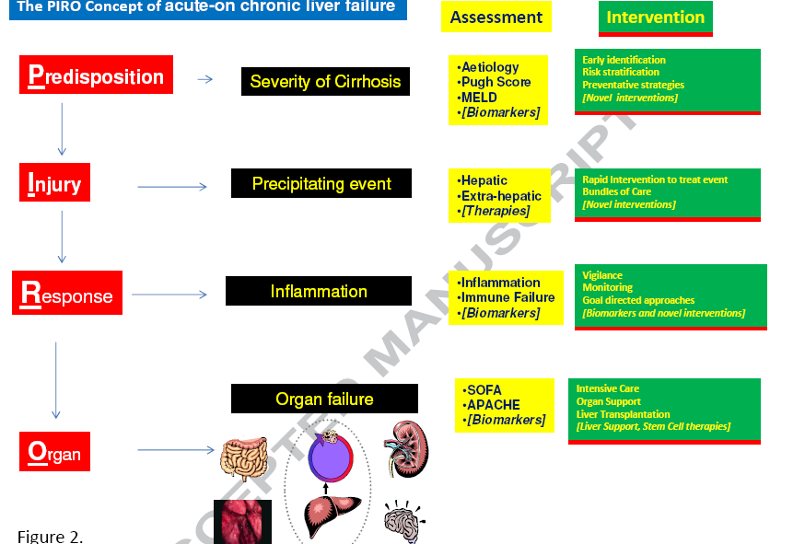
PIRO concept: degree of all end organ failure not just liver failure that will determine patient survival
Notes:
In patients with
ACLF, it is useful to think about the PIRO concept in determining pathogenesis and
prognosis. The Predisposition is indicated by the severity of the underlying illness.
Injury by the nature and severity of the precipitating event. Response by host
response to injury which determines the severity of inflammation and risk of infection.
Organs by the extent of organ failure. Categorisation of patients into these entities
allows definition of interventions and helps define prognosis at the different levels.

Slide 55
ICU admission for ACLF
  Indication for admission
  Variceal bleeding
  Hepatic Encephalopathy

Slide 56
ACLF: Indication for ICU Admission
Variceal Bleeding
Outcome of LITU admission ACLF KCH 2000-07. n=563
 | Survivors | Non-survivors | p value
Number | 307 (55%) | 256 (45%) | -
Age | 49 (30-68) | 51 (34-68) | ns
Male : Female | 196:111 | 152:104 | ns
Aetiology Alcohol Other | 146/263 (56%) 161/300 (54%) | 117/263 (44%) 139/300 (46%) | ns
Reason for Variceal Bleed Admission Non Variceal | 139/196 (71%) 168/367 (46%) | 57/196 (29%) 199/367 (54%) | <0.0001
Austin et al 2008 unpublished

Slide 57
ACLF: Indication for ICU Admission
Isolated HE
Fichet et al J Crit Care 200924:364-370
Outcomes in 71 patients with CLD and ICU
45 with isolated HE: Median GCS 8.2 /15
Median CP 11
73% required intubation and ventilation
  Sole organ support
ICU mortality 8.9%

Slide 58
ICU Admission for ACLF
Difficult decisions
  Is there a right answer ?
    Societal considerations
  Give the patient the benefit of the doubt ?
    Consider short and medium term prognosis
    If in doubt, admit and treat
    Aggressive short term therapy
    Review after 48-72 hours
    Set ceilings for therapy
    Consider withdrawal if no response

Slide 59
Summary
ACLF is a syndrome with high mortality
Acute deterioration in liver function with failure of one or more organ
Vast majority of liver cases on ITU
Management is a multidisciplinary
supportive approach (ITU/Hepatology)

Slide 60
Further reading
Olson et al. Intensive care of the patient with cirrhosis. Hepatology 2011;54: 1864-1872
Jalan et al. Acute on chronic liver failure. Journal of Hepatology 2012;57:1336-1348

Slide 61
Acute liver failure (ALF):

Slide 62
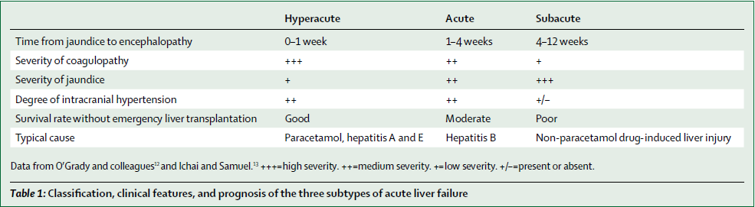
Definitions
Encephalopathy in a patient with NO previous liver disease

Slide 63
Aetiology
Cause
Viral hepatitis
Hepatitis A, B, D E, CMV, HSV, Seronegative hepatitis
Drug related
Paracetamol
Anti tuberculous drugs,
lipid therapies
Recreational drugs Idiosyncratic reactions Anticonvulsants, NSAID,

Slide 64
Aetiology
Toxins
Carbon tetrachloride, Amanita phalloides
Vascular events
Ischaemia VOD, Budd-Chiari
Other
Acute fatty liver of pregnancy, liver rupture, Heatstroke,
Wilson’s disease, lymphoma, carcinoma
Trauma

Slide 65
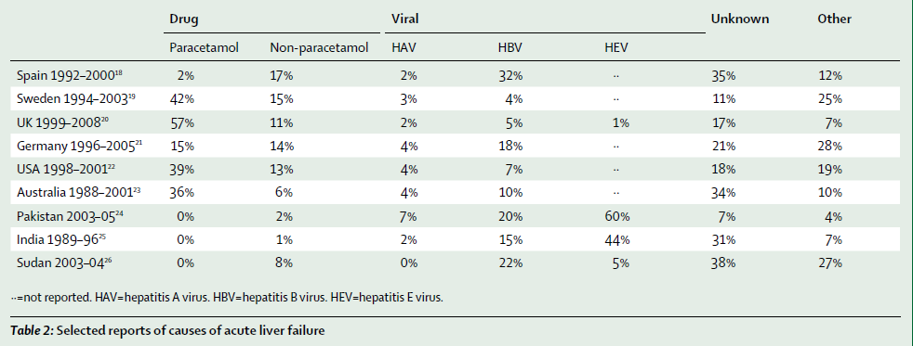
Aetiology: geographical variations

Slide 66
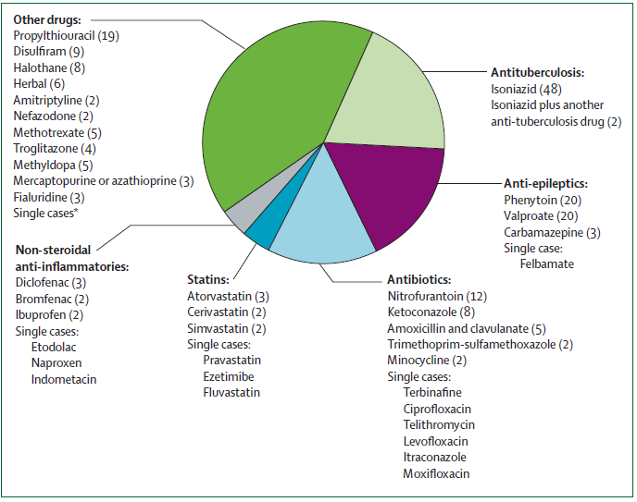
Causes of drug-induced liver injury

Slide 67
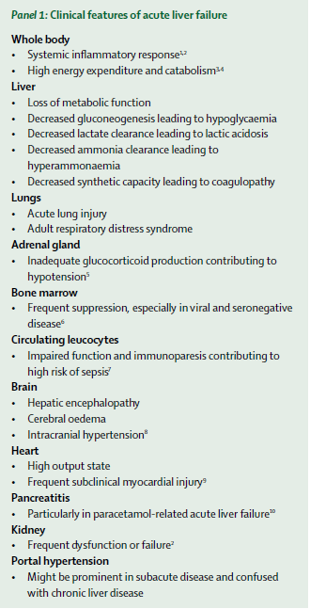
Clinical syndrome
Multisystem disorder
Typical stigmata of liver disease are very unusual (more common in subacute ALF)

Slide 68
Clinical syndrome
Multisystem involvement
Typical stigmata of liver disease are very unusual (more common in subacute LF)
Systemic inflammatory responses
Jaundice
Encephalopathy/intracranial hypertension
Renal failure
Haemodynamic failure
Respiratory failure
Haematological failure
Infection

Slide 69
SIRS in acute liver failure
ALF has striking phenotypic similarities with septic shock:
hyperdynamic circulation
Increased CO state
Profound peripheral vasodilatation
Effective intravascular depletion
Occurrence of SIRS in acute liver failure (ALF) is well recognised (Rolando et al Hepatology 2000, Vaquero et al Gastroenterology 2003)
SIRS was present in 40% patients with ALF in absence of infection
Massive elevations in both pro-(TNF-a, IL-1β, IL-6) & anti-(IL-10) inflammatory cytokines
Both studies demonstrated SIRS, independent of infection, is associated:
severity of organ failure (SOFA, APACHE II)*
↑ encephalopathy score
poorer outcome
* Schmidt et al, Crit Care Med ‘06

Slide 70
Encephalopathy & Intracranial hypertension
Encephalopathy:
I/II: mild disorientation, drowsiness, respond appropriately
III: agitation and disorientation, unable to follow commands
IV: deep coma
Intracranial hypertension:
Occurs in grade IV encephalopathy:
70% hyperacute liver failure
55% acute liver failure
Up to 15% subacute liver failure
Major cause of early mortality due to cerebral oedema and brainstem herniation

Slide 71
Ammonia & clinical studies
High circulating ammonia correlates:
encephalopathy
cerebral oedema/raised ICP
high mortality
Variable threshold concentrations for prediction of cerebral oedema/complications:
severe/progression HE: > 100-150μmol/L*
Risk of intracranial hypertension: >200μmol/L
(sensitivity 25%; 92% sensitivity)
Risk factors for progression & development HE:
ammonia
MELD>32
?other factors contribute to the development of HE/ICH
* Clemmesen et al, Hepatology ‘99; Bhatia et al, Gut ‘06; Bernal et al, Hepatology ‘07
Notes:
Raised ammonia conc is present in >90% patients with ALF.
Ammonia not able to detect threshold value for risk of ICP sensitivity 92%; specficity 92%. Failure to identify 75% of patients who develop ICH.

Slide 72
Ammonia & encephalopathy
Pathogenesis & mechanisms incompletely understood
Traditional theory: role of glutamine
hyperammonaemia → ↑ astrocyte glutamine → astrocyte swelling →cerebral oedema/ICH
Experimental models of ALF:
Changes in neurotransmitter synthesis/release
neuronal oxidative stress/impaired mitochondrial function
Astrocyte osmotic changes and swelling
Notes:
Changes in neurotransmitter: imparied glutaminergic neurotransmission (excitatory) leading to excessive neurointhibition (characterisitc of encephalopathy in ALF)

Slide 73
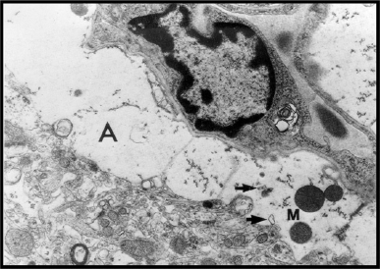
Neuroinflammation & HE
Inflammation & metabolic
  mediators (ammonia/lactate) play “synergisitc” role in pathogenesis of HE
Activated microglial cells:
  tissue macrophages
  activated by inflammatory stimulus
  implicated in other neuroinflammatory disorders
  ↑ pro-inflammatory cytokines (TNF-α, IL-1, IL-6)
Butterworth et al, Neurochemistry Int ‘12
Astrocyte
Microglial cell

Slide 74
Neuroinflammation & HE
Acute liver injury
-toxic
- viral
Neurotoxins
(ammonia, lactate)
glutamate
Astrocyte swelling
glutamine
TNF-a, IL-1, Il-6
ROS, RNI
Liver –brain inflammatory axis
Activated microglial cells
Systemic inflammation
(TNF-a, IL-1, IL-6)
CEREBRAL OEDEMA
RAISED ICP
Notes:
Evidence of neuroinflammation was first documented by a report of Jiang et al. (2006) followed by the results of a study suggestive of increased production of proinflammatory cytokines in brain in ALF patients (Wright et al., 2007) who measured TNF-a, IL-1b and IL-6 in blood sampled from an artery and a reverse jugular catheter in 16 patients with ALF due primarily to acetaminophen overdose. Crrelations of cytokines efflux and degree of ICH
Unequivocal evidence of neuroinflammation was subsequently provided by studies reported by Jiang et al. (2009a) who demonstrated microglial activation and concomitant increases in expression of genes coding for proinflammatory cytokines in experimental ALF in the rat resulting from hepatic devascularization
systemic proinflammatory mechanisms may initiate the signaling process, via one of several mechanisms that include
direct transfer of cytokines,
(2) interaction with receptors on circumventricular organs lacking a BBB or
(3) activation of afferent neurons of the vagus nerve. In addition, it has been proposed that systemic inflammatory signals
have the potential to result in increased permeability of the BBB to cytokines in ALF
A number of neurtoxic substancres are implcated in the pathogenesis of neuroinflammation in ALF. A wide range of molecules with the potential to threaten the functional integrity of the brain have the capacity to trigger the transformation of microglia from the resting to the active state. Such molecules include not only ammonia but also lactate, glutamate, and neurosteroids

Slide 75
Renal failure
Common 45% of all cases overall
75% paracetamol ALF with grade IV encepaholopathy
Multifactorial - frequently ATN rather than HRS
Intolerant of haemodialysis
  Haemodynamics and cerebral oedema
Buffer
  sodium bicarbonate
Anticoagulation
  epoprostenol, regional anticoagulation,
Does NOT respond to terlipressin/any other forms of “renal” inotropes!

Slide 76
Metabolic disorders
Hypoglycaemia- reduced gluconeogenesis
Hyperlactataemia- reduced hepatic lactate clearance to bicarbonate
Hypophosphataemia
Hyponatraemia
Metabolic acidosis (independent of renal function):
lactic acidosis, peripheral AV shunting (tissue hypoxia)

Slide 77
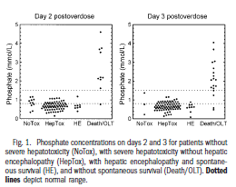
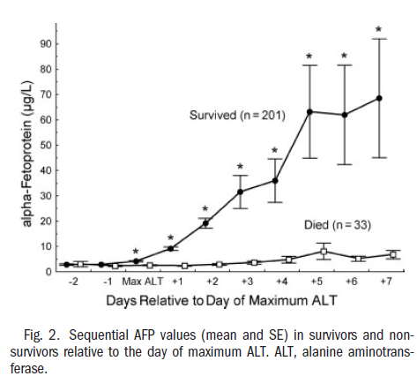
Hepatocyte regeneration
Alpha fetoprotein (AFP)
Serum phosphate
Regenerating livers:
↑ Protein phosphorylation/↑ ATP
↑ hepatic uptake of phosphorus
Hypophosphataemia correlates with acute liver injury
>1.2mmol/L indicator of non-survival
Detectable AFP at peak ALT (72-96hrs) post APAP
= favourable prognosis
↑ AFP often precedes ↓ INR
Schmidt et al, Hepatology ’04; Hepatology ‘02
Notes:
Following acute liver injury with extensive necrosis, an increase in AFP is interpreted as a sign of dedifferentiated hepatic regeneration. A peak ALT value was identifiable in all patients and appeared at a mean of 2.9 days (range, 1-6 days) after the overdose. In survivors, an increase in AFP was generally detectable 72 to 96 hours after the acetaminophen overdose.
When AFP values were related to the day of peak ALT, AFP values were significantly higher in survivors than in nonsurvivors starting on the day of peak ALT
In conclusion, an elevation of AFP above 3.9 g/L on the day after peak ALT was a highly discriminative indicator of survival from severe acetaminophen-induced liver injury. In many cases, the increase in AFP preceded the decrease in INR and thereby provided additional prognostic information
PHOSPHATE PAPER:
Hypophosphatemia is frequently observed in acetaminophen- induced hepatotoxicity and is correlated to the severity of liver damage.
Alternative
mechanisms leading to hypophosphatemia in acute liver failure include intracellular phosphate redistribution
because of hyperventilation, dextrose infusion, or phosphate consumption
Protein phosphorylation is a major regulatory
mechanism of cell proliferation, and, in regenerating rat
liver, hyperphosphorylation of nuclear proteins can be
demonstrated already 3 hours after partial hepatectomy.
The hepatic uptake of phosphorus and the mitotic activity of the hepatocytes increase more than 100-fold within 24 hours of major liver resection in rats.24 The peak increase in DNA synthesis at 24 hours and maximum mitotic activity at 48 hours after partial hepatectomy are preceded by a rapid turnover of intracellular high-energy phosphate, including adenosine triphosphate and creatine phosphate. A similar turnover of adenosine triphosphate
after major resection is seen in rabbits. Hepatic regeneration also involves plasma membrane proliferation, which requires phosphate for the synthesis of phospholipids.

Slide 78
Pulmonary complications
Non cardiogenic pulmonary oedema/ALI- occurs in 40% cases
Most common in POD ALF
Other causes:
Aspiration of gastric contents
Neurogenic 2º raised ICP
Primary pneumonia

Slide 79
Infection
Increased risk of bacterial and fungal sepsis
Conventional markers of sepsis (ie. Temp, WCC) are absent in ALF
Diagnosis difficult in context of progressive MOF
Common organisms: Staph, streps, coliforms, candida
Rolando et al

Slide 80
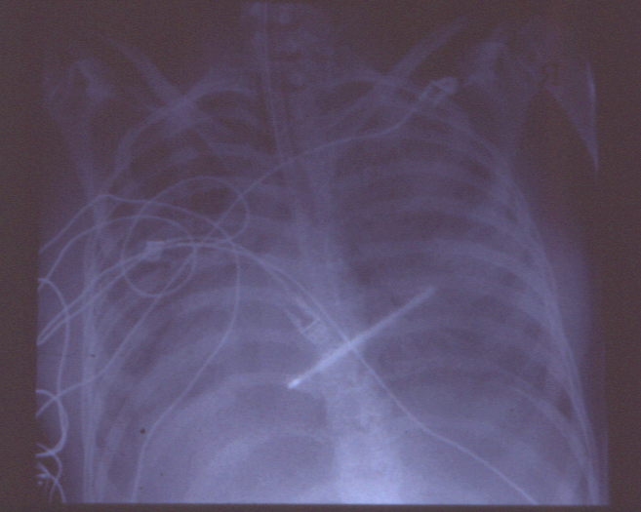
Infection and ALF
Rolando et al 2000 Hepatology 32:734 and 31(4):872
15 - 35% nosocomial infection rate vs 5 - 7 % in general hospital population (CLD)
Proven bacterial infection 335 of 887 patients (550 episodes)
Gram positives : 50%
Severe sepsis 58% mortality
Septic shock 98% mortality
Fungal infection 99 of 887 : 11%
64% mortality
prophylaxis (high risk)
viral infection :CMV,HSV

Slide 81
Haematological complications
Decreased circulating levels:
Fibrinogen
II, FV, VII, IX, X
Platelet dysfunction
Quantitative (70% <100)
Qualitative
Increased incidence of pancytopenia (haemopahogocytosis)

Slide 82
Investigations
Further Ix
Hepatitis serology
Autoantibodies
Serum copper, caeroplasmin, urinary copper
urinary myoglobin
Imaging
Liver biopsy???
Baseline Ix
FBC
U&E, LFT
CK
Amylase
Coagulation
Mg²⁺, PO²⁻
Haemolysis screen

Slide 83
Prognostic criteria
King’s College Criteria most widely adopted criteria for selection
Meta-analyses indicate good sensitivity but low sensitivity (unable to identify pts who need OLT)
rare condition (1-6 cases/million/year)
Low patients number; heterogeneous aetiology
Worldwide variation in definition of ALF
Changes in medical care and spectrum of disease
Exceptions:
Amanita phalloides poisoning
Wilson’s Disease
Pregnancy related liver failure syndromes
Acute Budd-Chiari syndrome

Slide 84
Indications for liver transplantation
Paracetamol Non-Paracetamol
pH < 7.30 pH<7.3
all 3 of the following INR > 6.5
within 24 hrs
PT > 100 INR > 6.5 Any 3 of :
Creatinine > 300 µmol/l seronegative hepatitis or
grade 3 - 4 encephalopathy drug reaction
Bilirubin > 300 µmol/l
INR > 3.5
Age < 10 yrs or > 40 yrs
J - E > 7 days
Lactate : 4 hrs > 3.5
Lactate : 12 hrs > 3.5
Clichy criteria (French)
Encephalopathy +
Factor V < 20%
or < 30% if > 30 yrs of age

Slide 85
Basis of Management
Recognition of
problems
Evolution of disease
- cerebral
- cardiovascular
- renal
- infection
- pulmonary
- metabolic
- nutrition
- coagulation
Monitoring
Measurement and
manipulation of
physiological
parameters
Multisystem Involvement

Slide 86
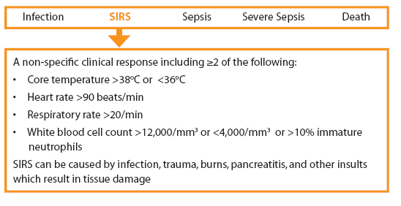
SIRS response – optimal fluid resucitation/high dependency care
Aggressive intravascular repletion
No dextrose – unless to correct hypoglycaemia
Pre-emptive invasive haemodynamic monitoring (CVP/art line)
Level 2 care
Regular clinical review
ABG/lactate/INR – 8 hourly

Slide 87
Management
Haemodynamics/tissue perfusion
Invasive monitoring (PICCO,PA catheter)
Achieve adequate/optimal fluid resuscitation
1st choice- noradrenaline
2nd line –vasopressin
Consider hydrocortisone infusion-
Functional adrenal insufficiency in ALF* (give supplemental steriods)
Synacthen test
abnormal synacthen response
  hypotension associated with lower baseline and increment (p<0.05)

Slide 88
Management of liver failure
Coagulopathy
    Give FFP only when decision for OLT listing established or significant bleeding
    Platelet/cryo support
Metabolic
    Correct all electrolyte deficiencies
    HCO⁻³ as temporary measure (8.4% used)
Nutrition
    Frequent poor recent oral intake ± vomiting
    No evidence for protein restriction in either acute or CLD
    Gastric prophylaxis : role unproven
        PPI routinely administered

Slide 89
Management of ALF
Renal failure
Almost always occurs in hyperacute ALF
Haemodialysis not tolerated
Continous veno-veno haemofiltration
Corrects acidosis and hyperlactataemia
Use of high volume CVVHF in ALF- achieve metabolic stability and bridge to OLT.
Anticoagulation: epoprostanol

Slide 90
Management
Infection
Those who fulfill transplant criteria
    This group get systemic antifungals in addition
    Most patients will be given anti-fungal prophylaxis (fluconazole)
Signs of sepsis / SIRS
Tazocin/Fluconazole as 1st line antimicrobial

Slide 91
Management
N-acetylcysteine (150mg/kg/24hrs)
Within 24 hours of POD- reduces/prevents liver damage
Role in improving outcome in late presentation POD (36-80hrs)
Improved oxygen delivery to tissues-inprovments in cerbral/systemic haemodynamics
“Antioxidant” use in ischaemic & toxic insults
Recent US ALF study demonstrating utility in non-paracetamol ALF- when initiated early in disease course*
* Lee et al, Gastroenterology ‘09
Notes:
When given within 24 h of paracetamol ingestion,
N-acetylcysteine can prevent or reduce liver damage evenN-acetylcysteine, and intervention studies showed
improvements in systemic and cerebral haemodynamics
and oxygen uptake.106,107 A multicentre double-blind
randomised trial108 of N-acetylcysteine in non-paracetamol
acute liver failure was completed after 8 years of
recruitment. N-acetylcysteine was well tolerated and
associated with improved non-transplanted survival, but
only in patients treated early in the course of disease and
with low-grade encephalopathy
after large overdoses.105 Early randomised trials suggested
reductions in mortality from late administration of

Slide 92
Management
Neurological
  Intubate/ventilate (grade III)
Head up 20⁰C
Sedation +++(decreases cerebral metabolism)
Temperature (34-35⁰C)
pCO2- 4.5-5
Insert RJV (measures cerebral oxygen extraction)-55-80%
Monitor pupillary abnormalities
Strong Na+ infusion (Na+~150mmol/L)

Slide 93
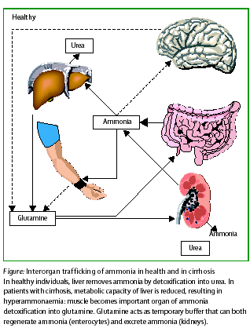
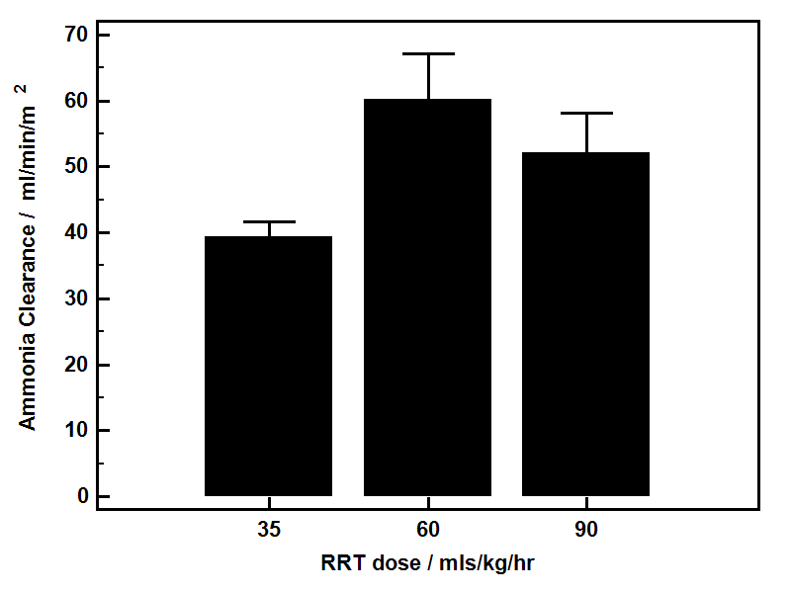
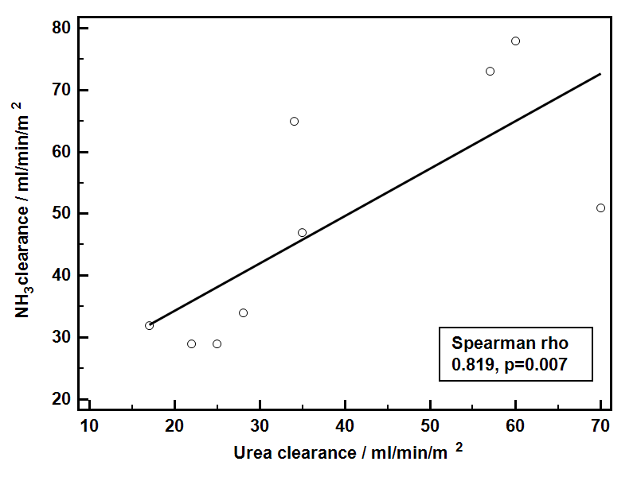
Haemofitration- clearance of ammonia

Slide 94
Cerebral Monitoring
ICP
  If JV saturations outside normal range
  Pupillary abnormalities
  Hypertonia and clonus
Prior to ICP bolt : coagulation support : FFP / platelets
Camino system : 5mm burr hole, make hole in dura, catheter inserted
CT scans - only if there is concern regarding bleed
Can do EEG and cerebral dopplers if concerned

Slide 95
Management
ICP: aim <25mmHg
Cerbral perfusion pressure (CPP)
>55 (MAP-ICP)
Rx options: raised ICP
Bolus sedation
Bolus strong Na+ (hypertonic saline)
Mannitol bolus
Indomethacin
Hepatectomy (anhepatic)

Slide 96
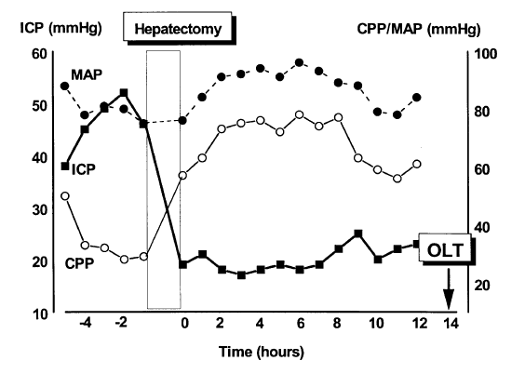
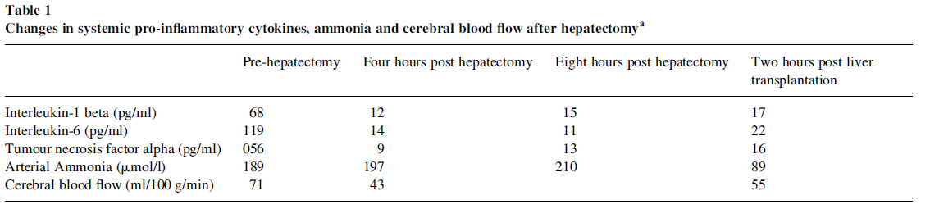
Liver-brain proinflammatory axis
Necrotic liver source of “pro-inflammatory”cytokines
Associated:
  ICH
  Changes in cerebral blood flow (CBF)
Removal of inflamed liver improved ICH/CBF
Jalan et al, J Hepatology ‘02
Notes:
Evidence of a relationship between systemic inflammatory responses derived from the inflamed liver and the encpehalopathy go back a decade from this very elegant case report from Jalan and colleagyes from Edinburgh....

Slide 97
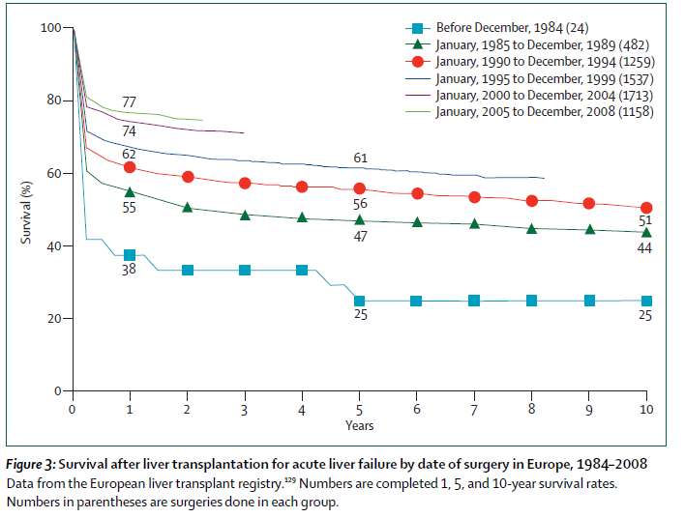
Outcome- transplantation

Slide 98
Novel therapies?
Liver assist devices
MARS/Prometheus- no benefit
Plasmapheresis

Slide 99
Plasmapheresis in ALF
Unpublished data; multicentre, multinational study

Slide 100
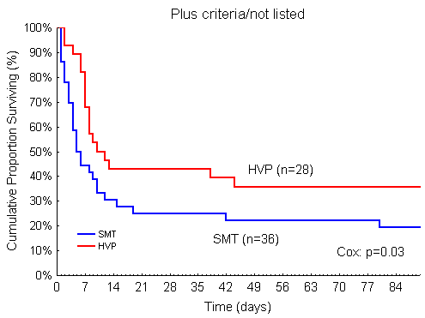
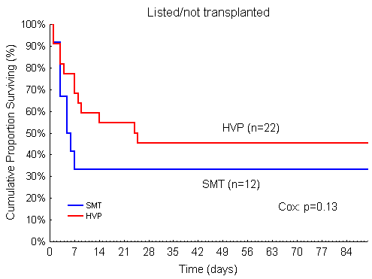
Stratified survival analysis
Plasmapheresis in ALF

Slide 101
Case scenario
27yr accountant
30g paracetamol 2/7
alcohol with overdose
nausea/vomting
epigastric pain
PMH
DHx
PSHx

Slide 102
Case scenario
Examination

Slide 103
Case Scenario
Bloods
Hb 12 Albumin 31
WCC normal Ur 8.5
Plts 120 Cr 90
INR 2.1
ALT 750 ABG pH 7.4
Bili 40 pCO2 3.9
pO2 11.5
HCO3 19
BE -9
Lactate 2.5

Slide 104
Case scenario
Advice & management plan?
24 later:
coffee ground vomiting
not wanting to continue with NAC/pulling out lines- wanting to self discharge

Slide 105
Case scenario
Advice/management plan?
-
Hb 9 ALT 4980
Plts 50 Bili 90
INR 7.5 ABG pH 7.3
Cr 140 pCO2 2.9
HCO3 12
BE -12
Lactate 8

Slide 106
QUESTIONS?

Slide 107
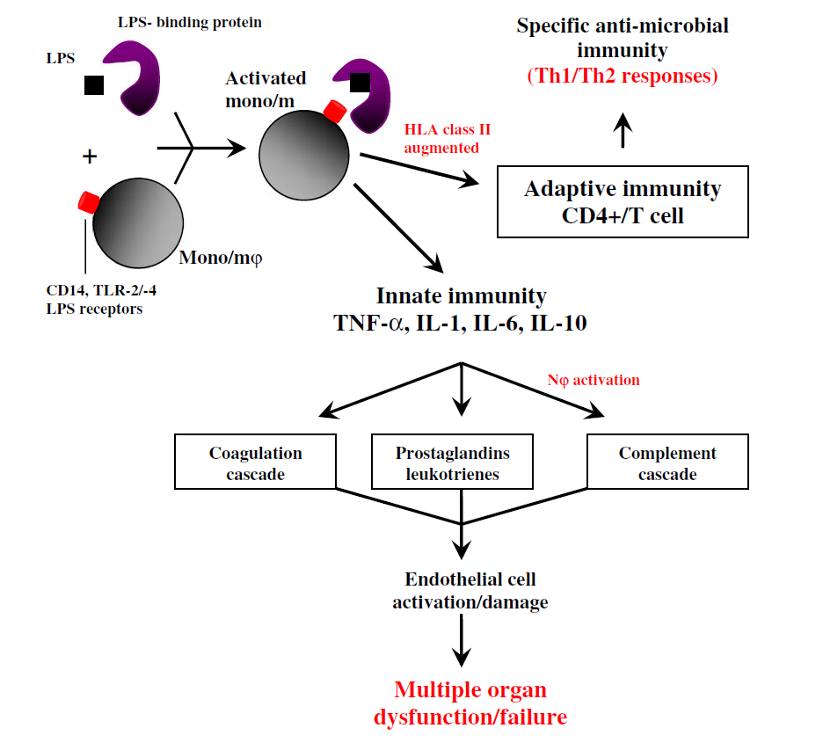
Monocytes/macrophages- “orchestrators” of SIRS
Notes:
Given both the clinical, biochemical and systemic inflammatory profiles point towards the importance of SIRS in acute liver failure; I propose that monocytes/macrophages are the protagonists of this response. It is very well documented in other inflammatory conditions that these cells are the orchestrators of the SIRs responses to infectious and non-infectious challenges through activation of innate and adatpive immune responses...Release of these inflammatory cytokines results in downstream activation of cog., etc that culminates in EC activation/leakiness and MODS
Recent research efforts have recently focused on these cells and their behaviour in ALF

Slide 108
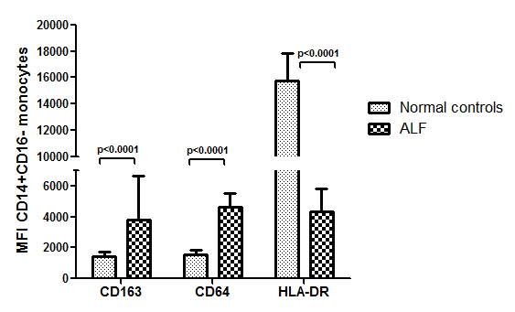
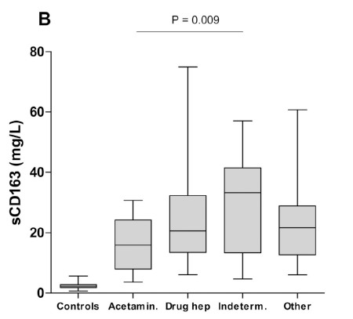
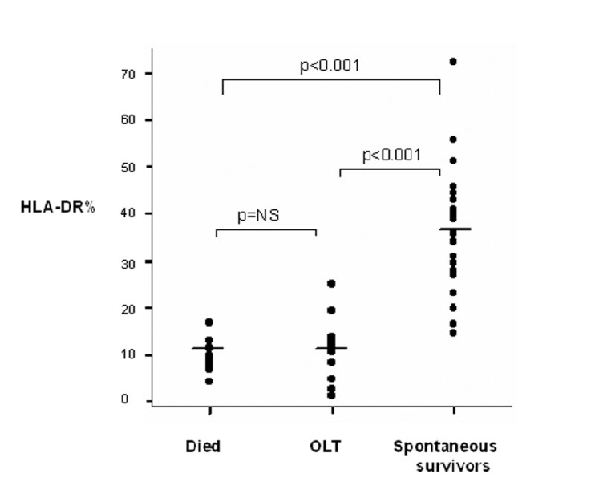
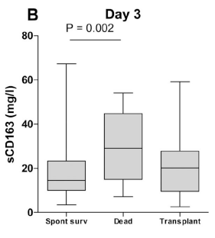
Monocyte/macrophage dysfunction in ALF
Anti-inflammatory, monocyte phenotype:
↓ monocyte HLA-DR & ↑CD163 & soluble CD163 levels
Strong correlation with severity of liver injury, organ failure & outcome
Antoniades et al, Hepatology ‘06; Abeles et al, CytometryA, ’12; Moller et al; J Hepatol ‘07
Notes:
Therefore our recent attention has focused on phenotypic characterisation of of circulating monocytes in ALF. Predmoinantely acetaminophen induced ALF. Here we also highlight the importance of the anti-inflammatory response in ALF where we describe: monocyte phenotypic changes associated with anti-inflammatory responses – where in– reductions in antigen presentation moecile HLA-DR was documented in association with elveations in the anti-inflammatory moecules CD163 and circulating levels of CD163. These changes were strongly correlated with elevations in levels of anti-inflammatory cytokines IL-10
All these biomarkers had strong correlation with severity of liver injury and predicted poor outcome

