Slide 1
BSc in Gastroenterology
Sugar malabsorption
IBS
16 October 2012
Julian RF Walters
Gastroenterology
Hammersmith Hospital
Imperial College London

Slide 2
Practical: Sugar absorption
Summary
To take part in a study of lactose absorption
To review mechanisms of carbohydrate digestion
To understand the basis for breath hydrogen tests
To appreciate genetic variation in nutrient absorption

Slide 3
Sugar Breath Tests
Lactose
Fructose / Sorbitol
Glucose
Lactulose
Principles:
H₂ only produced by bacterial action on sugars
Fasting breath H₂ < 20 ppm
Sugar taken by mouth
Breath samples every 30 mins for 2-3 hours
Increase of 20 ppm significant

Slide 4
Lactose-hydrogen Breath Test for Lactase Deficiency
Lactase persistent Deficient
Breath H2:
Low High
Small intestine:
Lactase
Present Not present
Glucose/galactose
Absorbed Not formed
Large intestine:
No lactose Lactose substrate for bacterial action
H2 production
Oral lactose

Slide 5
Malabsorption of Sugars – Lactose
Low lactase activity in the small intestinal brush-border membrane (hypolactasia) results in failure to digest lactose
Neonates all have high lactase
  Lactase non-persistence is the usual adult human phenotype worldwide
  Lactase persistence occurs in most (but not all) Northern Europeans

Slide 6
Malabsorption of Sugars – Lactose
Lactose malabsorption in small intestine gives symptoms when lactose breaks down by bacterial action in the colon – producing gases (H₂, CO₂) short chain fatty acids (lactate etc.)
Lactose intolerance diagnosed from history after lactose.

Slide 7
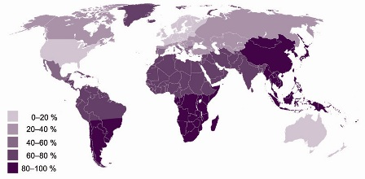
Lactase Non-Persistence
Oral lactose

Slide 8
Mechanisms of Lactase Persistence / Non-persistence
Genetic basis
Protein active in childhood
Polymorphisms in lactase gene
Heterozygote studies show cis acting elements
Transcription factors regulating expression of lactase
Developmental switches
Polymorphism 14kb upstream associated with persistence/non-persistence in Finnish population
        Enattah Nature 2002

Slide 9
Malabsorption of Sugars
Fructose and Sorbitol:
Abdominal pain and diarrhoea following fruit juices (especially in children) or diet/diabetic drinks
Small intestinal malabsorption of these monosaccharides results in metabolism in colon
Diagnosis from history and from breath H₂ excretion after ingestion of sugar

Slide 10
Sugar Maldigestion / Malabsorption
520 patients with functional dyspepsia
Lactose (25g), fructose (25g), sorbitol (5g)
Breath hydrogen and small bowel transit time measurements
Malabsorption of Lactose
  25% N. Europeans
  65-70% Greeks, Italians, Jews, Arabs
  85% Asians, Africans
Malabsorption of Fructose and Sorbitol
  40-65% overall
        (Mishkin et al. Dig Dis Sci 1997)

Slide 11
Glucose-hydrogen Breath Test for Small Intestinal Bacterial Overgrowth.
Normal SI bacterial overgrowth
Breath H2
Low High
Small intestine
Bacterial counts
Low High
Glucose
Absorbed Some metabolised to H2
Oral glucose

Slide 12
Causes of Small Intestinal Bacterial Overgrowth
Gastric surgery & achlorhydria
Jejunal diverticula
Intestinal blind loops after surgery (as in Crohn's)
Intestinal strictures (as in Crohn's)
Fistulae (as in Crohn's disease)
Impaired peristalsis (fibrosis, amyloid, myopathy, neuropathy)

Slide 13
Lactulose hydrogen breath test
Lactulose not digested or absorbed by small intestine
  Basis of use as laxative
Broken down by bacteria to give H₂
  Normal colonic flora
  Small intestinal flora in SIBO
Rise in breath hydrogen measures
  SI transit time
  SI bacterial overgrowth

Slide 14
Practical: Sugar absorption
Summary
To take part in a study of lactose absorption
To review mechanisms of carbohydrate digestion
To understand the basis for breath hydrogen tests
To appreciate genetic variation in nutrient absorption

Slide 16
Functional GI disorders
Psychogenic vomiting
Functional dyspepsia
Chronic abdominal pain
Irritable Bowel Syndrome
Classifications according to Rome criteria (I, II,) III

Slide 17
Rome III Functional Gastrointestinal Disorders
Gastroenterology 2006; 130:1377-1556
A. Functional Esophageal Disorders
  A1. Functional Heartburn
  A2. Functional Chest Pain of Presumed Esophageal Origin
  A3. Functional Dysphagia
  A4. Globus
B. Functional Gastroduodenal Disorders
  B1. FUNCTIONAL DYSPEPSIA
    B1a. Postprandial Distress Syndrome
    B1b. Epigastric Pain Syndrome
  B2. BELCHING DISORDERS
    B2a. Aerophagia
    B2b. Unspecified Excessive Belching
  B3. NAUSEA AND VOMITING DISORDERS
    B3a. Chronic Idiopathic Nausea
    B3b. Functional Vomiting
    B3c. Cyclic Vomiting Syndrome
  B4. Rumination Syndrome in Adults
C. Functional Bowel Disorders
  C1. Irritable Bowel Syndrome
  C2. Functional Bloating
  C3. Functional Constipation
  C4. Functional Diarrhea
  C5. Unspecified Functional Bowel Disorder
D. Functional Abdominal Pain Syndrome
E. Functional Gallbladder and Sphincter of Oddi Disorders
  E1. Functional Gallbladder Disorder
  E2. Functional Biliary Sphincter of Oddi Disorder
  E3. Functional Pancreatic Sphincter of Oddi Disorder
F. Functional Anorectal Disorders
  F1. Functional Fecal Incontinence
  F2. FUNCTIONAL ANORECTAL PAIN
    F2a. Chronic Proctalgia.
    F2a.1. Levator Ani Syndrome
    F2a.2. Unspecified Functional Anorectal Pain
    F2b. Proctalgia Fugax
  F3. Functional Defecation Disorders
    F3a. Dyssynergic Defecation
    F3b. Inadequate Defecatory Propulsion
G. Childhood Functional GI Disorders: Infant/Toddler
  G1. Infant Regurgitation
  G2. Infant Rumination Syndrome
  G3. Cyclic Vomiting Syndrome
  G4. Infant Colic
  G5. Functional Diarrhea
  G6. Infant Dyschezia
  G7. Functional Constipation
H. Childhood Functional GI Disorders: Child/Adolescent
  H1. VOMITING AND AEROPHAGIA
    H1a. Adolescent Rumination Syndrome
    H1b. Cyclic Vomiting Syndrome
    H1c. Aerophagia
  H2. ABDOMINAL PAIN-RELATED FUNCTIONAL GI DISORDERS
    H2a. Functional Dyspepsia
    H2b. Irritable Bowel Syndrome
    H2c. Abdominal Migraine
    H2d. Childhood Functional Abdominal Pain
    H2d1. Childhood Functional Abdominal Pain Syndrome
  H3. CONSTIPATION AND INCONTINENCE
    H3a. Functional Constipation
    H3b. Nonretentive Fecal Incontinence
Notes:
17

Slide 18
Irritable Bowel Syndrome
Interacting Mechanisms
Psychological response
Visceral perception
Gastrointestinal motility
Luminal factors (gas, digestible CHO, bile salts, allergens)

Slide 19
Irritable Bowel Syndrome
Constipation predominant
Diarrhoea predominant
Abdominal pain & Bloating

Slide 20
Rome II diagnostic criteria for Irritable Bowel Syndrome
At least 12 weeks, which need not be consecutive, in the preceding 12 months of abdominal discomfort or pain that has 2 of 3 features:
  1. Relieved with defecation; and/or
  2. Onset associated with a change in frequency of stool; and/or
  3. Onset associated with a change in form (appearance) of stool.
Symptoms that cumulatively support the diagnosis of IBS:
  1. Abnormal stool frequency (>3/ day or < 3 / week);
  2. Abnormal stool form (lumpy/hard or loose/watery stool);
  3. Abnormal stool passage (straining, urgency, or feeling of incomplete evacuation);
  4. Passage of mucus;
  5. Bloating or feeling of abdominal distension.
      NOTE. The diagnosis of a functional bowel disorder always presumes the absence of a structural or biochemical explanation for the symptoms.

Slide 21
Rome III diagnostic criteria:
C. Functional Bowel Disorders
C1. Irritable Bowel Syndrome
Diagnostic criterion*
Recurrent abdominal pain or discomfort** at least 3 days/month in last 3 months associated with two or more of the following:
  1. Improvement with defecation
  2. Onset associated with a change in frequency of stool
  3. Onset associated with a change in form (appearance) of stool
* Criterion fulfilled for the last 3 months with symptom onset at least 6 months prior to diagnosis
**“Discomfort” means an uncomfortable sensation not described as pain.
In pathophysiology research and clinical trials, a pain/discomfort frequency of at least 2 days a week during the screening evaluation is recommended for subject eligibility.
Notes:
21

Slide 22
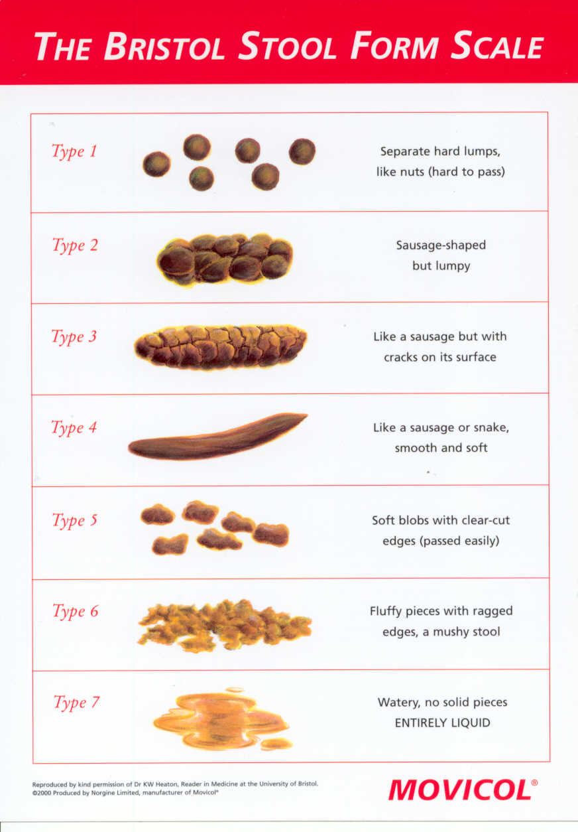
Constipation
Diarrhoea

Slide 23
“Red flags” in the diagnosis of IBS
Weight loss
Anaemia
Occult blood in stool
Travel history to locations with endemic parasitic diseases
Night-time symptoms
New onset after age 50
Family history of colon cancer or IBD
Arthritis or dermatitis on physical examination
Signs of malabsorption
Signs of thyroid dysfunction

Slide 24
Symptoms associated with IBS–related psychiatric disorders
Panic disorder
Palpations
Early insomnia
Ruminative thinking
Diaphoresis
Constant worries
Agoraphobia
Depression
Change in appetite
Late insomnia
Loss of interest
Decreased libido
Fatigue
Somatization complaints
Symptoms referable to >5 organ systems

Slide 25
Rome III criteria for Functional Constipation:
C3. Functional Constipation
Diagnostic criteria*
Must include two or more of the following:
  a. Straining during at least 25% of defecations
  b. Lumpy or hard stools in at least 25% of defecations
  c. Sensation of incomplete evacuation for at least 25% of defecations
  d. Sensation of anorectal obstruction / blockage for at least 25% of defecations
  e. Manual maneuvers to facilitate at least 25% of defecations (e.g. digital evacuation, support of the pelvic floor)
  f. Fewer than three defecations per week
2. Loose stools are rarely present without the use of laxatives
3. Insufficient criteria for irritable bowel syndrome
* Criteria fulfilled for the last 3 months with symptom onset at least 6 months prior to diagnosis

Slide 26
Rome III criteria for Functional Bloating:
C2. Functional Bloating
Diagnostic criteria*
Must include both of the following:
  1. Recurrent feeling of bloating or visible distension at least  days/month in the last 3 months
  2. Insufficient criteria for a diagnosis of functional dyspepsia, irritable bowel syndrome, or other functional GI disorder
* Criteria fulfilled for the last 3 months with symptom onset at least 6 months prior to diagnosis
Notes:
26

Slide 27
Constipation-predominant IBS: Treatment
Exclude obstruction (carcinoma etc.), hypothyroid, drugs (opiates, tricyclics)
Diet:
  fibre & fluids
Bulking agents
  ispaghula, cellulose
Osmotic laxatives
  Mg²⁺ salts, lactulose, etc.
  PEG/salts (Movicol)
Evacuation assessment, biofeedback / training
Psychological support

Slide 28
Irritable Bowel Syndrome – Dietary Factors
Constipation predominant
  Fibre
  Water
Diarrhoea predominant
  Lactose
  Fat / Bile Acid Malabsorption
Abdominal pain & Bloating
  Meal size
  Gas consumption
  Gas production
Notes:
28

Slide 29
Rome III criteria for Functional Diarrhoea:
C4. Functional Diarrhea
Diagnostic criterion*
Loose (mushy) or watery stools without pain occurring in at least 25% of stools
* Criterion fulfilled for the last 3 months with symptom onset at least 6 months prior to diagnosis
Notes:
29

Slide 30
Chronic Diarrhoea or IBS?
Consider Malabsorption
  Coeliac
  SI Bacterial overgrowth
  Chronic pancreatitis
  Lactose malabsorption
  Bile acid malabsorption
  …

Slide 31
Mechanism of Bile Acid Diarrhoea
Excess bile acids in colon – unabsorbed by the small intestine
Deconjugation of bile acids by bacteria
Unconjugated bile acids stimulate colonic secretion
  Anion secretion
  Motility changes
Diarrhoea
  Typically watery, nocturnal
Bile acid sequestrants are effective treatments
  Colestyramine, Colestipol, Colesevelam

Slide 32
A Classification of Types of Bile Acid Malabsorption
Type 1 - Secondary, following ileal resection, ileal disease (Crohn’s), bypass
Type 2 - Primary, idiopathic malabsorption
Type 3 - Miscellaneous causes: post-cholecystectomy, ulcer surgery, chronic pancreatitis, coeliac disease, diabetes mellitus, etc.
        Fromm & Malavolti 1986

Slide 33
ENTEROHEPATIC CIRCULATION OF BILE SALTS
Hepatic synthesis from cholesterol
Conjugated with glycine or taurine

Slide 34
ENTEROHEPATIC CIRCULATION OF BILE SALTS
Hepatic synthesis from cholesterol
Conjugated with glycine or taurine
Secreted via biliary tree into intestine

Slide 35
ENTEROHEPATIC CIRCULATION OF BILE SALTS
Hepatic synthesis from cholesterol
Conjugated with glycine or taurine
Secreted via biliary tree into intestine
Solubilise lipids in micelles for absorption

Slide 36
ENTEROHEPATIC CIRCULATION OF BILE SALTS
Hepatic synthesis from cholesterol
Conjugated with glycine or taurine
Secreted via biliary tree into intestine
Solubilise lipids in micelles for absorption
Reabsorbed in distal intestine:
  Passive absorption in jejunum (unconjugated)
  Active absorption in ileum (conjugated)

Slide 37
ENTEROHEPATIC CIRCULATION OF BILE SALTS
Hepatic synthesis from cholesterol
Conjugated with glycine or taurine
Secreted via biliary tree into intestine
Solubilise lipids in micelles for absorption
Reabsorbed in distal intestine:
  Passive absorption in jejunum (unconjugated)
  Active absorption in ileum (conjugated)
Reuptake by hepatocytes and resecreted

Slide 38
ENTEROHEPATIC CIRCULATION OF BILE SALTS
Hepatic synthesis from cholesterol
Conjugated with glycine or taurine
Secreted via biliary tree into intestine
Solubilise lipids in micelles for absorption
Reabsorbed in distal intestine:
  Passive absorption in jejunum (unconjugated)
  Active absorption in ileum (conjugated)
Reuptake by hepatocytes and resecreted
Bile salts entering the colon cause diarrhoea

Slide 39
Diagnosis of Bile Acid Malabsorption
SeHCAT
  Measure of BA retention
  Nuclear medicine
  7 day retention: normal values above 10-15%
  Not available in USA

Slide 40
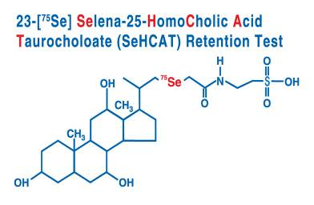
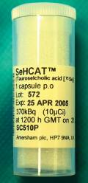


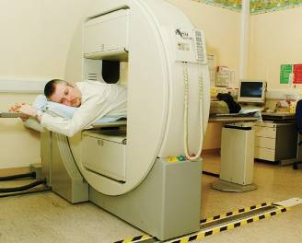
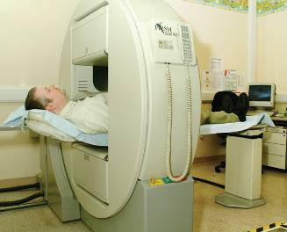
SeHCAT
Synthetic radioactive bile acid
Not metabolised
Not broken down by bacteria
Tracks enterohepatic circulation
SeHCAT retention test procedure
Uncollimated gamma camera
5 minute AP, PA views and background
Normal retention at day 7 : ≥ 10%

Slide 41
Bile Acid Malabsorption: Frequency
304 patients with diarrhoea
        Smith et al. JRCP 2000
 | SeHCAT retention <10% | Response in these to BA sequestrants
Crohn's with resection | 36 / 37 97% | 60%
Crohn's without resection | 24 / 44 54% | 40%
Vagotomy / pyloroplasty (+/- cholecystectomy) | 15 / 26 58% | 64%
Diarrhoea-predominant IBS | 65 / 197 33% | 70%

Slide 42
Diagnosis of Bile Acid Malabsorption
SeHCAT
  Nuclear medicine
  7 day retention: normal values above 10%
  Measure of BA retention
  Not available in USA
7α-hydroxy-4-cholesten-3-one (C4)
  CYP7A1 product
  Measure of bile acid synthesis
  Measured by HPLC
  Inversely correlates with SeHCAT

Slide 43
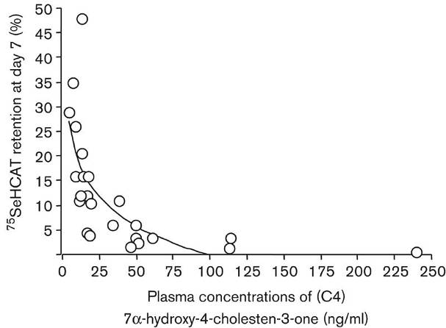
Inverse relationship of SeHCAT & C4
26 patients with chronic diarrhoea
        Bajor et al. 2006

Slide 44
Bile Acid Malabsorption
What are the possible mechanisms of BAM?
Secondary BAM
  Surgical removal of functioning ileal tissue
  Inflammatory changes leading to impaired ileal gene expression/function
Primary BAM
  Normal structure and histology
  Abnormal transporter function
    ? Mutant proteins
    ? Reduced expression

Slide 45
Ileal Absorption of Bile Salts
Na⁺
SLC10A2:
Also known as
Apical sodium-dependent bile acid transporter (ASBT)
Ileal bile acid transporter (IBAT)
FABP6:
Also known as
Ileal lipid-binding protein (ILBP)
Ileal bile acid-binding protein (IBABP)
OST-α/OST-β heterodimer

Slide 46
What causes Idiopathic Bile Acid Malabsorption?
? Defective ileal BA transport
  Rare cases of apical BST mutations
  No evidence of other mutations
  Normal expression levels
  Possible disordered regulation via FXR
Evidence for normal BA uptake into ileal biopsies
Possible rapid SI transit
Deconjugation
Changes in BA pool size

Slide 47
FGF19 (or FGF15) Regulation of Bile Acid Metabolism
Ileum
BA bind FXR
FXR increases FGF19 expression
FGF19 secreted
Liver
FGF19 binds to FGFR4 in liver
Activated FGFR4 increases SHP
SHP represses BA synthesis
FXR
SHP
LRH-1
FXR
CYP7A
Chol
BA
FGF19
FGFR4
FGF19
FGF19
FGF19 in humans
FGF15 in mice
Inagaki et al. Cell Metab 2005

Slide 48
FGF19 & Bile Acid Reabsorption - Normal
Chol
C4
BA
CYP7A1
FGF19
FGF19
BA
FXR
Could defective FGF19 signalling cause primary BA diarrhoea?

Slide 49
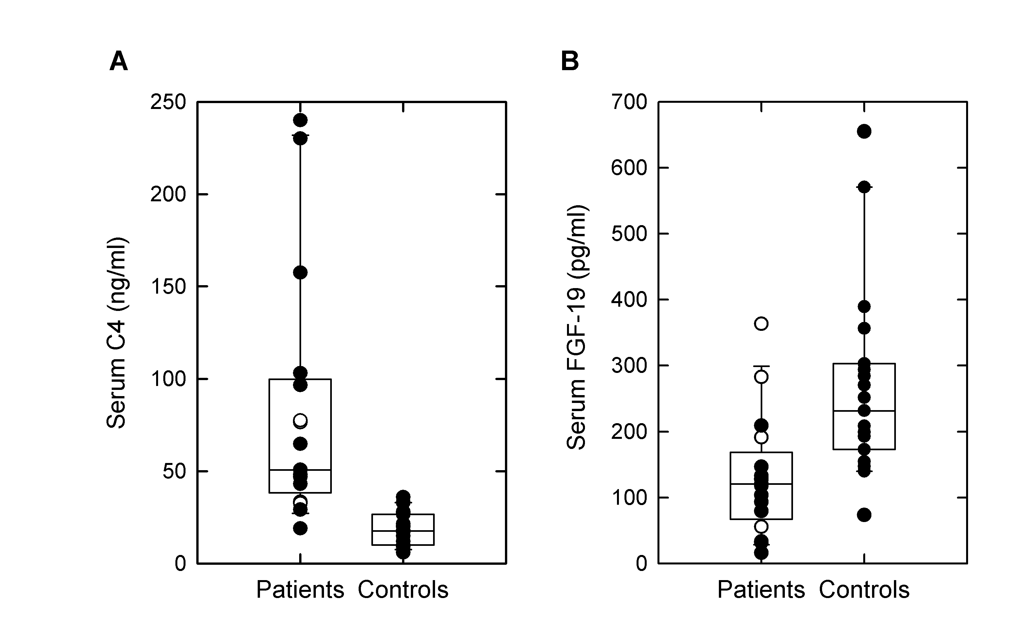
Raised 7aOH-4-Cholesten-3-one (C4) in Patients with Chronic Diarrhoea
Medians & quartiles
p < 0.001

Slide 50
Reduced FGF19 in Patients with Chronic Diarrhoea
Medians & quartiles
p < 0.005

Slide 51
FGF19 & Primary BA Diarrhea
Chol
C4
BA
Chol
C4
BA
CYP7A1
CYP7A1
FGF19
FGF19
FGF19
BA
FGF19
BA
FXR
FXR
Normal
Bile acid diarrhea:
↓ FGF19
↑ BA synthesis
↑ BA entering colon
↑ Secretory diarrhea

Slide 52
Diarrhoea-predominant IBS: Treatment
Exclude carcinoma / IBD as appropriate
Exclude coeliac & other malabsorption
? Spurious diarrhoea (in constipation)
? Dietary
  Lactose intolerance: modify diet
? Bile acid malabsorption
  colestyramine
Anti-diarrhoeals
  Loperamide, diphenoxylate, codeine etc.
Psychological support

Slide 53
Bloating / pain-predominant IBS
Gas production
Bacterial fermentation
  Colonic
  Small Intestinal
Rapid small bowel transit
? Antibiotic treatment
Visceral hypersensitivity

Slide 54

What are FODMAPs?
Fermentable
Oligosaccharides
fructans, galactans
Disaccharides
lactose
Monosaccharides
fructose
(in excess of glucose)
And
Polyols
sorbitol

Slide 55
The FODMAP hypothesis
Diet
Fructose
Fructans
Lactose
Galactans
Polyols
Osmotically active
Rapidly fermented
Physiological
↑
water
↑ gas
production
effects
delivery
Luminal
distension
Symptom
Motility changes
Bloating
Pain/discomfort
Wind
induction

Slide 56
Low FOMAP Diet in IBS:
Proportion of patients with improvement in symptoms
Staudacher J Nutr 2012
*
* P=<0.05

Slide 57
Antibiotics in IBS (1)
202 IBS patients (Rome I)
  SIBO in 78%: lactulose H₂ BT
  Antibiotic treatment (various) & then retesting
  Less diarrhea & pain (p<0.05) if SIBO eradicated
        Pimentel et al. 2000
111 consecutive IBS patients
  Randomised to neomycin or placebo
  35% improvement after neomycin: 14% placebo
  75% improvement if lactulose H₂ BT normalised
  Methane excretors only in constipated-IBS
        Pimentel et al. 2006

Slide 58
Antibiotics in IBS (2)
Rifaximin in 87 Rome I IBS patients
  Double-blind, randomised, placebo-controlled
  400mg tid for 10 days
  Improvement in symptom scores (esp. bloating) for up to 10 weeks after treatment
        Pimentel et al. 2006

Slide 59
Visceral Hypersensitivity in IBS
Increased capsaicin receptor TRPV1-expressing sensory fibres in irritable bowel syndrome and their correlation with abdominal pain
A Akbar, Y Yiangou, P Facer, J R F Walters, P Anand, S Ghosh.
Gut 2008; 57:923-929

Slide 60
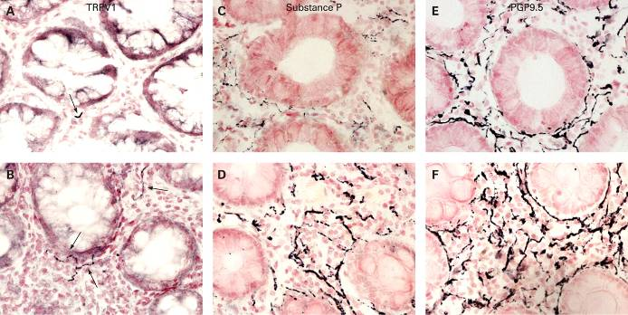

Photomicrographs showing transient receptor potential vanilloid type-1 (TRPV1)- (arrowed), substance P and protein gene product (PGP) 9.5-immunoreactive fibre immunostaining in a control (A, C and E) and an irritable bowel syndrome rectosigmoid biopsy (B, D and F), magnification x40.
Akbar, A et al. Gut 2008;57:923-929
Copyright ©2008 BMJ Publishing Group Ltd.

Slide 61
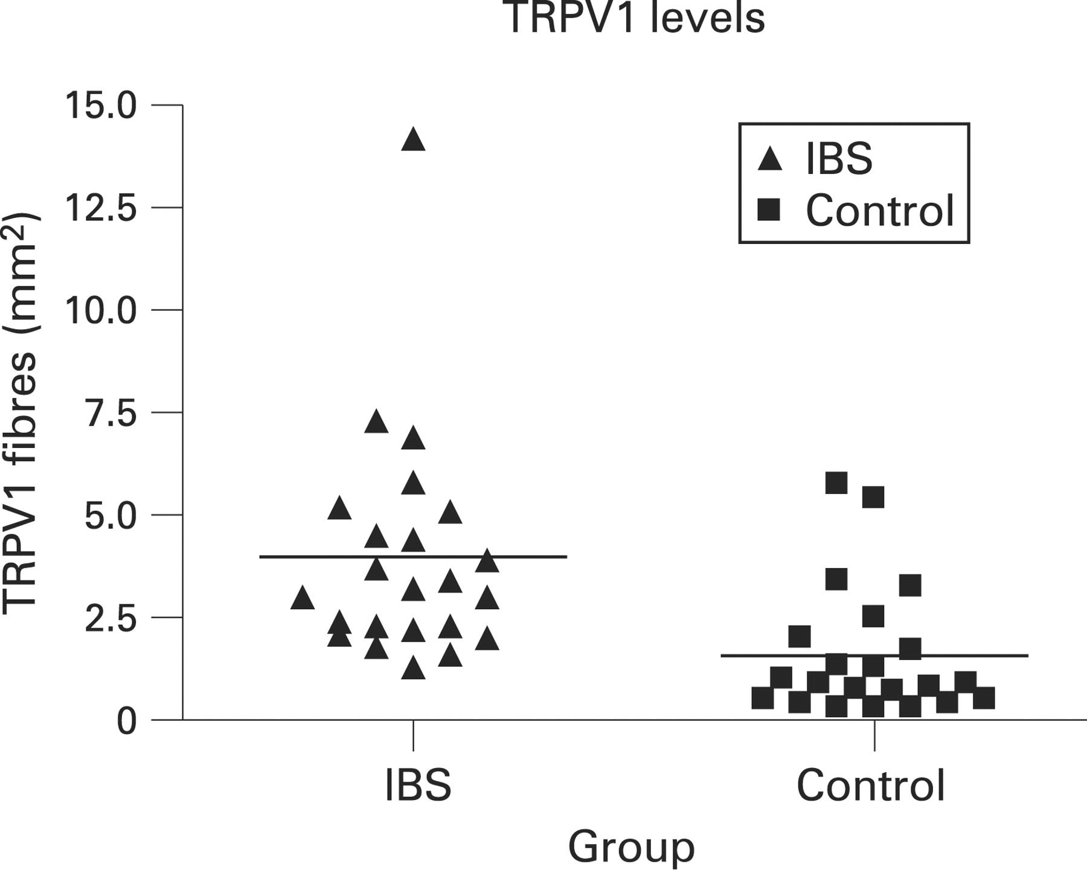
Transient receptor potential vanilloid type-1 (TRPV1) levels
p<0.001
Akbar, A et al. Gut 2008;57:923-929
Copyright ©2008 BMJ Publishing Group Ltd.

Slide 62
Pain-predominant IBS: Treatment
Exclude obstruction (carcinoma, adhesions etc.), ulcer, gallstones, ischaemia, chronic pancreatitis, etc.
Dietetic advice
Treat constipation
Treat urgency / diarrhoea
Anti-spasmodics
  mebeverine
Anticholinergics, SSRIs
Psychological support / CBT

Slide 63
IBS
Clinical patterns of recognisable common symptoms
Contributions from defined abnormalities:
  Physiological
  Genetic
  Dietary

