Slide 1
Effects of the gastrointestinal microbiota on metabolism
Dr Lucy Hicks BSc MBBS MRCP FHEA
Honorary Clinical Lecturer
October 2012
Notes:
Read title

Slide 2
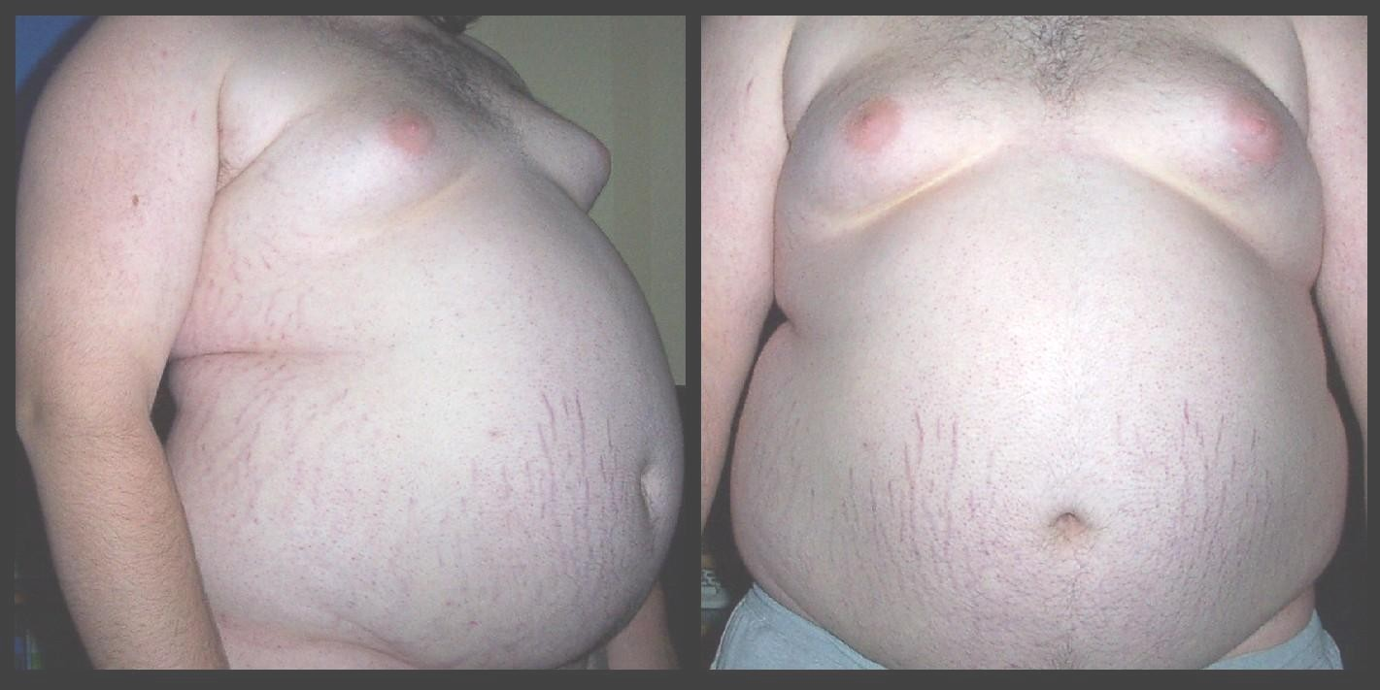
Metabolism and health
obesity
Athero-sclerosis
Cardiovascular disease
Diabetes
Insulin resistance

Slide 3

Why is it important?
Obesity related costs amount to 2-6% health care in Western world
500m obese individuals worldwide
1 in 4 in UK
1 in 3 in USA
Biggest killer
in the west?

Slide 4
Gut microbiota
Metabolic syndromes
Cardiovascular disease and diabetes

Slide 5

What is the microbiota?
Collective microbial community in a specific environment
Gut microbiota includes bacteria contained within whole length of human gut

Slide 6
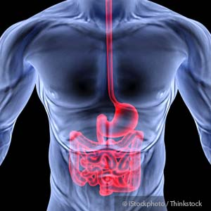

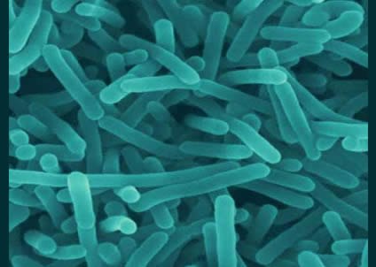
The gut flora - a forgotten organ
With 10¹² organisms per ml of luminal fluid there are more bacteria in our GI system than humans on the planet.

Slide 7
What we are going to cover......
Basic terms
Techniques involved in defining the gut microbiome
Diversity of the gut microbiome
Link between microbiome and obesity and diabetes

Slide 8
A few terms
(Gut) Microbiota
Collective microbial community in a specific environment (gut)
(Gut) Microbiome
  Genes of the microbiota = total genetic capacity of the (gut) community
Metagenome
Total DNA from the gut.....aggregate of DNA from host and microbiota
Microbe
  Microscopic or ultramicroscopic organisms

Slide 9
A few terms
Enterotype – grouping of the mictobiota of a given person....probably not as discrete as previously thought

Slide 10
A few more....
Gnotobiotic - organism with a known microbiome (either germ-free or colonised with known bacteria)
Conventionalised – Giving bacteria to germ free mice
Fermentation – energy production in anaerobic conditions

Slide 11
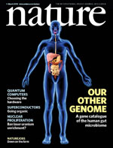
What makes up the Human Gut Microbiota

Slide 12
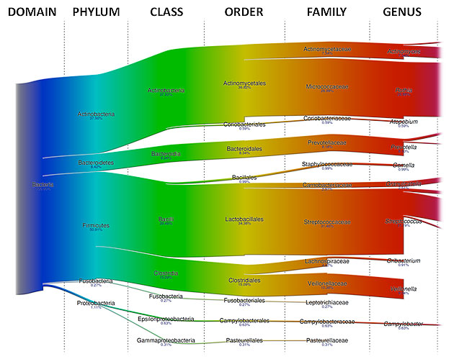
Human Gut Microbiota

Slide 14
What influences our gut microbiome?

Slide 15
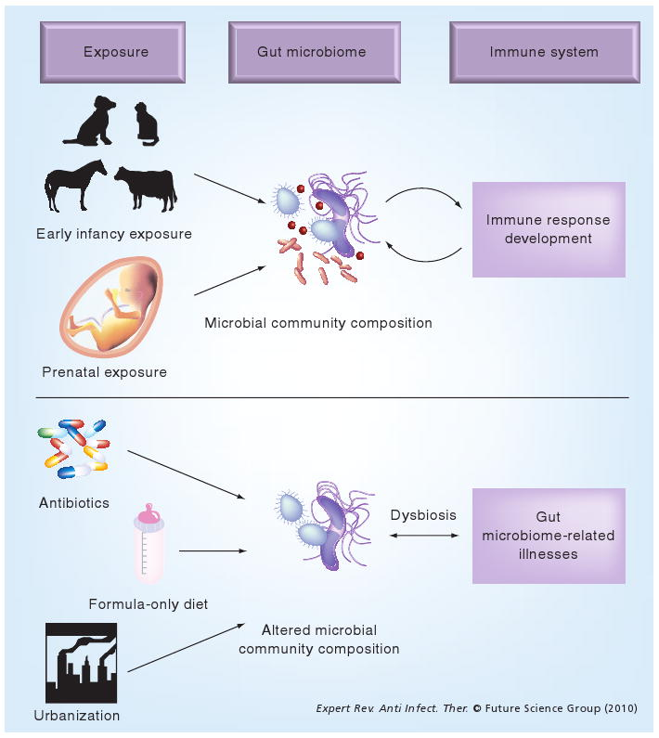
Early development

Slide 16
Adult microbiota
Gut microbiota
Host genome
Nutrition
Lifestyle

Slide 17


Diet influences the gut microbiota
Italian children
African children in rural village
Diet of plant polysaccharides
Mixed omnivorous diet

Slide 18
Diet influences the gut microbiota
Italian children
African children in rural village
Diet of plant polysaccharides
Mixed omnivorous diet
Low levels of Firmicutes and high levels of Bacteroidetes
High levels of Enterobacteriaceae

Slide 19
Diet influences the gut microbiota
African children in rural village
Diet of plant polysaccharides
Bacteroidetes: Prevotella and Xylanibacter – known to degrade cellulose and xylan
Suggests gut microbiota has adapted to maximise energy extraction from a diet rich in fibre
Low levels of Firmicutes and high levels of Bacteroidetes

Slide 20
Diet influences the gut microbiota – by how much?
Changing diet for 10 days does not alter the enterotype of an individual
Long-term changes required to shift microbial composition
Wu 2011 Science. 334; 105-108

Slide 21
How do we know?
Many gut bacteria (80%) are difficult (?impossible) to culture
Molecular biological techniques have improved to the point where organisms can be characterised without culture
The human microbiome is being mapped in its entirety

Slide 22
Techniques for mapping the microbiome

Slide 23
Metagenomics
Application of genomics to uncultured organisms
“community genomics”

Slide 24
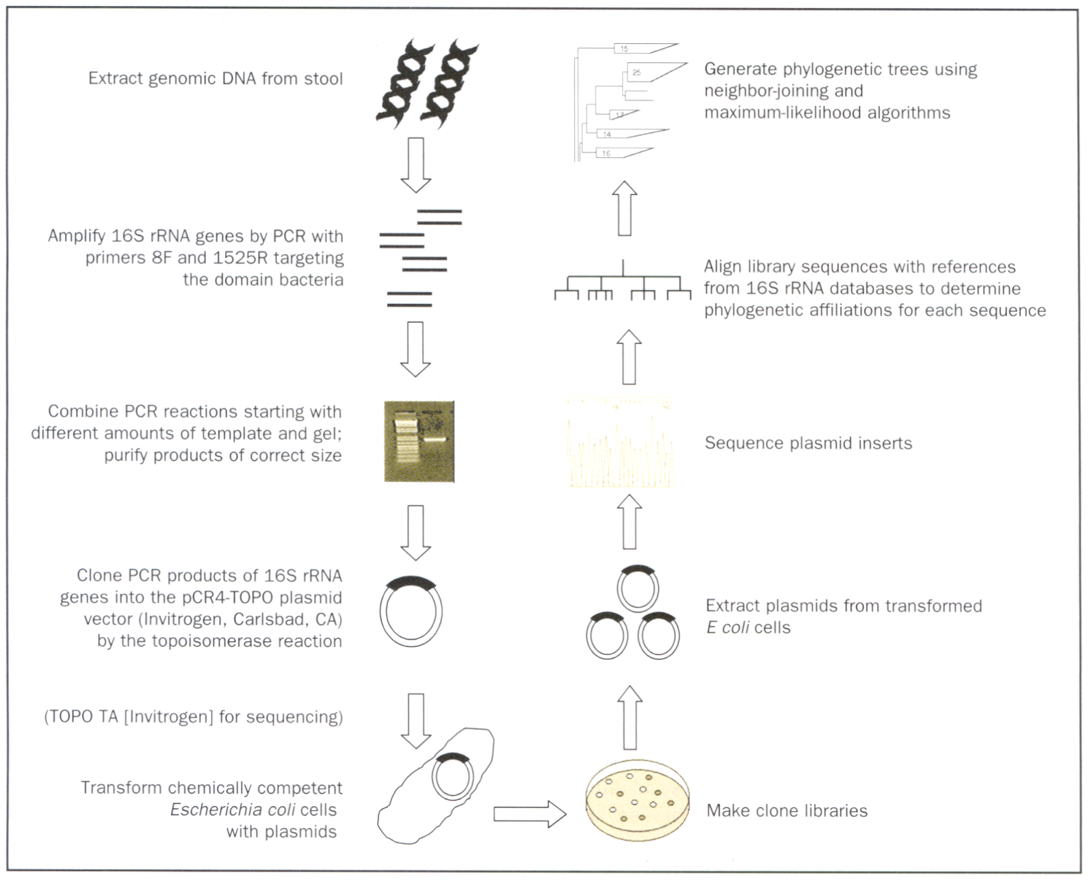
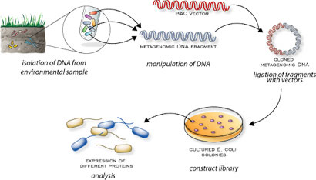

Slide 25
Role of the gut microbiome

Slide 26
Roles of the gut microbiota
Function of the microbiota
Protective function
Pathogen displacement
Production of anti-microbial factors e.g. lactic acid
Immune system development
Metabolic role:
Vitamin synthesis (biotin, folate)
Metabolic role: metabolism of indigestible dietary polysaccharides

Slide 27
Short chain fatty acids
Human enzymes unable to degrade complex carbohydrates / plant polysaccharides
Cellulose, xylans, starches, inulin

Slide 28
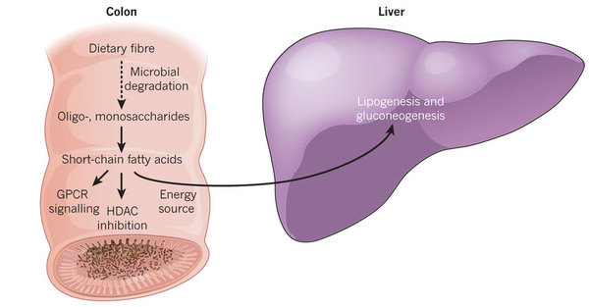
Metabolism and fermentation

Slide 29
Metabolism and fermentation
Acetate and propionate
Butyrate – energy for colonic epithelial cells

Slide 30
Metabolism and fermentation
Acetate and propionate
Carbohydrate type
Carbohydrate amount
Energy harvest
Gut microbiota
Butyrate – energy for colonic epithelial cells

Slide 31
Can Bacteria make you fat?

Slide 32
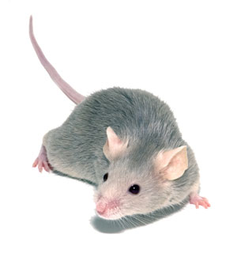
Can bacteria make you fat?
Germ-free mice on low fat diet

Slide 33
Can bacteria make you fat?
Reduced levels of intestinal SCFAs
Twice as much urinary and faecal excretion of calories than normal mice
Germ-free mice on low fat diet

Slide 34
Can bacteria make you fat?
Germ-free mice on low fat diet
Colonisation with microbes from normal mice
60% weight increase in 2 weeks
Backhed et al. 2004

Slide 35
Can bacteria make you fat?
Germ-free mice on low fat diet
Microbiota of obese mice
Microbiota of slim mice
Colonisation with microbes from normal mice
60% weight increase in 2 weeks

Slide 36
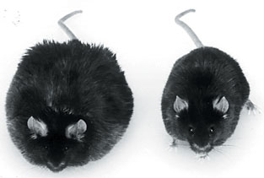
Can bacteria make you fat?
Germ-free mice on low fat diet
Microbiota of obese mice
Microbiota of slim mice
Colonisation with microbes from normal mice
60% weight increase in 2 weeks

Slide 37
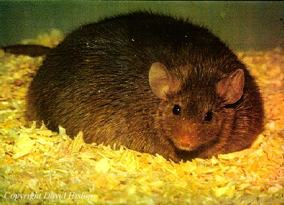
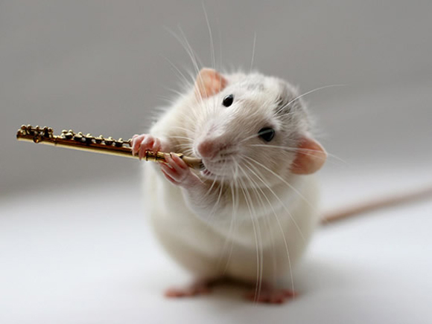
Does being fat change your bacteria?
Mice fed same low-fat polysaccharide-rich diet
Normal mice
Genetically obese ob/ob mice are hyperphagic as a result of gene that encodes for satiety-producing hormone leptin

Slide 38
Does being fat change your bacteria?
Mice fed same low-fat polysaccharide-rich diet
Normal mice
Genetically obese ob/ob mice are hyperphagic as a result of gene that encodes for satiety-producing hormone leptin
Increased amounts of SCFAs in the caecum than lean littermates

Slide 39
Does being fat change your bacteria?
Mice fed same low-fat polysaccharide-rich diet
Normal mice
Genetically obese ob/ob mice are hyperphagic as a result of gene that encodes for satiety-producing hormone leptin
Increased amounts of SCFAs in the caecum than lean littermates
Metagenomics shows enrichment of gene functions related to degradation of dietary polysaccharides

Slide 40
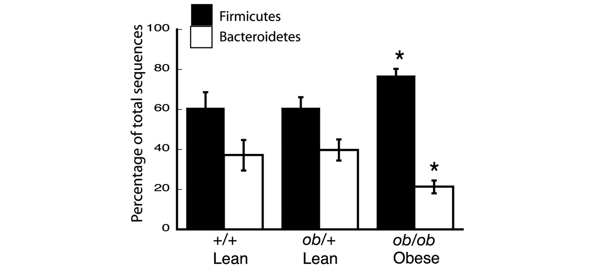
Does being fat change your bacteria?
Effects of kinship and obesity on gut microbial ecology.
Ley R E et al. PNAS 2005;102:11070-11075

Slide 41
Does being fat change your bacteria?
Effects of kinship and obesity on gut microbial ecology.
Firmicutes
Bacteroidetes
Ley R E et al. PNAS 2005;102:11070-11075

Slide 42
Does being fat change your bacteria?
Effects of kinship and obesity on gut microbial ecology.
Similar changes seen in obese humans
Ley RE Nature 2006
Ley R E et al. PNAS 2005;102:11070-11075

Slide 43
Does being fat change your bacteria?
Suggests increased capacity to harvest energy
Effects of kinship and obesity on gut microbial ecology.
Similar changes seen in obese humans
Ley RE Nature 2006
Ley R E et al. PNAS 2005;102:11070-11075

Slide 44
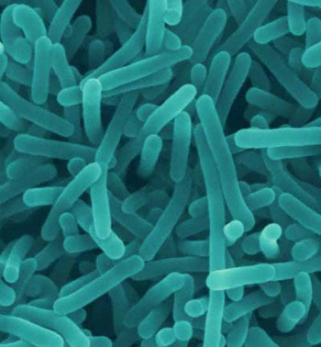
Which bacteria are important?

Slide 45
Which bacteria are important?
Bacteroidetes levels increase when weight is lost – suggesting they are responsive to calorie intake
Patients who underwent Roux-en-Y gastric bypass, Bacteroidetes are negatively correlated with energy intake and adiposity
Furet JP Diabetes 2010

Slide 46
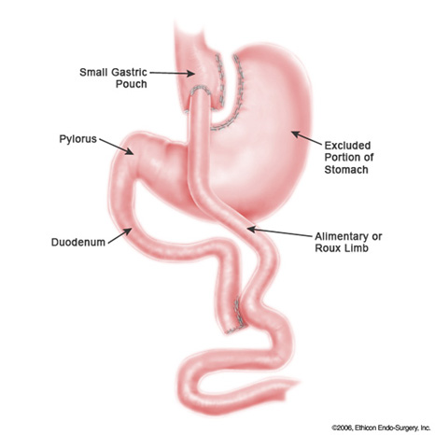
Roux-en-Y gastric bypass

Slide 47
Gastric bypass
Promotes weight reduction and diminishes effect of diabetes / CV risk in obese patients
Diabetes resolves before patients begin to lose weight – direct anti-diabetic effect
? Due to a change in composition of faecal microbiota to an improved metabolic phenotype

Slide 48
Chicken or egg – what are the mechanisms promoting obesity?

Slide 49
Mechanisms promoting obesity?
Products of microbial metabolism act as signalling molecules
Influence intestinal function, liver, brain, adipose and muscle tissues

Slide 50
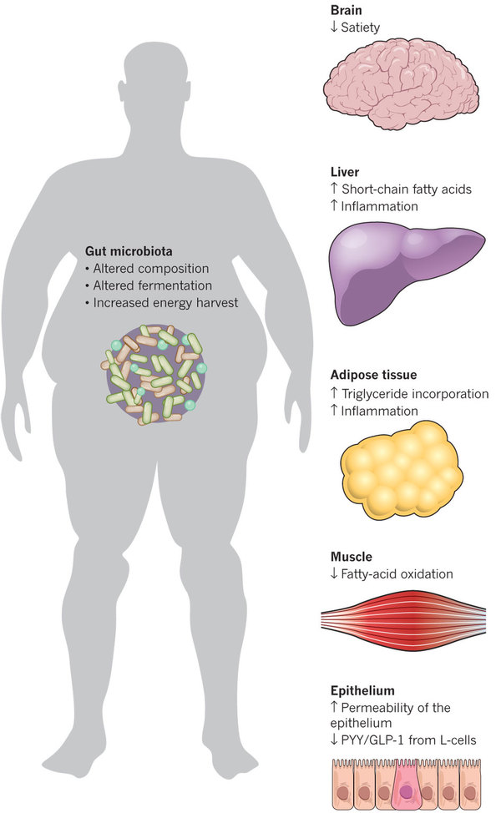
Mechanisms promoting obesity?

Slide 51
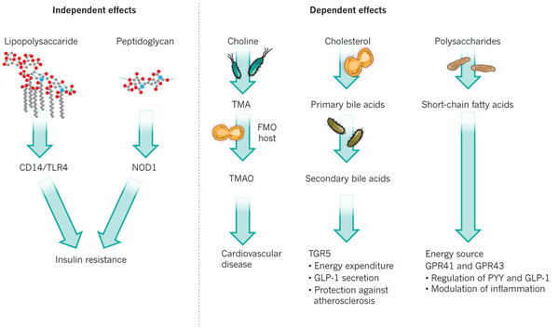
Diet independent and dependent effects

Slide 52
Diet independent and dependent effects

Slide 53

Microbial metabolism of choline
Component of cell membranes
Contained in red meat, eggs
Required for lipid metabolism, synthesis of VLD lipoprotein in liver
Low levels of choline in diet associated with liver steatosis in humans and mice

Slide 54
Microbial metabolism of choline
Toxic methylamines
Trimethylamine-N-oxide
TMAO shown to promote cardiovascular disease
(Wang Nature 2011)

Slide 55
Microbial metabolism of choline
Genetically atherosclerotic-prone mice
Toxic methylamines
Trimethylamine-N-oxide
TMAO shown to promote cardiovascular disease
(Wang Nature 2011)

Slide 56
Microbial metabolism of choline
Genetically atherosclerotic-prone mice
Toxic methylamines
Trimethylamine-N-oxide
Broad spectrum antibiotics
TMAO shown to promote cardiovascular disease
(Wang Nature 2011)
Reduced atherosclerosis

Slide 57
Microbial regulation of bile salt metabolism

Slide 58
Microbial regulation of bile salt metabolism
Cholic acid and chenodeoxycholic acid synthesized in liver from cholesterol
Allow cholesterol, dietary fats and fat soluble vitamins to be absorbed
Conjugated to glycine for re-uptake in distal ileum
A proportion of the primary salts are metabolised by gut microbiota to secondary bile acids

Slide 59
Microbial regulation of bile salt metabolism
Bile acids function as signalling molecules and bind to cellular receptors (FXR and TGR5)
TGR5 promotes glucose homeostasis
TGR5 signalling in enteroendocrine L-cells induces secretion of GLP-1
In mice = shown to enhance glucose tolerance / pancreatic function
TGR5 in adipose tissue and muscle increases energy expenditure and protects against diet-induced DM.

Slide 60
What does all this mean?
Gut microbiome with different capacities to metabolise may contribute to the development of cardiovascular disease and diabetes

Slide 61
Permeability and inflammation

Slide 62
Permeability and inflammation
Pro-inflammatory molecules produced by microbiota
Can induce adipose tissue inflammation and reduce insulin sensitivity

Slide 63
Permeability and inflammation
Plasma lipopolysaccharide levels increase with high fat intake
?increase due to lipopolysaccharides being taken up by chylomicrons

Slide 64
Permeability and inflammation
Plasma lipopolysaccharide levels increase with high fat intake
?increase due to lipopolysaccharides being taken up by chylomicrons
?increased gut permeability in obese mice

Slide 65
Permeability and inflammation
Gut permeability has been linked to increased visceral adiposity and hepatic steatosis.
Obese patients and type 2 diabetics also show higher levels of bacterial DNA in the blood – suggesting increased permeability contributes to adipose inflammation → diabetes

Slide 66
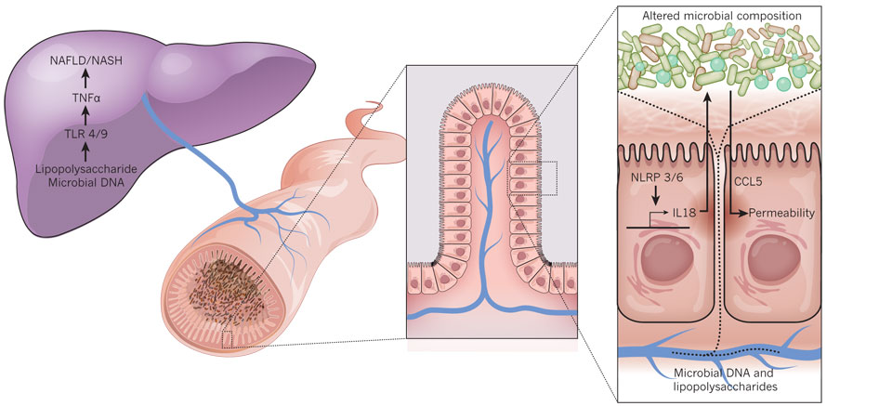
Permeability and inflammation

Slide 67
Permeability and inflammation
Activation of pro- inflammatory cascade

Slide 68
Permeability and inflammation
Effector protein which regulates the microbial ecology

Slide 69
Permeability and inflammation
Manipulation of NLRP 3/6 can alter microbiome
e.g. Deficiency in Nllp6 predisposes mice to colitis
Inflammasone complexes lacking NLRP3/6 promote NASH and NAFLD
Effector protein which regulates the microbial ecology

Slide 70
What does all this mean?
The interaction between diet, host and gut microbiota modulates gut permeability
Proinflammatory molecule
inflammatory signalling pathways activated peripherally
Linked to obesity, steatosis and insulin resistance

Slide 71

Gut microbiome as a potential treatment target
Many probiotic and prebiotic proof-of-concept trials have been disappointing
Open label trial of VSL#3 in NAFLD prematurely stopped because of rise in fat content
Solga et al. 2009

Slide 72
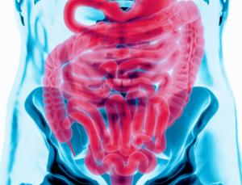
Gut microbiome as a potential treatment target
Faecal transplantation
Used for treatment of antibiotic-related diarrhoeal colitis
Potential transmission of unknown pathogenic bacteria

Slide 73
Gut microbiota
Obesity / Metabolic syndromes
CV disease and diabetes

Slide 74
Summary 1
The gut microbiota is a lush microbial ecosystem acting as a “metabolic organ”
Ability to harvest energy depends on ability of microorganisms
Diet and weight loss/gain can alter the microbiota

Slide 75
Summary 2
Microorganisms and their metabolic products alter gut hormones and inflammation, and therefore influence disease risk
Manipulation of the microbiota may have the potential to influence metabolism, weight change and disease risk

Slide 76
For the Future?
Problems......?
Previous difficulties with microbiota profiling
Heterogenous aetiology of obesity and diabetes – linked to different microbes
Not enough robust trials

Slide 77
Further reading
Tilg and Kaser 2011. Gut Microbiome, obesity and metabolic dysfunction. J Clin Inv 121:6;2126-2131
Delzenne et al. 2011. Targeting gut microbiota in obesity: effects of prebiotics and probiotics. Nat. Rev Endocrinology 7: 639-646
O’Hara and Shanahan 2006. The gut flora as a forgotten organ. EMBO reports 7: 688 - 693
Mueller and Macpherson 2006 Layers of mutualism with commensal bacteria protect us from intestinal inflammation. Gut 55: 276 - 284
DiBaise et al. 2008 Gut microbiota and its possible relationship with obesity. Mayo Clin Proc 83: 460 - 469

Slide 78
Acknowledgement
Tremaroli and Backhed 2012 Nature review article
Functional interactions between the gut microbiota and host metabolism 489:242-249
Dr Jonathan Tyrrell-Price
Consultant Gastroenterologist, Bristol Royal Infirmary, for some of the content of this lecture
Dr Jeremy Cobbold
Specialist Registrar in Hepatology at Royal London Liver Unit and Clinical Lecturer at Imperial College London for further content

Slide 79
Any questions?
Thank you

