Slide 1
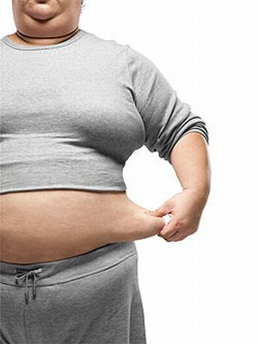
The Genetics of Obesity
Dr Andrew Walley
Dept of Genomics of Common Disease
School of Public Health

Slide 2
Summary
Why is obesity a current concern?
How do we measure it?
What causes it?
Is it genetic?
Genetics and obesity

Slide 3
The rise of obesity

Slide 4
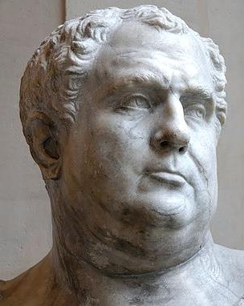
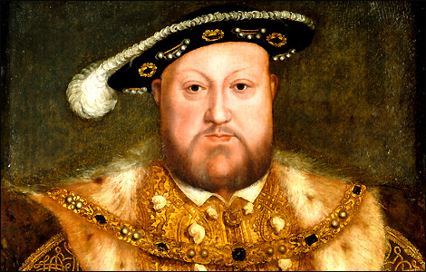
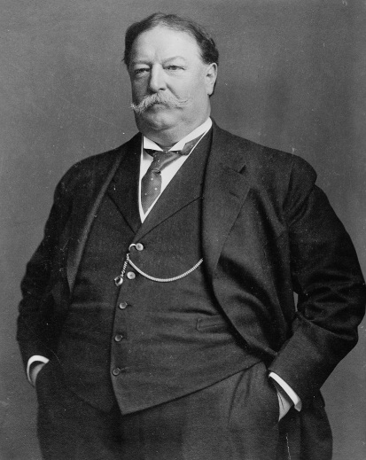
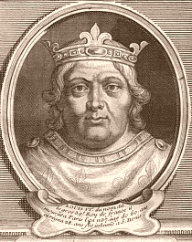
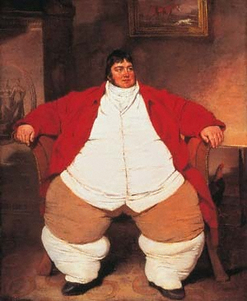
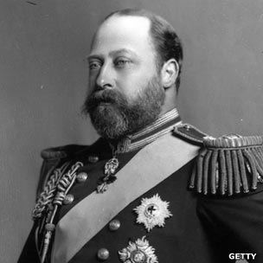
Obesity in history

Slide 5
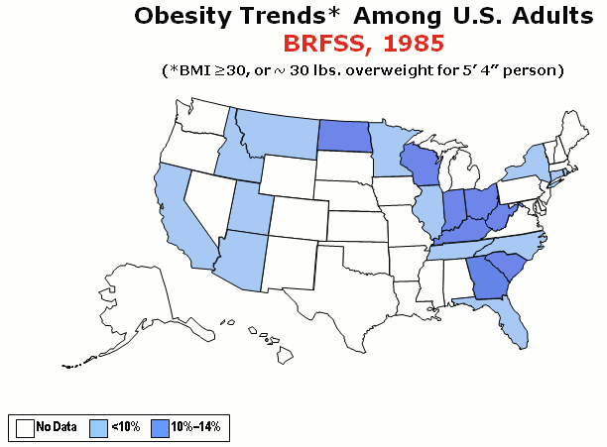

Increasing obesity rates
Source: Behavioural Risk Factor Surveillance System, CDC

Slide 6
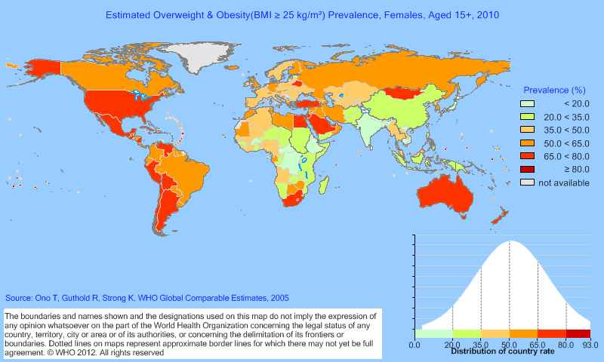
Global Obesity

Slide 7
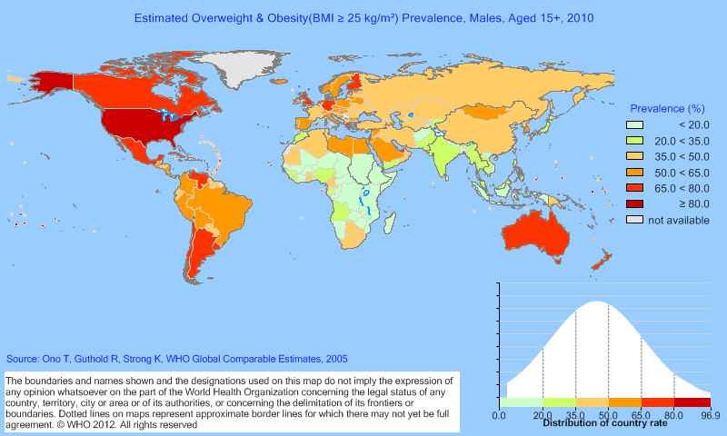
Global Obesity

Slide 8
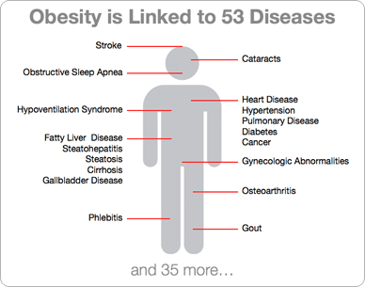
Obesity is linked to many diseases

Slide 9
What causes obesity?
Sedentary Lifestyle
Foetal Programming
Thrifty Genes
Predation Release
Ethnic Shift
Reproductive Fitness
Assortative Mating
Complex reasons!

Slide 10
Physiology of obesity
Disorder of energy balance
  Thermogenic (brown) adipose tissue
Disorder of the adipocyte
  Larger size/numbers as a child leads to obesity
Neurobehavioural disorder
  Obesity originates in the brain where mechanisms regulating appetite and satiety are disordered

Slide 11
Treating Obesity
Diet/Exercise
  Good for overweight
  Ineffective for morbid obesity
Drugs
  Appetite Suppression – Lorcaserin/Belviq
  Nutrient Malabsorption – Orlistat/Xenical
Bariatric Surgery
  Gastric Band
  Roux-en-Y

Slide 12
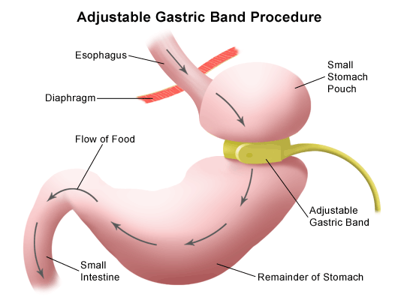
Gastric Band

Slide 13
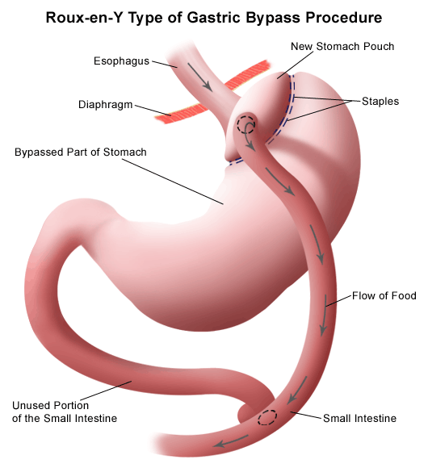
Roux-en-Y

Slide 14
Is Obesity Genetic?
Environment is very important
  Energy-dense foods
  Low physical activity (?)
Genetic changes occur over hundreds of generations
Eat less, lose weight! (If you can)
What determines my body shape?

Slide 15
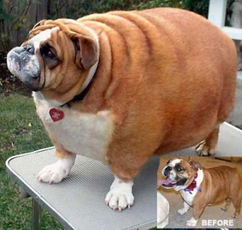
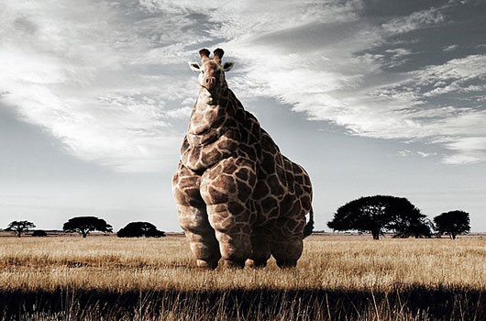
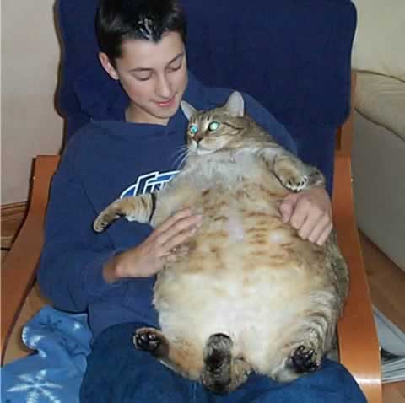
The Obesogenic Environment
Environment is important!

Slide 16
Defining Obesity
How do we define obese and non-obese?

Slide 17
Measuring Obesity
Anthropometry
Body Fat Composition
Body Mass Index (BMI)
Waist
Waist:Hip Ratio (WHR)
Skinfold Thickness
Impedance
Water displacement
DEXA

Slide 18
Body Mass Index
Simple calculation
Weight in kilograms divided by height in metres squared
E.g if you are 1.78m tall and weigh 88.5kg
BMI = 88.5/(1.78 x 1.78) = 27.9 kg/m²

Slide 19
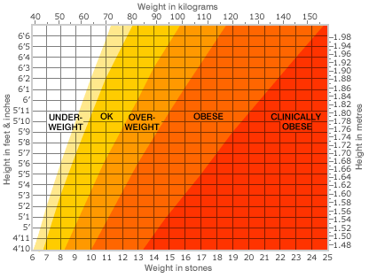
Adult BMI Ranges

Slide 20
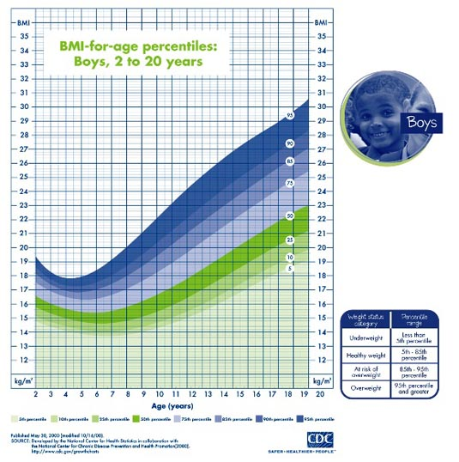
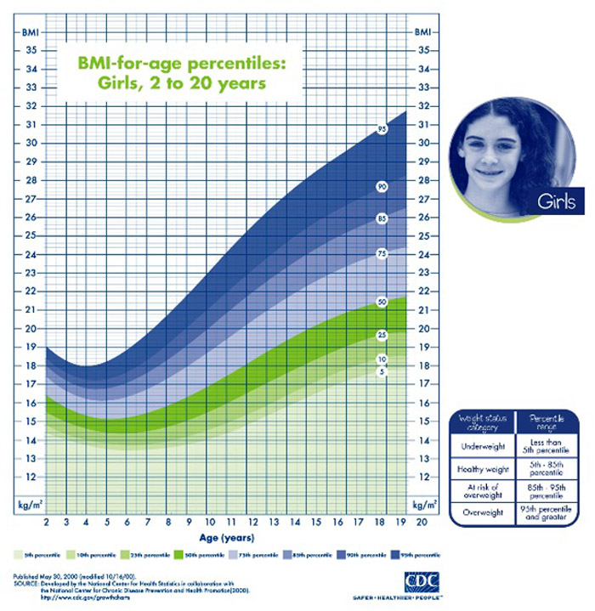
Child BMI ranges
From http://www.childobesityinfo.blogspot.com/

Slide 21
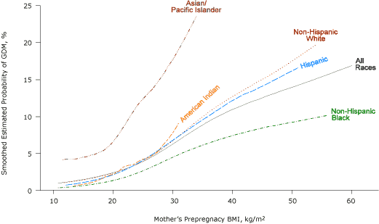
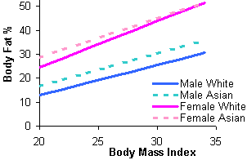
Problems with BMI - 1
Ethnicity is important
At the same BMI, Asians have a higher percent body fat compared to white subjects
This can mean that risks of disease are higher at the same BMI for Asians, e.g. Gestational Diabetes Mellitus
Am J Clin Nutr (1994) 60(1):23-8
Prev Chronic Dis 2012;9:E88

Slide 22
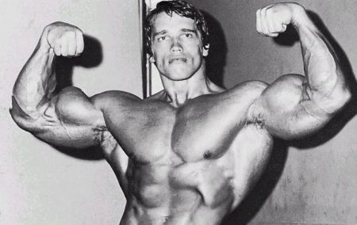
Problems with BMI - 2
BMI is affected by muscle/fat ratio as muscle is heavier than fat
E.g.
A person 1.87m tall and weighing 113kg is Obese as their BMI = 32.3
Normal or Underweight BMI is not necessarily healthy
Post-menopausal women tend to lose muscle mass but not fat and may have a normal range BMI but an abnormally high fat percentage
Underweight (BMI<18.5) is widely recognised to be associated with significant health problems
  Infertility
  Osteoporosis
  Increased mortality

Slide 23
Waist measurement
Very simple
Self-reported is variable
As good as BMI for health prediction
Waist/Hip ratio more accurate measure for fat distribution, especially as this varies between men and women

Slide 24
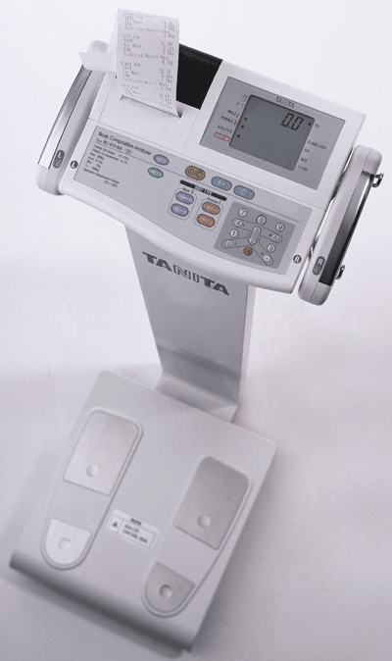
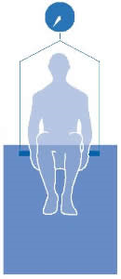
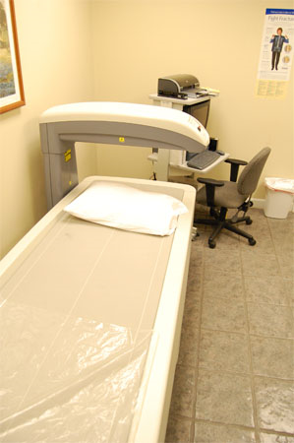
Body Fat Measurement
Impedance
Water/air displacement
DEXA

Slide 25
Is obesity genetic then?

Slide 26
Classic Genetic Study Designs
Twin studies
  Compare monozygotic (identical) and dizygotic (non-identical) twins . If phenotype is genetically-determined then identical twins will be much more similar
Adoption studies
  Compare body size of children and their biological parents when raised by adoptive parents. If phenotype is genetically determined then the children will resemble their biological parents and not their adoptive parents.

Slide 27
Study results
Twin studies
  70-80% of body shape is genetically determined
Adoption studies
  30-40%
Family studies
  40-60%

Slide 28
Genetic Forms of Obesity
Monogenic/Mendelian
Syndromic
Common/Polygenic/Complex

Slide 29
Monogenic Obesity
Rare
Single-gene disorder
Clear inheritance pattern
Little or no evidence of environmental influence

Slide 30
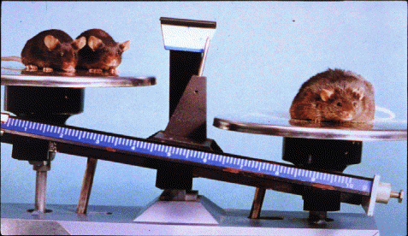
Monogenic Obesity
Knockout mouse model helped identify the first obesity “ob” gene
Human gene identified soon after and named Leptin
Nature 1994 372(6505):425-32

Slide 31
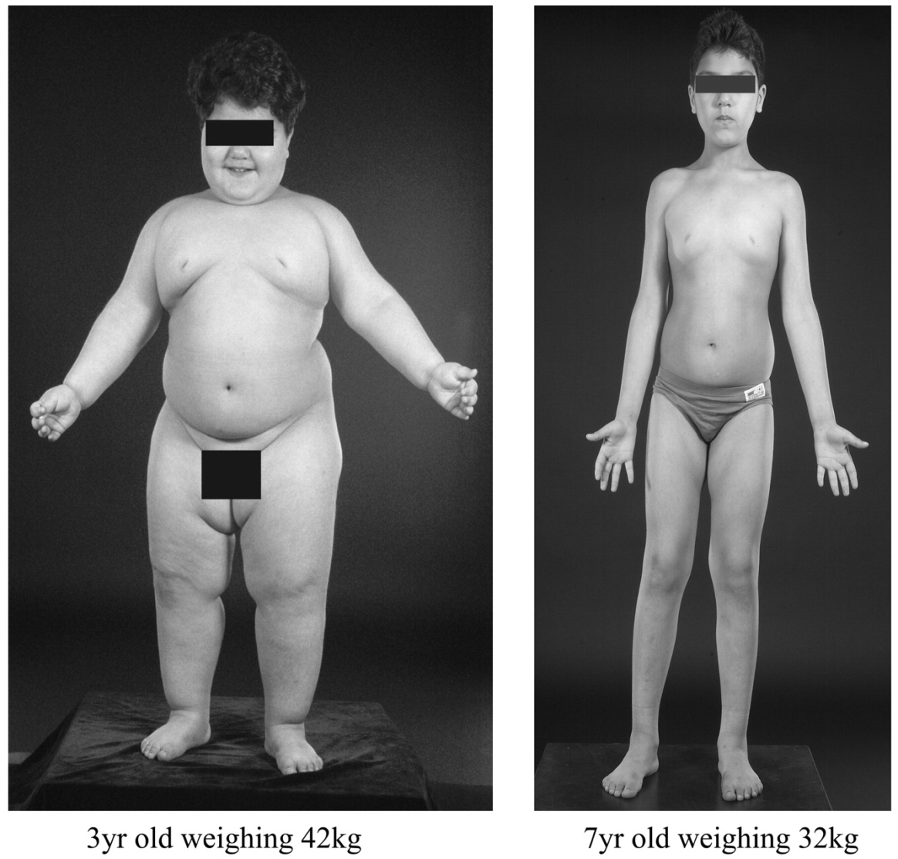
Monogenic Obesity
Leptin deficiency identified in humans
Nature 1997 387:903-8
Successful replacement therapy
N Engl J Med 1999 341:879-84

Slide 32
Monogenic Obesity
Many monogenic causes of obesity
  Leptin
  Leptin Receptor
  Melanocortin-4 receptor
  Proopiomelanocortin
  Brain-derived neurotrophic factor
  Neurotrophic tyrosine kinase receptor type 2
All involved in signalling in the hypothalamus

Slide 33
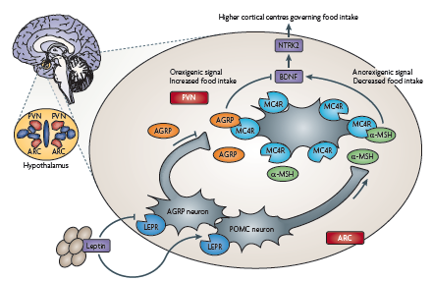
The leptin-melanocortin pathway

Slide 34
Syndromic Obesity
Obesity is part of the description of some syndromes but it is not always necessary for diagnosis
Examples include:
  Prader-Willi
  Bardet-Biedl
  Pseudohypoparathyroidism type 1A

Slide 35
Prader-Willi Syndrome
Symptoms include
  Muscle hypotonia
  Hyperphagia/Obesity
  Mental retardation
  Short stature
  Small hands and feet

Slide 36
Prader-Willi Syndrome
Lack of a functional paternal copy of 15q11-q13 (maternal copy is imprinted and inactive)
Deletion or duplication of the critical region on the paternal chromosome
Maternal uniparental isodisomy
Review of imprinting: Li and Sasaki Cell Res. (2011) 21(3):466-73

Slide 37
Common non-syndromic obesity
Common
No clear inheritance pattern
Evidence of environmental effects (complex)

Slide 38
Investigating common obesity
Whole Genome Linkage Studies
Candidate Genes
Genome-Wide Association Studies (GWAS)

Slide 39
Linkage and Association
Linkage
  Is a marker allele inherited more often than by chance alongside a disease within a family?
Association
  Is a marker allele present in more cases than controls across a population?

Slide 40
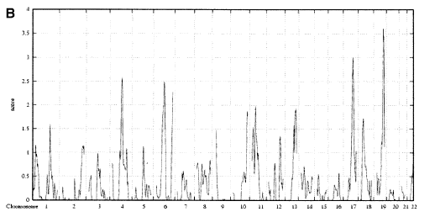
Whole Genome Linkage
Over 60 linkage genome scans by 2006
Over 250 regions linked to obesity
Major difficulties identifying underlying genes
e.g. Bell et al (2004) Diabetes 53:1857–1865

Slide 41
Genome-Wide Association
Hypothesis-free
“Common disease, common variant”
For obesity and BMI
Many novel genes identified by GWAS
More identified by meta-analysis

Slide 42
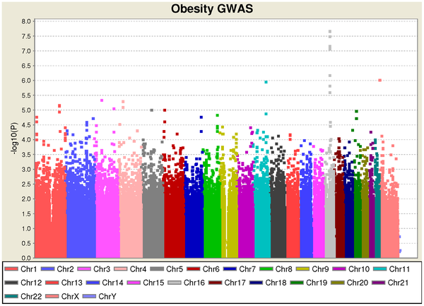
Single GWAS Results
Meyre et al (2009)
Nature Genetics 41, 157 - 159
Wang et al (2011)
PLoS ONE 6(4): e18939

Slide 43
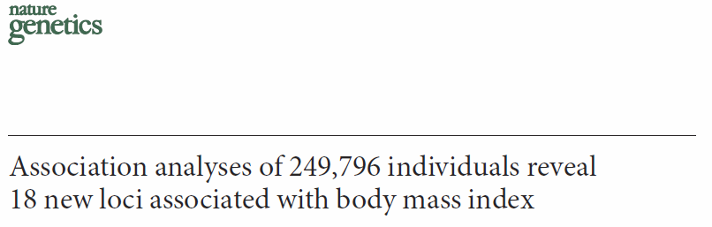
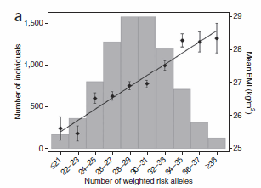
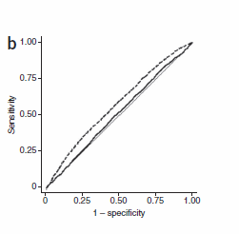
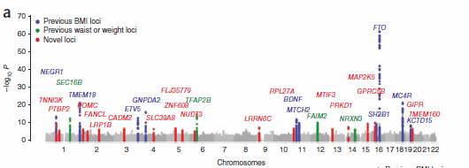
Meta-Analysis of GWAS
Speliotes et al (2010) Nat Genet. 42:937-48

Slide 44
Obesity GWAS results
Fall & Inglesson Mol Cell Endocrinol (2012) in press

Slide 45
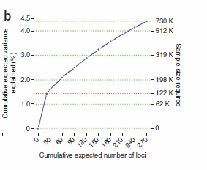
Problems with GWAS
GWAS so far has identified associations that are statistically strong and reproducible
However, their contribution to the genetic component of disease is estimated to be low (<5%)
More work is needed

Slide 46
Where next?
Whole genome sequencing
  Millions more SNPs – “Rare” variants
  Difficult statistical challenges
Advanced Phenotyping
  Ultrasound
  Photonic scanning
  CAT/MRI

Slide 47
Beyond SNPs
Copy Number Variation
  Association of variation in the number of copies of a gene or region and disease
Epigenetics
  Changes in the DNA that do not affect the primary sequence, e.g. DNA and histone methylation

Slide 48
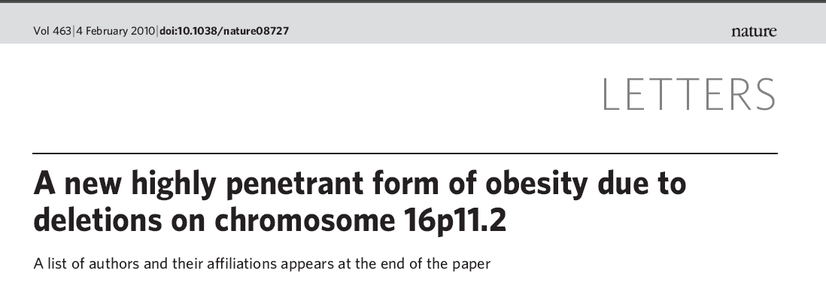
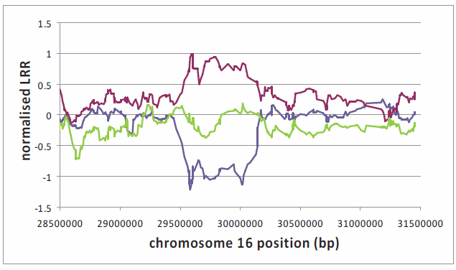
Copy Number variation on Chr16
Walters et al
Validation/investigation of parents by MLPA

Slide 49
16p11.2 duplications and low BMI
Second Nature paper 6th Oct 2011
Duplication of the region is associated with low BMI

Slide 50
Summary
Obesity is a complex genetic disease
Phenotype needs to be well-defined
Linkage and association have identified genes – SNPs and CNVs
Many genes remain to be discovered

Slide 51
Key References
The genetic contribution to non-syndromic human obesity Walley et al (2009 )Nat Rev Genet 10:431-42
The contribution of heredity to clinical obesity Andersson & Walley (2010) Endocrine Updates 30:25-52
Genome-wide association studies of obesity and metabolic syndrome. Fall & Inglesson (2012) http://dx.doi.org/10.1016/j.mce.2012.08.018

