Slide 1
Gene-environment interactions in IBD
Dr Matthew Shale
Translational Gastroenterology Unit, University of Oxford
& Chelsea & Westminster Hospital
October 2012

Slide 2
Outline
Evidence for environmental risk factors in IBD
Interaction of genetics and environment
The role of the gut flora in IBD
Mechanisms of interaction of implicated gene products and gut flora

Slide 3
Gene-Environment Interaction
IBD
UC CD
Familial
Adenomatous
Polyposis
Type 2
Diabetes
Trauma
Coronary
Heart
Disease
Cystic
Fibrosis
Scurvy
Purely
Environmental
Purely
Genetic

Slide 4
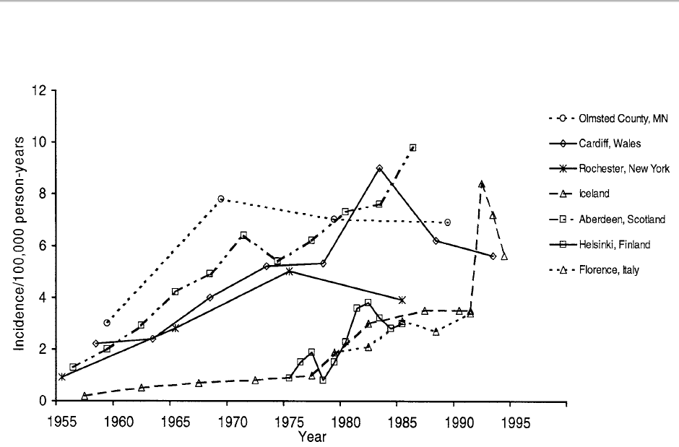
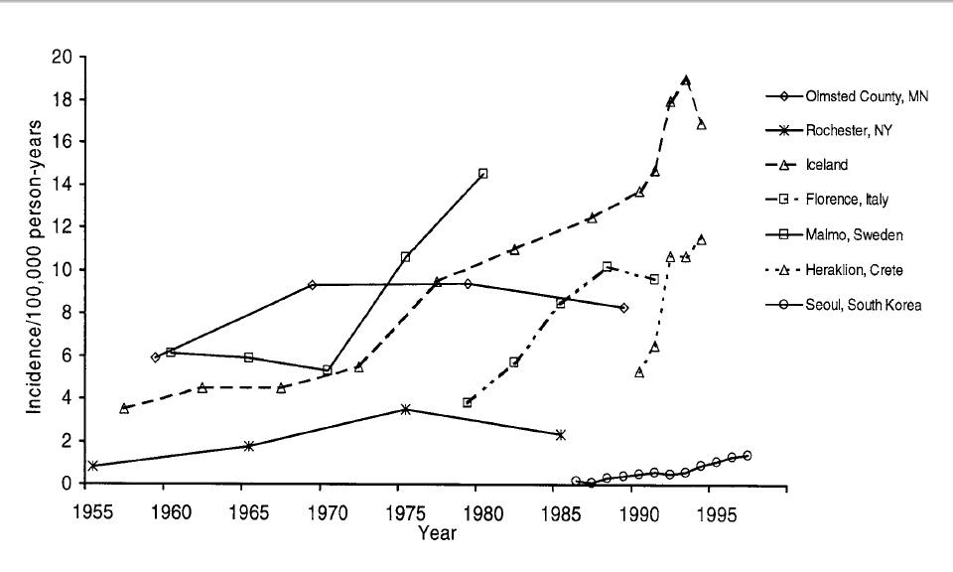
IBD Epidemiology
Crohn’s disease
Ulcerative colitis
Loftus Gastro 2004

Slide 5
Genetic Influences
Monozygotic twin concordance
  Crohns’ disease 35-60%
  Ulcerative colitis 10-15%
i.e. 40-50% non-heritable influence in CD
Even greater environmental effect in UC

Slide 6
Environmental Factors
Smoking
Social status
Low fruit & veg intake
High refined sugar intake
Toothpaste
Silicon dioxide
Breast feeding
OCP/oestrogens
NSAIDS
Enteric flora
Bacterial Infection
  Chlamydia
  Listeria
  E.coli
  Pseudomonas
Measles/MMR
Mycobacteria paratuberculosis
Appendicectomy
Dietary fatty acids

Slide 7
Environmental Factors
Smoking
Social status
Low fruit & veg intake
High refined sugar intake
Toothpaste
Silicon dioxide
Breast feeding
OCP/oestrogens
NSAIDS
Enteric flora
Bacterial Infection
  Chlamydia
  Listeria
  E.coli
  Pseudomonas
Measles/MMR
Mycobacteria paratuberculosis
Appendicectomy
Dietary fatty acids

Slide 8
Smoking and IBD
UC in current smokers: RR 0.4
    Rectal blood flow
    Mucus production
    Cytokines
    Eicosanoids
Former smoking history: RR 1.7
50% of patients who resume smoking improve
Some clinical benefit from nicotine patches
CD risk increased by smoking: RR 2
Not seen in all ethnic groups
More disabling course in current smokers

Slide 9
Appendicectomy and IBD
Protective against UC: RR 0.3-0.7
May associate with less severe course
    Lower colectomy rate
    Lower rate of immunosupprssive use
Less convincing data in Crohn’s
Overall small increase in CD risk

Slide 10
Gut flora and IBD
Murine models:
  IL-10^{-/-}
  IL-2^{-/-}
  STAT3^{-/-}
  CD4⁺CD45RB^{hi} adoptive transfer
  Chemical irritation:DSS & TNBS
Significant variation in susceptibility between mice strains – differ in flora
Do not develop in animals housed in germ free conditions
Some can be induced by individual bacterial families/species (e.g. helicobacter, bacteroides)

Slide 11
Gut flora and IBD
Altered composition of gut flora in IBD patients
  Reduction in flora variation
  Increased populations of Enterobacteracea
  Increased enteroadhesive E.coli
  Reduced Clostridia spp.
  Protection from Faecalibaterium prauznitzii
Seksik Gut 2003, Barnich J Clin Invest 2007

Slide 12
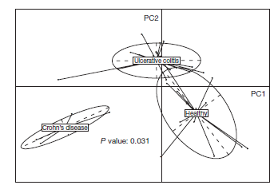
Gut flora and IBD
Qin Nature 2010

Slide 13
Host Specific Microbiota drives Intestinal Immune Maturation
Chung Cell 2012

Slide 14
IBD: Implicated Genes
NOD2
IRGM
ATG16L1
MST1
IL23R
PTGER4
TNFSF15
ZNF365
NKX2-3
PTPN2
PTPN22
ITLN1
IL12B
CDKAL1
CCR6
JAK2
ARP2C
IL10
LRRK2
MUC19
ORMDL3
STAT3
ICOSLG
GCKR
BTNL2
SLC26A3
HLA-DRB1
HLA-DQA1
PUS10
CCL2
CCL7
LYRM4
SLC22A23
IL18RAP
IL26
+92 others!

Slide 15
Genetic Interaction
Barrier function
    MDR-1 (UC)
Innate immunity
    NOD2
    ATG16L1
    IRGM
Innate-adaptive crosstalk
    IBD3 (HLA)
    IL23R
    IL12B
    STAT3
    IL-10 (UC)

Slide 16
NOD2

Slide 17
NOD2/CARD15
Nucleotide binding oligomerisation domain-2
Intracellular receptor for muramyl dipeptide (MDP)
mRNA expressed in epithelial cells and APCs
Protein expressed in Paneth Cells and APCs
Expression up-regulated by TNF and IFN
CARD
CARD
NOD
LRR
Arg702Trp
Gly908Arg
Leu1007fsinsC

Slide 18
NOD2 Function
CARD
CARD
NOD
LRR
NEMO
CARD
MDP
IKKα
IKKβ
RIP2
Nucleus
IKβ
p50
p65
p50
p65
NF-ĸB
Cytokines

Slide 19
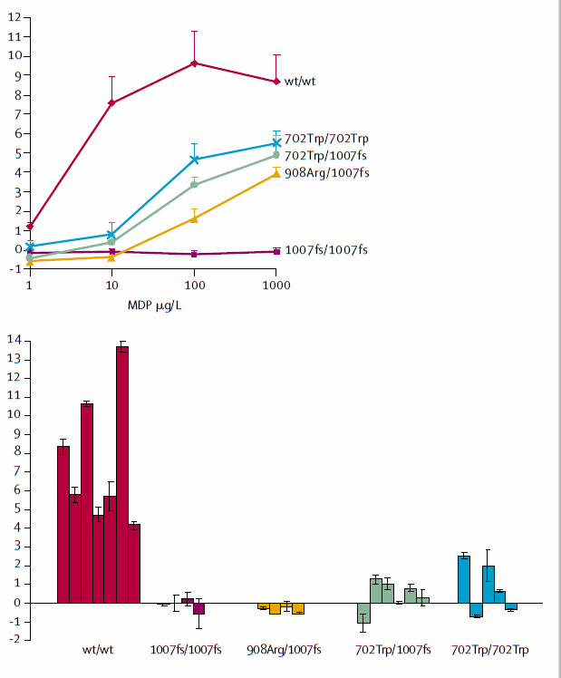
NOD2 Function
Reduced CXCL8 (IL-8) secretion when NOD2 mutant PBMCs exposed to MDP
Defective neutrophil recruitment?
Persistent adaptive immune response?
Van Heel Lancet 2005

Slide 20
NOD2 Function
Peptidoglycan
TLR2
TLR4
MyD88
MyD88
TRIF
LRR
NOD
CARD
CARD
NOD2
TLR3
TRIF
CARD
RIP2
IL-1
IL-12
IL-10
TNF
IKβ
p50
p65
NF-ĸB

Slide 21
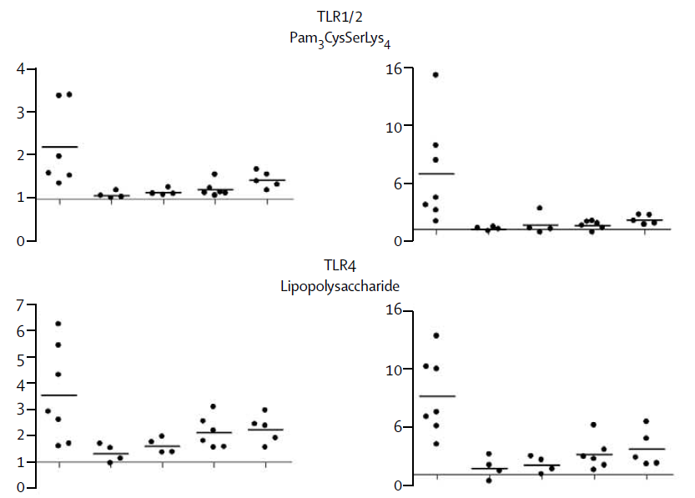
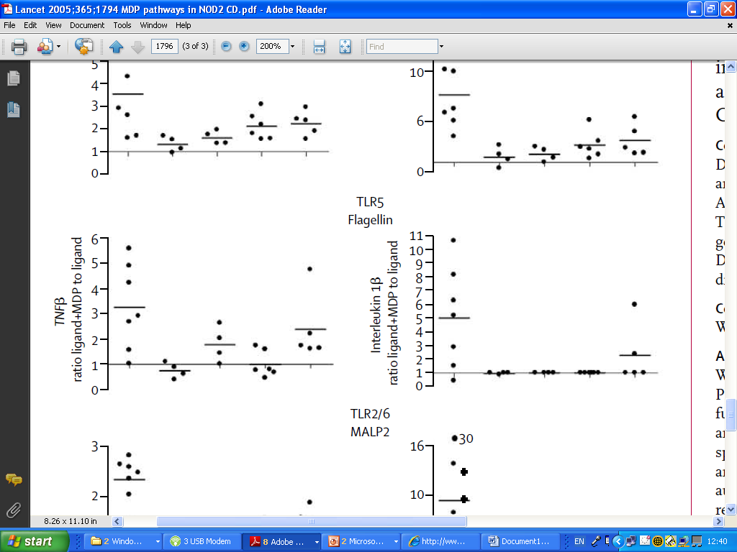
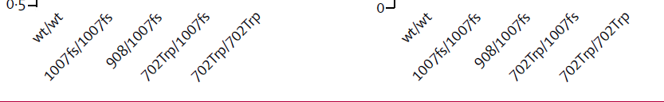
NOD2/TLR Crosstalk
NOD2 signalling augments TLR driven cytokine secretion
Van Heel Lancet 2005

Slide 22
NOD2 Function
NOD2^{-/-} murine macrophages – increased IL-12 following TLR2 stimulation
    No effect on signals downstream of other TLRs
    No effect on IL-10 or TNF following TLR2 stimulation
In humans, IL-10 following TLR2 ligation actively suppressed by NOD2 mutations
Watanabe Nat Immunol 2004, Noguchi Nat Immunol 2009

Slide 23
Peptidoglycan and Th17 Cells
Van Beelen Immunity 2007

Slide 24
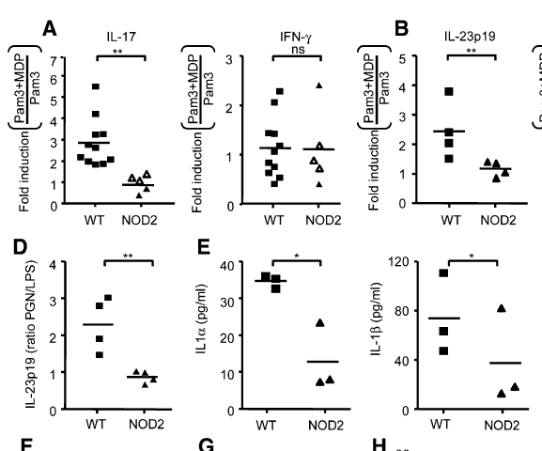
NOD2 and T-cell Polarisation
NOD2 mutations impair ability to polarise T-cells to Th17 phenotype
May relate to impaired DC secretion of IL-23
Van Beelen Immunity 2007

Slide 25
IL23R

Slide 26
IL-23R
p35
p19
p40
p40
IL12Rβ1
IL12Rβ2
IL12Rβ1
IL23R

Slide 27
CD4+ Cell Subtypes
IL-10
TGF- β
TReg
T_{H}0
IL-1
TGF-β
IL-6
IL-23
FOXP3
IL-12
T-bet
STAT6
GATA-3
IL-4
T_{H}1
T_{H}17
RORγt
T_{H}2
IL-2
IL-21
IL-12
IFN- γ
TNF
IL-17
IL-22
IL-21
IL-4
IL-5
IL-13

Slide 28
Type-17 responses in intestinal homeostasis and inflammation
RegIII
RORγt+
ILCs
Lymphoid
Follicle
Epithelial
Integrity
& Repair
RORγt+
IL-22
IL-23
IL-23
RORγt+
γδ
T-cells
Naive
T-cell
+IL-22
+IL-17A
CD4⁺
Th17-cells
IL-17A
IL-17F
TGF-β, IL-1,
IL-6, IL-21
GM-CSF
Non Type17
T-cells
RORγt+
TNFα
IFNγ
IL-21
IL-21

Slide 29
IL-23 Signalling
IL-23R expressed on activated T-cells via IL-6 dependent mechanism
IL-23R may also be expressed on intestinal macrophages and NK cells
IL-23 essential in multiple animal models of colitis
IL-12p40 blockade in humans ameliorates Crohn’s disease

Slide 30
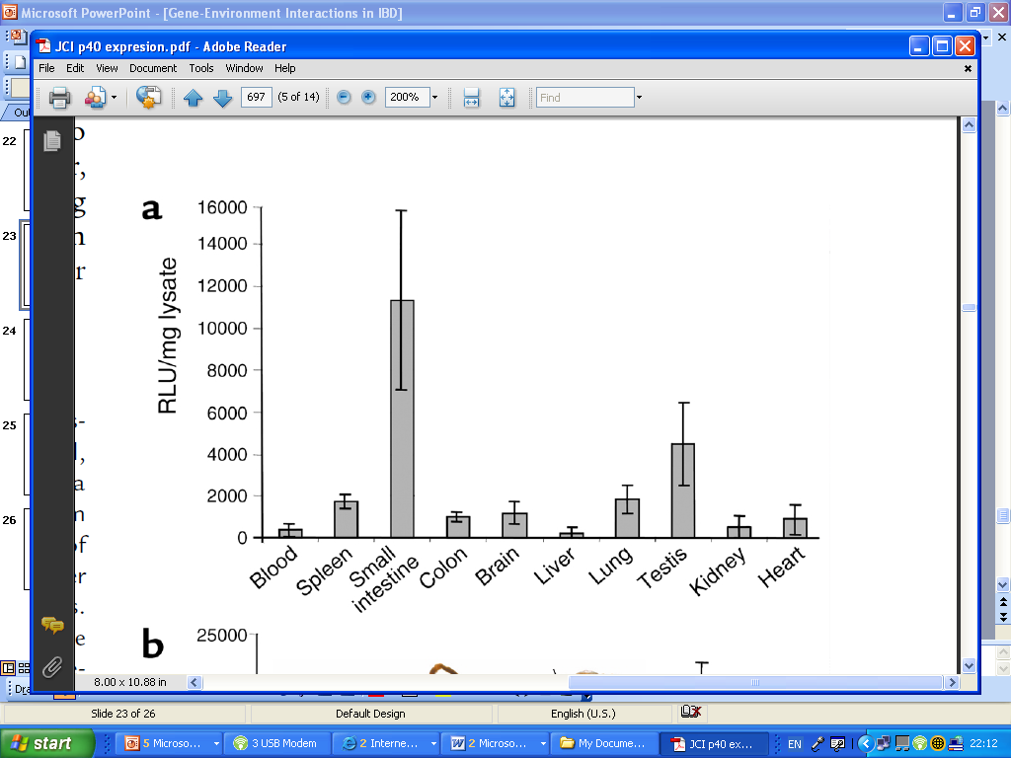
Physiological IL-12p40 Expression
Bacteria induce constitutive IL-12p40/p19 expression from DCs in distal ileum
Implicates a role for IL-23 in intestinal immune homeostasis
Becker JCI 2003

Slide 31
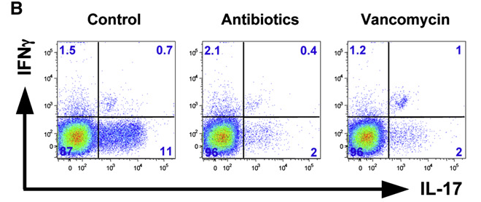
Specific flora components drive
Th17 cells
Ivanov CHM 2006

Slide 32
Autophagy

Slide 33
ATG16L1 Expression
Nat Genetics 2007;39:210

Slide 34
Autophagy
Conserved mechanism
Physiological role
Cytoplasmic homeostasis
    Sequestration of cytosolic portions
    Involved in protein breakdown
    Removes leaky mitochondria
    Regulates ER mass
Non-apoptotic programmed cell death
Immune functions

Slide 35
Autophagy
Autophagy
ATG5
ATG12
ATG7/10
TOR
ATG5-ATG12
ATG1 (ULK1)
ATG16
ISOLATION
MEMBRANE
ATG8 (LC3-II)
ATG8 (LC3-II)
AUTOPHAGOSOME
PI3K
ATG6 (Beclin)
Forming
AUTOPHAGOSOME

Slide 36
Autophagy in Action
Autophagy in action
Nat Genetics 2007;39:596

Slide 37
Autophagy
ATG5
ATG12
ATG7/10
TOR
ATG5-ATG12
ATG1 (ULK1)
ATG16
ISOLATION
MEMBRANE
ATG8 (LC3-II)
ATG8 (LC3-II)
AUTOPHAGOSOME
PI3K
ATG6 (Beclin)
IRGM
LC3-1

Slide 38
Autophagy in Innate Immunity
Autophagy in innate immunity
Elimination of intracellular pathogens
    Viruses
    Bacteria
    Mycobacteria
Processing of cytosolic contents for MHC-II presentation
Critical role in intracellular TLR recognition
Immunity 2007;26:79–92

Slide 39
Autophagy and TLRs/NLRs
Autophagy can be activated by NOD-like receptor and TLR stimulation
Required for intracellular presentation to TLRs/NLRs
Science 2007;315:1398, PLos Pathogens 2007;3:e111

Slide 40
Autophagy and Intracellular
Bacteria
Known to be linked to IFN-γ
Recently shown functional role for IRGM in human defence against TB
Involved in granuloma formation in mice
Science 2003;302:654, 2006;314:1438

Slide 41
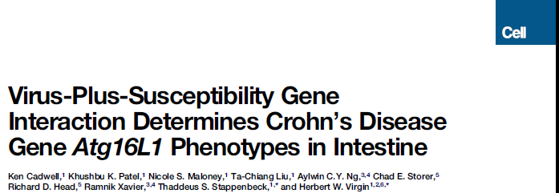
Environmental Effect on Gene Function
ATG16L1 transgenic (hypomorphic) mice
  Abnormal Paneth cell morphology/function
Rederivation in clean facility → loss of phenotype
Cadwell Cell 2010

Slide 42
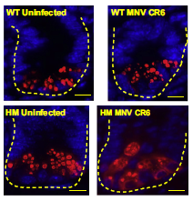
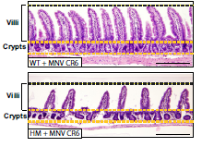
Environmental Effect on Gene Function
Abnormality due to presence of murine norovirus
  ATG16L1^{HM} without MNV normal Paneth cell function
  Wild-type ATG16L1 – no effect of MNV on Paneth cells
MNV infected ATG16L1^{HM} more susceptible to flora driven model of colitis
Cadwell Cell 2010

Slide 43
Summary
Multiple genes implicated in IBD
Multiple environmental factors implicated
Interaction poorly understood
Luminal flora likely to be most significant environmental factor
Potential mechanisms of interaction for common genes discussed
IBD clearly combination of genetics and environmental factors
Environmental factors may modify effect of genetics

Slide 44
Further Reading
Xavier, RJ & Podolsky, DK. Unravelling the pathogenesis of inflammatory bowel disease. Nature 2007;448:427–434
Singh, SB et al. Human IRGM induces autophagy to eliminate intracellular mycobacteria. Science 2006;313:1438–1441
Hue, S et al. Interleukin‑23 drives innate and T cell mediated intestinal inflammation. J Exp Med 2006;203:2473–2483
Wilson, NJ et al. Development, cytokine profile and function of human interleukin 17-producing helper T cells. Nature Immunol 2007;8:950–957
Watanabe, T et al. NOD2 is a negative regulator of toll-like receptor 2-mediated T helper type 1 responses. Nat Immunol 2004;5:800–8
Xavier, RJ et al. Autophagy as an important process in gut homeostasis and Crohn’s disease pathogenesis. Gut 2008;57:717 - 720
Cho J. The genetics and immunopathogenesis of inflammatory bowel disease. Nat Rev Immunol 2008;8:458
Cadwell K, et al. Cell 2010;141:1135-1145
Chung H. et al. Cell 2012;online ahead of print

