Slide 1
The genetic basis of gallstone disease
Dr Abigail Zabron
PhD, MRCP
Gastroenterology BSc
Imperial College
a.zabron@imperial.ac.uk

Slide 2
Aims
Understand the pathophysiology and significance of gall bladder calculi
Describe the production and circulation/ recirculation of bile
Give examples of genetic and molecular mechanisms underlying stone formation
Suggest where this knowledge may take us

Slide 3
Gallstones are common
Prevalence (%) | 20-29y |  | 30-39y |  | 40-49y |  | 50-59y |  | >60y
 | f | m | f | m | f | m | f | m | f | m
Brazil | 3.0 | 1.8 | 11 | 2.9 | 13 | 6.3 | 23 | 7.8 | 30 | 16
Germany | 1.9 | 1.4 | 5.6 | 4.3 | 9.5 | 10.5 | 14 | 10 | - | -
Italy | 3 | 2 | 9 | 3 | 17 | 8 | 22 | 12 | 28 | 17
Mexico | 11 | 1 | 13 | 5 | 20 | 7 | 22 | 10 | 27 | 14
USA | 4.4 | 1.3 | 5.2 | 1.1 | 8.2 | 5.9 | 12 | 7.3 | 16 | 17

Slide 4
Gallstones are a problem
Europe/ N.America: 10-20% (Everhart et al., 1999)
Women RR double
  30% prevalence over 50y age.
10y 26% incidence of biliary colic
1-2% become symptomatic p.a.
Surgical cholecystectomy caseload:
  700000 p.a.USA 170000 p.a. Germany
  mortality 0.4% in ASAI-II patients
  costs high

Slide 5
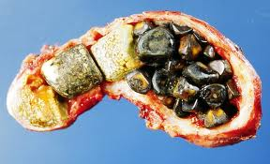
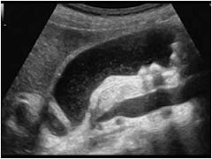
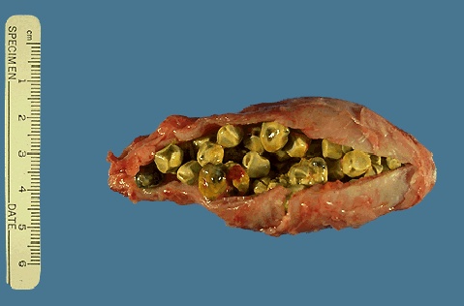
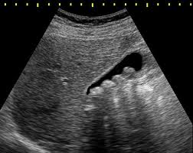
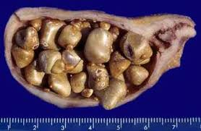
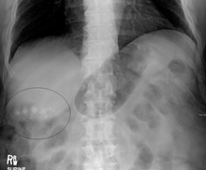
What are they?
gallstones

Slide 6
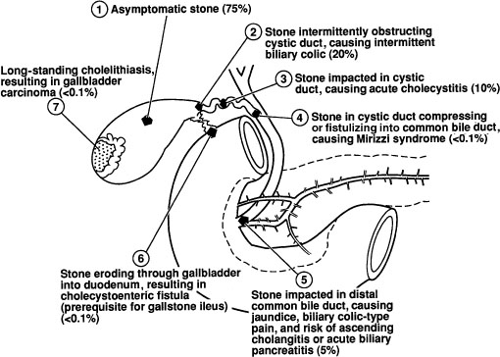
Clinical manifestations

Slide 7
Who gets gallstones?
Risk factors:
Age & gender
Obesity, weight loss, TPN
Pregnancy and parity
NIDDM, diet and lipid profiles
Ileal disease
Slow intestinal transit, spinal injury
Medication:
  e.g. oestrogens, clofibrate, octreotide, ceftriaxone

Slide 8
 |  | Increased cholesterol secretion | Increased cholesterol synthesis | Decreased bile acid synthesis | Decresed bile acid secretion | Gallbladder hypomotility | Reduced cholesterol conversion | Other
Age |  | x |  | x
Female Gender |  | x |  |  |  |  |  | Transit time↑
Obesity |  | x | x
Weight loss |  | x |  | x |  | x
TPN |  |  |  |  |  | x
Pregnancy |  | x |  |  |  | x
Genetic | ApoE4/E4 |  |  |  |  |  |  | ???
 | Scandinavian | x
 | Native American |  | x |  |  |  | x
Medications | OCP | x
 | Oestrogen ♀ | x |  | x
 | Oestrogen ♂ | x
 | Progestogens | x |  |  |  | x |  | ACAT ↓
 | Ceftriaxone |  |  |  |  |  |  | Salt preciptn
 | Octreotide |  |  |  |  | x
 | Clofibrate | x |  |  |  |  |  | ACAT ↓
Medical | Terminal ileal disease |  |  |  | X (decreased pool)
 | Decreased HDL |  | x
 | Increased TG |  | x

Slide 9
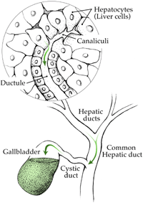
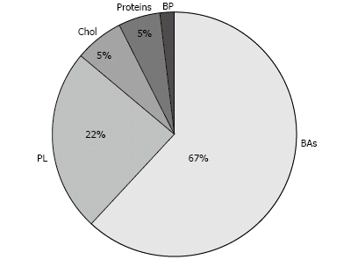
What is bile?

Slide 10
Bile constituents
Cholesterol and phospholipids
  elimination of excess cholesterol
  phospholipids enhance the cholesterol solubilizing properties of bile salts.
Bile salts (cholates, chenodeoxycholate, deoxycholate):
  derived from cholesterol
  amphipathic detergents dissolve dietary fat and allow it to be absorbed
  signal via FXR regulating bile synthesis, lipid, glucose and energy metabolism
  activate PXR and VXR for detoxification
Proteins including mucins
Bilirubin / bile pigments (0.3%)

Slide 11
Normal physiology
Cholesterol pool
  20% de novo by HMGCoA reductase
  80% diet/ HDL
Cholesterol esterified for VLDL excreted (bile) or converted to bile acids (CYP7A1)
Active transport across sinusoidal / canalicular membranes
  bile salts (67%), phospholipid (22%) and cholesterol (4%)
Unilammellar vesicles (PCh/Chol) convert to mixed micelles
+ HCO3/ Cl- with water from cholangiocytes via aquaporins
Enterohepatic circulation and active transporter mediated uptake at luminal and portal membranes

Slide 12
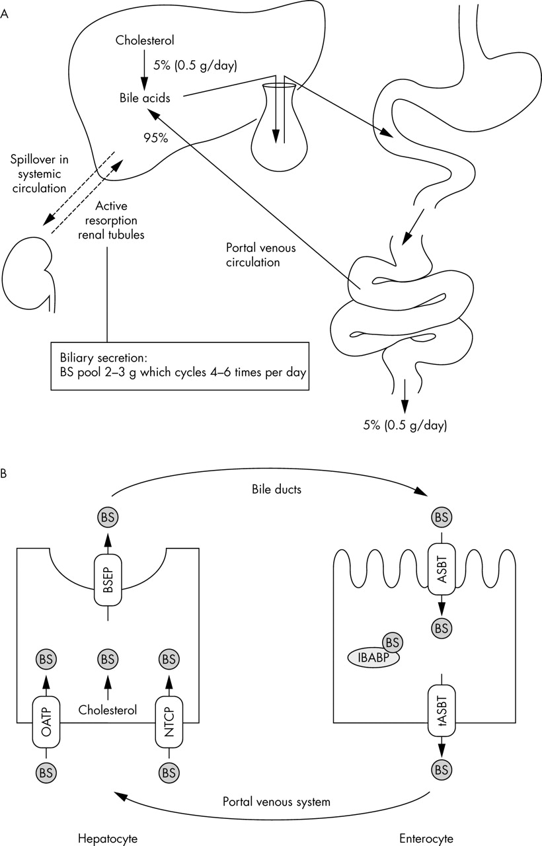

Bile salt enterohepatic circulation
CYP7A1
PPARs
ABC proteins
SCP2
FXR
FGF19
CH shunt
Stomach
APOE
APOB
D2
NTCP
Mucins
OATP1B1
CCKAR
FGF19
TI
SLC10A2
ASBT
OSTα/β
Modified from van Mil S W C et al. J Med Genet 2005;42:449-463
©2005 by BMJ Publishing Group Ltd
Notes:
Schematic representation of the enterohepatic circulation of bile salts. The organs (A) and cell types and transporters (B) that are involved in the enterohepatic circulation of bile salts are depicted. For simplicity, the cholangiocytes are not presented. For further details, see text. ASBT, apical sodium-dependent bile salt transporter; BS, bile salts explained; BSEP, bile salt export pump; IBABP, ileal bile acid binding protein; NTCP, sodium-dependent taurocholate protein; OATP, organic anion transporter; tASBT, truncated form of ASBT.

Slide 13
Bile salt enterohepatic circulation
Cholangiohepatic shunt
Stomach
D2
TI
Modified from van Mil S W C et al. J Med Genet 2005;42:449-463
©2005 by BMJ Publishing Group Ltd
Notes:
Schematic representation of the enterohepatic circulation of bile salts. The organs (A) and cell types and transporters (B) that are involved in the enterohepatic circulation of bile salts are depicted. For simplicity, the cholangiocytes are not presented. For further details, see text. ASBT, apical sodium-dependent bile salt transporter; BS, bile salts explained; BSEP, bile salt export pump; IBABP, ileal bile acid binding protein; NTCP, sodium-dependent taurocholate protein; OATP, organic anion transporter; tASBT, truncated form of ASBT.

Slide 14
Modified from van Mil S W C et al. J Med Genet 2005;42:449-463
©2005 by BMJ Publishing Group Ltd

Slide 15
Membrane transporters

Slide 16
BA-independent membrane transporters

Slide 17
BA-dependent membrane transporters

Slide 18
Ductal membrane transporters

Slide 19
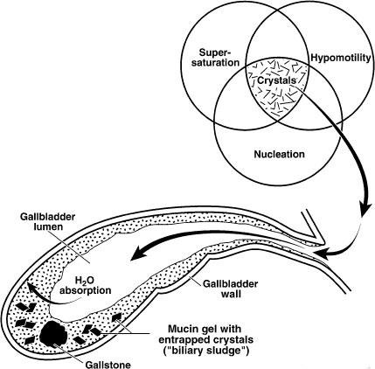
Cholesterol stone pathophysiology
Increased
uptake
Cholesterol
Gallbladder
Increased
production
Intestinal
hypomobility
Decreased lecithin
Decreased bile salts
Notes:
?role for bacteria
Supersaturation of bile
Mucus hypersecretion
Crystal nucleation
Reduced GB emptying/stasis
GI hypomobility: slow transit allows bacterial conversion of bile salts to deoxycholate and inhibits bile acid production in liver therefore increases cholesterol secretion into bile and supersaturation

Slide 20
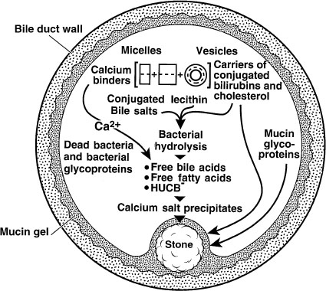
Pigment stone pathophysiology
Brown pigment –
cholesterol with pigment shell
can be intrahepatic
stasis/infection causes deconjugation
and precipitation of long chain fatty
acids
Black pigment – excess supply
e.g.haemolysis, ileal resection, Crohns
precipitated calcium bilirubinate polymerises with urobilirubin

Slide 21
Gallstones: why genetics?
Familial and linkage studies:
  1st degree relatives 4.5 times more likely to have gallstones
  Not strictly Mendelian
Ethnicity:
  African/ asian< caucasian < south american
  Pima Indians in Southern Arizona
    70% of women older than 25 years have cholesterol gallstones, early onset.
  In Chile, Mapuche mtDNA>Hispanic>Maori (Galman et al., 2004)
  Amerindians in USA>Caucasian>Afroamerican (Everhart et al., 2004)
Twin studies:
  Swedish Twin Studies (Grjibovski 2005)
  43,141 pairs, 40% concordance
  Symptomatic/ asymptomatic
  25% genetic component, 13% shared environmental, 62% unique environmental

Slide 22
How investigated
Above observational studies
Linkage analysis - difficult
Mouse model
  Feed lithogenic diet 15% fat, 1% cholesterol, 0.5% cholic acid
  Breed from and back-cross susceptible strains eg C75L, C57BL/6, SWR or resistant strains eg AKR, 129, A/J to link with known markers
  QTL
Genome Wide Association Studies in Man

Slide 23
Black pigment stones
UGT1A1
  Haemolytic anaemias and cystic fibrosis
  UGT1A1 Gilbert-associated promoter variant
  In sickle cell, serum bilirubin and stone incidence correlates with number of TA repeats (21% and 87% increase per repeat respectively)
  Vasavda et al., 2007; Haverfield et al., 2002
Ileal disease/ resection: e.g. genetics of Crohns
Ileal apical Na/bile salt transporter SLC10A2
  Regulates ileal transport of bile acids
  Mutation causes bile salt malabsorption
  Also pigment lithogenesis

Slide 24
Cholesterol stones: candidate genes
Supersaturation
  Hepatic lipid/ BA synthesis
  Hepatic lipoprotein uptake
  Enterohepatic lipid transporters
Nucleation
Mucin secretion
Gallbladder motility
Intestinal motility
Effects on biofilm/ response to infection
Notes:
Poor GB motility causes aggregation of crystals nucleated in sludge

Slide 25
Supersaturation

Slide 26
Lipid / BA production: CYP7A1
Human homozygous deletion:
  Reduced bile acid synthesis
  Accumulation and secretion of cholesterol
Biliary excretion of cholesterol increases
Associated with cholesterol gallstones
(Pullinger et al., 2002)

Slide 27
Hepatic lipid receptors: APOE
High affinity ligand for LDL receptor /related protein
E2, E3, E4 alleles: 6 isoforms
APOE knockout mice resistant to stones (Amigo et al., 2000)
E2 less common in women with stones
E4
  Higher total and LDL cholesterol in bile
  more common in cholesterol than pigment stone patients
  Associated with cholelithiasis (Bertomeu et al., 1996)
  Recurrence after lithotripsy 50% greater (Venneman et al., 2001)
Mechanism:
  increased chylomicron remnant uptake
  bile stability
Notes:
Other LDL receptors (APOB, APOA1, CETP) or HDL receptors (Scavenger Receptor 1), chylomicron remnants (hepatic lipase)
Other LDL receptors (APOB, APOA1, CETP) or HDL receptors (Scavenger Receptor 1), chylomicron remnants (hepatic lipase)
Other LDL receptors (APOB, APOA1, CETP) or HDL receptors (Scavenger Receptor 1), chylomicron remnants (hepatic lipase)

Slide 28
APOB
Ligand for receptor-mediated endocytosis of LDL
Association with diabetes, CHD
Chinese study: RFLP in exon 26 correlated with gallstones and increased cholesterol, LDL cholesterol and serum ApoB. (Jiang et al., 2004, Han et al.,2000)
Not replicated in Finnish study
Other LDL, HDL or chylomicron remnant receptors ?

Slide 29
Intracellular lipid transporters
Sterol carrier protein (SCP2)
  Transport within cell to membrane
  Overexpressed in cholesterol gallstone cases
Possible role for others eg Niemann-Pick Carrier 1, phospholipid and bile salt carriers

Slide 30
Hepatic/ intestinal membrane lipid transporters and cholesterol stones
ATP-binding cassette transporters
Secretion of lipids from hepatocyte to bile against concentration gradient
Roles in other biliary diseases
  eg MRP2/ABCC2 multispecific organic anion transporter
    excretes bilirubin
    mutation causes Dubin Johnson syndrome

Slide 31
ATP-binding cassette transporters
ABCB11: bile salt export pump BSEP
  equivalent to Lith1, causes PFIC2 in Man
ABCG5/8: dimerise for cholesterol transport
  Equivalent to Lith9
  Required for LXR regulation of cholesterol excretion
ABCB4: phosphatidyl choline flippase MDR3
  Strong monogenetic effect
  Causes PFIC3 in Man
  Low Phospholipid Associated Cholelithiasis (LPAC)
  Gallbladder disease locus 1 (GBD1)

Slide 32
ABCG5/8
p.D19H variant found by GWAS (Buch et al., 2007) and haplotype analysis in sitosterolaemia (Grunhage et al., 2007)
OR 2-3 (A:a) and 7 (a:a)
11% of total gallstone risk attributable
Decreased serum plant sterols, decreased cholesterol absorption, increased cholesterol synthesis,supersaturated bile
Use statins to decrease biliary cholesterol?
Interaction with hepatic insulin resistance
Notes:
ABCG5 and ABCG8 induced by LXR oxysterol sensor
Hepatic insulin resistance promotes cholesterol stones via FOX01 dysregulation and therefore ABCG5/8 upregulation (Biddinger et al., 2008)

Slide 33
ABCB4 / MDR3 deficiency
Monogenic, age of onset <40y, positive family history
Mutation search in known PL transporter gene
Consistent with knock-out mice for same transporter
ABCB4 point mutations in 56%
  non-sense/ frameshift and missense
  Nakken et al., 2009
Risks
  Cholesterol GB stones, sludge/ microlithiasis (OR 6.1)
  Recurrent symptoms post cholecystectomy (OR 8.5)
  Reduced PL in bile, mild chronic cholestasis, ICP
Carriers could benefit from UDCA?
  Rosmorduc et al., 2003

Slide 34
Membrane transporters at the enteral interface
Increased expression of apical sodium dependent bile acid transporter (ASBT) and ileal lipid binding protein (ILBP) in non-obese women with gallstones
  Bergheim et al., 2006
OSTα/β heterodimer (basolateral ileal membrane) reduced in non-obese gallstone disease.
  mRNA levels correlated with FXR and ASBT/ILBP , FGF19/ LRH-1
Possible decreased bile salt uptake allows increased deoxycholate formation

Slide 35
Membrane transporters at the portal interface
Basolateral uptake of BA from the blood via organic anion transporter protein OATP1B1 (12TMD)
Also conjugated molecules, thyroid hormone, peptides, drugs
Corresponds to Lith6 identified by QTL mapping
  Lyons et al., 2003
Highly polymorphic
No significant association in Man in recent RFLP study?need greater sample size (Jindal et al., 2009)

Slide 36
Transcriptional regulation: FXR
nuclear bile salt receptor
  Increased FXR expression and decreased bile salt synthesis in Lith7 mice
  Mexican cohort with FXR mutation – more gallstones
Activates SHP1 expression, inhibiting Cyp7a1 and Cyp8b1 expression
Induces ABCB11 (BSEP) and ABCB4 (MDR3) expression
Ileal activation induces FGF19, represses bile salt synthesis

Slide 37
FGF19
Binds cell surface receptor
  FGF receptor 4
  Tyrosine kinase
  Beta-klotho
Phosphorylation cascades to repress CYP7A1 via FXR

Slide 38
Peroxisome proliferator activated receptors
PPARs
Regulate lipoprotein metabolism, fatty acid oxidation, glucose homeostasis, inflammation
Involved in fibrate inhibition of bile acid synthesis
Significantly reduced expression in liver of gallstone patients
  Bertolotti et al., 2006
Correlation with Lith6 susceptibility locus in mice
  Lyons et al.,2003
Possible anti-inflammatory role in reducing stones

Slide 39
Mucin
QTL mapping in crossbred mice, lithogenic diet
Lith5 co-localising with Muc3
+ve correlation of mucin accumulation and stones
Mucin layer in GB required for nucleation of stones
Expression in gallbladder
Human correlation not proven
  Wittenberg et al., 2002

Slide 40
Gallbladder motility
CCKAR: equivalent to Lith13
Cholecystokinin regulates GB emptying
RFLP studies
  Pst1 polymorphism higher in stone patients
  nucleotide substitution at intron 1 /2 boundary
  Gallstone OR 2
Not significantly higher in gallbladder cancer
  Srivastava et al., 2007

Slide 41
Other
Biofilm
Inflammatory
Response to infection
Genes modifying other diseases

Slide 42
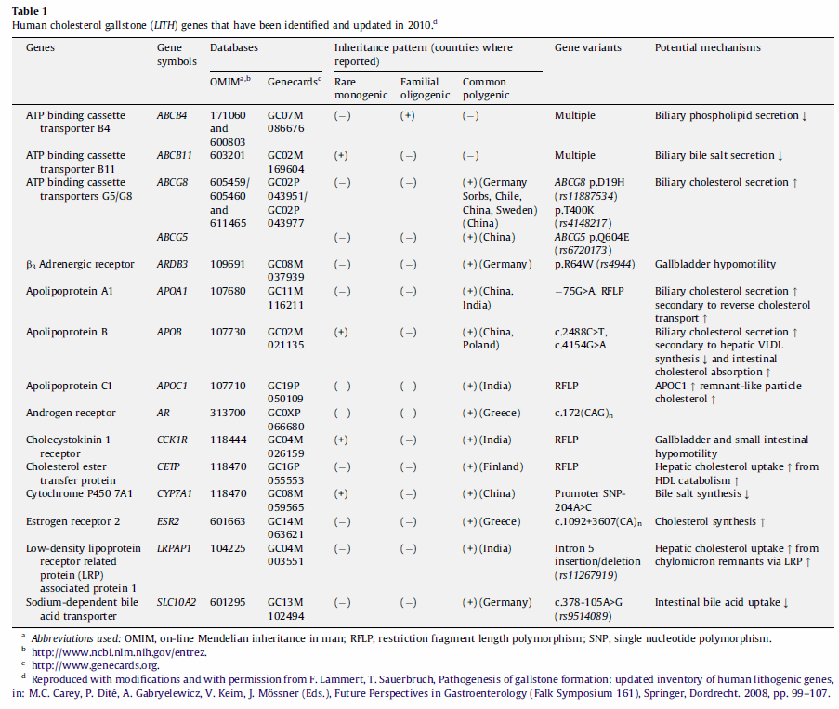
Summary of Identified Genes

Slide 43
What if you are at risk?
Screening will identify many people
Currently little to offer
In future ? UDCA, FXR agonists, antibiotics, prophylactic cholecystectomy?

Slide 44
Main points
Gallstones are common and important
Several genes involved in pathogenesis, delineating the enterohepatic circulation
Genetic screening is likely to produce a cohort of worried well

Slide 45
Selected References
Acalovschi, M., 2006 “Genetic factors in cholesterol gallstone disease” Medica 1(1): 49-54
Lammert, F. and Miquel, J-F, 2008 “Gallstone disease: from genes to evidence based therapy”, Journal of Hepatology 48 S124-S135
Esteller, A. 2008 “Physiology of bile secretion” World Journal of Gastroenterology 14 (37) 5641-5649
Marschall,H-U 2010 “The genetic background of gallstone formation: an update” Biochem. Biophys. Res. Comm. 396 58-62

