Slide 1
Fetal programming: its relevance to pregnancy and diabetes and obesity
Anne Dornhorst
October 2012

Slide 2
Fetal programming
Fetal programming: link between early nutrition, DNA methylation, and complex diseases, Agata Chmurzynska: Nutrition Reviews, Volume 68, Issue 2, pages 87–98, February 2010
Role of the pre- and post-natal environment in developmental programming of health and productivity, Reynolds et al, Molecular and Cellular Endocrinology
Volume 354, Issues 1–2, 6 May 2012, Pages 54–59
Epigenomics Gallou-Kabani et al, Diabetes, 2005, 54:1899

Slide 3
Fetal programming
Diabetes and obesity- are determined by multiple genes and environmental influences including epigenetic factors, such as DNA methylation, which occurs in utero
Changes in the structure and functioning of organs, as well as permanent changes in DNA methylation and gene expression, have been considered the molecular mechanisms of metabolic programming

Slide 4
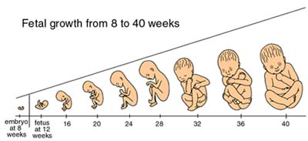
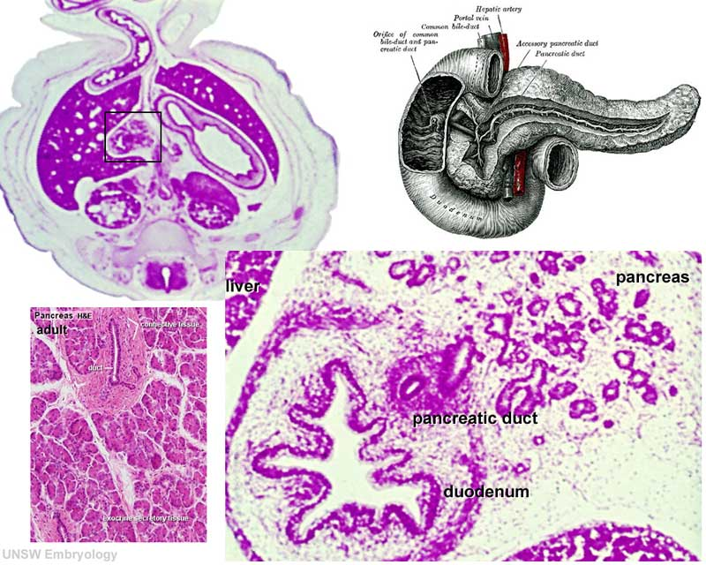
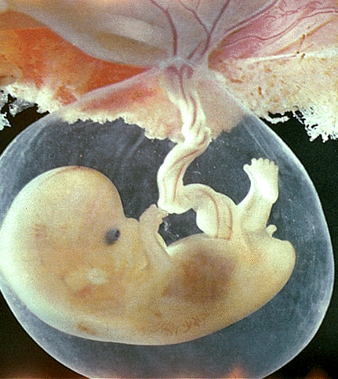
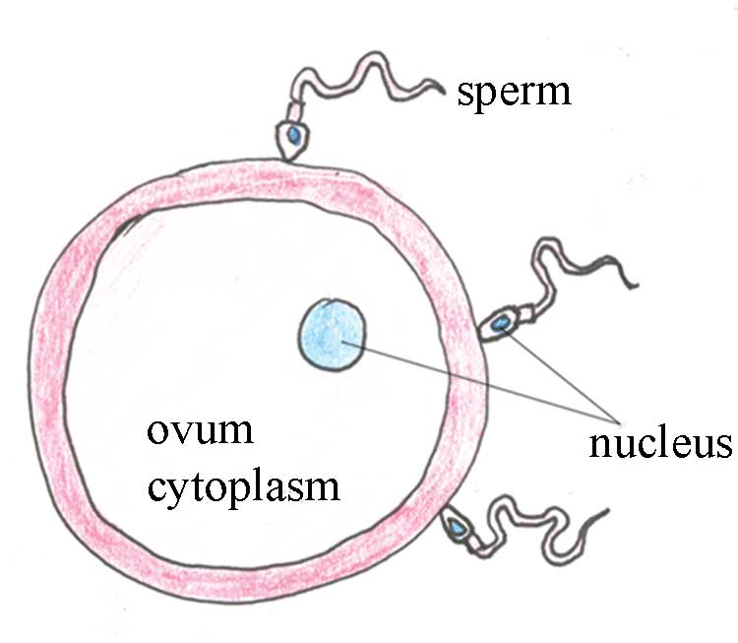
Early influences
in pregnancy
begins here
1st Trimester
0-14 wks
2nd Trimester
14-28 wks
3rd Trimester
28-42 wks
Period of Fetal Growth
Period of Fetal Programming
Period of Teratogenesis

Slide 5
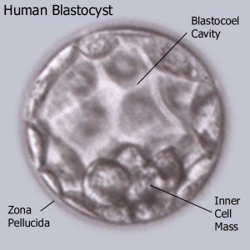
Fetal programming
One of the principal environmental factors influencing the developing oocyte, embryo, and fetus is the maternal diet and nutrient supply

Slide 6
Fetal programming

Slide 7
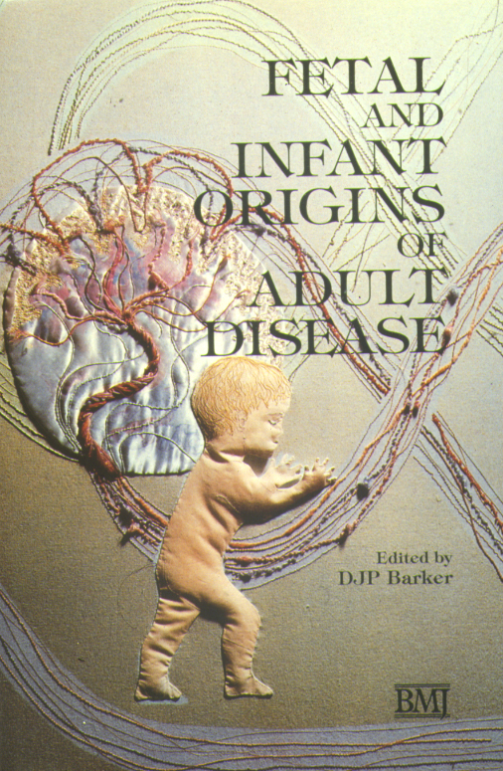
Fetal programming of metabolic disease
Undernutrition
A stimulus or insult at a critical period of early life, often when rates of growth are maximal, leads to irreversible changes in structure and function of target organs.
Pancreas ← Type 2 DM
Kidney ← BP
Heart ← CVD
Barker, DJ & Clark, PM. (1997) Reviews of Reproduction, 2: 105-112.

Slide 8
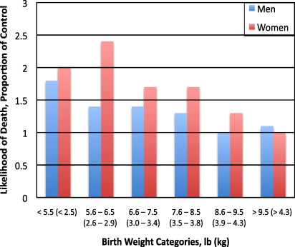
Role of the pre- and post-natal environment in developmental programming of health and productivity Births from Hertfordshire, UK, from 1911–1930. N = 1033 deaths for men and 120 deaths for women.
Likelihood of death due to CVD as adults for various birth weight categories as a proportion of controls (highest birth weight category).

Slide 9
Association of birthweight and type 2 diabetes in Pima Indian Children and Young Adults Dabelea, D et al 1999, 22: 944-950
U-shaped
association
BW vs. DM

Slide 10
Fetal programming of metabolic disease
Undernutrition
Undernutrition in utero:
Diverts nutrients to vital organs
Resulting in survival of the fetus
Potential postnatal advantages
Metabolic efficient
Barker, DJ & Clark, PM. (1997) Reviews of Reproduction, 2: 105-112.

Slide 11
The “thrifty phenotype” hypothesis
An adaptive response occurs that leads to altered metabolism
Potentially advantageous in a land of sparse food resource:
Potential disastrous in a land of plenty

Slide 12
Epigenomics Gallou-Kabani et al, Diabetes, 2005, 54:1899
Inheritance due to gene
expression rather than
gene sequence
Transient nutritional stimuli at critical ontogenic stages may through epigenetic mechanisms have lasting effects on gene expression
Influencing chromatin remodelling and regulation of gene expression

Slide 13
Fetal Programming of Metabolic Disease
Genotype
Intra-Uterine
Developmental plasticity
Irreversible
changes in structure and function.
ENVIRONMENT
ENVIRONMENT
Adult Phenotype

Slide 14
Diabetes in pregnancy
An Example of Fetal Programming
Its potential relevance to today’s increasing prevalence of diabetes
Its relevance to today’s obstetric and diabetic clinical practice

Slide 15
Gestational diabetes leads to the development of diabetes in adulthood in the rat Boloker, J, Diabetes. 2002;51:1499
A rat model of diabetes in pregnancy
That demonstrates that an altered metabolic intrauterine milieu
Directly causes diabetes in future generations

Slide 16
A rat model of diabetes in pregnancy Boloker, J, Diabetes. 2002;51:1499
Pregnant Sprague-Dawley
19 days gestation has a unilateral uterine artery ligation
Utero-placental insufficiency

Slide 17
A rat model of diabetes in pregnancy Boloker, J, Diabetes. 2002;51:1499
Intrauterine growth restriction (SGA)
On calorie rich postnatal diet
Growth catch up at ~7 weeks
Develop type 2 DM at 5-6 months
Or earlier if pregnant
In pregnancy gained more weight than controls
F1:

Slide 18
A rat model of diabetes in pregnancy Boloker, J, Diabetes. 2002;51:1499
At birth
High birth weight (LGA)
2nd-fetal hyperinsulinaemia
High β-cell mass at birth
Postnatal
5 weeks:
Defects in insulin secretion
15 weeks
IGT / Hyperinsulinaemia
26 weeks:
Diabetes Reduced β-cell mass
Insulin resistance
F2 (offspring of F1 SGA):

Slide 19
Rodent models of gestational diabetes Boloker, J, Diabetes. 2002;51:1499
F2 rats characterised by:
Increasing body weight
Decreasing B-cell mass
B-cell dysfunction (decreased insulin secretion in response to glucose)
Insulin resistance (decreased insulin mediated glucose uptake)
Down regulation of GLUT1 and -4

Slide 20
A human model of diabetes in pregnancy
Maternal diabetes in the
Pima Indian population
has contributed
to the rise in diabetes
and obesity that is seen today
Pima Indian Woman 1902
Exposure to diabetes in utero a RF for early obesity and Type 2 DM
Exposure to diabetes in utero accounts for ≈ 40% of type 2 DM in 5-19-year-old (1987 and 1996)
> 70% of persons with prenatal exposure have type 2 DM by 34 yrs
Today >50% of Pimas have type 2 DM

Slide 21
Type 2 DM in a Pima cohort of 5,274 children according to diabetic status of mother
Dabelea D, J Matern-Fetal Med 2000;9:83
Prevalence %
Non-DM
Pre-DM
DM
80
70
60
50
intra-utero effect
40
30
20
10
0
5-9.
10-14.
15-19.
20-24.
25-29.
30-34.
years

Slide 22
Obesity (>140% IBW) in 5,274 Pima children according to maternal DM status
Dabelea D et al, J Matern Fetal Med. 2000;9:83-88.
Children of mothers diabetic in pregnancy have a higher prevalence of severe obesity (IBW > 140%) in early adolescence
Intra-uterine effect

Slide 23
Obesity in 183 non-diabetic siblings born before or after their mother was diagnosed with diabetes Dabelea D, Diabetes, 2000, 49:2208-2211
earlier onset of obesity

Slide 24
Increasing prevalence of type 2 DM in Pima Indian girls Dabelea D et al, J Matern Fetal Med. 2000;9:83-88.
5274 children examined over 30 years.
The prevalence has increased 2-3 fold over this time
? intra-uterine effect
2nd to increasing DM in their mothers

Slide 25
Prevalence of impaired glucose tolerance in 88 Chicago children of diabetic mothers
Silverman BL, et al. Diabetes Care 1995;18:611-17
20
18
3.7% (1 / 27) had IGT
if AFI ≤100 pmol/l
33% (12 / 36) if AFI >100 pmol/l
(P < 0.001)
16
14
Prevalence of IGT (%)
12
intra-uterine effect
10
8
6
4
2
0
<5yr.
5-9yr.
10-16yr.
Controls

Slide 26
The Impact of Maternal Hyperglycemia During Pregnancy Pedersen Hypothesis
Maternal hyperglycemia
Fetal pancreas stimulated
By week 14 gestation
Placenta
Insulin
Fetal
hyperinsulinemia
Insulin resistance syndrome
Fetus
Mother

Slide 27
Maternal glycaemia

Slide 28
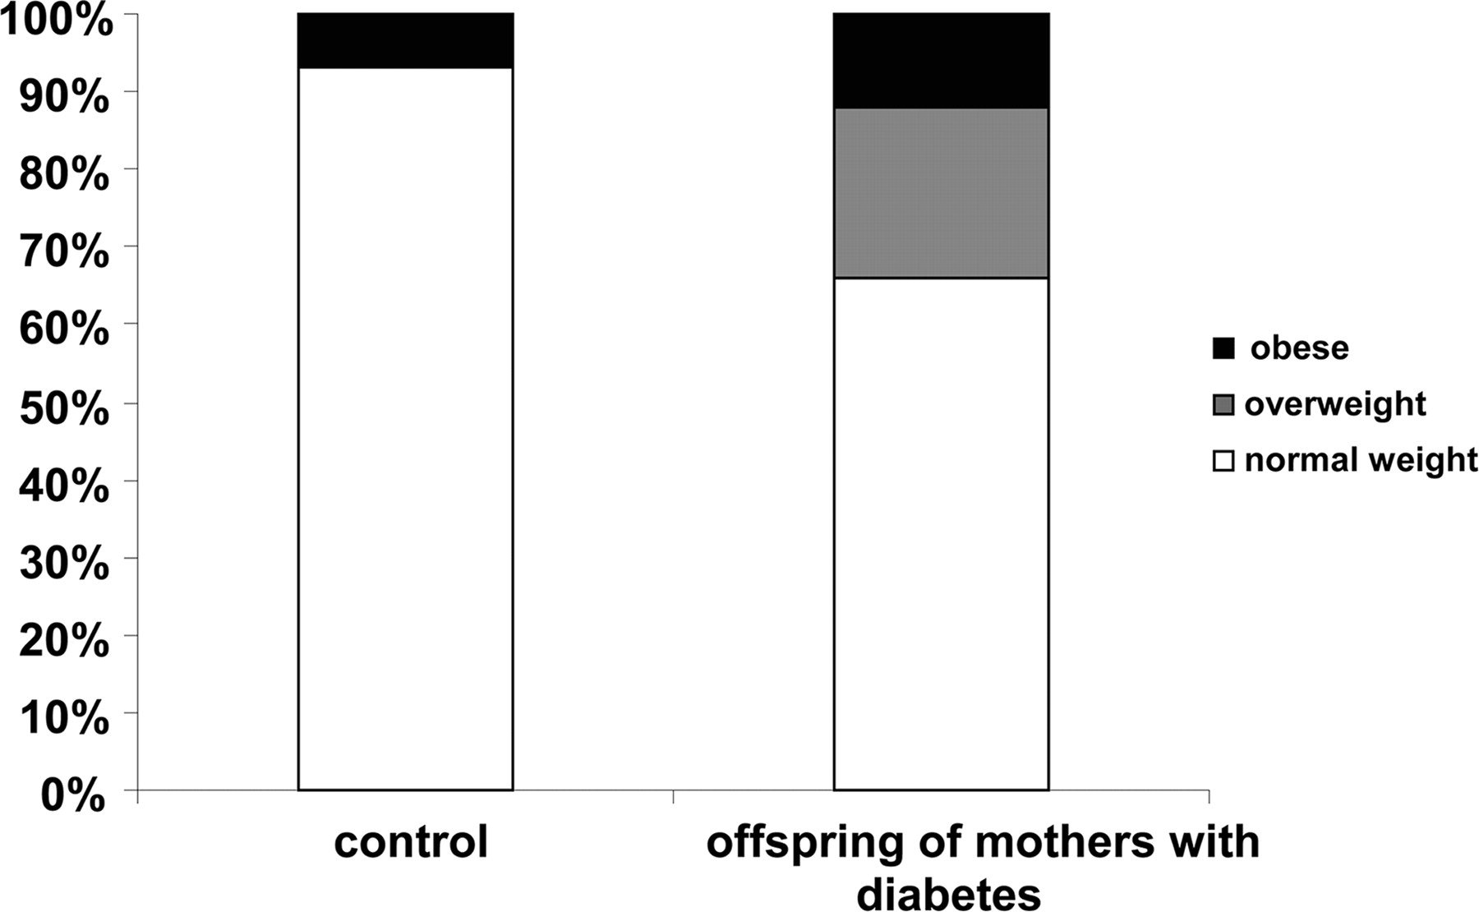
Proportion of Overweight and Obese Children
of Type 1 Mothers
100 offspring of mothers with type 1 diabetes
and 45 offspring of control mothers
The intrauterine
effect
Lindsay R S et al. Dia Care 2010;33:1080-1085
Copyright © 2011 American Diabetes Association, Inc.

Slide 29
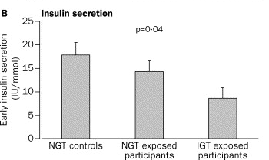
Insulin Secretion of 15 Children born to Mothers with Type 1 Diabetes and 16 Children born to Fathers with type 1 Diabetes
Sobngwi et al, the Lancet : 361, 2003 1861 - 1865
Fathers had
Type 1 Diabetes
Mothers had Type 1 Diabetes
Mean (SE) insulin secretion. NGT=normal glucose tolerance. IGT=impaired glucose tolerance.

Slide 30
Body composition and bone status of children born to mothers with type 1 diabetes mellitus Mughal MZ et al, Arch Dis Child 2010;95:281-285
67 children of type 1 diabetic mothers (35 boys; 5–18 yrs.) and 246 (121 boys) controls.
Children of mothers with diabetes had 30% more fat mass than controls and bigger bones

Slide 31
Children of mothers with type 1 diabetes Weiss et al Diabetes Care, 2000. 23: p. 905-911
75 Austrian offspring of Type 1 DM mothers (5-15 yrs)
Compared with 49 controls
significantly higher BMI; OGTT glucose, insulin, and C-peptide levels and dyslipidaemia
Metabolic Risk factors for Type 2 Diabetes related to amniotic fluid insulin concentration in mother’s pregnancy

Slide 32
Fetal Growth in a non-diabetic pregnancy
Third Trimester Growth

Slide 33
Fetal Growth in 217 pregnancies in insulin-treated women with diabetes in a single Obstetric Unit in UK Lim et al, Obstet Med March 2009 2:21—25
Rates of macrosomia (>90th percentile) type 1, type 2 & GDM
43.0%
50.0%
41.8%
respectively
The 5th, 50th and 95th centile data for infants
of non-diabetic mothers are plotted as dashed lines

Slide 34
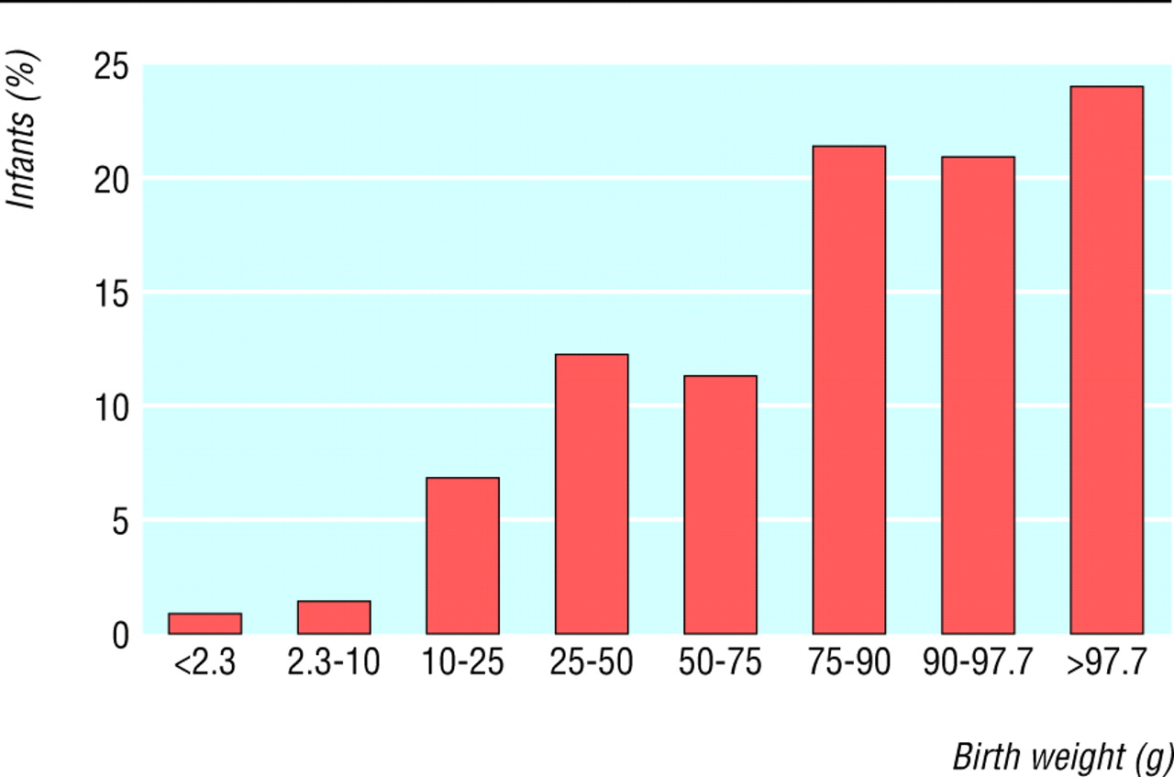
Distribution of birth weight among 324 infants of
women with type 1 diabetes
(reference data from Dutch perinatal database, 1999-2000.
Evers I M et al. BMJ 2004;328:915
©2004 by British Medical Journal Publishing Group

Slide 35
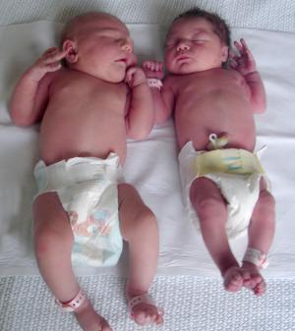
Neonatal outcomes for the mother with type 1 and type 2 diabetes England, Wales and Northern Ireland 3808 pregnancies 2002/3
Compared with women without diabetes
> 4 kg 21% vs. 11%
> 4.5 kg. 6% vs. 2%
> 90th percentile 52%

Slide 36
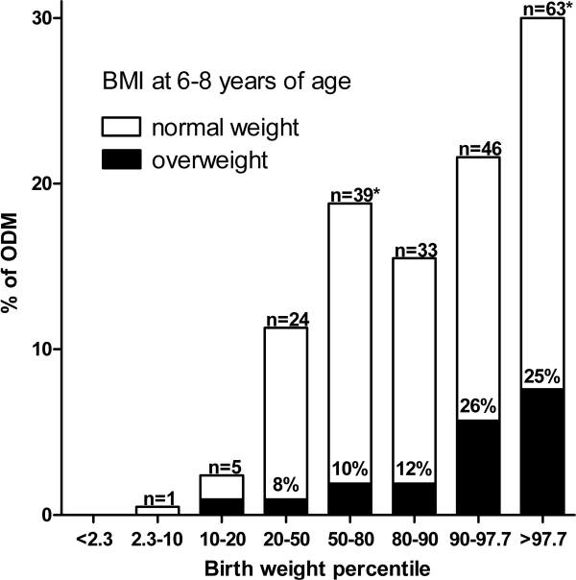
Prevalence of childhood overweight of 6-8 year olds of mothers with type 1 diabetes according to birth weight percentile.
M Rijpert - 2009

Slide 37
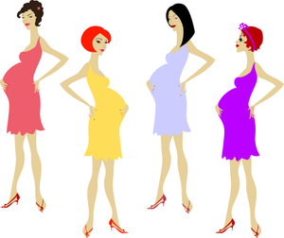
The Epidemiology of Diabetes in Women of Childbearing Age-(2006)
Years Prevalence
16–24 - 0.9%
25–34 - 1.2%
35–-44 - 1.2%
45–54 - 3.6%
Diabetes in the UK 2009:Key statistics on diabetes

Slide 38
The Epidemiology of Diabetes
Adapted from: 1. Diabetes UK. Diabetes in the UK 2004. Diabetes UK, London, 2004.
2. Diabetes UK. State of the Nation 2005. Diabetes UK, London, 2005.

Slide 39
Susceptibility Obesity & Diabetes
Parents
Genetic
Pregnancy
Epigenetics-begins in Utero
Lifestyle
Environment

Slide 40
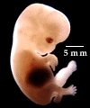
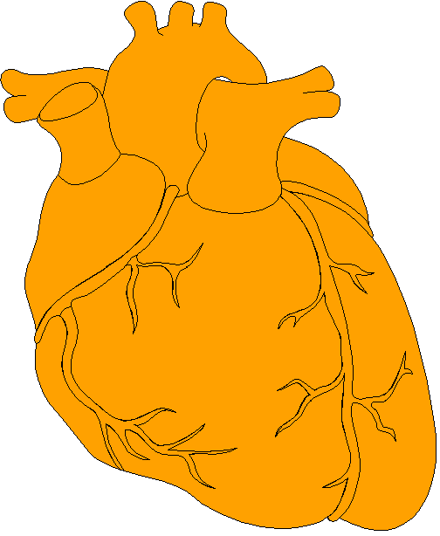
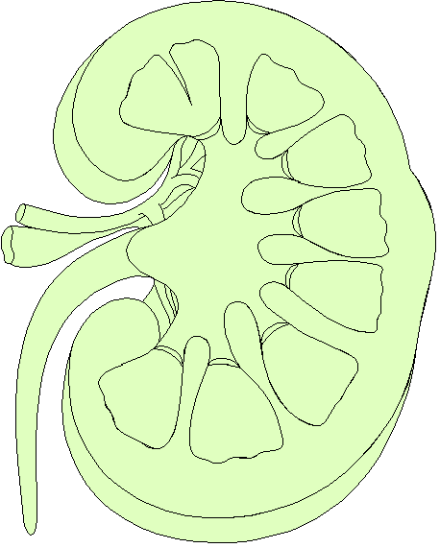
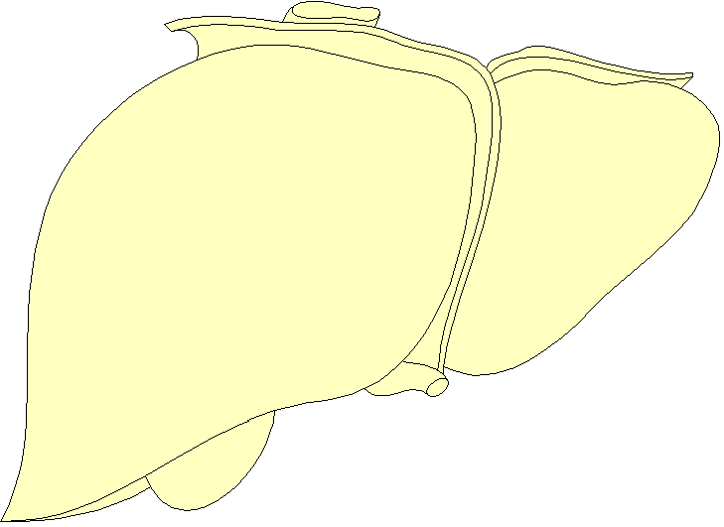
Mechanisms of Programming
Epigenetic factors
Glucose & Insulin/
Oxidative stress
Nutritional Influence
Altered Cell Number or
intracellular organization
Reorganisation of organ structure
Altered DNA expression
DNA methylation?
Altered morphology

Slide 41
The Thoughts Behind Fetal Programming-Epigenetics
Activating gene expression independent of the gene’s DNA sequence
Involves methylation of DNA on Cs (cytosines) in CG pairs, and various modifications (methylation, acetylation, etc.) of histones around which DNA is wrapped
Methylation of DNA determines its availability for transcription

Slide 42
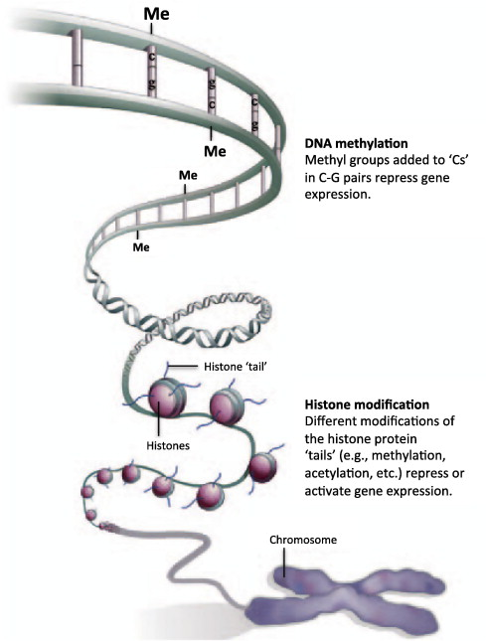
Role of the pre- and post-natal environment in developmental programming of health and productivity
Lawrence P. Reynolds , Joel S. Caton, Molecular and Cellular Endocrinology Volume 354, Issues 1?2 2012 54 - 59

Slide 43
Contributing factors to the epidemic of type 2 diabetes
genetic
susceptibility
Type 2
diabetes
environmental
pressures
family history
≈60% maternal
vs. 40% paternal
Alcolado, J.C, 1991
BMJ, 302:1178-80
fetal genes
parental genes
imprinting
epigenetic
intra-uterine

Slide 44
The epidemiology of diabetes in women of childbearing age
It is estimated that:
up to one in 20 people in England has diabetes* Diagnosed and undiagnosed
*Diabetes in the UK 2009:Key statistics on diabetes

Slide 45
Trends in Type 2 Diabetes
Type 2
Age of onset
Age at 1st pregnancy
5 10 15 20 25 30 35 40 45 50 55 60 65 70 75 80 85 90
Age of diagnosis
10/30/2012

Slide 46
Diabetes in Pregnancy
How much can we
blame
this all on
maternal factors ?
increasing birth weight
increasing childhood obesity
increasing adolescent diabetes
increasing worldwide prevalence of diabetes

Slide 47
Trends in overweight children (>95th percentile BMI for age) 6 months-19 yrs in US (NHANES 1999–2000) Ogden,C et al, JAMA 2002, 288: 1728–1732
Boys
Girls
> 2-fold increase
0.5-2 yrs
2-5 yrs
6-11 yrs
12-19 yrs

Slide 48
Maternal obesity in England, UK: trends in incidence and demographic inequalities in 619 323 births, 1989-2007 Heslehurst N et al, Int J Obes. 2010, 34:420-8
Geographic variation
Demographic inequalities associated with maternal obesity
Increasing age
Parity
Black ethnic group
Deprivation
An association between morbid obesity and unemployment

Slide 49
Diabetes – The New Epidemic? Diabetes among women in England (2006)
Years Prevalence
16–24 - 0.9%
25–34 - 1.2%
35–-44 - 1.2%
45–54 - 3.6%
Diabetes in the UK 2009:Key statistics on diabetes

Slide 50
Metabolic syndrome among children according to birth weight and maternal diabetes Boney, C. M. et al. Pediatrics 2005;115:e290-e296
Growth promoted babies maters
Obesity /hypertension, dyslipidemia and IGT
offspring of 92 mothers with GDM
83 without GDM
Metabolic syndrome at 6, 7, 9, and 11 yrs.
------- LGA
____ AGA

Slide 51
The Hidden Impact of Diabetes in Pregnancy
The infant:
Fetal programming
The child / adolescent
Obesity
Metabolic dysfunction
The adult
Early onset diabetes
10/30/2012
51

Slide 52
Diabetes – The New Epidemic? The Obesity Factor
The next generation

Slide 53
Maternal Diabetes a Perpetuating Legacy
Adult Type 2 Diabetes
Childhood Obesity / Type 2 DM

Slide 54
Questions

