Slide 1
Diet and the metabolic syndrome
Anne Dornhorst
Imperial College London

Slide 2
Mtabolic Syndrome Other Names Used:
Syndrome X
Cardiometabolic Syndrome
Cardiovascular Dysmetabolic Syndrome
Insulin-Resistance Syndrome
Metabolic Syndrome
Beer Belly Syndrome
Reaven’s Syndrome
etc.

Slide 3
Metabolic Syndrome
Insulin Resistance + Hyperinsulinemia
Increased BMI
Increased central adiposity
Coronary Artery Disease
&
Diabetes

Slide 4
Metabolic Syndrome
Metabolic Industry
Paper factory
A simplistic (outdated)
Answer to CHD;DM;BP etc

Slide 5
Insulin Resistance: Central to The Metabolic Syndrome
Adapted from McFarlane SI, et al. J Clin Endocrinol Metab. 2001;86:713-718; Reusch JEB. Am J Cardiol. 2002;90(suppl):19G-26G.
Hyperglycemia
Dysfibrinolysis
Hypertension
Insulin
Resistance
Macrovascular
Disease
Glucose
Intolerance
Dyslipidemia
Obesity
Endothelial
Dysfunction

Slide 6
Clustering of Components:
Hypertension
Hypertriglyceridemia
Low HDL-cholesterol
Obesity (central)
Impaired Glucose Handling
Microalbuninuria (WHO)

Slide 7
Insulin Resistance: Central to The Metabolic Syndrome

Slide 8
The Metabolic Syndrome
1960 6 papers
2010 1693 papers

Slide 9
Metabolic Syndrome
Metabolic Industry
1960-2010
WRONG
Paper factory 10738 Pub MED
A simplistic (outdated)
Answer to CHD;DM;BP etc

Slide 10
Prevalence of The Metabolic Syndrome
Among US Adults
45
Men
40
Women
35
30
Prevalence (%)
25
20
15
10
5
0
20–29
30–39
40–49
50–59
60–69
>70
Age (years)
Ford ES, et al. JAMA. 2002;287:356-359.

Slide 11
Is it a Syndrome?
The Metabolic Syndrome: Time for a Critical Appraisal.
Joint Statement from the American Diabetes Association and the European Association for the Study of Diabetes
Kahn, R, et al. Diabetes Care 2005;28:2289-2304
Notes:
Directed at attempts to devise a single treatment for Met. Syndr.

Slide 12
Why do some people get Type 2 DM and others do not?
Susceptible genes & vulnerable B-cells
Good genes, adaptable B-cells
Type 2 DM
No Type 2 DM

Slide 13
Definitions:
Insulin responsiveness
The maximal effect of insulin
Insulin sensitivity
Insulin concentration required for a half-maximal response
Insulin resistance
decreased sensitivity and/or responsiveness to insulin-mediated glucose disposal and/or inhibition of HGP

Slide 14
Insulin Receptor
Insulin receptor embedded in the plasma membrane
composed of 2 alpha & 2 beta subunits linked by disulfide bonds
The alpha chains extracellular and house insulin binding domains
the linked beta chains penetrate through the plasma membrane.
Insulin has concentration-dependent saturable actions to increase whole-body glucose disposal

Slide 15
Plasma insulin and insulin - mediated whole body glucose disposal
a: Normal insulin sensitivity and responsiveness
b: Decreased insulin sensitivity (increased EC50) with normal insulin responsiveness
c: Decreased insulin sensitivity (increased EC50) and reduced insulin responsiveness
d: Increased insulin sensitivity (decreased EC50) with normal insulin responsiveness
half maximal effective concentration (EC₅₀)

Slide 16
Euglycemic Hyperinsulinemic Glucose Clamp
After an overnight fast
Insulin is infused IV at a constant rate (5 - 120 mU/m2/min-calculated on weight
20% dextrose IV at a variable rate to “clamp” blood glucose in the normal range (euglycemic)

Slide 17
Euglycemic Hyperinsulinemic Glucose Clamp
After several hours of
Constant insulin infusion, steady- state achieved for plasma insulin, blood glucose, and the glucose infusion rate (GIR)
GIR equal to the glucose disposal rate (M) (providing HGO inhibited)
M is typically normalized to body weight or fat-free mass to generate an estimate of insulin sensitivity.

Slide 18
Insulin Resistance: Central to The Metabolic Syndrome
Adapted from McFarlane SI, et al. J Clin Endocrinol Metab. 2001;86:713-718; Reusch JEB. Am J Cardiol. 2002;90(suppl):19G-26G.
Hyperglycemia
Dysfibrinolysis
Hypertension
Insulin
Resistance
Macrovascular
Disease
Glucose
Intolerance
Dyslipidemia
Obesity
Endothelial
Dysfunction

Slide 19
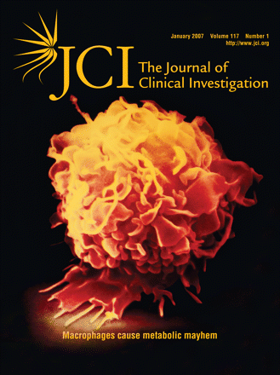

Slide 21
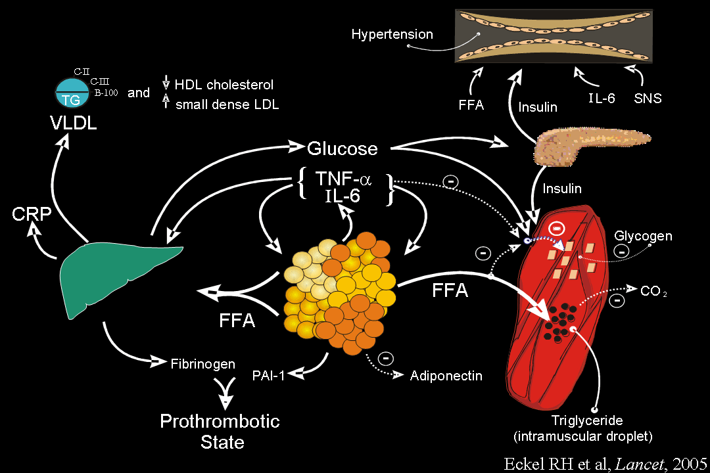

Slide 22
Fat proliferation (OBESITY)
Cytokines
Cytokines
Chronic inflammation develops
Notes:
22
There is an increase in the expression of cytokines like TNF-alpha in adipocytes but TNF-alpha remains bound…it’s a local signal. Macrophages are mainly responsible for the massive release of TNF-alpha. Adiponectin is secreted.

Slide 23
The New Culprit on the Block for The Metabolic Syndrome
Hyperglycemia
Dysfibrinolysis
Hypertension
Adipose Size
Macrovascular
Disease
Glucose
Intolerance
Dyslipidemia
Obesity
Endothelial
Dysfunction

Slide 24
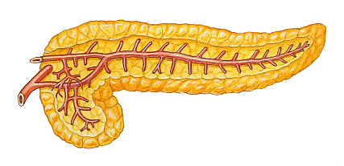
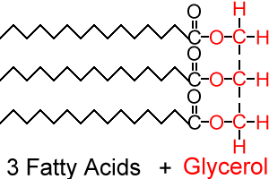
Adipose tissue expands
Proinflammatory Cytokines Released
Glucose Uptake Decreases
Blood Glucose Levels Increase
Pancreas Increases Insulin Production
Hyperglycemia
Triglycerides Released to Blood Stream
Hyperinsulinemia
Cardiovascular Disease

Slide 25
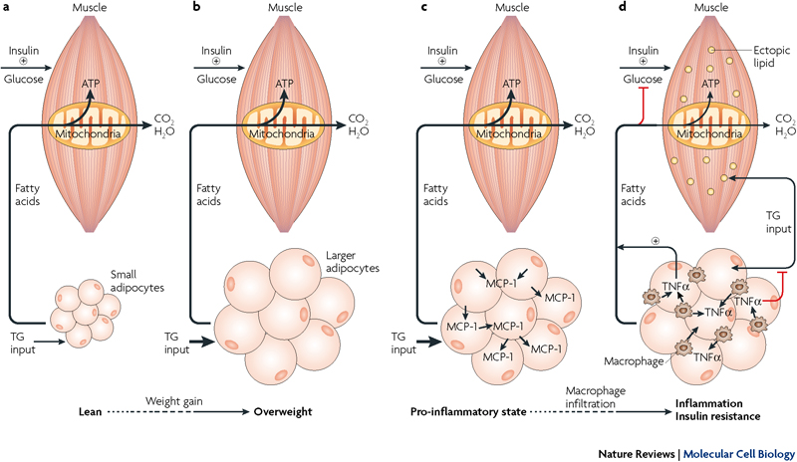
Adipose tissue & insulin resistance

Slide 26
Adipose tissue & insulin resistance
A; In the lean state, small adipocytes efficiently store fatty acids as TG (which can be mobilized and used to generate ATP through the mitochondrial β- oxidation in muscle
Insulin-stimulated glucose uptake under these conditions is normal

Slide 27
Adipose tissue & insulin resistance
b; Excess caloric intake leads to metabolic overload, increased TG input and adipocyte enlargement
In non-diabetic overweight individuals, TG storage by adipose cells and β-oxidation in muscle can often be maintained to prevent insulin resistance

Slide 28
Adipose tissue & insulin resistance
C; On further overloading with TG, hypertrophy of adipocytes & increased secretion of macrophage chemoattractants occurs, including:
the secretion of monocyte chemoattractant protein-1 (MCP-1; arrows), which recruits additional macrophages

Slide 29
Adipose tissue & insulin resistance
d. Macrophage recruitment results in a pro-inflammatory state
Infiltrating macrophages secrete TNFα causing a chronic inflammatory state with impaired TG deposition and increased lipolysis
The excess of circulating TG and FFAs results in the accumulation of activated lipids in the muscle disrupting:
mitochondrial oxidative phosphorylation & insulin-stimulated glucose transport, thus triggering insulin resistance

Slide 30
Adipose tissue & insulin resistance

Slide 32
The Fat Cell Is a Veritable Endocrine Factory
Adiponectin
Resistin
Leptin
Angiotensinogen
Fat Cell
IL-6
Stored Triglycerides
TNF-Alfa
Cortisol
Fat cells are continually absorbing or releasing substances in response to the body’s energy needs
Fat cells are better adapted to preserving calories than shedding them
Source: Underwood A, Adler J, Hand K, Ulick J. What You Don’t Know About Fat. Newsweek. 2004;144:40-47.

Slide 33
The Evidence in for a Key Role Of the Adipocyte in Insulin Resistance
The importance of adipose tissue in controlling whole-body metabolism by sequestering fat is reinforced by the observation that a lack of adipose tissue leads to elevated circulating concentrations of TGs & FFAs and insulin resistance in humans
Lipodystrophies cause impaired adipokine secretion
Normal insulin sensitivity and glucose homeostasis require functional adipose tissue in proper proportion to body size

Slide 34
The Fat Factor & Diabetes
First
Impaired responsiveness of skeletal muscle to insulin is a condition in obesity and a precondition for the onset of type 2 diabetes
Second
A defect required for progression from insulin resistance to type 2 diabetes is the failure of β- cells to secrete the required levels of insulin to maintain normal fasting blood glucose levels

Slide 35
Why do some people get Type 2 DM and others do not?
Susceptible genes & vulnerable B-cells
Good genes, adaptable B-cells
Type 2 DM
No Type 2 DM

Slide 36
The Fat Factor
High levels of circulating fatty acids disrupt insulin signalling pathways
Progression to type 2 diabetes occurs more frequently in obese humans compared with lean individuals
this association is highly dependent on genetic background.

Slide 37
At diagnosis β-cell function is significantly reduced
100
80
Start of treatment
60
β-cell function (%)
40
20
p < 0.0001
HOMA model, diet-treated (n = 376)
0
-10
-9
-8
-7
-6
-5
-4
-3
-2
-1
0
1
2
3
4
5
6
Time (years)
Holman RR. Diabetes Res Clin Pract 1998; 40 (Suppl): S21–S25.

Slide 38
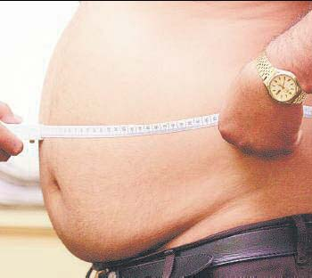
Abdominal Obesity Cause Insulin Resistance
Central Obesity
Notes:
38

Slide 41
Adipose Tissue
Visceral fat is waist circumference
Associated with all-cause mortality
Pro-inflammatory adipokines associated with insulin resistance, type 2 diabetes and CVD.
J Kreider, 2006

Slide 44
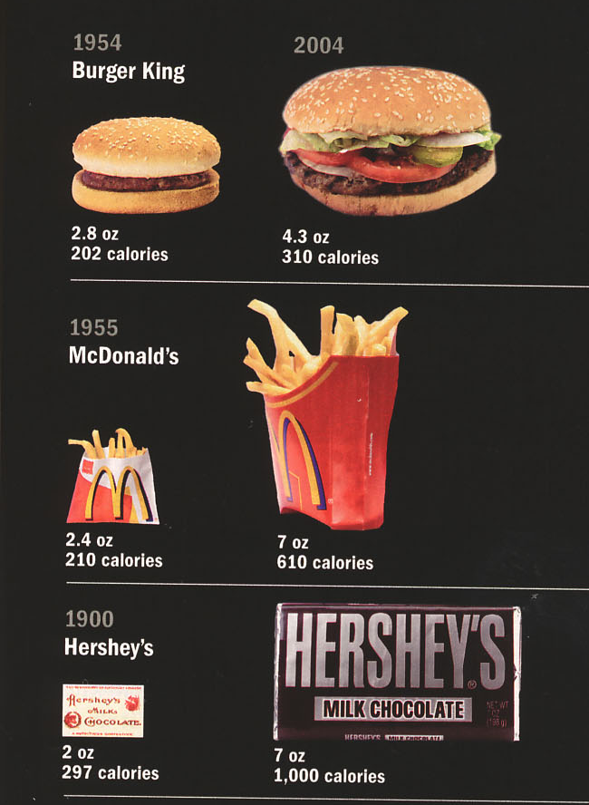
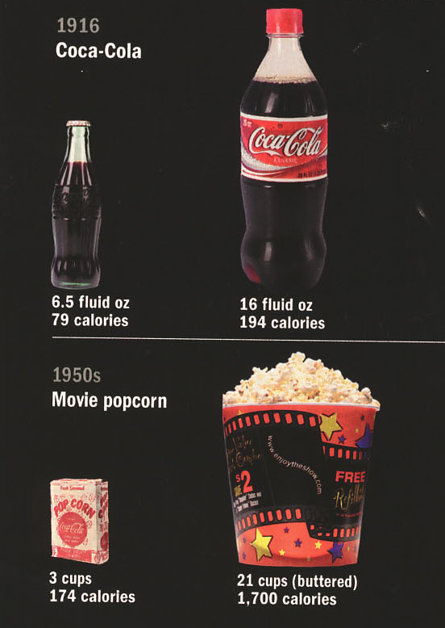
2004
2004
2004
2004
2004
National Geographic, August 2004

Slide 45
Adipokines Mediate Insulin Resistance and Inflammation
visfatin
Adipocyte
angiotensinogen
IL6
TNFα
adiponectin
PAI-1
leptin
FFA
Insulin sensitivity
insulin resistance
Vascular inflammation
endothelial dysfunction

Slide 46
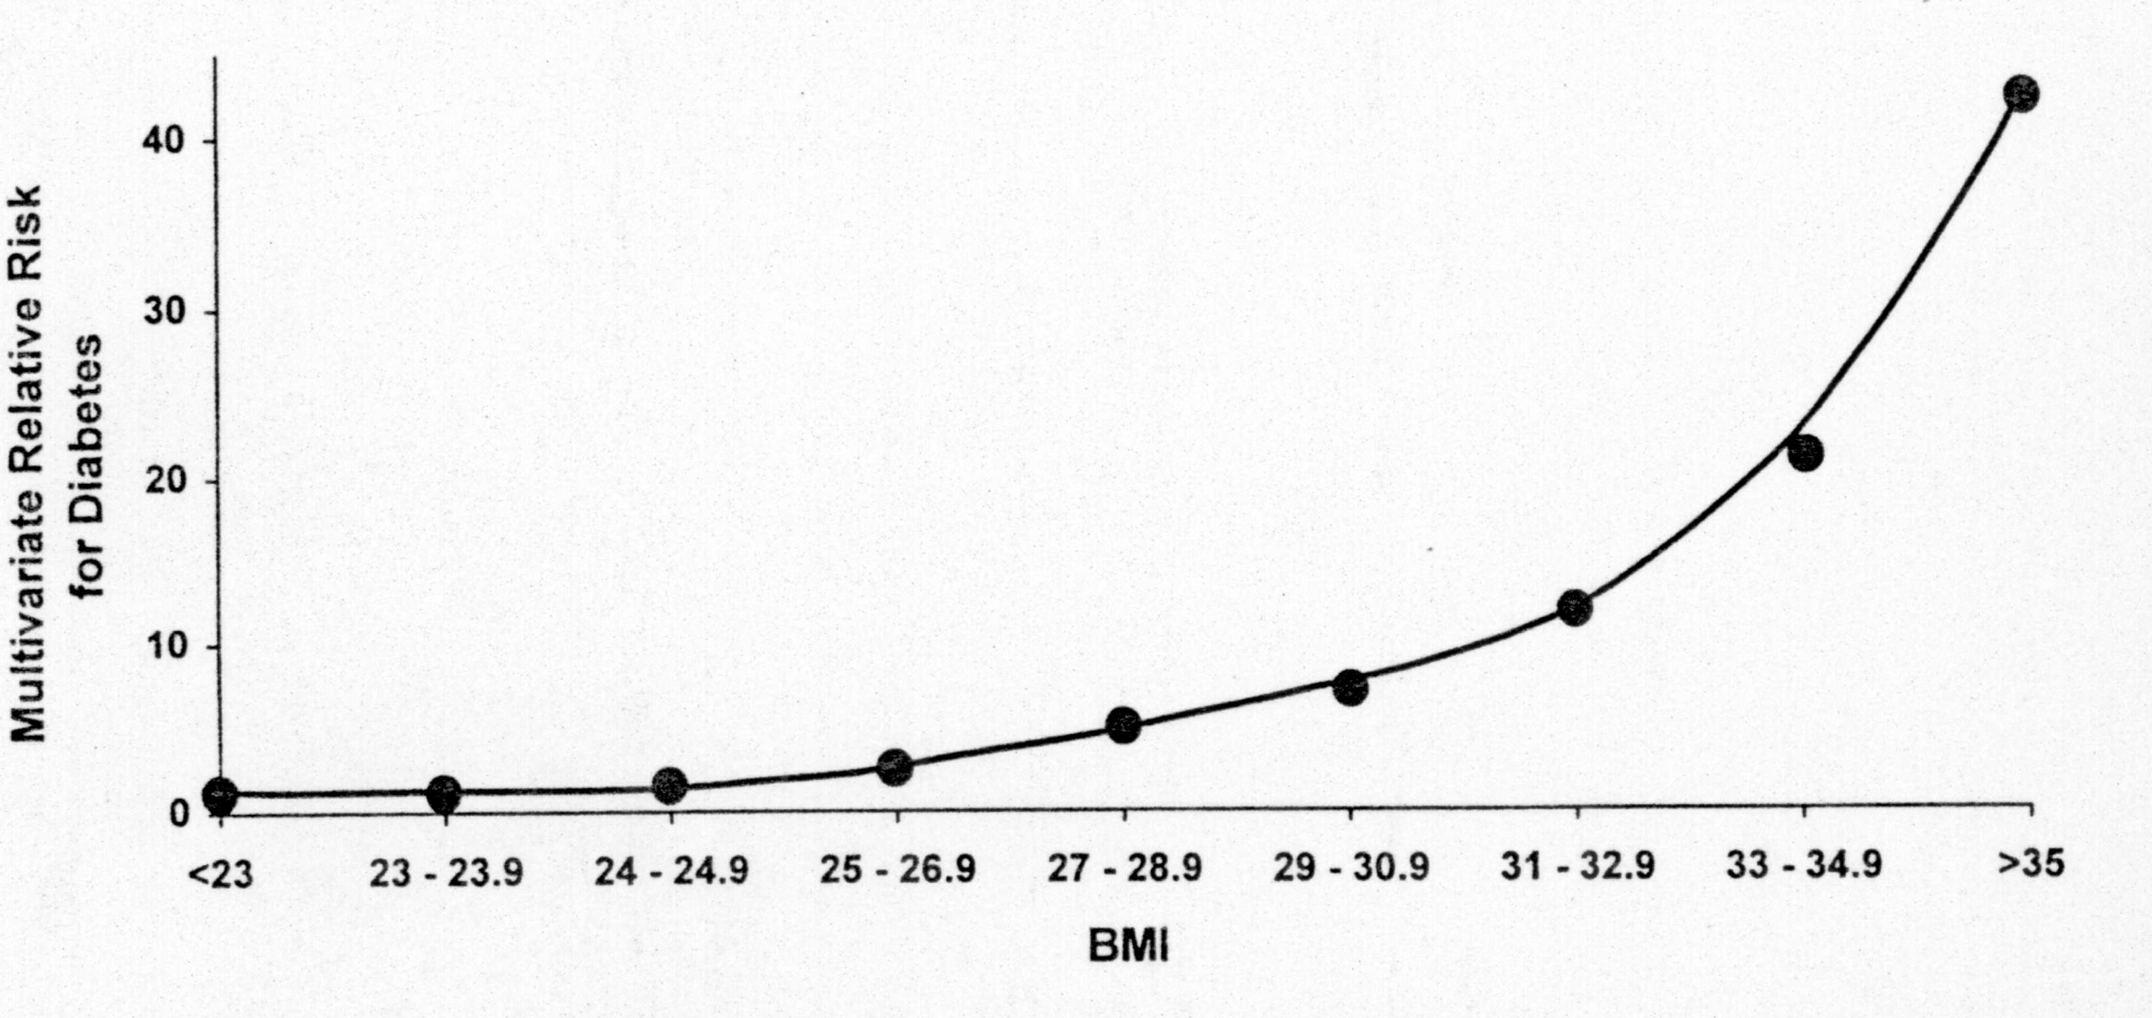
Environmental factors and type 2 diabetes

Slide 47
You Need Healthy Happy B-cells to be Get Away with Being Obese
You can be insulin resistant and obese as long as your B-cells can continue to secrete enough insulin

Slide 48
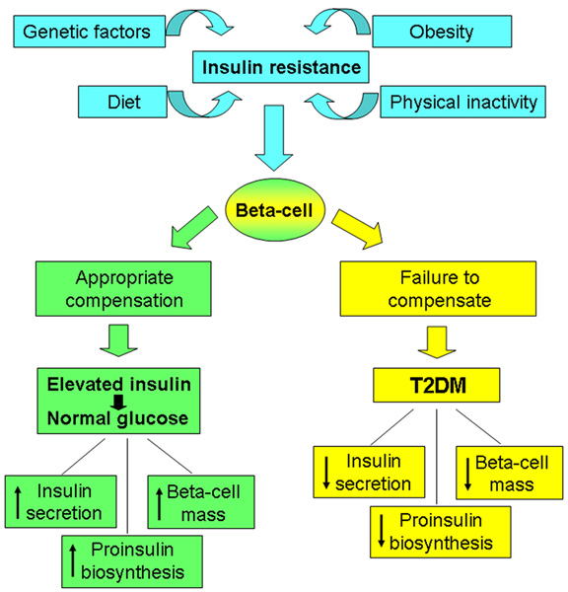
Healthy B-cells
Un-Healthy B-cells

Slide 49
Models That By Pass the B-cells Are Wrong

Slide 50
What Determines the risk of Type 2 Diabetes?
NGT
Type 2 DM

Slide 51
Type 2 DM Genes
Genome-wide association scans current gene count >20
The majority of the genes identified affect diabetes susceptibility through β-cell dysfunction
The risk alleles are common in the population, with a relatively small effect on diabetes risk

Slide 52
The evolution of mankind
2.5 mn years
50 years

Slide 53
Thank You

