Slide 1
Critical appraisal
Geoff Smith
Consultant Gastroenterologist

Slide 2
‘There are three types of lies: lies, damn lies and statistics’
Benjamin Disraeli, Prime Minister 1874-80

Slide 3
Publications on H.pylori
30535

Slide 4
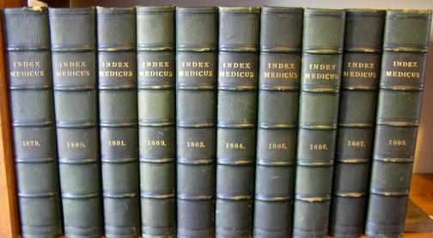

Slide 5
Searches for data
Keyword searches in large web-based databases:
Pubmed / NIH
Medline
Biomednet
Cochrane Collaboration
Index Medicus
Journal specific
Google (!)

Slide 6
Problems with searches…

Slide 8
Narrowing the search
Use limits
Human or animal studies
Trial types
Controlled trials
Randomised / blinded / multi-centre
Publication years
English vs. non-english papers

Slide 9
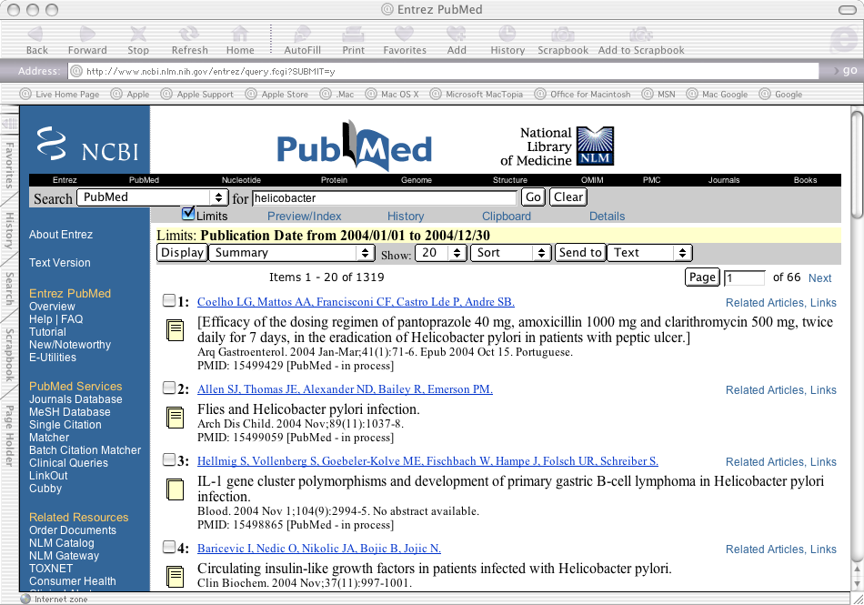

Slide 12
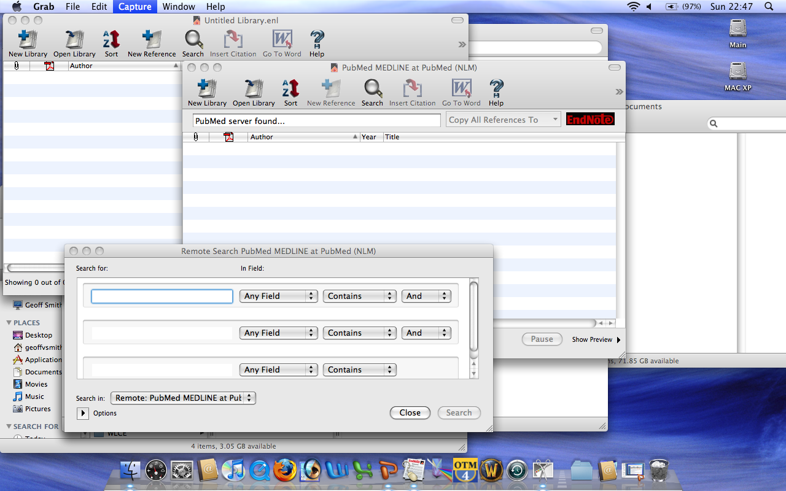

Slide 13
Quality Control of published data
Peer review
Statistician
Editor
Readership

Slide 14
Peer review
Critical and scientific appraisal by those with an interest in the field being written about
Not ‘quality controlled’
Rarely see the original data
Conflict of interests?
Similar / same research field
Importance of ‘first past the post’
Anonymous or named reviewers

Slide 15
Why are some papers rejected by one journal and then accepted by another?

Slide 16
Impact Factors
Measure of the ‘popularity’ of a journal
IF = number of citations (over 2 years)
Number of articles
Does ‘good journal’ = ‘good paper’?

Slide 17
Impact factors 2008
NEJM 52.5
JAMA 24.8
Gastroenterology 12.6
Lancet 18.3
Hepatology 10.45
BMJ 12.8
GUT 9.8
Journal of Hepatology 6.07
APT 3.5

Slide 18
What are the limitations of the IF?
Sloppy referencing
Papers from established authors
Advertising
Self referencing

Slide 19
Components of a paper

Slide 20
Key parts of a paper
Abstract
Introduction
Hypothesis
Methodology
Results
Discussion
Conclusion

Slide 21
What is a hypothesis?
‘To study the effect of orange juice on resistance to the common cold in humans’
‘That orange juice consumption results in a reduction in the number of common colds in humans’
‘That orange juice consumption does not reduce the number of common colds in humans’

Slide 22
The Null hypothesis
That no difference exists between the groups being compared
This is what statistical tests actually test
p is the probability that the null hypothesis is correct

Slide 23
What is the hypothesis?
A double blind randomised controlled trial of calcium supplementation in the prevention of colonic adenoma formation was carried out.
A double blind crossover trial of amlodipine vs, ramipril was carried out. The Primary endpoint was the risk of stroke or acute cardiac event.

Slide 24
What does p<0.05 mean?
p=0.05 is a 1 in 20 or 5% chance
Statistical tests assess the possibility that the null hypothesis is correct
Therefore statistical significance (p<0.05) suggests that there is a less than 1 in 20 chance that the two groups being compared are actually the same

Slide 25
N = …….
Does the study examine an appropriate number of individuals?
Power calculations
Intention to treat vs. per protocol analysis

Slide 26
Power calculations
α is the ‘power’
The probability that a real effect will not be missed
Should always be ≥ 80%
Often 90 - 95% for clinical trials
p is the ‘significance level’
e.g. p<0.05
Clinically important result
e.g. 10% difference in effect

Slide 27
Power calculation
The power of a statistical test is the probability that the test will reject the null hypothesis when the alternative hypothesis is true (i.e. that it will not make a Type II error).
As power increases, the chances of a Type II error decrease. The probability of a Type II error is referred to as the false negative rate (β). Therefore power is equal to 1 − β.

Slide 28
Errors
Type I error
Demonstrating a difference when none exists.
Occurs 1 in 20 times if p = 0.05
i.e. a false positive
Type II error
Not detecting a difference when one exists
i.e. a false negative

Slide 29
Types of trial
Randomized
Blinded
Double Blind
Controlled
Multi-centre
Crossover
Placebo controlled
Comparative

Slide 30
Endpoints
Primary Endpoint
The ‘Headline’ outcome that the study is examining
Power calculation should be based on this
Secondary Endpoints
Other outcomes measured during the trial
May be beneficial or detrimental

Slide 31
Appropriate statistics
Parametric vs. non-parametric
Determines the type of statistical test that should be used
One-tailed vs. two tailed tests
Vast majority of studies of biologial systems should be two-tailed
Appropriate statistical test for the data

Slide 32
Bias
Geographical
Non-identical groups
Non-blinded groups
Selection criteria
Publication bias

Slide 33
Clinical utility
Is the measured result important in the ‘real world’?
Does the beneficial outcome depend on a realistically achievable management?
Is the trial populations comparable with your populations?
What are the downsides?

Slide 34
Clinical utility
Abracadiximab
Reduces cholesterol by 0.01 mmol l⁻¹
Reduces the risk of MI by 55% in male Amazonian pygmies over the age of 89
Reduces the risk of CVA if taken every 2 hours
Only works if the blood level is maintained between 5.5 and 5.6 ng l⁻¹
Induces a predictable fall in blood sugar to 1.0 mmol l⁻¹

Slide 35
Good scientific research
Much harder to quantify
‘me too’ vs. novel research
Fishing trips vs. hypothesis
N=1 / n=3 papers / single experiments
Adequate controls
Rule out all false positives
Demonstrate the same results using different methods

Slide 36
Multiple methods
Demonstrating induction of an enzyme due to the stimulation of a cell
Show mRNA transcription (RT PCR)
Show presence of the protein (Western blot / ELISA / Immunohistochemistry)
Demonstrate enzyme product (Western blot / ELISA)
Demonstrate viable cells
Ensure that other components (e.g. solvents) are not the cause.

Slide 37
Other issues
Ethics committee approval
Local and national assessment of the ethical aspects of the research
Rarely required for lab based research
Research fraud / Plagiarism
The pressure to publish
The need to get grants / jobs / recognition
Pharmaceutical Co. vs. independent

Slide 38
Publication
Negative trials may not get published
‘Blue Sky’ hypotheses may not get funded or published
Small volume of good work vs. large volume of poor work
Replication
Salami slicing

Slide 39
‘Good’ papers
Draw up a logical conclusion based on previous data.
Formulate a clear, testable hypothesis from that conclusion
Describe appropriate experiments to test that hypothesis
Use appropriate statistical methods to examine the results
Draw reasonable conclusions from the results

Slide 40
Summary
Clear hypothesis
Appropriate methods
Appropriate controls
Appropriate sample size
Correct statistical analysis
Reasonable conclusions
Transferable to a clinical context

