Slide 1
BSc in Gastroenterology / Hepatology
Genetics of coeliac disease
Professor Julian Walters
Tuesday 9 October 2012

Slide 2
COELIAC DISEASE
“Gluten-sensitive enteropathy”
Inflammatory disease of upper small intestine resulting from gluten ingestion in genetically susceptible individuals
What is the evidence that coeliac disease is genetic?
Which genes predispose to coeliac disease?

Slide 3
EVIDENCE FOR A GENETIC PREDISPOSITION
Population prevalence
Family studies
Twin studies

Slide 4
Coeliac Disease – UK Population Studies
Case finding in GP practices
    30/3000 3%
    (Oxfordshire, Hin et al, 1999)
    12/1200 1%
    (Yorkshire, Sanders et al, 2003)
Cambridge GP health study
    87/7550 1.2%
    (East Anglia, West et al, 2003)
Avon Longitudinal Study of Parents & Children
    54/5470 1.0%
    (7-8 year olds, Bingley et al, 2003)

Slide 5
Coeliac Family Studies
Studies of the familial nature of celiac sprue using biopsy of the small intestine.
  Risk in first-degree relatives of ~10%
        MacDonald et al., NEJM 1965
10 further systematic studies
  Risk in first degree relatives ranges from 4-20%
Overall risk to siblings is ~10%

Slide 6
Twin Studies:- Concordant MZ Twins
MZ twins genetically identical
Concordance rate reflects genetic contribution
MZ twins 1st reported in 1923
Idiosyncratic reporting of MZ twins
Only 1 systematic study
MZ concordance ~80%

Slide 7
Evidence for a Genetic Predisposition
Population prevalence 1%
Family studies 10%
Twin studies (MZ) > 80%

Slide 8
Sibling Relative Risk (λ_{s})
Gives a measure of familial aggregation
Ratio of sibling risk to prevalence
λ_{s} = sibling risk / prevalence
= 0.1 / 0.01
= 10
An individual is 10 times more likely to get CD if he has an affected sibling

Slide 9
COELIAC DISEASE: HLA
HLA associations:
Class I
  HLA - A1
  HLA - B8
Class II
  HLA - DR3
    65 – 95% of N. European patients
    HLA – DR5 / DR7 in Mediterranean patients
  HLA - DQ2
    ~ 90% of N. Europeans

Slide 10
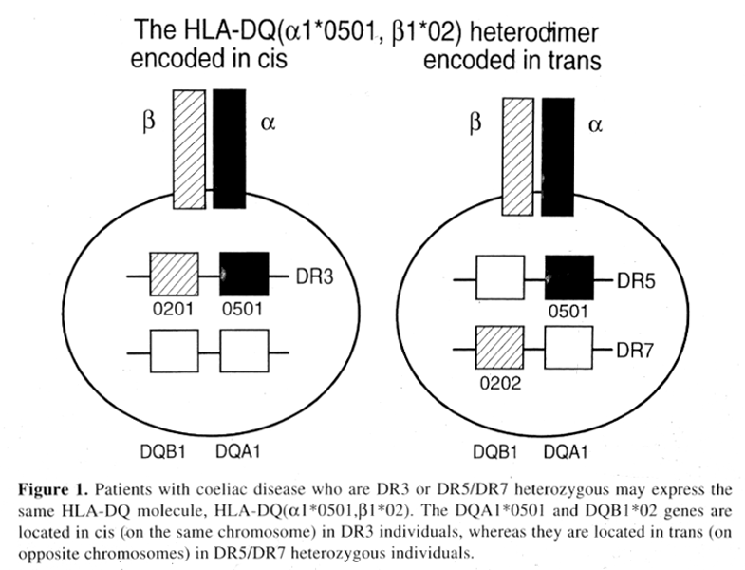
HLA-DQ2

Slide 11
COELIAC DISEASE: HLA
Most coeliacs have DQ2 (DQA1* 05, DQB1*02) in cis or trans
~ 5% are DR4 – DQ8 (DQA1*0301, DQB1*0302)

Slide 12
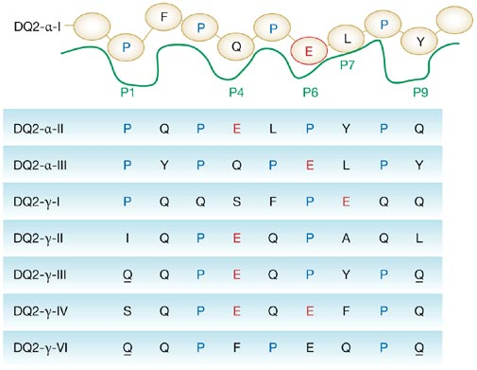

Figure 2 Schematic depiction of the HLA-DQ2 peptide binding site accommodating the deamidated DQ2-α-I epitope
Permission obtained from the American Gastroenterological Association
© Howard L and Ashley C (2003) Gastroenterology 124: 1651–1661.
Jabri B and Sollid LM (2006) Mechanisms of Disease: immunopathogenesis of celiac disease
Nat Clin Pract Gastroenterol Hepatol 3: 516–525 doi:10.1038/ncpgasthep0582

Slide 13
HLA-DQ in Coeliac Disease
Karell et al., Hum Immunol 2003

Slide 14
COELIAC DISEASE:
EVIDENCE FOR NON-HLA GENES
HLA - DQ2.5 serology
  DQA1* 05, DQB1*02 alleles
  90% of Northern European coeliac patients
  20% non-coeliac controls
In HLA-matched sibs
  Concordance for coeliac disease ~ 30%
Everyone eats gluten!
  Other gene(s) must contribute to the inheritability ...

Slide 15
STRATEGIES TO MAP NON-HLA GENES
Genome Wide Linkage Studies
Candidate Gene Analyses
Genome Wide Association Studies

Slide 16
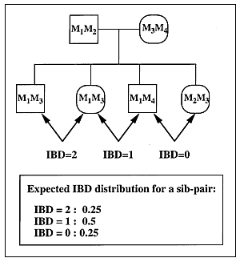
Genome-Wide Linkage Studies:
Principles of Sib-pair Analysis
Sharing by sibs of markers throughout entire genome
Markers in LD with causative genes more frequently shared

Slide 17
COELIAC DISEASE:
GENOME WIDE LINKAGE STUDIES
At least 13 studies:
  Variable findings in different populations
  Often not confirmed
HLA implicated in most studies CELIAC 1
Non-HLA regions with significant linkage in some cohorts:
  2q33 (CD28-CTLA-ICOS region) CELIAC 3
  4p15
  5q31-33 (cytokine cluster) CELIAC 2
  6p23 (distinct from HLA)
  9p21-p13
  11p11
  15q12
  19p13.1 (Myosin 9B) CELIAC 4

Slide 18
COELIAC DISEASE: ASSOCIATION STUDIES
CLASSES OF CANDIDATE NON-HLA GENES
Antigen processing genes
  TGM2 (tissue transglutaminase)
  DPPIV (dipeptidyl peptidase IV)
Antigen recognition genes:
  TCR, HLA genes, co-activation molecule genes
Immune response genes:
  Cytokines, IL12β etc

Slide 19
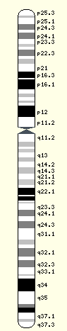
Chromosome 2q33 Gene Map
Chromosome 2q33-34
D2S1391
10.64 cM
D2S2392
1.8 cM
D2S116
0.01 cM
D2S2214
0.3 cM
CD28
0.1 cM
CTLA4 +49 (A/G) SNP
0.01 cM
CTLA4(AT)_{n}
0.1 cM
ICOS
0.2 cM
D2S2189
1.25 cM
D2S2237

Slide 20
Regulation of T cell activation
Antigen presenting cell
HLA
Antigen presenting cell
CTLA4 /CD28 binding regulates T-cell activation
(A/G) Polymorphism in CTLA4 exon 1 +49 associated with:
  IDDM (G)
  Graves’(G)
CD80
CD4
Peptide
T cell
T cell receptor
T cell
CTLA4
CD3
CD28
Activated T cell
T-cell
anergy

Slide 21
COELIAC DISEASE:
CHROMOSOME 2q33 STUDIES
Definite linkage across the entire region
Association between marker alleles centromeric to CTLA4 and Coeliac Disease
Other autoimmune diseases associated with this region
Common haplotypes identified in CD
Alleles at 2q33 might predispose to CD, but unlikely that the CTLA4 (+49A/G) polymorphism is implicated
        Hunt, et al., Eur. J. Hum. Genet. 2005

Slide 22
COELIAC DISEASE AND CHROMOSOME 6:
NON-HLA LOCI WITHIN MHC
Strong linkage disequilibrium
  Extended haplotypes (B8/DR3/DQ2)
Most association is due to HLA-DQ2
Studies of TNF, TAP1, TAP2
MICA 5.1 allele
  Spanish and Saharwi cohorts
  Genotype frequency:
    Atypical 91%, Typical 53%, Controls 44%
    OR 8.6 (atypical vs. typical)
    Independent of LD
  ? Involved with NK/CD8+ Tγδ cell binding
        Lopez-Vazquez et al. Gut 2002

Slide 23
COELIAC DISEASE: CHROMOSOME 19p13.1
19p13.1 identified in GWLS in Netherlands population and other pooled European cohort
  Strongest association with SNPs in Myosin 9B
  Homozygous individuals have 2.3x higher risk of CD
  Myosin 9B may have role in actin remodelling
        Monsuur et al., Nat Genetics 2005
Association not confirmed in UK or Italian cohorts
        Van Heel et al., Gut 2006

Slide 24
COELIAC DISEASE
Candidate genes: Summary
HLA class II (DQ2.5)
  Strongly suggestive, much evidence
2q33 (CD28-CTL4-ICOS)
  Suggestive, good evidence
MICA (non-HLA, Chr. 6 region)
  Evidence in some populations)
19p13.1 (Myosin 9B)
  Unclear, some evidence

Slide 25
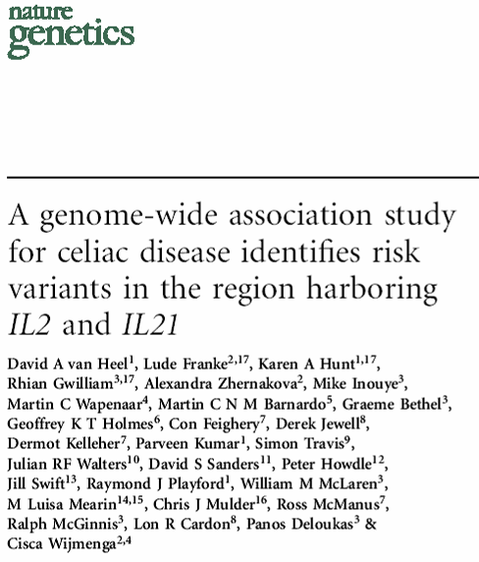
July 2007
Coeliac UK Funded
Multiple UK sites
778 UK coeliacs
1,422 UK population controls

Slide 26
COELIAC DISEASE:
GENOME WIDE ASSOCIATION STUDY
        Nature Genetics 39, 827 - 829 (2007)
Illumina BeadChips
310,605 SNPs (with minor allele frequency >1%)
Overall SNP call rate 99.87%

Slide 27
COELIAC DISEASE:
GENOME WIDE ASSOCIATION STUDY
Association with previously reported genes:
HLA-DQ2.5cis
  inferred by rs2187668 genotype
  89.2% of UK coeliacs vs 25.5% controls
  Chi² = 769.1, P < 10⁻¹⁹
CD28-CTLA4-ICOS region
  rs4675374, P = 0.007
  rs11681040, P = 0.008
No association with MYO9B region

Slide 28
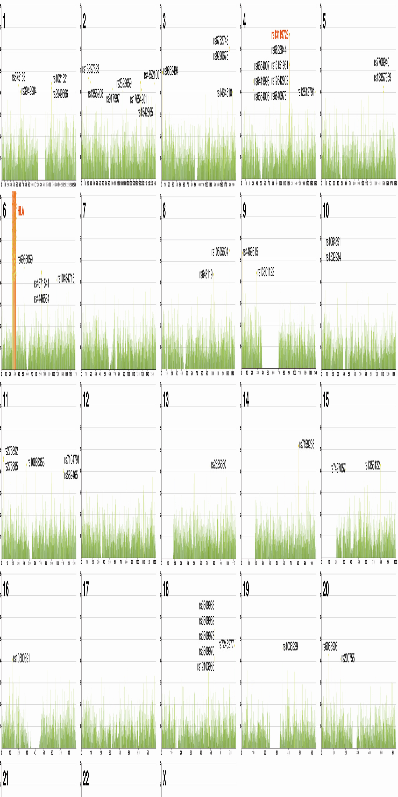

Coeliac Disease: Summary of Genome Wide Association Study p Values

Slide 29
CHROMOSOME 4q27
rs13119723
  P = 2.0 x 10⁻⁷
  Frequency of minor G allele (cases : controls)
  UK 10.1%: 15.8%
  Dutch 11.5% : 16.4%; Irish 12.8% : 16.2%
  Combined OR 0.65; p = 4.8 x 10⁻¹¹
rs 6822844
  Strongest association overall in combined cohorts
  OR 0.63; P = 1.3 x 10⁻¹⁴
  24kb 5’ of IL21

Slide 30
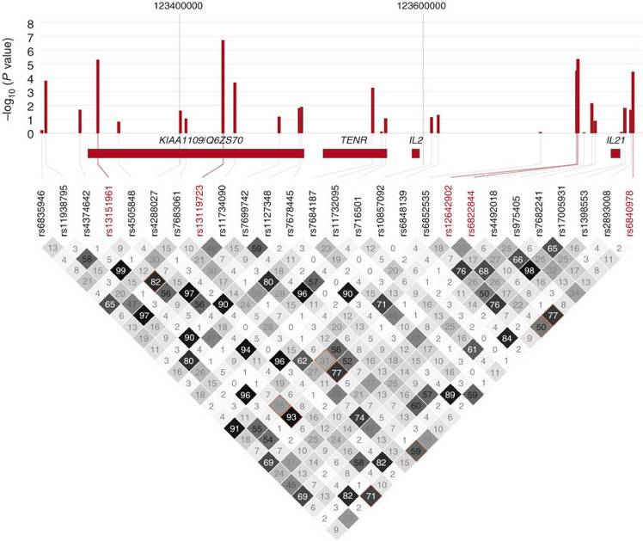
Chromosome 4q27: Linkage Disequilibrium

Slide 31
CHROMOSOME 4q27: GENES
IL21
  Enhances B,T, NK cell proliferation & Interferon-γ production
  Implicated in intestinal inflammation
  Greatly increased expression in untreated Coeliac disease
IL2
  Key cytokine for T-cell activation and proliferation
  Modest reduction in untreated Coeliac disease
  Syntenic region in mouse (Idd3) determines susceptibility to autoimmune diseases in the NOD mouse by influencing IL2 mRNA / protein levels & CD4+ CD25+ regulatory T cell activity
KIAA1109
  Unknown function
  Modest reduction in untreated Coeliac disease
TENR / ADAD1
  Expressed in testes

Slide 32
COELIAC DISEASE GWAS 1
HLA-DQ
Allelic odds ratio = 6.8
IL2/IL21 region
Allelic odds ratio = 1.6

Slide 33
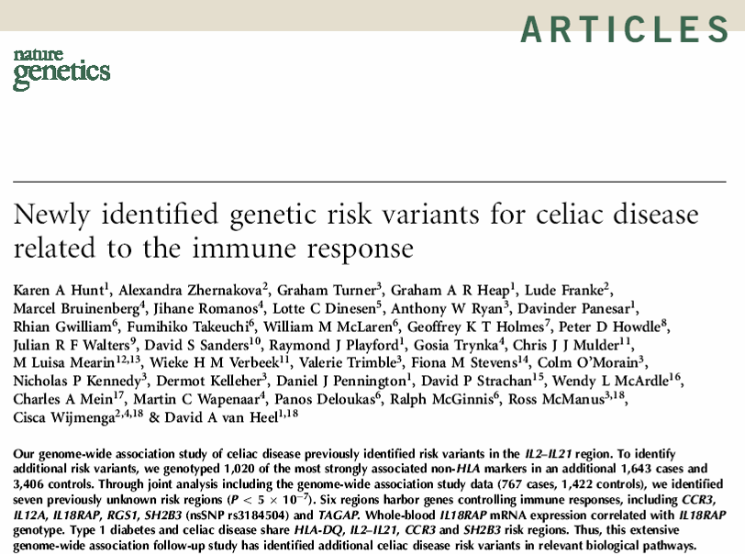
March 2008

Slide 34
Follow-up of Coeliac GWAS Findings
Top 1020 non-HLA SNPs from GWAS (p < 0.00275)
Additional UK2 + Irish + Dutch patients:
1643 cases, 3406 controls
+ GWAS: 767 cases, 1422 controls
totalling 2410 cases, 4828 controls
7 further regions identified
p overall < 5x10⁻⁷ = ‘genome wide significance’

Slide 35
Combined UKGWAS, UK2, IRISH, DUTCH
UKGWAS

Slide 36
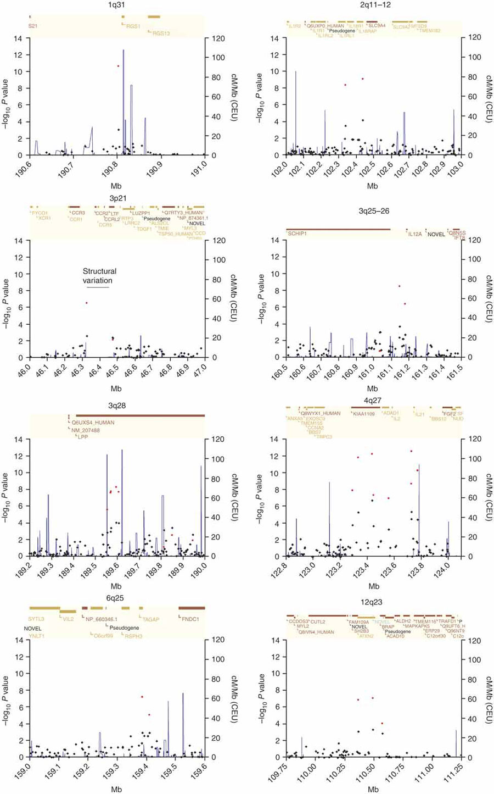
Eight non-HLA Coeliac Disease Associated Regions

Slide 37
Non-HLA Coeliac Disease Associated Regions (1)
4q27 (OR 0.73)
  KIAA1109-ADAD1-IL2-IL21
  Also identified in T1DM, Grave’s disease & Rh. Arthritis
1q31 (OR 0.71)
  RGS1 (regulator of G-protein signalling 1)
  Regulates chemokine receptor signalling
  Involved in B-cell activation
  Strongly expressed in intestinal intra-epithelial lymphocytes

Slide 38
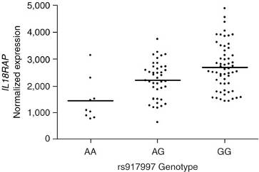
Non-HLA Coeliac Disease Associated Regions (2)
2q11-2q12 (OR 1.27)
  IL18RAP & IL18R1
  IL18 induces T-cells to synthesize Interferon-γ
  IL18 expressed in intestinal mucosa of coeliacs but not healthy controls
    IL18RAP mRNA Expression
    in Blood from Treated Coeliacs

Slide 39
Non-HLA Coeliac Disease Associated Regions (3)
3p21 (OR 1.21)
  Cluster of chemokine receptor genes
  CCR1, CCR2, CCRL2, CCR3, CCR5, XCR1
  Associated with T1DM
3q25-3q26 (OR 1.34)
  IL12A – encodes IL12p35
  Induces Interferon-γ secreting Th1 cells
3q28 (OR 0.82)
  LPP
  Highly expressed in small intestine
  ? Involved in cell shape & motility

Slide 40
Non-HLA Coeliac Disease Associated Regions (4)
6q25 (OR 1.21)
  TAGAP (T-cell activation GTPase activating protein)
  Expressed in activated T-cells
12q24 (OR 1.19)
  SH2B3 (also known as LNK) & ATXN2
  Strong association with T1DM
  Expressed in monocytes & dendritic cells
  Found in small intestine, especially inflamed coeliac tissue

Slide 41
Summary of Variant Genes in Coeliac Disease
DA van Heel 2008

Slide 42
Summary of Initial Coeliac Genetic Studies
HLA-DQ
IL2-IL21
7 more risk variants/regions
Genes from 8 regions involved in immune response
4 of 9 regions overlap with type 1 diabetes

Slide 43
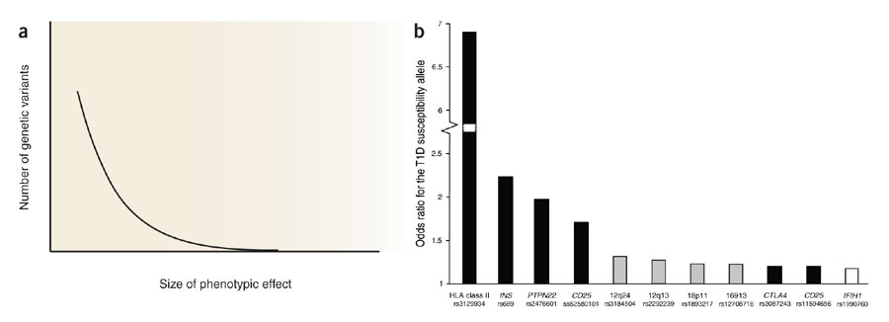
Comparison with findings in Type 1 Diabetes mellitus
(Figure from Todd, J.A. et al., Nat. Genet. 39, 857–864, 2007.)

Slide 44
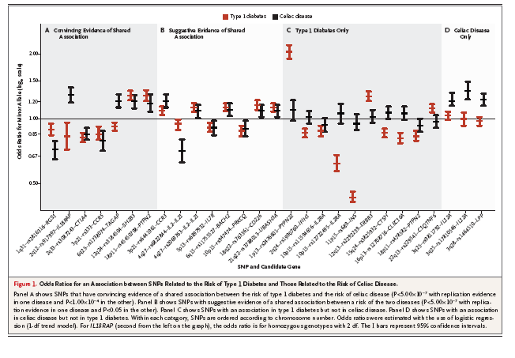
Shared and Distinct Genetic Variants in Type 1 Diabetes and Celiac Disease
        Smyth et al NEJM 2008

Slide 45
Coeliac Genetics - Questions
Are there more coeliac genetic risk factors ?
  HLA DQ2/8 may explain ~35% heritability
  8 new variants explain < 5% heritability
  Small individual effects of new genes (OR 1.2-1.3)
How to find them:
  Larger sample SNP GWAS study
  Rare variants
  Structural variants
Which are the causal variants from each region ?
How do variants alter biological function ?

Slide 46
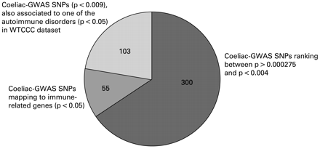
GWAS follow-up
        Trynka et al Gut 2009

Slide 47
GWAS follow-up
        Trynka et al Gut 2009
458 SNPs were assayed in 1682 cases and 3258 controls from three populations (UK, Irish and Dutch).
Results combined with the original GWAS cohort (767 UK cases and 1422 controls);
6 SNPs showed association with p<1 x 10(-04) and were then genotyped in an independent Italian coeliac cohort (538 cases and 593 controls).
2 novel coeliac disease risk regions identified:
  6q23.3 (OLIG3-TNFAIP3)
  2p16.1 (REL)
  genome-wide significance in the combined analysis (2987 cases and 5273 controls) p = 1.3 x 10(-08) & 5.2 x 10(-07)
  Both involved in NFkB pathway

Slide 48
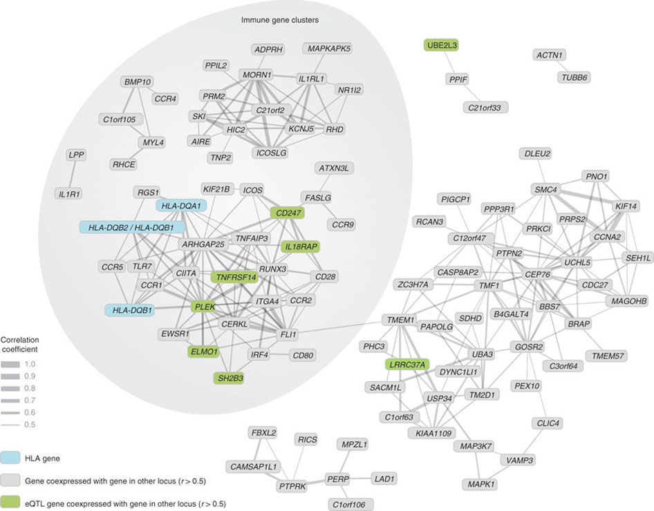
Second Generation GWAS results
Dubois et al. Nat Gen 2010; 42: 295
GWAS in 4,533 celiacs & 10,750 controls; + 4,918 celiacs & 5,684 controls for 113 selected SNPs
Coexpression analysis of genes mapping to 40 genome-wide significant and suggestive celiac disease regions in 33,109 heterogenous human samples from the Gene Expression Omnibus.

Slide 49
GENETICS OF COELIAC DISEASE: FUTURE STUDIES
Only proportion of inheritability explained from HLA-DQ and GWAS genes
Other genetic effects
  ? Weak genetic effects of even more genes
  ? Additional genes with rare mutations (MAF <0.01)
  ? Copy number variation
Interactions with other environmental effects

Slide 50
Other Environmental Factors affecting Development of Coeliac Disease
Genetics
Environmental
  Gluten
  Weaning and tolerance
  Influences at time of exposure

Slide 51
Timing of Gluten Introduction & Development of Coeliac Disease Autoimmunity (CDA)
        Norris et al. JAMA 2005; 293:2343
1560 children in Denver (DAISY)
  HLA-DR3-DQ2 or DR4-DQ8, or 1st-degree relative with T1D
  Mean follow-up 4.8y
  CDA = tTG +ve x2 [n=51]; or tTG + Villous atrophy on Biopsy [n=25]
Age of exposure to wheat, barley or rye | CDA +ve | CDA -ve | Hazard ratio of CDA | Biopsy +ve | Biopsy -ve | Hazard ratio of Biopsy +ve
1 – 3 mo | 3 6% | 40 3% | 5.17 [95% CI: 1.44 – 18.57] P = 0.02 | 3 12% | 40 3% | 22.97 [95% CI: 4.55 – 116] P = 0.001
4 – 6 mo | 12 23% | 574 38% | 1 | 3 12% | 583 38% | 1
> 7 mo | 36 71% | 895 59% | 1.87 [95% CI: 0.97 – 3.60] P = 0.07 | 19 76% | 912 59% | 3.98 [95% CI: 1.18 – 13.46] P = 0.04

Slide 52
Rotavirus Infection Frequency and Rick of Celiac Disease Autoimmunity
        Stene et al. Am J Gastro 2006; 101: 2333
1931 children in Denver (DAISY)
  HLA-DR3/DQ2 or DR4, or 1st-degree relative with T1D
  CDA = tTG +ve x2 [n=54]; or tTG + Villous atrophy on Biopsy [n=27]
  Two matched controls for each case
  Rotavirus serology at defined times
Rotavirus infections | Cases | Controls | Risk ratio of CDA
0 | 3 6% | 12 3% | 1
1 | 18 23% | 46 38% | 1.94 [95% CI: 0.39 – 9.56]
>2 | 33 71% | 50 59% | 3.76 [95% CI: 0.76 – 18.7]
Test for trend p = 0.037

Slide 53
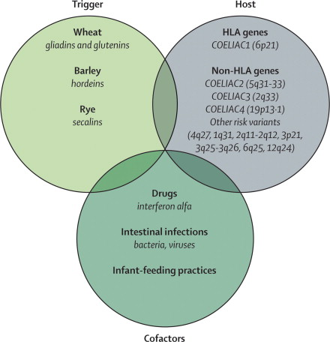
Figure 1 Causative factors in coeliac disease
Antonio Di Sabatino, Gino Roberto Corazza. Coeliac disease. Lancet 2009; 373: 1480 - 1493

Slide 54
GENE / ENVIRONMENTAL INTERACTIONS IN
COELIAC DISEASE: SUMMARY
Gluten-sensitive enteropathy
Strong inheritability
HLA-DQ most important factor
Weak effects from linkage and candidate gene studies
Genome-wide association study
  IL21/IL2
  Further genes involved in immune function
Overlap with T1DM, Grave’s disease etc.
Only proportion of inheritability explained so far
Other environmental factors
  Weaning age
  Infections
  Factors affecting tolerance ….

