Slide 1
BSc in Gastroenterology
Professor Julian Walters
Basics of coeliac disease
Tuesday 9 October 2012

Slide 2
Plan
Review:
Definition of coeliac disease
Presenting features
Diagnosis
Treatment
Complications
Epidemiology
Pathophysiology
Inheritance

Slide 3
COELIAC DISEASE – Definition
A chronic small intestinal immune-mediated enteropathy precipitated by exposure to dietary gluten in genetically susceptible individuals
Oslo definitions for coeliac disease and related terms
Ludvigsson et al. Gut 2012
= Gluten-sensitive enteropathy

Slide 4
What are the clinical features of Coeliac disease?
Frequent (~50%)
Malaise
Fatigue
Steatorrhoea
Diarrhoea
Weight loss
Anaemia
Folate
Fe
Common (>25%)
Anorexia
Abdominal pain
Oral ulcers
Distension
Bloating
Flatulence
Osteopenia
Childhood history
Family history
B12
Albumin
25-OH vit. D
↑ PTH
Occasional (<25%)
Nausea
Muscle Pains
Tetany
Bone pains
Bruising
Oedema
Constipation
Rashes
Fractures
Lymphoma
Alk. Phos.
Ca²⁺
Mg²⁺
↓ Zn²⁺
Transaminases
PT
Completely asymptomatic

Slide 5
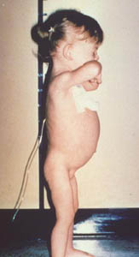
COELIAC DISEASE IN CHILDREN
Classical symptoms such as those described by Gee in 1888
Diarrhoea
Steatorrhoea
Vomiting
Anorexia
Abdominal distension
Abdominal pain
Weight loss
Failure to gain weight
Lassitude
Irritability
Respiratory infections

Slide 6
CHANGING PRESENTATION OF COELIAC DISEASE
Average age of diagnosis is now > 50
Less severe disease in children
Non-specific disease in adults
Detection of disease in mild anaemia

Slide 7
COELIAC DISEASE: DIAGNOSIS
Serology
Endomysial antibodies
Tissue Transglutaminase
Intestinal biopsy
Villous atrophy
Crypt hyperplasia
Increased intraepithelial lymphocytes

Slide 8
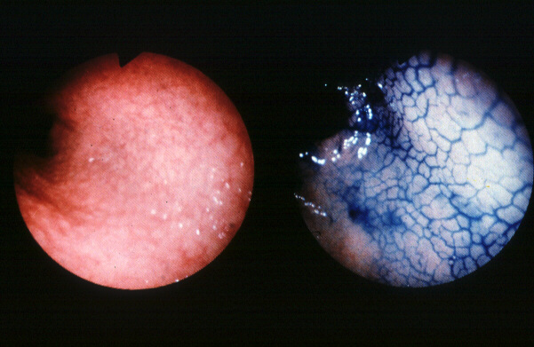
TYPICAL DUODENAL APPEARANCES ON ENDOSCOPY
Flattened or "scalloped" mucosa

Slide 9
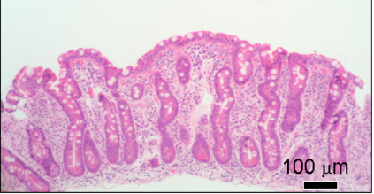
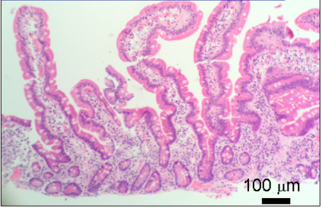
DUODENAL HISTOLOGY
Subtotal villous atrophy with crypt hyperplasia
Normal mucosa

Slide 10
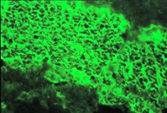
ENDOMYSIAL ANTIBODIES IN COELIAC DISEASE
First described 1983 (Chorzelski et al.)
Similar to reticulin / jejunal antibodies
Detected by indirect immunofluorescence
primate oesophagus
gastric / small bowel muscle
umbilical cord
IgA class
IgG in selective IgA deficiency
High specificity (>95%) & sensitivity in diagnosis
Useful in monitoring response to treatment

Slide 11
AUTOANTIBODIES & COELIAC DISEASE
Tissue transglutaminase (TTG)
Shown to be the autoantigen recognized by endomysial antibodies
tTG cross-links glutamine residues including those in gliadin
Produces neo-antigens
IgA antibodies measured by ELISA
Now better clinically than Endomysial IgA antibodies
TTG2 in intestine: other tissues have different TTG isoforms

Slide 12
AUTOANTIBODIES & COELIAC DISEASE
Antigliadin antibodies
Less specific than endomysial antibodies
Deamidated-gliadin peptide antibodies
Possible role

Slide 13
Tissue Transaminase IgA Antibodies in Diagnosis
Burgin-Wolf et al – Sc J Gastro 2002

Slide 14
Tissue Transaminase IgA Antibodies in Follow-up
Burgin-Wolf et al – Sc J Gastro 2002

Slide 15
COELIAC DISEASE: Diagnostic Criteria in Children
ESPGHAN: 1990
1. Characteristic initial biopsy on gluten:
Villous atrophy, hyperplastic crypts, raised IEL, abnormal surface epithelium
2. Complete clinical remission on GFD:
Demonstrate histological remission if previously asymptomatic
3. Positive IgA antibodies
Tissue transglutaminase (endomysial, gliadin or reticulin) disappearing on GFD
Gluten provocation if in doubt
ESPGHAN: 2012
Symptomatic: Diagnosis based on symptoms, positive serology, and histology consistent with CD.
If IgA TTG2Ab titres are high (>10 ULN), option to diagnose CD without duodenal biopsies, by applying a strict protocol with further laboratory tests.
Asymptomatic: Diagnosis based on positive serology and histology.
HLA-DQ2/8 of value in excluding diagnosis.

Slide 16
The Coeliac Iceberg
Complicated
Clinically active
Subclinical
Latent / potential
Lymphoma
Nutritional deficiencies
DH
Villous atrophy
Subtle histology
IEL
Antibodies

Slide 17
COELIAC DISEASE: Definitions
Oslo definitions for coeliac disease and related terms
Ludvigsson et al. Gut 2012
Classical
Symptomatic CD
(Typical disease)
(Atypical disease)
Subclinical CD
Asymptomatic
(Silent)
Refractory CD
Symptoms + villus atrophy on strict GFD >12mnths
Potential CD
(Latent)
Gluten-related disorders
(Gluten intolerance)
Non-coeliac gluten sensitivity

Slide 18
COELIAC DISEASE: Treatment
Identification and replacement of nutrient deficiencies
Gluten-free diet
Prevention of complications

Slide 19
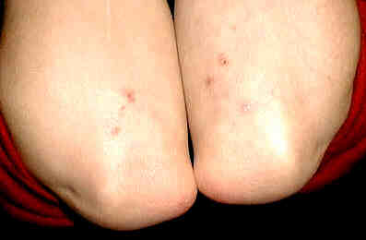
DERMATITIS HERPETIFORMIS
Vesicular rash
intense pruritus
blisters rarely present
esp. arms & shoulders
Skin biopsy
granular IgA deposits
Associated villous atrophy and gluten-sensitivity

Slide 20
COELIAC DISEASE: COMPLICATIONS
Nutrient malabsorption & impaired nutritional status
(Slow growth, anaemia, neurological disorders, ? infertility)
Osteoporosis / osteopenia
Refractory Coeliac disease
Small bowel malignancy
Lymphoma
Enteropathy-associated T-cell lymphoma (EATL)
Adenocarcinoma
(and ? other cancers)

Slide 21
Coeliac Disease and Malignancy
Primary small-bowel malignancy in the UK and its association with coeliac disease
Howdle et al., QJM 2003
395 cases reported by BSG members 6/1998 – 5/2000
Total Coeliacs
Adenocarcinomas 175 23 (13%)
Lymphomas 107 42 (39%)
Prognosis of lymphoma complicating coeliac disease poor:
Survival at 30 months 52% overall
13% coeliac

Slide 22
Coeliac Disease and Lymphoma
Series from Galway
~700 patients over 22 years (1972-94)
30 cases of Enteropathy Associated T-cell Lymphoma
23 with EATL and CD diagnosed together
27 / 30 Adult onset coeliac disease
Overall 5 yr survival - 11%
Median Survival - 10 months
Egan et al., J Clin. Gastroenterol. 1995.

Slide 23
Malignancy and Coeliac Disease
UK GP Research Database:
4732 Coeliacs, 1987-2002
66% prevalent cases
134 (2.8%) with at least one malignancy
West et al., Aliment Pharmacol Ther 2004
 | Overall |  | After first year after diagnosis
Variable | Hazard ratio | 95% CI | Hazard ratio | 95% CI
Any Malignancy | 1.29 | 1.06–1.55 | 1.10 | 0.87-1.39
Mortality | 1.31 | 1.13-1.51 | 1.17 | 0.98-1.38
GI cancer | 1.85 | 1.22-2.81 | 1.65 | 0.99-2.76
Breast cancer | 0.35 | 0.17-0.72 | 0.24 | 0.10-0.60
Lung cancer | 0.34 | 0.13-0.95 | 0.37 | 0.11-1.20
Lymphoproliferative disease | 4.80 | 2.71-8.50 | 3.40 | 1.58-7.34

Slide 24
COELIAC DISEASE: Evidence for Silent Disease
Family studies
one in ten of first-degree relatives
Dermatitis Herpetiformis
>30% have no GI symptoms
Population screening
Patients with associated disorders
Asymptomatic
Prevalence of undiagnosed cases is up to 10x that of those previously diagnosed

Slide 25
COELIAC DISEASE: SCREENING POPULATIONS
In general population, prevalence may be ~1%
Groups with prevalence between 1 and 5%:
Diabetes (T1)
Thyroid disease
Anaemic blood donors
Irritable Bowel Syndrome
Osteoporosis
Addison’s disease
Turner’s syndrome
Down’s syndrome

Slide 26
Coeliac Disease: Screening Type I Diabetes
Cronin & Shanahan Lancet 1997
Screening IDDM patients with IgA Endomysial Abs + small bowel biopsy if positive
Incidence of villous atrophy between 1% & 5%
Common HLA associations including HLA-DR3
Considerable dietary restrictions
Improvement in metabolic control with treatment of villous atrophy

Slide 27
Coeliac Disease: Screening IBS
Sanders et al Lancet 2001
Irritable Bowel Syndrome
300 consecutive patients with Rome II criteria for IBS
300 matched controls without IBS from family practices
Coeliac disease diagnosed in
14 patients with IBS (~5%)
2 controls (0.7%)
Odds ratio = 7, p = 0.004

Slide 28
Coeliac Disease in Osteoporosis
Subjects recruited at DXA scan:
Sanders et al. Dig Dis Sci. 2005
All with coeliac disease had subtle GI symptoms or anaemia!
 | Number | F / M | Coeliac Prevalence %
Osteoporosis | 243 | 231 / 12 | 5 | 2.1%
Osteopenia | 431 | 416 / 15 | 5 | 1.2%
Normal | 304 | 289 / 15 | 2 | 0.7%
Total | 978 | 936 / 42 | 12 | 1.2%

Slide 29
Coeliac Disease: Screening Populations
Catassi C, Lancet, 1994
3351 students in central Italy:
anti gliadin & endomysial Ab
18 subjects selected for biopsy
11 had villous atrophy
Prevalence 3.3 per 1000
Ratio of silent : known cases > 5 : 1

Slide 30
Coeliac Disease: Screening Populations
Hin et al BMJ 1999
General practices:
1000 consecutive patients with specific symptoms
(IBS, anaemia, FH, malabsorption/diarrhoea, fatigue, thyroid disease, diabetes, weight loss, short stature, epilepsy, infertility, arthralgia, eczema)
EMA followed by SI biopsy
Coeliac disease diagnosed in 30:
15 / 30 with anaemia
25 / 30 with non-GI symptoms
6 “tired all the time”
Prevalence 3%

Slide 31
Coeliac Disease: Screening Populations
West et al., Gut 2003
Cambridge GP Health Study:
12 practices 1990-1995
7550 subjects aged 45-76
87 EMA IgA positive, 77 also TTG abnormal. No biopsy
Sero-prevalence = 1.2%
Positive subjects
Lighter, good/excellent health, less likely to smoke (OR=0.36)
Lower cholesterol, Hb, corrected Ca
Increased risk of osteoporosis (OR=3.1) & mild anaemia (OR=4.6)

Slide 32
Coeliac Disease: Screening Populations
Sanders et al., Eur J Gastro Hepatol 2003
5 practices 1999-2001
1200 volunteers
Serology and then SI biopsy
12 new coeliacs
Prevalence = 1% (95% CI 0.4-1.3%)
3.3% in IBS
4.7% in iron deficiency anaemia
3.3% in fatigue

Slide 33
Coeliac Disease: Screening Children
Undiagnosed coeliac disease at age seven: population based prospective birth cohort study
Bingley et al., BMJ 2004
Avon Longitudinal Study of Parents and Children
Children gave blood at age 7.5; 5470 tested
Serology
54 positive for IgA-EMA
Sero-Prevalence = 1% (95% CI 0.8-1.4%)
More common in girls (OR 2.12)
Shorter and weighed less (p<0.0001)
50% with diarrhoea (OR 1.96)
Comparable prevalence to that found in adults

Slide 34
COELIAC DISEASE
Different presentations & severity of disease suggests differences in individual responses
? different amounts of gluten intake
? different sensitivities
? different enteropathies

Slide 35
COELIAC DISEASE = GLUTEN SENSITIVE ENTEROPATHY
GLUTEN
Fraction of cereals that binds (glues)
Proteins found in wheat, barley, rye
Evolution of cereal proteins
A-gliadin (wheat), hordein (barley), secalin (rye)
Fractionation and identification of immunologically active components

Slide 36
COELIAC DISEASE = GLUTEN SENSITIVE ENTEROPATHY
Identification of
Specific polypeptides rich in Q and P
LQLQPFPQPQLPYPQPQLPYPQPQLPYPQPQPF
33-mer, residues 57 – 89 of α2-gliadin
stable in gastric, pancreatic & intestinal proteases
Q reacts with tTG; deamidated to E
stimulates HLA- restricted intestinal T cell clones from coeliacs
Shan et al Science 2002
Other similar peptides found

Slide 37
COELIAC DISEASE = GLUTEN SENSITIVE ENTEROPATHY
SENSITIVE
Immunological reaction
tissue transglutaminases and neo-antigen formation
activated HLA-restricted T-lymphocytes
Genetic predisposition to immune response ...

Slide 38
COELIAC DISEASE = GLUTEN SENSITIVE ENTEROPATHY
ENTEROPATHY
Inflammatory damage
Cell death (apoptosis)
Histological changes
Enterocyte apoptosis (villous atrophy)
Stimulated regeneration (hyperplastic crypts)
Functional changes leading to malabsorption of nutrients

Slide 39
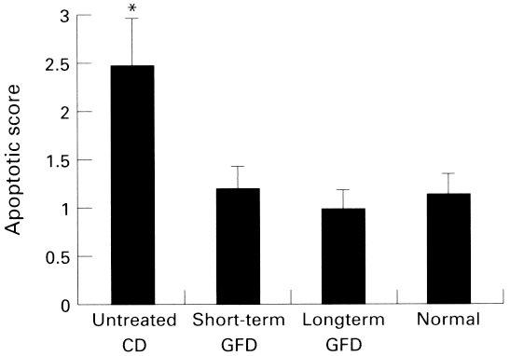
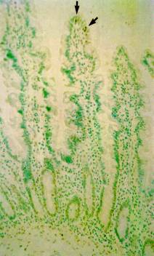
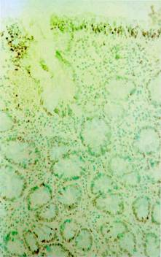
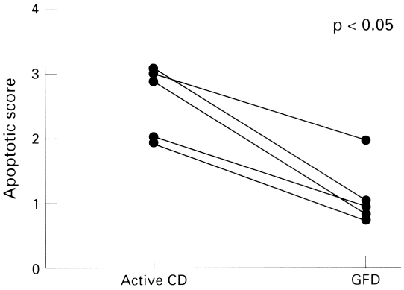
COELIAC DISEASE AND APOPTOSIS
Moss et al Gut 1996
Normal Coeliac

Slide 40
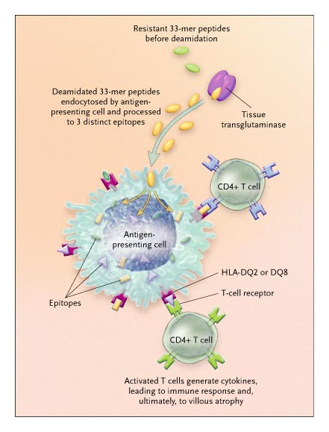

Slide 41
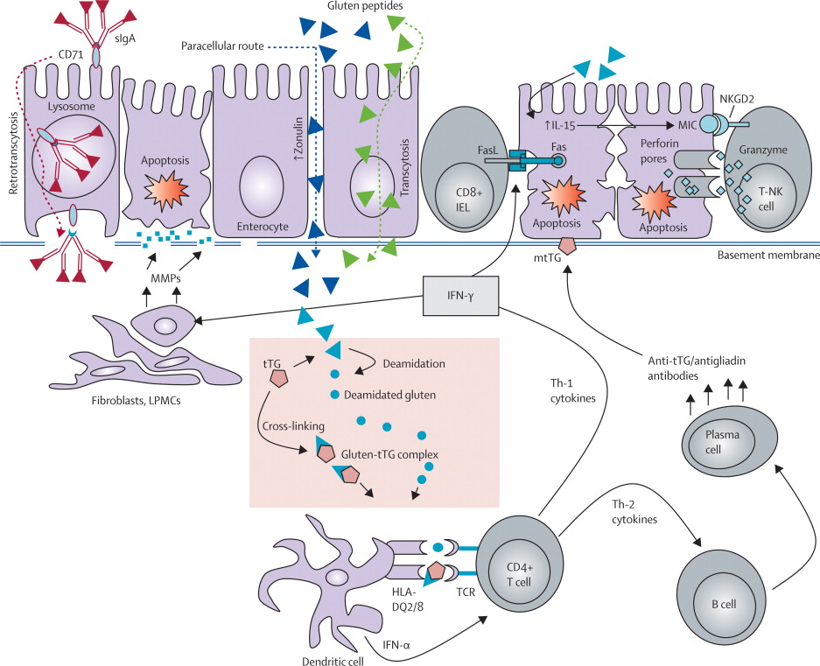
Figure 2 Mechanisms of mucosal damage in coeliac disease z...
Antonio Di Sabatino , Gino Roberto Corazza. Coeliac disease. Lancet 2009; 373: 1480 - 1493

Slide 42
Coeliac references
Sollid LM. Coeliac disease: dissecting a complex inflammatory disorder. Nature Reviews Immunology 2002; 2: 647-655
McManus R, Kelleher D. Celiac disease--the villain unmasked? N Engl J Med. 2003; 348:2573-4. Comment on: N Engl J Med 2003; 348:2517-24.
Green PH, Cellier C. Celiac disease. N Engl J Med. 2007; 357:1731-43.
Di Sabatino A, Corazza GR. Coeliac disease. Lancet 2009; 373: 1480-1493
Ludvigsson JF, et al. The Oslo definitions for coeliac disease and related terms. Gut 2013; epub

