Slide 1
Gastrointestinal and hepatobiliary manifestations of cystic fibrosis
Dr David Westaby

Slide 2
Cystic Fibrosis
Autosomal recessive lethal disorders
1 : 2,500 newborn Caucasians

Slide 3
Cystic Fibrosis
Described 1938
Based upon organ involvement
Obstructive lung disease
Pancreatic insufficiency
Absence vas deferens

Slide 4
Cystic Fibrosis
1953 documented abnormality of chloride efflux
Formed basis of diagnostic test
Sweat chloride

Slide 5
Cystic Fibrosis
1989 – cloning of responsible gene
Named cystic fibrosis transmembrane regulator (CFTR)
Protein encoded – chloride channel

Slide 6
Cystic Fibrosis Transmembrane Regulator
Chromosome 7
>1000 recorded mutations
> 200 polymorphisms.
70% Δ 508
5 groups of mutations based upon residual CFTR function

Slide 7
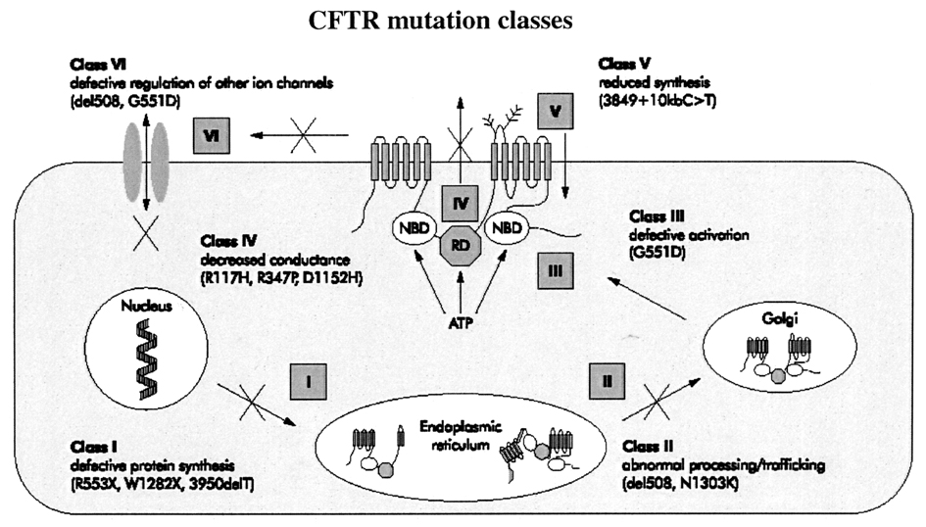

Slide 8
Cystic Fibrosis Transmembrane Regulator
Member of the ATP-binding cassette (ABC) transporter family
Lumenal surface all epithelial cells
CI⁻ and HCO₃⁻ secretion
Controls fluid flow

Slide 9
Cystic Fibrosis
Pathogenesis:
Decreased hydration of epithelial cell secretion
Increased viscosity of secretion
Secondary obstructive organ damage

Slide 10
Cystic Fibrosis
Important sites epithelial cell expression:
Lung
Pancreas
Liver and biliary
Gastrointestinal
Sweat glands
Vas deferens

Slide 11
Manifestations of Organ Damage
Pulmonary - Bronchiectasis
Pancreas - Pancreatic insufficiency
Liver - Cirrhosis
Biliary - Gall stones
Gastrointestinal - Obstruction/Motility disturbance
Vas deferens - Sterility

Slide 12
Cystic Fibrosis – Morbidity and Mortality
95% mortality pulmonary related
Pancreato-biliary important causes
Gastro-intestinal of morbidity

Slide 13
Genotype - Phenotype Relationship
Strong correlation for:-
Pulmonary disease
Pancreatic disease
Absent for:-
Chronic liver disease

Slide 14
Pancreatic Involvement
85% pancreatic insufficient
Most present in 1st year of life
Managed by pancreatic enzyme replacement
30% become diabetic in later life

Slide 15
Pancreatic Involvement
15% pancreatic sufficient
May become insufficient with age
May develop symptomatic pancreatitis

Slide 16
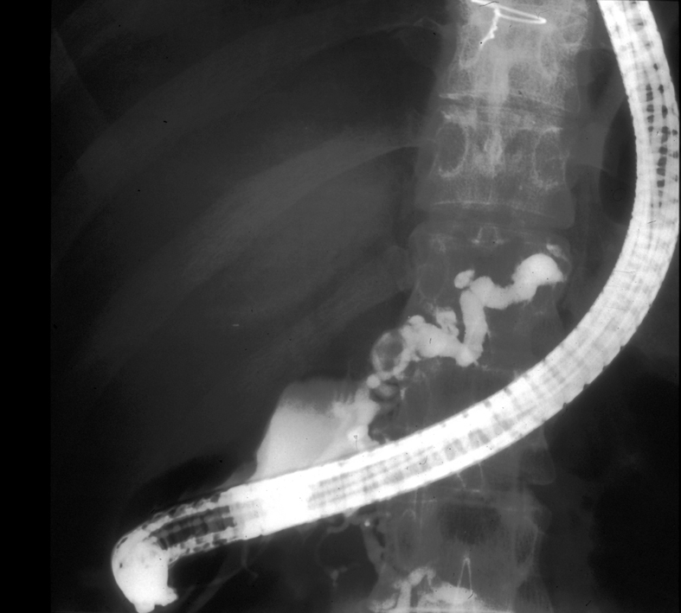

Slide 18
Role of CF Mutations in Idiopathic Pancreatitis
Whole Gene Sequencing
 |  | CF Mutations | Compound Heterozygote
Idiopathic Pancreatitis | 67 | 21(31%) | 4
Matched Controls | 60 | 11(18%) | 0
Weiss et al 2005

Slide 19
Role of CF Mutations in Idiopathic Pancreatitis
complete gene screening
Idiopathic Pancreatitis | CF Mutations | Compound Heterozygote
136 | 33(24 %) 28 mutations 22 polymorphisms | 8
Audrezed 2008

Slide 20
Interactions of CF Mutations and other Putative Gene Defects in Pancreatitis
Patients with CP
381
CF Mutations
122(32%)
Compound Heterozygote with CF Mutations:-
SPINK 1 25(20%)
PRSS 1 7(5.5%)
Keiles 2006

Slide 21
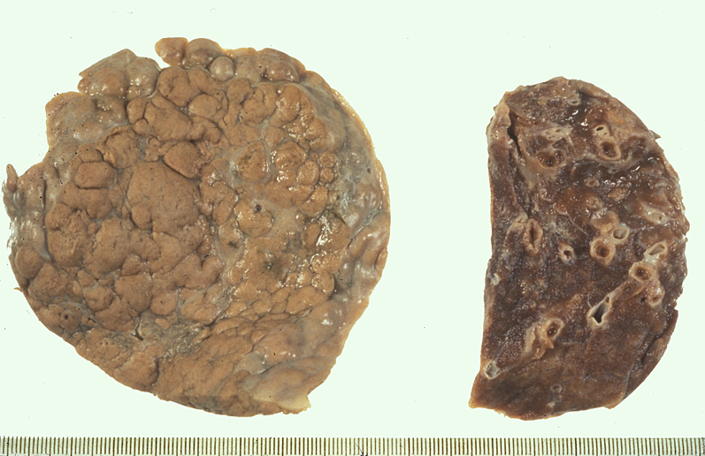

Slide 22
Pathogenesis of chronic liver disease in cystic fibrosis
Biliary Epithelial Cell
Cystic Fibrosis Transmembrane
Conductance Regulator (CFTR)
Abnormal Ductular Secretion
Inspissated Bile
Bile Duct Obstruction
Focal Biliary Cirrhosis
Genetic Determined
Dysfunction
Hydrophobic Bile Acid
Retention
Immune Response

Slide 23
Prevalence of Liver Disease in Cystic Fibrosis
20% evidence of liver fibrosis.
8% established cirrhosis.
Progression to cirrhosis in first 2 decades of life.

Slide 24
Genetic Modifiers of Liver Disease in Cystic Fibrosis
non-CFTR genetic variability
Several candidate genes investigated.
Proven correlation with α₁-antitrypsin Z allele ( SERPINA Z).
Leads to enhanced inflammatory response and stellate cell activation.

Slide 25
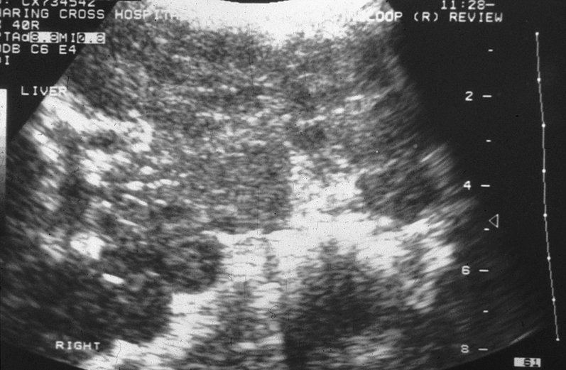

Slide 26
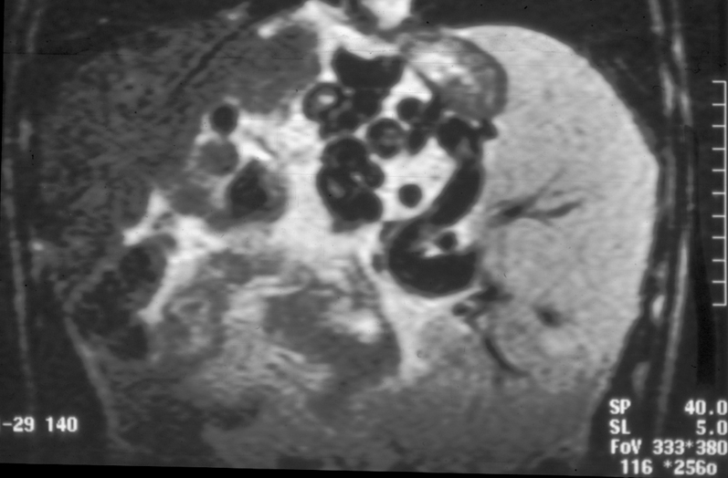

Slide 27
Complications of liver disease
1. Portal Hypertension
Ascites
Variceal haemorrhage
Porto-systemic encephalopathy

Slide 28
Distal Intestinal Obstruction Syndrome (DIOS)
Features:-
Right liliac fossa pain
Associated palpable mass
Evidence of partial or complete small bowel obstruction
Inspissated mucofaeculant material in the terminal ileum and right colon

Slide 29
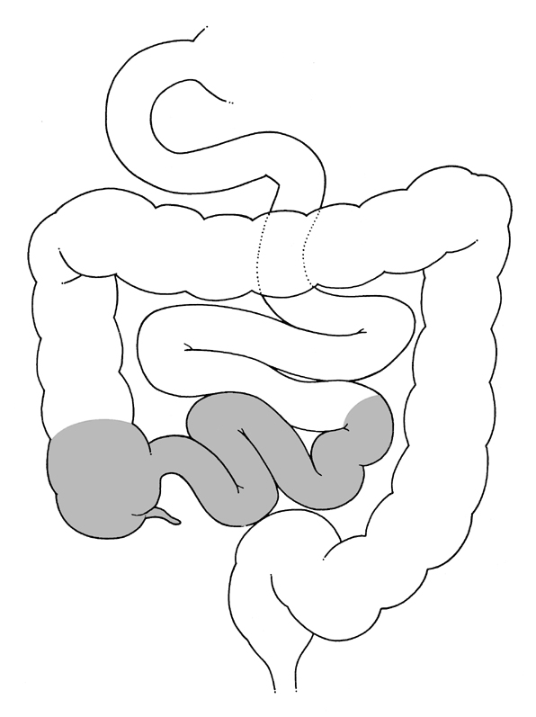
The Distal Intestinal Obstruction Syndrome: Site of Obstruction
Ileum
Caecum
Rectum

Slide 30
Distal Intestinal Obstruction Syndrome in CF
Overall Incidence
Evidence in 15-20% cases
Partial/complete obstruction 2-3%

Slide 31
Distal Intestinal Obstruction Syndrome
Predisposing Factors:-
Dehydration
Poor control of pancreatic insufficiency
Gut motility dysfunction
Low intestinal PH

Slide 32
Distal Intestinal Obstruction Syndrome
Clinical Presentation:-
Variable course and severity
Frequently chronic and recurrent
May range from minor symptoms to frank small bowel obstruction

Slide 33
Distal Intestinal Obstruction Syndrome in Cystic Fibrosis

Slide 34
Cystic Fibrosis Summary
Most common lethal recesive gene mutation.
Mutations coding for the CFTR.
Regulates chloride and bicarbonate secretion from epethelial cells.
Well documented genotype-phenotype relationships.
Clinical course dominated by pulmonary disease.
Significant pancreas ,liver and gastrointestinal involvement.

