Slide 1
BSc in Gastroenterology
Calcium, vitamin D and osteoporosis
29 October 2012
Professor Julian RF Walters
Gastroenterology
Hammersmith Hospital
Imperial College London

Slide 2
CALCIUM, VITAMIN D & OSTEOPOROSIS
Calcium homeostasis
Vitamin D
Calcium absorption
Regulation
Mechanisms
Bone mineralisation
GI disease & osteoporosis
Prevention of osteoporosis
Dietary supplements
Vitamin D & other GI disease

Slide 3
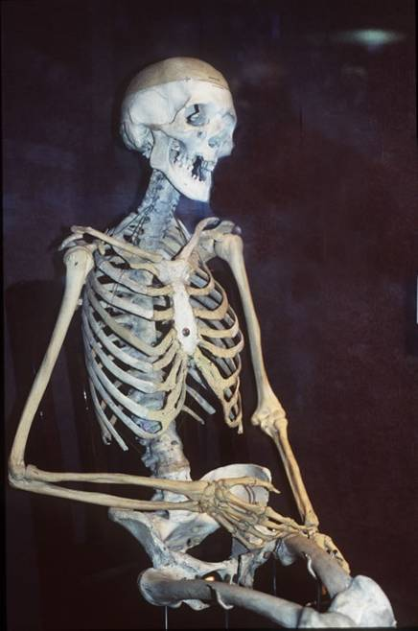
Vitamin D & Calcium
Calcium
Total in adults ~ 1kg
~99% in bones
Crucial roles in intracellular signalling
Absorption from diet by intestine
Vitamin D
Classical actions in intestine, kidney & bone

Slide 4
Calcium Kinetics
99% of calcium is in bone
Blood levels carefully regulated
Absorption of dietary calcium in the intestine
Renal excretion & control
DIET
KIDNEY
INTESTINE
Blood
Ca²⁺
(1g)
BONE
1000g = 1kg
SKIN
OTHER TISSUES
(14g)

Slide 5
Calcium Fluxes (mg/d)
DIET
300 - 1300
KIDNEY
INTESTINE
100 - 200
10000
Blood
Ca²⁺
(1g)
9850
200 - 500
500
150 +
500
BONE
(1000g)
SKIN
OTHER TISSUES
(14g)
200 - 1000
25

Slide 6
Calcium Requirements Change
Childhood & Adolescence
to attain Peak Bone mass
Pregnancy & Lactation
increased needs for infant
Post-menopause & Elderly
to prevent loss of bone mineral

Slide 7
Calcium Fluxes (mg/d) Pregnancy & Lactation
FETUS
(30g)
MILK
DIET
SUPPLEMENTS
260
300 - 1300
500 - 1000
KIDNEY
INTESTINE
100 - 200
10000
Blood
Ca²⁺
(1g)
9850
200 - 800
500
150 +
500
BONE
(1000g)
SKIN
OTHER TISSUES
(14g)
200 - 1000
25

Slide 8
Factors Affecting Intestinal Calcium Absorption
Dietary sources of calcium
Differing dietary calcium intake from various foods
Differing availability of calcium
Solubility in gastric acid
Greatest rates of absorption in duodenum & proximal jejunum
Transit times
Specific genes expressed in this region
Regulation by the vitamin D hormonal system
1,25-dihydroxyvitamin D₃

Slide 9
HOW TO MAKE VITAMIN D

Slide 10
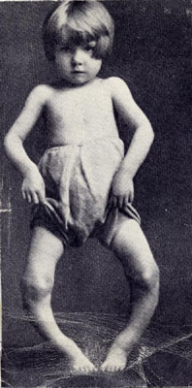
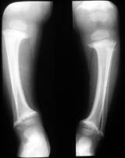
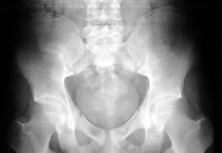
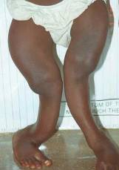
Rickets & Osteomalacia
Rickets in sunlight (vitamin D) deficient children
Osteomalacia in sunlight (vitamin D) deficient adults

Slide 11
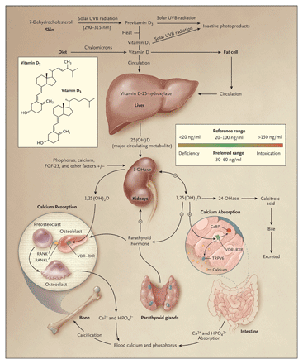
Classic Vitamin D
Holick NEJM 2007
Classic actions but much not properly understood and much else too ..

Slide 12
Vitamin D Metabolites
Vitamin D
(calciferol, ergocalciferol, cholecalciferol)
Skin synthesis (+ diet)
25-hydroxy vitamin D
Hepatic synthesis
Main storage form
1,25-dihydroxy vitamin D
(1,25(OH)₂D₃ Cholecalciferol, calcitriol)
Renal synthesis + other tissues
Hormonal active form
24,25-dihydroxy vitamin D
Inactive breakdown metabolites
1,24,25-trihydroxy vitamin D
24-hydroxylase is expressed in vitamin D target tissues
1,25(OH)₂D₃ dependent

Slide 13
Vitamin D Receptor
Intracellular “steroid hormone” family receptor
Binds 1,25-(OH)₂D₃
Dimerisation with retinoid X receptor
9-cis retinoic acid
1,25-(OH)2D3
Retinoid X receptor
Vitamin D receptor
Transcription activation of target genes with vitamin D response elements

Slide 14
GENE EXPRESSION
Transcription activation
RNA polymerase
PROMOTER ELEMENTS
DNA
TATA
Transcription
PreRNA
Post-transcriptional processing
mRNA
AAAAAAA
Translation
Protein

Slide 15
Vitamin D Response Elements (VDRE)
Heterodimers of VDR with RXRα:
Direct Repeat spaced by 3 (DR3) – consensus RGKTSA
AGGTCA nnn AGGTCA
? Inverted Palindrome spaced by 9 (IP9)
TGACCT nnnnnnnnn AGGTCA
Genes with VDRE:
24-OHase
TRPV6
Osteocalcin, Osteopontin
PTH
Cathelicidin
c-Fos, β2-integrin etc.

Slide 16
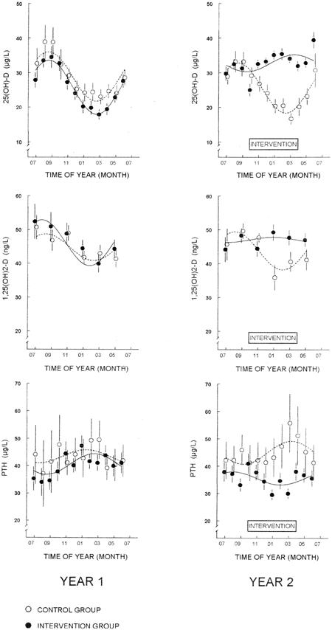
Seasonal variation
Vitamin D synthesis in skin dependent on UV light
Insufficient energy in light (& reduced exposure) in winter months
Blood 25(OH)-D levels fall from September to March
Changes in 1,25(OH)₂D & PTH
Vitamin D (500IU) & Ca (500mg) supplements prevent the changes
Meier et al. JBMR 2004

Slide 17
HYPOCALCAEMIA AND VITAMIN D
1. Classical vitamin D deficiency:
↓↓ vitamin D → ↓ 1,25 (OH)₂D₃ → ↓ Ca²⁺ absorption
2. Calcium deficiency producing vitamin D deficiency
Ca²⁺ malabsorption → ↓ serum Ca²⁺ → ↑ PTH
↑ PTH → ↑ renal 1α hydroxylase → ↑ 1,25 (OH)₂D₃
↑ 24-hydroxylase → ↑catabolism of vitamin D metabolites
↓ stores of vitamin D and 25 (OH)-vitamin D

Slide 18
Actions of Vitamin D
Classical tissues
Intestine
Kidney
Bone
Immune functions
Macrophages, monocytes, dendritic cells (sarcoid, TB)
Lymphocytes (autoimmune disorders)
Proliferation / cancer prevention
Skin (psoriasis)
Colorectal cancer
Breast cancer

Slide 19
Intestinal Fractional Calcium Absorption in “Normal” Humans
Proportion of calcium in GI tract absorbed
Considerable variation in fractional calcium absorption between individuals (10-50%)
The active metabolite of vitamin D, 1,25(OH)₂D₃, is important for calcium absorption, but studies have suggested that much of the variability in human fractional calcium absorption is not due to this, or other known factors.

Slide 20
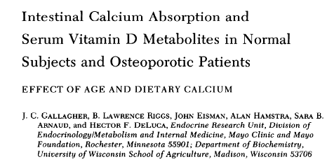
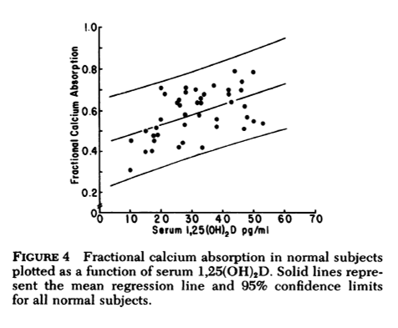
Human Calcium Absorption & 1,25(OH)₂D
Gallagher et al. J Clin Invest 1979
Fractional Calcium Absorption
100mg dose without food
6h determination

Slide 21
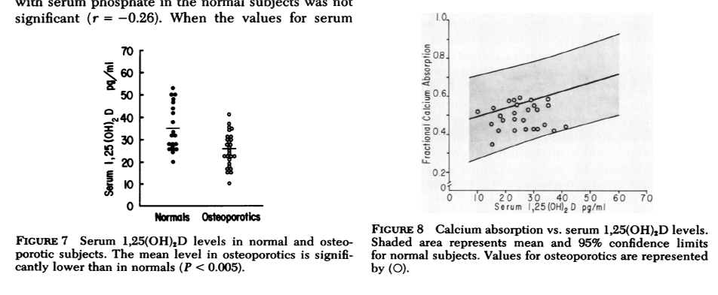
Human Calcium Absorption & 1,25(OH)₂D: Osteoporotics
Gallagher et al. J Clin Invest 1979

Slide 22
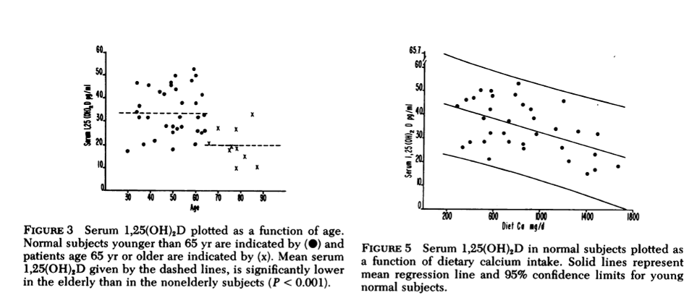
Human Calcium Absorption & 1,25(OH)₂D: Age & Diet
Gallagher et al. J Clin Invest 1979

Slide 23
Factors Determining Fractional Calcium Absorption
An investigation of sources of variation in calcium absorption efficiency
Barger-Lux et al. 1995
41 healthy premenopausal women
Fractional Calcium Absorption, 200 mg dose with food
5h determination
Mean absorption fraction = 42 ± 8%
Positively correlated with:
Urinary calcium/creatinine ratio (r = 0.45)
Mouth-caecal transit time (r = 0.38)
25(OH) vitamin D
No correlation with:
1,25(OH)₂D₃
Vitamin D receptor levels
Model explains only 44% of observed variation

Slide 24
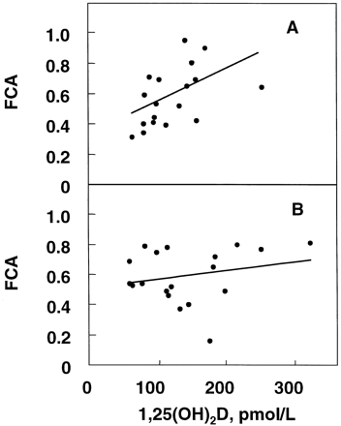
Evidence for Age-related Intestinal Resistance to 1,25-(OH)₂D
Pattanaungkul 2000
Young women 29 ± 5
Elderly women 73 ± 3
5 different calcium diets or 1,25(OH)₂D supplements
Fractional calcium absorption:
Dual label staple isotope
100mg, 4h measurement

Slide 25
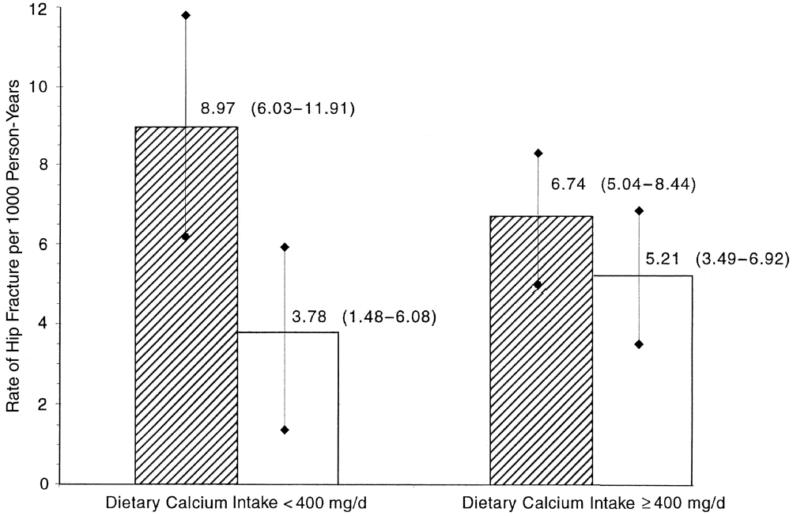
Calcium absorption and fractures
The incidence of hip fractures is significantly increased (2.5x) in healthy elderly subjects with:
Low fractional calcium absorption (< 32.3% vs > 32.3%)
Low dietary calcium intake (< 400 mg/d vs > 400 mg/d)
(153 hip fractures in 5452 women over 69 years of age)
Ensrud et al. 2000

Slide 26
CALCIUM ABSORPTION BY THE INTESTINE
10⁻³ M
TRPV6
10⁻⁷ M
Calbindin
ADP
PMCA1
ATP
10⁻³ M

Slide 27
Calcium pump in the Intestine – Summary
Energy-dependent step in active transport of calcium
Basolateral membrane location
Expression greatest in duodenum
Co-localised with calbindin-D9k
PMCA1 (ATP2B1) isoform
Minimal stimulation of expression by 1,25(OH)₂D₃

Slide 28
Human Calbindin-D9k – Summary
Buffers intracellular calcium
Calbindin-D9k 10⁻³ M
Free calcium 10⁻⁷ M
Expression correlates with 1,25(OH)₂D₃
Mechanism for vitamin D responsiveness still unclear
Proximal intestinal expression
Little evidence for expression in other tissues in humans
(uterus, placenta, kidney in mice)

Slide 29
Human Epithelial Apical Membrane Calcium Transport Proteins
TRPV6 transcripts in normal human duoudenum are:
variable
correlated with calbindin-D9k
highly correlated with PMCA1 transcript expression.
This suggests fundamental mechanisms regulating the expression of TRPV6 and PMCA1 – the two genes whose products control calcium entry and exit from the enterocyte.
Barley et al 2001

Slide 30
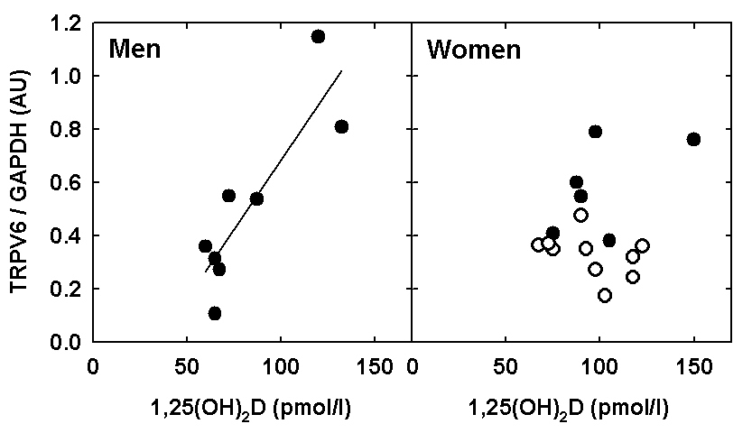
Duodenal TRPV6 Expression: Differences in 1,25(OH)₂D₃ dependence
Men: r = 0.87, p < 0.01
Women: r = 0.20, p = NS
Walters et al. 2006

Slide 31
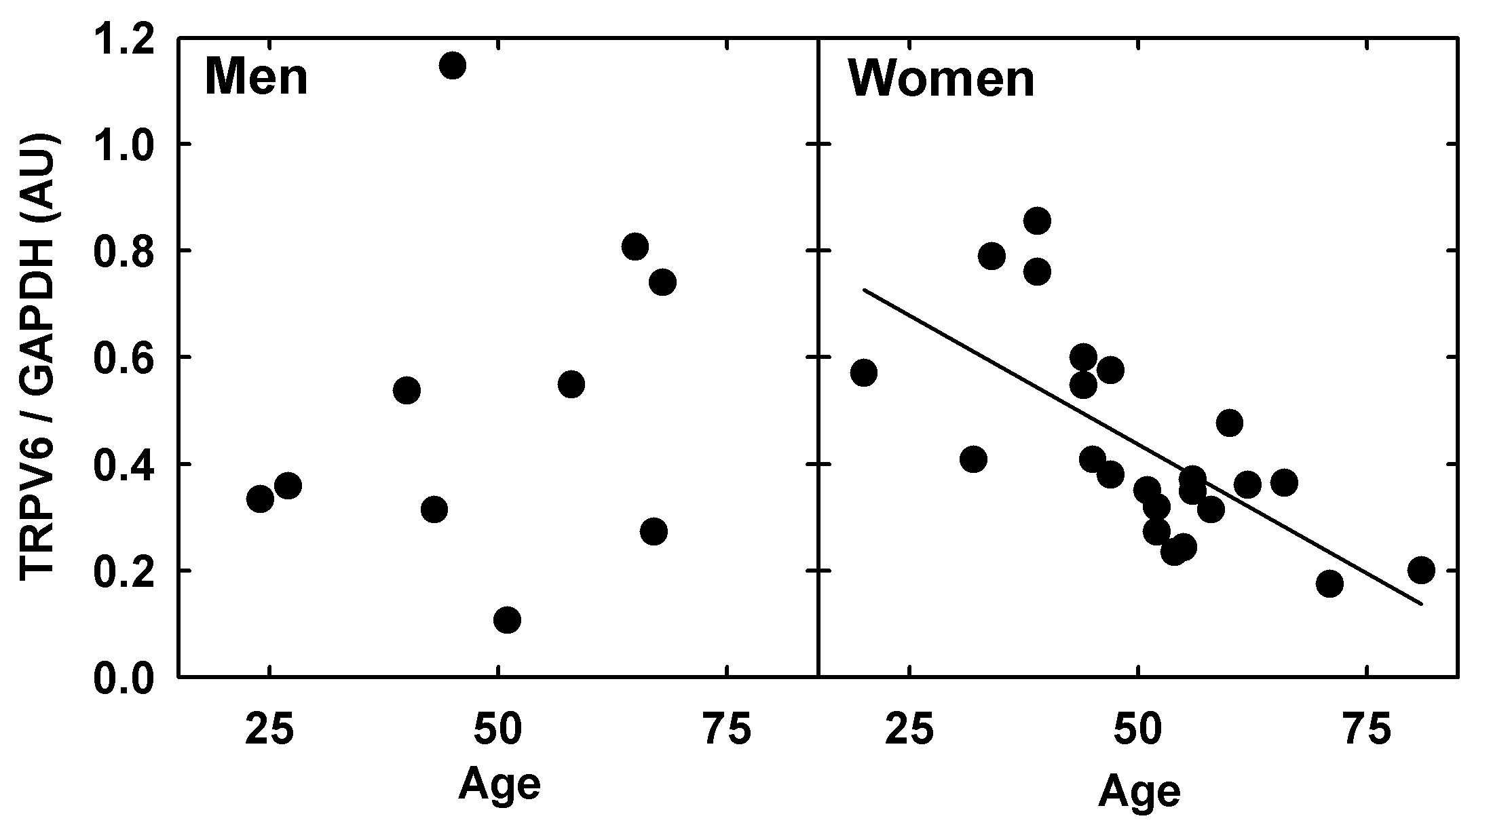
Duodenal TRPV6 Expression: Age and sex differences
Men: r = 0.24, p = NS
Women: r =-0.69, p < 0.001
Walters et al. 2006

Slide 32
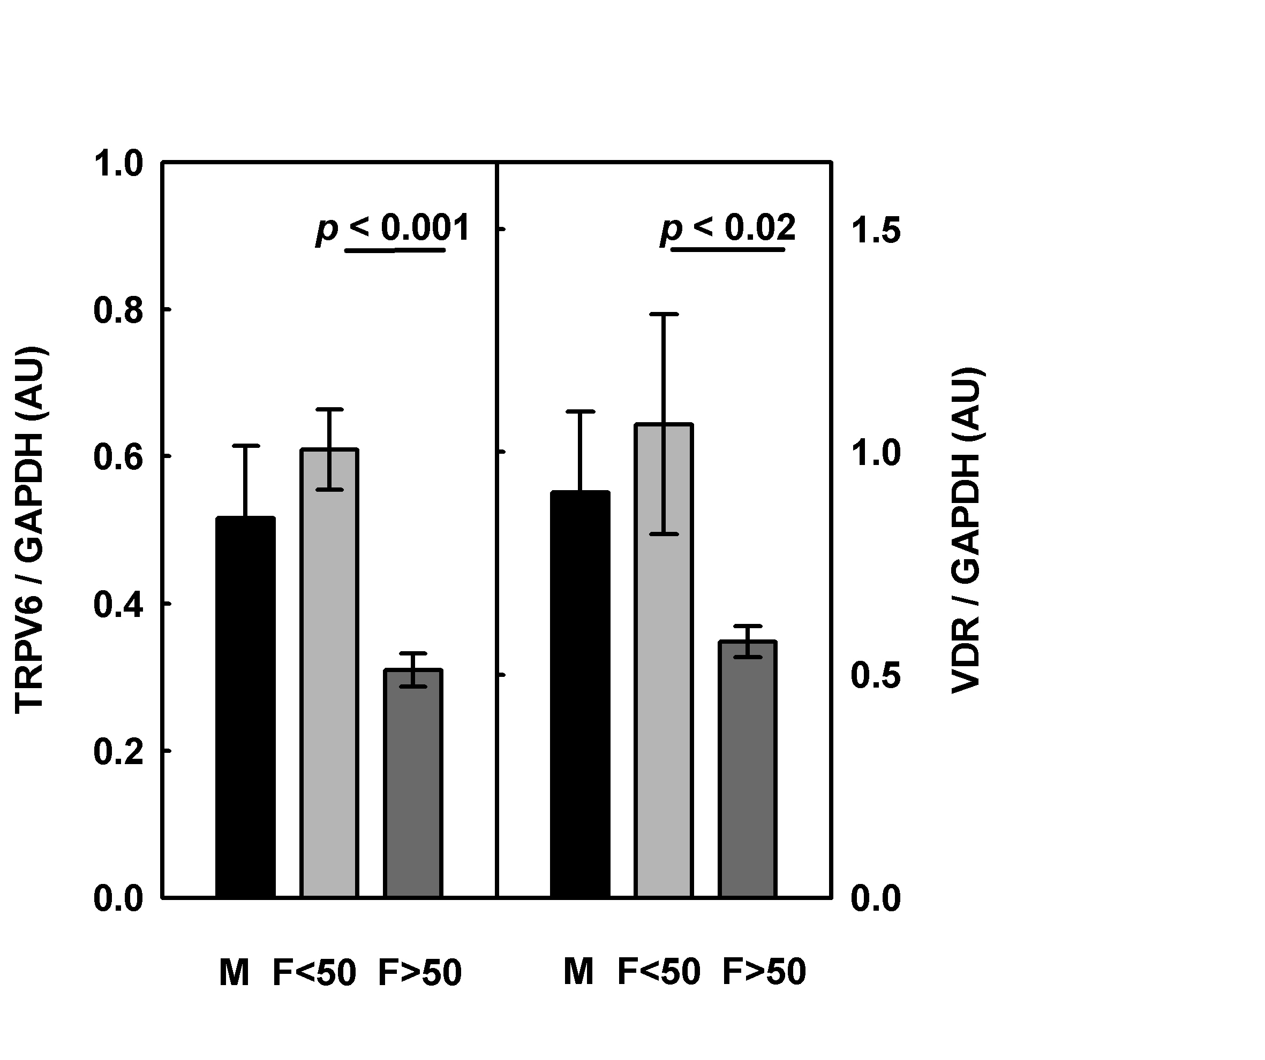
Duodenal TRPV6 & VDR Expression is Reduced in Older Females
TRPV6 and VDR transcripts are both decreased in older (postmenopausal) females
VDR and TRPV6 are strongly correlated (p < 0.01)
Oestrogen levels may affect VDR (and TRPV6) expression
These findings can explain the vitamin D resistance and lower calcium absorption found in older women
Means ± SEM; n = 6-13
Walters et al. 2006

Slide 33
TRPV6, Calbindin-D9k & PMCA1b mRNA in Vitamin D-Receptor Knock-out Mice
Van Cromphaut et al 2001
TRPV6 Calbindin-D9k PMCA1b
VDR KO strain
Leuven Tokyo
VDR KO strain
Leuven Tokyo
VDR KO strain
Leuven Tokyo

Slide 34
Summary of Findings in Vitamin D Receptor Knock-out Mice
Impaired growth, bone formation, uterine hypoplasia, alopecia
Phenotype (bones & growth retardation) can be rescued by high calcium diet
Calbindin-D9k (C9K) is absent from kidney and reduced, but not absent, from intestine
TRPV6 virtually absent
Similar findings in humans with
“vitamin D-resistant rickets”
and VDR mutations

Slide 35
Variables affecting Vitamin D-Dependent Gene Expression
1,25(OH)₂D₃ concentrations
Plasma levels
Local tissue production / metabolism
Cellular uptake
Vitamin D receptor
Concentration
Polymorphisms
Differential splicing
Other ligands
Bile acids
VDRE affinity
RXR / co-activators / co-repressors

Slide 36
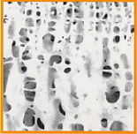
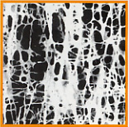
Osteoporotic Bone
Normal
Osteoporotic

Slide 37
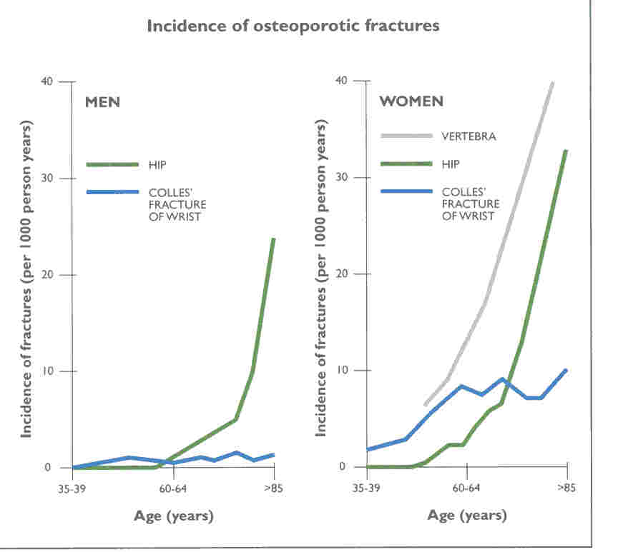

Slide 38
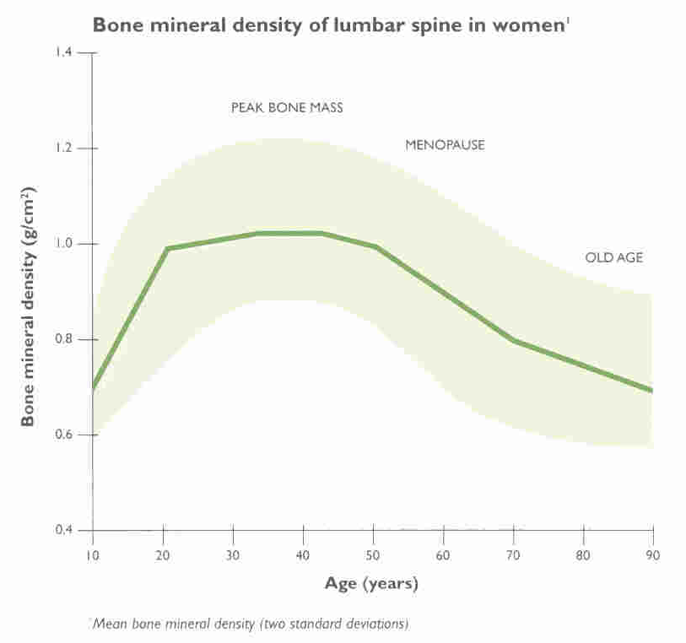

Slide 39
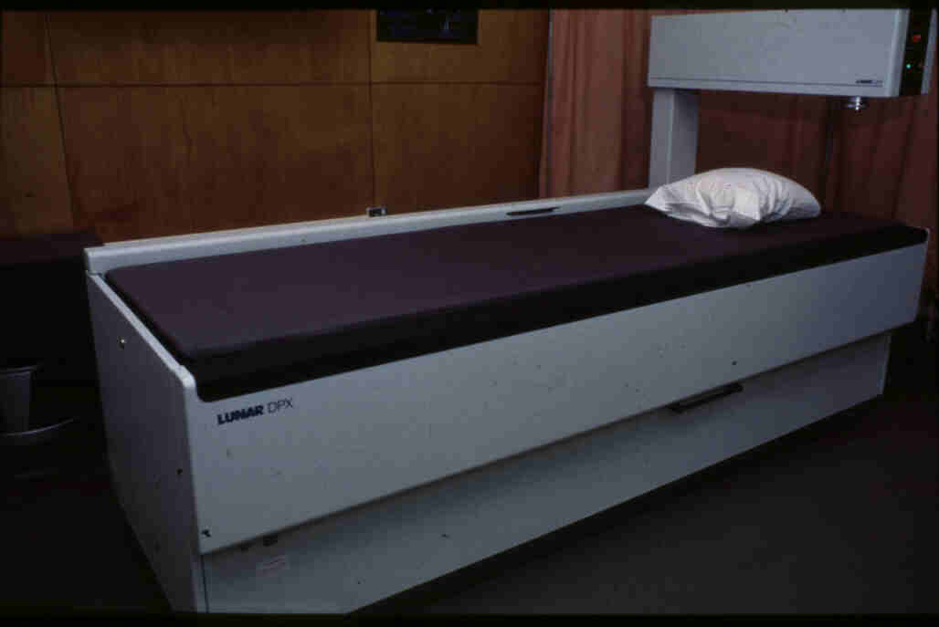
DETECTION OF OSTEOPOROSIS
Dual-energy X-ray absorptiometry
Simple
Cheap
Low radiation
Regions / total body
Bone Mineral Density

Slide 43
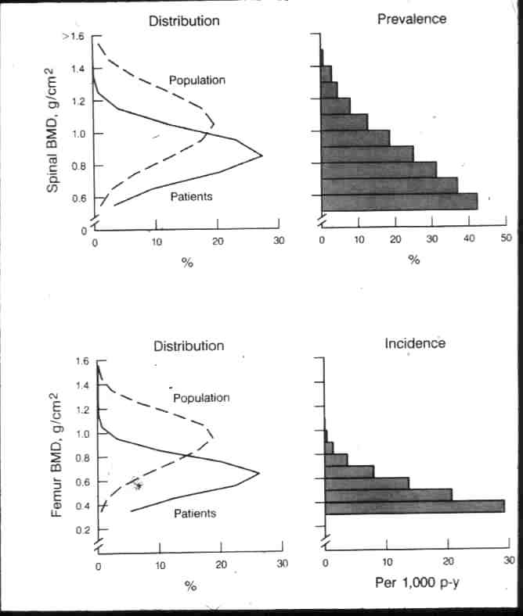
Prevalence of Osteoporotic Fractures Increases as Bone Mineral Density Decreases

Slide 44
Definitions
Z-score: Age-matched normal standard deviate
T-score: Young adult normal standard deviate
WHO Definitions
Osteopenia T between –1 and –2.5
Osteoporosis T below –2.5
(using Caucasian women)
Consider:
normal distribution
normal / abnormal ageing
other ethnic groups
men …

Slide 45
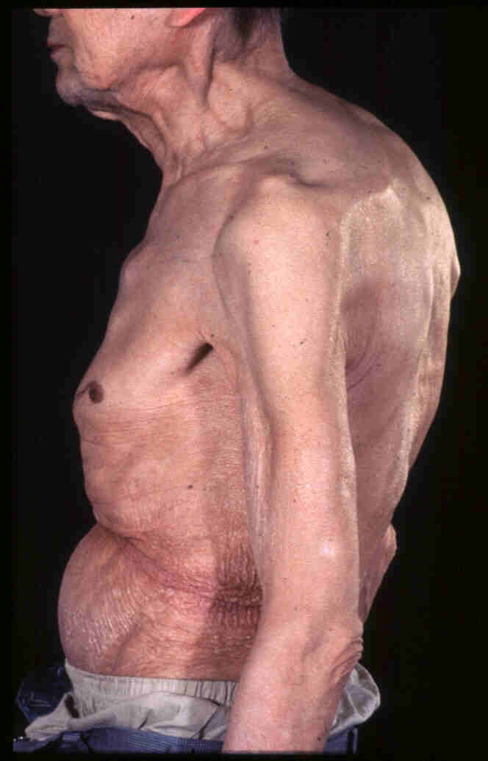
Osteoporosis in Gastroenterology
Coeliac disease
Crohn's / UC
(Steroid treatment)
Liver disease
Chronic pancreatitis
Post-gastrectomy

Slide 46
Osteoporosis in Coeliac Disease: Intestinal factors
Calcium malabsorption
Loss of proximal villous cells
Binding to unabsorbed fatty acids
? Reduced expression of specific proteins
Calcium deficiency
Gluten Free Diet
Associated lactose intolerance
Vitamin D deficiency
From reduced sunlight exposure
From secondary hyperparathyroidism

Slide 47
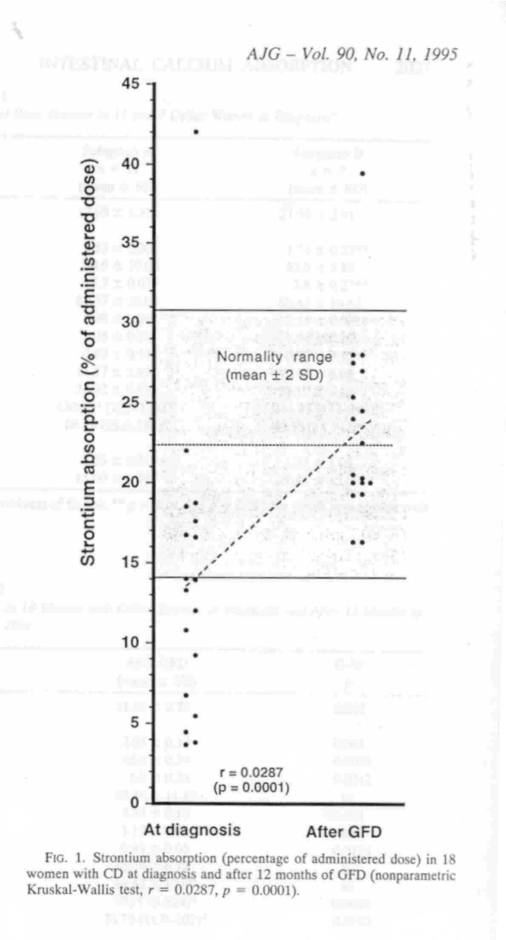
CALCIUM ABSORPTION IS REDUCED IN UNTREATED COELIAC DISEASE
18 Females with newly diagnosed coeliac disease and 12 months after GFD
Molteni et al Am J Gastro 1995

Slide 48
Osteoporosis in Coeliac Disease: Non-intestinal factors
Generalised malnutrition / low BMI
Reduced (bone) growth factors
IGF1
Increased bone resorption
Cytokines
Secondary hyperparathyroidism
Reduced physical activity
Hypogonadism
Low testosterone in men
Delayed menarche
Early menopause

Slide 49
COELIAC DISEASE IN OSTEOPOROSIS
Subjects recruited at DXA scan:
Sanders et al. Dig Dis Sci 2005
All new coeliacs had GI symptoms or anaemia
 | Number | F / M | Coeliac Prevalence %
Osteoporosis | 243 | 231 / 12 | 5 | 2.1%
Osteopenia | 431 | 416 / 15 | 5 | 1.2%
Normal | 304 | 289 / 15 | 2 | 0.7%
Total | 978 | 936 / 42 | 12 | 1.2%

Slide 50
Fractures in Coeliac Disease
UK GP Research Database: 4732 Coeliacs, 1987-2002
West et al. Gastro 2003
Variable | n | Hazard ratio | 95% CI
Any fracture
Control cohort | 23,616 | 1
Coeliac disease cohort | 4732 | 1.30 | 1.16–1.46
Hip fracture
Control cohort | 23,620 | 1
Coeliac disease cohort | 4732 | 1.90 | 1.20–3.02
Ulna/radius fracture
Control cohort | 23,619 | 1
Coeliac disease cohort | 4732 | 1.77 | 1.35–2.34

Slide 51
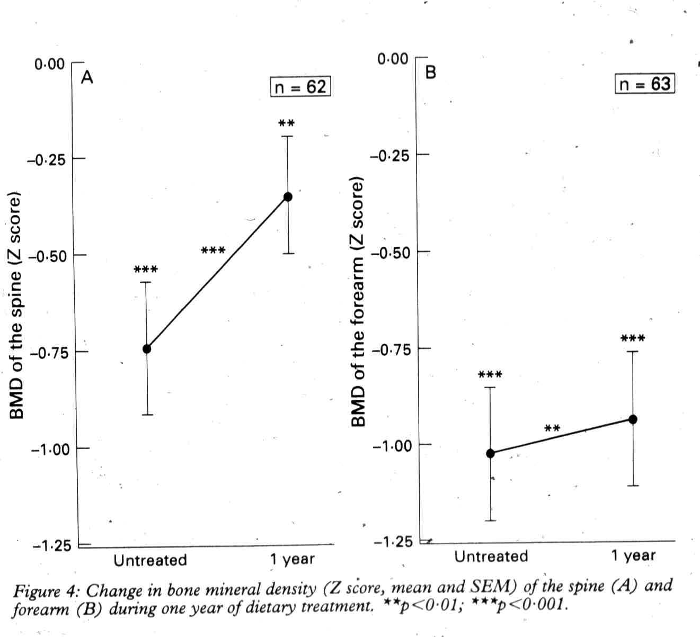
Improvement in BMD in spine and forearm with GFD for one year in new coeliacs
Valdimarsson et al

Slide 52
Summary Strategy for Prevention & Treatment of Osteoporosis in Coeliac Disease
General advice
Strict GFD
Adequate Ca²⁺ intake
Exercise
No smoking
No alcohol excess
Seek & treat vitamin D deficiency
Measure BMD at diagnosis; if low reinforce above
Postmenopausal women
Measure BMD at menopause
If OP, consider Bisphosphonate,
Sr, HRT
Men > 55yrs
Measure BMD
If OP, consider Bisphosphonate, Sr
All with fragility fracture
Measure BMD
If OP, consider Bisphosphonate, Sr
Consider adding others if on HRT
Duration of treatment
For Bisphosphonates, measure yearly BMD
If BMD falls > 4%, change ...
Rationalise BSG Coeliac OP Guidelines with new NICE Guidelines for OP

Slide 53
OSTEOPOROSIS IN COELIAC DISEASE Summary
Untreated coeliacs have reduced bone mineralisation
BMD improves after treatment with GFD for 1 year
Some "treated" patients have reduced BMD
this can only be determined by DXA
Treated patients who have reduced BMD have persistent villous atrophy
Need better diets

Slide 54
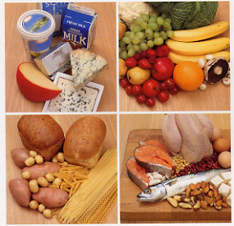
Osteoporosis and Diet

Slide 55
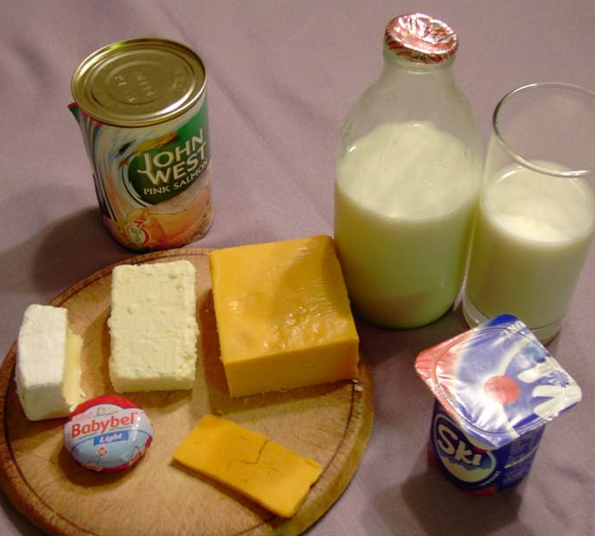
FOOD SOURCES OF CALCIUM
Elemental Calcium per serving
4 x 100mg
180mg
195mg
150mg

Slide 56
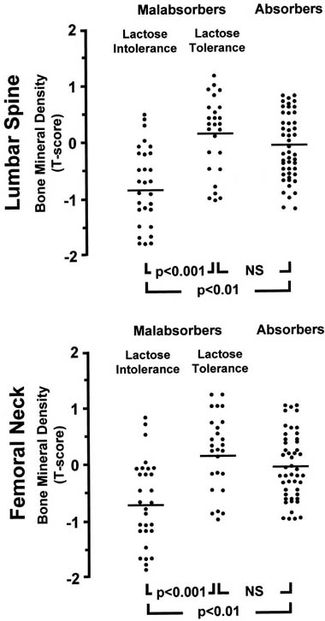
Lactose Intolerance and BMD
Di Stefano 2002

Slide 57
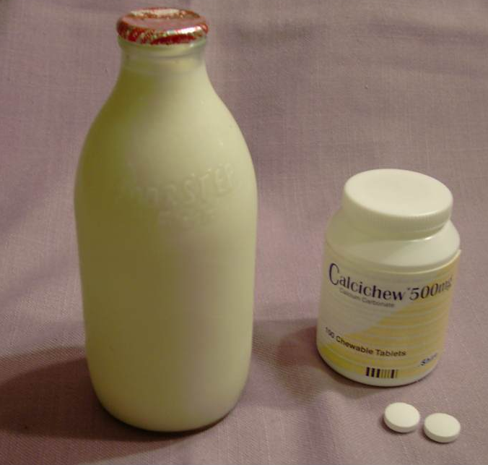
Calcium Supplements
Elemental Calcium
700mg
1000mg

Slide 58
Calcium & Vitamin D Supplements
Usually given together
Evidence for Ca/vit D in fractures, growth, cancer prevention
Benefit in those with deficient intake/synthesis
Malabsorption, low sun exposure
Conflicting evidence of benefit to populations
Not effective in secondary prevention of osteoporotic fractures
RECORD 2005
Reduced fracture risk if 700-800 IU /d of cholecalciferol but not 400 IU/d
Meta-analysis
Bischoff-Ferrari JAMA 2005
No effect on hip fracture of 1g/d Ca + 400 IU/d in 36,000 women
Women’s health Inititative
Jackson et al 2006

Slide 59
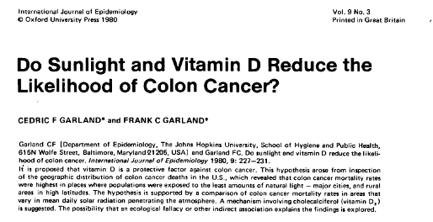
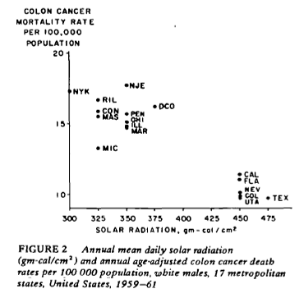
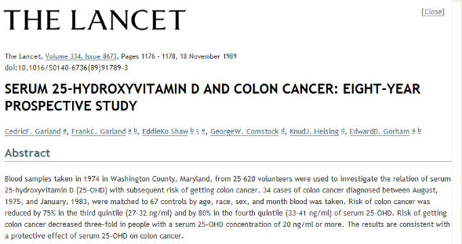
Vitamin D & Colorectal Cancer: Epidemiology

Slide 60
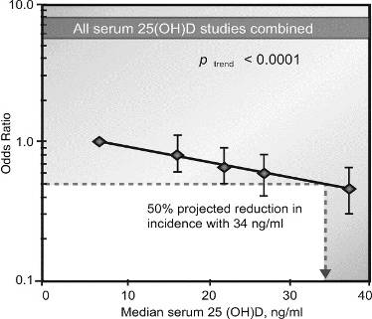
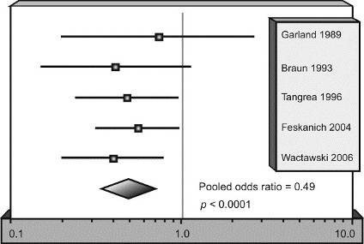
Vitamin D & Colorectal Cancer: Epidemiology
American Journal of Preventive Medicine 2007
Highest vs lowest quintiles

Slide 61
Vitamin D & Colorectal Cancer: Epidemiology
Brit Med J 2010
EPIC cohort
500,000 subjects
>1200 incident CRC
Highest quintile of Serum 25OH D had 40% incidence vs. lowest (p<0.001)
Rectal cancer not significant
Dietary D intake not significant
Significantly positive interactions with high dietary calcium and low retinol

Slide 62
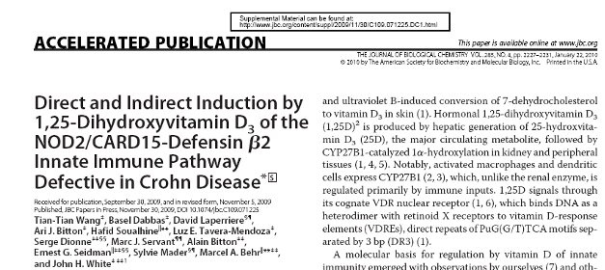
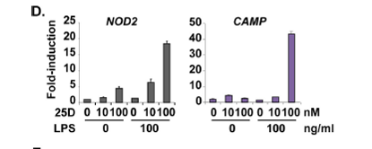
Vitamin D & Crohn’s Disease
J Biol Chem 2010
NOD2 = first gene identified in intestinal Crohn’s
CAMP = cathelicidin antimicrobial peptide

Slide 63
CALCIUM, VITAMIN D & OSTEOPOROSIS
Calcium homeostasis
Vitamin D
Calcium absorption
Regulation
Mechanisms
Bone mineralisation
GI disease & osteoporosis
Prevention of osteoporosis
Dietary supplements
Vitamin D & other GI disease

