Slide 1
BSc in Gastroenterology & Hepatology
Intestinal absorption: normal and abnormal
Monday 15 October 2012
Julian Walters
Hammersmith campus

Slide 2
INTESTINAL ABSORPTION IN HEALTH & DISEASE
Digestion & absorption
Pancreatic and biliary secretion
Duodenum, jejunum, ileum
Regional specialisation
Epithelial cells
Crypt and villus
Apical and basolateral membranes
Specific transport proteins
Diseases causing malabsorption

Slide 3
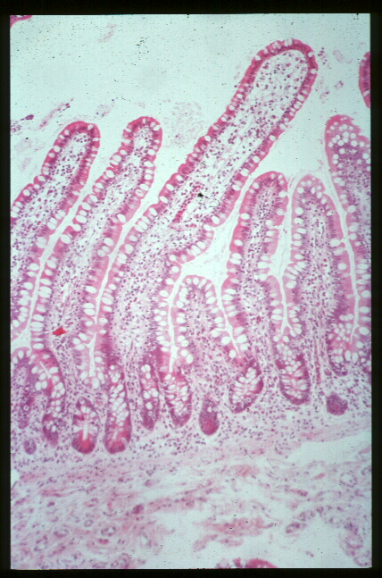
THE INTESTINAL MUCOSA
Villus
Crypt
Muscularis mucosa
Submucosa

Slide 4
THE INTESTINAL MUCOSA
Amplification of surface area by villi

Slide 5
THE INTESTINAL MUCOSA
Further increase in surface area for absorption by microvilli (brush-border membrane) of enterocytes

Slide 6
INTESTINAL SURFACE AREA
Type of Surface | Amplification Factor | Surface Area (cm²)
Mucosal cylinder | 1 | 3,300
Folds of Kerckring | 3 | 10,000
Villi | 10 | 100,000
Microvilli | 20 | 2,000,000
Total surface area = 200 m²
Double tennis court = 175 m²
Notes:
(AGA 25-9)

Slide 7
MECHANISMS OF ABSORPTION
Nutrient absorption results from a complex series of processes:
Digestive enzymes
Gastric
Pancreatic (and biliary secretions)
Intestinal
Transport of the products through the intestinal mucosa
Specific genes are expressed at various sites in the gastro-intestinal tract to produce the proteins involved in digestion and transport

Slide 8
ABSORPTION ALONG LENGTH OF SMALL INTESTINE – GLUCOSE
Duod.
Jejunum
Ileum
100
50
0
% absorbed
Virtually completely absorbed
0 50 100 150 200 250 300
Distance from teeth (cm)
Notes:
(AGA 12-44)

Slide 9
ABSORPTION ALONG LENGTH OF SMALL INTESTINE – PROTEIN
Duod
Jejunum
Ileum
100
50
0
% absorbed
500ml meal
25g protein
Some ileal absorption
20% not absorbed by small intestine
0 50 100 150 200 250 300
Distance from teeth (cm)
Notes:
(AGA 12-42)

Slide 10
ABSORPTION ALONG LENGTH OF SMALL INTESTINE – FATS
Duod.
Jejunum
Ileum
100
50
0
% absorbed
500ml meal
30g fat
Some ileal absorption
5% not absorbed by small intestine
0 50 100 150 200 250 300
Distance from teeth (cm)
Notes:
(AGA 12-45)

Slide 11
Rates of Absorption of Different Nutrients Along the Small Intestine
Duodenum
Jejunum
Ileum
Carbohydrates
Protein & Lipids
Iron & calcium
Bile salts
Cobalamin (B12)
Notes:
(AGA 12-45)

Slide 12
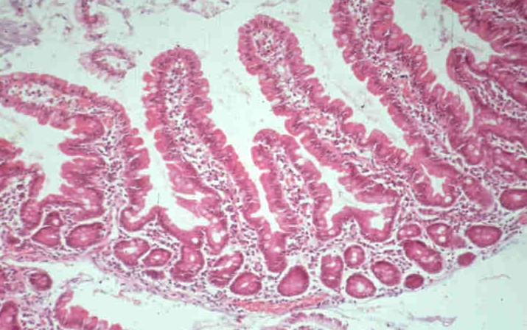
INTESTINAL STRUCTURE
Villus tip enterocytes express the genes that are necessary for active transport

Slide 13
Digestive and transport properties of villus and crypt regions differ
 | Brush border hydrolases | Nutrient transport | Net water & ion transport | Permeability
Villus | Abundant | High | Absorption | Low
Crypt | Sparse | Low | Secretion | High
Notes:
(AGA 25-11)

Slide 14
Cells of the Intestinal Mucosa
Enterocytes
Goblet cells
M-cells
Enteroendocrine cells
Paneth cells
Intra-epithelial lymphocytes (T)
Lamina propria lymphocytes (B)
Dendritic cells
Monocytes
Myofibroblasts
Vascular & lymphatic cells
Neuronal cells etc.
Stem cells

Slide 15
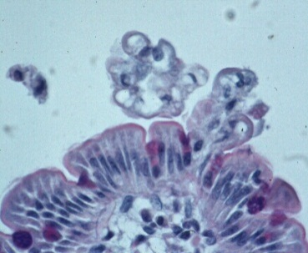
Epithelial Cells Are Continually Renewed
Cell death (apoptosis) and extrusion
Turnover time = 48 – 72 h
Dividing cells
Stem cells
Number of cells lost =
number of cells formed
Notes:
(AGA 25-10)

Slide 16
The Brush-border & Basolateral domains of enterocytes are structurally & functionally distinct
Glycocalyx
Complex cytoskeleton
Specific exchangers & channels
Apical brush-border membrane
Basolateral membrane
Simple cytoskeleton
Different exchangers & ion-pumps
Notes:
(AGA 25-12)

Slide 17
Digestive Processes
Digestion:
Salivary
Gastric
Pancreatic (& biliary) secretions
Intestinal
Absorption:
Brush-border
Cytoplasmic
Basolateral
Post-mucosa

Slide 18
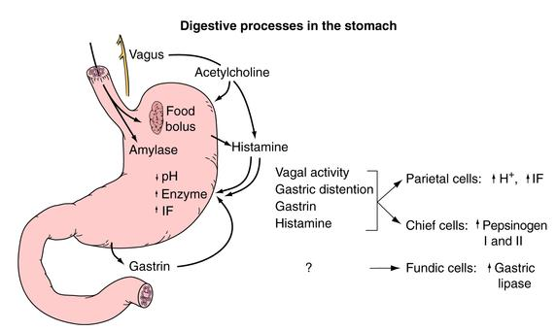
©Copyright Science Press Internet Services

Slide 19
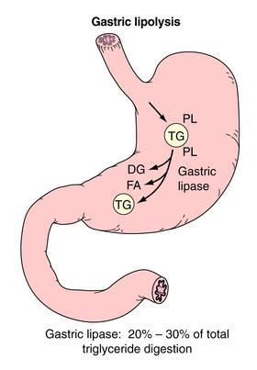
©Copyright Science Press Internet Services

Slide 20
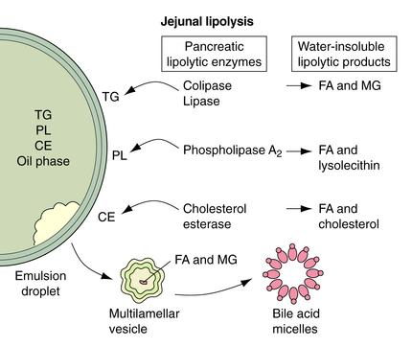
©Copyright Science Press Internet Services

Slide 21
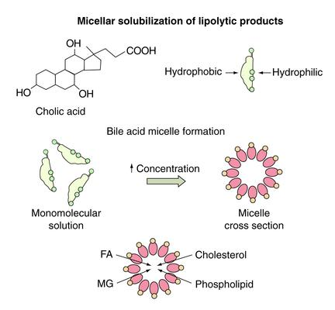
©Copyright Science Press Internet Services

Slide 22
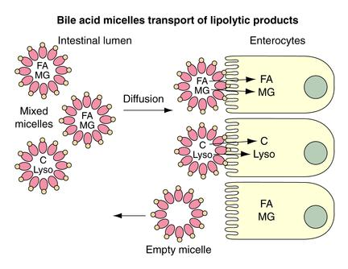
©Copyright Science Press Internet Services

Slide 23
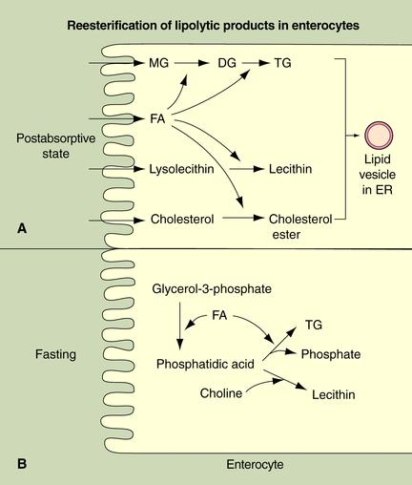
©Copyright Science Press Internet Services

Slide 24
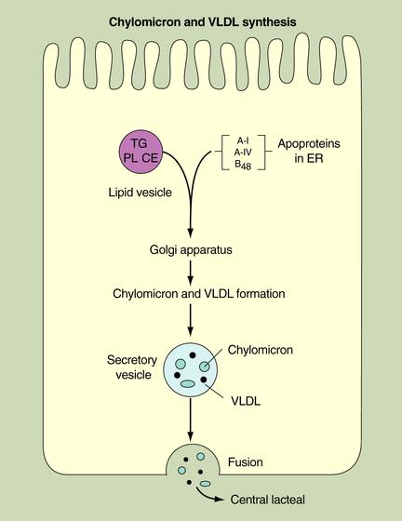
©Copyright Science Press Internet Services

Slide 25
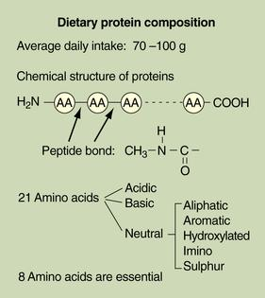
©Copyright Science Press Internet Services

Slide 26
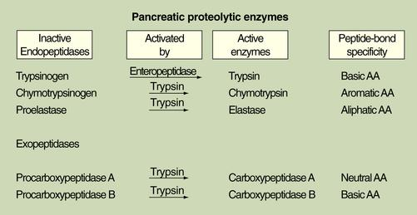
©Copyright Science Press Internet Services

Slide 27
Brush-border Proteolytic Enzymes
©Copyright Science Press Internet Services

Slide 28
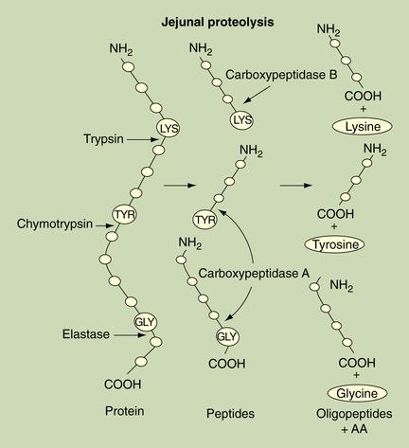
©Copyright Science Press Internet Services

Slide 29
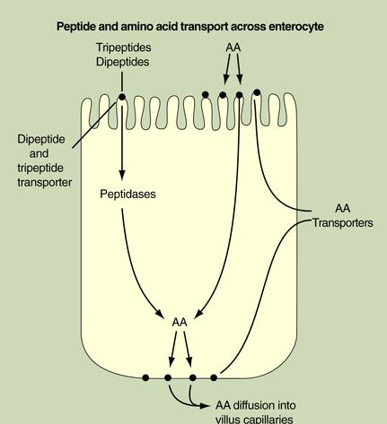
©Copyright Science Press Internet Services

Slide 30
Amino Acid Transport Systems
©Copyright Science Press Internet Services

Slide 31
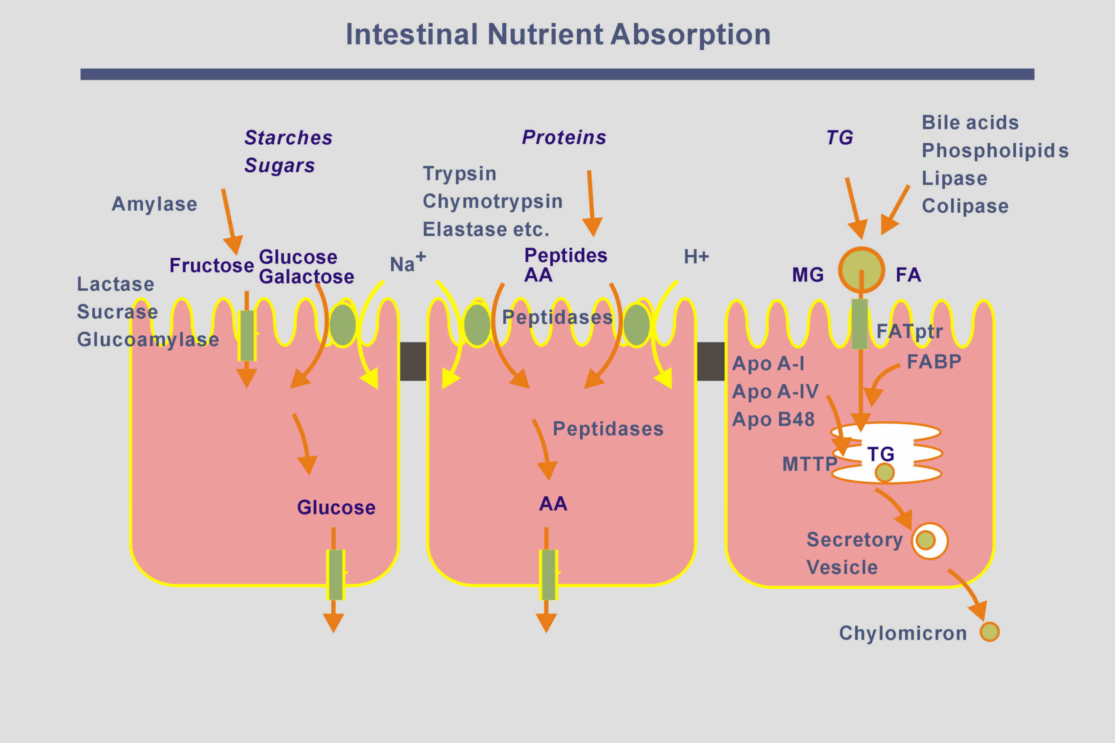
Notes:
Transport pathways in small intestinal enterocytes (CHO, proteins, lipids)

Slide 32
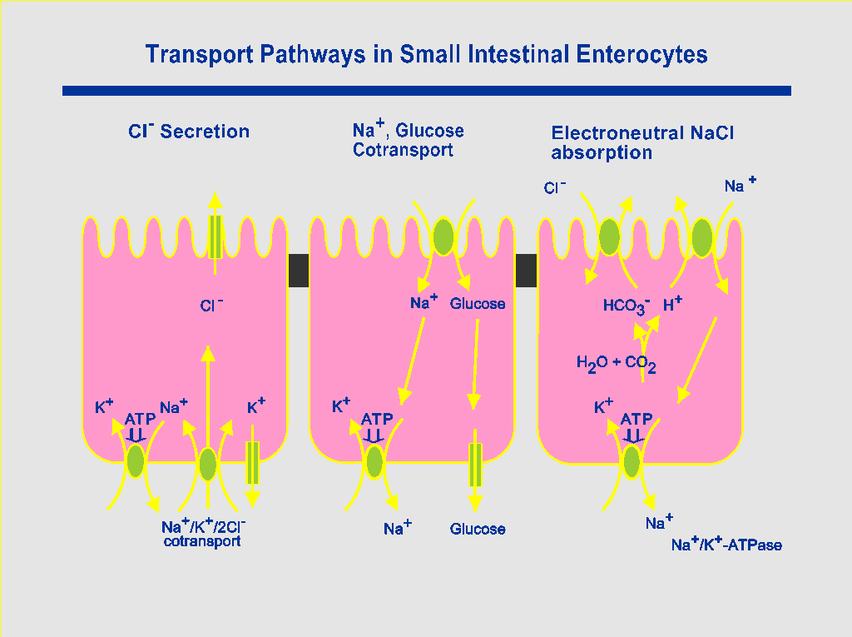
Notes:
Transport pathways in small intestinal enterocytes (NaCl)

Slide 33
Maldigestion & Malabsorption
Abnormal digestion
Reduced gastric tissue/secretion
Loss of pancreatic tissue
Impaired bile secretion
Reduction in intestinal brush-border enzymes
Abnormal absorption
Loss of functional enterocytes
Pre- and post-mucosal effects
Single gene disorders

Slide 34
Malnutrition
?
Increased needs
Insufficient supply
Food intake
?
Malabsorption
Maldigestion

Slide 35
Investigation of Malabsorption
Generalised or specific malabsorption
Nutritional assessment
Is there steatorrhoea?
Is it maldigestion or malabsorption?
Pancreatic
Intestinal
What is the pathology?

Slide 36
Tests for Malabsorbed Nutrients
Fats
Steatorrhoea: clinical +/- faecal fat
Protein & nitrogen
Urinary excretion, albumin
Minerals
Iron, calcium, magnesium, zinc etc.
Vitamins
B₁₂ (cobalamin), D (calciferol), folate, vitamin K

Slide 37
Look for specific causes of malabsorption
Coeliac serology
Tissue transglutaminase
Histology
Duodenal biopsy
Other causes …
Glucose hydrogen breath test
Faecal pancreatic elastase
etc.

Slide 38
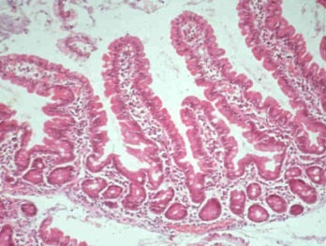
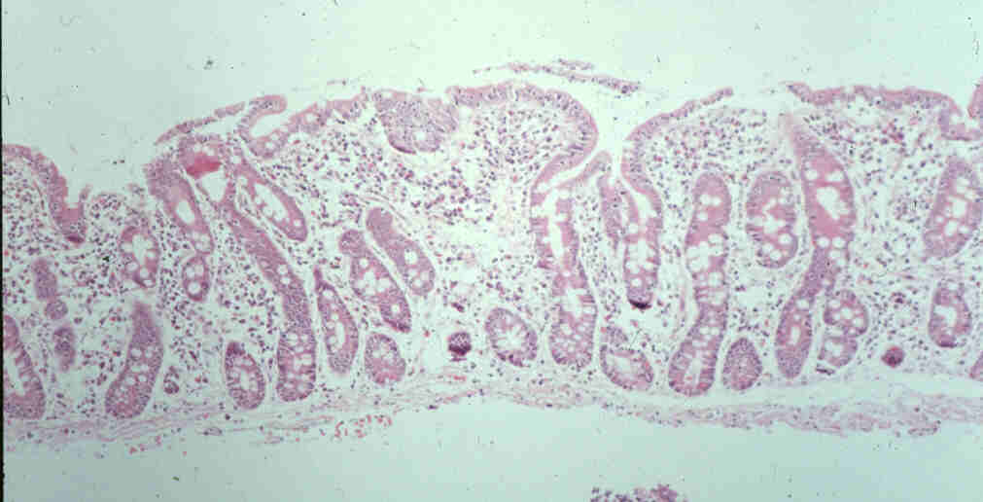
Duodenal Histology
Endoscopic biopsies of mucosa to look for villous atrophy
Normal mucosa Subtotal villous atrophy with crypt hyperplasia

Slide 39
Investigation of Malabsorption – some tests
Tubeless tests
(Xylose absorption)
(Pancreolauryl test)
Schilling test
Fecal Pancreatic Elastase 1
Stable during passage through GI tract
Small sample of stool collected
Monoclonal antibody to human protein - ELISA
High sensitivity and specificity for diagnosing pancreatic insufficiency
Values below 200 µg elastase/g stool indicate exocrine pancreatic insufficiency

Slide 40
Vitamin B12 Absorption: Schilling Test
Part 1
Large dose B12 (IM)
Saturate stores in liver
Labelled B12 (orally)
Intrinsic Factor (IF) from stomach
Absorbed in the terminal ileum
Urinary excretion (abnormal if < 8%)

Slide 41
Vitamin B12 Absorption: Schilling Test
Part 2
Labelled B12 (orally) with Intrinsic factor
Absorbed in the normal terminal ileum
Urinary excretion

Slide 42
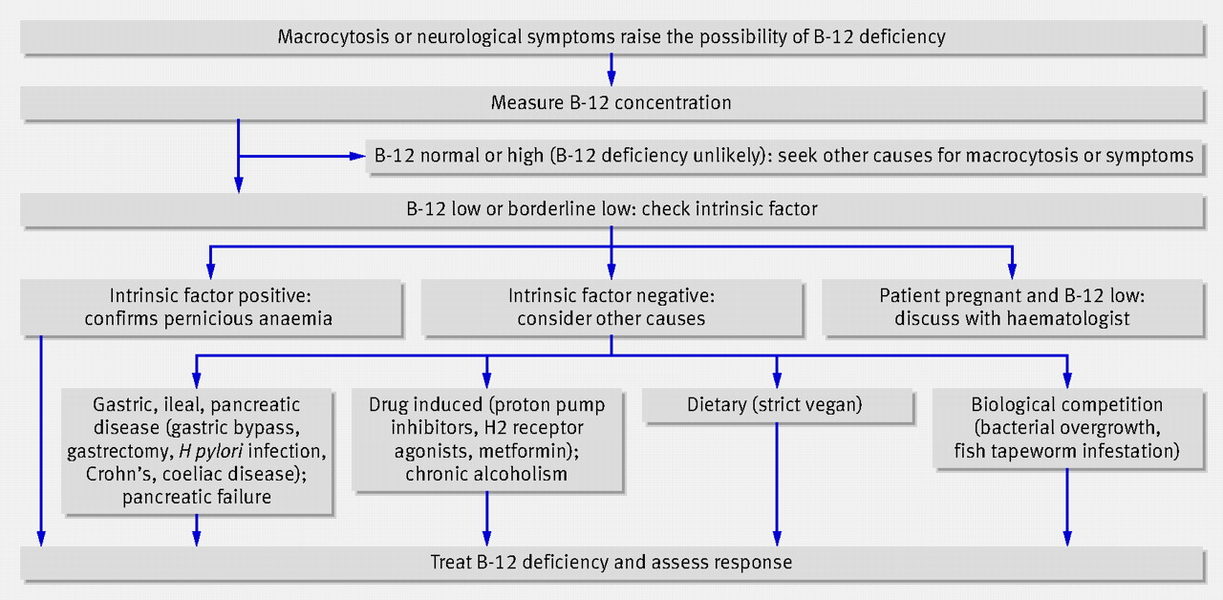
Assessing vitamin B-12 deficiency
Hudson, B. BMJ 2010;340:c2305
Copyright ©2010 BMJ Publishing Group Ltd.

Slide 43
Causes of Malabsorption
Common | Coeliac disease | Gluten sensitive enteropathy
 | Small bowel bacterial overgrowth | Gastric surgery and achlorhydria Intestinal blind loops post-surgery Jejunal diverticula Intestinal strictures Fistulae (as in Crohn's disease) Impaired peristalsis (fibrosis)
 | Pancreatic insufficiency | Chronic pancreatitis Cystic fibrosis

Slide 44
Causes of Malabsorption
Less common | Short bowel syndrome | Intestinal resection for Crohn's disease, mesenteric vascular disease or injury
 | Chronic infections | Tropical sprue Giardiasis, Other parasites (e.g. Strongyloides) Tuberculosis, AIDS, Whipple’s
 | Lymphoma | IPSID, EATL, refractory sprue & ulcerative jejuno-ileitis
 | Radiation enteritis | Fibrosis, Atrophy, Strictures, Lymphangiectasia
 | Intestinal lymphangiectasia | Congenital, Infective, Fibrotic, Malignant, Cardiac
 | Drugs | Orlistat, Laxatives, Neomycin Cholestyramine (and certain others with specific interactions)
 | Allergic | Eosinophilic enteritis, Milk and soya enteropathy Autoimmune enteropathy
 | Immunodeficiency | Congenital, acquired

Slide 45
Common Forms of Malabsorption of Specific Nutrients
Nutrient
Condition
Lactose
Lactase non-persistence
Vitamin B12
Pernicious anaemia
(loss of intrinsic factor)
Bile salts
Bile salt diarrhoea

Slide 46
Rare Inherited Disorders of Intestinal Absorption
Disorders associated with non-functional transporters can present in childhood:
Glucose-galactose malabsorption
Sucrase deficiency
Fructose malabsorption
Cystinuria (Cys, Lys, Arg)
Hartnup disease
(Trp, Phe, his)
Lysinuric protein intolerance
(Lys, Arg)
Blue diaper syndrome (Trp)
Oasthouse urine disease
(Met, Leu, Ile, Val)
Iminoglycinuria (Pro, Gly)
Congenital chloride diarrhoea
Acrodermatitis enteropathica (Zn)
Menkes’s kinky-hair disease (Cu)
Abetalipoproteinaemia and hypolipoproteinaemia

Slide 47
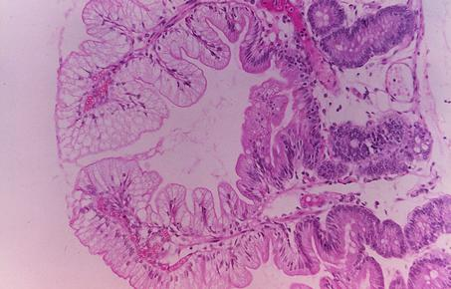
Small Intestinal Biopsy in Abetalipoproteinaemia
Fat droplets in enterocytes
Failure to form chylomicrons
Abnormal MTTP
©Copyright Science Press Internet Services
Notes:
(Courtesy of David R. Mack, MD, University of Nebraska, Omaha, NE.)

Slide 48
Abetalipoproteinaemia – a single gene disorder
Autosomal recessive genetic disorder
Presents in early childhood
Malabsorption of fat and fat-soluble vitamins
mucosa engorged with fat droplets
neuropathy, retinitis pigmentosa, acanthocytosis
Absence of serum chylomicrons, VLDL, LDL containing Apo-B
Apo-B100 in liver, apo-B48 in intestine
mRNA processing occurs in enterocytes
Apo-B48 gene and editing in intestine is normal
Mutations in microsomal triglyceride transport protein
Mutations in apo-B gene cause hypobetalipoproteinaemia

Slide 49
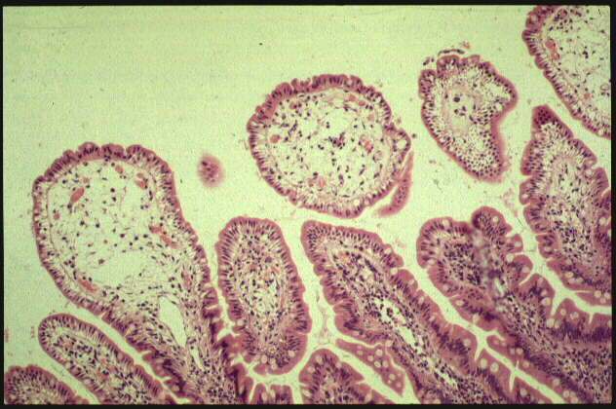
Intestinal Lymphangiectasia
Malabsorption of lipids & fat-soluble vitamins
Loss of protein → protein-losing enteropathy
Loss of lymphocytes → lymphopenia

Slide 50
Intestinal Lymphangiectasia
Primary:
Localized or generalised lymphatic abnormalities
(Milroy's, Noonan's and Di George syndromes)
Secondary:
abdominal / retroperitoneal neoplasia
(carcinoma and lymphoma)
fibrosis
inflammation
infective (TB, filaria, Whipple's etc)
pancreatic, pericarditis, R-sided heart disease

Slide 51
INTESTINAL ABSORPTION IN HEALTH & DISEASE
Digestion & absorption
Pancreatic and biliary secretion
Duodenum, jejunum, ileum
Regional specialisation
Epithelial cells
Crypt and villus
Apical and basolateral membranes
Specific transport proteins
Diseases causing malabsorption

