Slide 1
Stats workshop
Professor Julian Walters
BSc Gastroenterology
Monday 1 October 2011

Slide 2
Why?
Basic background differs
Core knowledge
A-level maths statistics
Other courses
Need to interpret findings in papers
Need to pass exam questions!

Slide 3
BMJ Statistics at Square One
http://www.bmj.com/collections/statsbk/

Slide 4
Statistics at Square One Ninth Edition T D V Swinscow Revised by M J Campbell, University of Southampton Copyright BMJ Publishing Group 1997
1 Data display and summary
2 Mean and standard deviation
3 Populations and samples
4 Statements of probability and confidence intervals
5 Differences between means: type I and type II errors and power
6 Differences between percentages and paired alternatives
7 The t tests
8 The chi-squared tests
9 Exact probability test
10 Rank score tests
11 Correlation and regression
12 Survival analysis
13 Study design and choosing a statistical test

Slide 5
Types of data
Quantitative
Continuous
Discrete
Categorical
Ordered
Nominal

Slide 6
Why do we do statistics?
Mathematical description of a population
Characterisation of the difference in two populations

Slide 7
A few basics
1, 1, 2, 4, 9, 9, 9
Mean
Median
Mode

Slide 8
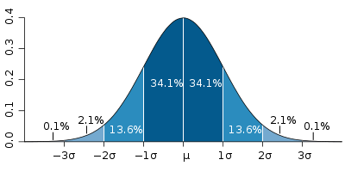
Distribution
Normally distributed
Positive skew
Negative skew

Slide 9
Describe the distribution
Standard deviation vs Standard error
SD - This is descriptive. Summary of the scatter of observations.
SE - This is an inference. Describes the uncertainty about the mean.

Slide 10
Infer they are (not) different populations
You don’t test an entire population, so you want to make inferences about the total population from your sample.
Standard error X 1.96 = 95% confidence interval
T-test, Mann-Whitney

Slide 11
Accepting / rejecting the null hypothesis
Alpha error or Type I error - 5%, false positive, false rejection of null hypothesis.
Beta error or Type II error (1 - beta = Power) - Falsely accepting null hypothesis - 10%.
Multiple testing

Slide 12
How good are our tests?
Sensitivity
Proportion of true positives correctly identified by the test.
Specificity
Proportion of true negatives correctly identified by the test.

Slide 13
How good are our tests?
Positive predictive value
Is the proportion of patients with positive test results who are correctly diagnosed.
Negative predictive value
Is the proportion of patients with negative test results who are correctly diagnosed

Slide 14
How common is the disease?
Prevalence vs Incidence
Prevalence = Total number with disease / Total number of people in the population
Incidence = Number of new diseased in a time period / Total population

Slide 15
Comparing binary outcomes
Odds ratio of rolling a 6
1/5
Relative risk of rolling a 6
1/6

Slide 16
That seems like a good treatment!
Relative risk reduction
RR in the treatment group - RR in control / RR in control
Absolute risk reduction
RR in the treatment - RR in control

Slide 18
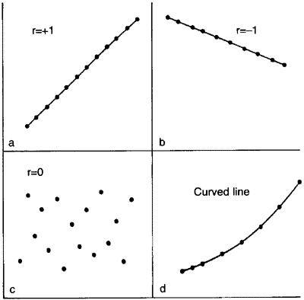
Correlation and regression

Slide 19
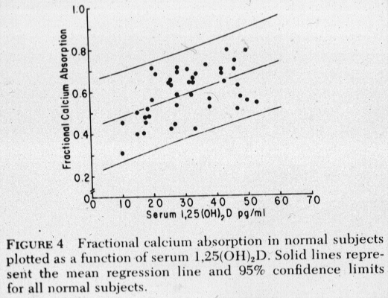

Slide 20
ANOVA
= Analysis of variance
Observed variation e.g. Ca²⁺ absorption
Variance due to independent variables
1,25(OH)₂D
Age
Weight
Calcium intake etc.
Residual variance
Ratio of individual variance to residual variance
“F-tests”

Slide 21
BMJ Endgames: Statistical question Statistical significance and confidence intervals
A prospective population based cohort study investigated the association between occupation and pregnancy outcome for mothers who had missed antenatal visits. The mean birth weight was 3371 g (95% confidence interval 3274 to 3469) and 3227 g (3140 to 3315 g) for babies born to mothers in non-manual and manual jobs, respectively.
On the basis of the above information, which of the following can be deduced for mothers who missed antenatal visits?
a) In the population, 95% of mothers with a non-manual occupation have a baby with a birth weight between 3274 g and 3469 g
b) Because the 95% confidence intervals overlap, the mean difference in birth weight between mothers in non-manual and manual jobs is not statistically significant at the 5% level
c) On average, mothers with a non-manual job had heavier babies than those with a manual job
d) If a mother has a manual job, this will cause her baby to have a lower birth weight than if she had a non-manual job.
BMJ 2009;339:b3401

Slide 22
Answer = c
c—In this sample, babies born to mothers with a non-manual job were heavier than those born to mothers with a manual job by an average of 144 g.
Answer a) is incorrect because the 95% confidence interval does not provide information about the distribution of birth weights in the population. It represents the uncertainty of the sample mean in estimating the population mean.
Answer b) is false because, although the 95% confidence intervals overlap, we cannot infer that the mean difference in birth weight between mothers in non-manual and manual jobs is not statistically significant at the 5% level. For the data presented, the mean difference in birth weight (non-manual minus manual) was 144 g (95% confidence interval 14 to 274; P=0.03). We observe that the mean difference in birth weight is statistically significant at the 5% level. More generally, when 95% confidence intervals for two sample means overlap, it is not possible to make any inference about statistical significance, either present or absent, at the 5% level. However, if the 95% confidence intervals for two means do not overlap, then the mean difference will be statistically significant at the 5% level. When comparing two group means, it is good practice and more informative to present a confidence interval for the mean difference rather than the separate group means.
Answer d) is false because we cannot conclude causation from an observational study. Mothers with a manual job may have had poorer diets, smoked more, and so on, and these factors may have produced the observed difference in birth weight.
BMJ 2009;339:b3401

Slide 23
BMJ Endgames: Statistical question Relative risk reduction and absolute risk reduction
In a trial comparing a drug with a placebo for the prevention of stroke, the incidence of stroke at 1 year was 3% in the group receiving drug A (treatment group) and 4% in the group receiving placebo (control group); P=0.01.
What is the reduction in incidence of stroke in patients treated with drug A compared with those on placebo, and what is the difference in incidence between the two groups?
a) 25% and 1%
b) 50% and 1%
c) 75% and 1%
d) 100% and 1%
BMJ 2009;339:b3626

Slide 24
Answer = a
The reduction in incidence of stroke achieved by treatment with drug A compared with placebo is termed the relative risk reduction. Relative risk reduction is calculated by dividing the difference in event rates between the control and treatment groups by the event rate in the control group. Relative risk is the ratio of event rates in the treatment and control groups; hence relative risk reduction can also be calculated as 1 minus relative risk.
In this example, stroke occurred in 3% of patients treated with drug A compared with 4% of patients on placebo. The relative risk would be 0.75 (0.03/0.04), and the relative risk reduction would be 0.25 (1 minus 0.75) or 25% when expressed in percentage. This means that treatment with drug A reduced incidence of stroke by 25% compared with placebo.
The simple difference between event rates in control group and treatment group is termed absolute risk reduction. In this example, the absolute risk reduction would be 0.01 (0.04 minus 0.03) or 1% when expressed in percentage. This means that one additional stroke would be prevented by treating 100 patients with drug A.
The treatment benefit reported as relative risk reduction generally appears larger than absolute risk reduction, if the event rate is low in the control group. In this example, the relative risk reduction is 25% and absolute risk reduction is 1%. Clinicians can interpret the size of treatment benefit more carefully if they are aware of the difference between relative risk reduction and absolute risk reduction.
BMJ 2009;339:b3626

Slide 25
Statistics programme
Excel data analysis package
Add-ins e.g. Winstat
SPSS
Web-based
SEEK HELP!

Slide 26
Exam format
For each module there will be:
Section 1 (40%)
One essay from a choice of 3 (1 hour and 15 minutes time allocation recommended to students)
Section 2 (30%)
Compulsory data interpretation task which can be one of two types:
a) graphs, tables, and image data for interpretation; and
b) summary of key findings and critical appraisal of a published scientific paper;
Both types of the task should be used in the three papers, one for each Part B module, of the Part B exam, i.e. either two Part B modules offer type 1 and one module – type 2 task or vice versa. (1 hour allocation)
Section 3 (30%)
3 out of 5 short answer questions (45 minutes allocation)
Total exam time 3 hours

