Slide 1
Introduction to neoplasia
Dr Laksh Ayaru (Consultant Gastroenterologist)
September 2012

Slide 2
What is Neoplasia?
Abnormal growth / replication of new cells (non-physiological)
Does not = cancer
Cancer (malignancy) suggests
  irreversible process
  Associated with injury to local or distant tissue
  ‘invasion’ – i.e. malignant cells grow through another tissue

Slide 3
Definitions
Hyperplasia
  Increase in number of cells in a tissue
Hypertrophy
  Increased growth of a tissue
Dysplasia
  Abnormal looking cells
  Nuclear abnormalities
Metaplasia
  Change from one cell type to another

Slide 4
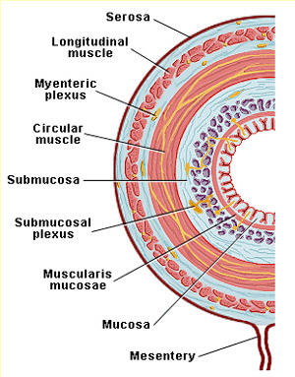

Slide 5
Benign vs. Malignant
Benign
  Uncontrolled growth of a cell line
  Does not invade adjacent structures
  Does not metastasise
Malignant
  Invasion of adjacent structures
    E.g from mucosa into muscularis mucosa
  Metastasis
    Into distant tissues

Slide 6
Carcinogenesis in the GI Tract
Follows 2 basic patterns
  Initiated by chronic inflammation with increased cell turnover and DNA duplication errors
And/Or
  Genetic /environmental factors resulting in DNA errors

Slide 7
Examples

Slide 8
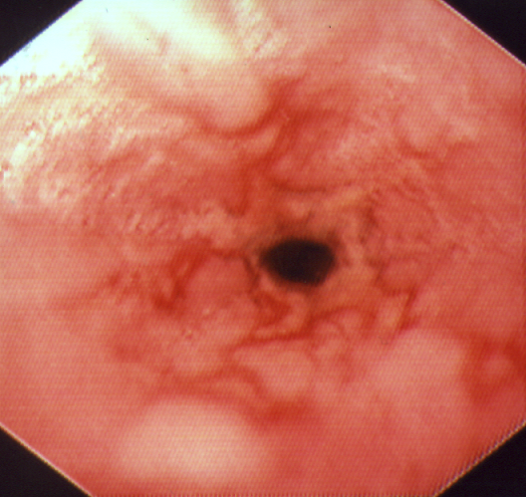
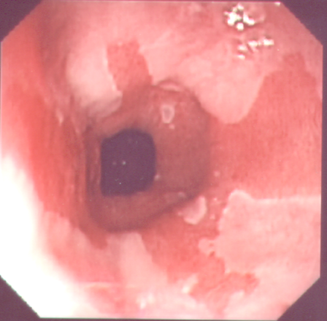
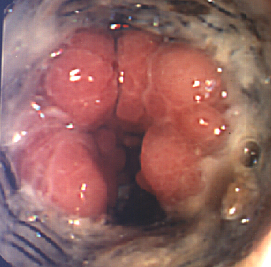
Oesophageal neoplasia
Injury
ongoing inflammation
Cytokine drive
Chronic exposure
To acid
p53 / COX-2
expression
Oesophagitis Barrett’s Carcinoma
(Inflammation) (metaplasia) (neoplasia)

Slide 9
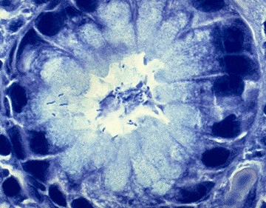
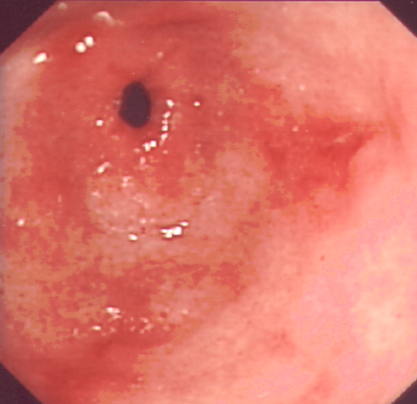
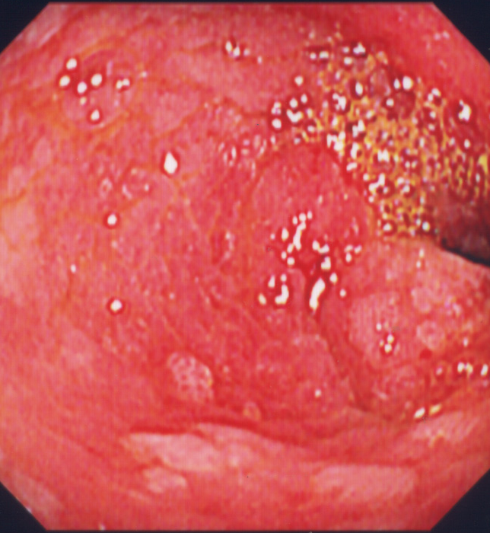
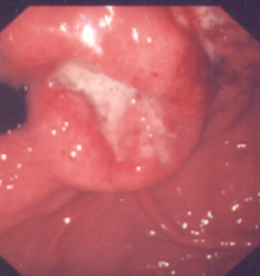
Cag
positivity
IL 1β
genotype
Bacterial nitrosamine
Smoking
↓ Antioxidant vitamins
Helicobacter
pylori
Corpus
gastritis
Intestinal
Metaplasia
and atrophy
Dysplasia
& Cancer
COX 2
iNOS
? APC
p53
c-myc
COX 2
p53
APC
Gastric neoplasia

Slide 10
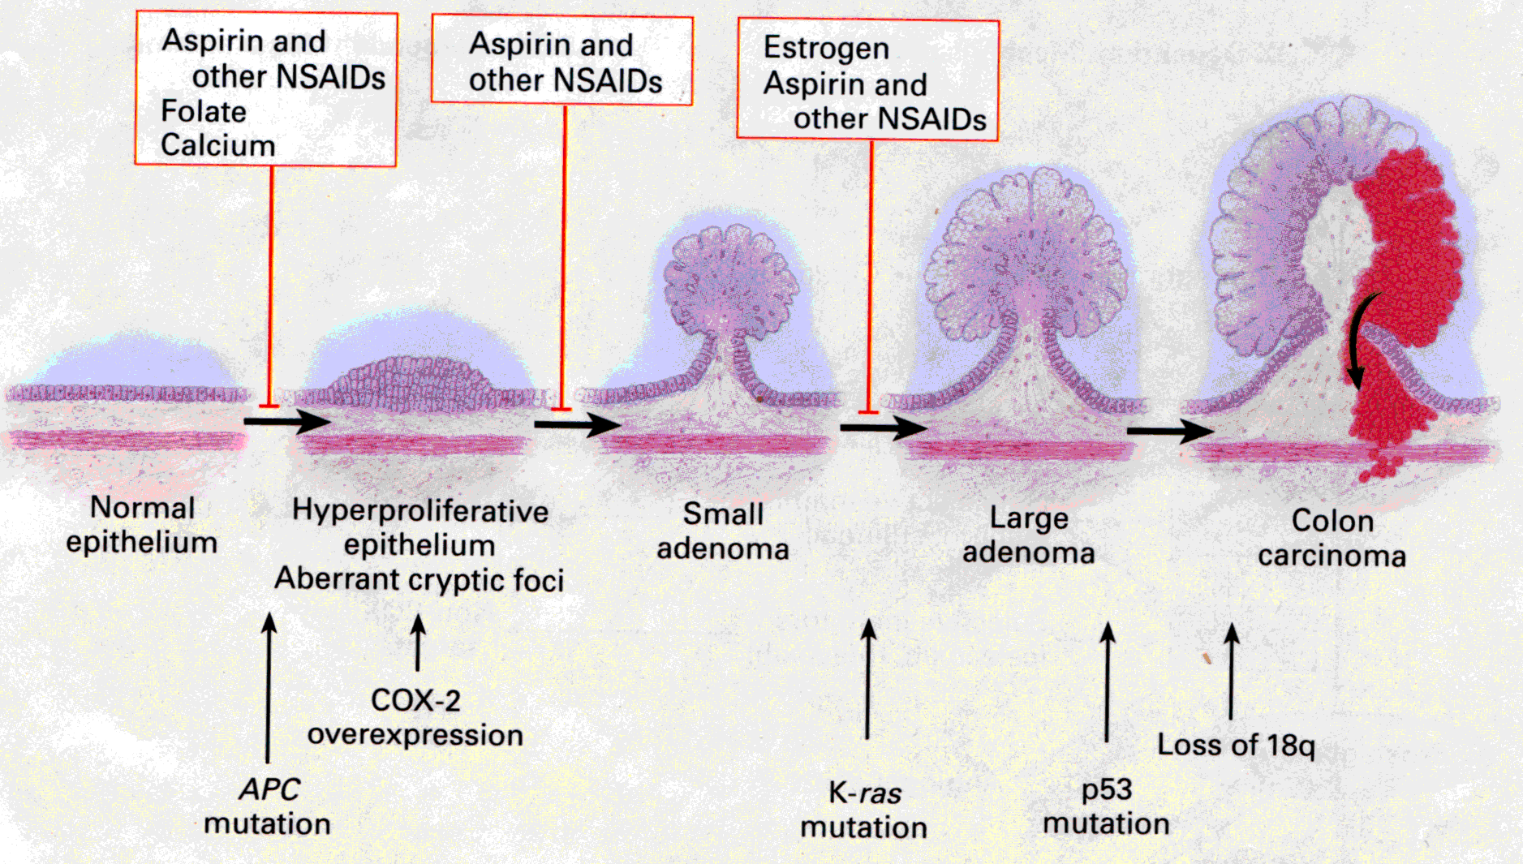
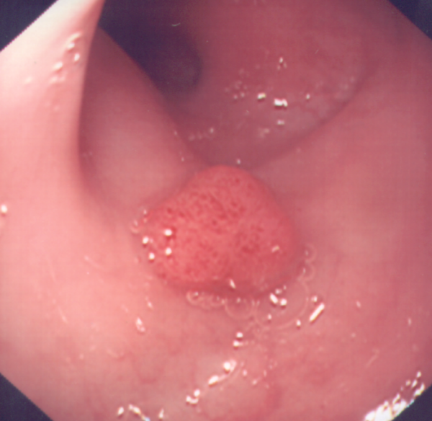
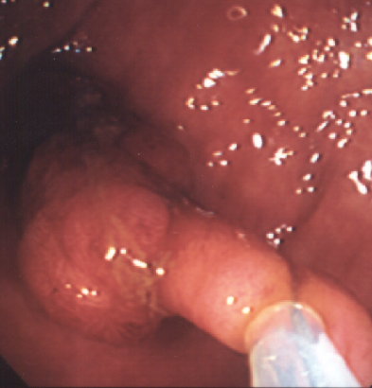
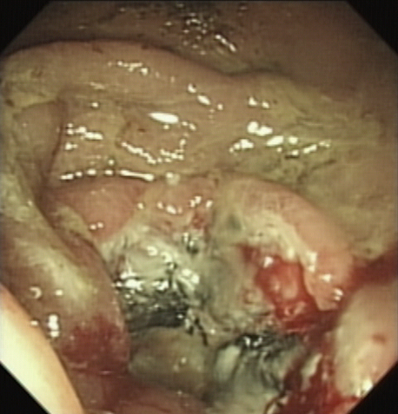
Colorectal neoplasia - Janne & Mayer NEJM 2000

Slide 11
Why is it important?
CRUK

Slide 12
CRUK

Slide 13
CRUK

Slide 14
CRUK

Slide 15
How does cancer kill?
Local damage
  Haemorrhage
  Obstruction
  Pressure on vital structures
Metastasis
  Hepatic
  Cerebral
  Pulmonary
Systemic effects
  Cachexia
  Nutritional failure
  Toxin load due to necrosis
  Hypercoaguability → thrombo-embolic disease

Slide 16
Mechanisms of metastasis
Vascular
  Disruption of endotheilium
    Extra-mural vascular invasion
    Cancer cells into circulation
    Filtered out in liver / lungs / bone / brain
Lymphatic
  Invasion of lymphatics
  Spread to local lymph node chains
Peritoneal
  Free tumour in peritoneum

Slide 17
Stage and Grade
Grade
  Pathological definition
  Description of cells and structures
  E.g. well / moderately / poorly differentiated
Stage
  Describes level of invasion
  E.g. TNM system

Slide 18
Well differentiated
Clear glandular formation
Nuclei along basement membrane
Moderately differentiated
Glands less well formed
Nuclear stratification
Poorly differentiated
Minimal gland formation
Erratic nuclei
V Bravou, G Klironomos, E Papadaki, D Stefanou and J Varakis
British Journal of Cancer (2003) 89, 2340-2341.

Slide 19
Tumor (T)
T1: Tumor invades submucosa.
T2: Tumor invades muscularis propria.
T3: Tumor invades through the muscularis propria into the subserosa, or into the pericolic or perirectal tissues.
T4: Tumor directly invades other organs or structures, and/or perforates.
Node (N)
N0: No regional lymph node metastasis.
N1: Metastasis in 1 to 3 regional lymph nodes.
N2: Metastasis in 4 or more regional lymph nodes.
Metastasis (M)
M0: No distant metastasis.
M1: Distant metastasis present.

Slide 20
Pathguy.com

Slide 21
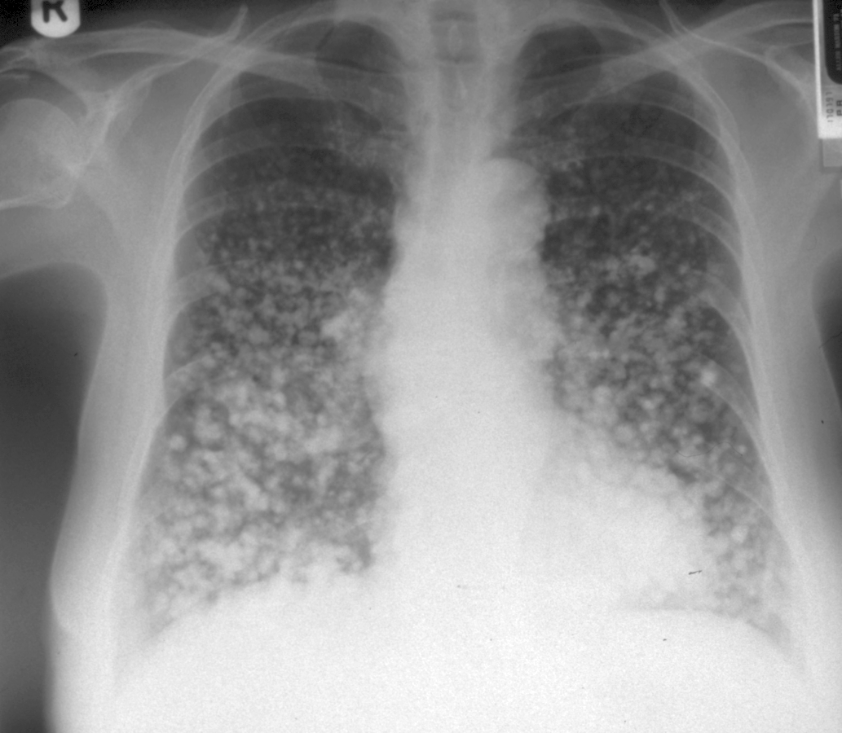

Slide 22
The Molecular origins of GI cancer

Slide 23
Cancer genetics
Oncogenes and tumour suppressor genes
Chromosomal abnormalities
Epigenetics
Immunology
Angiogenesis

Slide 24
Oncogenes
Cancer is caused by abnormalities of:
  Tumour suppressor genes
  or
  Oncogenes
  Signal transducers
  Transcription factors
  Growth factors and their receptors
Usually somatic events
Sequential abnormalities in multiple genes
Heterogenous clones within a cancer

Slide 25
Two hit theory
Inherited abnormality of a gene
Second, somatic, mutation rendering complete loss of gene function
Works well for tumour suppressor gene models
  p53
  DNA repair systems

Slide 26
Single hit theory
Single somatic mutation resulting in uncontrolled expression
  ABL
  C-myc
  ➔ Unopposed cell replication and clonal expansion

Slide 27
In reality…
Multiple hits leading to
  activation of proliferation
  Inhibition of apoptosis
  DNA repair failure
  Loss of cell-cell adhesion
  Enablement of metastatic systems
  Immune avoidance

Slide 28
Multiple regions of neoplasia with differing genetic abnormalities within a cancer
Each clone competes
Results in differing degrees of differentiation and cell morphology
Often only a single clone becomes dominant

Slide 29
In ‘high risk’ tissues…
Multiple clonal areas may arise
  Some will be detected and destroyed immunologically
  Others will compete if they avoid apoptotic drive
  Often results in synchronos and metachronos cancers

Slide 30
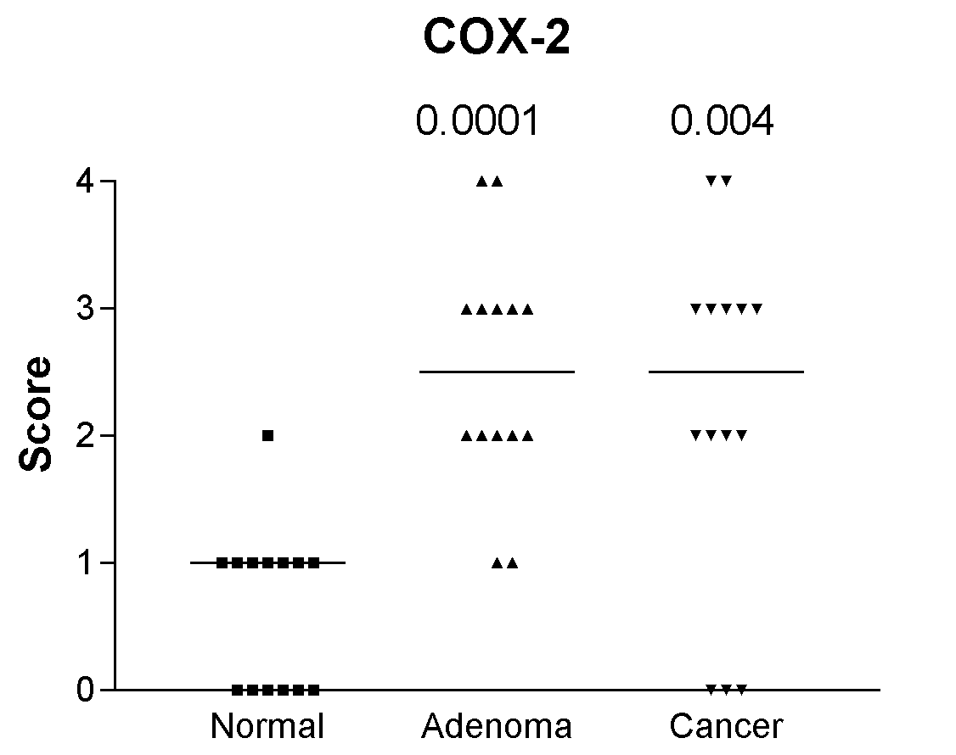
Altered expression of normal genes
Dysregulation of normal gene expression linked to tumour progression

Slide 31
Loss of expression of tumour suppressors
Usually ‘brake systems’ that control proliferation or induce apoptosis
  P53
  APC

Slide 32
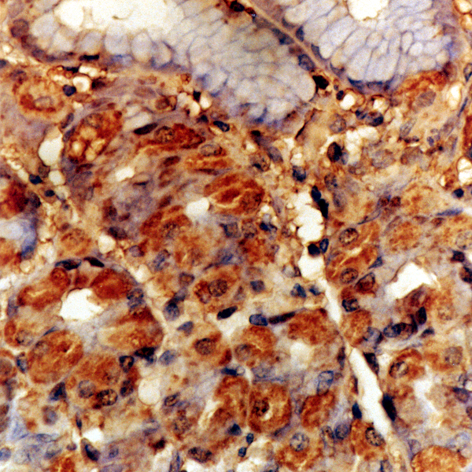
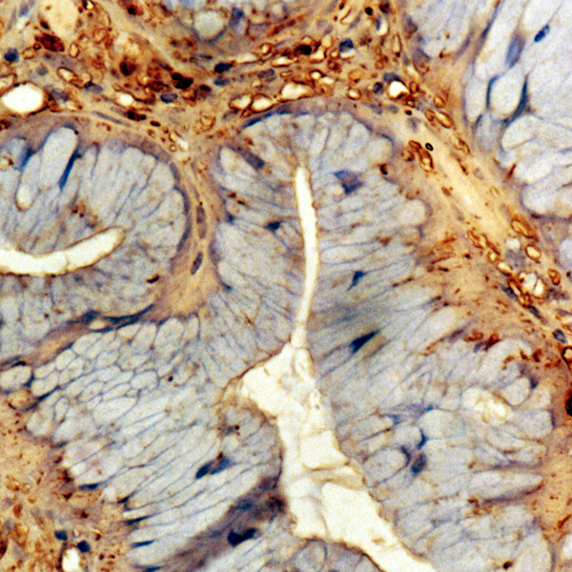
Loss of expression of tumour suppressor genes
Normal APC expression Loss of expression in neoplasia

Slide 33
APC - β catenin pathway
β-catenin
  Membrane bound adhesion molecule
  Cytoplasmic β-catenin degraded by ubiquitin in the presence of APC
  Loss of APC expression allows β catenin accumulation in the cytoplasm

Slide 34
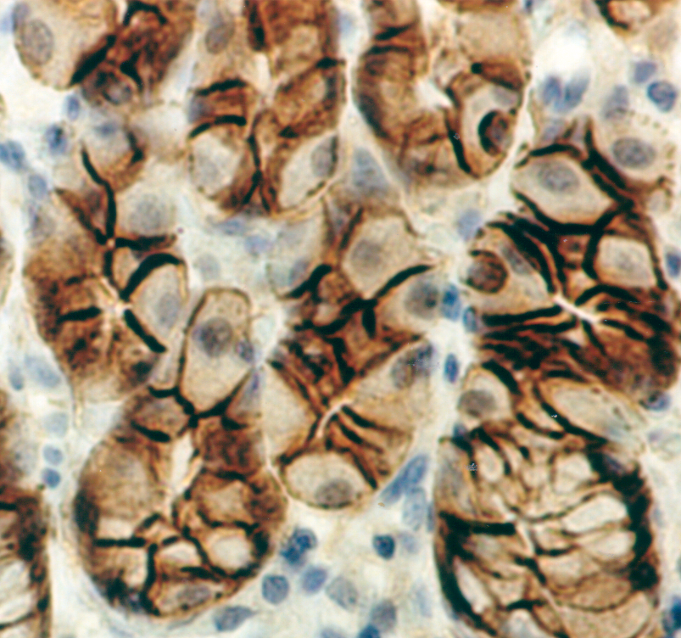
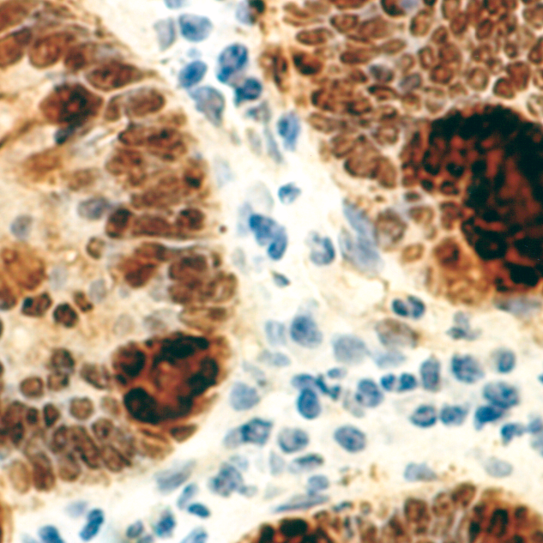
Gastric cancer
Normal
β-catenin expression in normal
and malignant gastric mucosa

Slide 35
Conversion of proto-oncogene to oncogene

Slide 36
Chromosomal abnormality
Chromosomal deletion
Re-arrangements
  Segment loss
    del(5)(q21-q22) APC in CRC
    Del(4)q12) REST in CRC
  Segment inversion
  Amplification
    amp(11)(q13-q22) in HCC

Slide 37
Chromosomal abnormality
All lead to either loss of function
  Tumour suppressor gene deletion
  Loss of promoter region control mechanisms
Or uncontrolled expression
  Movement of the gene so that the controls on transcription are lost or adjacent to constitutive gene promotor region

Slide 38
Aetiology
Inherited abnormalities
Acquired
  Ionising radiation
  Alkylating agents
  Other drugs / chemicals
    Tobacco
    Organic solvents
    Many unidentified

Slide 39
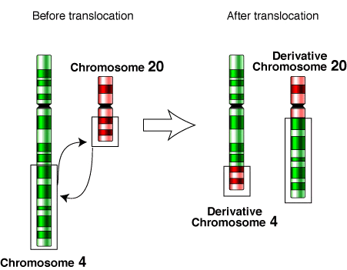

Slide 40

Effects of translocation
Promoter region of constitutively
expressed gene
Pro-proliferative
Anti-apoptotic
Matrix metalloproteinase
Pro-angiogenic

Slide 41
Epigenetics
Apparent that the numbers of different phenotypes cannot be explained by the relatively limited numbers of genes
Monozygotic twins and cloned organisms demonstrate phenotypic variation
Modification of (onco)genes hold the key to the apparent disparity

Slide 42
methylation
DNA hypomethylation is a common finding in human cancer
Often in combination with hypermethylation of tumour suppressor gene promoter regions
Micro-RNA inactivation by methylation

Slide 43
What does methylation do?
Common finding in dinucleotide CpGs at the 5’ end (regulatory end) of genes
Act as a control mechanism for transcription at the promoter region
Also stabilises the DNA, reducing chromosomal instability via replication and repair errors
Cells with hypomethylation carry multiple nuclear abnormalities

Slide 44
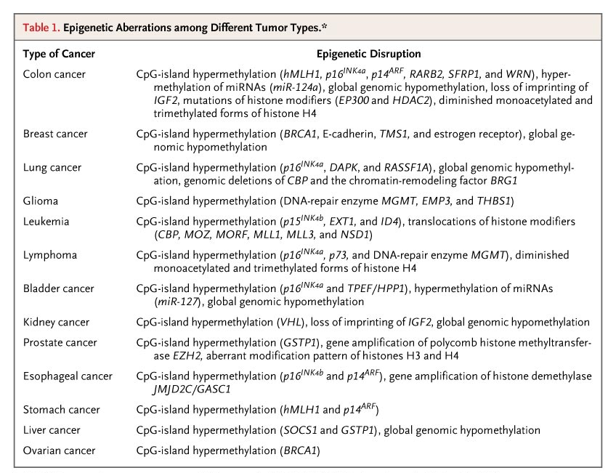

Esteller M. N Engl J Med 2008;358:1148-1159
Notes:
Table 1. Epigenetic Aberrations among Different Tumor Types.

Slide 45
Promoter hypermethylation
Reduces transcription
Typically at tumour suppressor genes
  e.g. hypermethylation at histones H3 & H4 silences p21 (WAF1)

Slide 46
MicroRNA
22 nucleotide RNA strands
Regulate gene expression
  Sequence specific pairing with 3’ end of mRNA
  Results in mRNA degradation or inhibition of translation
Important role in proliferation and apoptosis
5’ hypermethylation down-regulates miRNA in tumour cells

Slide 47
Cancer Immunology

Slide 48
Immune surveillance
Immune system response to tumour cells depends on identifications of:
  Tumour specific cell surface antigens
    E.g. carcinogenic virus antigens
  Tumour associated antigens (differential expression on tumour cells compared with normal cells

Slide 49
Outcome of immune response
Elimination of the cancer
Immune tolerance / equilibrium
  Less immunogenic clones are selected for
Tumour escape

Slide 50
Does this happen in ‘real life’?
Post transplant patients on immune suppression have RR of 7.1 of developing new cancers
Azathioprine / infliximab combinations increases risk of hepato-splenic T cell lymphomas
Suggests that immune surveillance failure increases risk of tumour escape

Slide 51
Tumour related immune suppression
Growing evidence that tumours can induce immune-suppression, both locally and systemically, to increase the chance of tumour immune escape.
  Soluble Fas ligand
  TGF-β
  Indoleamine-2,3-dioxygenase (IDO)
  Induction of Il-10 expression by regulatory T-cells

Slide 52
Angiogenesis

Slide 53
Key to tumour survival
New vascular supply to maintain tumour growth
Expression of Vascular endothelial growth factor (VEGF) and its receptor is key to this.
VEGF expressed by the majority of cancer cells. This acts both on local endothelium and via a paracrine circuit on VEGF-R expressed on tumour cell themselves

Slide 54
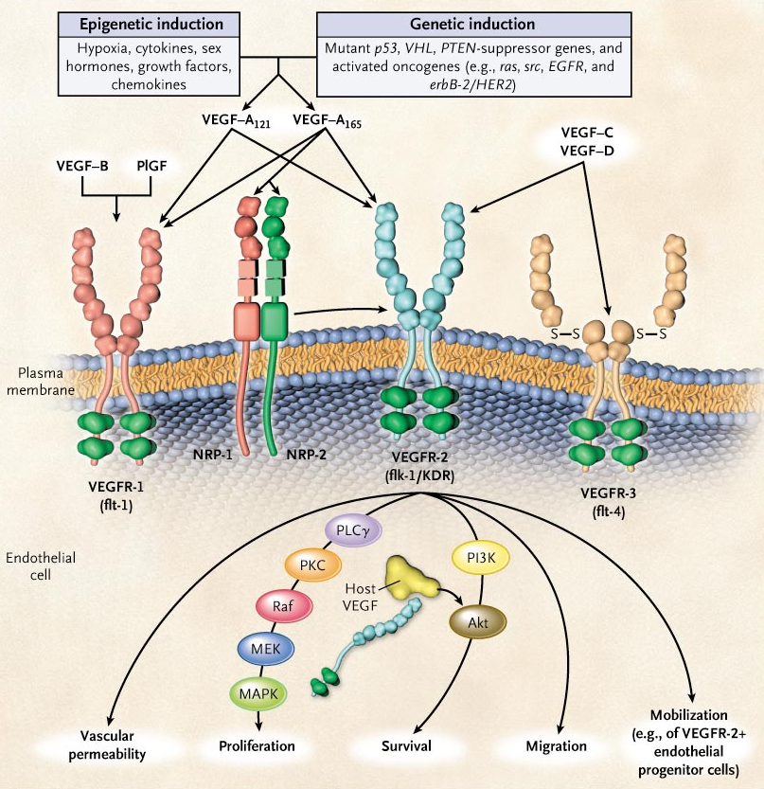

Slide 55
Summary
Carcinogenesis results from a series of molecular changes:
  Proto-oncogene activation
  Loss of control of gene expression
  Escape from immunological response
  Induction of angiogenesis

