Slide 1
Welcome to the BSc in Medical Sciences with Gastroenterology & Hepatology
Professor Julian Walters
Course Director

Slide 2
Resources
Guidebook
Aims & Learning Objectives
People
Support

Slide 3
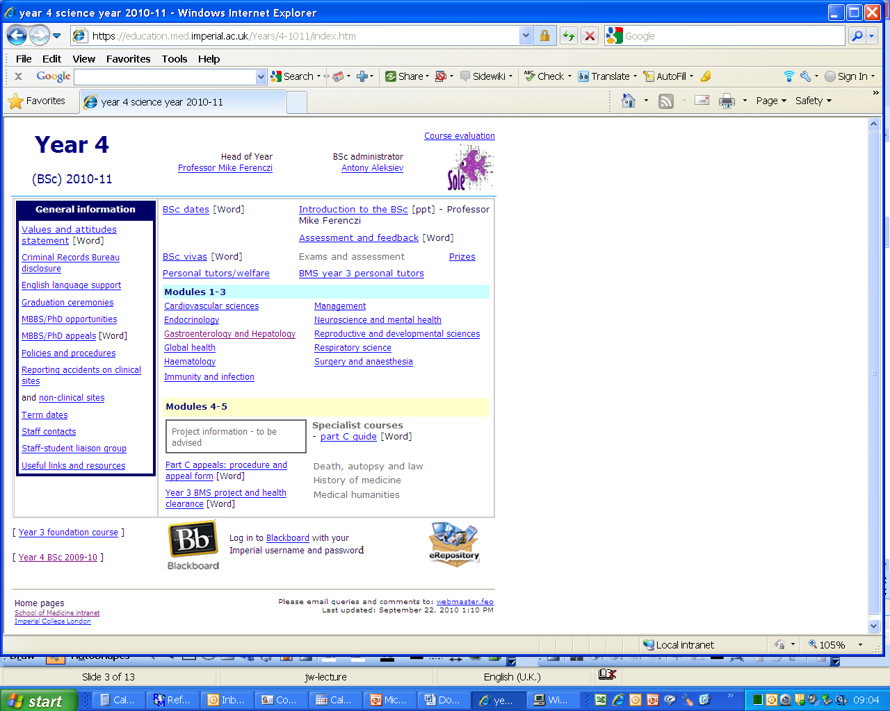

Slide 4
Aims & Objectives
General
To deliver a rational and coherent programme of study which provides the student with a sound training in science and an understanding of how scientific knowledge has been acquired and how it is advanced

Slide 5
Aims & Objectives: Specific
A sound knowledge and understanding of their field of study, extending to current research controversies and challenges
An understanding of and critical approach to the scientific evidence on which this knowledge based
An appreciation of the fundamental principles and practice of scientific research within the field including:
Legal and ethical issues and practice
The requirement for critical review of the relevant literature
The concept of developing and testing a hypothesis
The principles of experimental design
The principles underlying research methods and techniques (pertinent to the field of study)
Data analysis and interpretation, including statistics
Experience of oral and written scientific communication
Teaching will be designed to encourage originality of thought and breadth of vision and will be delivered in a supportive learning environment, underpinned by world class research.

Slide 6
Modules
Introductory course
Module 1 Gene-environmental interactions:
Metabolic, genetic and nutritional disorders
Module 2 Diagnostic and therapeutic principles:
Science underlying imaging and neoplasia
Module 3 Infective, immunological and inflammatory mechanisms in gut and liver disease

Slide 7
Introductory Course
Leaders
Professor Julian Walters julian.walters@imperial.ac.uk
Dr Marco Purbhoo marco.purbhoo@imperial.ac.uk
Aims
- To provide an introduction to the study of medical sciences related to the liver and gastrointestinal tract
Content
- Introductory talks on immunology, genetics, metabolism and pathology
- A basic review of complex diseases of the liver and GI tract
- Introductory lectures on key generic skills including statistics and critical analysis

Slide 8
Module 1: Gene-environmental interactions: Metabolic, Genetic & Nutritional disorders of Gut & Liver
Module Leaders: Julian Walters julian.walters@imperial.ac.uk Horace Williams horace.williams@imperial.ac.uk
Aims
To appreciate how genetic and environmental factors contribute to GI and liver diseases.
To learn about the scientific principles linking metabolic, genetic and nutritional factors to GI function and disorders.
Content
Specific gene/environment interactions in GI diseases such as IBD and coeliac disease
Genetic factors underlying GI and liver disease
Principles of human nutrition in health and disease, the assessment of nutritional state, and interactions of GI function, nutrition and metabolic diseases

Slide 9
Module 2: Diagnostic & Therapeutic Principles in Gastrointestinal & Liver Disease
Module Leaders:
Belinda Smith belinda.smith2@imperial.nhs.uk
Shahid Khan shahid.khan@imperial.ac.uk
Laksh Ayaru Lakshmana.ayaru@imperial.nhs.uk
Aims
To gain a broad knowledge of diagnostic and therapeutic principles relevant to the GI tract and liver
To develop a greater understanding of development and diagnosis of neoplasia in the GI tract and liver, and the rationale for various therapeutic approaches.
Content
The role of new diagnostic imaging and therapeutic techniques including endoscopy, laparoscopic surgery, ERCP, CT, magnetic resonance imaging, MR spectroscopy, position emission tomography, physiological studies and nuclear medicine
An emphasis on neoplastic diseases of the liver and GI tract.

Slide 10
Module 3: Infective, Immunological and Inflammatory Mechanisms in Gut & Liver Disease
Module Leaders:
Marco Purbhoo marco.purbhoo@imperial.ac.uk
Harry Antoniades c.antoniades@imperial.ac.uk
Aims
To learn about interactions between pathogenic infectious agents and the host immune response in the liver and gastro-intestinal tract.
Content
To become familiar with the host immune responses to infection
To be develop an understanding of the interactions of infectious agents with the immune system in Liver & GI disease
To appreciate aspects of autoimmunity in Liver & GI disease

Slide 11
Specialist Modules
Projects
or
Specialist taught courses
History of medicine
Medical humanities
Death, autopsy & law

Slide 12
Learning Resources
Lectures, seminars, practicals
Intranet
Feedback – SOLE
FEO
Email contact
Course Administrator: Olive Thomas
o.thomas@imperial.ac.uk
Welfare tutor: Marco Purbhoo
marco.purbhoo@imperial.ac.uk

Slide 13
Class Reps
Elect / Appoint
Point of contact
Student issues
Feedback to staff
Registration lists
Copies of presentations

Slide 14
Assessment
In-course assessment
Essay
“ Something requiring analytical and critical skills ”
(for each module)
Exams
February 2013
Three questions per module
Long essay
Data handling
Short answer questions
Plagiarism, references

Slide 15
Introductory Course Work
Find how to access the top journals in our field
Gastroenterology, Hepatology, Gut, J. Hepatol
Select one paper in the most recent edition
Write 500 words “why you find this paper interesting”
Submit via electronic portal by Friday 5 October.

