Slide 1
Innate immune system of the gastrointestinal tract
Dr K Cheent
Wellcome Trust Research Fellow/ SpR Gastroenterology
Imperial College London

Slide 2
Overview
Role of immune system
What is innate immunity
Components wrt GI tract
Limitations
Questions

Slide 3
Functions of the immune system
Destroying invading infectious organisms
Defend against cancer
Wound healing
Removal of cells that have died through natural processes

Slide 4
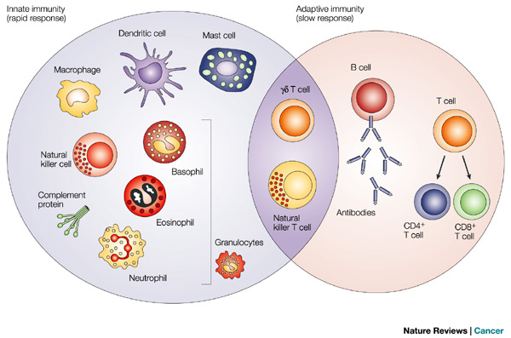
Overview: innate and adaptive

Slide 5
Innate versus adaptive
 | Innate | Adaptive
Found in | All multicellular organisms | Only in vertebrates
Memory | No | Yes
Specific | No | Yes
Cellular component | Neutrophils, monocytes, macrophages, dendritic cells, NK cells, basophils, eosinophils, mast cells | T and B cells
Non-cellular | Complement | Antibodies

Slide 6
Innate immune system
First line of defence
Provides protection against a wide variety of pathogens
Primes the adaptive immune response

Slide 7
Challenges in the gut
Primary Role of GIT?
Digestion and absorption of nutrients
Challenges:
Efficient transport of nutrients v excluding harmful organisms
Responding to pathogens v unresponsive to food antigens and commensal bacteria.
Breakdown of this tolerance can lead to chronic inflammation, as seen in inflammatory bowel disease.

Slide 8
Innate immune components of the GIT
barrier
epithelium
peristasis
commensals
cellular
neutrophils
dentritic cells (DCs)
monocyte/ macrophage
natural killer (NK) cells
granulocytes
chemicals
gastric acid
bile acid
digestive enzymes
mucus
AMPs
Others: e.g. complement

Slide 9
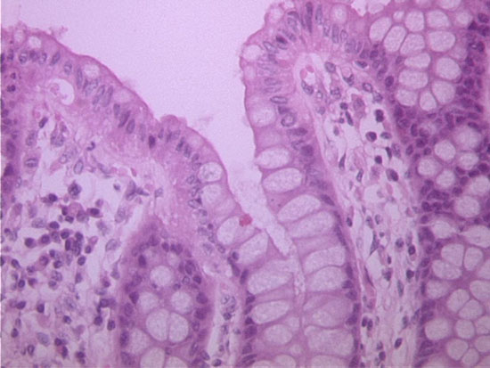
Gut epithelium
Epithelial cells: Single layer. Millions of villi: surface area expanded to ~400 m²
Tight junctions prevent bacterial translocation. Peptides may enter the mucosa via intracellular pathway in epithelial cells, results in generation of small/ non-immunogenic peptides. Paracellular transport: defective tight junctions allow macromolecules to pass: linked with IBD and coeliac disease
Gut motility/ peristalsis
Gut epithelium renewal
Other cells at luminal surface:
Goblet Cells: secrete mucus/ trefoil peptides- for growth and repair
Enteroendocrine cells: neuroendocrine peptides e.g. somatostatin, cholecystokinin
Paneth Cells: AMPs
APCs: sample luminal contents
M Cells (Microfold cells. Peyers patches)
Notes:
Antigen enters PP via specialized microfold (M) cells within the Follicular Associated Epithelium (FAE) where it is taken up and processed by dendritic cells in the sub-epithelial dome (SED) for presentation to T cells

Slide 10
Chemicals
Saliva
gastric acid
Bile
proteolytic enzymes
Mucus
Mucin: long chain carbohydrate molecules ➔ stick to microbes to prevent binding to epithelium
>95% Water
IgA (product of adaptive immune system “plasma cells”)
Antimicrobial peptides (AMPs)

Slide 11
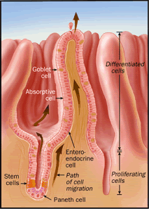
Paneth cells
Specialised secretory intestinal epithelial cells
Located at the bottom of the crypts of Lieberkuhn in the small intestine
Produce AMPs

Slide 12
Antimicrobial peptides (AMPs)
Three main types:
Defensins
Secretory phospholipase A2 (sPLA2): enzyme against bacterial phopholipids
Lysozyme: hydrolyses peptidoglycan of bacterial cell walls
Notes:
Spla-2 enzyme against bacterial phospholipids- destroys cell integrity

Slide 13
Defensins
α and β in mammals. Human Paneth cells produce the α-defensins HD-5& HD-6. Also known as cryptdins (produced in crypts).
Constitutively expressed. Pathogens ➔ production
Small cationic peptides ➔ interact with negatively charged phospholipids (PLs) in cell membrane. Bacterial membranes have more –ve charged PLs therefore preferential binding.

Slide 14
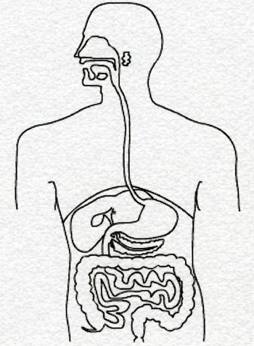
Bacterial symbiosis
Oral Cavity
Indigenous
microflora
500 species
Saliva contains
10¹⁰ cfu/mL
<24 hours birth GIT colonised by unique microflora
>400 species. Upper GIT <10⁵ cfu/ ml, Lower GIT 10¹¹ cfu/ ml
Do not penetrate eipithelium
Beneficial effects for host:
Prevent pathogenic microbes from growing (compete for nutrients/ access to mucosa).
Produce Vitamin K
exert trophic effect on mucosa
maintain mucosal immune homeostasis
Microbial antagonism can be severely disturbed (e.g. C. Difficile following antibiotics)
Stomach/
duodenum
10¹ -10³ cfu/mL
Helicobacter pylori
Jejunum/
ileum
10⁴ -10⁸ cfu/mL
Streptococci, lactobacillus,
bacteroides,
enterobacter
Colon
10¹⁰ -10¹² cfu/ml
E. coli,
Clostridia

Slide 15
Complement
Rapidly activated biochemical cascade involving a series of small peptides made in the liver
Classical and alternate pathways
Classical pathway requires antibodies i.e. strictly speaking involves adaptive immune response
Alternate pathway: Attracted by abnormal surfaces e.g. sugars in bacterial cell wall.
Disrupt the plasma membrane resulting in cytolysis

Slide 16
Innate immune cells
Involved once mucosa is breached (although DCs sample luminal contents).
Located in the lamina propria: Form part of gut associated lymphoid tissue (GALT)- largest mass of lymphoid tissue in the body.
“hyporesponsive” compared to counterparts at other sites (do not want immune response to dietary antigens/ gut flora)
However, must be able to mount a response to pathogens.
Breakdown of tolerance/regulatory mechanisms ➔ food allergies, coeliac disease, IBD
Notes:
GIT immune environment is highly regulated to maintain intestinal homeostasis:

Slide 17
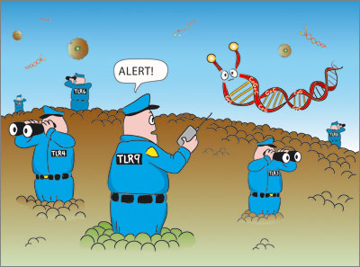
Pattern recognition receptors (PRRs): TLRs & NODs
PRRs: Recognise structurally conserved molecules derived from microbes – PAMPs (pathogen associated moleclular patterns) e.g. LPS. Although still “non-specific” binding -bind patterns rather than antigens.
2 types of PRR:
TLRs (toll like receptors)
Transmembrane PRRs.
10 types in humans (TLR 1-10)
present on DCs, epithelial cells, also NK cell
Activation results in cytokine release ➔ primes of adaptive immune response
NODs (nucleotide binding oligomerisation domains).
Intracellular PRRs
recognising bacterial MDP.
Mutations associated with Crohn’s disease
www.invivogen.com

Slide 18
NOD2-CARD15
Nucleotide binding and oligomerisation domain 2 (NOD2)/ capase-activating recruitment domain 15 (CARD15)
First identified genetic susceptibility locus for IBD
Encodes highly expressed cytoplasmic receptor in monocytes/macrophages that binds bacterial MDP ➔ activation of NFκB signalling
Polymorphism affects the ligand binding domain, associated with Crohn’s ➔increased NFκB signalling following activation by MDP ➔ increased proinflammatory cytokines e.g. IL-1B

Slide 19
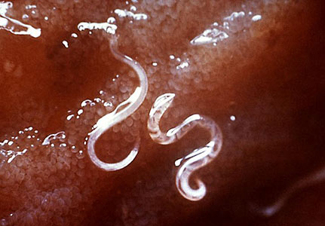

Slide 20
Dealing with Worms
Mast cells degranulate
➔ Release of histamine, proteases, leukotrienes, prostoglandins.
intense mucus production
& increased bowel contractility
attempt to shift the worm

Slide 21
Limitations of the Innate immune system
Not good at dealing with intracellular infection
Starts from scratch each time round
No specificity
in isolation will be overwhelmed after days/weeks

Slide 22
Summary of Innate Immune System
Barrier prevents infection
Role for PAMPs/ PRRs (TLRs + NODs)
Cellular components/ Role of cytokines
Primes the adapative immune response:
Immune tolerance v inflammatory
If defective, overwhelming infection can develop rapidly

