Slide 1
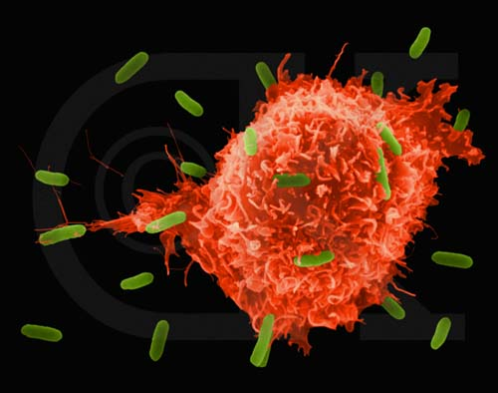
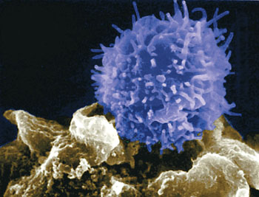
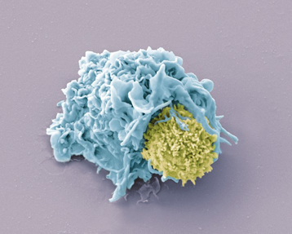
Immunological Mechanisms
Adaptive Immunity
Marco Purbhoo
marco.purbhoo@imperial.ac.uk

Slide 2
Learning Objectives
By the end of this lecture you should –
Be familiar with the key characteristics adaptive immunity and the major components involved
Understand the basis of clonality of T and B lymphocyte responses
Be able to describe the how antigen is sampled in the periphery

Slide 3
Why do we study immunology?
Infectious diseases are a major burden worldwide.
Major challenges are HIV, HCV, TB and malaria
42 million people living with HIV worldwide
130 million people chronically infected with HCV.
Malaria causes more than 300 million acute illnesses and at least one million deaths annually.
An estimated two million deaths resulted from tuberculosis in 2002.
Notes:
These diseases are a huge economic burden

Slide 4
When the immune system goes wrong…
Autoimmune disease – e.g. multiple sclerosis, rheumatoid arthritis, autoimmune hepatitis
Allergy – Allergy and asthma prevalence increasing dramatically
Unwanted responses – transplantation.

Slide 5
The role of the immune system
To protect us from infection:
Viruses; 20-400nm (obligate intracellular)
Bacteria; 1-5 μm
Fungi; 2-20 μm
Protozoan parasites; 1- 50μm
Metazoan parasites (worms) 3mm – 7m
Notes:
The immune is complicated because of the wide range of pathogens we must resist
Infection is the result of immune evasion and the immune response

Slide 6
The Immune System
Physical Components
Epithelial barrier
Gastric acid
Non-cellular Components
Secreted enzymes and inhibitors
Complement
Antibodies
Cytokines
Cellular Components
Bone marrow derived

Slide 7
Innate and adaptive immunity
Innate immunity
• Immune response to invariant antigens generally found in pathogens
• Receptors encoded in germline
• Fast, immediate response
• No memory
• NK cells, Macrophages (Kupffer cells), Neutrophils, Dendritic cells, γδ T cells, NKT cells
Adaptive immunity
• ‘Tailor-made’ immune response to unique antigens
• Unique receptors generated by gene rearrangement
• Slow initial response
• Immunological memory
• αβ T cells (CD4+ T cells, CD8+ T cells), B cells

Slide 8
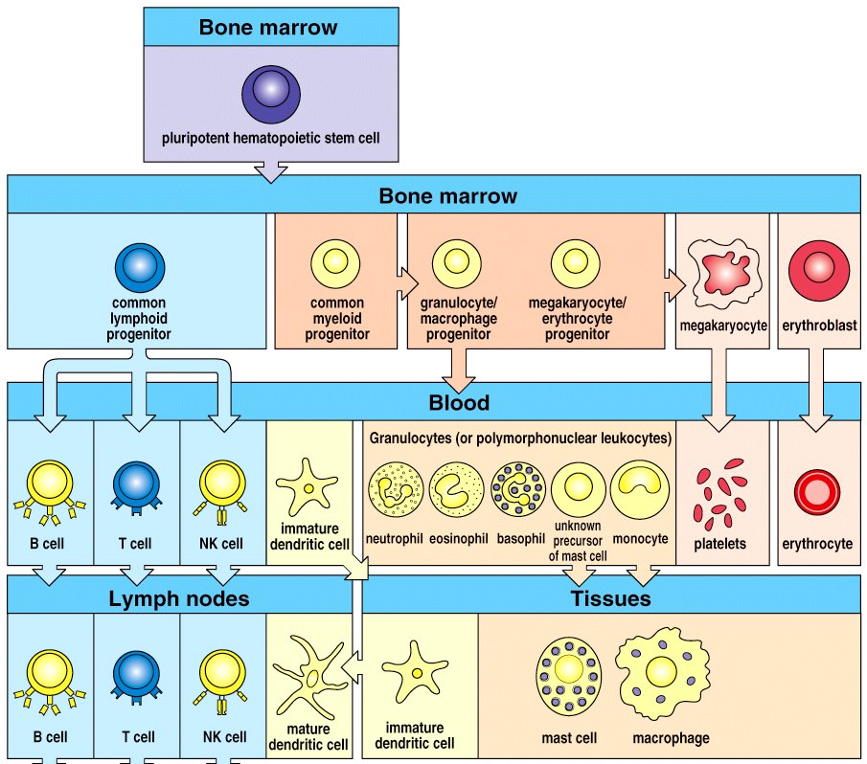
Cells of the immune system
Notes:
Immune cells all originate in the bone marrow
We have a large variety of cells because they need to be specialised to perform particular functions – in other simpler organisms this is simpler and cells are less specialised.
We also have soluble proteins to fight infection

Slide 9
Acquired / adaptive Immunity
Specific to a particular antigen – detected by specific receptors on T and B cells
Response improves with time
Results in memory =
Protection against re-infection with the same pathogen
Evolutionarily late – only present in vertebrates
Involves T and B lymphocytes
Notes:
An antigen is any molecule capable of eliciting an immune response

Slide 10
Antigen-specific receptors
• T cells express the T cell Receptor (TCR)
• B cells express the B cell Receptor (BCR)
• The soluble form of the BCR is known as an Antibody
Notes:
All on different chromosones – 22, 2 and 14 respectively
Many different heavy chain C regions (not shown). Always start by using mu – IgM
The constant region is not spliced permenantly – this is important to allow class switching later on

Slide 11
The TCR and BCR are extremely variable
Variable
α
light chain
β
Constant
heavy chain
αβTCR
BCR/Antibody
• the antigen recognizing sequences of the TCR and BCR are extremely variable
• for each antigen there is therefore a different receptor

Slide 12
Antigen-receptor diversity
• For each antigen there is a specific TCR or BCR/Antibody
• There are millions of different antigens
• There are millions of different TCRs and BCRs/Antibodies
• Your body can produce 10⁸ different types of antigen-receptors at any one time
• There is not enough space in your genome to encode this many TCR or BCR/Antibody genes!!
• How is antigen-receptor diversity generated?

Slide 13
Gene segments of the TCR and BCR
• Each T or B cell generates its own, distinct antigen-receptor gene
V = Variable gene segment (40x)
J = Joining segment (25x)
D = Diversity segment (6 x)
C = Constant sequence
Notes:
All on different chromosones – 22, 2 and 14 respectively
Many different heavy chain C regions (not shown). Always start by using mu – IgM
The constant region is not spliced permenantly – this is important to allow class switching later on

Slide 14
Gene segment rearrangement
• The Variable, Joining, and Diversity segments rearrange randomly to form a single antibody gene
V
J
D
C
Notes:
Within a SINGLE B cell

Slide 15
Gene segment rearrangement
• The Variable, Joining, and Diversity segments rearrange randomly to form a single antibody gene
• J and D regions rearrange first
V
J
D
C
Notes:
All on different chromosones – 22, 2 and 14 respectively
Many different heavy chain C regions (not shown). Always start by using mu – IgM
The constant region is not spliced permenantly – this is important to allow class switching later on

Slide 16
Gene segment rearrangement
• The Variable, Joining, and Diversity segments rearrange randomly to form a single antibody gene
• J and D regions rearrange first
• The V region then rearranges to the JD region
V
J
D
C
Notes:
Each B cell generates only one antibody variant

Slide 17
Generation of diversity
• Different combination of V, D, an J rearrangements
• Rearrangement is imprecise
• DNA sequences are added or subtracted randomly
• Estimated 10¹⁶ (10 000 trillion) possible BCR/Antibody or TCR variations
Notes:
Not the same for everyone – some polymprphism
In practice some combinations occur more often than others. Not all combinations of H and Li chains work.

Slide 18
The T and B cell response is clonal
• each T or B cell expresses only one variant of its receptor
• each cell recognises a different antigen
• specific antigen recognition leads to clonal expansion
• long-lived memory cells allow for a more rapid response against future challenge with same antigen
precursor cell
antigen
clonal
proliferation
effector cells
memory cells

Slide 19
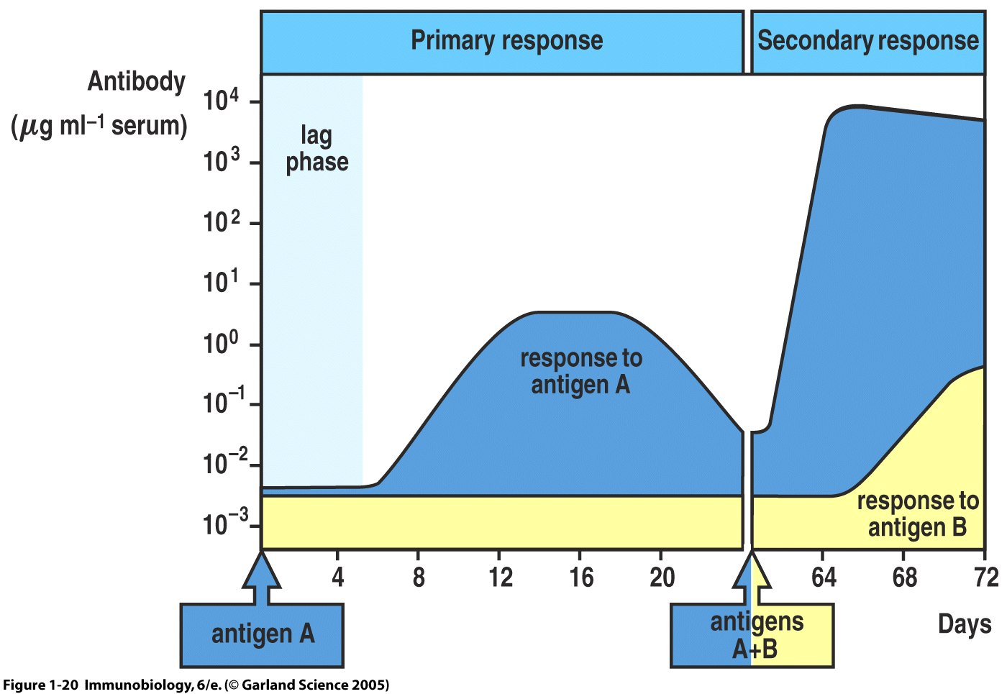
Primary and secondary immune responses
Notes:
Basis of vaccination – a rapid high affinity response if produced following previous exposure.
It takes about 4 days + for the acquires immune system to respond
Secondary – much larger and more rapid

Slide 20
B cells
Produce antibodies
Sometimes called ‘humoral immunity’
Antigen
Proliferation
Differentiation
B cell receptors
Long lived

Slide 21
Ig Isotypes
• IgA: dimer, predominant Ig in secretions, e.g. saliva, milk.
• IgD: mainly membrane bound as BCR
• IgG: major Ig in serum. Can cross the placenta
• IgM: pentamer, involved in complement activation
• IgE: binds to the high affinity Fc receptor of Mast cells and basophils
Antibody
Fc region interacts with other parts of the immune system

Slide 22
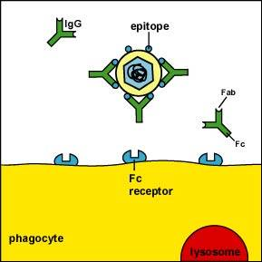
1) Neutralization
• antibodies block the interaction of virus with its receptor

Slide 23
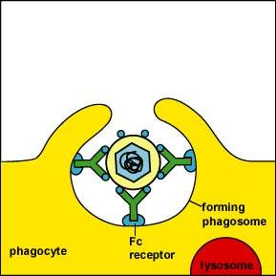
2) Opsonisation
• antibodies label the virus, which can thus by recognised by phagocytes
• antibodies can also label whole virally infected cell for phagocytosis
Notes:
NB: remember some viruses use this mechanism to infect the cell

Slide 24
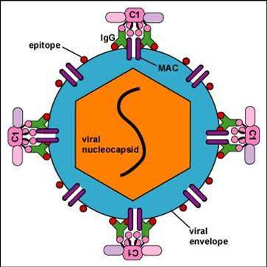
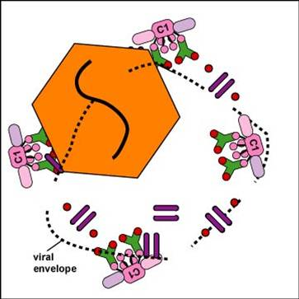
3) Complement activation
• MAC damage to the viral envelope
Without its envelope, the virus is unable to infect new host cells.
Notes:
Only happens with enveloped viruses

Slide 25
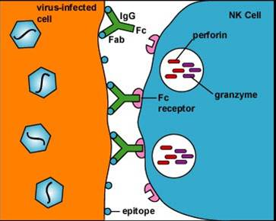
4) Antibody dependent cellular cytotoxicity (ADCC)
• Antibody binds to epitopes on the virus-infected cell. The NK cell binds to the Fc portion of the antibody. Results in NK lysis of infected cell

Slide 26
T-cells
T cell receptor (TCR) only recognises foreign antigen as a peptide on an MHC molecule on an antigen presenting cell (APC)
Notes:
CD4 cells are helper cells
Many subsets of CD4+ cells

Slide 27
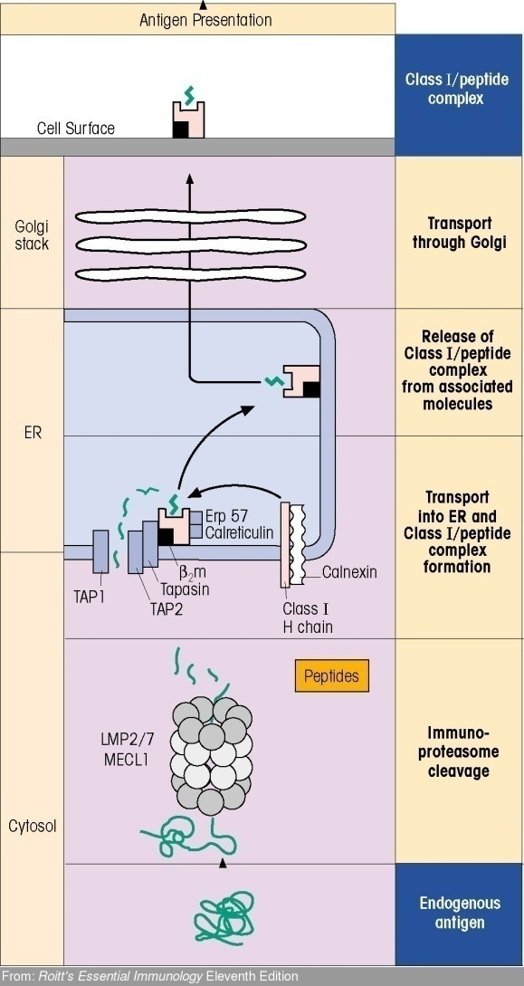
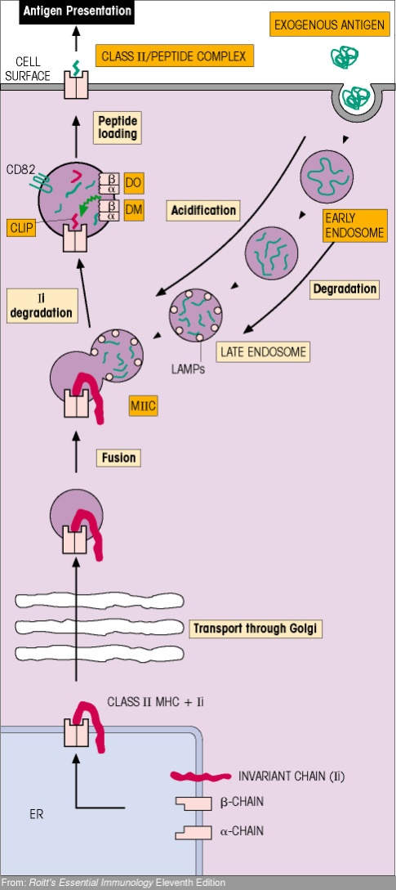
Antigen presentation to T cells
Endogenous Antigen
Exogenous Antigen
MHC class I
MHC class II

Slide 28
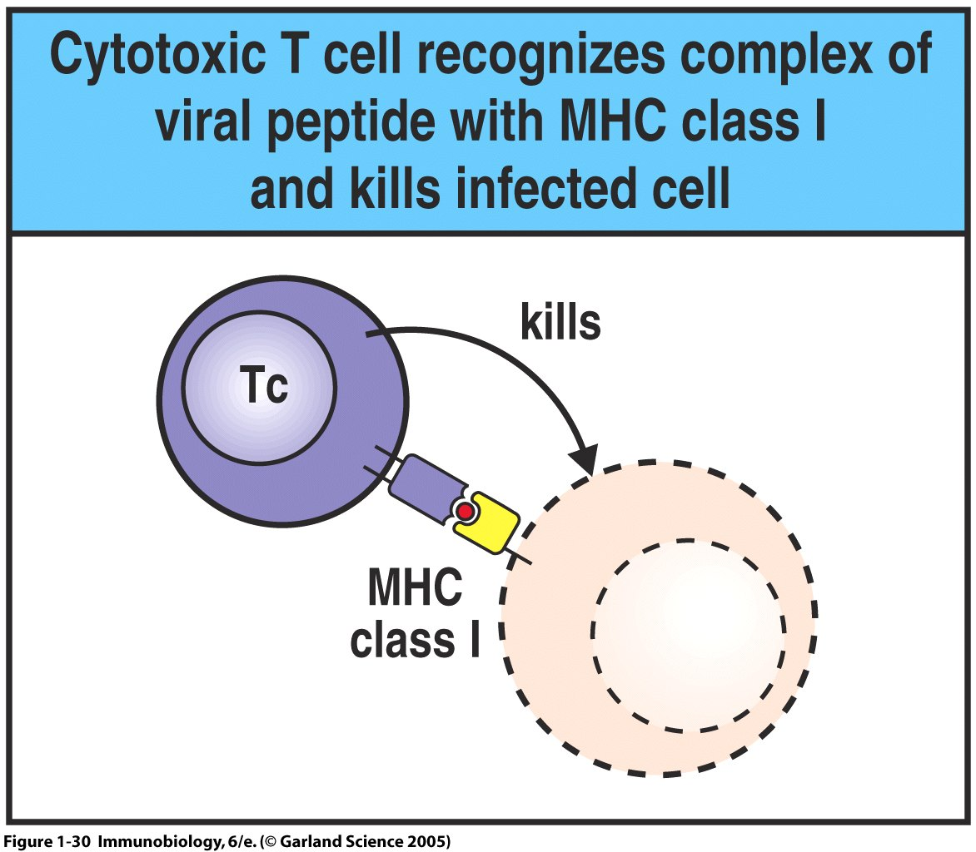
T-cells
CD8+ cytotoxic T lymphocytes (CTL)
Recognise viral antigens on MHC class I
Directly kill target cells
Notes:
CD4 cells are helper cells
Many subsets of CD4+ cells

Slide 29
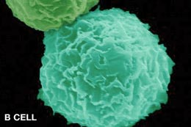
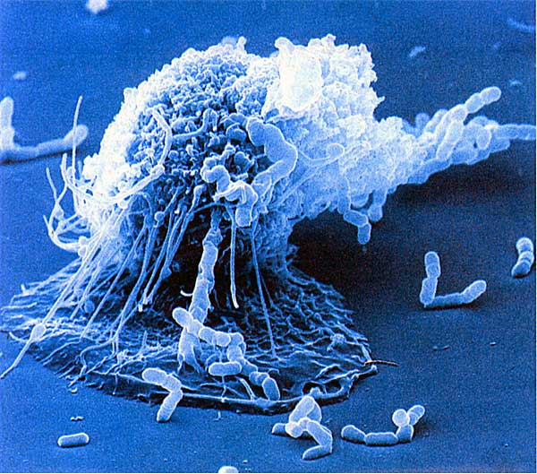
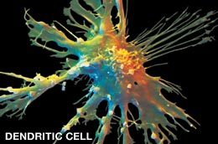
•T-cell activation requires both recognition of the MHC-bound foreign peptide the T-cell is specific to, and a costimulatory signal. •Only professional antigen presenting cells (APCs) have the appropriate cell surface molecules to provide costimulatory signal for T cell-activation.
Professional APCs
B-cell
Macrophage
Dendritic Cell

Slide 30
•T-cell activation requires both recognition of the MHC-bound foreign peptide the T-cell is specific to, and a costimulatory signal. •Only professional antigen presenting cells (APCs) have the appropriate cell surface molecules to provide costimulatory signal for T cell-activation. •DCs are the APCs most potent at activating naïve T-cells.
Professional APCs
B-cell
Macrophage
Dendritic Cell
Professional APC
-MHC class I -MHC class II -Costimulatory molecules
Non-professional APCs
-MHC class I

Slide 31
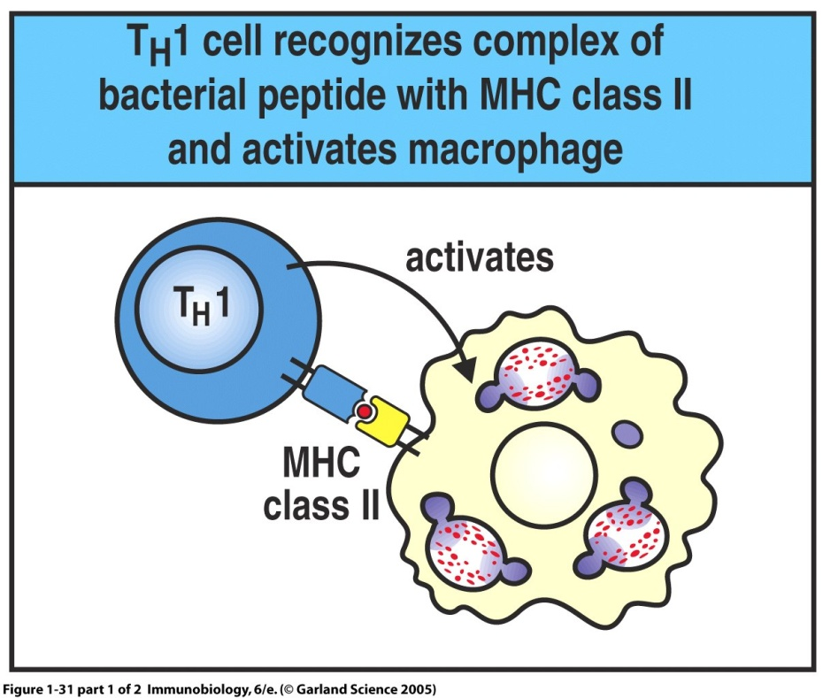
T-cells
CD4+: Helper T cells
No direct anti-pathogen effects but
Direct and regulate other arms of the immune system
Determine the type of immune response that occurs
Notes:
CD4 cells are helper cells
Many subsets of CD4+ cells

Slide 32
CD4+ Cell Subtypes
IL-10
TGF- β
TReg
T_{H}0
FOXP3
IL-1
TGF-β
IL-6
IL-23
IL-12
T-bet
STAT6
GATA-3
IL-4
T_{H}1
T_{H}17
RORγC
T_{H}2
IL-2
IL-12
IFN- γ
TNF
IL-17
IL-22
IL-21
IL-4
IL-5
IL-13

Slide 33
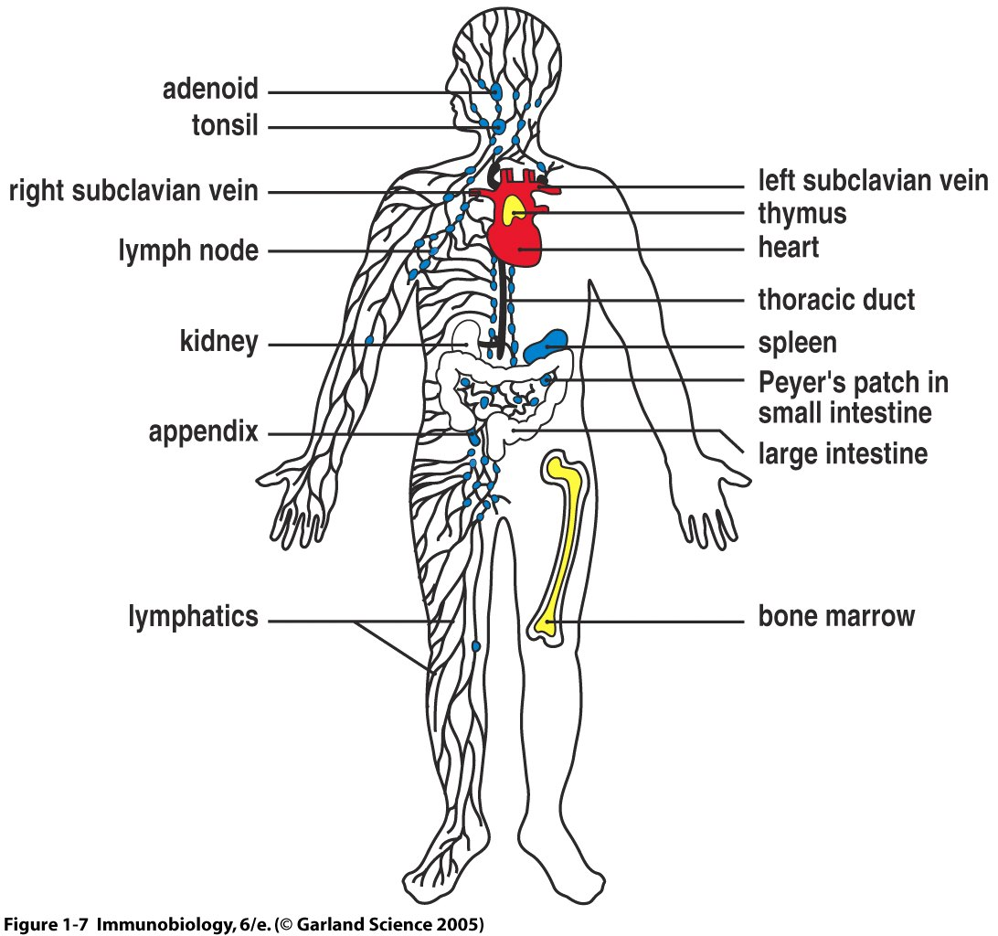
T and B cell responses are initiated in specialised secondary lymphoid organs – lymph nodes and spleen
T cell development
Haematopoiesis
B cells
Neutrophils etc
Notes:
T and B cell responses are initiated in specialised secondary lymphoid organs – lymph nodes and spleen
LN expand to many times their original size as T and B cell numbers expand
They can then migrate into tissues

Slide 34
Lymph Node Anatomy
B
Lymphoid Follicle
- B-cells
Dendritic
Cell
B
B
Afferent
lymphatic
Germinal Centre
- B-cells
B
B
T
Paracortical Area
- T-cells
T
T
T
T
Medullary Cords
- APCs
- plasma cells
Efferent Lymphatic
To thoracic duct &
bloodstream

Slide 35
Activation of adaptive immunity
• dendritic cells pick up antigen in the periphery and migrate via lymphatics to lymph nodes
• dendritic cells present antigen to naive T cells in lymph node
Lymph node
Notes:
T and B cells proliferate and form memory cells

Slide 36
Peyer’s Patch Structure
Follicle
Associated
Epithelium
M Cell
Sub-epithelial
dome
Follicle (B-cells)
B
T
B
B
T
T
B
B
B
T
T
B
B
T
B
T Cell Areas
(naïve T-cells)
Lymph Nodes

Slide 37
Trans-epithelial Antigen Sampling
Tight-junction proteins
Mucosal Epithelial Cells
Mesenteric
Lymph
Node

Slide 38
Summary
-Involves T and B lymphocytes
-Responses are antigen specific and clonal
-Receptor Diversity is generated by gene rearrangement
-Secondary responses are faster and better than primary responses
-Crosstalk with innate immunity
-Dendritic cells sample antigen in the periphery and present it to T and B cells in the lymph nodes

