Slide 1

Genotyping, gene expression analysis and microarray technology
Dr Marco Purbhoo
Lecturer in Hepatology

Slide 2
Learning Outcomes
At the end of this lecture you should be able to
Explain how specific DNA sequences can be amplified
Be aware of different mechanisms of genotyping
Describe how markers throughout the genome may be used to allow us to localise the site of a gene or mutation associated with a particular phenotype
Discuss techniques available to determine differential gene expression in health and disease
Notes:
The observation that…
Suggests

Slide 3
INTRODUCTION
The human genome contains ~3 billion bases.
  Estimated to contain 30,000 genes.
  2% of genome encodes proteins (exons).
  The remaining 98% is non-coding ‘intronic’ DNA.
  About 50% of discovered genes have unknown functions.
  Considerable homology exists with other species (e.g. mouse)
At least 99.9% of DNA is identical between all humans.
It is the interaction between our genes and our environment that determine variations in our susceptibility to disease.

Slide 4
DISEASE = GENES INTERACTING WITH ENVIRONMENT

Slide 5
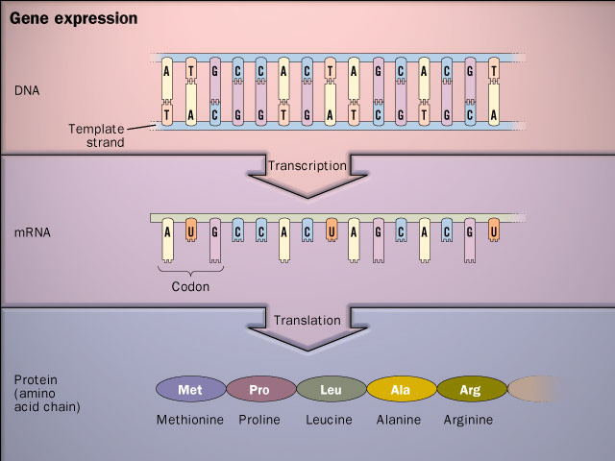
GENE EXPRESSION
Are there mutations
in the DNA code?
What gene causes
this phenotype?
Which genes are
active in each cell?
Does this change
with disease?
Which proteins are
made by a cell?
Are there more
or less than normal?

Slide 6
THE POLYMERASE CHAIN REACTION
A quick and easy method to generate unlimited copies of a fragment of DNA.
Key reagents:
  Template DNA
  Oligonucleotide primers
  Nucleotides (dNTPs)
  Taq DNA Polymerase
Many variations of the basic PCR process now established.

Slide 7
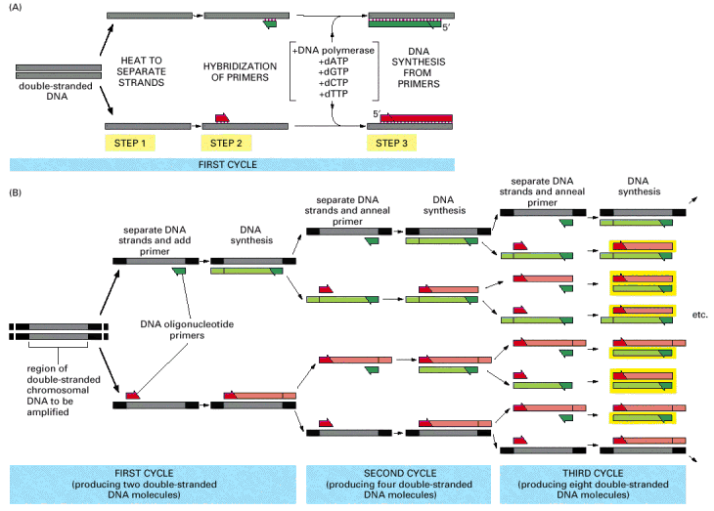
THE POLYMERASE CHAIN REACTION
DENATURATION
ANNEALING
EXTENSION
94ºC
54ºC
72ºC
Alberts et al, Molecular Biology of the Cell 2002
Notes:
Knowledge of the DNA sequence to be amplified is used to design two synthetic DNA oligonucleotides, each complementary to the sequence on one strand of the DNA double helix at opposite ends of the region to be amplified. These oligonucleotides serve as primers for in vitro DNA synthesis, which is performed by a DNA polymerase, and they determine the segment of the DNA that is amplified. (A) PCR starts with a double-stranded DNA, and each cycle of the reaction begins with a brief heat treatment to separate the two strands (step 1). After strand separation, cooling of the DNA in the presence of a large excess of the two primer DNA oligonucleotides allows these primers to hybridize to complementary sequences in the two DNA strands (step 2). This mixture is then incubated with DNA polymerase and the four deoxyribonucleoside triphosphates so that DNA is synthesized, starting from the two primers (step 3). The entire cycle is then begun again by a heat treatment to separate the newly synthesized DNA strands. (B) As the procedure is performed over and over again, the newly synthesized fragments serve as templates in their turn, and within a few cycles the predominant DNA is identical to the sequence bracketed by and including the two primers in the original template. Of the DNA put into the original reaction, only the sequence bracketed by the two primers is amplified because there are no primers attached anywhere else. In the example illustrated in (B), three cycles of reaction produce 16 DNA chains, 8 of which (boxed in yellow) are the same length as and correspond exactly to one or the other strand of the original bracketed sequence shown at the far left; the other strands contain extra DNA downstream of the original sequence, which is replicated in the first few cycles. After three more cycles, 240 of the 256 DNA chains correspond exactly to the original bracketed sequence, and after several more cycles, essentially all of the DNA strands have this unique length.

Slide 8
THE POLYMERASE CHAIN REACTION
PCR Allows exponential amplification of DNA
  After 35 cycles = 2³⁶ = 68 billion copies.
Alberts et al, Molecular Biology of the Cell 2002
Notes:
Knowledge of the DNA sequence to be amplified is used to design two synthetic DNA oligonucleotides, each complementary to the sequence on one strand of the DNA double helix at opposite ends of the region to be amplified. These oligonucleotides serve as primers for in vitro DNA synthesis, which is performed by a DNA polymerase, and they determine the segment of the DNA that is amplified. (A) PCR starts with a double-stranded DNA, and each cycle of the reaction begins with a brief heat treatment to separate the two strands (step 1). After strand separation, cooling of the DNA in the presence of a large excess of the two primer DNA oligonucleotides allows these primers to hybridize to complementary sequences in the two DNA strands (step 2). This mixture is then incubated with DNA polymerase and the four deoxyribonucleoside triphosphates so that DNA is synthesized, starting from the two primers (step 3). The entire cycle is then begun again by a heat treatment to separate the newly synthesized DNA strands. (B) As the procedure is performed over and over again, the newly synthesized fragments serve as templates in their turn, and within a few cycles the predominant DNA is identical to the sequence bracketed by and including the two primers in the original template. Of the DNA put into the original reaction, only the sequence bracketed by the two primers is amplified because there are no primers attached anywhere else. In the example illustrated in (B), three cycles of reaction produce 16 DNA chains, 8 of which (boxed in yellow) are the same length as and correspond exactly to one or the other strand of the original bracketed sequence shown at the far left; the other strands contain extra DNA downstream of the original sequence, which is replicated in the first few cycles. After three more cycles, 240 of the 256 DNA chains correspond exactly to the original bracketed sequence, and after several more cycles, essentially all of the DNA strands have this unique length.

Slide 9
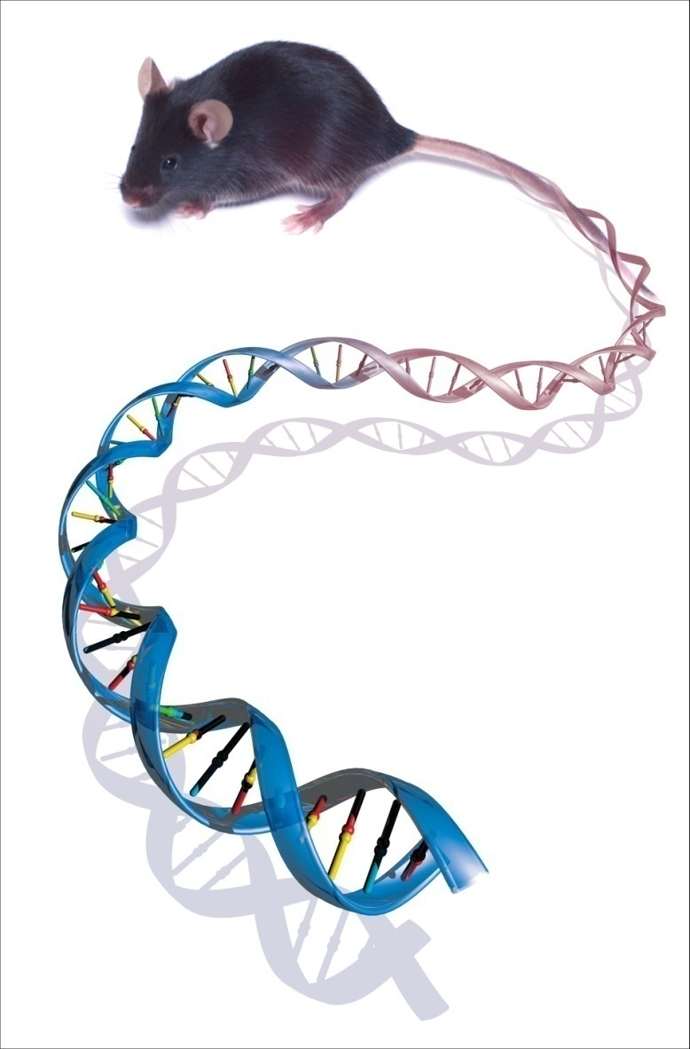
GENOTYPING &
LINKAGE ANALYSIS
Image: NIH/National Human Genome Research Institute

Slide 10
GENE EXPRESSION
Are there mutations
in the DNA code?
What gene causes
this phenotype?

Slide 11
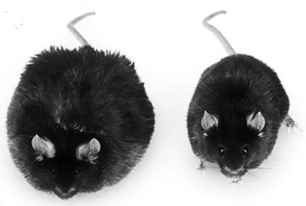
THE PROBLEM…
How do you locate the mutation which causes a certain phenotype or disease within the genome?
  Obese (leptin deficient) mouse
  Cystic fibrosis in humans
  etc.....
Image: 1995 Amgen Inc.

Slide 12
Genotyping
Genotyping is the process of determining the genes of an individual by examining its DNA sequence
All genotyping is partial
Look for polymorphic markers
Image: T.A. Brown: Genomes 2nd Ed.

Slide 13
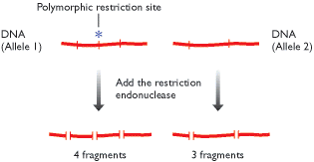
MARKERS FOR GENETIC MAPPING
Genes as markers
  Genes with different phenotypes (e.g. fruit fly eye colour)
DNA markers
  Restriction fragment length polymorphisms (RFLPs)
    Variations according to presence or absence of specific sites where an enzyme can cut the DNA.
  Simple sequence length polymorphisms (SSLPs)
  Single nucleotide polymorphisms (SNPs)
Image: T.A. Brown: Genomes 2nd Ed.

Slide 14
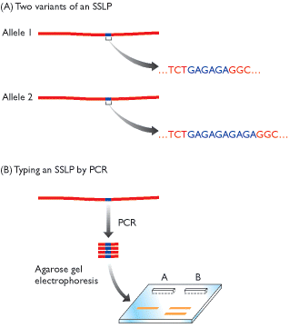
MARKERS FOR GENETIC MAPPING
Genes as markers
  Genes with different phenotypes (e.g. fruit fly eye colour)
DNA markers
  Restriction fragment length polymorphisms (RFLPs)
  Simple sequence length polymorphisms (SSLPs)
    Minisatellites (repeats up to 25bp)
    Microsatellites (repeats 2-3bp)
  Single nucleotide polymorphisms (SNPs)
Image: T.A. Brown: Genomes 2nd Ed.

Slide 15
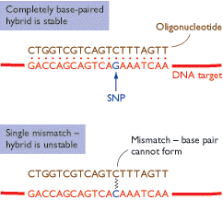
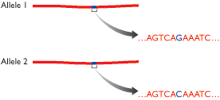
MARKERS FOR GENETIC MAPPING
Genes as markers
  Genes with different phenotypes (e.g. fruit fly eye colour)
DNA markers
  Restriction fragment length polymorphisms (RFLPs)
  Simple sequence length polymorphisms (SSLPs)
  Single nucleotide polymorphisms (SNPs)
    Abundant single base pair changes that can be detected by changes in oligonucleotide binding specificity.
Image: T.A. Brown: Genomes 2nd Ed.

Slide 16
We describe a map of 1.42 million single nucleotide polymorphisms (SNPs) distributed throughout the human genome, providing an average density on available sequence of one SNP every 1.9 kilobases. These SNPs were primarily discovered by two projects: The SNP Consortium and the analysis of clone overlaps by the International Human Genome Sequencing Consortium. The map integrates all publicly available SNPs with described genes and other genomic features. We estimate that 60,000 SNPs fall within exon (coding and untranslated regions), and 85% of exons are within 5 kb of the nearest SNP. Nucleotide diversity varies greatly across the genome, in a manner broadly consistent with a standard population genetic model of human history. This high-density SNP map provides a public resource for defining haplotype variation across the genome, and should help to identify biomedically important genes for diagnosis and therapy.

Slide 17

GENETIC MAPPING OF MUTATIONS
In order to find genes within the genome we need
  A set of markers with known positions on each chromosome to take a fix from.
  A way of measuring our distance from the markers.

Slide 18
GENETIC MAPPING OF MUTATIONS
Genetic markers can be typed using techniques such as PCR
The parental origin of a DNA sequence can be determined
Pairs of chromosomes segregate during meiosis
Linkage analysis – what is the frequency that 2 markers are passed on
to the offspring together

Slide 19
GENETIC MAPPING OF MUTATIONS
a
A
A
A
Linkage analysis – what is the frequency that 2 markers are passed on
to the offspring together
Markers on separate chromosomes separate independently of each
other and therefore have a 50% chance of being passed on together to
the next generation (50% linkage)
Markers on the same chromosome separate together. 100% linkage??
c
C
Meiosis
C
C
b
B
B
b

Slide 20
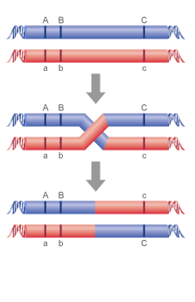
Linkage Analysis
During meiosis, chromosome pairs can
recombine, exchanging regions of DNA
After recombination, the chromosomes
contain a mixture of maternal and
paternal alleles
Linkage of 2 markers proportional to distance
apart (1 centrimorgan cM = 1% chance
of recombination in one generation)
Gene of interest can be narrowed down to a region of 1-5 million bp

Slide 21
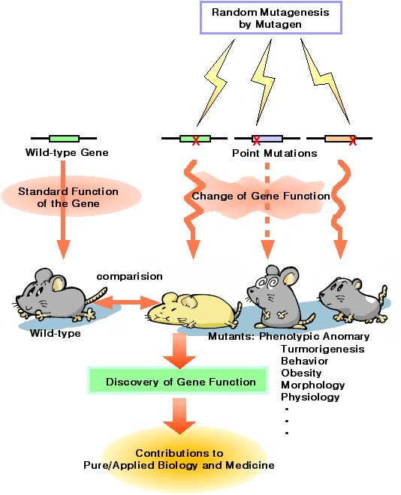
ENU MUTAGENESIS PROGRAMME
The ethylating agent ENU induces random, genome wide mutations.
  Mutation frequency ~1.08 x 10⁻³
  (Coghill & Hugill et al, 2002)
Base-pair changes accurately model the subtle mutations found in nature.
Mutations occur at random, no assumptions are made about the genes involved in specific metabolic pathways.
‘Non Hypothesis-driven’ phenotypic mutagenesis screens are free from any bias introduced by candidate gene selection.
EXAMPLE
Image: http://www.gsc.riken.go.jp/Mouse/
Notes:
Equivalent to isolating a functional mutation in a given gene approx. once per 900 gametes screened (Coghill & Hugill et al, 2002).

Slide 22
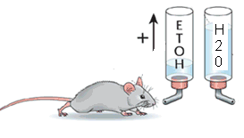
ALCOMOUSE
Mutagenesis to male Balb/cAnN mice (alcohol averse).
G0 crossed to C3H/HeH females (also alcohol averse).
1047 G1 offspring tested for increased alcohol consumption using two bottle choice paradigm over two ten day periods.
Male G1 mice with increased consumption of 10% ethanol solution greater than 2.5SD above the mean of a control Balb/c x C3H cohort were backcrossed to C3H females for trait inheritance testing.
EXAMPLE
(Knapp et al, in preparation)

Slide 23
ETHANOL CONSUMPTION OF ALCO/22
The ALCO/22 line was shown to have a highly penetrant ethanol preference trait.
ALCO/22 consume 4-5x more ethanol than non-mutant littermates.
  Equivalent by weight to consumption of ~2 bottles whiskey per day.
  More than alcohol seeking C57BL/6.
Testing for saccharine, quinine, sucrose and calorific intake showed no discernable difference.
Mean Alcohol Intake/24 hours
11.6
6.0*
2.3
n = 24
n = 18
EXAMPLE
(Knapp et al, in preparation)
Notes:
Indeed, we have identified (AMOUNG SEVERAL)
a mouse line from the ENU mutagenesis program, which drinks 4-5 times as much of a 10% ethanol solution in a continuous two-bottle choice paradigm compared to their littermates, equivalent to 2 bottles of whisky per day. This mouse line was called ALCO/22.
The (ALCO/22) mutant consumes twice as much (2x!) EtOH as the conventional high drinking B6 mouse!

Slide 24
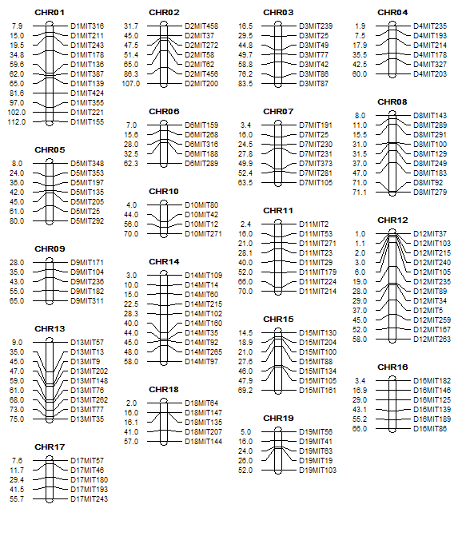
MICROSATELLITE MAPPING
THE CAUSATIVE ENU MUTATION
Backcross mice were genotyped using a panel of 135 simple sequence length polymorphism (SSLP) microsatellite markers distributed throughout the mouse genome.
Linkage between microsatellite markers and phenotype was sought.
EXAMPLE

Slide 25
MICROSATELLITE MAPPING
THE CAUSATIVE ENU MUTATION
Mutation mapped to a region of chromosome 5 containing ~20 genes.
Genes sequenced
Mutation identified in the GABAβ1 gene
EXAMPLE

Slide 26
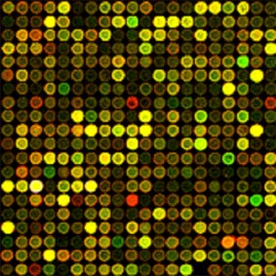
GENE EXPRESSION ANALYSIS
Quantitative rt-PCR & Microarray Technology

Slide 27
GENE EXPRESSION
Which genes are
active in each cell?
Does this change
with disease?
Does this change
with treatment?

Slide 28
GENE EXPRESSION = ‘RNA VOLUME’
1
3
5
7
9
11
13
15
17
19
21
23
25
27
29
31
33
1
63
65
67
69
71
73
787
89
91
93
95
97
Nucleus
Proteins
Normal Cell Line
500
400
DNA
300
RNA
Intensity
200
100
0
Genes
Cell membrane
1
3
5
7
9
11
13
15
17
19
21
23
25
27
29
31
33
35
37
39
41
43
45
47
49
51
565
67
69
Nucleus
Malignant Cell Line
Proteins
500
400
DNA
300
RNA
Intensity
200
100
0
Genes
Cell membrane
Affymetrix Inc. 2005

Slide 29
MEASURING GENE EXPRESSION
There are two main techniques currently used:
  Quantitative rt-PCR
    The expression of a single gene is measured relative to a standard or invariant house keeping gene.
    More accurate quantification of expression.
    Often used to validate microarray findings for a small sample of genes.
  Microarray Technology
    Allows the expression of every known gene in genome to be assessed simultaneously.
    Techniques vary depending on platform used as does the accuracy of expression quantification.

Slide 30
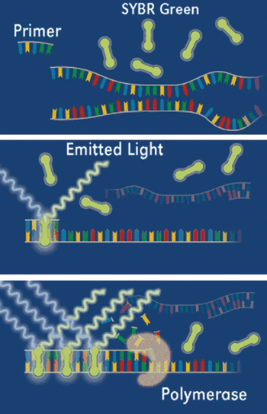
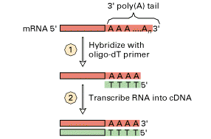
QUANTITATIVE RT-PCR
Quantitative rt-PCR based on the ability of the PCR reaction to amplify a DNA sequence between specific primers.
  Total RNA is extracted from tissue,
  RNA is Reverse transcribed into cDNA by Reverse transcriptase enzyme.
  A PCR reaction is then performed.
  The amount of DNA product is measured after each cycle by measuring the incorporation of a fluorescent marker (e.g. SYBR Green) into the dsDNA product.
Lodish et al, Molecular Cell Biology 1999

Slide 31
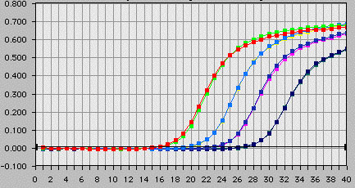
QUANTITATIVE RT-PCR
The fluorescence measured with each cycle is measured.
The number of cycles taken to reach a certain fluorescence level is proportional to the amount of cDNA present at the start and hence the amount of RNA.
The fluorescence level may either be compared to a known standard to give an absolute expression level or changes relative to a control sample be recorded.

Slide 32
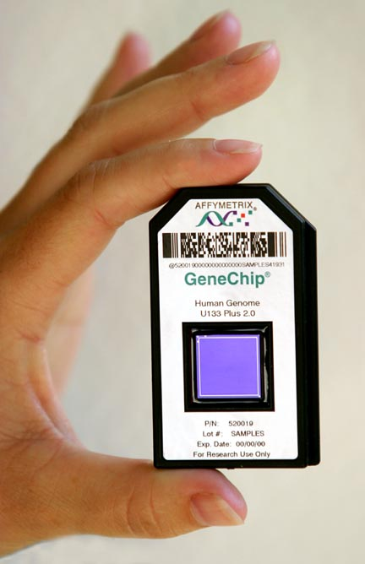
MICROARRAY TECHNOLOGY
Many variations of this technology are available.
  ‘Two colour’ cDNA microarrays
  ‘Bead’ Arrays
  Oligonucleotide microarrays.
We will discuss one of the more widely used platforms (Affymetrix).

Slide 33
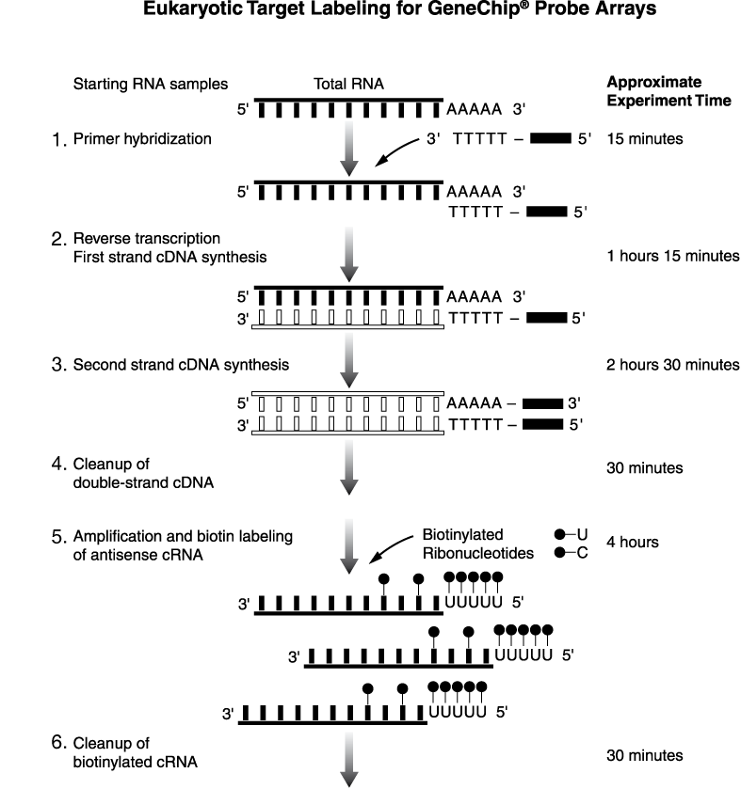
SAMPLE PREPARATION
Multi step process which combines:
  Amplification of RNA sample by repeated cycles of cDNA synthesis and transcription to cRNA.
  Labelling with fluorescent marker.
Samples are then hybridised onto a microarray chips and the fluorescence of each probe measured.
Affymetrix 2006

Slide 35
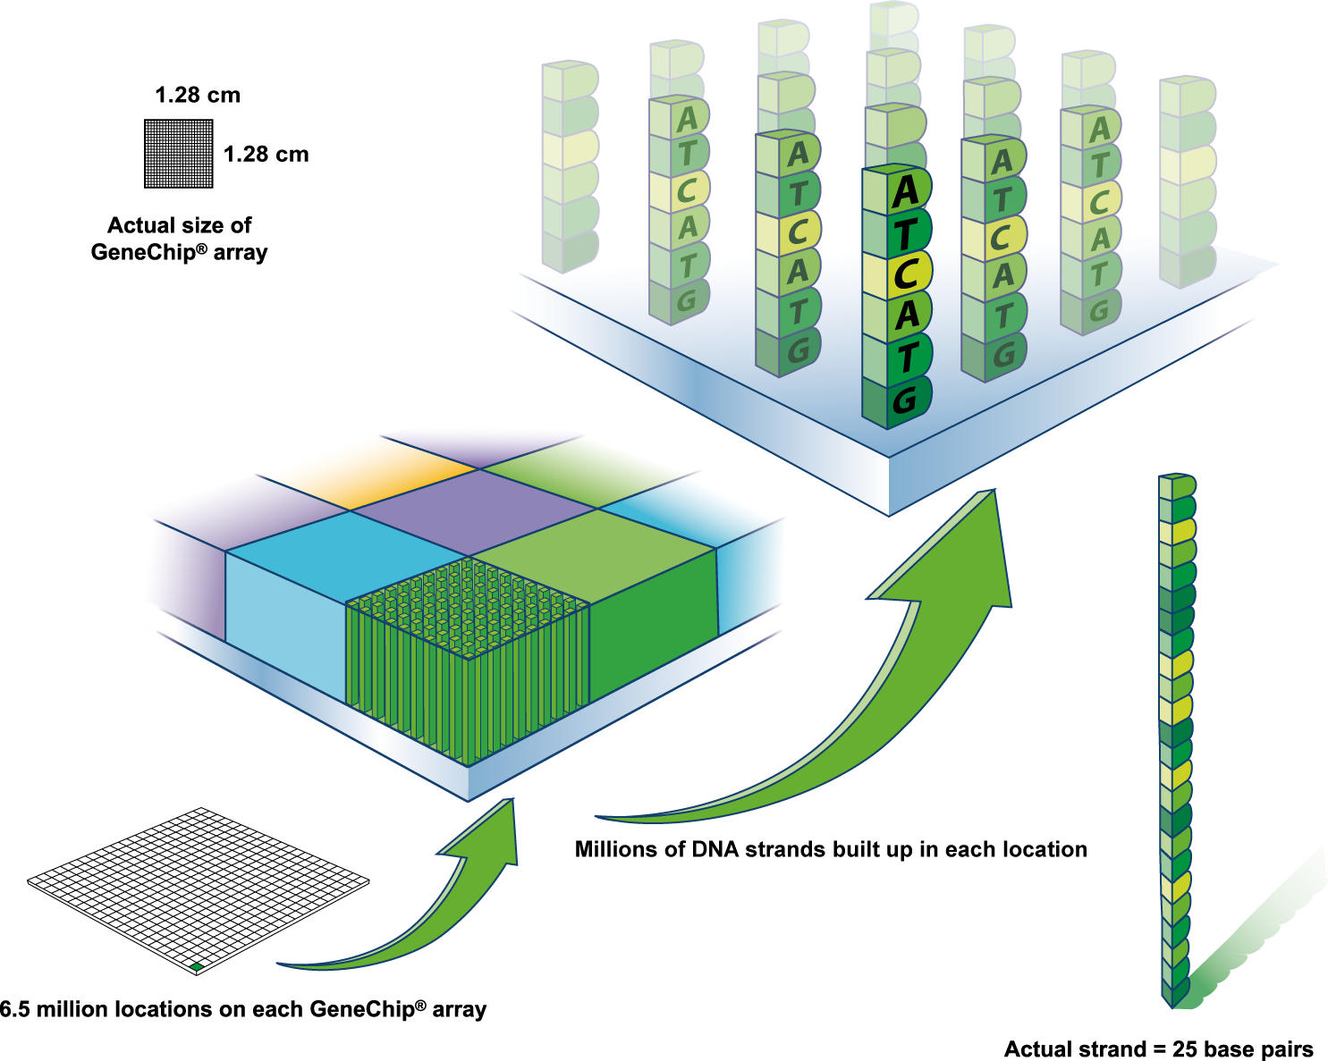
AFFYMETRIX MICROARRAY
Affymetrix Inc. 2005

Slide 36
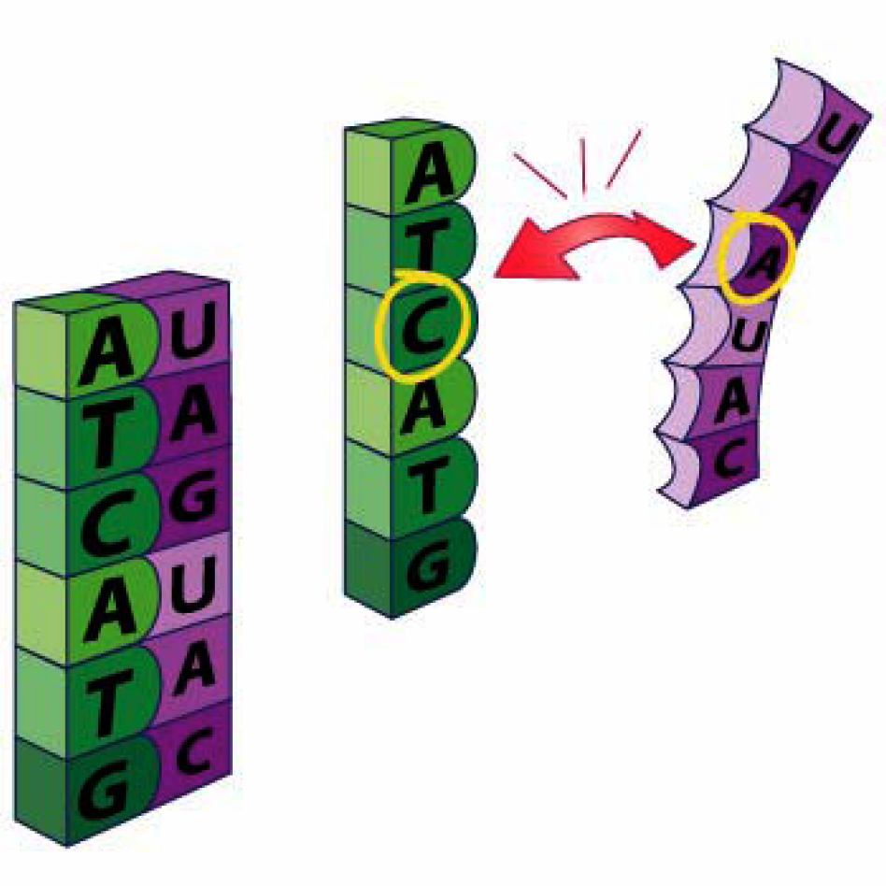

Slide 37
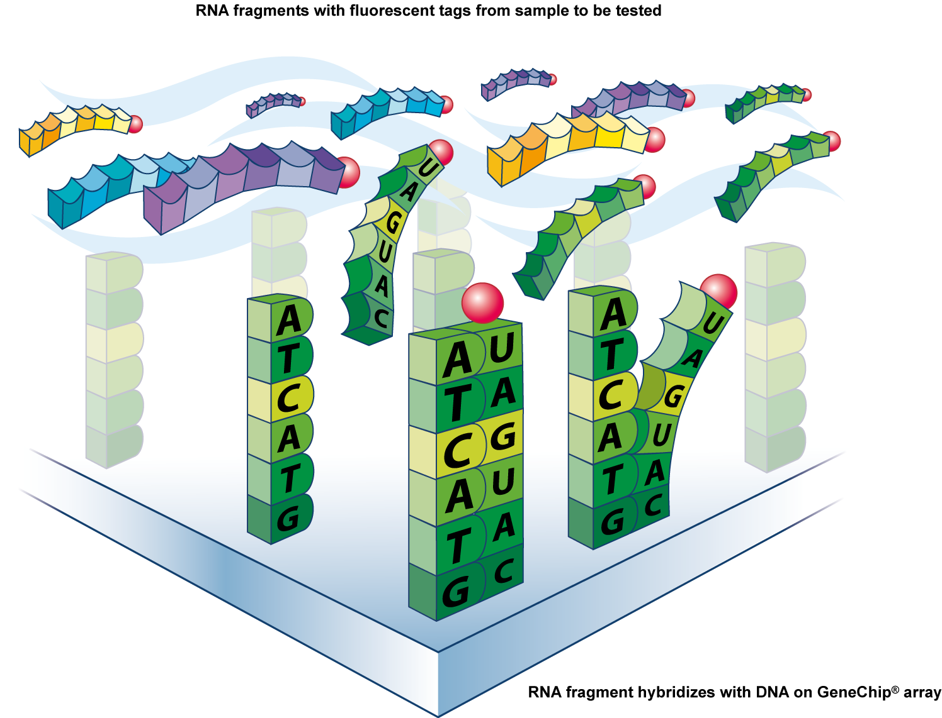
Affymetrix Inc. 2005

Slide 38
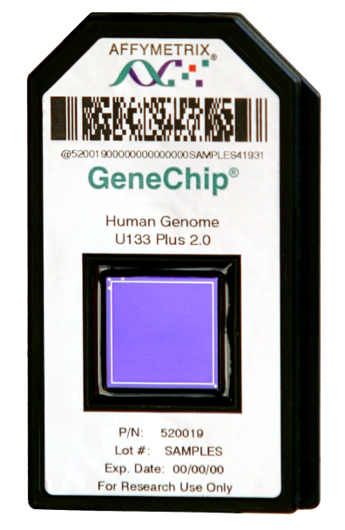
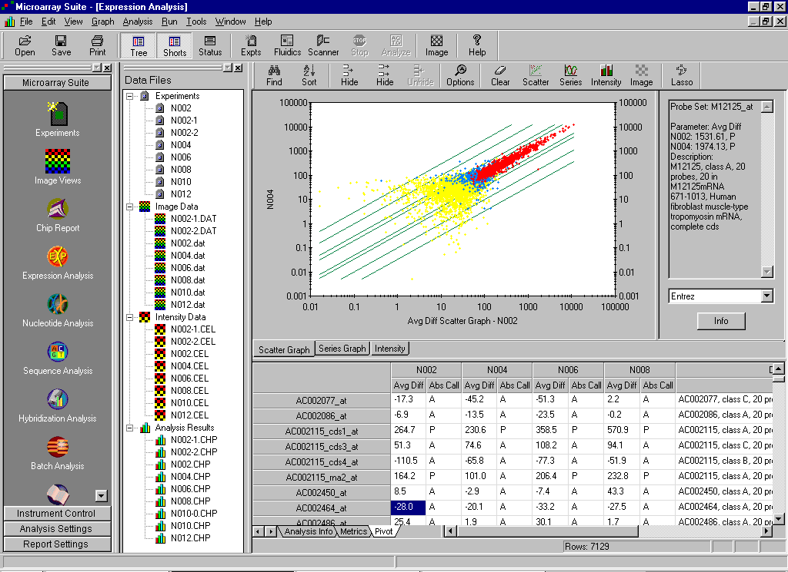
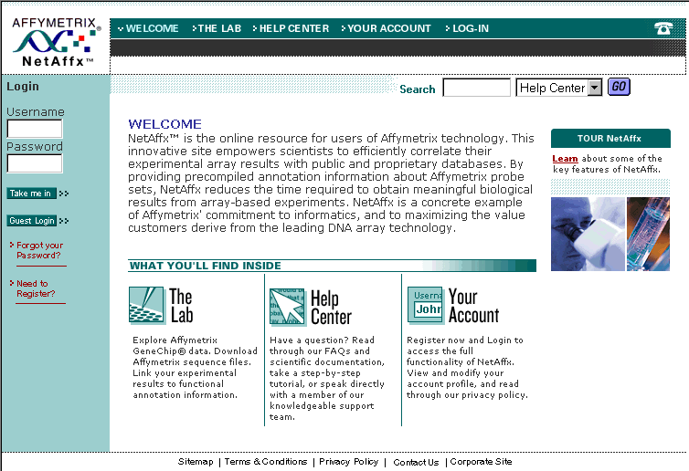
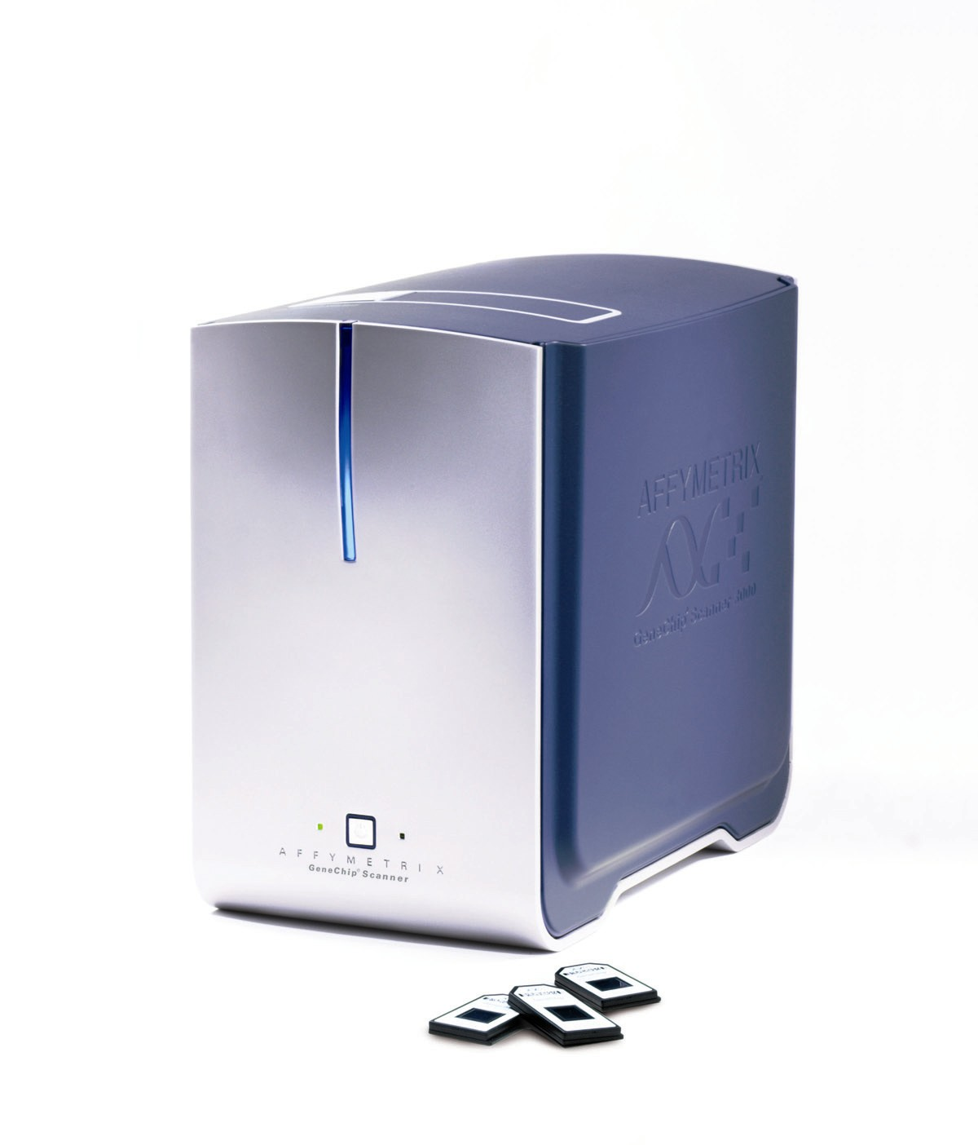
AFFYMETRIX MICROARRAY TECHNOLOGY
Scanner
Probe
Arrays
(chips)
Software
Data Analysis
Scanner
Affymetrix Inc. 2005

Slide 39
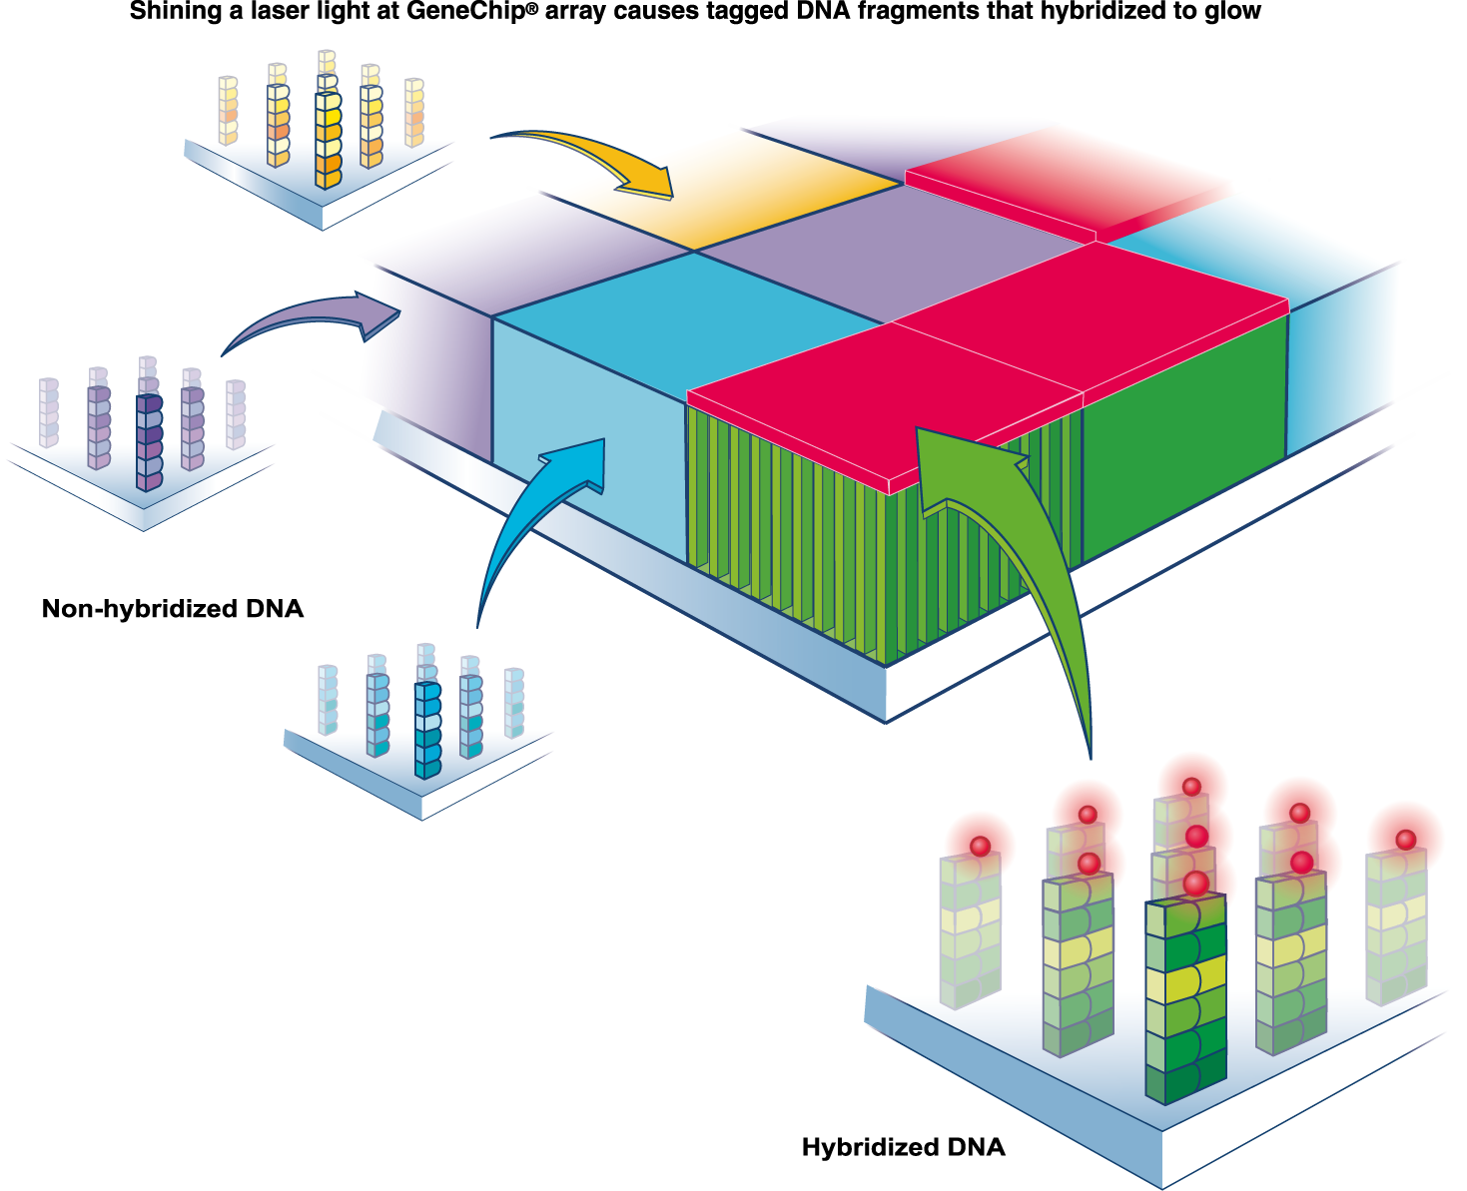
Affymetrix Inc. 2005

Slide 40
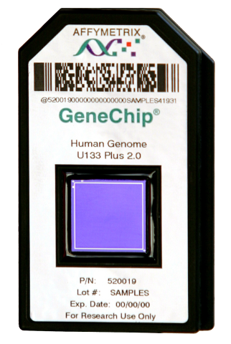
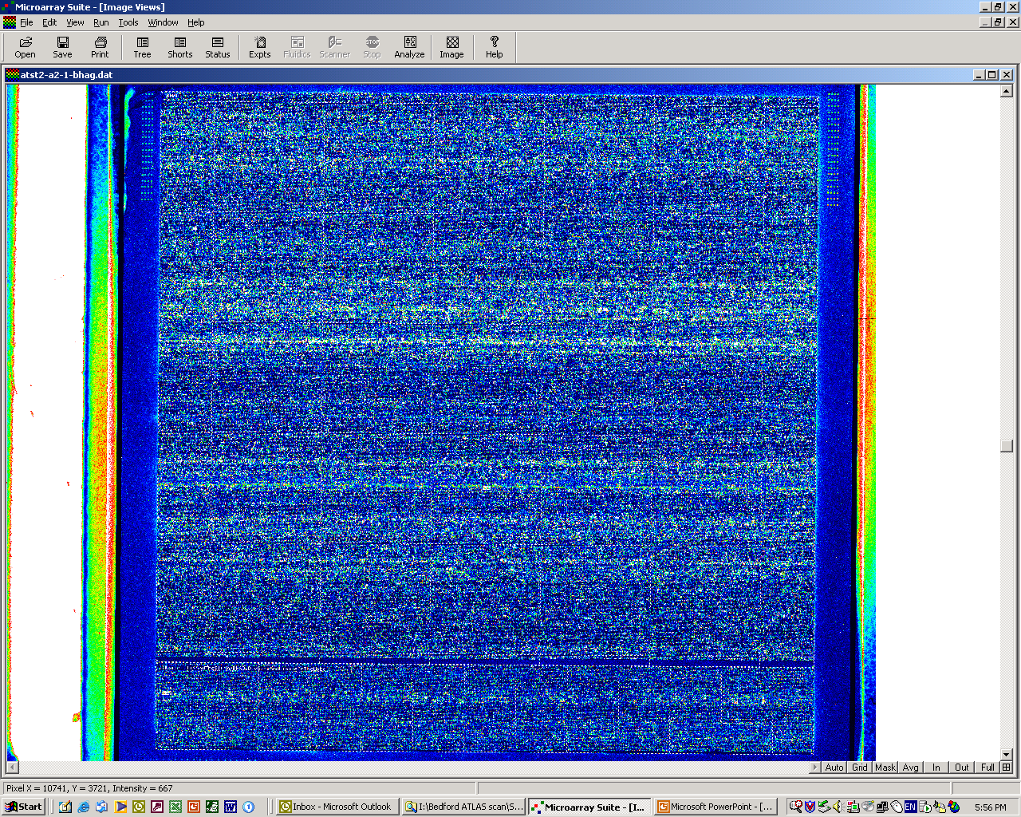
*
*
*
*
*
*
5µm
5µm
Millions of identical
probes / feature
1.28cm
Up to ~6,500,000 features / chip
1.28cm
Affymetrix Inc. 2005

Slide 41
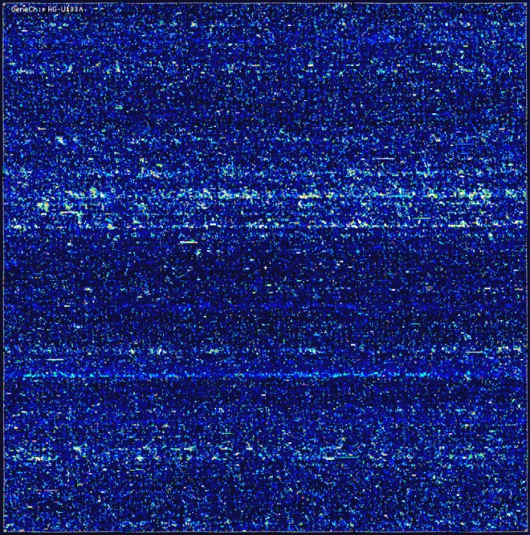
AFFYMETRIX MICROARRAY SCAN

Slide 42
AFFYMETRIX MICROARRAY HYBRIDISATION
Each chip carries 11-20 duplicates for each oligonucleotide sequence (Perfect Match) and a similar number of oligonucleotides that differ slightly (Mismatch).
This allows statistical ‘background correction’ for non-specific binding.
The scanned chip images are then analysed and statistically filtered to produce a list of genes that are differentially expressed.

Slide 43
ARRAY ANALYSIS WORK FLOW
Background Correction
Steps in Microarray analysis
  Background correction
  Normalisation
  P value threshold
  Expression fold change threshold
Probe Level Normalisation
Expression Summary
Filtering
Statistical Analysis
Filtering
Gene List
High Level Analysis

Slide 44
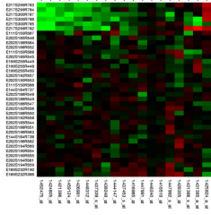
Data displayed as Heat Maps
Each cell is colorized based on the level of expression of that gene in that sample.
Heat maps help you find groups of genes which behave similarly across a set of experiments.
Genes identified in this way may then be studied further: ‘hypothesis generating research’.

Slide 45
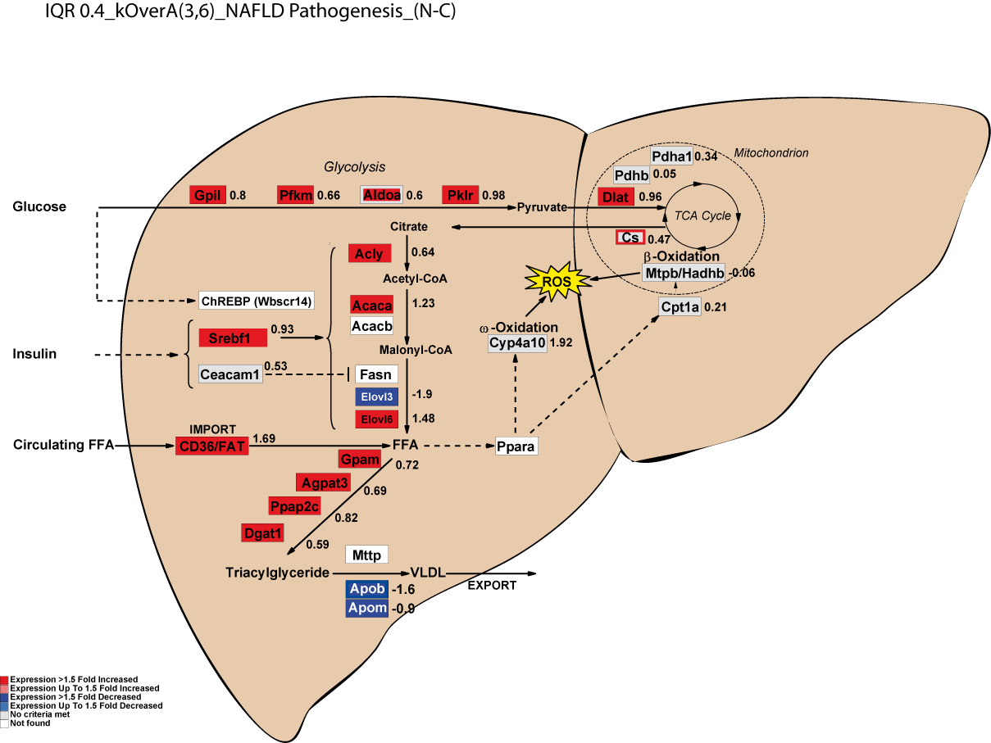
IGT/6-NASH vs. CONTROL
Fold Change Values are in log2

Slide 46
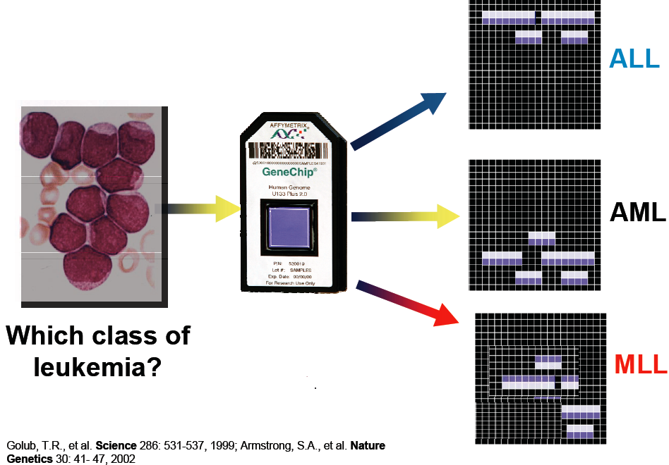
POTENTIAL CLINICAL APPLICATIONS
Diagnostics
  Cancer?
  Haematological Malignancies?
  Hereditary conditions?
Risk stratification
  Adverse drug reactions?
  Heart disease in later life?
Treatment optimisation
  Appropriate chemotherapy?
mixed-lineage leukemia?
acute myeloid leukemia ?
acute lymphoblastic leukemia ?

Slide 47
SUMMARY
Our understanding of the human genome provides a new opportunity to identify and study changes within our genes and how they influence disease pathogenesis.
The Polymerase Chain Reaction revolutionised molecular biology and has made study of the genome possible.
The PCR coupled with Microsatellite and SNP linkage analysis is a powerful tool to locate genes and mutations within the genome.
Microarray technology offers the first opportunity to simultaneously study the expression of the whole genome and to see how this changes with disease and therapy.

